Slide 1

5-Year Incidence of Bioprosthetic Valve Dysfunction in Patients Randomized to Surgery or TAVI: Insights from the CoreValve US Pivotal and SURTAVI Trials
Steven J. Yakubov, MD, FACC, MSCAI
Riverside Methodist, Ohio Health, Columbus, OH, USA
For the CoreValve – Evolut Clinical Investigators

Slide 2




Research support from Boston Scientific and Medtronic.
Honoraria from Boston Scientific and Medtronic outside the submitted work.

Slide 3

Long-term bioprosthetic valve performance is a critical consideration when evaluating the durability of transcatheter aortic valve implantation (TAVI), particularly in younger, low risk patients with longer life expectancies.
The VARC-3 and EAPCI consensus documents recognize four components of valve performance, evaluated as bioprosthetic valve dysfunction (BVD) ^{1,2}:
  Structural Valve Deterioration (SVD)
  Non-Structural Valve Dysfunction (NSVD)
  Valve Thrombosis
  Endocarditis
¹ VARC-3 Writing Committee, et al. European Heart Journal 42.19 (2021): 1825-1857
² Capodanno D., et al. European Heart Journal 38.45 (2017): 3382-3390

Slide 4
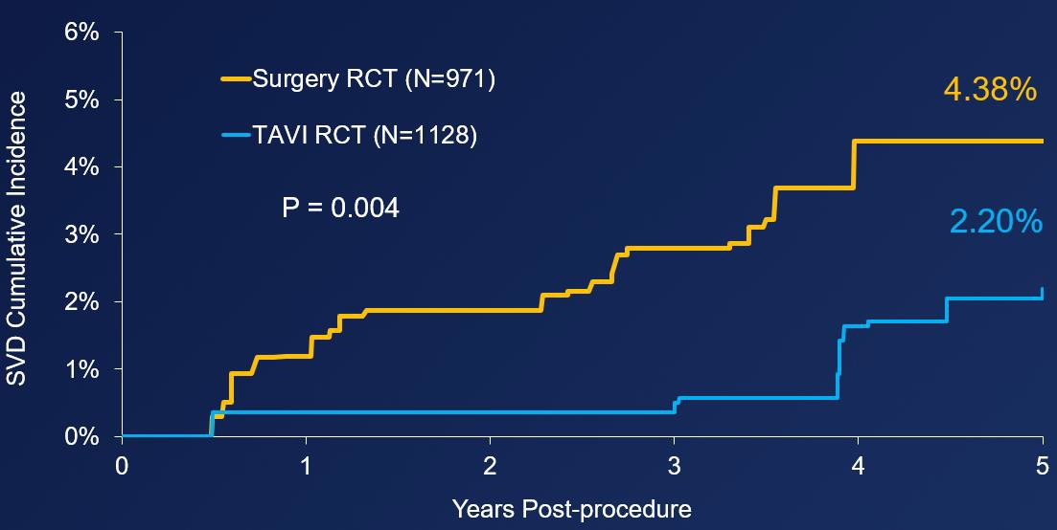
A recent analysis with supra-annular, self-expanding TAVI bioprostheses demonstrated a significantly lower 5-year rate of SVD with TAVI vs. Surgery and reported an association between SVD and worse clinical outcomes. ¹
¹ O’Hair, D., et al. JAMA Cardiology (2022) doi:10.1001/jamacardio.2022.4627

Slide 5
A recent analysis with supra-annular, self-expanding TAVI bioprostheses demonstrated a significantly lower 5-year rate of SVD with TAVI vs. Surgery and reported an association between SVD and worse clinical outcomes. ¹
Limited data exist on the incidence and clinical importance of all components of valve performance after TAVI and surgery from large- scale, multicenter and randomized clinical trials.
¹ O’Hair, D., et al. JAMA Cardiology (2022) doi:10.1001/jamacardio.2022.4627

Slide 6


To evaluate the incidence, outcomes and predictors of long-term valve performance, as assessed by 5-year BVD, in patients undergoing supra-annular, self- expanding TAVI or surgery

Slide 7



Datasets: CoreValve US High Risk Pivotal and SURTAVI Intermediate Risk Randomized Clinical Trials
Analysis 1: Cumulative incidence rate of BVD Analysis 2: Association of BVD with clinical outcomes Analysis 3: Pre-procedure predictors of BVD
BVD definition ^{1,2}
SVD ³ | Mean gradient increase ≥10 mmHg from discharge/30-day to last echo AND ≥20 mmHg at last echo OR new onset/increase of ≥ moderate intraprosthetic aortic regurgitation *
NSVD | Severe prosthesis-patient mismatch (PPM) at 30-day/discharge OR severe paravalvular regurgitation (PVL) through 5 years *
Thrombosis † | Clinical valve thrombosis
Endocarditis † | Modified Duke criteria
* Core lab if available, otherwise site-reported
† CEC adjudicated
¹ VARC-3 Writing Committee, et al. European Heart Journal 42.19 (2021): 1825-1857
² Capodanno D., et al. European Heart Journal 38.45 (2017): 3382-3390
³ Adapted from VARC-3 Writing Committee, et al. & Capodanno D., et al.

Slide 8

CoreValve US Pivotal and SURTAVI trials (N=2099) | CoreValve/Evolut TAVI (N=1128) | Surgery (N=971)
Age, years | 80.9 ± 6.5 | 80.6 ± 6.3
Male | 632 (56.0) | 527 (54.3)
Body surface area, m² | 1.9 ± 0.2 | 1.9 ± 0.2
STS-PROM, % | 5.2 ± 2.4 | 5.3 ± 2.5
NYHA III/IV | 757 (67.1) | 639 (65.8)
Diabetes mellitus | 390 (34.6) | 374 (38.5)
Hypertension | 1056 (93.6) | 889 (91.6)
Cerebrovascular disease | 218 (19.4) | 184 (19.0)
Coronary artery bypass surgery | 229 (20.3) | 213 (21.9)
Atrial fibrillation/flutter | 348 (30.9) | 305 (31.4)
Prior percutaneous coronary intervention | 280 (24.8) | 253 (26.1)
6-minute walk, m | 236.8 ± 118.0 | 241.1 ± 119.9
Creatinine clearance < 30 ml/min | 57 (5.1) | 42 (4.3)
Prior anticoagulation therapy | 236 (20.9) | 236 (24.3)
Mean ± SD or no. (%)
No significant differences between randomized cohorts

Slide 9





Significantly lower rate of BVD with TAVI vs. Surgery through 5 years
20%
CoreValve/Evolut TAVI (N=1128) *
BVD Cumulative Incidence
Surgery (N=971)
14.2%
15%
HR, 0.50; 95%CI, 0.38-0.66; P<0.001 †
10%
7.8%
5%
0%
0
* CoreValve 88%, Evolut R 12%
1
2 3
Years Post-procedure
4
5
† Fine-Gray regression interval censoring and treating death as a competing risk, HR = hazard ratio

Slide 10



2x lower SVD and 3x lower severe PPM with TAVI vs. Surgery
CoreValve/Evolut TAVI (N=1128) |  | Surgery (N=971) | HR (95% CI) | P value
BVD, % | 7.8 | 14.2 | 0.50 (0.38, 0.66) | <0.001
SVD | 2.2 | 4.4 | 0.46 (0.27, 0.78) | 0.004
NSVD * | 4.3 | 8.8 | 0.48 (0.33, 0.68) | <0.001
Severe PPM (30-day/discharge) | 3.7 | 11.8 | 0.29 (0.19, 0.43) † | <0.001
Severe PVL | 1.2 | 0.2 | 5.51 (1.24, 24.41) | 0.02
Thrombosis | 0.3 | 0.2 | 1.26 (0.21, 7.62) | 0.80
Endocarditis | 1.1 | 1.3 | 0.85 (0.38, 1.88) | 0.68
BVD, SVD, NSVD, and severe PVL were calculated using Fine-Gray regression interval censoring and treating death as a competing risk.¹ Rate of severe PPM was estimated as a proportion (n/N). Thrombosis and endocarditis rates were estimated using proportional sub-distribution hazard regression for right-censored data.
* The survival method used to estimate the rate of NSVD considered all patients in the analysis. However, the proportion rate of severe PPM excluded subjects without 30-day/discharge PPM from the denominator. Therefore, due to the smaller denominator the rate of severe PPM may be higher than the overall rate of NSVD.
† Odds ratio (OR)
¹ Delord M. and Genin E., Journal of Statistical Computation and Simulation 86.11 (2016): 2217-2228

Slide 11













Significantly lower rate of BVD with TAVI vs. Surgery through 5 years in smaller annuli
CoreValve/Evolut TAVI (N=268) Surgery (N=218)
19.7%
20%
BVD Cumulative Incidence
15%
10%
HR, 0.31; 95%CI, 0.18-0.55; P<0.001 *
8.6%
5%
0%
0 1 2 3
4
5
Years Post-procedure
* Fine-Gray regression interval censoring and treating death as a competing risk

Slide 12




Significantly lower rate of BVD with TAVI vs. Surgery through 5 years in larger annuli
20%
CoreValve/Evolut TAVI (N=856)
Surgery (N=748)
BVD Cumulative Incidence
15%
12.6%
HR, 0.60; 95%CI, 0.43-0.82; P=0.002 *
10%
8.1%
5%
0%
0 1 2 3
4
5
Years Post-procedure
* Fine-Gray regression interval censoring and treating death as a competing risk

Slide 13







HR (95% CI)
P value
Pooled Surgery and TAVI (N=2099)
All-cause mortality
1.46 (1.13, 1.88)
0.004
Cardiovascular mortality
1.84 (1.34, 2.51)
<0.001
Hospitalization for valve disease/worsening HF
1.67 (1.23, 2.26)
0.001
Composite †
1.46 (1.16, 1.83)
0.001
Surgery (N=971)
All-cause mortality
1.58 (1.15, 2.19)
0.005
Cardiovascular mortality
2.14 (1.44, 3.18)
<0.001
Hospitalization for valve disease/worsening HF
1.67 (1.11, 2.51)
0.01
Composite †
1.51 (1.12, 2.02)
0.007
TAVI (N=1128)
All-cause mortality
1.34 (0.88, 2.04)
0.18
Cardiovascular mortality
1.51 (0.87, 2.60)
0.14
Hospitalization for valve disease/worsening HF
1.82 (1.14, 2.91)
0.01
Composite †
1.49 (1.04, 2.15)
0.03
0.10
Decreased risk to patients with BVD
1.00
10.00
Higher risk to patients with BVD
† All-cause mortality or hospitalization for valve disease or worsening heart failure (HF)

Slide 14



Pooled Surgery and TAVI (N=2099) | Patients with BVD (N=210) | Patients without BVD (N=1889)
Age, years | 79.5 ± 7.0 | 80.9 ± 6.3 †
Male | 101 (48.1) | 1058 (56.0) †
Body surface area, m² | 1.9 ± 0.2 | 1.9 ± 0.2
STS-PROM, % | 5.3 ± 2.8 | 5.2 ± 2.4
NYHA III/IV | 141 (67.1) | 1255 (66.4)
Diabetes mellitus | 86 (41.0) | 678 (35.9)
Hypertension | 189 (90.0) | 1756 (93.0)
Cerebrovascular disease | 33 (15.7) | 369 (19.6)
6-minute walk, m | 216.9 ± 131.1 | 241.1 ± 117.2 †
Creatinine clearance < 30 ml/min | 18 (8.6) | 81 (4.3) †
Baseline LVEF, % * | 57.5 ± 12.5 | 60.4 ± 10.5 †
Baseline AVA, cm² * | 0.7 ± 0.2 | 0.8 ± 0.2 †
Baseline mean gradient, mmHg * | 50.0 ± 14.4 | 47.2 ± 13.7 †
Mean ± SD or no. (%)
* Core lab if available, otherwise site-reported
† P<0.05 vs. Patients with BVD

Slide 15





Univariable Model |  |  | Multivariable Model §
Pooled Surgery and TAVI (N=2099) | HR (95% CI) | P value | HR (95% CI) | P value
Age, years | 0.97 (0.95, 0.99) | 0.004 | 0.98 (0.96, 1.00) | 0.02
Male | 0.73 (0.56, 0.96) | 0.03 | 0.61 (0.44, 0.86) | 0.004
Body surface area, m² * | 1.10 (0.98, 1.23) | 0.12 | 1.22 (1.06, 1.40) | 0.005
Diabetes mellitus | 1.20 (0.92, 1.58) | 0.18
Hypertension | 0.70 (0.44, 1.09) | 0.12
Cerebrovascular disease | 0.77 (0.53, 1.11) | 0.17
6-minute walk, m | 1.00 (1.00, 1.00) | 0.02
Creatinine clearance < 30 ml/min | 1.99 (1.24, 3.20) | 0.005 | 1.96 (1.21, 3.17) | 0.006
CT-measured aortic annulus ≤ 23 mm | 1.28 (0.94, 1.73) | 0.11
Baseline LVEF, % † | 0.98 (0.97, 0.99) | <0.001 | 0.98 (0.97, 0.99) | <0.001
Baseline AVA, cm² † | 0.22 (0.10, 0.48) | <0.001 | 0.29 (0.12, 0.73) | 0.008
Baseline mean gradient, mmHg † | 1.01 (1.00, 1.02) | 0.002 | 1.01 (1.00, 1.02) | 0.07
Lower risk of developing BVD in older patients, men, and those with a higher baseline LVEF and AVA
Higher risk of developing BVD in patients with a higher body surface area and more renal impairment
* HR per 0.2 m² increase in BSA
† Core lab if available, otherwise site-reported
§ Backwards elimination multivariable modeling with stay criteria of P=0.1.
Univariable analysis was also performed for additional covariates, those with a P>0.3 included: STS-PROM, NYHA III/IV, chronic lung disease/COPD, peripheral vascular disease, coronary artery disease, coronary artery bypass surgery, atrial fibrillation/flutter, prior percutaneous coronary intervention, prior antiplatelet therapy, and prior anticoagulation therapy.

Slide 16

Current follow-up is limited to 5 years. Ten-year follow-up is ongoing for the SURTAVI clinical trial.
Further analysis in younger patients is warranted.
The competing risk of mortality and inclusion of only randomized patients limited the number of subjects with BVD.

Slide 17

In patients with symptomatic severe AS undergoing aortic valve replacement, valve performance was superior at 5 years in patients undergoing TAVI compared to surgery (7.8% BVD TAVI vs. 14.2% BVD surgery; P<0.001).
This difference in valve performance was driven by a 2-fold lower SVD and 3- fold lower severe PPM with TAVI vs. surgery, and was more profound in patients with smaller (≤23 mm) annuli (8.6% BVD TAVI vs. 19.7% BVD surgery; P<0.001).
BVD imparted a ~1.5-fold risk for all-cause mortality (P=0.004), cardiovascular mortality (P<0.001), and hospitalization for valve disease or worsening heart failure (P=0.001) at 5 years.

Slide 18


Long-term valve performance should be a key consideration in the selection of the first bioprosthesis, particularly in younger, low risk patients with longer life expectancies.
The CoreValve / Evolut supra-annular, self-expanding bioprosthesis is the only transcatheter valve to demonstrate superior valve performance at 5 years compared with surgery in randomized clinical trials.
This is the first analysis to validate clinical criteria for valve performance (BVD) and its association with clinical outcomes, resulting in a near ~1.5-fold increased risk for death and hospitalization for valve disease or worsening heart failure.

