Slide 1
Using temporary permanent pacemaker as a
one-month bridge after TAVI
Guangyuan Song
Interventional Center of Valvular Heart Disease, Beijing AnZhen Hospital, Capital Medical University, National Clinical Research Centre for Cardiovascular Diseases, Beijing, China

Slide 2
Potential conflicts of interest
Speaker's name:
Guangyuan Song
☑ I do not have any potential conflict of interest to declare

Slide 3
High Incidence and Variability of PPM after TAVI
40%
35%
34%
30%
25%
20%
15%
10%
5%
9%
0%
SEV
Rogers 2018
Alasti 2018
Arnold 2019
Malebranche 2021
BEV
Chamandi 2018
Nadeem 2018
Maeno 2019
Fujita 2020
Walther 2018
Bhardwaj 2018
Xi 2019
Pascual 2022
Gonska 2018
Marzahn 2018
Costa 2019
Grubb 2023
Aljabbary 2018
Jorgensen 2019
Meduri 2019
Blankenberg 2024

Slide 4
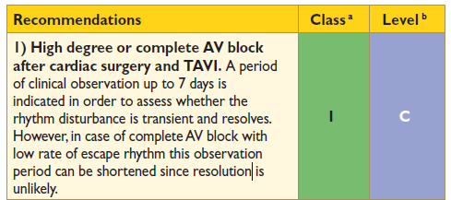
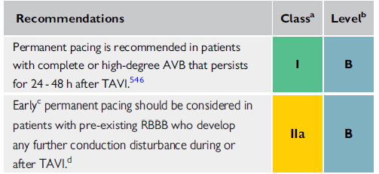
Weak Evidence in Guidelines
7 days
24-48 h

Slide 5
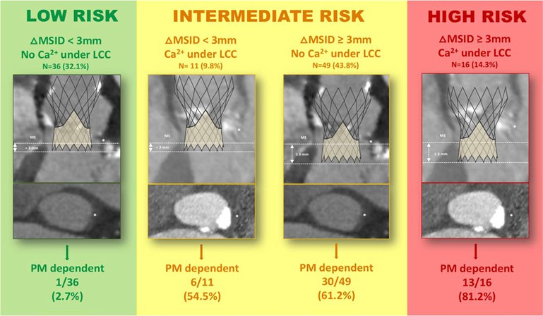
Low Dependency of PPM after TAVR
Of 728 TAVR patients, 112 (53.5% men; median age, 81 years) underwent PPM after TAVR
44.6% (50 of 112) were pacemaker dependent at 30 days and 46.7% (36 of 77) at 1 year
Independent predictors of pacemaker dependency included LVOT calcifications and ΔMSID ≥3mm
Circ Arrhythm Electrophysiol. 2021;14:e009028

Slide 6
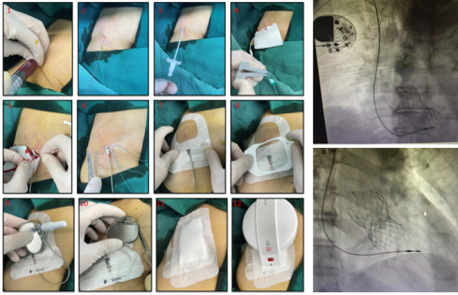
Explosive Study
Ventricular pacing rate of TPPM during the bridge window
100,0% 92,8% 95,8% 98,5% 98,5%
100%
80%
77,0%
60%
57,0%
49,0%
40%
29,0%
26,0%
33,0%
34,0%
25,0%
20%
9,0%
0,1%
17,0%
0,1%
0%
During TPPM Procedure
1
8
1st week
2nd week
3rd week
4th week
2
9
3
10
4
11
5
12
6
13
7
14
Temporary permanent pacemaker (TPPM) were placed on the 21 patients for 35±7 days. 81.0% of the patients
recovered from high degree atrioventricular block and no longer needed PPM implantation
Front Cardiovasc Med. 2023 Jan 25;10:978394. eCollection 2023.

Slide 7
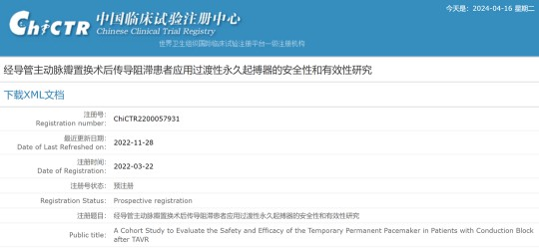
Prospective Multi-centre Study
Permanent pacemaker reduction using temporary permanent pacemaker as a 1-month bridge after TAVR: a prospective multi-centre single-arm study
ChiCTR2200057931
Prospective multi-centre study
13 tertiary hospitals in China
From Mar. 1, 2022 to Sep. 1, 2023
This study aimed to explore the potential reduction in the PPM implantation rate using temporary-permanent pacemaker (TPPM) as a 1-month bridge in the multi-centre patient population

Slide 8
Patients and Outcomes
Inclusion Criteria
Endpoints Definitions
The primary efficacy endpoints
Absence of pacing signals in the ECG and HOLTER at 1 month, meanwhile the pacemaker interrogation of the previous week revealed a VPR of 0%
Persistent* complete heart block occurred during TAVR procedure or within 1 month after TAVR
Rate of freedom from PPM implantation at 1 month
Persistent* high-degree atrioventricular AVB) occurred during TAVR procedure month after TAVR
block (≥2:1 or within 1
The Secondary efficacy endpoints
Rate of freedom from PPM implantation at 6 months
12-lead ECG reading and 24-h HOLTER monitoring were repeated at 6 months to confirm if the indications for PPM implantation recurred
Persistent* first-degree AVB (PR interval ≥240ms and
≥20ms larger than baseline) plus new onset left bundle branch block (LBBB) (QRS duration ≥150ms) occurred during TAVR procedure or within 1 month after TAVR
The safety endpoints
All-cause mortality Cardiovascular mortality
TPPM Procedure-related adverse events
All deaths regardless of etiology Deaths resulted from cardiovascular diseases Infection, vascular access complications, cardiac perforation, lead dislocation and thromboembolism
*Persistent means a minimum of 30 min duration of the HAVB/CHB episode

Slide 9
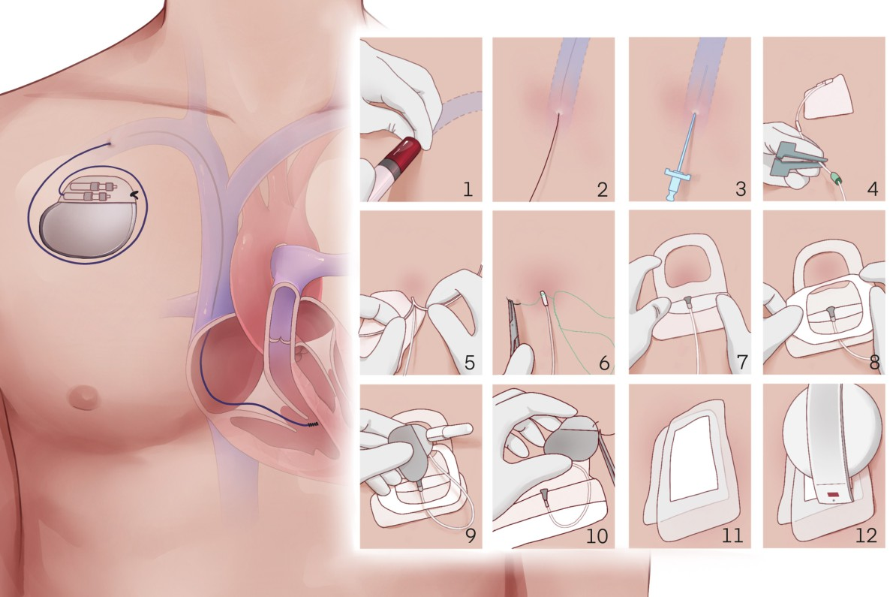
TPPM procedure step by step

Slide 10
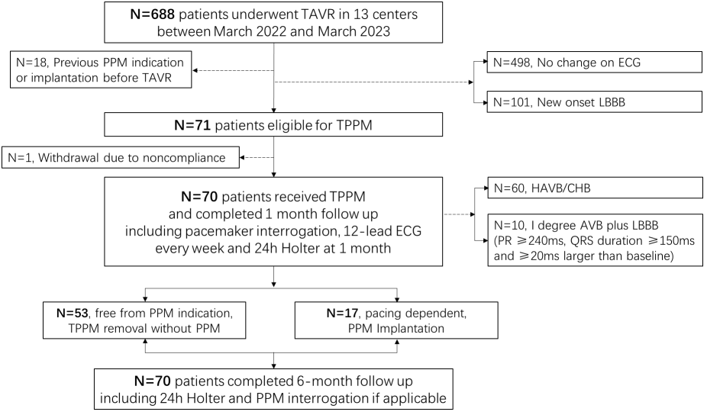
Flow Chart

Slide 11
Baseline Characteristics
Free from PPM implantation (N=53)
PPM implantation (N=17)
All patients (N=70)
P value
Age, years
74.3±7.3
73.8±7.4
76.1±7.1
0.25
Female sex
29 (41.4%)
22 (41.5%)
7 (41.2%)
0.98
STS score, %
4.0±1.4
3.9±1.3
4.1±1.8
0.77
Aortic valve regurgitation
22 (31.4%)
16 (30.2%)
6 (35.3%)
0.69
LBBB
6 (8.6%)
5 (9.4%)
1 (5.9%)
0.65
RBBB
14 (20.0%)
9 (17.0%)
5 (29.4%)
0.27
Atrial fibrillation
6 (8.6%)
5 (9.4%)
1 (5.9%)
0.65
First-degree AVB
10 (14.3%)
5 (9.4%)
5 (29.4%)
0.041
PR interval, ms
173.8±29.3
169.3±28.8
187.4±27.4 0.03
AVB = atrioventricular block; LBBB = left bundle-branch block; RBBB = right bundle branch block; PPM = permanent pacemaker

Slide 12
Imaging and TAVR Procedural Characteristics
Free from PPM implantation (N=53)
PPM implantation (N=17)
All patients (N=70)
P value
Bicuspid aortic valve
27 (38.6%)
22 (41.5%)
5 (29.4%)
0.37
Aortic valve Calcium*, mm³
71.5±104.4
70.9±107.3
73.6±98.1
0.93
Membrane septum length , mm
3.0±2.1
2.9±2.2
3.0±1.6
0.90
Self-expandable valve
68 (97.1%)
52 (98.1%)
16 (94.1%)
0.39
Oversizing of the annulus (%)
10.9±8.1
10.8±7.9
11.0±9.0
0.94
Implantation depth#, mm
6.2±2.8
5.7±2.9
7.5±2.0
0.022
ΔMSID, mm
3.4±3.1
2.9±3.2
4.7±2.5
0.040
ΔMSID ≥3 mm 54.9% 43.2%
*Under the left coronary cusp；# under the non-coronary cusp
ΔMSID = difference between implantation depth and membranous septum length
85.7%
0.0070

Slide 13
TPPM Procedural Characteristics
Free from PPM implantation(N=53)
PPM implantation (N=17)
All patients (N=70)
P value
Intraprocedural conduction disturbance
41 (58.6%)
29 (54.7%)
12 (70.6%)
0.25
Reason of TPPM
CHB
54 (77.1%)
37 (69.8%)
17 (100%)
0.010
HAVB
6 (8.6%)
6 (11.3%)
0 (0%)
0.15
First-degree AVB + LBBB
10 (14.3%)
10 (18.9%)
0 (0%)
0.05
Time, min
28.6±8.9
27.7±9.1
31.4±8.0
0.28
X ray, mGy
37.8±46.3
36.8±46.6
40.7±48.1
0.83
CHB = complete heart block;
HAVB = high degree atrioventricular block;
AVB = atrioventricular block

Slide 14
Primary Endpoint: Trends of Freedom from Indication for PPM
100%
HAVB/CHB + 1° AVB plus LBBB
HAVB/CHB
80%
75,7%
70,0%
58,6%
71,7%
60%
65,0%
44,3%
55,0%
40%
43,3%
21,7%
20%
18,6%
0,0%
0%
During TPPM
48h after TPPM
1st week after
2nd week after
3rd week after
4th week after

Slide 15
Rate of Indications for PPM at Different Time Points
12%
10,17%
P＜0.0001
P＜0.0001
Rate of Indications
for PPM implantation at different time points
10%
8,28%
8,72%
8%
6,83%
6%
4%
2,47%
2,47%
2%
0%
Time of enrollment to receive TPPM
48-h observation period (guideline)
1-month observation period (TPPM)
Time of enrollment to receive TPPM
48-h observation period (guideline) HAVB/CHB
1-month observation period (TPPM)
HAVB/CHB + First degree AVB plus LBBB

Slide 16
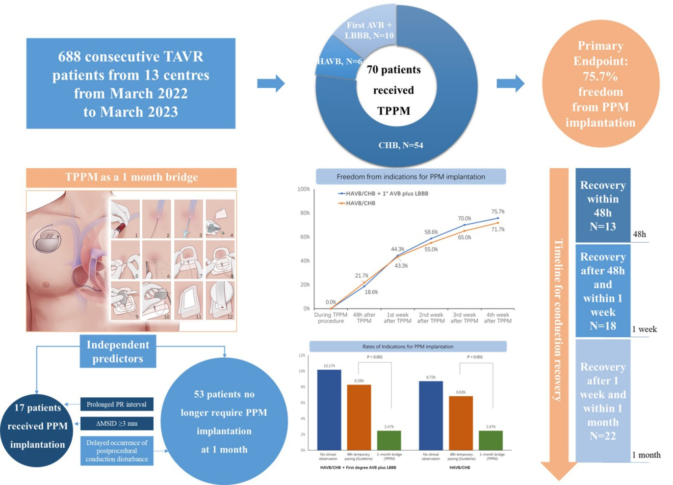
Central Illustration
Accepted in eClinicalMedicine, a subjournal of Lancet

Slide 17
Conclusions and Implications
Of 70 patients who received TPPM after TAVR, 75.7% did not require PPM implantation at 1 month follow-up, with no recurrences of HAVB during 6-month follow-up
For all 688 patients who have undergone TAVR, the rate of PPM implantation at 1 month was 2.47%, representing a significant reduction in self-comparison with the rate at 48h after TPPM (8.28%)
Using TPPM as a 1-month bridge after TAVR allows for a valuable buffer period to distinguish whether conduction disturbances are reversible or persistent. This could reduce unnecessary permanent pacemaker implantations, lower costs, improve patients' quality of life and clinical outcomes

Slide 18
Randomized Controlled Trial
REducing permanent pacemaker implantation in patients with COnduction disturbances after transcatheter aortic ValvE Replacement（RECOVER）
P I C O S
Participant: patients who developed high-degree atrioventricular block after TAVR
Intervention: temporary permanent pacemaker as a one-month bridge
Comparison: temporary pacemaker for 24-48h
Outcome: freedom from PPM implantation at 6 month after TAVR
Study design: randomized, controlled, open-label, superiority design
Ethics approved and under registration

Slide 19
PCRonline.com

