Slide 1
Pulsed Field Ablation Treatment in Paroxysmal and Persistent Atrial Fibrillation Patients:
Acute and Long-term Outcomes from the PULSED AF Pivotal Trial
Dr. Atul Verma
On behalf of the PULSED AF Investigators
@atulverma_md

Slide 2
Disclosures
Company Medtronic Biosense Webster Biotronik
Bayer
Kardium Medlumics
Relationship
Consultant/ Honoraria/ Research grant
Consultant/ Honoraria/ Research grant Research grant
Research grant/ Honoraria Consultant
Consultant/ Honoraria
The PULSED AF study (NCT04198701) was funded by Medtronic, Inc.
Reference materials were requested and obtained from Medtronic, Inc. for portions of this presentation.
The Medtronic PulseSelectTM PFA system is investigational, not approved in the US.
The following data and analyses have not been reviewed by any regulatory bodies, including FDA.

Slide 3
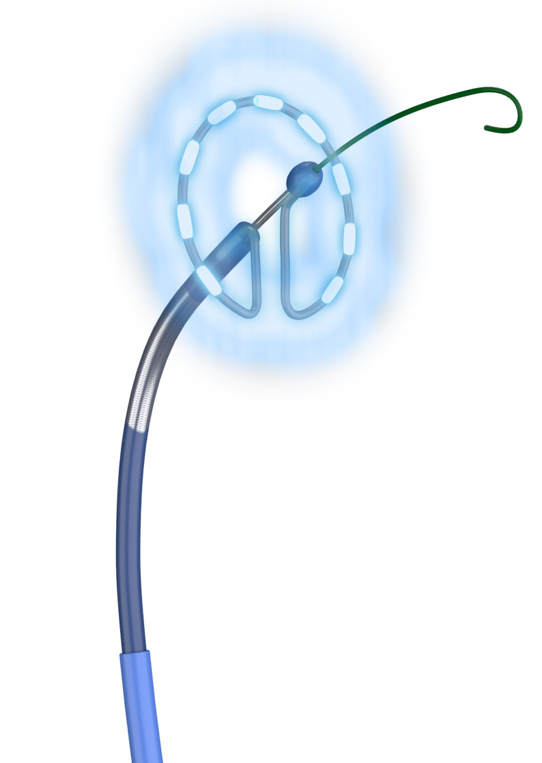
Introduction
Catheter ablation is an effective treatment for patients with symptomatic, drug-refractory atrial fibrillation.^{1,2}
Thermal modes of ablation are limited by the potential for collateral tissue damage.³
Pulsed field ablation creates lesions in cardiac tissue non-thermally through the mechanism of irreversible electroporation (IRE).^{4,5}
IRE involves tissue exposure to high electric field gradients, inducing cell membrane hyper-permeabilization within milliseconds, leading to cell death.⁶
Calkins H et al. Europace. 2018;20:e1-e160
Hindricks G et al. Eur Heart J. 2021;42:373-498.
Cappato R et al. Circ Arrhythm and Electrophysiol. 2010;3:32-38
Stewart MT et al. J Cardiovasc Electrophysiol. 2021;32:958-969.
Yarmush ML et al. Annu Rev Biomed Eng. 2014;16:295-320.
Kotnik T et al. Annu Rev Biomed Eng. 2019;48:63-91.

Slide 4
One application = 4 bipolar, biphasic trains lasting 100-200 ms, 2800-3000 V peak to peak

Slide 5
PULSED AF Study Design
PULSED AF: prospective, global, multi-center, non-randomized paired single-arm trial
41
Centers
67
Operators
9
Countries
150
Paroxysmal AF
150
Persistent AF
Key Inclusion Criteria
Key Exclusion Criteria
Prior antiarrhythmic drug failure
Diagnosis of recurrent symptomatic paroxysmal or persistent AF
18-80 years old
Long-standing persistent AF (continuous AF that is sustained >12 months)
Left atrial diameter > 5.0 cm
Prior left atrial ablation or surgery
Patient not on oral anticoagulation therapy for at least 3 weeks prior to procedure
Patients underwent pulmonary vein isolation using the PulseSelectTM Pulsed Field Ablation System and were followed for 12 months

Slide 6
Primary Efficacy Endpoint
Freedom from a composite endpoint of acute procedural failure, arrhythmia recurrence, repeat ablation, direct current cardioversion, left atrial surgery, or antiarrhythmic drug escalation through 12 months (excluding a 90-day blanking period)
Pre-Specified Performance Goal: >50% (paroxysmal) or >40% (persistent) at 12 months
All cardiac monitoring was adjudicated by an independent core laboratory
Cardiac Monitoring During Follow-up
 | 1-M | 2-M | 3-M | 4-M | 5-M | 6-M | 7-M | 8-M | 9-M | 10-M | 11-M | 12-M
TTM |  |  |  | Weekly and symptomatic transmissions
ECG |  |  | X |  |  | X |  |  |  |  |  | X
HM |  |  |  |  |  | X |  |  |  |  |  | X
 | Blanking period |  |  | Post-blanking period

Slide 7
Primary Safety Endpoint
Freedom from a composite of serious procedure and device-related adverse events
Pre-Specified Performance Goal: <13%
All primary safety endpoint events were adjudicated by an independent clinical events committee

Slide 8
Patient Flow Diagram
Enrolled: 383
Paroxysmal AF
(n = 200)
14 Not Ablated:
-Screen failure (4)
-Physician decision (3)
-Withdrawal by patient (3)
-Protocol deviation (1)
-Sponsor request (1)
-Other (2)
Persistent AF
(n = 183)
9 Not Ablated:
-Screen failure (5)
-Procedure not
attempted (3)
-Sponsor request (1)
36 Roll-In Patients
24 Roll-In Patients
150 Primary Cohort
150 Primary Cohort
96% of patients reached 12-month follow-up

Slide 9
Results: Patient Baseline Characteristics
Patient Characteristics Paroxysmal (n = 150) Persistent (n = 150)
Male Sex 64% 75%
Age (years) 63.4 ± 9.9 66.0 ± 9.0
Left Atrial Diameter (mm) 38.7 ± 5.8 42.0 ± 5.0
Left Ventricular Ejection Fraction (%) 60.3 ± 4.8† 57.6 ± 6.4
Years Since AF Onset 3.8 ± 6.2 2.7 ± 3.7
Number of Failed Antiarrhythmic Drugs 1.3 ± 0.6 1.3 ± 0.6
Cardioversions Prior to Enrollment
Electrical Pharmaceutical
22%
10%
62%
7%
Body Mass Index (kg/m²) 28.6 ± 5.9 30.9 ± 6.8
Medical History
Stroke
3% 2%
1% 2%
5% 5%
21% 21%
49% 65%
20% 31%
15% 11%
16% 14%
Transient ischemic attack
Myocardial infarction
Coronary artery disease
Hypertension
Obstructive sleep apnea
Valve dysfunction
Diabetes
CHA₂DS₂VASc 1.8 ± 1.4 2.1 ± 1.4
Data represented as mean ± SD or percentage; †n=149

Slide 10
Procedural Characteristics
Parameter Paroxysmal (n = 150) Persistent (n = 150)
Acute Pulmonary Vein Isolation
100% 100%
125 (102-157) 133.5 (107-173)
58.5 (46-76) 62.5 (51-84)
Skin-to-skin Procedure Time (min)*
Device Left Atrial Dwell Time (min)†
53 (40-68) 60 (45-77)
21 (15-31) 23 (14-38)
23 (19-28) 27 (23-34)
43.5 (37-54) 52.5 (44-67)
Time Between First and Last Application
Fluoroscopy Time (min)
Total pulsed field ablation energy delivered (sec)
Number of applications per procedure
Type of anesthesia used – no. (%)
General anesthesia | 89% | 84%
Deep sedation | 5% | 7%
Conscious sedation | 5% | 9%
Neuromuscular Blockade Use | 5% | 7%
Intra-procedural Cardioversions | 17% | 65%
Max esophageal temperature change from baseline (°c) | 0.3 (0.1-0.5) § | 0.2 (0.0-0.5) ǁ
Mapping / Navigation system used – no. (%) CARTO | 26% | 23%
EnSite | 57% | 59%
Rhythmia | 11% | 10%
None | 5% | 8%
Data represented as median (IQR) or percentage; *First sheath in, to last sheath out; †Includes protocol-mandated 20-minute wait period and post-ablation mapping
§Data were available for 67 patients; ǁData were available for 73 patients.

Slide 11
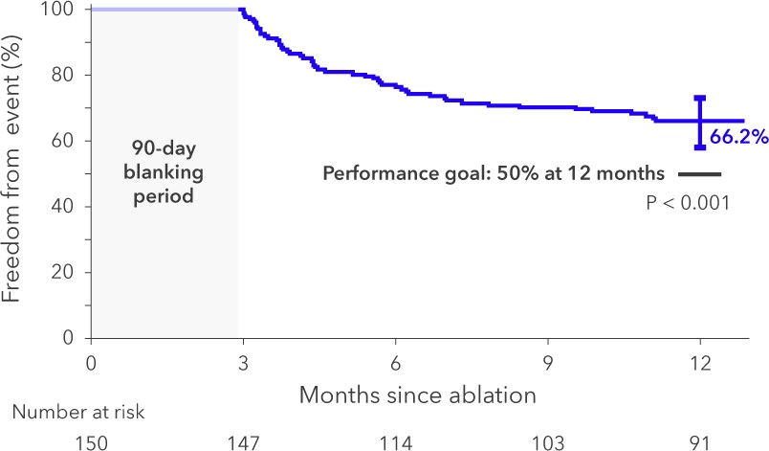
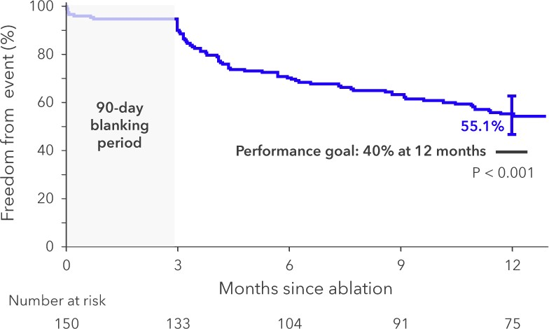
Primary Efficacy Results
Freedom from a composite endpoint of acute procedural failure, arrhythmia recurrence, repeat ablation, direct current cardioversion, left atrial surgery, or antiarrhythmic drug escalation through 12 months (excluding a 90-day blanking period)
Paroxysmal Atrial Fibrillation
Persistent Atrial Fibrillation
Both paroxysmal and persistent atrial fibrillation cohorts met predetermined effectiveness performance goals.

Slide 12
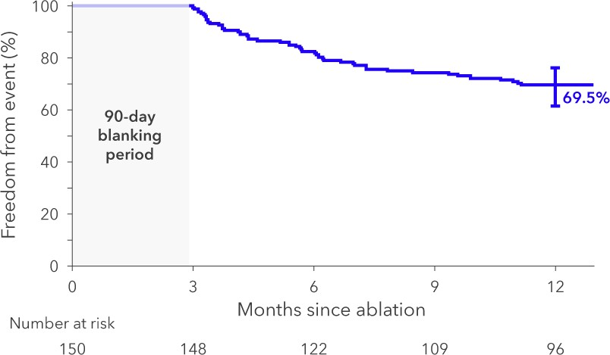
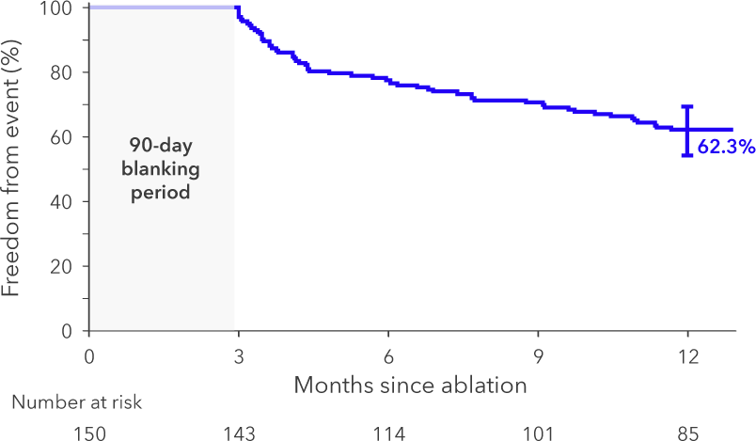
Freedom from AT/AF/AFL
Paroxysmal Atrial Fibrillation
Persistent Atrial Fibrillation
Freedom from atrial arrhythmia recurrence at 12 months was 69.5% in the paroxysmal and 62.3% in the persistent atrial fibrillation cohort

Slide 13
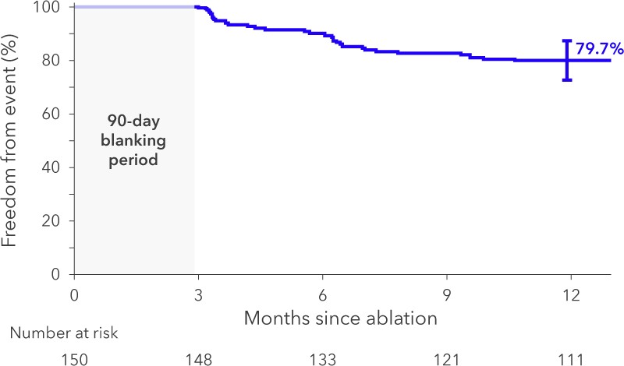
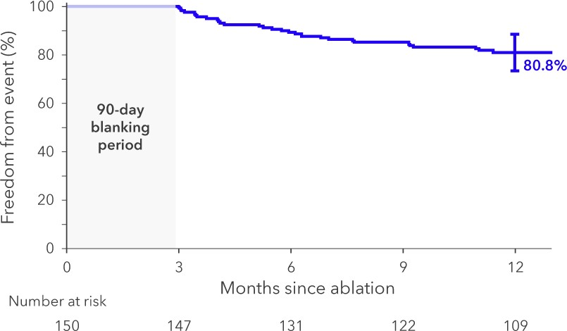
Clinical Success
Clinical success was defined as freedom from symptomatic atrial arrhythmia recurrence at 12 months
Paroxysmal Atrial Fibrillation
Persistent Atrial Fibrillation
Freedom from symptomatic recurrence is based on trans-telephonic monitoring only

Slide 14
Primary Safety Results
0.7% safety event rate in each cohort
Both paroxysmal and persistent atrial fibrillation cohorts met predetermined safety performance goals (<13%, p=0.002)
)
Number with a Primary Safety Event
Primary Safety Event Within 6 months | Paroxysmal AF (n = 150) | Persistent AF (n = 150)
Pulmonary vein stenosis (>70% diameter reduction) | 0 | 0
Phrenic nerve injury/diaphragmatic paralysis ongoing at 6 months | 0 | 0
Atrioesophageal fistula | 0 | 0
Within 30 days
Cardiac tamponade/perforation | 0 | 1
Cerebrovascular accident | 1 | 0
Transient ischemic attack | 0 | 0
Major bleeding requiring transfusion | 0 | 0
Myocardial infarction | 0 | 0
Pericarditis requiring intervention | 0 | 0
Vagal nerve injury resulting in esophageal dysmotility or gastroparesis | 0 | 0
Vascular access complications requiring intervention | 0 | 0
Death | 0 | 0
PFA system- or procedure-related cardiovascular and pulmonary adverse event prolonging/requiring hospitalization >48 hours (excluding recurrent AF/AFL/AT) | 0 | 0

Slide 15
Quality of Life
Quality of life measures indicate a clinically meaningful improvement¹⁻³
AFEQT EQ-5D-5L
22% more patients were not anxious or depressed at 12 mo vs. baseline
Mean AFEQT score
100
80
60
40
20
0
1
0.8
+0.05 (p<0.0001)
Paroxysmal AF
+29.4 (p<0.0001)
89.8
Mean EQ-5D-5L
score
0.91
0.86
11% more patients had no problems doing their usual activities at 12 mo vs. baseline
60.4
0.6
0.4
0.2
Baseline
12 Months
0
Baseline
12 Months
19% more patients were not anxious or depressed at 12 mo vs. baseline
Persistent AF
Mean AFEQT score
100
1
+0.06 (p<0.0001)
+29.0 (p=0.001)
91.0
Mean EQ-5D-5L
score
0.92
80
0.8
0.86
21% more patients had no problems doing their usual activities at 12 mo vs. baseline
60
40
20
0
62.0
0.6
0.4
0.2
0
1, Dorian P et al. Am Heart J. 2013;166:381-
387.e388.
2, Holmes DN et al. Circ Cardiovasc Qual Outcomes. 2019;12:e005358.
3, Coretti S et al. Expert Rev Pharmacoecon Outcomes Res. 2014;14:221-233.
Baseline
12 Months
Baseline
12 Months

Slide 16
PV Stenosis Sub-Study
No moderate or severe stenosis was observed in 275 pulmonary veins on cardiac computed tomography or MRI imaging at 3 months
Pulmonary Vein Stenosis Sub-Study
 |  | Pulmonary Vein Diameter Change
Vein | N* | Moderate Change no. (%)¹ | Severe Change no. (%)²
All | 275 | 0 (0) | 0 (0)
RIPV | 63 | 0 (0) | 0 (0)
RSPV | 62 | 0 (0) | 0 (0)
RMPV | 9 | 0 (0) | 0 (0)
LIPV | 63 | 0 (0) | 0 (0)
LSPV | 63 | 0 (0) | 0 (0)
LCPV | 15 | 0 (0) | 0 (0)
¹50-70% reduction, ¹≥70% reduction.

Slide 17
Cerebral MRI Sub-Study
New silent cerebral lesions were observed in 4 of 45 patients (9%) undergoing cerebral MRI at baseline and within 72 hours post-ablation
Cerebral MRI Sub-Study
Cohort | Number of Patients | Silent Cerebral Lesions -- no. (%)
Paroxysmal AF | 26 | 2 (8)
Persistent AF | 19 | 2 (11)
Total | 45 | 4 (9)

Slide 18
Conclusion
Primary safety endpoint rate of 0.7% observed for both cohorts
No occurrence of phrenic, esophageal, pulmonary vein injury, or coronary artery spasm
Both paroxysmal and persistent atrial fibrillation cohorts met predetermined safety performance goals (<13%)
Acute isolation was demonstrated in 100% of all pulmonary veins
Both paroxysmal and persistent atrial fibrillation cohorts met predetermined effectiveness performance goals
66.2% freedom from a primary efficacy endpoint event in paroxysmal AF patients
55.1% freedom from a primary efficacy endpoint event in persistent AF patients
Pulsed field ablation resulted in a clinically meaningful improvements in quality of life
Pulsed field ablation resulted in 79.7% (paroxysmal) and 80.8% (persistent) clinical success

Slide 19
PULSED AF Committees
Steering Committee
Dr. Atul Verma
Dr. Lucas V.A. Boersma Dr. Hugh Calkins
Dr. Prashanthan Sanders Dr. David E. Haines
Dr. Francis E. Marchlinski Dr. Andrea Natale
Dr. Gerhard Hindricks
Dr. Douglas L. Packer Dr. Karl-Heinz Kuck
Southlake Regional Health Center, Toronto, Canada
St Antonius Hospital, Nieuwegein, Netherlands Johns Hopkins Hospital, Baltimore, MD
Univ of Adelaide & Royal Adelaide Hospital, Adelaide, Australia Beaumont Health, Royal Oak, MI
Hospital of the Univ of Pennsylvania, Philadelphia, PA Texas Cardiac Arrhythmia Institute, Austin, TX
Heart Center - University of L, Leipzig, Germany
Mayo Clinic-St. Mary`s Hospital, Rochester, MN LANS Cardio, Hamburg, Germany
Clinical Events Committee
Dr. Wendy Tzou Dr. Pierre Fayad Dr. Peter Friedman
Dr. Melissa Robinson
Dr. Jonathan Steinberg
Data Monitoring Committee
Dr. George Crossley Dr. Timothy Church Dr. Daryl Gress
Dr. Carina Blomström-Lundqvist
Dr. Stephan Willems Dr. Jeanne Poole

Slide 20
PULSED AF Investigators
Principal Investigator Site Name
Site Name
Northwestern University
Mattias Duytschaever AZ Sint-Jan Brugge-Oostende av
Principal Investigator
David DeLurgio (co-author) Emory Saint Joseph's Hospital (Atlanta GA)
Bradley Knight
Nitesh Sood (co-author) Southcoast Health System
Hiroshi Tada (co-author) University of Fukui Hospital
Larry Chinitz NYU Langone Medical Center
Robert Hoyt Iowa Heart Center
John Rhyner Mission Hospital
Andrea Natale Texas Cardiac Arrhythmia Research Foundation
Ángel Arenal Maiz Hospital General Universitario Gregorio Marañón
James Irwin BayCare Medical Group Cardiology
Ethan Ellis Medical Center of the Rockies
David Haines Beaumont Health System
Jason Andrade Vancouver General Hospital
Suneet Mittal The Valley Hospital
J. Michael Mangrum University of Virginia Medical Center
Sarfraz Durrani MedStar Washington Hospital Center
Bradley Wilsmore John Hunter Hospital
Robert Sangrigoli Doylestown Health Cardiology
Alexandre Zhao CMC - Clinique Ambroise Paré
Luigi Di Biase Montefiore Medical Center
Raman Mitra Northwell Health
Oussama Wazni Cleveland Clinic
Alefiyah Rajabali Providence Saint Vincent Medical Center
Atul Verma Southlake Regional Health Centre
Sandeep Jain University of Pittsburgh Medical Center
Jose Osorio Grandview Medical Center
Andre Gauri Spectrum Health
Teiichi Yamane The Jikei University Hospital
Peter Noseworthy Mayo Clinic (Rochester MN)
Tetsuo Sasano Tokyo Medical and Dental University Hospital
Vidal Essebag McGill University Health Centre (MUHC)
Institut Universitaire de Cardiologie et de Pneumologie de Québec
Swedish Medical Center
The Ohio State University Heart and Vascular Research Organization
Royal Adelaide Hospital
Hirofumi Tomita Hirosaki University Hospital
Jean-Francois Sarrazin
Sanjaya Gupta St. Luke's Mid America Heart Institute
Helmut Friedrich Pürerfellner Ordensklinikum Linz GmbH / Elisabethinen
Darryl Wells
Francis E Marchlinski Hospital of the University of Pennsylvania
John Hummel
Lucas V. A. Boersma St. Antonius Ziekenhuis
Hugh Calkins The Johns Hopkins Hospital
Prashanthan Sanders

Slide 21
Thank you to all PULSED AF investigators and all patients
On behalf of Dr. Atul Verma and the PULSED AF steering committee
@atulverma_md

Slide 22
Announcing publication release:

