Slide 1
Embargoed for 9am CT 11-17-20
DESIGN, IMPLEMENTATION, INITIAL RESULTS
James A. de Lemos, MD, David A Morrow, MD, MPH, Tracy Wang, MD,
Fatima Rodriguez, MD,MPH Heather Alger, PhD Christine Rutan, CPHQ
Steven Bradley, MD, MPH, Mitchell Elkind, MD, MS, Sandeep Das, MD, MPH

Slide 2
Disclosures
J.A. De Lemos: Research Grant; Significant; Roche Diagnostics, Abbott Diagnostics. Honoraria; Significant; Ortho Clinical Diagnostics. Honoraria; Modest; Amgen, Regeneron, Novo Nordisc. Honoraria; Significant; Siemen's Diagnostic. Honoraria; Modest; Janssen, Quidel Cardiovascular, Eli Lilly. D. Morrow: Research Grant; Significant; Abbott laboratories, Roche Diagnostics. Other; Significant; Roche Diagnostics. Research Grant; Significant; Siemens. Other; Modest; InCarda Therapeutics, Merck & Co. Other; Significant; Novartis. Research Grant; Significant; Amgen, Anthos, AstraZeneca, Daiichi Sankyo, Eisai, Johnson & Johnson, Merck & Co, Novartis, Pfizer. T. Wang: Research Grant; Modest; Abbott. Research Grant; Significant; AstraZeneca. Research Grant; Modest; BMS. Research Grant; Significant; Cryolife. Research Grant; Modest; Boston Scientific, Merck, Portola. Research Grant; Significant; Regeneron. Research Grant; Modest; Chiesi. F. Rodriguez: Other; Modest; HealthPals, NovoNordisk, Janssen, The Medicines Company. H. Alger: None. S. Bradley: None. M.S. Elkind: Other Research Support; Significant; BMS-Pfizer Alliance for Eliquis. Research Grant; Significant; Roche. Other; Modest; UpToDate.

Slide 3
Creation of the registry
Volunteer Steering Committee
AHA Leadership and Professional Staff
Site Investigators and Research/QI Teams

Slide 4
January 1, 2020
February 1, 2020
March 1, 2020
April 1, 2020
May 1, 2020
June 1, 2020
December 31, 2019
WHO Country Office in Wuhan China receives first reported cases of a pneumonia of unknown cause
February 11
WHO announced a name for the new coronavirus disease: COVID-19
June 8
34 Proposals Submitted for
First Review Cycle
March 11
WHO declares COVID-19 a global pandemic
January 19
Presentation of first reported case of novel coronavirus in U.S. (Snohomish County, WA)
Late March – Early May
AHA volunteers and staff conduct environmental scan of the published literature, anecdotal evidence, and data elements captured in COVID-19 clinical care; build, test, and launch platform
March 29
AHA Volunteers and Leadership conceptualize a COVID-19 CVD Quality Improvement Program for hospitals
April 27
Upload of first records into COVID-19 CVD Registry platform
April 3
AHA announced the development of the COVID-19 CVD Registry and began recruiting sites
Notes:
Sources:
WHO (2020) Rolling Updates on coronavirus disease (COVID-19) https://www.who.int/emergencies/diseases/novel-coronavirus-2019/events-as-they-happen
WHO (2020) WHO Timeline COVID-19 https://www.who.int/news-room/detail/27-04-2020-who-timeline---covid-19
Holshue (2020, NEJM) First Case of 2019 Novel Coronavirus in the United States https://www.nejm.org/doi/full/10.1056/NEJMoa2001191

Slide 5
Objectives of the Registry
accelerate the pace of COVID-19 CVD research and Quality improvement
Unprecedented time horizon
Need to think “outside the box” for solutions
Granular Data Collection
Over 200 unique data elements
Extensive serial laboratory data
Complete case capture from beginning of pandemic
Minimize selection bias
Enhance generalizability

Slide 6
Disrupting and democratizing the research process
Leverage the AHA Precision Medicine platform (PMP)
Secure cloud-based environment that allows dozens of teams of investigators to work in parallel on the same curated and de-identified dataset
AHA scientists provide support
Analysts share best practices in a “learn as we go” approach
Advantages
Shorten time to discovery and dissemination of results
Lower cost/higher yield approach to knowledge acquisition and dissemination
Leverage talent and energy of a larger number of investigators
Challenges
Need to maintain rigor despite less central control of research processes
Unprecedented pace
Clinical priorities at enrolling sites

Slide 7
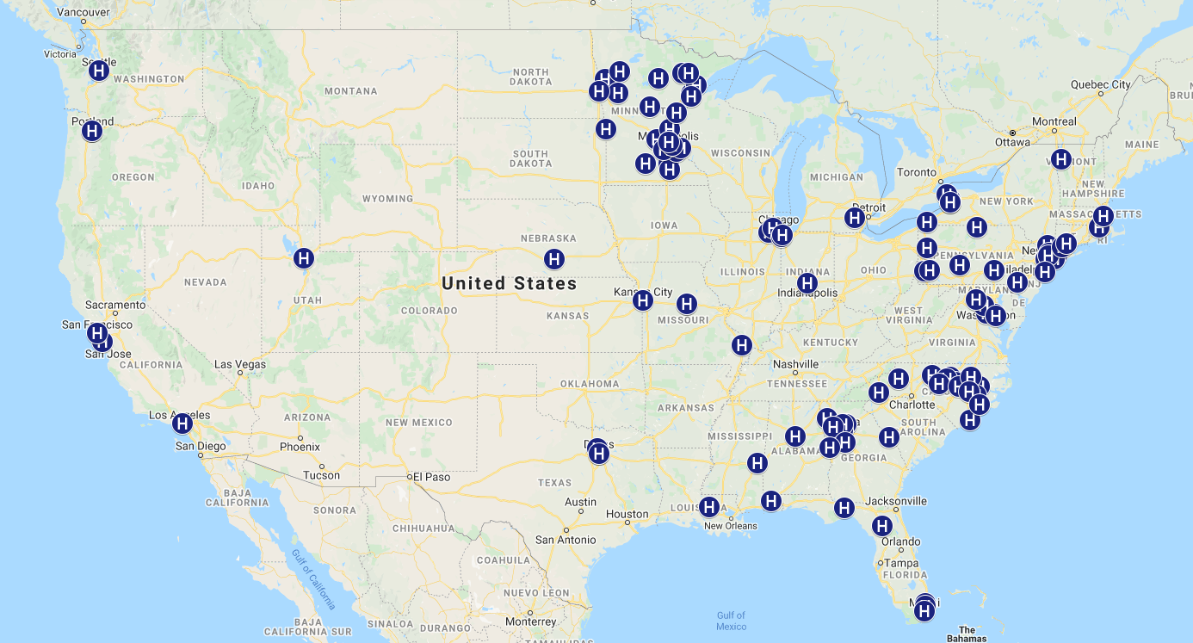
Registry Dashboard Update as of 11/9/20
Supporting a Burst Science Approach
109 Hospitals & Medical Centers Entering Data
> 22,500 patient records and growing
> 200 data fields per patient
75,000+ days of serial labs
55 Research proposals received, 21 active (38% acceptance rate)
Notes:
120 Hospitals and Medical Centers are enrolled in the COVID-19 CVD Registry
18-101 years – age range of patient data entered in Registry
44 Sites are actively uploading data into the platform
3154 Records – 67% marked complete
13,847 days of serial labs
5/22/2020: AHA announced Research RFP to study the COVID-19 CVD Registry dataset
Aggregate, deidentified national dataset
Burst science approach to decentralize and accelerate discovery with real-world data
First round RFP open to all sites submitting data
Proposals accepted through June 8, 2020

Slide 8
Cardiovascular Risk Factors
Data Cut through 9/30/20
N=99 sites
N=14,889 patients

Slide 9
Prior Cardiovascular Disease

Slide 10
In Hospital Cardiac Complications
CV death, MI, Stroke, HF, Shock

Slide 11
In Hospital Mortality
All Cause Death
or Hospice
Cause of Death

Slide 12
Non-Cardiac Complications

Slide 13
Conclusions: Hospitalized COVID-19
Pandemic has driven Disruptive (and likely enduring) innovation to registry research
COVID-19 admissions have High prevalence of CVD risk factors and prevalent CVD
High Risk for mortality and major morbidity
More than 20% required mechanical ventilation and 20% died or were referred for hospice
Dominant cause of complications are related to ARDS with high rate of respiratory mortality
Cardiovascular complications in an important subset, but less common than initially feared
Composite CVD in 8.8%
MI, Stroke, DVT/PE all < 5%
Given scale of pandemic, cumulative number of these cardiovascular events is still large

Slide 14
Request for Proposals
COVID-19 CVD Registry Research Opportunities are now available to the broader research community
regardless of registry participation.
Need to know:
Proposals will be accepted through Wednesday, December 2nd, 2020, 5:00 pm CT.
Proposals will be evaluated by the Registry Steering Committee on priority, novelty, feasibility with available data, and merit.
Data will be made available for approved research on the AHA Precision Medicine Platform
For more information or to submit a proposal:
Visit www.heart.org/covidresearch
Email: qualityresearch@heart.org

