Slide 1
Impact of hemodynamics on clinical outcomes after self-expanding transcatheter aortic valve implantation in failed surgical valves
David Holzhey, MD for the VIVA and EUS Investigators

Slide 2

Potential conflicts of interest
Speaker's name : David Holzhey, MD
☑ I have the following potential conflicts of interest to declare:
Proctor and advisor for Medtronic, proctor for Boston Scientific and advisor for Edwards Lifesciences
David Holzhey, MD

Slide 3
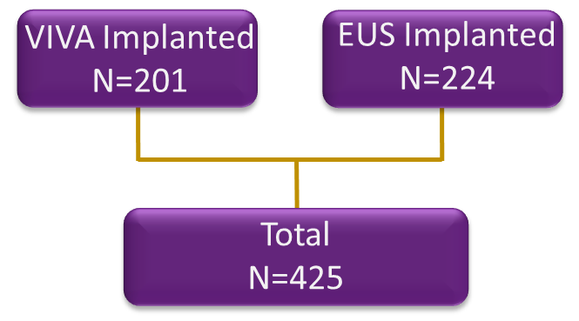
Background
Two trials, Valve in Valve (VIVA) in Europe and Expanded Use United States (EUS) have been combined to analyze TAV in SAV.
We evaluated clinical and hemodynamic outcomes of patients with failing surgical aortic valves (SAV) that underwent transcatheter aortic valve implantation (TAVI) with the self-expandable platform.
David Holzhey, MD

Slide 4
Methods
VIVA and EUS were prospective, observational, single-arm, multi-center studies that evaluated the safety and effectiveness of TAVI in patients with symptomatic failed surgical aortic valves.^{1,2}
This analysis combined data from these 2 studies to further assess outcomes of TAV in SAV procedures using a CoreValve or Evolut R bioprosthesis.
The primary safety endpoint was all-cause mortality analyzed by
  SAV failure mode (regurgitation, stenosis or combined)
  Post-implant mean gradient ≥20 mmHg
David Holzhey, MD
¹Tchétché D, et al. JACC Cardiovasc Interv. 2019; 12, 923–32.
²Dauerman H, et al. Circ Cardiovasc Interv. 2019; 12(10): e008155

Slide 5
Baseline and valve characteristics
Mean ± standard deviation or n (%) | N=425
Age, years | 78.2 ± 9.4
Male sex | 237 (55.8)
STS-PROM, % | 7.8 ± 6.1
Logistic EuroSCORE, % | 24.2 ± 15.5
Previous stroke | 39 (9.2)
Diabetes mellitus | 141 (33.2)
Previous MI | 66 (15.5)
Surgical valve age, years | 9.8 ± 4.4
Surgical valve type, stented | 372 (87.5)
Surgical valve label size (mm)
19-21 mm | 154/412 (37.4)
23 mm | 131/412 (31.8)
25–29 mm | 127/412 (30.8)
Surgical valve failure mode
Stenosis | 239 (56.2)
Regurgitation | 95 (22.4)
Combined | 91 (21.4)
David Holzhey, MD

Slide 6
Clinical and haemodynamic outcomes
Kaplan-Meier rates at 2 years (%) | All | SAV Failure Mode
 |  | Regurgitation | Stenosis | Combined
All-cause mortality | 16.7 | 9.8 | 20.3 | 14.5
All stroke | 6.1 | 3.2 | 8.8 | 2.4
Disabling/major stroke | 2.1 | 1.1 | 3.4 | 0.0
Prosthetic valve thrombosis | 1.3 | 2.2 | 0.9 | 1.2
Prosthetic valve endocarditis | 0.8 | 1.2 | 1.0 | 0.0
Life-threatening bleeding | 7.5 | 7.5 | 7.6 | 6.8
Acute kidney injury stage II or III | 0.8 | 0.0 | 1.1 | 1.1
New pacemaker implantation | 12.5 | 11.9 | 14.0 | 9.1
Haemodynamics (mean ± SD)
Discharge mean gradient, mmHg | 18.5±9.7 | 14.5±6.9 | 20.1±10.3 | 18.3±9.2
Mean gradient at 1 year, mmHg | 15.5±8.0 | 12.8±8.1 | 16.8±7.6 | 15.7±8.1
David Holzhey, MD

Slide 7
Mortality at 2 years by discharge mean gradient
Log-rank P=0.008
All-Cause Mortality %
20.6%
10.1%
David Holzhey, MD
Years Post Procedure
No. subjects at risk
<20 mmHg ≥20 mmHg | 223 221 130 130 | 201 111 | 163 89

Slide 8
Multivariable predictors of 2-year mortality from time of discharge by failure mode
Variable | Hazard Ratio (95% CI) | P-value
Stenosis
Discharge MG ≥20 mmHg | 1.79 (0.87-3.66) | 0.11
STS Score, % | 1.06 (1.0-1.13) | 0.04
SAV tissue type
Bovine vs homograft | 0.37 (0.11-1.28) | 0.12
Porcine vs homograft | 0.86 (0.24-3.12) | 0.82
Regurgitation and combined
Discharge MG ≥20 mmHg | 2.64 (0.91-7.60) | 0.07
Age, years | 1.11 (1.03-1.19) | 0.005
Diabetes Mellitus | 2.21 (0.77-6.33) | 0.14
Prior Stroke or TIA | 4.41 (1.30-14.99) | 0.02
David Holzhey, MD

Slide 9
Multivariable predictors of discharge mean gradient ≥ 20 mmHg
Variable | Odds Ratio [95% CI] | P-value
NYHA class III/IV | 0.62 (0.32-1.18) | 0.15
STS Score, % | 1.04 (0.99-1.09) | 0.09
TAV implant size
26 vs 23 mm | 0.20 (0.11-0.37) | 0.43
29/31 vs 23 mm | 0.08 (0.02-0.27) | <0.01
David Holzhey, MD

Slide 10
Conclusions
This combined analysis shows good clinical and hemodynamic outcomes in these TAV in SAV patients.
Patients with a discharge mean gradient of ≥20 mmHg had a significantly higher rate of all-cause mortality at 2 years.
TAVI implant size of 23 mm and higher STS Score were predictors for discharge mean gradient ≥20 mmHg.
Discharge mean gradient ≥20 mmHg was significantly associated with 2-year mortality.
David Holzhey, MD

