Slide 1

Integrating the Effect of Polygenic Scores, Low Density Lipoproteins and Systolic Blood Pressure on the Lifetime Risk of Cardiovascular Disease
*Brian A Ference MD, MPhil, MSc; *Qi Guo PhD; Deepak L. Bhatt MD, MPH; Kausik K Ray MD, MPhil; Stephen J. Nicholls MBBS, PhD; Thatcher B Ference; Chris J. Packard DSc; Ian Graham MD; John E. Deanfield, MD, FMedSci; G. Kees Hovingh MD, PhD; John J. P. Kastelein MD, PhD; C. Michael Gibson MD, MS; Ulrich Laufs MD, PhD; Lale Tokgozoglu MD; Jan Borén MD, PhD; Christian T Ruff MD, MPH; Michael V Holmes MBBS, PhD; George Davey Smith MD, DSc; Steven E. Nissen MD; Colin Baigent FMedSci; Eugene Braunwald MD; Nilesh J. Samani MD, FMedSci; #Marc S Sabatine MD, MPH; #Alberico L Catapano PhD
*contributed equally
From the Centre for Naturally Randomized Trials, University of Cambridge, Cambridge, U.K. (B.A.F., Q.G., T.B.F); MRC Populati on Health Research Unit and the Clinical Trial Service Unit and Epidemiological Studies Unit, Nuffield Department of Population Health, University of Oxford, Oxford, UK (M.V.H.; C.B.); MRC Integrative Epidemiology Unit, University of Bristol, Bristol, U.K. (G.D.S.); Imperial Centre for Cardiovascular Disease Prevention, Department of Primary Care and Public Health, School of Public Health, Imperial College London, London U.K. (K.K.R.); Monash University, Melbourne, Australia (S.J.N.). Brigham and Women’s Hospital Heart and Vascular Center, Harvard Medical School, Boston, MA (D.L.B.); Institute of Cardiovascular and Medical Sciences, University of Glasgow, Glasgow, U.K. (C.J.P.); School of Medicine, Trinity College, Dublin, Ireland (I.G.); Institute of Cardiovascular Science, University College London, London, U.K. (J.E.D.); Department of Vascular Medicine, Academic Medical Center, University of Amsterdam, Amsterdam, The Netherlands (A.C., G.K.H); PERFUSE Study Group, Beth Israel Deaconess Hospital, Harvard Medical School, Boston, Massachusetts (C.M.G.); Department of Cardiology, University of Leipzig, Leipzig, Germany (U.L.); Department of Cardiology, Hacettepe University, Ankara, Turkey (L.T.); Department of Molecular and Clinical Medicine, Institute of Medicine, University of Gothenburg and Sahlgrenska University Hospital, Gothenburg, Sweden (J.B.); Thrombolysis in Myocardial Infarction (TIMI) Study Group, Division of Cardiovascular Medicine, Brigham and Women’s Hospital, Harvard Medical School, Bos ton, USA (C.T.R., E.B., M.S.S.); Cleveland Clinic Coordinating Center for Clinical Research, Department of Cardiovascular Medicine, Cleveland Clinic, Cleveland, Ohio (S.E.N); Department of Cardiovascular Sciences, University of Leicester, Leicester, U.K.; National Institute for Health Research Leicester Cardiovascular Biomedical Research Centre, Leicester, U.K. (N.J.S.); Department of Pharmacological and Biomolecular Sciences, University of Milan and Multimedica IRCCS, Milano, Italy (A.L.C.)
Centre for Naturally Randomized Trials

Slide 2
Financial Disclosures
Research Grants: Merck, Novartis, Amgen, Esperion Therapeutics, Ionis Pharmaceuticals Consulting Fees, Advisory Boards, Honoraria: Merck, Amgen, Regeneron, Sanofi, Novartis, Pfizer, Eli Lilly, Novo Nordisk, The Medicines Co, Mylan, Daiichi Sankyo, Silence Therapeutics, Ionis Pharmaceuticals,, dalCOR, CiVi Pharma, KrKa Phamaceuticals, Medtronic, Celera, American College of Cardiology, European Atherosclerosis Society, European Society of Cardiology

Slide 3


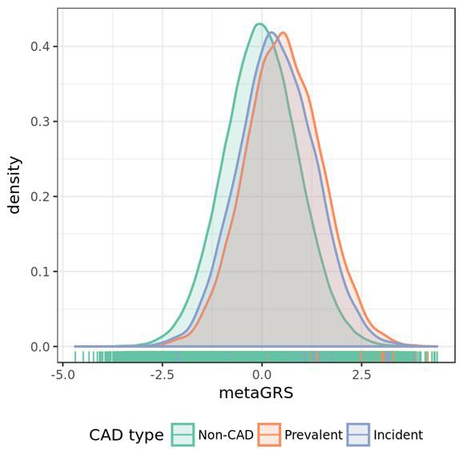
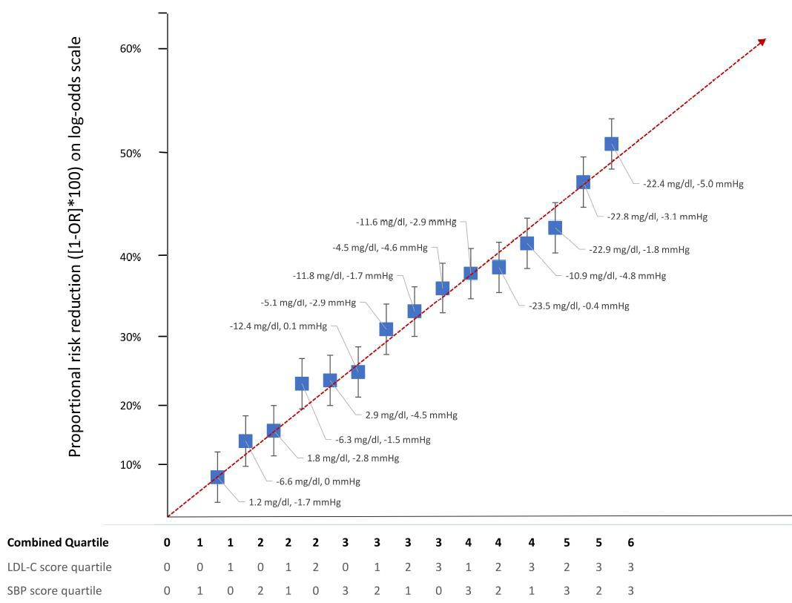
Background
Polygenic score (PGS) predicts lifetime risk of CAD
LDL and SBP have cumulative effects on lifetime risk of CAD
Inouye M, et al. bioRxiv doi: http://dx.doi.org/10.1101/250712
Ference BA, et al. JAMA. 2019;322(14):1381-1391.

Slide 4
Objectives
Objective: to evaluate how much lifetime risk of cardiovascular disease varies at all levels of a polygenic score (PGS) for CAD depending on differences in lifetime exposure to low-density lipoproteins (LDL) and systolic blood pressure (SBP)
  To make inferences about how a PGS for CAD can be combined with information about LDL and SBP - which are modifiable and the current targets of therapy to reduce risk
  To directly inform individual screening and treatment decisions
  To provide a potential framework for incorporating PGS for CAD into clinical medicine

Slide 5
Study population and primary outcomes
Study Population: 445,566 participants enrolled in the UK Biobank
  54% females
  Mean age at enrolment: 57.2 years (mean age at last follow-up 65.2 years)
  Mean LDL-C: 138 mg/dl (mean apoB level: 104.4 mg/dL)
  Mean SBP: 137.8 mmHg
Primary Outcomes: Major coronary events (MCE); N = 23,032
  First occurrence of fatal or non-fatal myocardial infarction, or coronary revascularization
Primary Analysis: time to event analysis
  Age as the time scale
  Participants censored at age of the first occurrence of a primary outcome event, death due to a cause other than myocardial infarction (as a competing risk), or end of follow-up

Slide 6

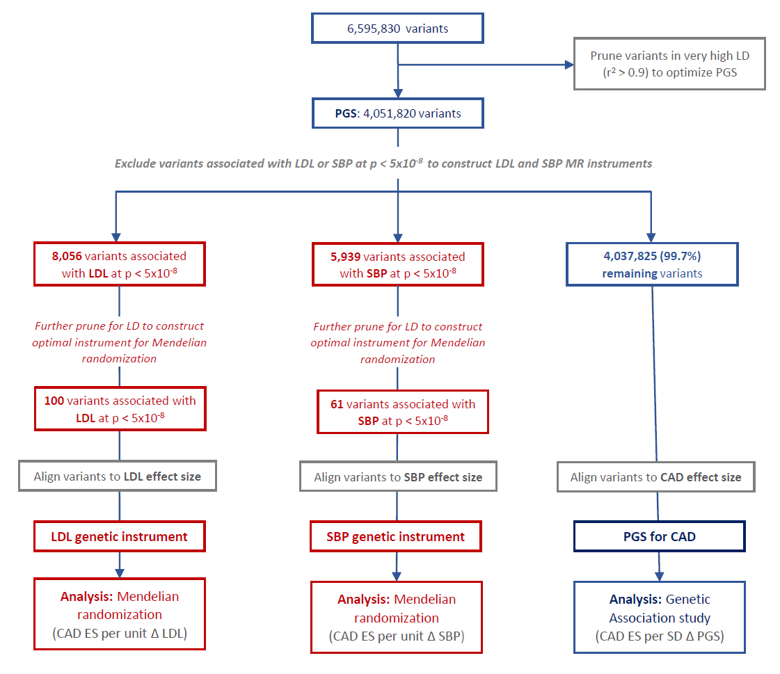
Construction of genetic scores

Slide 7
Associations of polygenic score with major coronary events
Polygenic score for CAD
Participants | PGS | Quintile 1 | Quintile 2 | Quintile 3 | Quintile 4 | Quintile 5
All
No. participants | 445,566 | 89,121 | 89,128 | 89,114 | 89,105 | 89,098
No. events | 23,032 | 2,791 | 3,618 | 4,466 | 4,990 | 7,167
Risk (%) | 5.2 | 3.1 | 4.1 | 5.0 | 5.6 | 8.0
HR (95% CI) | 1.45 (1.43-1.47)* | reference | 1.31 (1.25-1.38) | 1.63 (1.56-1.71) | 1.85 (1.76-1.93) | 2.77 (2.65-2.89)
Men
No. participants | 203,545 | 40,576 | 40,728 | 41,040 | 40,814 | 40,387
No. events | 17,783 | 2,137 | 2,829 | 3,497 | 3,857 | 5,463
Risk (%) | 8.7 | 5.3 | 6.9 | 8.5 | 9.4 | 13.5
HR (95% CI) | 1.44 (1.42-1.46)* | reference | 1.34 (1.26-1.41) | 1.66 (1.56-1.71) | 1.87 (1.76-1.93) | 2.78 (2.65-2.89)
Women
No. participants | 242,021 | 48,545 | 48,400 | 48,074 | 48,291 | 48,711
No. events | 5,249 | 654 | 789 | 969 | 1,133 | 1,704
Risk (%) | 2.2 | 1.4 | 1.6 | 2.0 | 2.4 | 3.5
HR (95% CI) | 1.46 (1.42-1.50)* | reference | 1.22 (1.10-1.36) | 1.52 (1.37-1.68) | 1.76 (1.60-1.94) | 2.70 (2.46-2.94)
* Per 1 SD increase in PGS

Slide 8

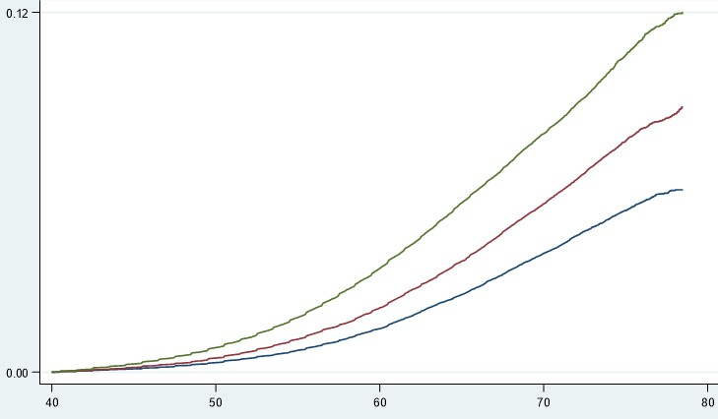
Trajectories of cardiovascular risk by PGS
Highest PGS quintile
Cumulative lifetime risk of major coronary events (%)
Middle PGS quintile
Lowest PGS quintile
Age (years)

Slide 9
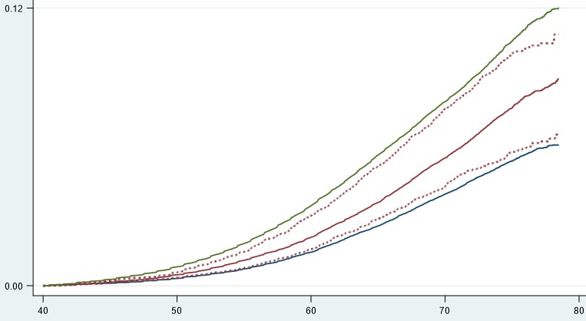
Changes in PGS trajectories of cardiovascular risk by LDL and SBP
Highest PGS quintile
Middle PGS quintile
10 mg/dl LDL & 2 mmHg SBP
HIGHER than average
Middle PGS quintile
Middle PGS quintile
10 mg/dl LDL & 2 mmHg SBP
LOWER than average
Lowest PGS quintile
Cumulative lifetime risk of major coronary events (%)
Age (years)

Slide 10

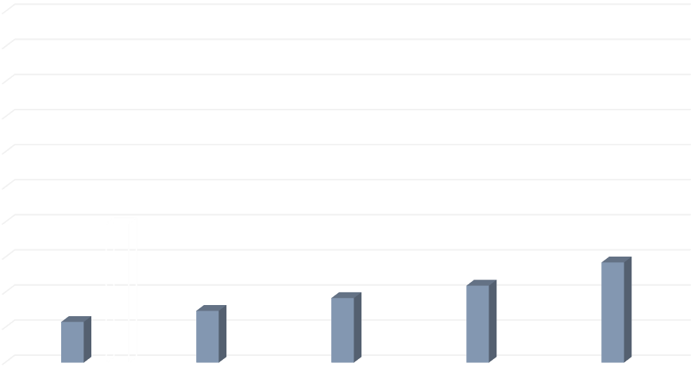
Lifetime risk of MCE to age 75 by PGS, LDL and SBP
Variation in lifetime risk of MCE within each decile of PGS depending on lifetime exposure to LDL and SBP
(Mendelian randomization analyses)
50
45
Lifetime risk of major coronary events by PGS WITHOUT considering lifetime exposure to LDL and SBP
Cumulative lifetime risk (%) to age 75
40
35
30
25
20
15
10
5
0 | PGS quintile 1 | PGS quintile 2 | PGS quintile 3 | PGS quintile 4 | PGS quintile 5
1 mmol/L LDL & 10 mmHg SBP lower than average 0.5 mmol/L LDL & 5 mmHg SBP lower than average
population average LDL and SBP 0.5 mmol/L LDL & 5 mmHg SBP higher than average 1 mmol/L LDL & 10 mmHg SBP higher than average

Slide 11
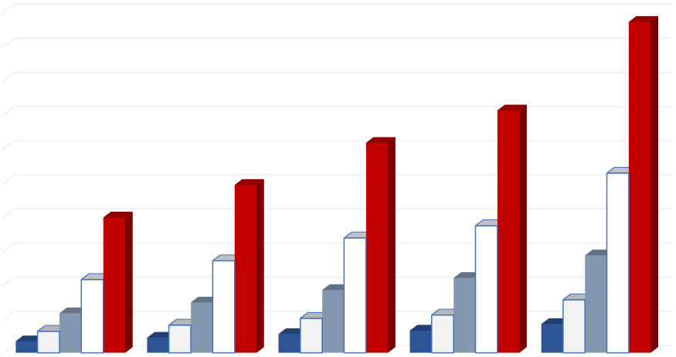
Lifetime risk of MCE to age 75 by PGS, LDL and SBP
Variation in lifetime risk of MCE within each decile of PGS depending on lifetime exposure to LDL and SBP
(Mendelian randomization analyses)
50
45
Lifetime risk of major coronary events by PGS WITHOUT considering lifetime exposure to LDL and SBP
Cumulative lifetime risk (%) to age 75
40
35
30
25
20
15
10
5
0
 | PGS quintile 1 | PGS quintile 2 | PGS quintile 3 | PGS quintile 4 | PGS quintile 5
1 mmol/L LDL & 10 mmHg SBP lower than average
population average LDL and SBP
1 mmol/L LDL & 10 mmHg SBP higher than average
0.5 mmol/L LDL & 5 mmHg SBP lower than average
0.5 mmol/L LDL & 5 mmHg SBP higher than average

Slide 12


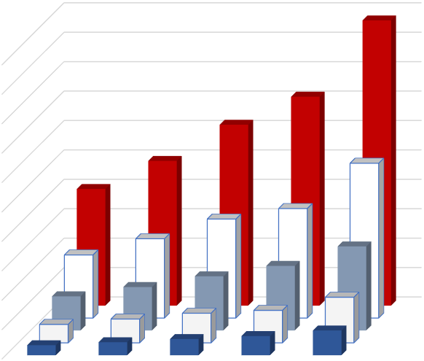
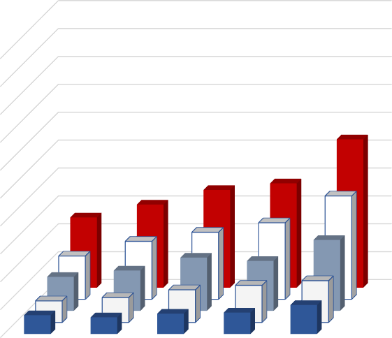
Risk of major coronary events by PGS, LDL and SBP
Mendelian randomization analysis of lifetime risk
Observational cohort analysis of short-term risk
Lifetime risk of major coronary events by PGS
WITHOUT considering lifetime exposure to LDL and SBP
50
45
40
35
30
25
20
15
10
5
0
PGS quintile 1 PGS quintile 2 PGS quintile 3 PGS quintile 4 PGS quintile 5
Participants in LOWEST PGS quintile with high LDL and SBP had higher risk compared
to participants in HIGHEST PGS quintile with low LDL and SBP (p < 0.001)
Short-term risk of major coronary events by PGS
WITHOUT considering LDL and SBP levels
10.0
9.0
8.0
7.0
6.0
5.0
4.0
3.0
2.0
1.0
0.0
PGS quintile 1 PGS quintile 2 PGS quintile 3 PGS quintile 4 PGS quintile 5
Participants in LOWEST PGS quintile with high LDL and SBP had higher risk compared
to participants in HIGHEST PGS quintile with low LDL and SBP (p < 0.001)
Cumulative lifetime risk of MCE (%) by age 75 years
Short-term incidence of MCE (%)

Slide 13


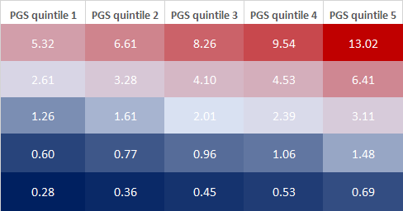
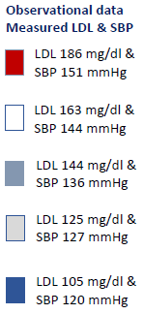
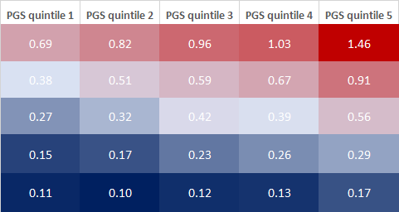
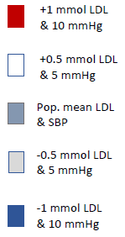
Expected clinical benefit of lipid lowering on risk of MCE
Mendelian randomization analysis of lifetime risk
Observational cohort analysis of short-term risk
Expected ARR (%) in lifetime risk from lowering LDL by 30% assuming
RRR of 20% per mmol lower LDL OVER 5 YEARS of treatment
Expected ARR (%) in short-term risk from lowering LDL by 30% assuming
RRR of 20% per mmol lower LDL OVER 5 YEARS of treatment
Less expected clinical benefit
More expected clinical benefit
Less expected clinical benefit
More expected clinical benefit
Observational prospective cohort analysis of risk of incident major coronary events among participants not on lipid lowering therapy at baseline; divided into groups with 1 SD higher/lower LDL and SBP compared to mean

Slide 14
Sensitivity analyses
Sensitivity analyses: results essentially unchanged with the same “pattern” of results for:
  Men and women (with different absolute rates of disease)
  Mendelian randomization analyses of lifetime risk, and observational data analyses of short-term risk (with different absolute rates of disease)
  Multiple methods for constructing PGS for CAD
    External weighting by CARDIoGRAMplusC4D effect size estimates
    LDpred
    metaGRS
  Regardless of number variants included in the PGS for CAD
    Including scores composed of 1,800, 1.7M, 4.1M or 6.6M genetic variants

Slide 15
Conclusions
At any level of a PGS for CAD, lifetime risk of cardiovascular disease varies substantially depending on differences in lifetime exposure to LDL and SBP
Therefore, a PGS for CAD should be combined with information about lifetime exposure to LDL and SBP to more accurately estimate lifetime risk of cardiovascular disease, more accurately identify persons who may benefit from early interventions to reduce risk, and better estimate the potential benefit from early interventions
  absolute lifetime risk of cardiovascular disease depends on PGS and lifetime exposure to LDL and SBP
  clinical benefit depends on BOTH absolute risk (which depends on PGS as well as LDL and SBP) & the absolute reduction in LDL or SBP achieved with treatment (which depends on baseline LDL and SBP levels)
When combined with LDL and SBP, a PGS for CAD has the potential to help personalize the prevention of cardiovascular disease by helping to identify persons who may benefit the most from early interventions to minimize the cumulative effects of lifetime exposure to LDL and SBP

Slide 16
One more thought …
It is important to recognize that the trajectories of lifetime risk for cardiovascular disease
predicted by a PGS are not fixed
At the same level of a PGS for CAD, participants with lower lifetime exposure to LDL and SBP had a lower trajectory of risk for cardiovascular disease
This finding implies that the trajectory of cardiovascular risk predicted by a PGS can be reduced by lowering LDL and SBP
Indeed, participants with low lifetime exposure to LDL and SBP had a low lifetime risk of
cardiovascular disease at all levels of PGS for CAD
This implies that LDL and SBP, which are modifiable, may be more powerful determinants of lifetime risk than polygenic predisposition
Therefore, maintaining low levels of LDL and SBP throughout life should be the primary focus to reduce the lifetime risk of cardiovascular disease for all persons at all levels of PGS for CAD

Slide 17
Thank you
Brian A Ference, MD, MPhil, MSc Centre for Naturally Randomized Trials University of Cambridge baf29@medschl.cam.ac.uk
March 2020
Alberico L. Catapano, PhD Department of Pharmacological and Biomolecular Sciences
University of Milan alberico.catapano@unimi.it
Marc S. Sabatine, MD, MPH TIMI Study Group
Brigham & Women’s Hospital Harvard Medical School msabatine@bwh.harvard.edu

