Slide 1
SOLVE-TAV
A 2x2 Randomized Trial of
Self-Expandable vs Balloon-Expandable Valves and General vs Local Anesthesia in
Patients Undergoing Transcatheter Aortic Valve Implantation
Holger Thiele, MD
on behalf of the SOLVE-TAVI Investigators

Slide 2
Disclosure Statement of Financial Interest
I, Holger Thiele DO NOT have a financial interest/arrangement or affiliation with one or more organizations that could be perceived as a real or apparent conflict of interest in the context of the subject of this presentation.

Slide 3
Background I
- TAVR
is developing as standard strategy for
symptomatic patients with severe aortic stenosis at high to intermediate risk.
TAVR device design led to relevant technical and clinical improvements (e.g. pacemaker rates, paravalvular leakage, vascular complications).
There is limited evidence for direct valve comparisons (CHOICE, REPRISE III) in particular for latest generation valve designs.
Abdel-Wahab et al. JAMA 2014;311:1503-1514 Feldman et al. JAMA. 2018;319:27-37

Slide 4
Background II – Anesthesia Strategy
- In clinical routine TAVR is performed in ≈50% using general or local anesthesia with conscious sedation.
Registry data suggest
lower mortality
lower morbidity
shorter ICU and hospital stay
shorter procedure times with local anesthesia.
There is a lack of adequately powered randomized trials.
Villablanca et al. Catheter Cardiovasc Interv. 2017;1–13

Slide 5
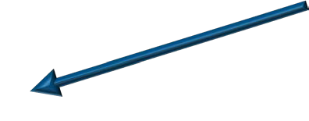
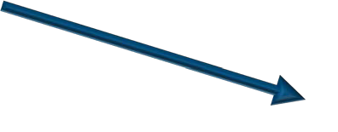
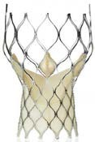
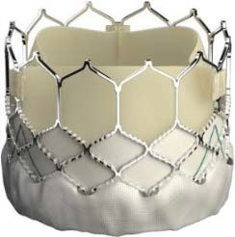
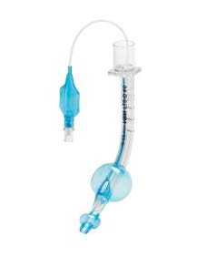
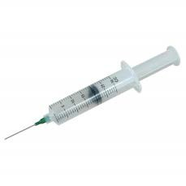
SOLVE-TAVI Program
Symptomatic Aortic Stenosis with TAVR Indication
1:1
CoreValve Evolut R
Valve Strategy
Edwards Sapien 3
1:1
Local Anesthesia
Anesthesia Strategy
General Anesthesia

Slide 6
Hypotheses
Self-expanding CoreValve Evolut R is equivalent to
balloon-expandable Sapien 3 (Edwards) valve
Local anesthesia with conscious sedation is equivalent to
general anesthesia
in symptomatic aortic stenosis patients undergoing transfemoral TAVR.

Slide 7
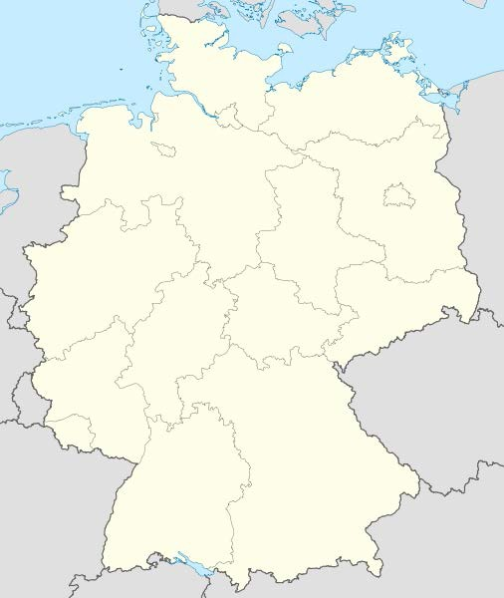
SOLVE-TAVI Trial
Investigator-initiated German multicenter trial; 1:1 randomization
PI:
Holger Thiele
Kiel
Rostock
Funding:
Lübeck Bremen
Study Coordination:
Suzanne de Waha-Thiele
University Heart Center Lübeck: Thomas Kurz, Roza Meyer-Saraei Ingo Eitel, Matthias Heringlake Klinikum Links der Weser Bremen: Rainer Hambrecht, Harm Wienbergen Heart Center Leipzig:
Hans-Josef Feistritzer, Steffen Desch Marcus Sandri, Mohamed Abdel-Wahab David Holzhey, Michael Borger
Yvonne Rückert, Jörg Ender University of Giessen: Holger Nef, Oliver Dörr Charité Berlin:
Alexander Lauten, Sascha Treskatsch
University of Rostock:
Hüseyin Ince, Mohamed Sherif
University Schleswig-Holstein, Campus Kiel:
Norbert Frey, Derk Frank
Berlin
Leipzig
CROs:
Giessen

Slide 8
Study Flow Chart - Valve Strategy
447 randomized
Allocation
225 randomized to Evolut R
4 withdrawal of informed consent 1 death prior to TAVI procedure
1 medical treatment (no aortic stenosis)
222 randomized to Sapien 3
2 withdrawal of informed consent 1 death prior to TAVI procedure
Intervention
219 undergoing TAVI procedure 216 Evolut R as allocated 1 cross-over Sapien 3
1 conventional AVR
1 balloon valvuloplasty only
219 undergoing TAVI procedure 218 Sapien 3 as allocated
1 cross-over Corevalve Evolut R
Follow-up
219 eligible for 30-day follow-up
2 missing data for primary endpoint
219 eligible for 30-day follow-up
1 withdrawal of informed consent
3 missing data for primary endpoint
Primary endpoint analysis
215 primary endpoint analysis
217 primary endpoint analysis

Slide 9
Baseline Characteristics – Valve Strategy
Characteristic | Evolut R (n=219) | Sapien 3 (n=219)
Age (years); mean ±SD | 81.7 ± 5.3 105/219 (47.9) | 81.5 ± 5.7 109/219 (49.8)
Male sex; n/total (%)
Risk scores STS score (%); mean ±SD | 7.7 ± 7.2 18.4 ± 12.1 6.1 ± 5.5 93/216 (43.1) | 7.6 ± 7.4 18.3 ± 13.1 5.4 ± 4.9 80/217 (36.9)
Log. EuroScore I (%), mean ±SD
EuroScore II (%), mean ±SD
Frailty; n/total (%)
Peripheral arterial disease; n/total (%) | 28/219 (12.8) 19/219 (8.7) 84/219 (38.4) 26/219 (11.9) | 27/219 (12.3) 22/219 (10.1) 79/219 (36.1) 18/219 (8.2)
Prior myocardial infarction; n/total (%) Prior PCI; n/total (%) Prior CABG; n/total (%)
Atrial fibrillation; n/total (%) | 103/219 (47.0) | 93/219 (42.5)
Pacemaker/ICD; n/total (%) | 24/218 (11.0) 25/219 (11.4) | 23/219 (10.5) 26/218 (11.9)
Prior stroke; n/total (%)
Renal insufficiency; n/total (%) | 177/216 (81.9) | 184/214 (86.0)
Pulmonary hypertension; n/total (%) | 106/216 (49.1) | 105/218 (48.2)
COPD; n/total (%) | 30/219 (13.7) 79/218 (36.2) 193/219 (88.1) 118/218 (54.1) 8/218 (3.7) | 29/217 (13.4) 68/219 (31.1) 204/219 (93.2) 80/217 (36.9) 10/219 (4.6)
Cardiovascular risk factors Diabetes; n/total (%) Arterial hypertension; n/total (%) HLP; n/total (%) Current smoking; n/total (%)

Slide 10
Primary Endpoint – Valve Strategy
All-cause mortality, stroke, moderate or severe prosthetic valve regurgitation, permanent pacemaker implantation at 30 days
Rate difference -1.14
90%CI -8.15 – 5.87
50
^{P}equivalence^{=0.02 P}superiority^{=0.83}
40
30
27.2%
26.1%
%
20
10
0
Evolut R
Sapien 3

Slide 11
Endpoints – Valve Strategy
Individual components primary endpoint
50
Evolut R
Sapien 3
40
^{P}equivalence^{=0.06 P}superiority^{=0.34} 22.9%
19.0%
30
%
20
^{P}equivalence^{<0.001 P}superiority^{=0.77}
^{P}equivalence^{=0.003 P}superiority^{=0.01}
4.7%
0.5%
P
<0.001
equivalence
10
P
superiority^{>0.99}
2.8%
2.3%
1.9%
1.4%
0
Moderate/severe valve regurgitation
Pacemaker implantation
Mortality Stroke Valve Pacemaker regurgitation implantation
Mortality
Stroke

Slide 12
Study Flow Chart - Anesthesia Strategy
447 randomized
Allocation
222 randomized to local anesthesia
3 withdrawal of informed consent 1 death prior to TAVI procedure
225 randomized to general anesthesia 3 withdrawal of informed consent 1 death prior to TAVI procedure
1 medical treatment (no aortic stenosis)
Intervention
218 undergoing TAVI procedure 217 local anesthesia
13 bailout general anesthesia 1 elective cross over general anesthesia
220 undergoing TAVI procedure 219 general anesthesia
1 elective cross-over to local anesthesia
Follow-up
218 eligible for 30-day follow-up
withdrawal of informed consent
missing data for primary endpoint
220 eligible for 30-day follow-up
Primary endpoint analysis
220 primary endpoint analysis
215 primary endpoint analysis

Slide 13
Baseline Characteristics – Anesthesia Strategy
Characteristic | Local Anesthesia (n=218) | General Anesthesia (n=220)
Age (years); mean ±SD | 81.8 ± 5.3 107/218 (49.1) | 81.4 ± 5.7 107/220 (48.6)
Male sex; n/total (%)
Risk scores STS score (%); mean ±SD | 6.9 ± 6.2 17.8 ± 12.6 5.5 ± 4.8 91/214 (42.5) | 8.3 ± 8.2 18.9 ± 12.5 6.0 ± 5.6 82/219 (37.4)
Log. EuroScore I (%), mean ±SD
EuroScore II (%), mean ±SD
Frailty; n/total (%)
Peripheral arterial disease; n/total (%) | 29/218 (13.3) 24/218 (11.0) 92/218 (42.2) 22/218 (10.1) | 26/220 (11.8) 17/220 (7.7) 71/220 (32.3) 22/220 (10.0)
Prior myocardial infarction; n/total (%) Prior PCI; n/total (%) Prior CABG; n/total (%)
Atrial fibrillation; n/total (%) | 98/218 (45.0) | 98/220 (44.6)
Pacemaker/ICD; n/total (%) | 13/218 (6.0) 24/217 (11.1) | 20/220 (9.1) 27/220 (12.3)
Prior stroke; n/total (%)
Renal insufficiency; n/total (%) | 179/213 (84.0) | 182/217 (83.9)
Pulmonary hypertension; n/total (%) | 100/216 (46.3) | 111/218 (50.9)
COPD; n/total (%) | 27/216 (12.5) 70/218 (32.1) 199/218 (91.3) 92/216 (42.6) 9/218 (4.1) | 32/220 (14.6) 77/219 (35.2) 198/220 (90.0) 88/219 (40.2) 9/219 (4.1)
Cardiovascular risk factors Diabetes; n/total (%) Arterial hypertension; n/total (%) HLP; n/total (%) Current smoking; n/total (%)

Slide 14
Primary Endpoint – Anesthesia Strategy
All-cause mortality, stroke, myocardial infarction,
infection requiring antibiotic treatment, acute kidney injury at 30 days
Rate difference -1.52
50
90%CI -8.47 – 5.42
^{P}equivalence^{=0.02}
40
P =0.74
superiority
30
27.0%
25.5%
%
20
10
0
Local anesthesia
General anesthesia

Slide 15
Endpoints – Anesthesia Strategy
Individual components primary endpoint
50
Local anesthesia
General anesthesia
40
^{P}equivalence^{=0.005 P}superiority^{>0.99} 21.0% 21.0%
30
%
20
^{P}equivalence^{<0.001}
^{P}equivalence^{<0.001}
10 ^{P}superiority^{=0.77}
^{P}equivalence^{=0.002 P}superiority^{>0.99}
^{P}superiority^{>0.99}
P
<0.001
9.2%
equivalence
8.9%
P
>0.99
superiority
2.8%
2.3%
2.4%
2.8%
0.5% 0.5%
Myocardial
0
Mortality
Stroke
Infection requiring
Acute kidney
Mortality Stroke Myocardial Infection Acute
infarction requrning kidney
antibiotics injury
infarction
antibiotics
injury

Slide 16
Summary and Conclusions I
In patients with symptomatic aortic stenosis
undergoing
transfemoral TAVR the self-expanding Corevalve Evolut R valve is equivalent to the balloon-expandable Edwards Sapien 3 with respect to the composite of all-cause mortality, stroke, moderate or severe prosthetic valve regurgitation, and permanent pacemaker implantation at 30 days.
The rate of relevant valve regurgitation was low whereas permanent pacemaker rates are still relatively high.
There may be a higher stroke rate with the balloon-expandable
valve.

Slide 17
Summary and Conclusions II
Local anesthesia with conscious sedation is equivalent to general
anesthesia with respect to the composite of all-cause stroke, myocardial infarction, infection requiring treatment, and acute kidney injury.
General anesthesia is associated with a higher
mortality, antibiotic
rate of
catecholamine use but does not affect procedure times, valve- related outcome, or clinical outcome.

Slide 18
Acknowledgement and Thank You
SOLVE-TAVI Patients and Investigators
Steering Committee
Holger Thiele, MD (Chair) Steffen Desch, MD
Suzanne de Waha-Thiele, MD Thomas Kurz, MD
Holger Nef, MD
Rainer Hambrecht, MD Norbert Frey, MD
Alexander Lauten, MD
Hüseyin Ince, MD Michael Borger, MD David Holzhey, MD Matthias Heringlake, MD Jörg Ender, MD
DSMB
Gerhard Schuler, MD Steffen Schneider, PhD Bernd Böttiger, MD
CRO
Leipzig Heart Institute: Yvonne Rückert
Anne-Kathrin Funkat, PhD Ina Wagner
IMBS Lübeck
Funding
German Heart Research Foundation
Inke König, PhD Reinhard Vonthein, PhD Jördis Stolpmann
Echo Core lab Heart Center Leipzig:: Georg Stachel, MD
Suzanne de Waha-Thiele, MD
ZKS Lübeck:
Arne Schreiber, PhD Alicia Illen

