Slide 1
Transcatheter Aortic Valve Replacement for the treatment of Pure Native Aortic Valve Regurgitation in Selected Non-Surgical Candidates- on behalf of TAVR-NAVR Investigators
Danny Dvir, MD University of Washington, Seattle, USA

Slide 2
Disclosure Statement of Financial Interest
Within the past 12 months, I [Danny Dvir] or my spouse/partner have had a financial interest/arrangement or affiliation with the organization(s) listed below.
Affiliation/Financial Relationship
Company
Consulting Fees/Honoraria
Edwards Lifesciences, Medtronic, Abbott, Jena

Slide 3
TAVR for pure, severe aortic regurgitation (AR)
Patients with severe non-calcified native aortic valve regurgitation (NAVR) are occasionally at increased risk for open heart surgery.
There are currently no indicated transcatheter devices for the treatment of isolated NAVR.
Transcatheter heart valves (THVs) were utilized off-label for the treatment of NAVR and data were collected and evaluated retrospectively.

Slide 4
TAVR for pure, severe aortic regurgitation (AR)
Since March2017, we have collected data on 254 TAVR-NAVR patients (DATA LOCK Aug 2017) by use of the international, multicenter collaboration within the VIVID Registry.

Slide 5
Baseline Characteristics
 | Pure Severe NAVR (n = 254)
Patient Characteristics
Age, years | 74 ± 12
Male | 134/250 (54%)
EuroSCORE II | 8.7 ± 9.3
STS Score | 6.5 ± 6.2
Echocardiographic Assessment
LVEF, % | 44.7 ± 14.9
LVEDD, mm | 58.7 ± 11
Mean aortic valve gradient, mmHg | 11.2 ± 6.4
Aortic valve area, cm2 | 1.9 ± 0.7
Mitral regurgitation, moderate or severe | 89/206 (43%)
Pulmonary hypertension | 74/154 (48%)
Etiology of AR
Degenerative | 139/229 (61%)
Aortic aneurysm | 24/229 (10%)
Rheumatoid vasculitis/Takayasu arteritis | 5/229 (2%)
Post-endocarditis | 16/229 (7%)
Post-radiotherapy | 7/229 (3%)
Post-LVAD | 3/229 (1%)
Ross Procedure | 1/229 (0.5%)
Unknown/Other | 34/229 (15%)

Slide 6
Procedural Characteristics
 | Pure Severe NAVR (n = 254)
General Anesthesia | 144/240 (60%)
Access Route
Transfemoral | 192/254 (76%)
Transsubclavian | 6/254 (2%)
Direct aortic | 7/254 (3%)
Transapical | 46/254 (18%)
Other | 3/254 (0.5%)
THV Device
CoreValve | 103/254 (41%)
Evolut R/PRO | 37/254 (15%)
Engager | 10/254 (4%)
JenaValve | 34/254 (13%)
Portico | 3/254 (1%)
Symetis Acurate | 17/254 (7%)
Lotus | 12/254 (5%)
Direct Flow | 20/254 (8%)
SAPIEN XT | 6/254 (2%)
SAPIEN 3 | 12/254 (5%)
Contrast, mL | 163 ± 95
Hospitalization
Intensive Care Unit (days) | 4.2 ± 8.4
Total Length (days) | 12.5 ± 12.1
New Pacemaker Implantation | 44/225 (19.6%)

Slide 7
Procedural Characteristics
 | Non-repositionable THV | Repositionable THV
First Generation THV | CoreValve
 | SAPIEN XT
Newer Generation THV | Symetis Acurate | Evolut R
 | SAPIEN 3 | Lotus
 |  | Portico
 |  | JenaValve, Engager, Direct Flow

Slide 8
Procedural Characteristics
 | First Generation THV (n = 109) | Newer generation THV (n = 145) | p value
Device Success (VARC 2) | 47/101 (47%) | 113/137 (82%) | < 0.001
Absence of procedural mortality | 105/108 (97%) | 140/144 (97%)
Successful access, delivery, deployment, system retrieval | 108/109 (99%) | 145/145 (100%)
Correct positioning of a single valve into proper location | 73/109 (67%) | 132/145 (91%)
Intended THV performance | 68/102 (67%) | 126/137 (92%)
Mean gradient < 20 mmHg or peak v < 3 m/s | 101/103 (98%) | 130/137 (95%)
No moderate or severe AR | 70/102 (69%) | 132/137 (96%)

Slide 9
Clinical Outcomes
 | First Generation THV (n = 109) | Newer generation THV (n = 145) | p value
Early safety at 30 days (VARC 2) | 67/93 (72%) | 96/130 (74%) | 0.88
All-cause mortality | 18/105 (17%) | 11/143 (8%)
All stroke | 3/100 (3%) | 5/136 (4%)
Major vascular complication | 7/105 (7%) | 7/143 (5%)
Life-threatening bleeding | 5/103 (5%) | 1/142 (1%)
Acute kidney injury stage ≥ 2 | 15/95 (16%) | 15/136 (11%)
Coronary artery obstruction | 0/109 (0%) | 1/135 (1%)
Repeat procedure for valve-related dysfunction | 4/109 (4%) | 6/135 (4%)
Clinical efficacy after 30 days (VARC 2) | 44/78 (56%) | 75/104 (72%) | 0.04
All-cause mortality | 18/105 (17%) | 11/143 (8%)
Cardiac mortality | 13/105 (12%) | 10/143 (7%)
Non-cardiac mortality | 5/105 (5%) | 1/143 (1%)
All stroke | 3/100 (3%) | 5/137 (4%)
Valve-related dysfunction | 26/91 (29%) | 12/124 (10%)
Mean gradient ≥ 20 mmHg or EOA ≤ 0.9-1.1 cm2 | 4/95 (4%) | 7/126 (6%)
Moderate or severe AR | 24/94 (26%) | 6/128 (5%)
NYHA class III or IV | 15/85 (18%) | 16/120 (13%)

Slide 10
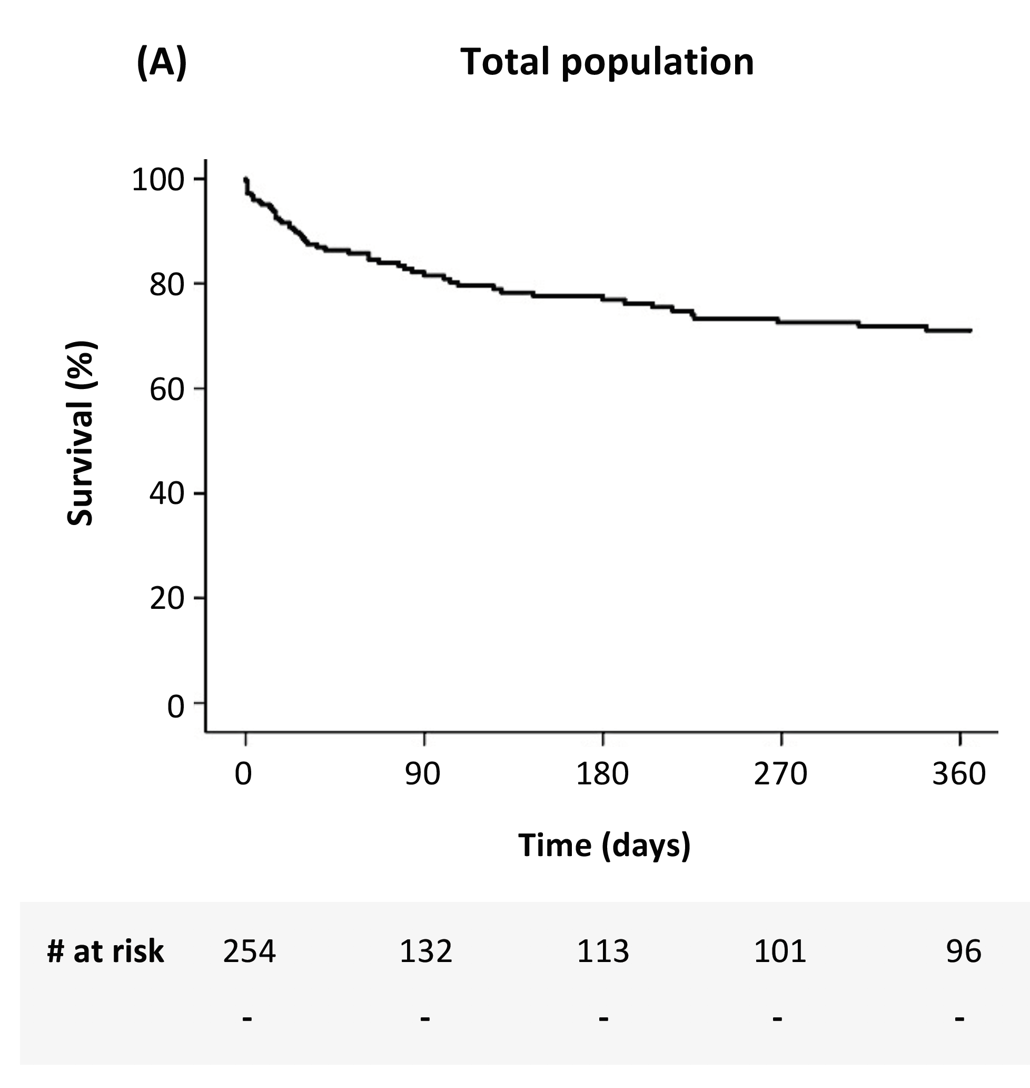

Slide 11
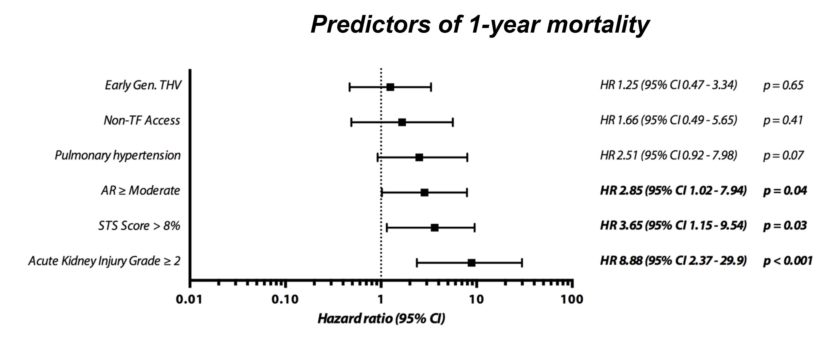

Slide 12
Conclusions
Although significant improvement is seen with newer-generation THV devices, TAVR for NAVR is a challenging approach associated with limited procedural efficacy.
Widely utilized THV devices have suboptimal clinical outcomes in NAVR - malposition, significant AR and a need for a second THV.
THV sizing considerations TAVR-NAVR may require different approach than in aortic stenosis.
Better clinical outcomes can be expected if patients would get referred at an earlier clinical stage.
Novel THV devices designed to treat NAVR may potentially improve clinical outcomes.

