Slide 1
A Permanent Polymer Zotarolimus-eluting Stent versus a Polymer-Free
Amphilimus-eluting Stent in all-comers; Results of the ReCre8 Trial
Pieter Stella, MD, PhD
On behalf of the ReCre8 Study investigators
R Rozemeijer, M Stein, M Voskuil, R van den Bor, P Frambach, B Pereira, S Koudstaal, G Leenders, L Timmers, S Rittersma, A Kraaijeveld, P Agostoni, C Roes, P Doevendans.

Slide 2
Disclosure Statement
Within the past 12 months, I, Pieter Stella have had a financial interest
/ arrangement or affiliation with the organization(s) listed below
Member of speakers bureau Alvimedica
Member advisory board Keystone Heart
Consultant Dekra CE

Slide 3
Background
Poba
BMS
BMS
DES
DES
ST !
1992/3
2001/2
2005/6
PP: Delayed arterial healing / Chronic Inflammation / Aneurysm Formation
Permanent Polymer Evolution
Biodegradable Polymers
Polymer Free DES

Slide 4
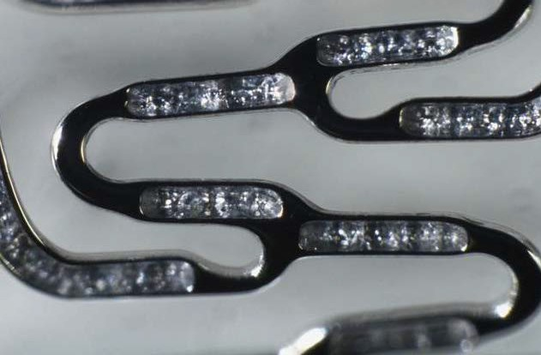
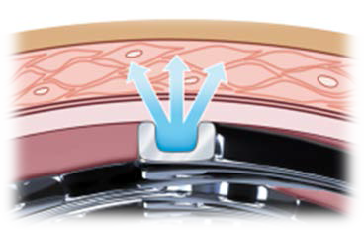
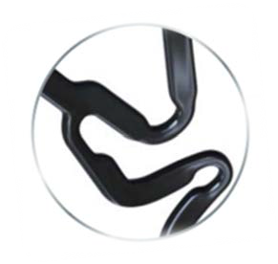
Introduction – PF AES
Thin-strut (80 µm) Co-Cr alloy
Abluminal Reservoir Technology
Amphilimus™ Formulation: Sirolimus + organic acid (fatty acid)
BIS: Bio Inducer Surface

Slide 5
Why this study?
The clinical safety and efficacy of polymer-free amphilimus- eluting stents (PF-AES) have not yet been compared to latest- generation permanent polymer drug-eluting stents in a large all comers trial.
Secondary interests (non powered):
Is a short DAPT duration (1-month) with these devices in troponin-negative
patients safe ?
Does PF-AES shows its promise of positive outcomes in diabetic patients ?

Slide 6
How was the study executed?
Physician-initiated, prospective, multicenter, randomized, trial in all-comers population
12 months DAPT in Troponin +
1 month DAPT in Troponin -
1532 Patients
1:1 randomization
3 European Sites
PF-AES
PP-ZES
Primary endpoint Secondary endpoint
TLF at 12 months
NACE at 12 months
1m 1y
Clinical FU
3y
Rozemeijer et al. Catheter Cardiovasc Interv. 2018;91:410–416.

Slide 7
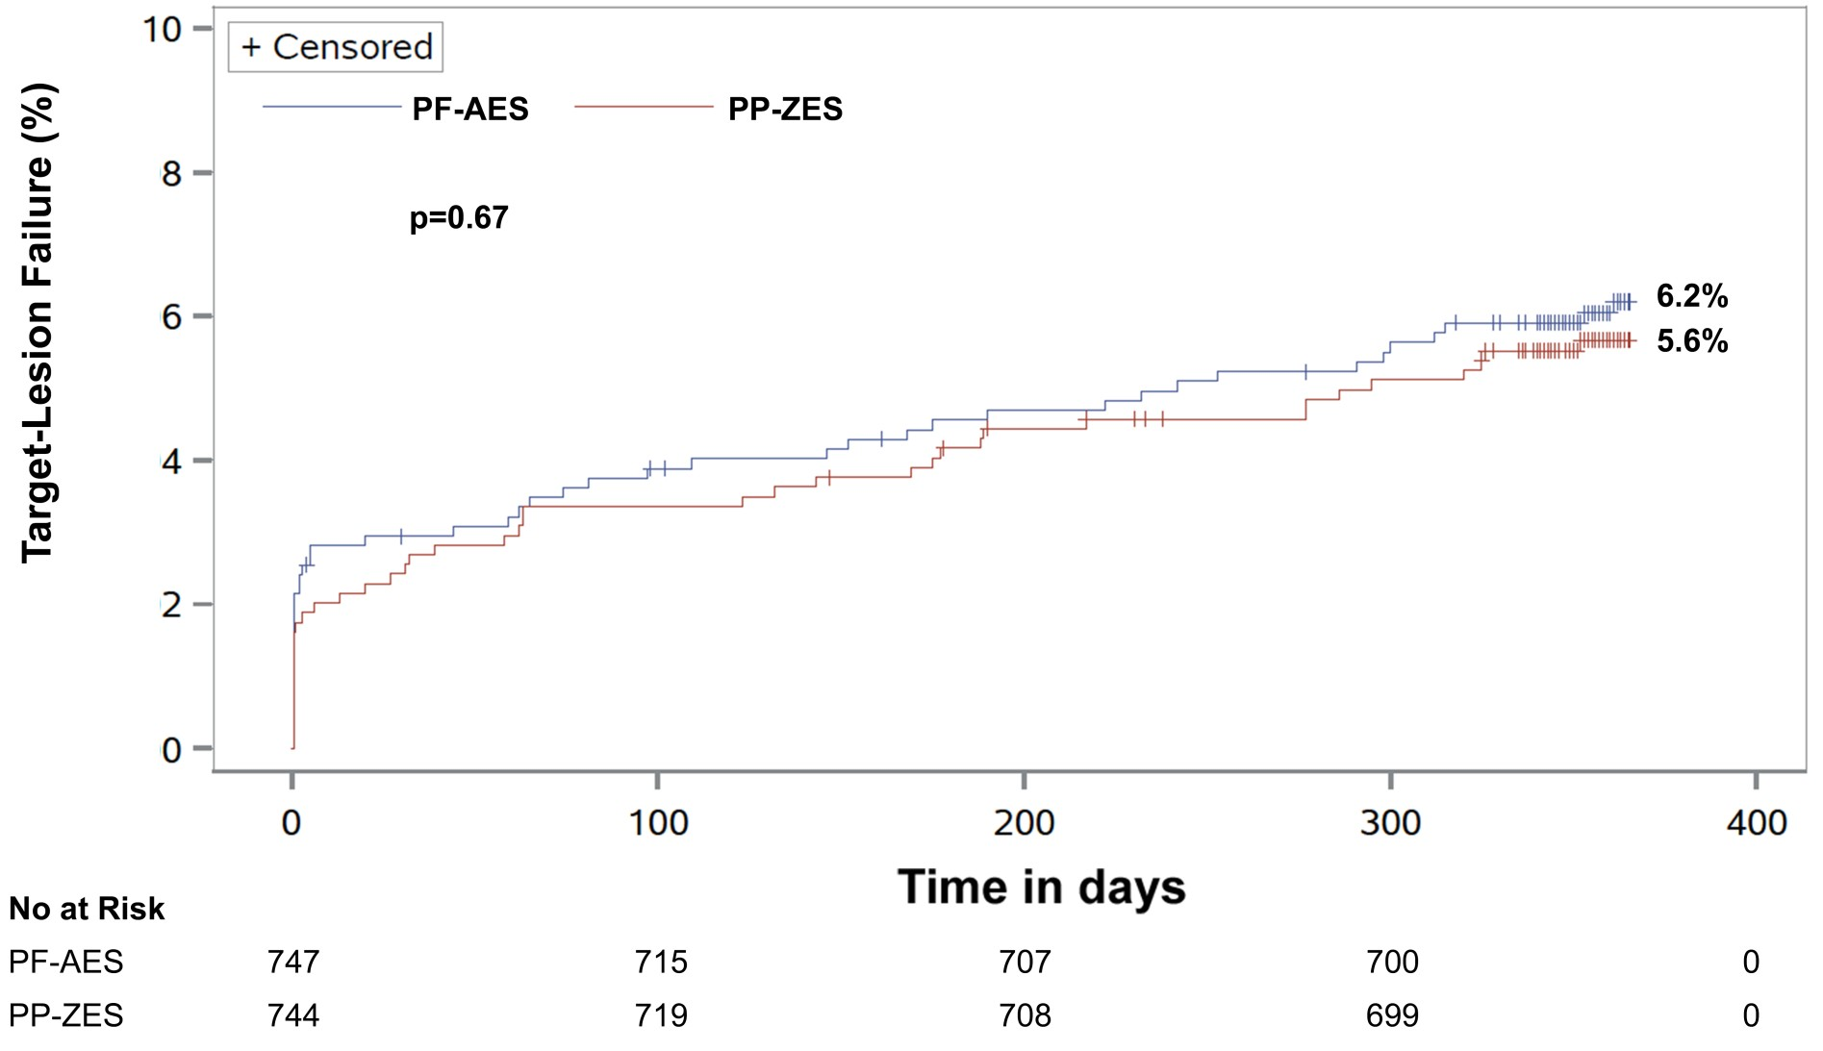
What are the results?
Target Lesion Failure at 12-months

Slide 8
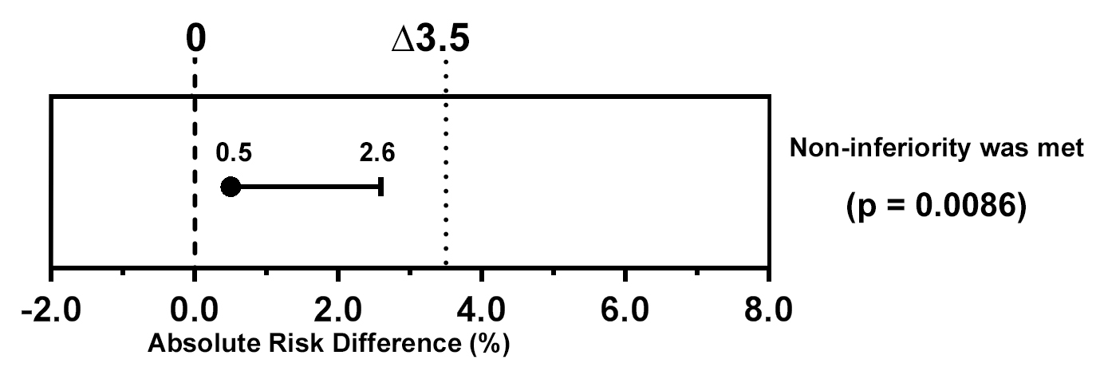
What are the results?
Target Lesion Failure at 12-months
PF- AES |  | PP- ZES | Risk Diff | One sided 95% CI | NI- margin | ^{p}non- inferiority
TLF at 12 months | 6.2 | 5.6 | 0.5% | 2.6% | 3.5% | 0.0086
Clinical non-inferiority of PF-AES was met!

Slide 9
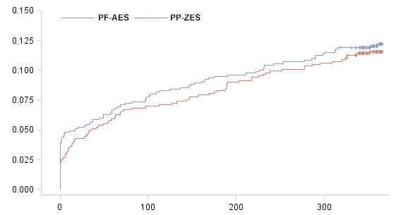
What are the results?
Net Adverse Clinical Events at 12-months
12.2%
11.6%
No At Risk
PF-AES | 747 | 689 | 675 | 662 | 0
PP-ZES | 744 | 692 | 677 | 665 | 0

Slide 10
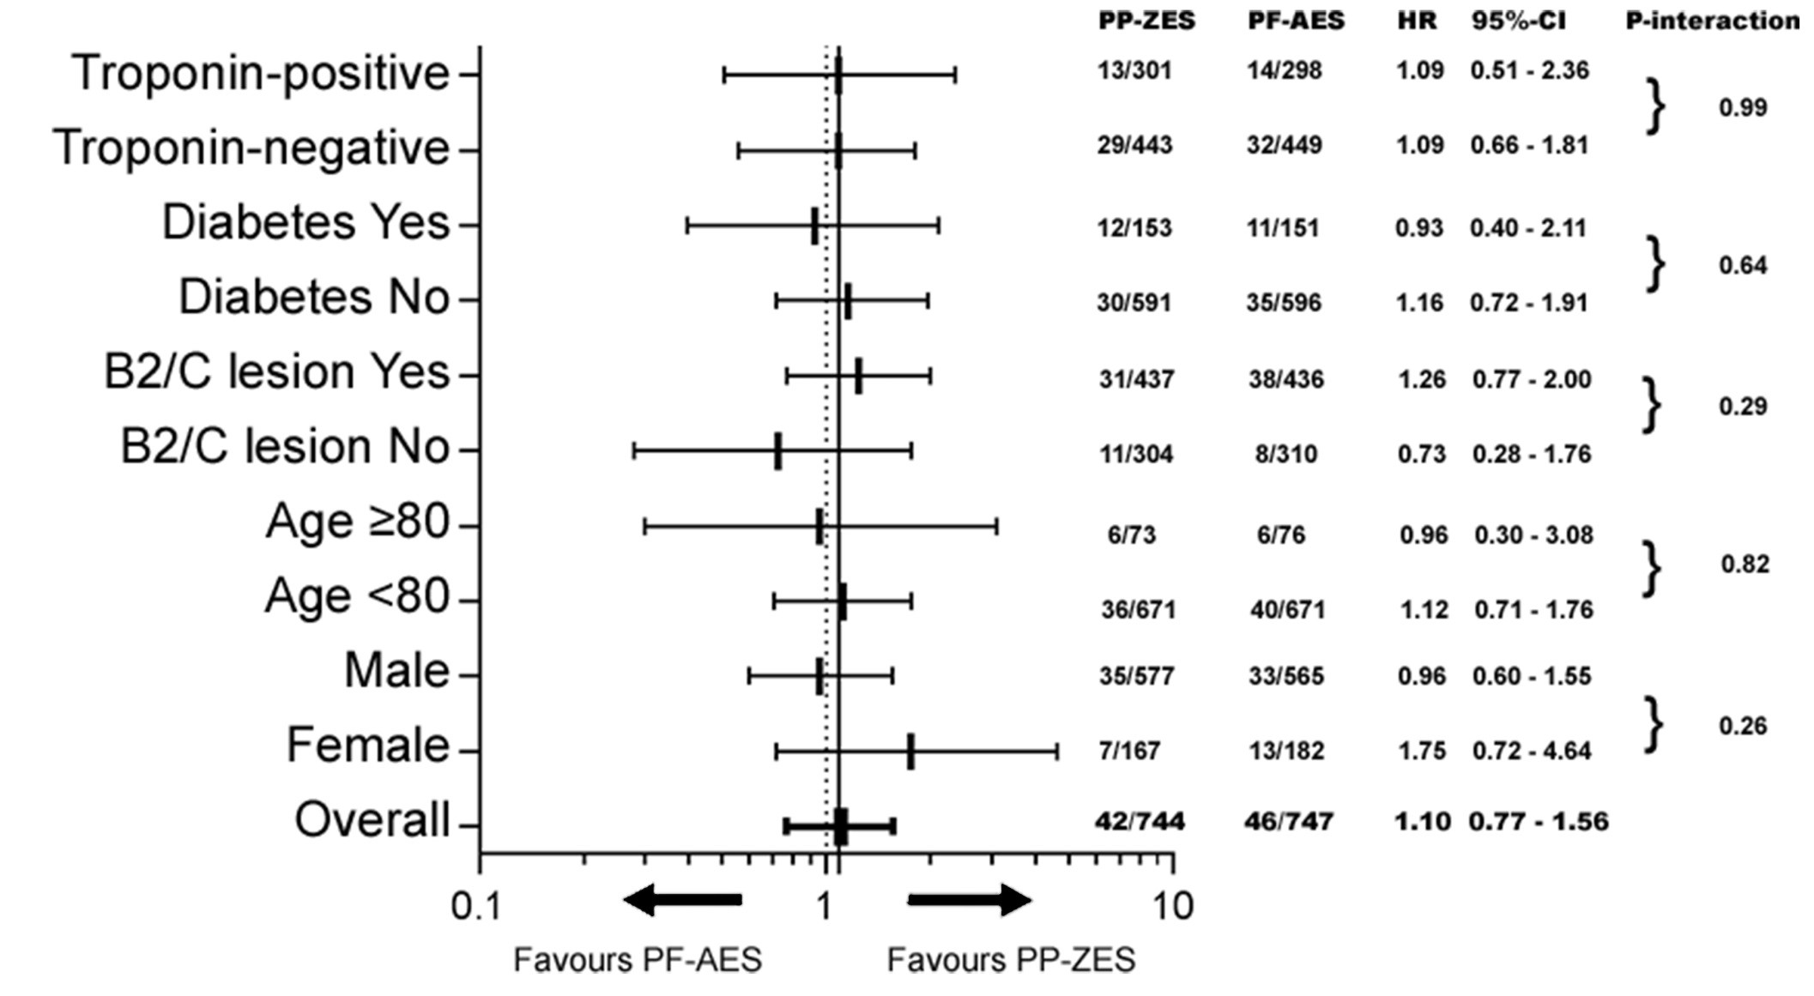
What are the results?
Consistency across all subgroups, with no significant statistical interactions

Slide 11
Conclusions
ReCre8 was the first RCT comparing PF-AES versus latest gen PP ZES in an all comers PCI population.
Main finding was that clinical non-inferiority of PF-AES as compared to PP-ZES in terms of TLF at 12 months was met.
Findings regarding the secondary endpoint and pre-specified subgroups were generally consistent with the primary endpoint.
Short DAPT following these latest-generation drug-eluting stents in troponin- negative patients needs further evaluation (not powered!).
Future trials need to investigate efficacy of PF-AES in patients with diabetes

