Slide 1
Cardiac Amyloidosis Presenting as a Rapid Decline in Ejection Fraction and Persistent Troponinemia.

Slide 2
Temidayo Abe, MD
Internal Medicine Resident
Morehouse School Of Medicine,
I have no relevant financial relationships

Slide 3
HPI
A 78 Y/O AA Male
Presents to the Emergency department with worsening fatigue and exercise intolerance
This has been ongoing for the past 2 months.
In addition, he reports shortness of breath on exertion, progressive lower extremity swelling and episodic chest pressure.

Slide 4
History
Past medical history
Paroxysmal Atrial fibrillation
Hypertension
Heart failure with reduced Ejection fraction (EF 25%)
Medication
Toprol XL 25 mg
Lasix 40 mg
Lisinopril 5 mg
Xarelto 15 mg, Crestor 20 mg
No history of cardiac cath or coronary angiography
Nuclear stress test 6 months prior: No evidence of ischemia at rest or exercise

Slide 5
Physical Examination
VS: BP 106/71, RR 14, HR 70; T 98F.
General: Well appearing
Heart: Regular heart rhythm. No murmurs, rubs, or gallops
Lung: Dry inspiratory crackles on lung auscultation.
Extremities: +1 B/L lower extremity edema, peripheral pulse + 2
Abdomen: Soft, non distended, no tenderness.
Lab Assessment:
Troponin-I 0.27,
B-type Natriuretic Peptide 389,
normal renal function, slightly elevated liver enzymes AST/ALT 82,98

Slide 6
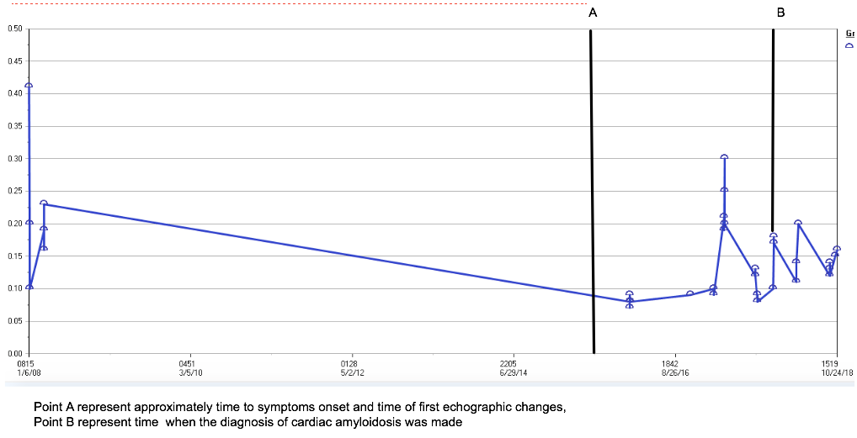
The patient had persistent elevation of troponin I and ranging from 0.41 to 0.08 with a mean value of 0.1454 dating back to 2008, approximately 10 years before this admission, 6 years before he was diagnosed with HFpEF

Slide 7
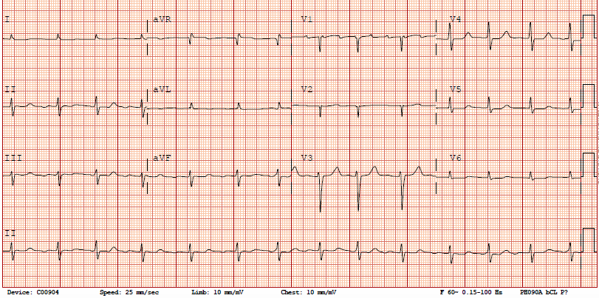
EKG on admission

Slide 8
Heart Failure history
Diagnosed: HFpEF 3 years prior to admission
Echo at diagnosis:
(LVEF) of 50-55%, mild concentric left hypertrophy, mild atrial enlargement, MV E/A 0.73, E max 57.8 cm/sec, medial and lateral E/E’ > 12 and 15 respectively on tissue Doppler indicating diastolic dysfunction.
Most Recent Echo:
Repeat ECHO 1. 5 years prior revealed a decline in LVEF to 30-40%.
Despite adherence of medical therapy.

Slide 9
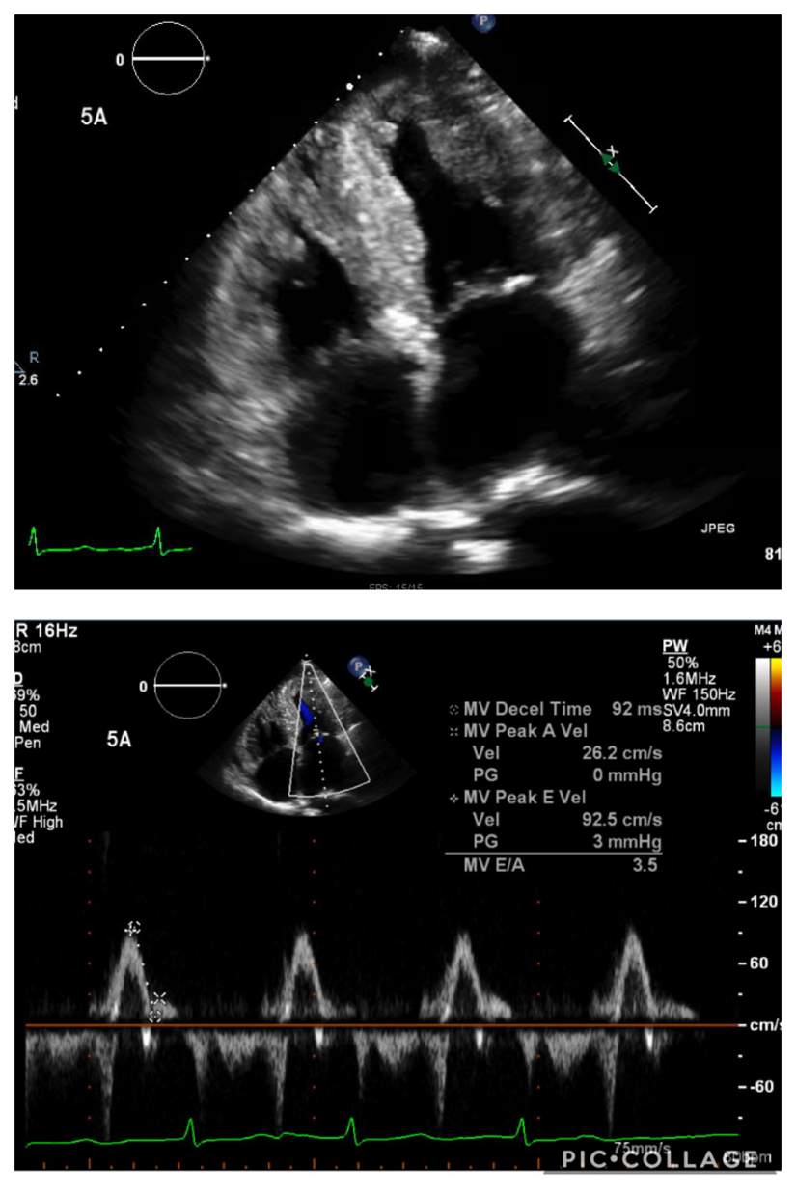
Echo on this admission with severe concentric hypertrophy, further worsening of the LVEF 25-35%, and worsening of diastolic function with MV E/A of 3.5 (Fig 1), Medial E/E’ of 24

Slide 10
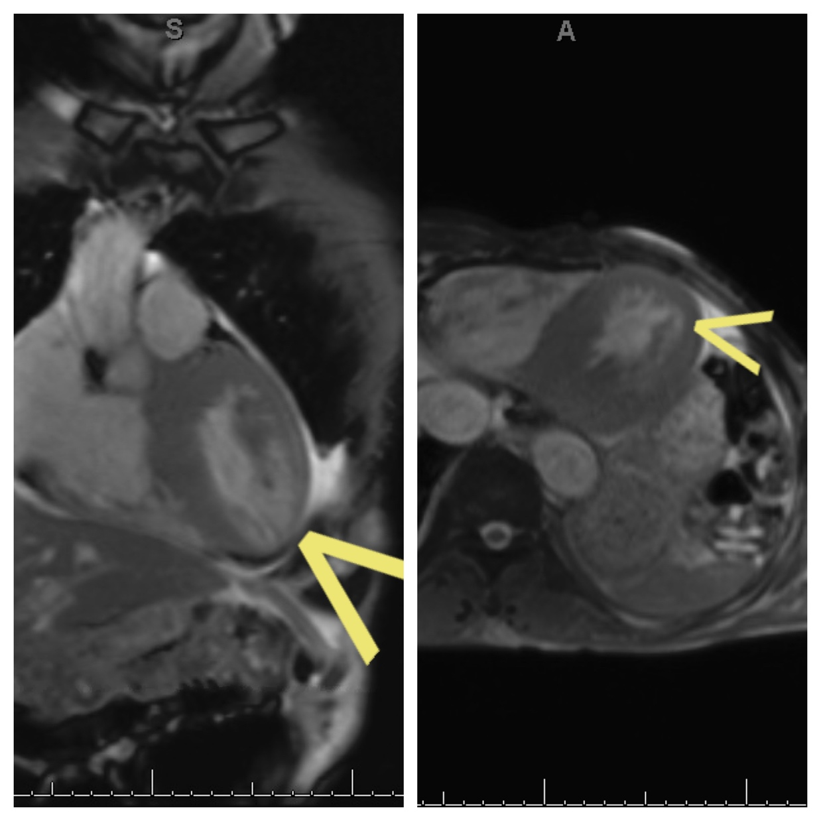
To rule out LV thrombi, Cardiac MRI was obtained and it revealed prolong T1 relaxation and significant delayed gadolinium enhancement suspicious for cardiac amyloidosis

Slide 11
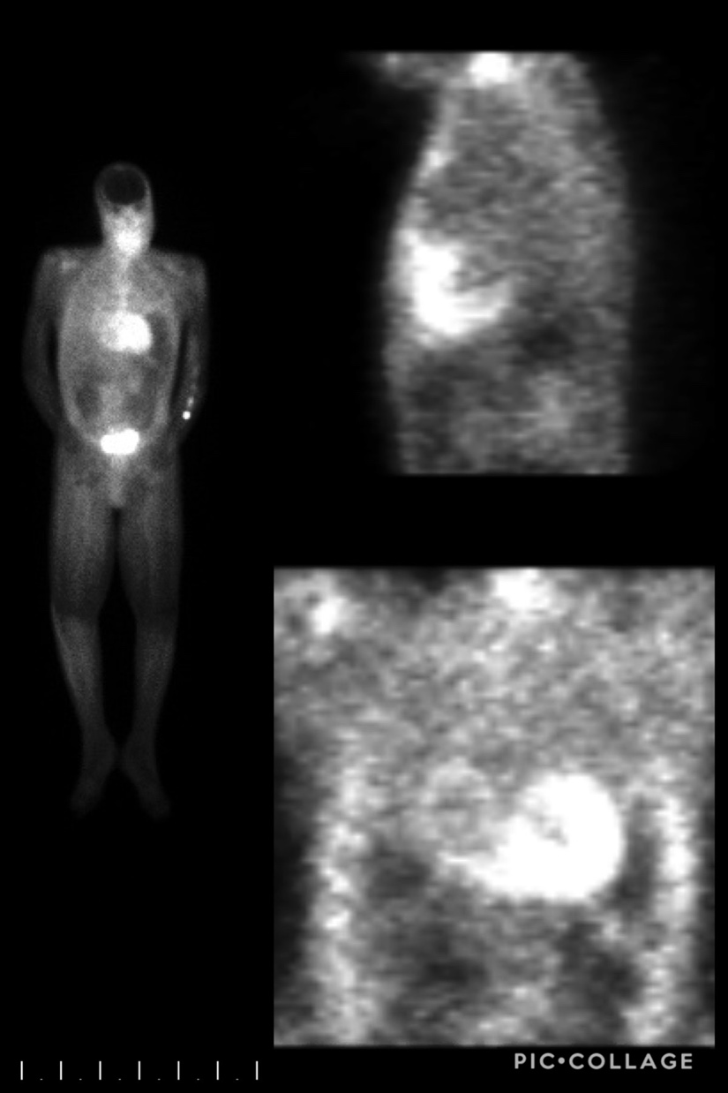
Follow up Technetium Pyrophosphate NM bone scan spect reveals abnormal radiotracer uptake within the cardiac myocardium that is greater than bone uptake. Findings characteristic of grade 3 cardiac amyloidosis.

Slide 12
Fat pad biopsy and mass spectrometry confirmed tissue transthyretin amyloidosis.
Coronary angiography was done to r/o CAD as a cause of his troponin leak. It revealed a non obstructive CAD.
The patient was managed conservatively with diuretics and discharged with appropriate follow-ups in place.
His home lisinopril and metoprolol were discontinued due to concerns that they may worsen his symptoms.

Slide 13
Discussion
Persistently elevated cardiac biomarkers may be of prognostic value in patients who do not respond to normal HF therapies and have rapid disease progression.
Studies have shown that these markers may also be of diagnostic significance and help to differentiate cardiac amyloidosis from other causes of heart failure.
In addition, this case illustrates the fact that more frequent ECHOs may be necessary to monitor disease progression in this patient population.

Slide 14
Conclusion
Troponinemia might play a role in the early diagnosis of Cardiac amyloidosis, however this needs to be further investigated.

