Slide 1
The Pragmatic Urinary Sodium-based treatment algoritHm in Acute Heart Failure (PUSH-AHF) trial
Jozine M. ter Maaten, Iris E. Beldhuis, Peter van der Meer, Jan A. Krikken, Douwe Postmus, Jenifer E. Coster, Wybe Nieuwland, Dirk J. van Veldhuisen, Adriaan A. Voors, Kevin Damman
University of Groningen, University Medical Center Groningen, The Netherlands Aug 28th 2023 – Hotline Session ESC

Slide 2
Disclosures
Investigator initiated trial funded by the Netherlands Heart Foundation
No industry funding

Slide 3
Background
In acute heart failure, treatment of congestion with loop diuretics has remained unchanged over the last 50 years.
Adequate and quick congestion relief remains difficult and this
one-size-fits-all approach falls short in a great number of patients
A personalized treatment approach is urgently needed to improve effective decongestion
Urinary sodium (natriuresis) has been suggested as a potential marker to guide diuretic therapy and has already been incorporated in the ESC HF guidelines

Slide 4
Aim and design of the trial
The PUSH-AHF trial aimed to investigate the effectiveness and safety of natriuresis guided diuretic therapy in acute heart failure
Pragmatic, prospective, single-center, open-label, randomized, controlled clinical trial
Investigator initiated
Enrolment between February 2021 and November 2022
180-days follow-up (by telephone call)

Slide 5
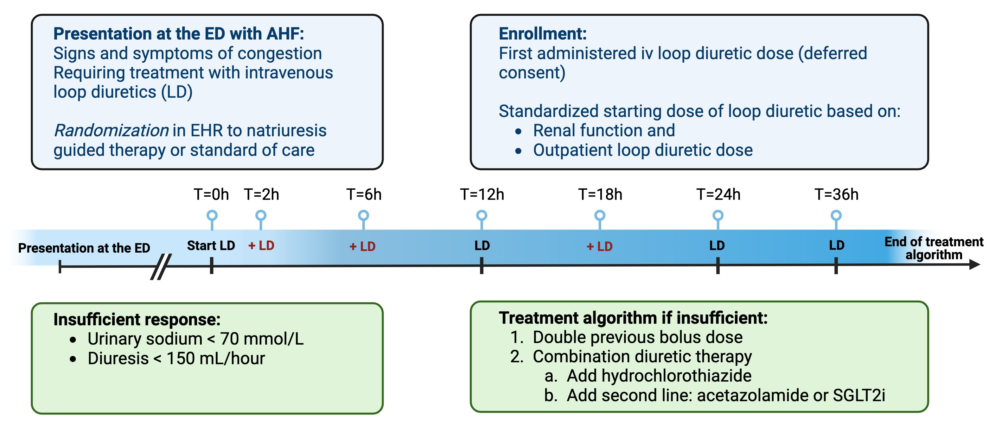
PUSH-AHF study design

Slide 6
Statistical methods & outcomes
The study was powered for a dual primary endpoint (both
P<0.025)
24-hours natriuresis
180-day all-cause mortality and adjudicated heart failure hospitalization
Key secondary endpoints:
48-hour natriuresis, 24- and 48-hour diuresis, length of stay, heart failure rehospitalizations, all-cause mortality, percentage change in NT-proBNP at 48- and 72-hours
Safety endpoints: cardiac and renal safety events

Slide 7
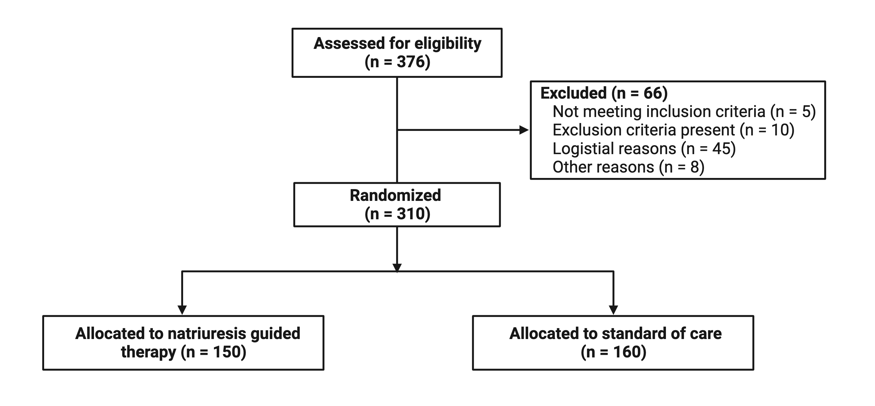
Study flow chart

Slide 8
Results – clinical characteristics
Natriuresis guided therapy Standard of Care (n=160) (n=150)
Demographics
Age (years) |  | 74 [66-82] | 74 [65-81.2]
Sex (n (%) female) |  | 61 (41%) | 77 (48%)
Race (n (%) white) |  | 142 (96%) | 155 (98%)
Physical examination at presentation
Rales (n (%)) |  | 108 (73%) | 109 (71%)
Ascites (n (%)) |  | 12 (12%) | 16 (17%)
Edema (n (%)) |  | 99 (68%) | 103 (67%)
Orthopnea (n (%)) |  | 85 (67%) | 88 (72%)
NYHA Class (n (%))
 | II | 5 (3%) | 11 (7%)
 | III | 39 (26%) | 29 (18%)
 | IV | 106 (71%) | 120 (75%)

Slide 9
Results – clinical characteristics
Natriuresis guided therapy (n=150) |  | Standard of Care (n=160)
Heart failure
LVEF (%) | 35 [25-53] | 38 [28-48]
HFpEF (n (%)) | 30 (26%) | 21 (18%)
New-onset heart failure (n (%)) | 66 (44%) | 69 (43%)
Ischemic etiology (n (%)) | 56 (37%) | 55 (34%)
Laboratory values at baseline
eGFR (ml/min/1.73m2) | 54 [35-72] | 53 [34.8-73.2]
NT-proBNP (ng/L) | 4390 [2554-8226] | 4947 [2607-9809]
Treatment before admission
ACEi/ARB/ARNI (n (%)) | 82 (55%) | 87 (54%)
Beta-blocker (n (%)) | 100 (67%) | 115 (72%)
MRA (n (%)) | 53 (35%) | 54 (34%)
SGLT2i (n (%)) | 8 (5%) | 12 (8%)
Home loop diuretic (n (%)) | 84 (56%) | 93 (58%)
Home loop diuretic dose (mg of bumetanide equivalents) | 2 [1-4] | 2 [1-4]

Slide 10
Results - treatment
Median starting dose in both groups was 2 [1-4] mg of bumetanide bid (furosemide equivalent dose of 80 [40-160] mg)

Slide 11
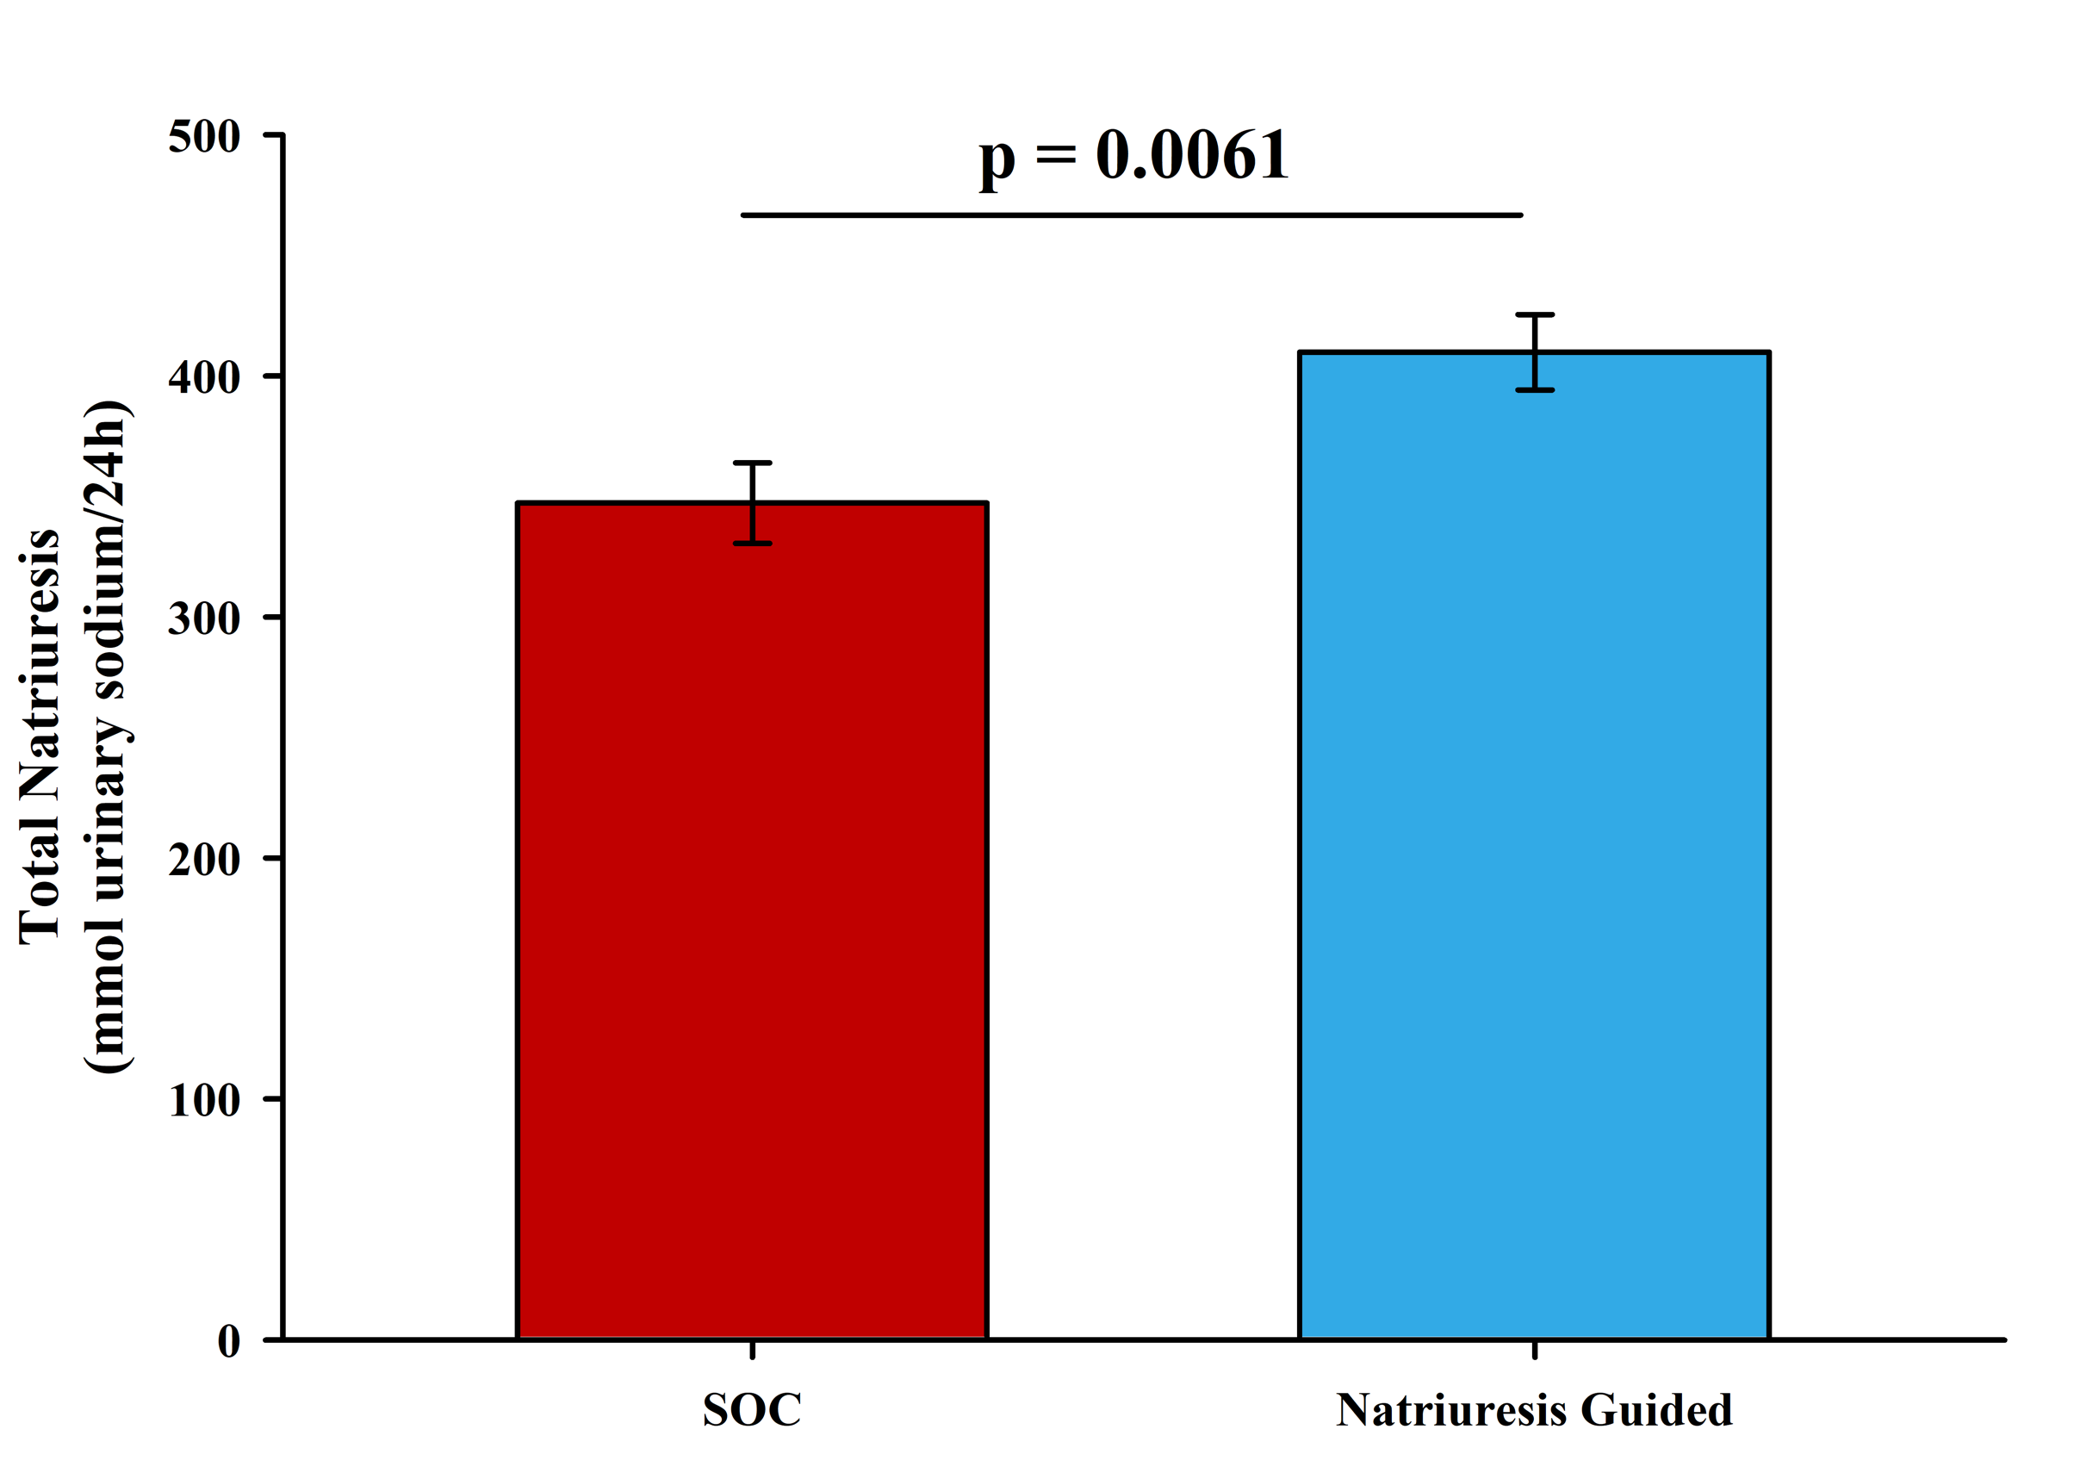
1st primary endpoint – 24-hours natriuresis
Estimated difference: 63 (95% CI: 18-109) mmol
urinary sodium

Slide 12
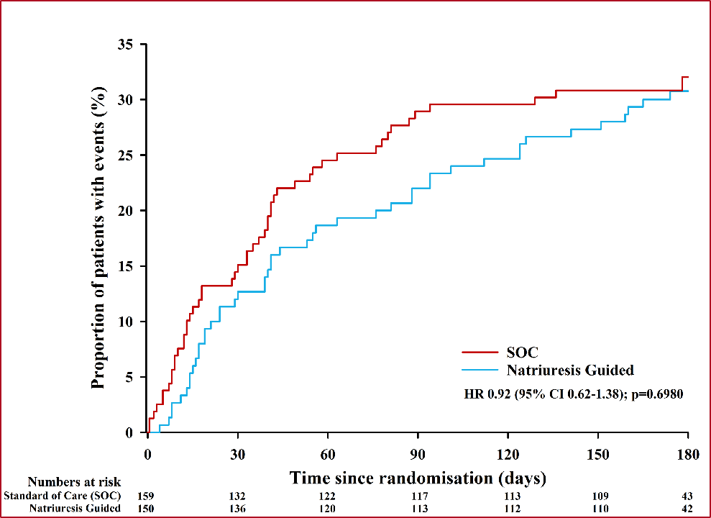
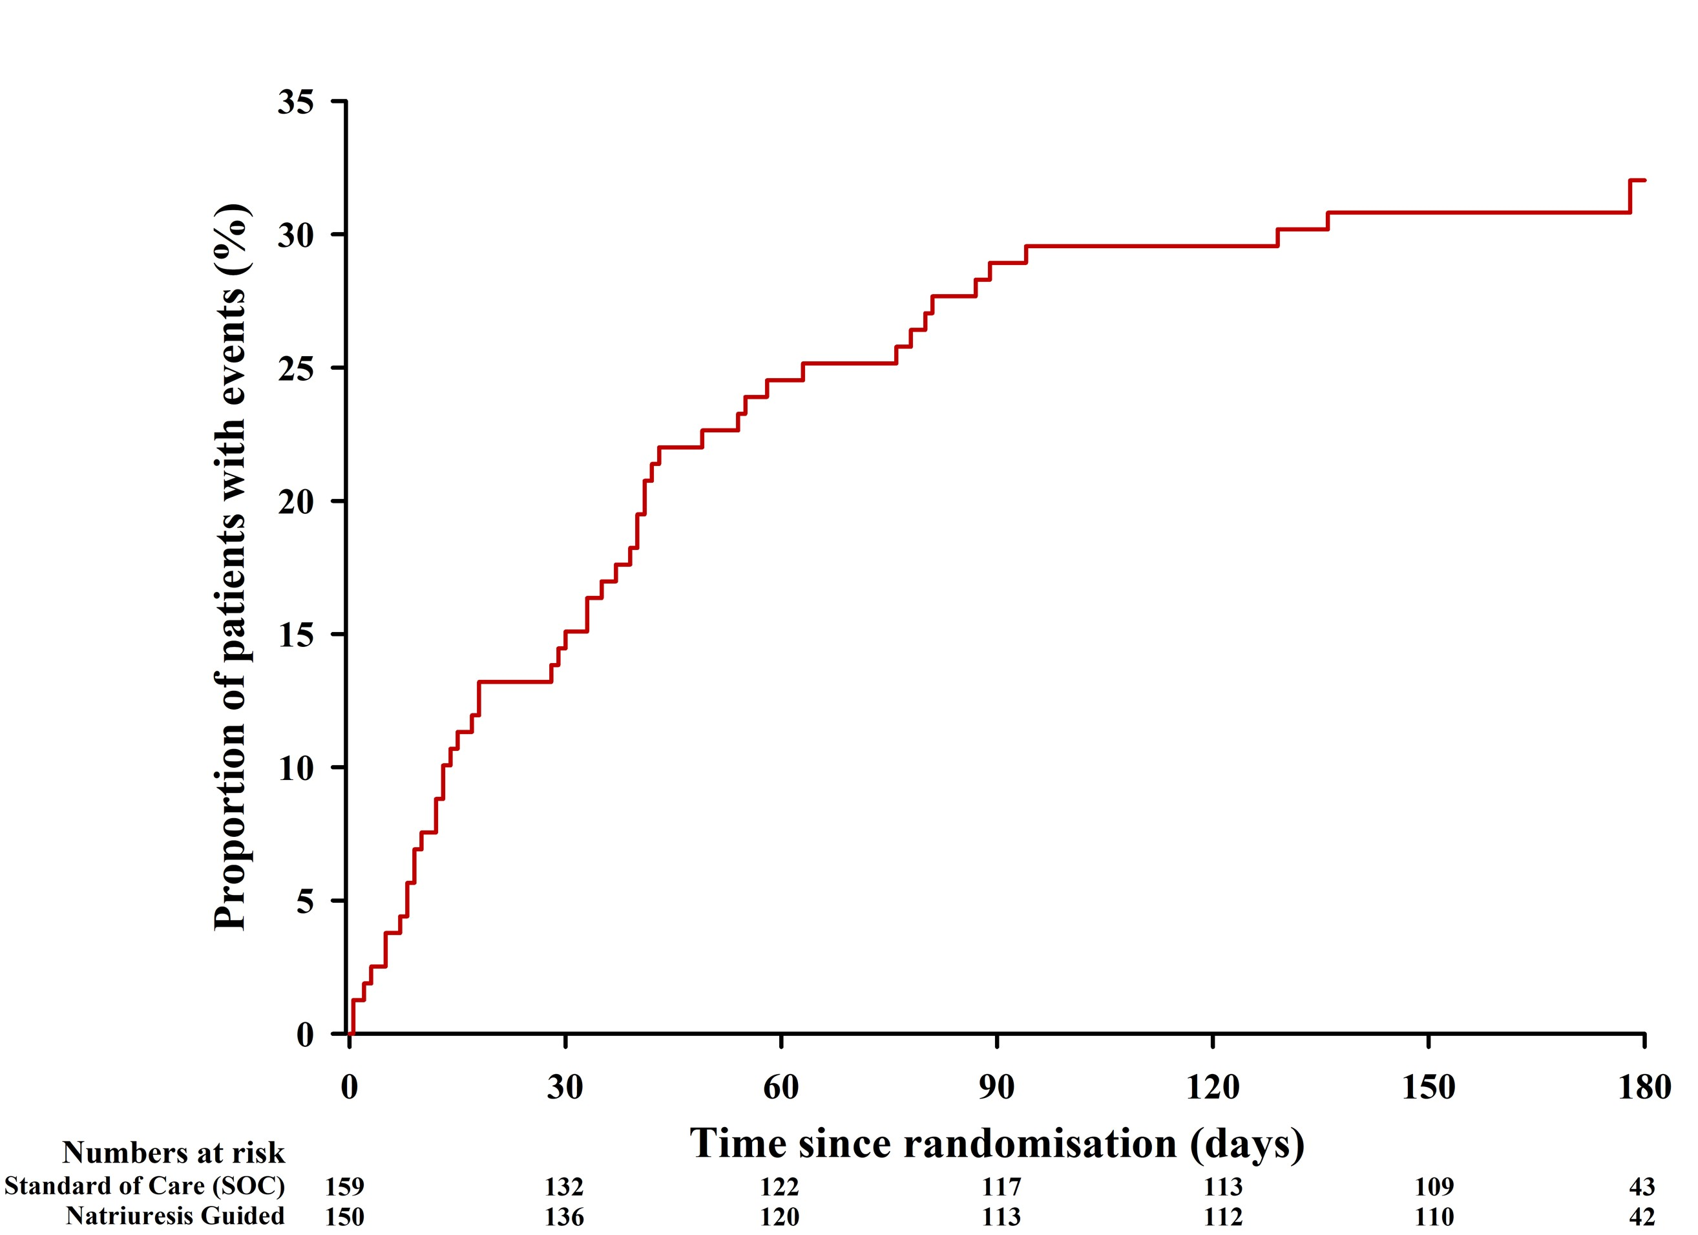
2nd primary endpoint – 180-day all-cause mortality and adjudicated HF rehospitalization
Significant difference in inhospital death (P=0.0192)
Natriuresis guided therapy: 1.4% (n=2)
Standard of care: 7.5% (n=14)

Slide 13
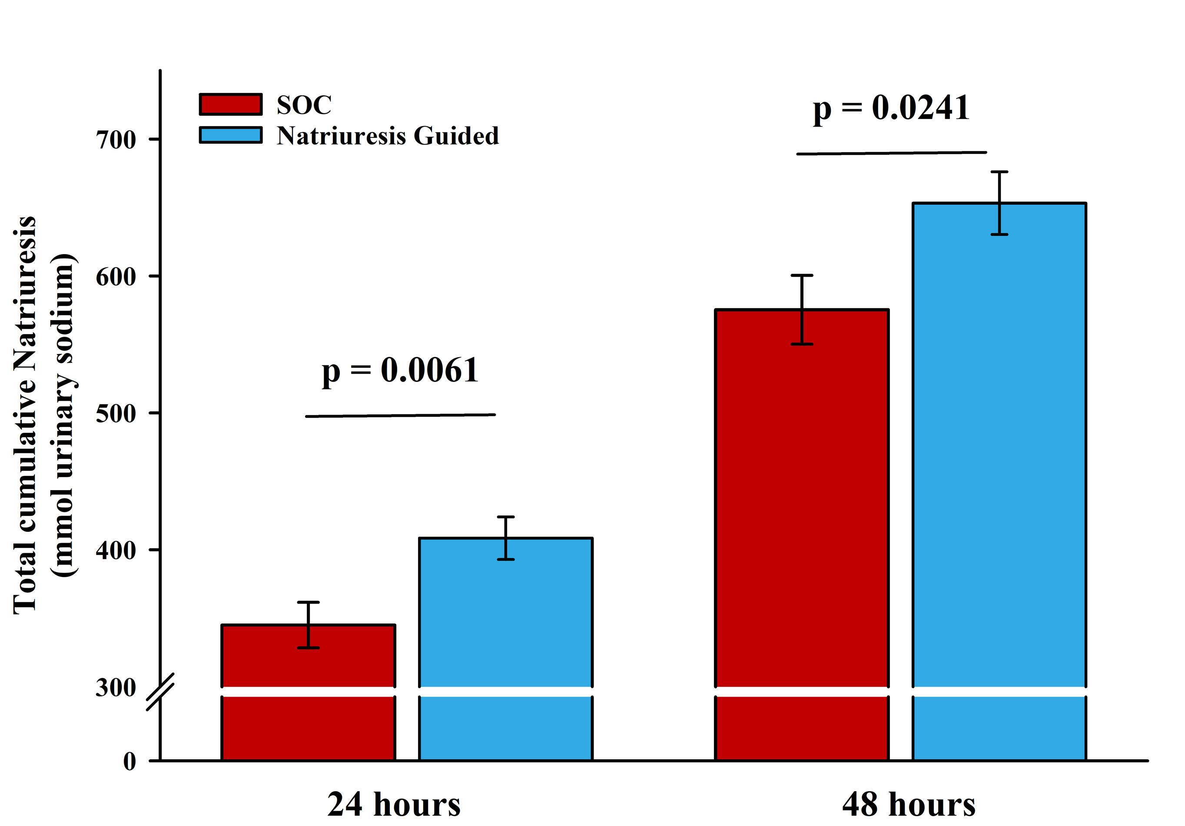
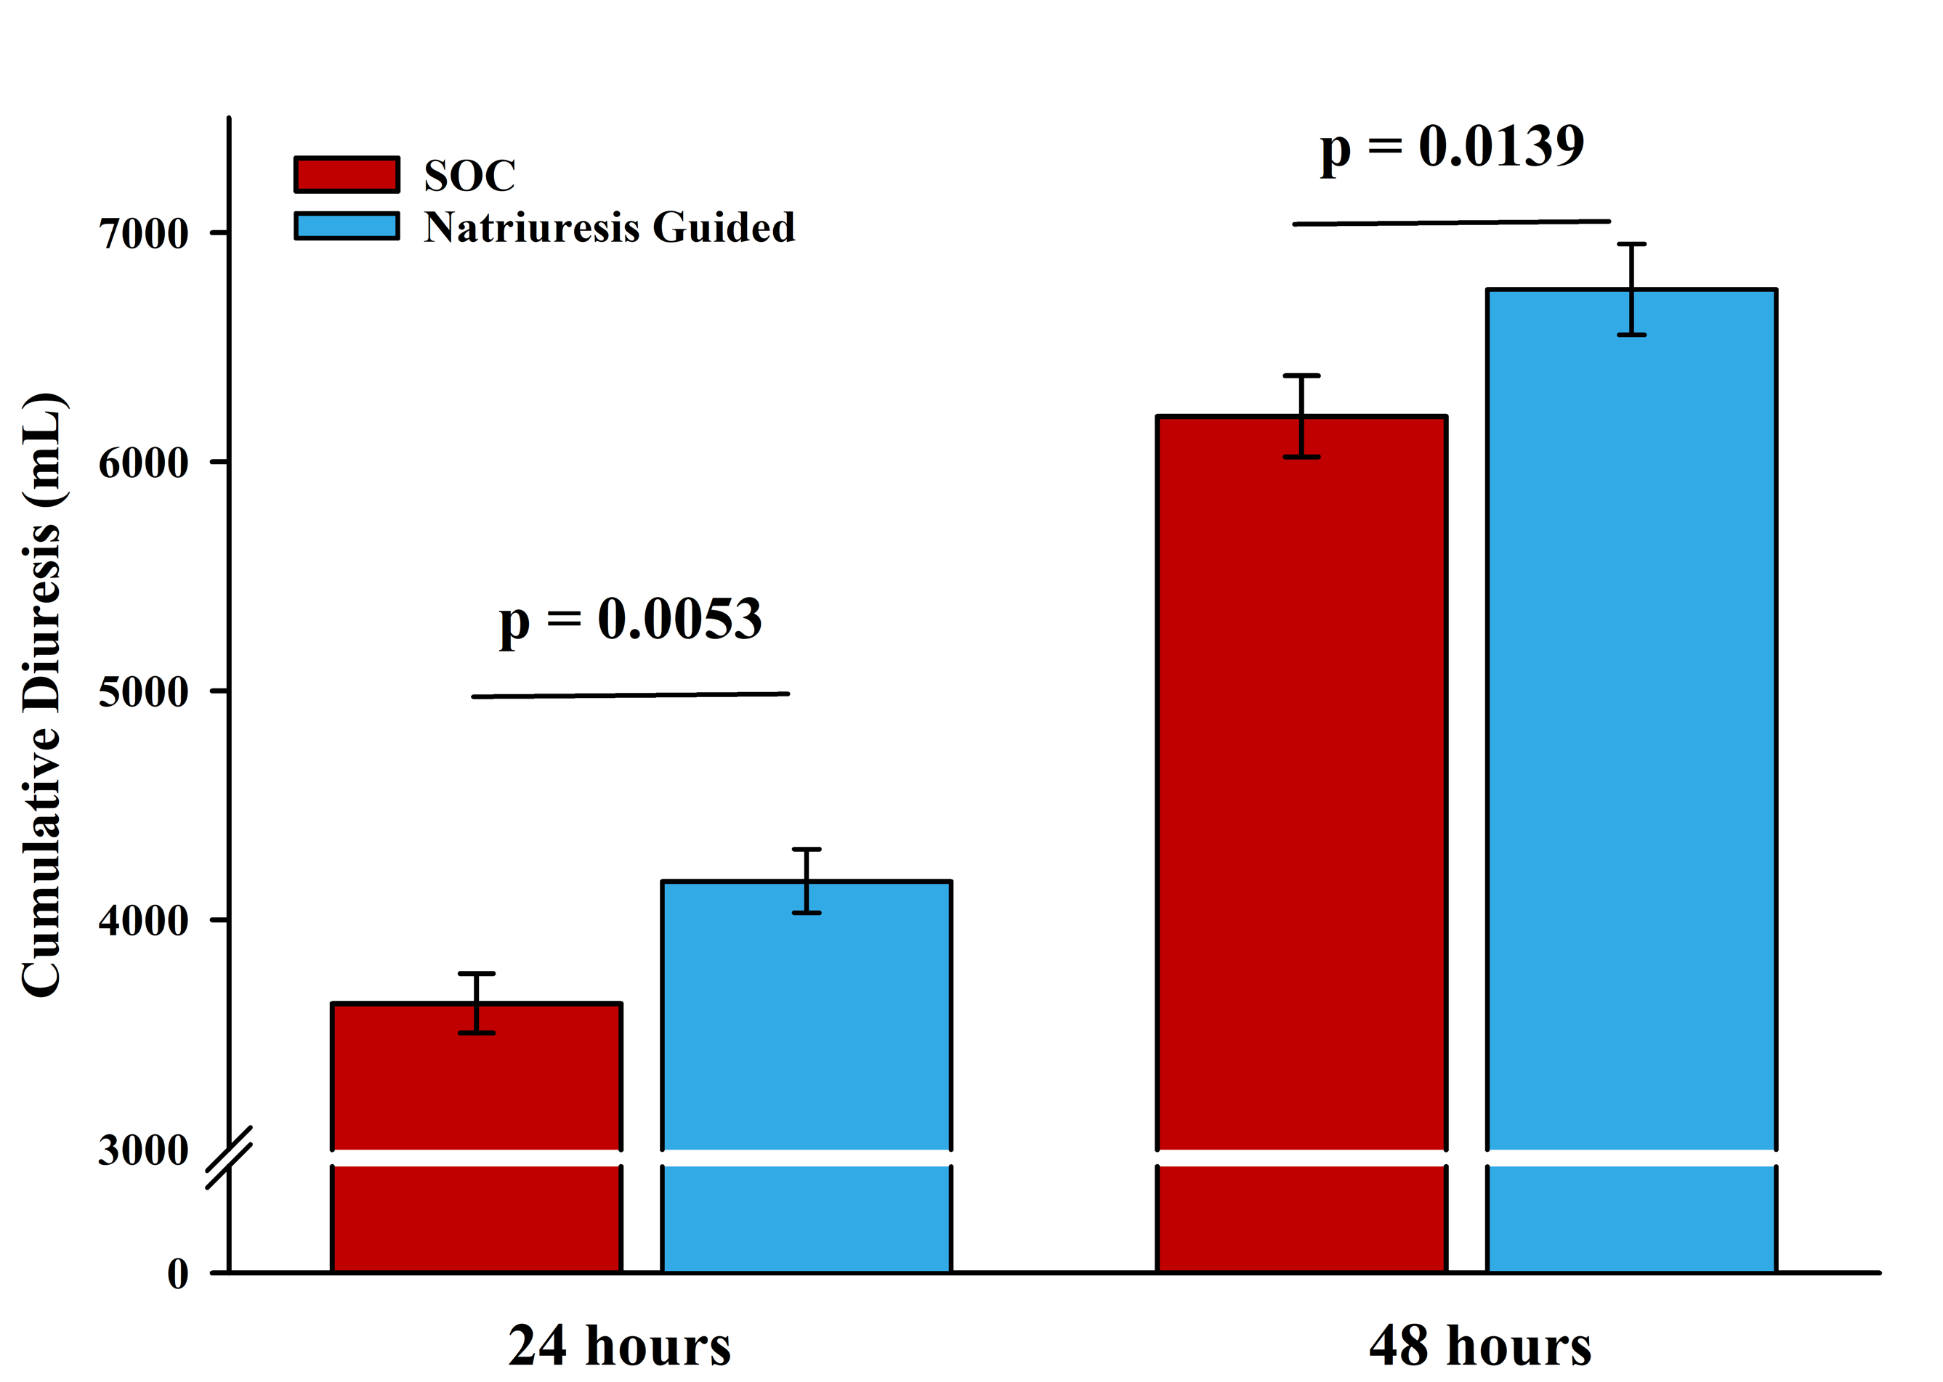
Results– secondary endpoints
Natriuresis
Diuresis

Slide 14
Results – other secondary endpoints
Natriuresis guided therapy |  | Standard of care | P-value
Length of hospital stay (days) | 6 [5-9] | 7 [5-10] | 0.1436
Heart failure rehospitalization (%(n)) | 17 (25) | 17 (26) | 0.8904
180-day all-cause mortality (%(n)) | 19 (29) | 21 (33) | 0.6369
Percentage change in NT-proBNP (%)
At 48 hours | -22 [-48-12] | -18 [-41-17] | 0.4351
At 72 hours | -33 [-61-0] | -33 [-58-8] | 0.7881

Slide 15
Results – safety endpoints
Natriuresis guided therapy |  | Standard of care | P-value
Safety endpoints
Serious adverse events (%(n)) | 40 (60) | 44 (70) | 0.5799
Adverse events (%(n)) | 57 (86) | 60 (96) | 0.7180
Renal safety events
Doubling of serum creatinine at 24 hours from baseline (%(n)) | 0 (0) | 1 (1) | 1.0000
Doubling of serum creatinine at 48 hours from baseline (%(n)) | 1 (1) | 1 (2) | 1.0000
Prespecified AE’s
Worsening heart failure (%(n)) | 6 (9) | 9 (15) | 0.3689
True worsening renal function (%(n)) | 1 (1) | 1 (2) | 1.0000

Slide 16
Strengths and limitations
Single center study in the Netherlands
Open label design
Natriuresis values in the standard of care group were blinded
Heart failure rehospitalizations were adjudicated
Primary endpoint analyses were performed by an independent statistician
Pragmatic trial
Incorporation in the electronic health record
Swift enrollment of a generalizable, all-comer, acute heart failure population

Slide 17
Conclusions
The PUSH-AHF trial showed that natriuresis-guided diuretic therapy improved natriuresis and diuresis in patients with acute heart failure without affecting 180-day outcomes
Natriuresis-guided therapy was safe as it did not increase renal and cardiac events

Slide 18
Clinical implications
The results of the PUSH-AHF trial are directly implementable as spot urinary sodium values are easy to obtain, inexpensive and widely available, as are the medications used in the treatment algorithm
Our results underscore the use of repeated spot urinary sodium assessments for personalized treatment targets as proposed by the ESC HF guidelines

Slide 19
Acknowledgements
Co-primary investigator: K. Damman
Steering committee: P. van der Meer, I.E. Beldhuis, J.A. Krikken, J.E. Coster, W. Nieuwland, D.J. van Veldhuisen, and A.A. Voors
Independent statistician: D. Postmus
We thank the patients, physicians, nurses, and monitor involved in the trial

Slide 20
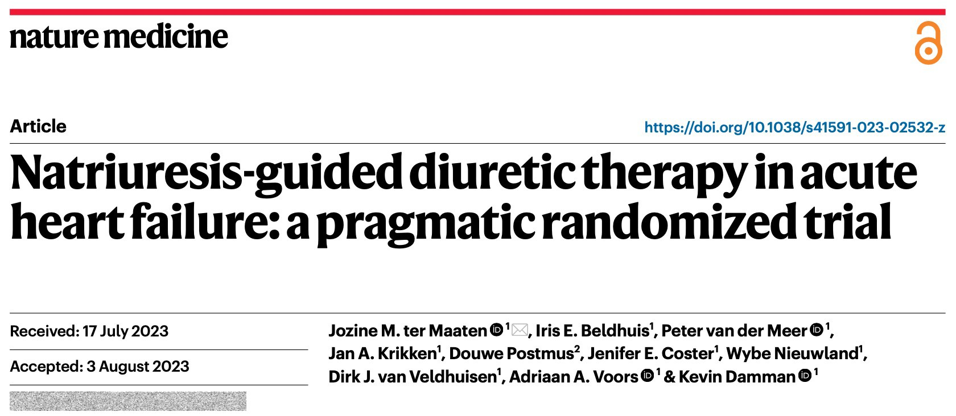
Now online in Nature Medicine
j.m.ter.maaten@umcg.nl

