Slide 1

Randomized trial for Evaluation in Secondary Prevention Efficacy of Combination Therapy
- Statin and Eicosapentaenoic Acid
(RESPECT-EPA)
AHA 2022 Scientific Session Late-Breaking Clinical Trial
November 6, 2022
Hiroyuki Daida, Yuji Nishizaki, Hiroshi Iwata, Teruo Inoue, Atsushi Hirayama, Kazuo Kimura, Yukio Ozaki, Toyoaki Murohara, Kenji Ueshima, Yoshihiro Kuwabara, Sachiko Tanaka-Mizuno, Naotake Yanagisawa, Tosiya Sato, Katsumi Miyauchi
and RESPECT-EPA investigators
Supported by: Japan Heart Foundation

Slide 2
COI disclosure
Hiroyuki Daida
Speakers’ Bureau / Honorarium
Novartis Pharma K.K., Bayer Yakuhin, Ltd., Sanofi K.K., Kowa Company, Limited,
Taisho Pharmaceutical Co., Ltd., Abbott Medical Japan LLC,
Otsuka Pharmaceutical Co., Ltd., Amgen K.K., MSD K.K.,
Daiichi Sankyo Company, Limited, Pfizer Japan Inc., FUKUDA DENSHI CO., LTD., Tsumura & Co., TOA EIYO LTD.
Trust research / joint research funds Philips Japan, Ltd., FUJIFILM Holdings Corporation, Asahi Kasei Corporation,
Inter Reha Co.,Ltd., TOHO HOLDINGS Co.,Ltd, GLORY LTD., BMS K.K,
Abbott Japan LLC, Boehringer Ingelheim Japan, Inc.
Scholarship fund Eisai Co., Ltd., Bayer Yakuhin, Ltd., Daiichi Sankyo Company, Limited

Slide 3
Background
In 2005, the Japan EPA Lipid Intervention Study (JELIS) first demonstrated a beneficial effect of highly purified eicosapentaenoic acid (EPA) on cardiovascular outcomes in patients with and without coronary artery disease (CAD).
Recently, optimal medical therapy (OMT) particularly with high-intensity statins, has become the gold standard of care for CAD patients; however, they are still at substantially high residual risk.
Despite of the evidence provided by JELIS, the conflicting results in recent omega-3 fatty acid trials have led to an intense controversy regarding the relevance of EPA intervention on top of the latest OMT.
To assess the prognostic merit of EPA, when used with current statin therapy in patients with CAD, a Randomized trial for Evaluating the Secondary Prevention Efficacy of Combination Therapy – statin and EPA (RESPECT-EPA) was conducted.

Slide 4
Objective and Eligibility Criteria of the Study
Objective
To determine the effect of highly purified EPA (icosapent ethyl: IPE) on cardiovascular events in Japanese chronic CAD patients with a low EPA/AA ratio (< 0.4), who received statins
Eligibility criteria
  Chronic CAD
  Receiving statins for at least 1 month before inclusion
  20–79 years old at the time of obtaining consent
  Provided a written consent form to participate after receiving a full explanation of the study

Slide 5
Trial Scheme
Highly purified EPA (icosapent ethyl: IPE 1,800mg/day)
+ standard statin
EPA/AA* < 0.4
Randomization
Consent for
study
enrollment
Measurement
of
EPA/AA ratio
Standard statin
EPA/AA ≥ 0.4
No randomization (standard statin)
Study enrollment and randomization
Follow-up period
: Open-label randomized control trial
: Biomarker observational study
Enrollment period: 4 years from November 1, 2013
Follow-up period: 4 years from the end of the enrollment period
*EPA/AA: ratio of plasma eicosapentaenoic acid/ arachidonic acid

Slide 6
Study Design and Sample Size Estimation
Primary Endpoint: The composite of cardiovascular death, nonfatal myocardial infarction, nonfatal cerebral infarction, unstable angina pectoris requiring emergency hospitalization and coronary revascularization procedure, and revascularization procedure based on clinical findings
Secondary Endpoint: Composite events of CAD, composite events of stroke, events related to death
Sample Size Calculation
Hypothesis: Detecting a hazard ratio of 0.70 in the EPA group
Assumptions: Four-year cumulative event rate of 12% and annual withdrawal rate of 2.5%
Power: 80% Alpha: 0.05（two-tailed）
Estimated sample size: 2,600 cases (1,300 for control and Purified EPA group)

Slide 7
Patient Flow Diagram
Enrolled N=3844
High-EPA/AA group N=1338
Randomized N=2506
EPA group N=1249
Control group N=1257
Withdrawal/Missing consent etc. N=24
Withdrawal/Missing consent etc. N=22
Early stopping N=398
Protocol deviations N=225
Early stopping N=267
Protocol deviations N=61
Full analysis set (FAS) N=1225
Full analysis set (FAS) N=1235

Slide 8
Baseline Characteristics
Variables | Purified EPA group (N = 1225) | Control group (N = 1235)
Age - median (IQR) year | 68.0 (61.0, 73.0) | 68.0 (61.0, 73.0)
Male n (%) | 1013 (82.7) | 1022 (82.8)
Diabetes mellitus, n (%) | 545 (44.5) | 566 (45.8)
Hypertension, n (%) | 1010 (82.5) | 1038 (84.1)
History of coronary artery disease
Myocardial infraction, n (%) | 658 (53.7) | 682 (55.2)
Post CABG, n (%) | 149 (12.2) | 131 (10.6)
Post PCI, n (%) | 1075 (87.8) | 1088 (88.1)
LDL-C, median (IQR) mg/dL | 80.6 (67.4, 97.1) | 80.6 (65.8, 95.8)
HDL-C, median (IQR) mg/dL | 49.0 (41.0, 58.0) | 49.0 (42.0, 58.0)
TG, median (IQR) mg/dL | 120.0 (86.0, 173.0) | 117.0 (86.0, 163.0)
EPA, median (IQR) µg/mL | 46.5 (34.6, 60.2) | 44.9 (32.6, 58.4)
DHA, median (IQR) µg/mL | 108.9 (87.6, 131.5) | 106.6 (86.9, 128.5)
AA, median (IQR) µg/mL | 195.1 (164.7, 231.0) | 194.2 (165.7, 231.6)
EPA/AA ratio, median (IQR) | 0.243 (0.180, 0.314) | 0.235 (0.163, 0.310)
Highly sensitive CRP level, median (IQR) mg/L | 0.48 (0.25, 1.11) | 0.46 (0.22, 1.05)

Slide 9
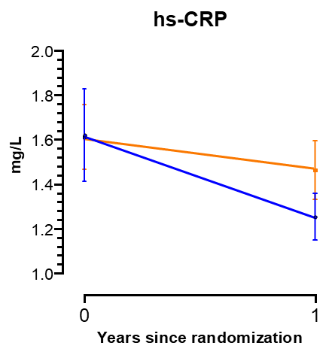
Changes in Fatty Acid, Lipid and hs-CRP
*
*
1.61
1.46
μg/mL
μg/mL
Control
*
1.62
Purified EPA
*
1.25
*
*
*
*
*
*
*
*: p<0.05 compared to baseline level by analysis of covariance

Slide 10
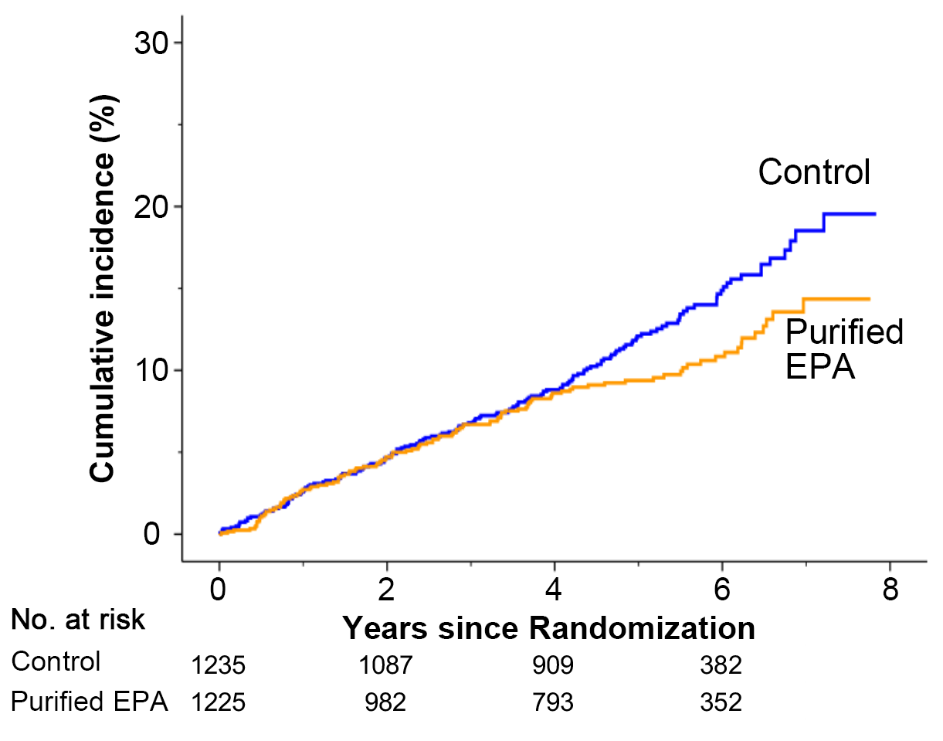
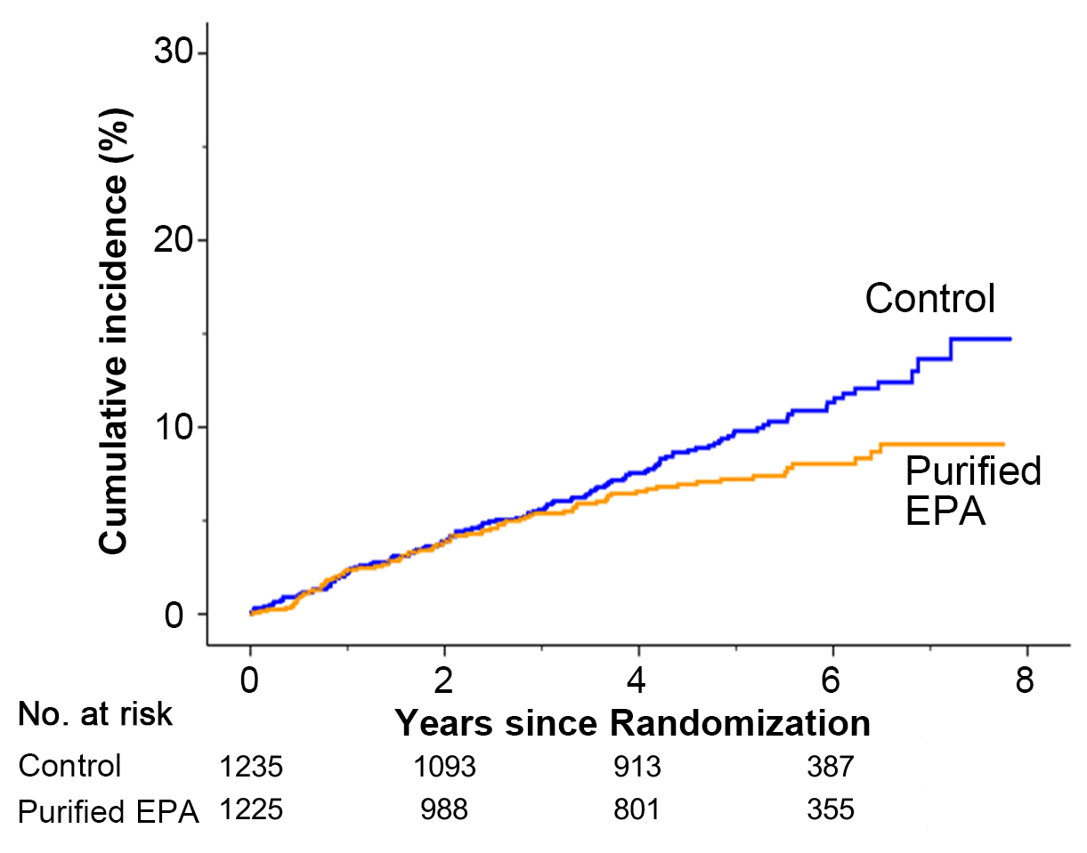
Primary and Secondary Endpoints
Primary Endpoint*
Secondary Endpoint**
HR (Cox): 0.785 (0.616-1.001)
Stratified log-rank p-value = 0.0547
HR (Cox): 0.734 (0.554-0.973)
Stratified log-rank p-value = 0.0306
14.9%
11.3%
8.8%
10.9%
7.6%
4.7%
8.6%
3.9%
6.6%
8.0%
4.7%
3.9%
*: The composite of CV death, nonfatal MI, nonfatal Ischemic stroke, unstable angina, coronary revascularization)
**: Sudden cardiac death, MI, unstable angina, coronary revascularization

Slide 11
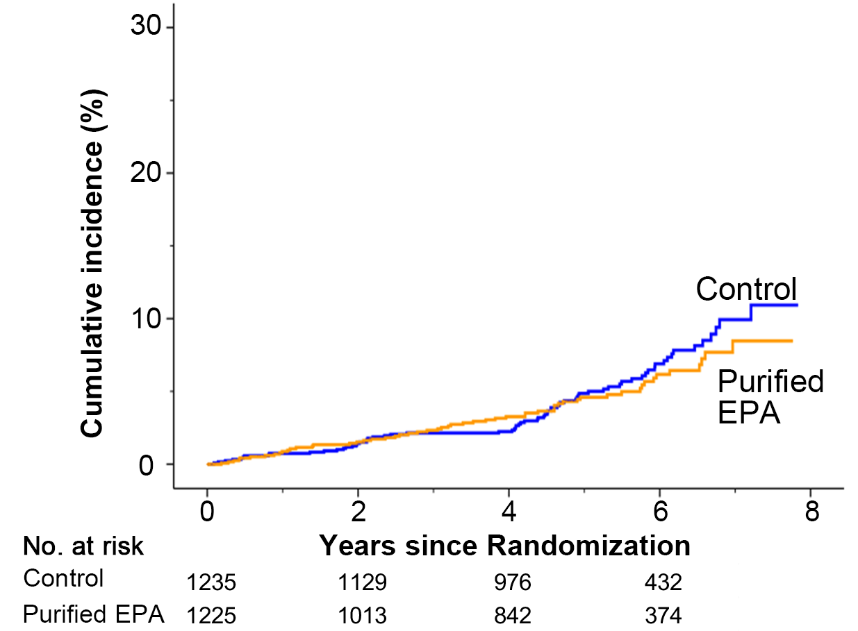
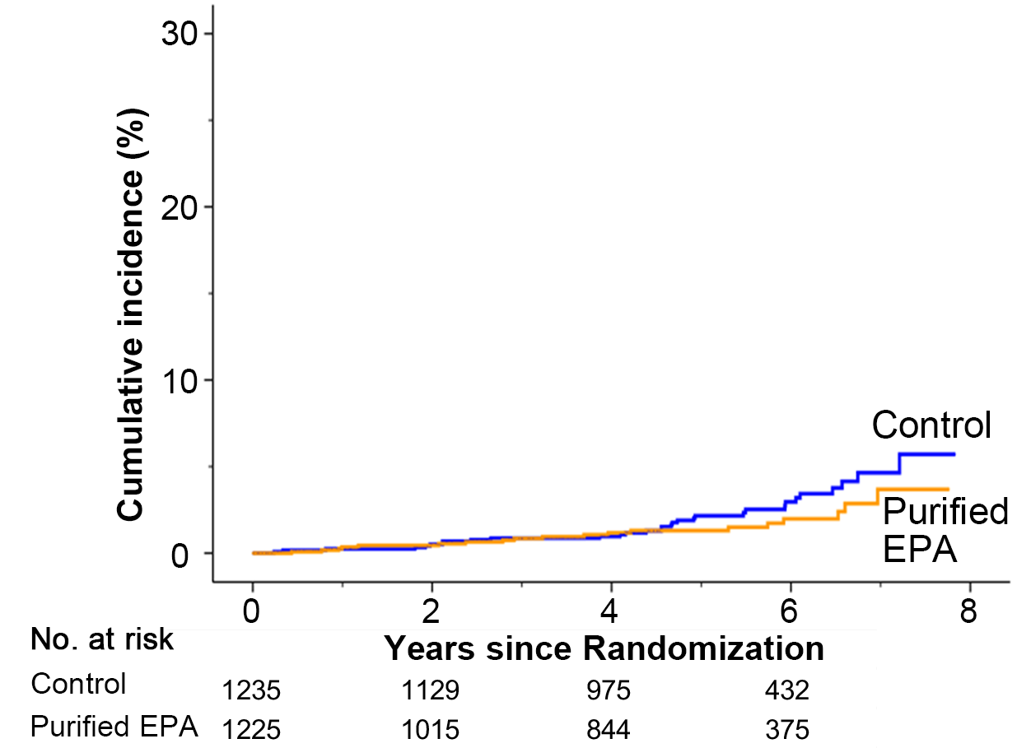
All-cause and Cardiovascular mortality
All-cause Mortality
Cardiovascular Mortality
HR (Cox): 0.682 (0.385-1.208)
Stratified log-rank p-value = 0.1928
HR (Cox): 0.888 (0.625-1.262)
Stratified log-rank p-value = 0.5303
6.9%
2.2%
3.0%
1.4%
6.2%
0.5%
1.0%
1.5%
3.3%
0.5%
1.2%
2.0%

Slide 12
Each Secondary Endpoint

Slide 13
Safety Outcomes
Events | Purified EPA group (N = 1225) | Control group (N = 1235) | P value
Gastrointestinal disorders, n (%) | 42 (3.4%) | 15 (1.2%) | <0.001
TIMI Bleeding, n(%) | 27 (2.2%) | 32 (2.6%) | 0.599
Major | 13 (1.1%) | 15 (1.2%) | 0.850
Minor/Minimum | 14 (1.1%) | 17 (1.4%) | 0.718
New-onset diabetes mellitus, n(%) | 26 (2.1%) | 15 (1.2%) | 0.085
Low density lipoprotein increase, n(%) | 22 (1.8%) | 31 (2.5%) | 0.267
Liver enzyme elevation, n(%) | 8 (0.7%) | 13 (1.1%) | 0.381
New-onset atrial fibrillation | 38 (3.1%) | 20 (1.6%) | 0.017

Slide 14
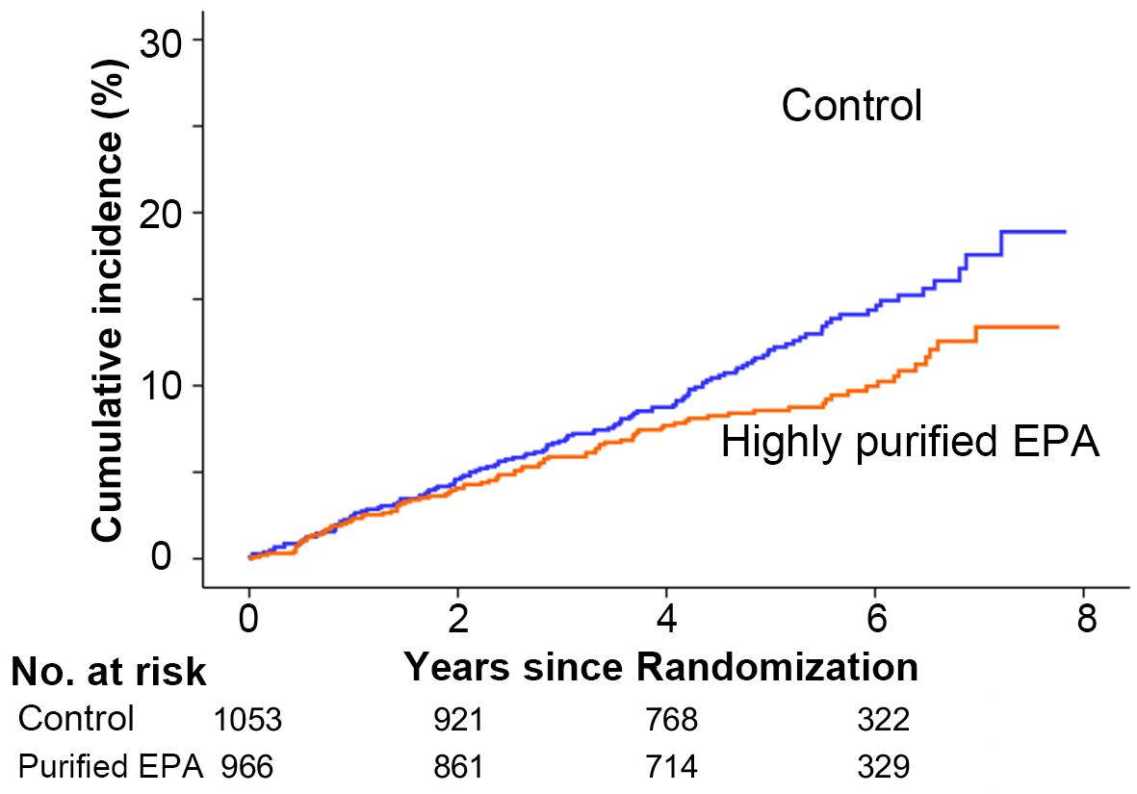
Post-hoc Analysis (Primary Endpoint)
HR (Cox): 0.725 (0.553-0.951)
Stratified log-rank p-value = 0.0202
(n=1053)
Excluded:
EPA increase from baseline >30 μg/mL
(n=182)
(n=966)
Excluded:
EPA increase from baseline <30 μg/mL
(n=259)

Slide 15
Study Limitations
As the actual event rate in the present study was lower than estimated, and the alternative hazard ratio was set as 0.7, this study might be underpowered.
The present study was conducted as an open-label, not double-blind, randomized trial with its inherent limitations.
The vast majority of participants in the present study were Japanese, whose baseline level of EPA has been considered to be relatively higher than that in Western countries.

Slide 16
Conclusions and Implications
This study showed a borderline statistical significance regarding the effect of highly purified EPA of 1,800 mg/day for reducing the risk of adverse cardiovascular events in Japanese patients with chronic CAD treated by statins.
Additionally, highly purified EPA of 1,800 mg/day was significantly associated with a decreased risk of the composite of coronary events.
Present findings indicate a possible prognostic benefit of EPA (1,800 mg/day) in chronic CAD patients with statins whose EPA/AA ratio was low (< 0.4).

Slide 17
RESPECT-EPA Study Organization
Principal Investigator: Hiroyuki Daida
Advisers: Masunori Matsuzaki, Hiroaki Shimokawa, Issei Komuro and Hisao Ogawa
Steering Committee: Hiroyuki Daida, Teruo Inoue, Atsushi Hirayama, Kazuo Kimura, Yukio Ozaki,
Toyoaki Murohara and Kenji Ueshima
Protocol Preparation Committee: Katsumi Miyauchi, Hiroyoshi Yokoi, Shichiro Abe,
Yoshihisa Nakagawa, Koichi Nakao, Masato Kasahara, Shinji Yasuno and Yoshihiro Kuwabara
Event Evaluation Committee: Hiroshi Ito, Takeshi Kimura, Takashi Akasaka, Hiroyuki Tsutsui,
Kengo Tanabe, Nobuyuki Komiyama, Yasuhiko Sakata, Takumi Higuma, Mitsuru Abe, Norihiro Suzuki, Yoshiaki Ito, Ryota Tanaka, Satoshi Suda, Hidetaka Mitsumura, Arihiro Kiyosue, Tadateru Takayama, Hidehiko Hara, Junichi Yamaguchi and Ken Kozuma
Independent Data Monitoring Committee: Akira Yamashina, Masakazu Yamagishi, Yoshihiko Saito and Kunihiko Hayashi
Medical Statistics Commissioners: Toshiya Sato and Naotake Yanagisawa
Data Center: Juntendo University Hospital Clinical Research and Trial Center, Tokyo, Japan
Study Headquarters: Research Institute for Production Development (General Incorporated Foundation), Kyoto, Japan

Slide 18
Investigators
Hiroyuki Daida (Juntendo University Graduate School of Medicine) | Teruo Inoue (Japan Red Cross Sciety, Nasu Red Cross Hospital) | Atsushi Hirayama (Osaka Police Hospital) | Kazuo Kimura (Yokohama City University Medical Center)
Yukio Ozaki (Fujita Health University) | Toyoaki Murohara (Nagoya University Graduate School of Medicine) | Kenji Ueshima (Uji-Takeda Hospital) | Katsumi Miyauchi (Juntendo University Graduate School of Medicine)
Hiroyoshi Yokoi (Fukuoka Sanno Hopsital) | Shichiro Abe (Dokkyo Medical University Hospital) | Yoshihisa Nakagawa (Shiga University of Medical Science) | Koichi Nakao (Saiseikai Kumamoto Hospital Cardiovascular Center)
Masato Kasahara (Nara Medical University Hospital) | Shinji Yasuno (The Jikei University School of Medicine) | Yoshihiro Kuwabara (Osaka International Cancer Institute) | Masunori Matsuzaki (St. Hill Hospital)
Hiroaki Shimokawa (Tohoku University Graduate School of Medicine) | Issei Komuro (Graduate School of Medicine, The University of Tokyo) | Hisao Ogawa (Kumamoto University) | Hiroshi Ito (Okayama University Graduate School of Medicine, Dentistry and Pharmaceutical Sciences)
Takeshi Kimura (Graduate School of Medicine, Kyoto University) | Takashi Akasaka (Wakayama Medical University) | Hiroyuki Tsutsui (Kyushu University) | Kengo Tanabe (Mitsui Memorial Hospital)
Nobuyuki Komiyama (St. Luke's International Hospital) | Yasuhiko Sakata (National Cerebral and Cardiovascular Center) | Takumi Higuma (Kawasaki Municipal Tama Hospital, St. Marianna University) | Mitsuru Abe (National Hospital Organization Kyoto Medical Center)
Norihiro Suzuki (Shonan Keiiku Hospital) | Yoshiaki Ito (Osaka Metropolitan University Graduate School of Medicine) | Ryota Tanaka (Jichi Medical University School of Medicine) | Satoshi Suda (Nippon Medical School)
Hidetaka Mitsumura (The Jikei University School of Medicine) | Arihiro Kiyosue (Graduate School of Medicine, The University of Tokyo) | Tadateru Takayama (Nihon University School of Medicine) | Hidehiko Hara (Toho University Ohashi Medical Center)
Junichi Yamaguchi (Tokyo Women's Medical University) | Ken Kozuma (Teikyo University School of Medicine) | Akira Yamashina (Tokyo Medical University) | Masakazu Yamagishi (Osaka University of Human Sciences)
Yoshihiko Saito (Nara Medical University) | Kunihiko Hayashi (Gunma University) | Tosiya Sato (Kyoto University School of Public Health) | Naotake Yanagisawa (Juntendo University)
Shuko Nojiri (Juntendo University) | Yuji Nishizaki (Juntendo University Graduate School of Medicine) | Hiroshi Iwata (Juntendo University Graduate School of Medicine) | Sachiko Tanaka-Mizuno (Graduate School of Medicine, Kyoto University)
Akira Fujii (Ehime University Hospital) | Jun Nakazato (Okinawa Chubu Hospital) | Hideki Ishii (Nagoya University Hospital) | Kouichi Sugiya (Hokkaido Ohno Memorial Hospital.)
Yusuke Hitora (Nagoya University Hospital) | Teruyoshi Uetani (Ehime University Hospital) | Hiroki Kojima (Nagoya University Hospital) | Naomi Komatsu (Dokkyo Medical University Saitama Medical Center)
Yumiko Shibuya (Hokkaido Ohno Memorial Hospital.) | Maki Kudou (Juntendo University Nerima Hospital) | Takayuki Nagai (Ehime University Hospital) | Yukiko Kumono (Yokohama City University Medical Center)
Katsuji Inoue (Ehime University Hospital) | Takahiro Inoue (Fukuoka Sanno Hospital) | Tetsu Watanabe (Yamagata University Hospital) | Erisa Watanabe (Tokyo Women's Medical University Hospital)
Hirokazu Wakabayashi (Aichi Medical University Hospital) | Daisuke Wakatsuki (SHOWA University Fujigaoka Hospital) | Miho Yoshida (Tosei General Hospital) | Keiko Yoshizawa (Dokkyo Medical University Nikko Medical Center)
Renzo Yokoyama (Okinawa Chubu Hospital) | Yokoyama Miduki (Rakuwakai Marutamachi Hospital) | Shiori Yokota (Nihon University Itabashi Hospital) | Kana Yamamoto (Aichi Medical University Hospital)
Koji Yamaguchi (Tokushima University Hospital) | Hiroyuki Yamakawa (Yokohama Municipal Citizen's Hospital) | Shusuke Yagi (Tokushima University Hospital) | Chiharu Moriyama (Kurashiki Central Hospital)
Morishita Tetsuji (University of Fukui Hospital) | Miki Morishita (Kishiwada City Hospital) | Kenji Miwa (Ishikawa Prefectural Central Hospital) | Miyazaki Tetsuro (Juntendo University Urayasu Hospital)
Koshi Miyake (Kurashiki Central Hospital) | Kotaro Miyagawa (Kansai Electric Power Hospital) | Atsushi Mizuno (St. Luke's International Hospital) | Hiroyuki Miura (National Cerebral and Cardiovascular Center)

Slide 19
Investigators
Michiro Maruyama (Toyama Prefectural Central Hospital) | Maruhashi Michiyo (Gunma Cardiovascular Center) | Ichiro Matsumoto (Takamatsu Hospital) | Ayumi Matsunuma (Dokkyo Medical University Hospital)
Mitsuo Matsuda (Kishiwada City Hospital) | Yuki Matsui (Kokura Kinen Hospital) | Harue Masuko (Caress Sapporo Tokeidai Memorial Hospital) | Masayo Maezato (Naha City Hospital)
Maemura Koji ( Nagasaki University Hospital) | Nobuhiko Maejima (Yokohama City University Medical Center) | Ryo Futagi (Nihon University Itabashi Hospital) | Yasumasa Fujiwara (Juntendo University Nerima Hospital)
Yo Fujimoto (Toranomon Hospital) | Fujinuma Kanako (Tosei General Hospital) | Ayumi Fujinami (Shizuoka City Shizuoka Hospital) | Ryoko Fujita (Hirakata kohsai Hospital)
Daichi Fukumoto (Izumi Regional Medical Center) | Daiju Fukuda (Tokushima University Hospital) | Yutaka Fukuizumi (Fukuoka Sanno Hospital) | Akiko Fukatsu (SHOWA University Fujigaoka Hospital)
Hisako Fukazawa (Kyoto University Hospital) | Ken-Ichi Hirata (Kobe University Hospital) | Kiyoshi Hibi (Yokohama City University Medical Center) | Ichiro Hamanaka (Rakuwakai Marutamachi Hospital)
Tomoko Hamada (Kanazawa Medical University Hospital) | Kazuhisa Nishimura (Ehime University Hospital) | Nawada Ryuzou (Shizuoka City Shizuoka Hospital) | Hiroyuki Naruse (FUJITA HEALTH UNIVERSITY HOSPITAL)
Mamoru Nanasato (Japanese Red Cross Aichi Medical Center Nagoya Daini Hospital) | Mariko Nakahara (Kagoshima University Hospital) | Akira Nakano (Hikone Municipal Hospital) | Miyako Nagatomi (Hospital of the University of Occupational and Environmental Health, Japan)
Masato Nagashima (Hokkaido Ohno Memorial Hospital.) | Maki Nakashima (Kurashiki Central Hospital) | Yumiko Nakagawa (Kanazawa Medical University Hospital) | Koji Nakagawa (Okayama University Hospital)
Shigeto Naito (Gunma Cardiovascular Center) | Chihiro Tomokiyo (Yamaguchi University Hospital ) | Takafumi Todoroki (Tokushima University Hospital) | Tetsuya Tobaru (Sakakibara Heart Institute)
Ryuji Toh (Kobe University Hospital) | Yuya Terao (Kakogawa Central City Hospital) | Mitinao Tan (Caress Sapporo Tokeidai Memorial Hospital) | Hiroyuki Tabata (Izumi Regional Medical Center)
Kazuhiko Tabata (Naha City Hospital) | Seiichi Taniai (Kyorin University Hospital) | Hiroyuki Tanaka (Tokyo Metropolitan Tama Medical Center) | Mitsuaki Tanaka (Tohoku Rosai Hospital)
Naoko Takemoto (Hirakata kohsai Hospital) | Isao Taguchi (Dokkyo Medical University Saitama Medical Center) | Naoko Takahashi (Saiseikai Kumamoto Hospital) | Kanako Takahashi (Tenri Hospital)
Jun Takahashi (Tohoku University Hospital) | Takeshi Sonoda (Kagoshima University Hospital) | Takeshi Soeki (Tokushima University Hospital) | Chie Seto (Kanazawa Medical University Hospital)
Satoru Suwa (Juntendo University Shizuoka Hospital) | Tamako Suzuki (Japanese Red Cross Aichi Medical Center Nagoya Daini Hospital) | Hiroshi Suzuki (SHOWA University Fujigaoka Hospital) | Yukari Suzuki (Nihon University Itabashi Hospital)
Hiroyuki Sugimura (Dokkyo Medical University Nikko Medical Center) | Takashi Shiroto (Tohoku University Hospital) | Atsuko Shiratori (Juntendo Hospital) | Kaoru Shimizu (Tokyo Women's Medical University Hospital)
Kaori Shiba (Juntendo University Shizuoka Hospital) | Tokutada Sato (SHOWA University Fujigaoka Hospital) | Akira Sato (University of Tsukuba Hospital) | Masataka Sata (Tokushima University Hospital)
Naoko Sasajima (Tokyo Metropolitan Tama Medical Center) | Satoru Sakuragi (National Hospital Organization Iwakuni Clinical Center) | Ichirou Sakuma (Caress Sapporo Hokko Memorial Clinic) | Kenichi Sakakura (Jichi Medical University Saitama Medical Center)
Yuriko Sakaguchi (SHOWA University Fujigaoka Hospital) | Kouhei Saiin (Caress Sapporo Tokeidai Memorial Hospital) | Toshihiko Goto (Nagoya City University Hospital) | Kodera Kumi (Hokkaido University Hospital)
Kazuhisa Kodama (Saiseikai Kumamoto Hospital) | Masako Kojima (Yokohama City University Medical Center) | Shunsuke Kojima (Tokyo Bay Urayasu Ichikawa Medical Center) | Nobuaki Kokubu (Sapporo Medical University Hospital)
Koga Seiji ( Nagasaki University Hospital) | Yumi Koike (Kyorin University Hospital) | Kenichi Kuremoto (Koto Hospital) | Satoshi Kurisu (Hiroshima University Hospital)

Slide 20
Investigators
Shoichi Kuramitsu (Kokura Kinen Hospital) | Kenya Kusunose (Tokushima University Hospital) | Keizo Kimura (Kinan Hospital) | Syunsuke Kitani (Caress Sapporo Tokeidai Memorial Hospital)
Yoichi Kijima (Osaka Saiseikai Nakatsu Hospital) | Kitae Kim (Kobe City Medical Center General Hospital) | Daisuke Kanda (Kagoshima University Hospital) | Saki Kawaguchi (Sakakibara Heart Institute)
Kawaguchi Ren (Gunma Cardiovascular Center) | Machiko Kawai (Nihon University Itabashi Hospital) | Naoya Kameyama (Takamatsu Hospital) | Takashi Kamiyama (Koto Hospital)
Kamiya Kiwamu (Hokkaido University Hospital) | Chika Kamata (National Hospital Organization Kyoto Medical Center) | Masaya Kato (Hiroshima City North Medical Center Asa Citizens Hospital) | Eri Kato (Kyoto University Hospital)
Yasuko Kato (Japanese Red Cross Aichi Medical Center Nagoya Daini Hospital) | Nobuaki Kato (SHOWA University Fujigaoka Hospital) | Toru Kato (Tochigi Medical Center) | Koji Kajinami (Kanazawa Medical University Hospital)
Hitomi Onohara (Tokyo Bay Urayasu Ichikawa Medical Center) | Neiko Ozasa (Kyoto University Hospital) | Yumiko Okuyama (Iwate Medical University Hospital) | Yasushi Okumoto (Kinan Hospital)
Hideto Okino (Izumi Regional Medical Center) | Mikie Ogawa (Dokkyo Medical University Hospital) | Takanori Ogawa (Ogawa Cardiovascular internal medicine Clinic) | Kaori Urabe (Fukuoka University Hospital)
Kazushi Urasawa (Caress Sapporo Tokeidai Memorial Hospital) | Takuro Takumi (Kagoshima University Hospital) | Hitoshi Uchinoumi (Yamaguchi University Hospital ) | Usui Saori ( Nagasaki University Hospital)
Yoshio Ueno (Takamatsu Hospital) | Kana Ueno (Caress Sapporo Tokeidai Memorial Hospital) | Atsushi Iwata (Fukuoka University Hospital) | Tetusya Iwaguro (Kinan Hospital)
Miyako Imanaka (Tenri Hospital) | Hiroyuki Itou (Tokushima University Hospital) | Kansuke Itou (Tokyo Metropolitan Tama Medical Center) | Tatsuya Ichinose (Takamatsu Hospital)
Takayuki Ise (Tokushima University Hospital) | Takenori Ishisone (Iwate Medical University Hospital) | Shiho Ishikawa (FUJITA HEALTH UNIVERSITY HOSPITAL) | Tetsuya Ishikawa (Dokkyo Medical University Saitama Medical Center)
Atsushi Izawa (Shinshu University Hospital) | Yasumi Igarashi (Caress Sapporo Tokeidai Memorial Hospital) | Kazuhiro Anzaki (Izumi Regional Medical Center) | Mizuhiro Arima (International Goodwill Hospital)
Masaru Araki (Hospital of the University of Occupational and Environmental Health, Japan) | Tetsuya Amano (Aichi Medical University Hospital) | Masayoshi Ajioka (Tosei General Hospital) | Hiroko Akutsu (Tochigi Medical Center)
Naoko Aki (Tokushima University Hospital) | Minako Aono (Shinshu University Hospital) | Yumi Nozawa (Juntendo Hospital, Juntendo Tokyo Koto Geriatric Medical Center) | Naohisa Nakajima (Juntendo Tokyo Koto Geriatric Medical Center)
Eiryu Sai (Juntendo Tokyo Koto Geriatric Medical Center) | Hideo Izawa (FUJITA HEALTH UNIVERSITY BANTANE HOSPITAL) | Mutsuharu Hayashi (FUJITA HEALTH UNIVERSITY BANTANE HOSPITAL) | Yasuchika Kato (FUJITA HEALTH UNIVERSITY BANTANE HOSPITAL)
Wakaya Fujiwara (FUJITA HEALTH UNIVERSITY BANTANE HOSPITAL) | Satoshi Okumura (FUJITA HEALTH UNIVERSITY BANTANE HOSPITAL) | Moriaki Inoko (Kitano Hospital, Tazuke Kofukai Medical Research Institute) | Miki Ikusue (Kitano Hospital, Tazuke Kofukai Medical Research Institute)
Miwako Kubota (Tochigi Medical Center) | Kanako Koyama (St. Luke's International Hospital) | Tsutomu Araki (Saiseikai Kanazawa Hospital) | Toshinori Ko (Nippon Medical School Tama Nagayama Hospital)
Eitaro Kodani (Nippon Medical School Tama Nagayama Hospital) | Taichirou Morisawa (Nippon Medical School Tama Nagayama Hospital) | Hiroyuki Nakano (Nippon Medical School Tama Nagayama Hospital) | Sanae Watanabe (Nippon Medical School Tama Nagayama Hospital)
Itaru Takamisawa (Sakakibara Heart Institute) | Chiaki Matsushita (Tosei General Hospital) | Miura Hiromi (Tosei General Hospital) | Sakamoto Takashi (Fukuchiyama City Hospital)
Toshihiro Tamura (Tenri Hospital) | Tsuyoshi Shinozaki (Sendai Medical Center) | Takashi Yamano (Wakayama Medical University Hospital) | Uemura Mariko (Wakayama Medical University Hospital)
Yoshinori Terai (Shimada General Hospital) | Issei Shimada (Shimada General Hospital) | Kenji Sakamoto (Kumamoto University Hospital) | Masahiko Saito (Morioka Red Cross Hospital)

Slide 21
Investigators
Taku Asano (St. Luke's International Hospital) | Ibuki Higuchi (Japanese Red Cross Aichi Medical Center Nagoya Daini Hospital) | Okazaki Akimi (Tosei General Hospital) | Daisuke Higashi (Tosei General Hospital)
Sakakibara Yuka (Tosei General Hospital) | Eiko Fujimoto (National Hospital Organization Iwakuni Clinical Center) | Fumie Ichiyama (Nihon University Itabashi Hospital) | Kanao Ishida (Tosei General Hospital)
Takahiro Kanbara (Tosei General Hospital) | Yusuke Katayama (National Hospital Organization Iwakuni Clinical Center) | Shin Kashimura (Yokohama Municipal Citizen's Hospital) | Hiroki Matsumoto (Juntendo Tokyo Koto Geriatric Medical Center)
Akihiro Tobe (Nagoya University Hospital) | Takahiro Kawamoto (Tosei General Hospital) | Mikako Fukuyama (National Hospital Organization Kyoto Medical Center) | Yuka Gohara (Tokyo Women's Medical University Hospital)
Atsuko Uehara (Tokyo Women's Medical University Hospital) | Takenobu Simada (Kurashiki Central Hospital) | Yuki Sato (Tosei General Hospital) | Hirohiko Suzuki (Japanese Red Cross Aichi Medical Center Nagoya Daini Hospital)
Chie Nomura (National Hospital Organization Iwakuni Clinical Center) | Mai Katumoto (National Hospital Organization Iwakuni Clinical Center) | Misao Kanemasa (National Hospital Organization Iwakuni Clinical Center) | Junji Iwasaka (Kansai Medical University Hospital)
Mayumi Ninomiya (Yokohama City University Medical Center) | Masako Yahagi (Yokohama City University Medical Center) | Yuko Yamashita (Kyoto University Hospital) | Kanae Asami (Sakakibara Heart Institute)
Aya Fujimoto (Fukuoka University Hospital) | Niina Kimura (Fukuoka University Hospital) | Hiroki Ikenaga (Hiroshima University Hospital) | Tamiya Eiji (Koto Hospital)
Makiko Myouga (SHOWA University Fujigaoka Hospital) | Keisuke Shioji (Kishiwada City Hospital) | Hiroyasu Uzui (University of Fukui Hospital) | Satoshi Ikeda ( Nagasaki University Hospital)
Yurina Sugita (Juntendo Tokyo Koto Geriatric Medical Center) | Toshihiro Arimura (Izumi Regional Medical Center) | Yosuke Takamiya (Fukuoka University Hospital) | Harumi Katou (Kurashiki Central Hospital)
Nozomi Kanbara (Koto Hospital) | Shoko Miyata (Koto Hospital) | Daisuke Shinmura (Yokohama Municipal Citizen's Hospital) | Yukako Koike (Juntendo University Shizuoka Hospital)
Makoto Kadotani (Kakogawa City Hospital) | Atsushi Kato (Sendai Open Hospital) | Takehiro Yamashita (Hokkaido Ohno Memorial Hospital) | Hiroyuki Watanabe (Tokyo Bay Urayasu Ichikawa Medical Center)
Takafumi Okura (Ehime University Graduate School of Medicine) | Minoru Wake (Okinawa Chubu Hospital) | Toshiyuki Nagai (Graduate School of Medicine, Hokkaido University) | Yoshihiro Morino (Iwate Medical University)
Yutaka Otsuji (University of Occupational and Environmental Health) | Hirohiko Motoki (Shinshu University School of Medicine) | Hideaki Yoshino (Kyorin University School of Medicine) | Shinichiro Miura (Fukuoka University School Of Medicine)
Yasuki Kihara (Kobe City Medical Center General Hospital) | Hirosh Ito (Okayama University Graduate School of Medicine) | Tomoya Onodera (Shizuoka City Shizuoka Hospital) | Takaaki Nakamoto (Dokkyo Medical University Nikko Medical Center)
Nobuyuki Ohte (Graduate School of Medical Sciences, Nagoya City University) | Kazushige Kadota (Kurashiki Central Hospital) | Yutaka Furukawa (Kobe City Medical Center General Hospital) | Koji Negishi (Yokohama Municipal Citizen's Hospital)
Koichiro Shiojima (Shimada General Hospital) | Shoji Kitaguchi (Hirakata Kohsai Hospital) | Masafumi Yano (Yamaguchi University Graduate School of Medicine) | Kazutaka Aonuma (University of Tsukuba)
Nobuhisa Hagiwara (Tokyo Women's Medical University) | Junya Shite (Osaka Saiseikai Nakatsu Hospital) | Katsuhisa Ishii (Kansai Electric Power Hospital) | Shinichi Momomura (Jichi Medical University)
Kenji Ando (Kokura Memorial Hospital) | Masafumi Watanabe (Yamagata University Faculty of Medicine) | Akihito Tanaka (Nagoya University Graduate School of Medicine) | Tetsuji Miura (Sapporo Medical University School of Medicine)
Keigo Dote (Hiroshima City Asa Hospital)

