Slide 1
Combining Valve and Structural: Severe Aortic Stenosis and Atrial Septal Defect
Fahad Gilani, MD, FACC, FSCAI
New England Heart and Vascular Institute
Catholic Medical Center
Manchester, NH

Slide 2
Case Presentation
74 NYHA Class III Acute on Chronic Systolic Heart Failure
PMHx: Mod COPD, HTN, Intracranial Hemorrhage, Afib/Flutter, DM
TTE: AVA .49, Aortic Velocity 3.5m/s, EF40-45%,L>R Shunt atrial septal defect, RV Dilation with volume/pressure overload with septal flattening
CATH: Nonobstructive
STS 3.3%

Slide 3
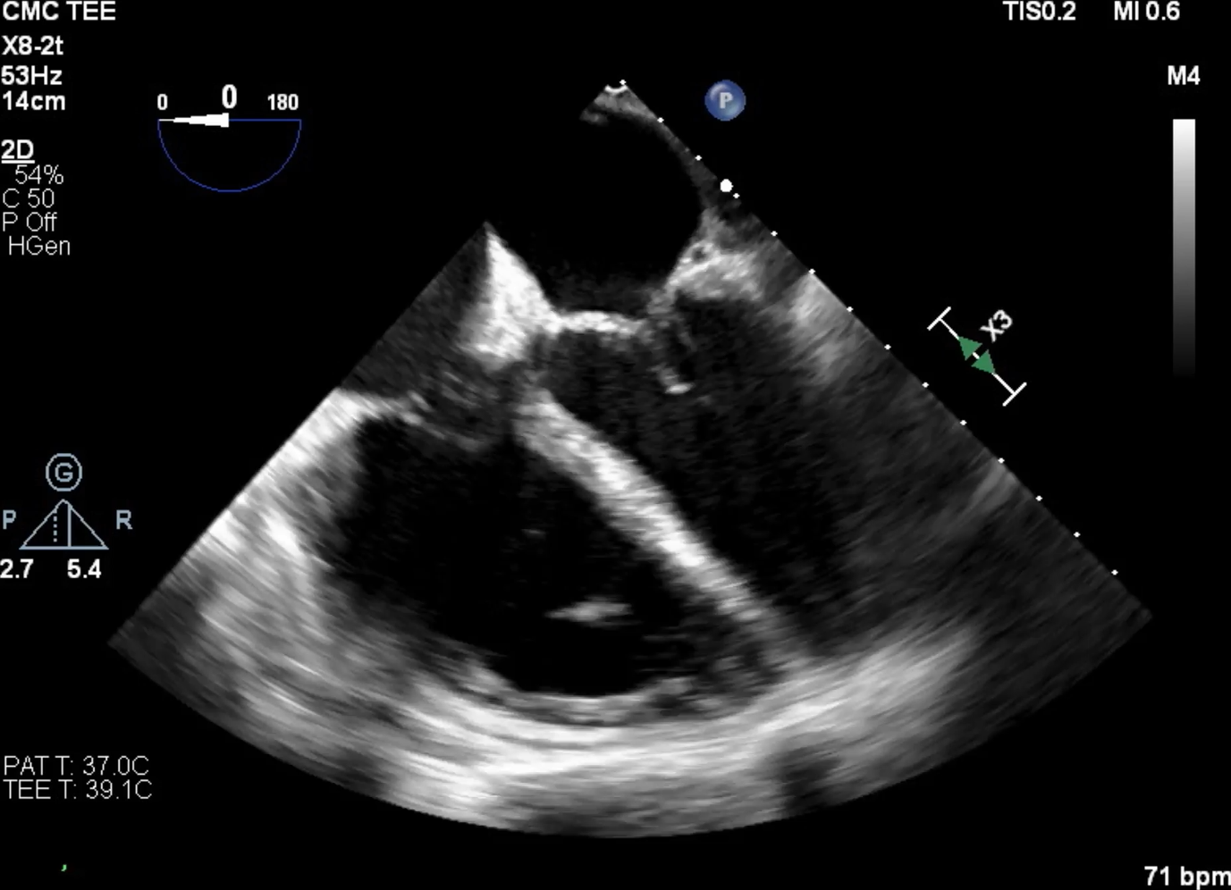

Slide 4
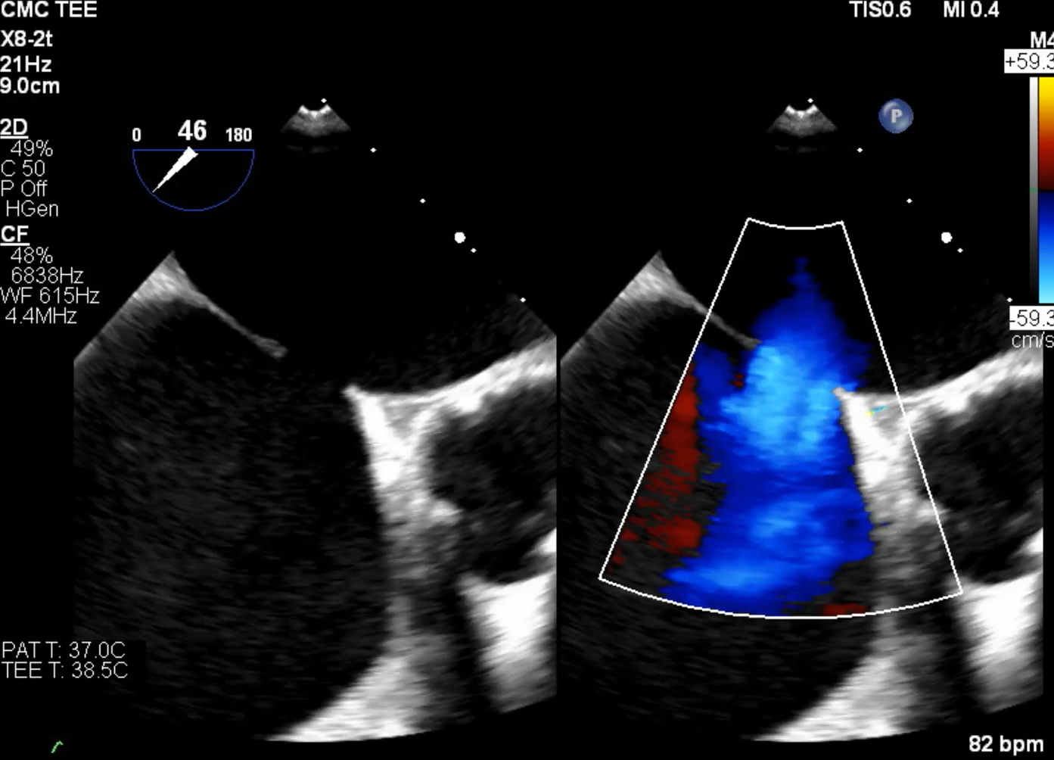

Slide 5
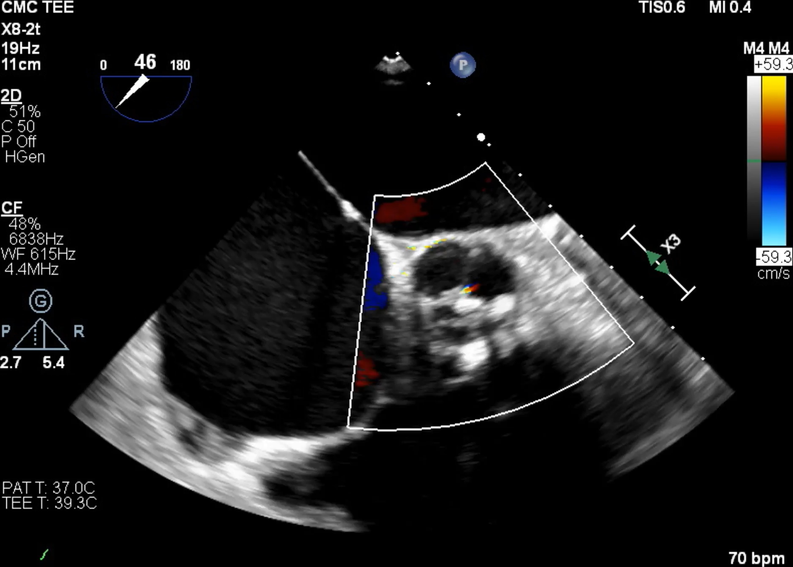

Slide 6
Next step in management if you are seeing this patient in structural heart clinic?

Slide 7
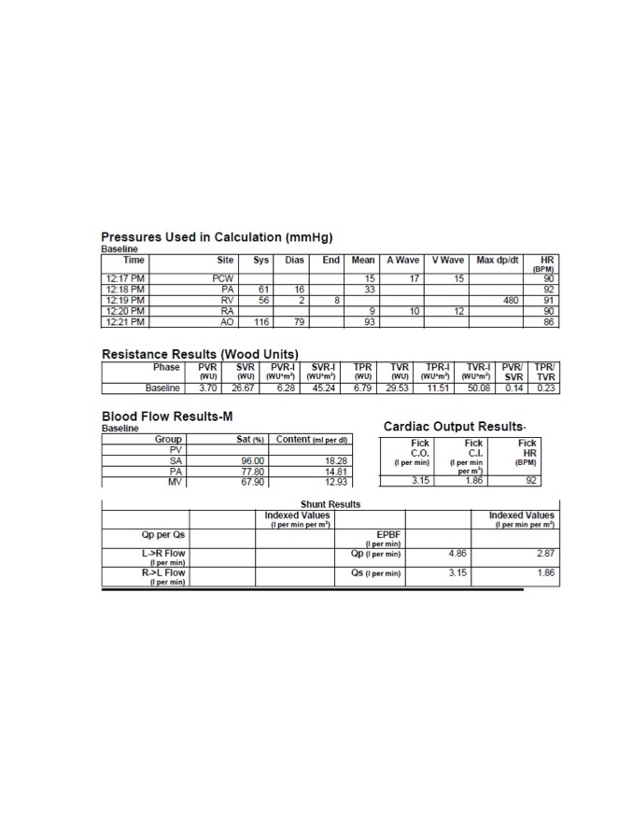
Rule Out Irreversible Pulmonary Hypertension:
PVR >2/3 SVR or Pulmonary artery pressure > 2/3 Systemic arterial pressure; PVR greater than 15 Woods units or 1200 dsc is absolute contraindication to ASD closure)
  QP/QS = 2.87/1.85 = 1.55

Slide 8
What would you do?
Option 1: Continue medical management
Option 2: Surgical AVR and ASD Repair
Option 3: Percutaneous ASD Closure
Option 4: TAVR
Option 5: Percutaneous ASD Closure and TAVR

Slide 9
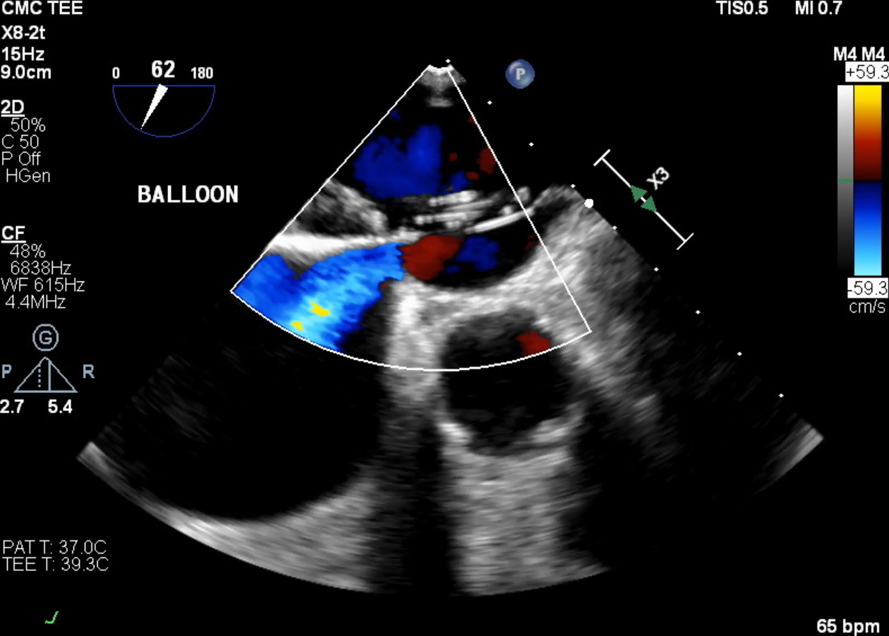
During balloon occlusion, measure PCWP to ensure it does not increase >20mmHg or by more than 10mmHg from baseline (Risk of development of pulmonary edema). In such cases, consider preconditioning with oral diuretics or afterload reduction
Torres et. al. J Thoracic Dis. 2018 Sept; 10: S2882-S2889

Slide 10
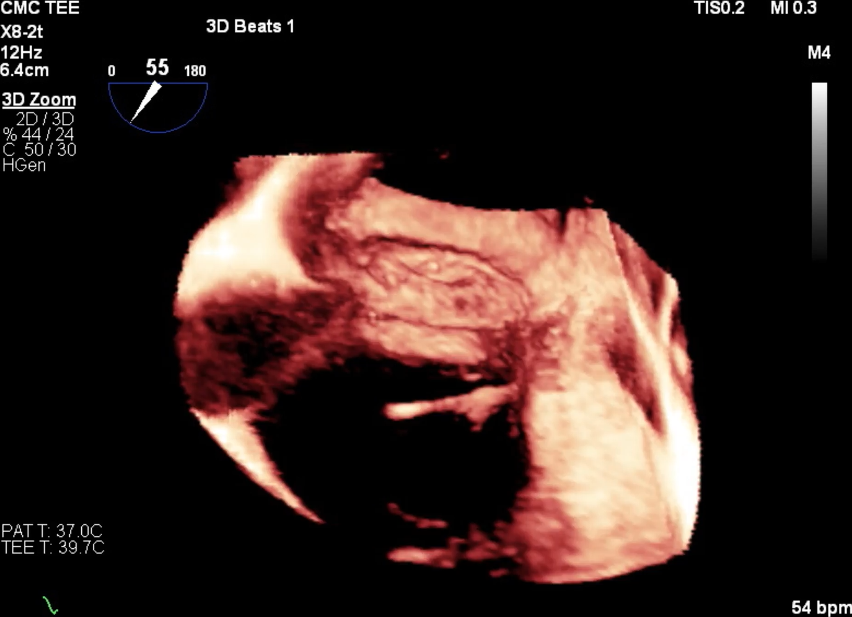

Slide 11
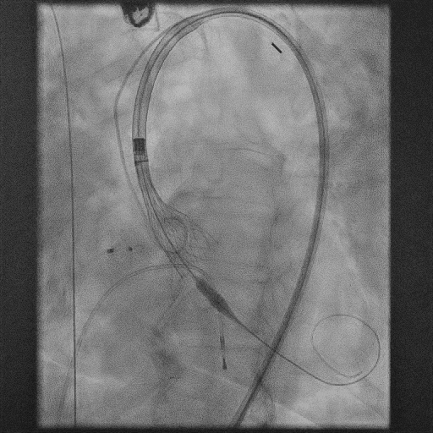

Slide 12
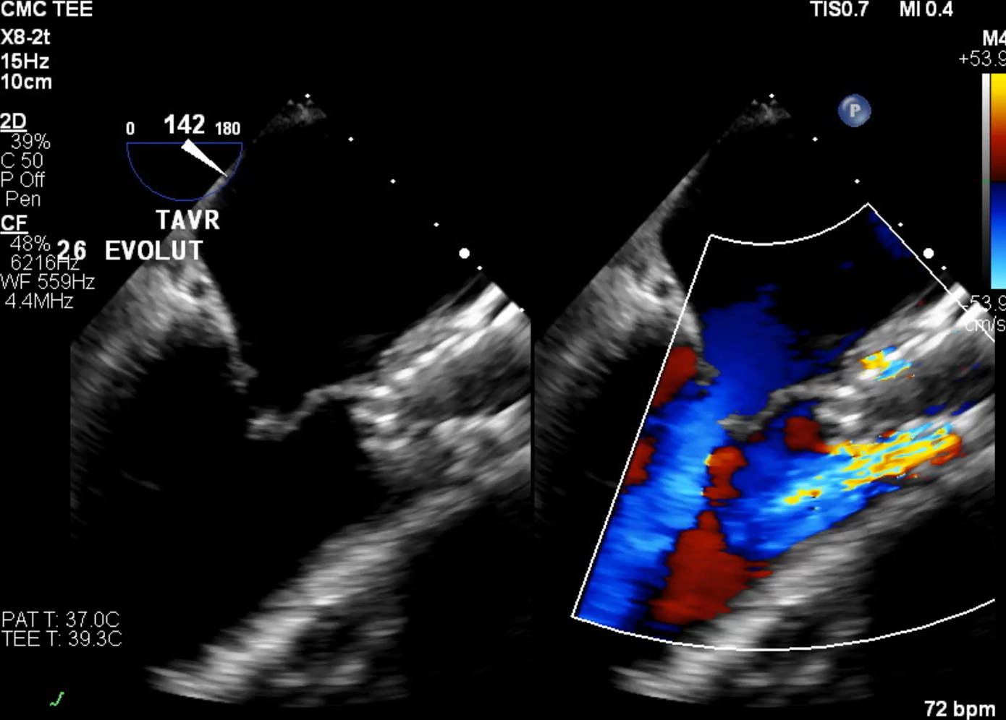

Slide 13
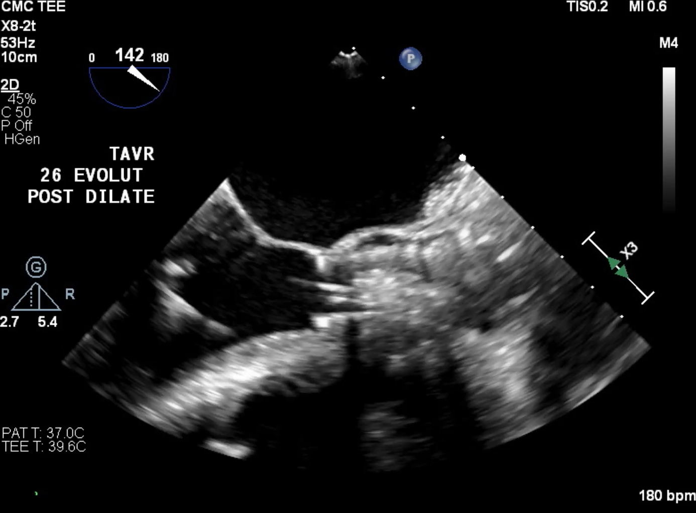

Slide 14
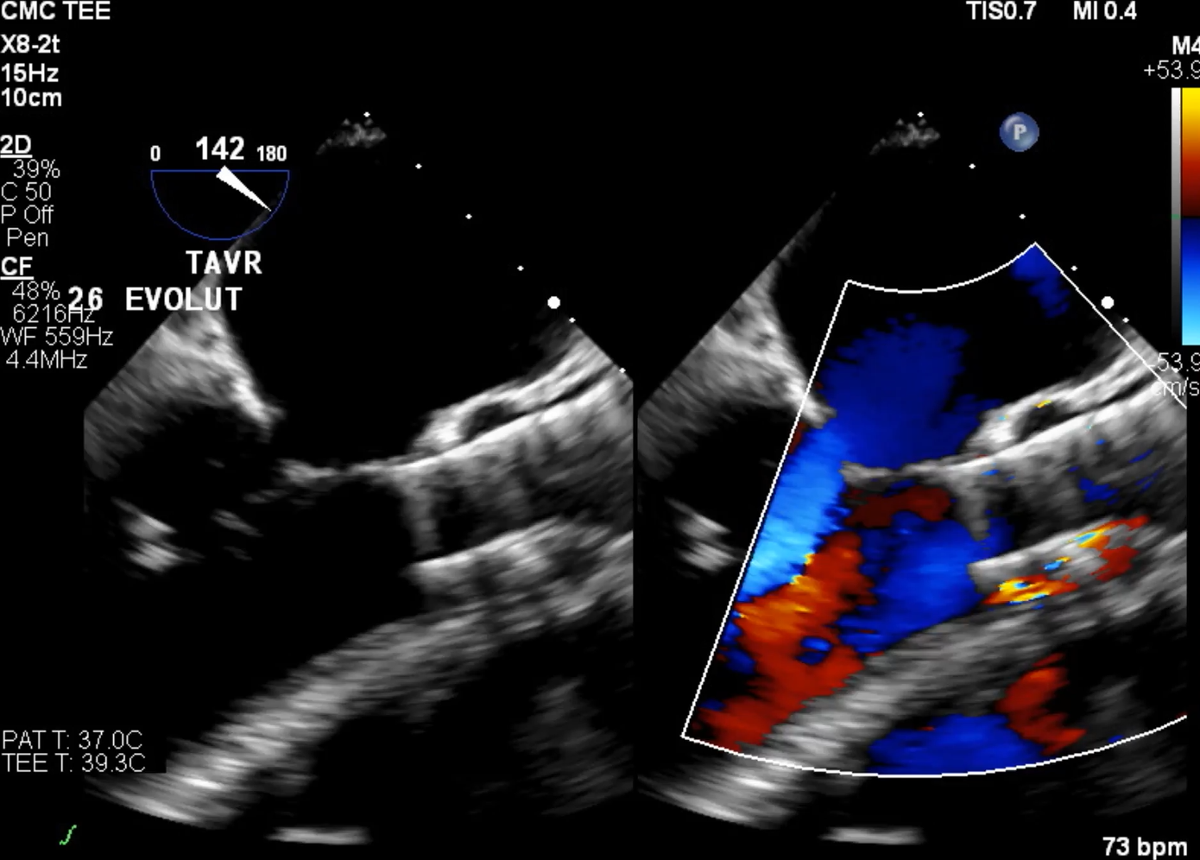

Slide 15
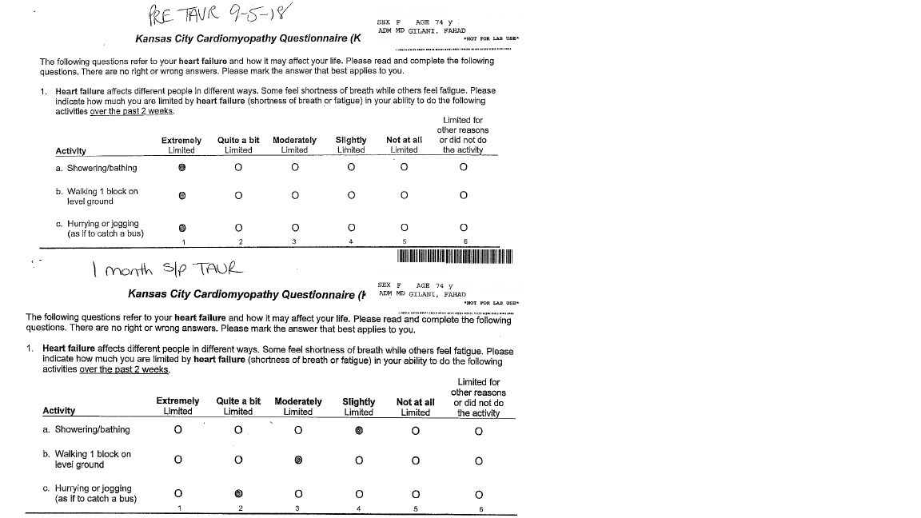
Followup TTE at 30 days: EF50-55%, Mild RV dilation, trivial AI

Slide 16
Take Home Points
Complete percutaneous approach to valvular and structural heart disease in one stage procedure
Complex case that requires systematic workup with invasive hemodynamics
Expansion of traditional valve clinic into a structural heart clinic model is integral in tackling these cases

