Slide 1
Real-world Experience with WATCHMAN FLX: Outcomes at One-year from SURPASS
Samir R Kapadia, Robert W Yeh, Matthew J Price, Jonathan P Piccini, Devi G Nair, Jonathan C Hsu, James V Freeman, Thomas Christen, Dominic J Allocco, and Douglas N Gibson

Slide 2
Samir Kapadia, MD
I have no relevant financial relationships
The SURPASS analysis was funded by the Boston Scientific Corporation. The views expressed here represent those of the authors, and do not necessarily represent the official views of the American College of Cardiology Foundation’s National Cardiovascular Data Registry (NCDR) or its associated professional societies identified at CVQuality.ACC.org/NCDR.

Slide 3
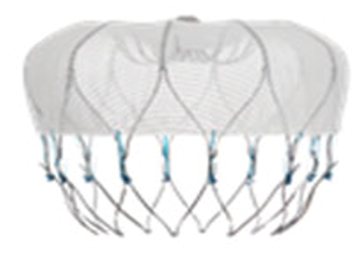
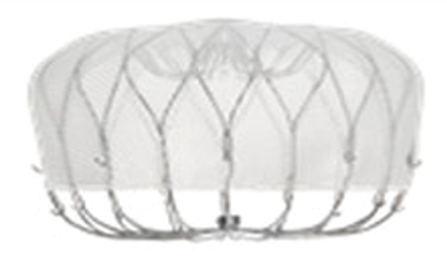
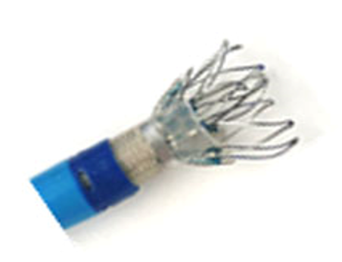
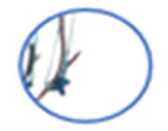
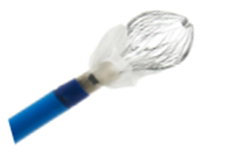
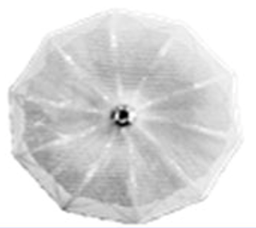
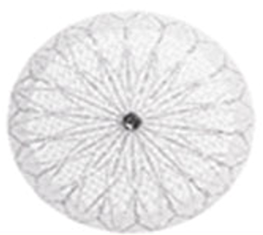
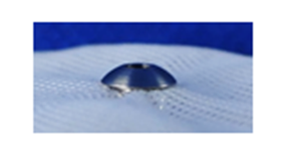
WATCHMAN & WATCHMAN FLX
WATCHMAN
First-generation percutaneous left atrial appendage closure device
WATCHMAN FLX
Next-generation percutaneous left atrial appendage closure device
Larger size range
Shorter device
Dual-row anchors
Distal tines folded back
Greater number of struts
Reduced metal exposure
Kar et al Circulation. 2021;143:1754–1762

Slide 4
Study Design
Objective | SURPASS was designed to assess outcomes with WATCHMAN FLX in a routine clinical setting
Study Population | Includes patients in the National Cardiovascular Data Registry (NCDR) LAAO Registry™ undergoing LAAO with WATCHMAN FLX between 05Aug2020 and 31Mar2022
Current Analysis | Outcomes through 1 year

Slide 5
Patient Flow & Enrolment Cadence
Patient Flow
Discharge*
N=66,894
N=4931 no follow-up or event
45-day Follow-up**
N=61,963
N=43,730 not yet in 1-year follow-up window or lost-to-follow-up
1-year Follow-up**
N=18,233
2020
2021
2022
*Enrolled between 5Aug20 to 31Mar22 at 743 sites
**Patients with follow-up or an event 31 days or 305 days after the procedure

Slide 6
SURPASS: Sites & Operators
2020
2021
2022
2020
2021
2022
*Procedures between 5Aug20 to 31Mar22

Slide 7
Patient & Procedure Characteristics
Patient Characteristics
Age | 76.2 ±7.9 y | CHA₂DS₂-VASc Score | 4.8±1.5
Women | 41% | HAS-BLED Score | 2.4±1.0
White | 94.3% | Prior stroke | 21.2%
Black/African American | 4.1% | Increased fall risk | 41.3%
Hispanic/Latino Ethnicity | 3.1% | Clinically relevant bleeding | 57.7%
Procedural Characteristics
Successful implantation | 97.6% | Concomitant procedure | 2.2%
Ave. # of devices | 1.2±0.5 | Length of stay | 1.9±1.5 days
One access system used | 97.4% | Same day discharge | 30.1%

Slide 8
Discharge Medication
 | Alone
DOAC | + ASA
 | + P2Y12 inhibitor
 | Alone
Warfarin | + ASA
 | + P2Y12 inhibitor
DAPT
SAPT
Triple Therapy
No OAC or APT
Other
Patients discharged on medication regimen

Slide 9
Key Safety Endpoint
Defined as the occurrence of all-cause death, ischemic stroke, systemic embolism, or device or procedure related events requiring open cardiac surgery or major endovascular intervention between device implantation and seven days or hospital discharge (whichever is later)
Event | SURPASS N=66,894
Key Safety Endpoint | 0.49% (328/66,894)
All-cause death | 0.18% (123/66,894)
Ischemic stroke | 0.13% (84/66,894)
Systemic embolism | 0.00% (3/66,894)
Device or procedure related events requiring intervention | 0.22% (150/66,894)
Binary rate; patients may have had more than one safety event.

Slide 10
Clinical Events through Discharge
N=66,894 | All Death | All Stroke | Systemic Embolism | Major Bleeding | Major Vascular Comp | Pericardial Effusion
Binary Event rate

Slide 11
Clinical Events through 45 days
N=66,894 | All Death | All Stroke | Systemic Embolism | Major Bleeding | Major Vascular Comp | Pericardial Effusion
Kaplan Meier event rate

Slide 12
1-year Outcomes
All Death | All Stroke | Systemic Embolism | Major Bleeding
Kaplan Meier event rate

Slide 13
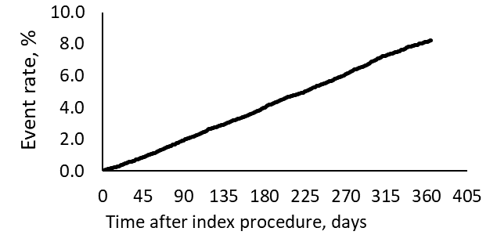
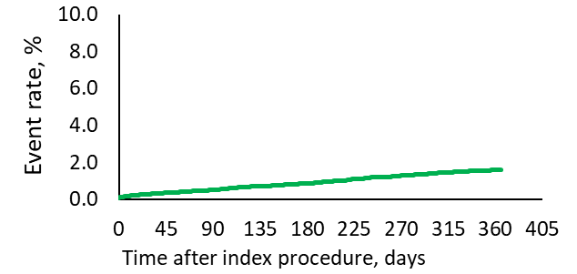
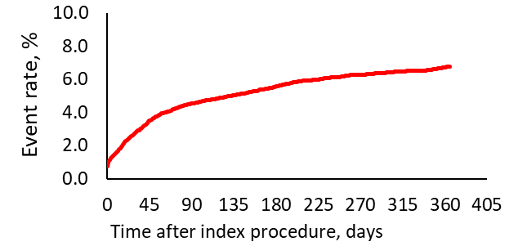
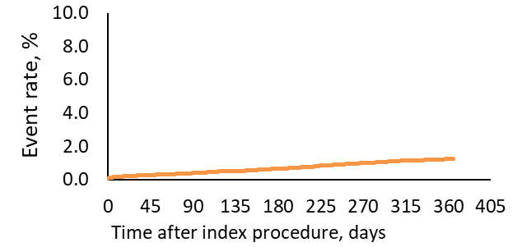
Events through 1 year
All-cause Death
All Stroke
8.3%
Stroke
1.6%
Major Bleeding
Ischemic Stroke
6.7%
1.2%
Kaplan Meier event rate

Slide 14
LAA Closure Assessment
 | Procedure (N = 66,894) | 45-days (N = 60,799) | 1-year (N = 16,285)
Complete seal (no leak) | 96.1% | 83.0% | 84.4%
Leak >0 to ≤3 mm | 3.2% | 12.9% | 12.1%
Leak >3 to ≤5 mm | 0.8% | 3.7% | 2.8%
Leak >5 mm | 0.03% | 0.4% | 0.7%
Missing data | 2535 | 11,729 | 13,563
Assessed in patients with TEE imaging at the timepoint specified.

Slide 15
45-day Outcomes by Sex
p=0.33
p=0.95
P=0.51
P<0.001
P=0.0009
P<0.001
N=66,894 | All Death | All Stroke | Systemic Embolism | Major Bleeding | Major Vascular Comp | Pericardial Effusion
 | Women: In-hospital |  | Men: In-hospital
 | Women: Discharge to 45 days |  | Men: Discharge to 45 days
Kaplan Meier event rate; Log-rank p-value

Slide 16
1-year Outcomes by Sex
p=0.003
p=0.94
P>0.99
P<0.001
All Death | All Stroke | Systemic Embolism | Major Bleeding
Kaplan Meier event rate; Log-rank p-value

Slide 17
Comparison to Prior Studies
 | WATCHMAN 2.5 Registries |  | WATCHMAN FLX Studies
 | EWOLUTION¹ (N=1025) | NCDR Registry^{2,3} (N=36,681) | PINNACLE FLX^{4,5} (N=400) | FLXiblity^{6,7} (N=300) | SURPASS (N=66,894)
Mean age, years | 73 ± 9 | 76 ± 8 | 74 ± 9 | 75 ± 8 | 76 ± 8
Female sex | 40.1% | 41.1% | 36% | 38% | 41%
CHA₂DS₂-Vasc score | 4.5 ± 1.6 | 4.8 ± 1.5 | 4.2 ± 1.5 | 4.3 ± 1.6 | 4.8 ± 1.5
Early Outcomes | 0-7 days | In-hospital | 0-7 days | 0-7 days | In-hospital
All death | 0.4% | 0.21% | 0.0% | 0.0% | 0.10%
All stroke | 0.0% | 0.09% (ischemic) | 0.5% (ischemic) | 0.0% | 0.09%
Major bleeding | 0.9% | 2.05% | -- | 3.7% | 1.04%
Pericardial effusion* | 0.3% | 1.23% | 0.0% | 1.0% | 0.38%
1-Year Outcomes
All death | 9.8% | 8.5% | 6.6% | 10.8% | 8.3%
All stroke | 1.1% | 2.1% | 2.6% | 2.0% | 1.6%
Major bleeding | 2.6% | 6.9% | 7.9% | 8.5% | 6.7%
Pericardial effusion* | Not reported | Not reported | 1.0% | 1.0% | 0.7%
1. Boersma et al Heart Rhythm. 2017; 14 (9): 1302-1308; 2. Price et al JACC:CI 2022 15 (21): 2115-2123;
3. Price et al JACC CI 2022 15(7): 741–750; 4. Kar et al Circulation. 2021; 143:1754–1762; 5. Doshi et al HRS 2020;
6. Betts et al EHRA 2022; 7. Betts et al accepted for publication *requiring intervention

Slide 18
Summary & Conclusions
This SURPASS registry showed that WATCHMAN FLX implantation can be accomplished safely with clinical outcomes similar to pivotal trials (at 30 days and 1 year) in a large number of patients (>60,000) at large number of sites (743) by large number of operators (2384).
These data provide benchmarks for success and complications
In-Hospital outcomes
Death 0.10%, stroke 0.09%, and pericardial effusion req intervention 0.38%
High rates of complete seal: 96% with leak<3mm, 84% with no leak
1-year outcomes
Stroke (1.6%) and ischemic stroke (1.2%), mortality (8.3%) and major bleeding (6.7%)
Although overall outcomes were similar in women and men; mortality was higher in men than women whereas women experienced more major bleeding and pericardial effusion requiring intervention within 1 year

Slide 19
Comparison to Prior Studies
 | WATCHMAN 2.5 Registries |  | WATCHMAN FLX Studies
 | EWOLUTION¹ (N=1025) | NCDR Registry² (N=36,681) | PINNACLE FLX³ (N=400) | FLXiblity⁴ (N=300) | SURPASS (N=66,894)
Mean age, years | 73 ± 9 | 76 ± 8 | 74 ± 9 | 75 ± 8 | 76 ± 8
Female sex | 40.1% | 41.1% | 36% | 38% | 41%
CHA₂DS₂-Vasc score | 4.5 ± 1.6 | 4.8 ± 1.5 | 4.2 ± 1.5 | 4.3 ± 1.6 | 4.8 ± 1.5
HAS-BLED score | 2.3 ± 1.2 | 3.0 ± 1.1 | 2.0 ± 1.0 | 2.6 ± 1.0 | 2.4 ± 1.0
1-Year Outcomes
All death | 9.8% | 8.5% | 6.6% | 10.8% | 8.3%
All stroke | 1.1% | 2.1% | 2.6% | 2.0% | 1.6%
Systemic embolism | Not reported | 0.7% | 0.3% | 0% | 0.1%
Major bleeding | 2.6% | 6.9% | 7.9% | 8.5% | 6.7%
Pericardial effusion* | Not reported | Not reported | 1.0% | 1.0% | 0.7%
Boersma et al Heart Rhythm. 2017; 14 (9): 1302-1308; 2. Price et al JACC Cardiovasc Interv; 2022 15(7):
741–750; 3. Kar et al Circulation. 2021; 143:1754–1762; 4. Betts et al EHRA 2022; *requiring intervention

