Slide 1
Association of Body Mass Index with Death, Mechanical Ventilation, and Cardiovascular Outcomes in COVID-19: Findings from the AHA COVID-19 CVD Registry
Embargoed for 9am CT 11-17-20
Nicholas S. Hendren MD^{1,2}, James A. de Lemos MD^{1,2}, Colby Ayers MS¹, Sandeep R. Das MD MPH^{1,2}, Anjali Rao MD^{1,2}, Anna Rosenblatt MD^{1,2}, Spencer Carter MD^{1,2}, Jason Walchok³, Wally Omar MD⁴, Rohan Khera MD MS⁵, Anita A. Hegde MD^{1,2}, Mark H. Drazner MD MSc¹, Ian J. Neeland MD⁶, Justin L. Grodin MD MPH^{1,2}.
¹ Department of Internal Medicine, University of Texas Southwestern Medical Center, Dallas, TX; ² Department of Internal Medicine, Parkland Memorial Hospital, Dallas, TX; ³ American Heart Association, Dallas, TX; ⁴ Department of Internal Medicine, Beth Israel Deaconess Medical Center, Boston, MA; ⁵ Department of Internal Medicine, Yale School of Medicine, New Haven, CT; ⁶ University Hospitals Harrington Heart and Vascular Institute and Case Western Reserve University, Cleveland, Ohio
@nickhendrenMD

Slide 2
Disclosures
James A. de Lemos has received fees for participating in Data Monitoring Committees from Eli Lilly and Novo Nordisk, and consulting income from Jannssen.
Ian J. Neeland has received honoraria, consulting, speaker’s bureau fees, and travel support from Boehringer-Ingelheim/Lilly Alliance (significant), a research grant from Novo Nordisk (significant), and has been a member of a scientific advisory board regarding obesity for AMRA Medical (modest) and Merck (modest).
Justin L. Grodin has received research funding from the Texas Health Resources Clinical Scholarship and consulting fees from Pfizer, Eidos, and Alnylam.
All remaining authors (NSH, CA, SRD, A. Rao, SC, AR, JW, WO, RK, AAH and MHD) report no relevant conflicts of interest or disclosures.

Slide 3
Introduction
Young adults are perceived to be at low risk for severe COVID-19
Obesity may increase the risk for morbidity and mortality in patients with COVID-19
The association of obesity with higher risk has been seen with other respiratory viruses, such as influenza

Slide 4
Hypothesis
We hypothesized that obesity would be associated with worse outcomes in COVID-19, particularly among younger individuals

Slide 5
Methods
Primary exposure - BMI stratified by World Health Organization (WHO) obesity class
Underweight | Normal Weight | Overweight | Class I Obesity | Class II Obesity | Class III Obesity
<18.5 kg/m² | 18.5-24.9 kg/m² | 25.0–29.9 kg/m² | 30.0–34.9 kg/m² | 35.0–39.9 kg/m² | ≥40.0 kg/m²
Cohort: All adults with available BMI data and completed field entries for age, sex, admission date, discharge date, discharge disposition, and a prior medical history (n = 7606) through July 22, 2020
Primary outcome: Composite of in-hospital death or mechanical ventilation, in-hospital death, and mechanical ventilation
Secondary outcomes:
Major adverse cardiovascular events (MACE, a composite of in-hospital all-cause death, stroke, heart failure, or myocardial infarction)
Composite of deep vein thrombosis (DVT) or pulmonary embolism (PE)
Renal replacement therapy (RRT, in-hospital initiation of hemodialysis or continuous renal replacement)

Slide 6
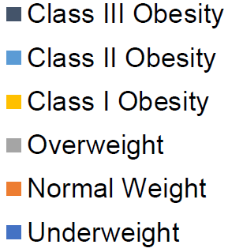
NHANES vs AHA COVID-19 BMI Distribution
NHANES
AHA COVID-19 CVD
NHANES
AHA COVID-19 CVD

Slide 7
NHANES vs AHA COVID-19 BMI Distribution
NHANES
AHA COVID-19 CVD
NHANES
AHA COVID-19 CVD

Slide 8
Baseline Characteristics by WHO Obesity Class
 | Underweight (n = 194) | Normal (n = 1793) | Overweight (n = 2308) | Class I Obesity (n = 1623) | Class II Obesity (n = 846) | Class III Obesity (n = 842)
Age, years | 77 (62-86) | 71 (59-82) | 63 (51-75) | 59 (47-71) | 56 (45-66) | 53 (41-63)
Male | 104 (54) | 1021 (57) | 1472 (64) | 865 (53) | 394 (47) | 351 (42)
Race/Ethnicity
White | 81 (42) | 655 (37) | 747 (32) | 477 (29) | 269 (32) | 260 (31)
Black | 43 (22) | 364 (20) | 453 (20) | 400 (25) | 263 (31) | 328 (40)
Hispanic | 34 (18) | 462 (26) | 772 (34) | 547 (34) | 243 (29) | 189 (23)
Asian | 22 (11) | 177 (10) | 152 (7) | 48 (3) | 11 (1) | 11 (1)
Baseline values are presented as median (25th-75th percentile) for continuous variables and number (%) for categorical variables. WHO BMI Classes: Underweight <18.5 kg/m²; Normal Weight 18.5-24.9 kg/m²; Overweight 25.0-29.9 kg/m²; Class I Obesity 30.0-34.9 kg/m²; Class II Obesity 35.0-39.9 kg/m²; Class III Obesity ≥40.0 kg/m²

Slide 9
Baseline Characteristics by WHO Obesity Class
 | Underweight (n = 194) | Normal (n = 1793) | Overweight (n = 2308) | Class I Obesity (n = 1623) | Class II Obesity (n = 846) | Class III Obesity (n = 842)
Comorbidities
Hypertension | 116 (60) | 1084 (61) | 1316 (57) | 961 (59) | 527 (62) | 521 (63)
Diabetes | 53 (27) | 609 (34) | 770 (33) | 656 (40) | 357 (42) | 354 (42)
Smoking | 18 (9) | 140 (8) | 153 (7) | 105 (7) | 45 (5) | 49 (6)
Prior CVD | 63 (33) | 459 (26) | 440 (19) | 285 (18) | 158 (19) | 160 (19)
Prior DVT | 9 (5) | 73 (4) | 58 (3) | 44 (3) | 23 (3) | 33 (4)
Prior PE | 3 (2) | 37 (2) | 38 (2) | 27 (2) | 13 (2) | 25 (3)
Dialysis | 11 (6) | 126 (7) | 88 (4) | 44 (3) | 18 (2) | 18 (2)
CKD | 25 (13) | 316 (18) | 281 (12) | 178 (11) | 94 (11) | 78 (9)
Baseline values are presented as number (%) for categorical variables. WHO BMI Classes: Underweight <18.5 kg/m²; Normal Weight 18.5-24.9 kg/m²; Overweight 25.0-29.9 kg/m²; Class I Obesity 30.0-34.9 kg/m²; Class II Obesity 35.0-39.9 kg/m²; Class III Obesity ≥40.0 kg/m²

Slide 10
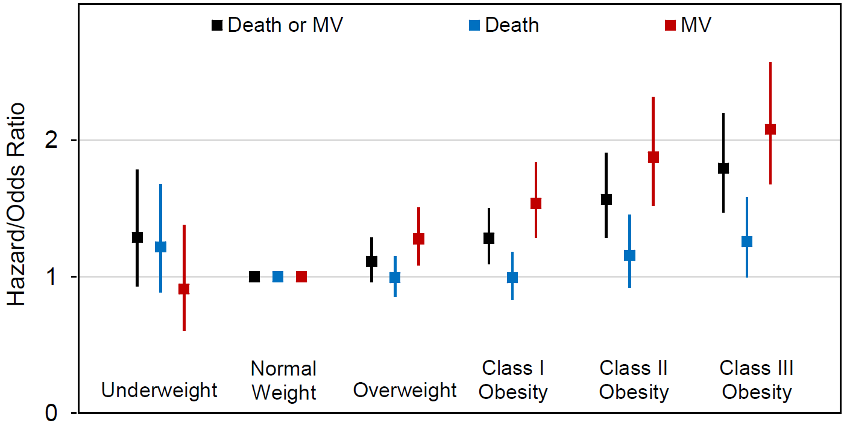
Adjusted Risk of Primary Outcome
MV = Mechanical Ventilation
Adjusted for age, sex, race, hypertension, diabetes, prior cardiovascular disease and chronic kidney disease.

Slide 11
Adjusted Risk of Primary Outcome
MV = Mechanical Ventilation
Adjusted for age, sex, race, hypertension, diabetes, prior cardiovascular disease and chronic kidney disease.

Slide 12
Adjusted Risk of Primary Outcome
MV = Mechanical Ventilation
Adjusted for age, sex, race, hypertension, diabetes, prior cardiovascular disease and chronic kidney disease.

Slide 13
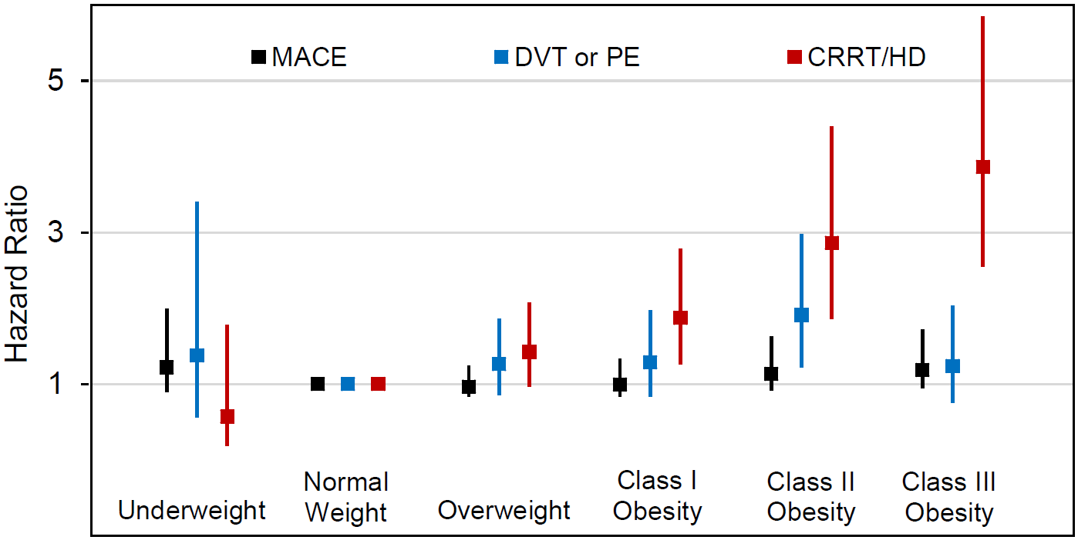
Adjusted Risk of Secondary Outcomes
Adjusted for age, sex, race, hypertension, diabetes, prior cardiovascular disease and chronic kidney disease.

Slide 14
Adjusted Risk of Secondary Outcomes
Adjusted for age, sex, race, hypertension, diabetes, prior cardiovascular disease and chronic kidney disease.

Slide 15
Adjusted Risk of Secondary Outcomes
Adjusted for age, sex, race, hypertension, diabetes, prior cardiovascular disease and chronic kidney disease.

Slide 16
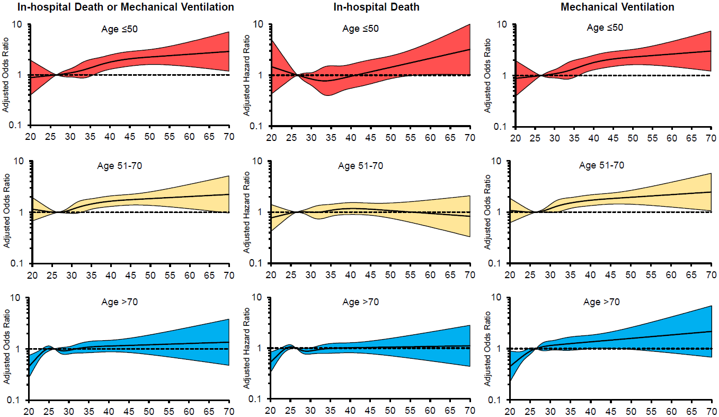
Primary Outcome BMI by Age Strata
Adjusted Hazard/Odds Ratio
BMI
BMI
BMI

Slide 17
Primary Outcome BMI by Age Strata
Adjusted Hazard/Odds Ratio
BMI
BMI
BMI

Slide 18
Primary Outcome BMI by Age Strata
Adjusted Hazard/Odds Ratio
BMI
BMI
BMI

Slide 19
Conclusions
After adjustment, BMI ≥30 kg/m² was associated with higher risk of mechanical ventilation regardless of age
BMI ≥40 kg/m² was associated with a higher risk of in-hospital death in those age ≤50
Clear public health messaging is needed for younger obese individuals who may underestimate their risk of severe COVID-19
Severely obese individuals (BMI ≥40 kg/m²) should be considered high risk for severe COVID-19 infection and may warrant prioritization for a COVID-19 vaccine

Slide 20
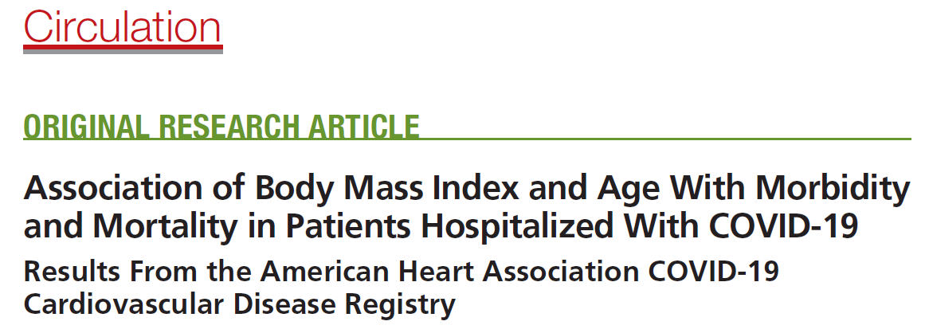
Thank You!
We are excited to announce a simultaneous publication at Circulation!
@nickhendrenMD
Cardiology Fellow

