Slide 1
Considerations on Effective Borrowing of External Data Using Propensity Scores
Zengri Wang, Ph.D.
Medtronic
CRT 2019, March 2-5, Washington DC
Notes:
1

Slide 2

Zengri Wang, PhD
Disclosure: Employee of Medtronic plc
Disclosure

Slide 3
Outline
Evidence & External Data
Effective Data Borrowing
Practical Considerations
Summary & Remarks

Slide 4
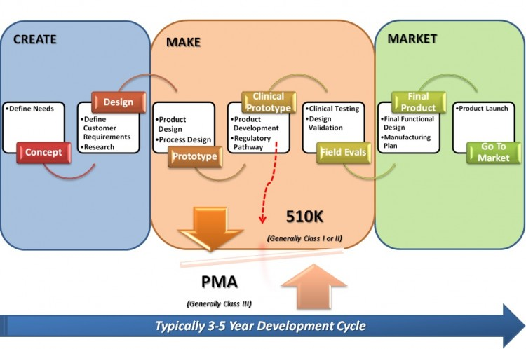
Medical Device Development Cycle
Notes:
Verbally comment on opportunity to move towards Total Product Life Cycle (TPLC) approach, to close the loop.

Slide 5
Evidence Level vs Study Type
Case, OBS
One-Arm
H-Control
RCT
Evidence Level Increasing
C-Control
New
Product
Resource Increasing
Often necessary to meet regulatory requirements
Type of Study

Slide 6
Data Sources in Real World
All DATA
Case Series, Survey
Historical Study
Old Generation
Health Care Record
Registry Data
Off-Label
RWD
Competitor Device

Slide 7
Evidence for Regulatory Requirements
Controlled (RCT)
RWD Analyses
Non-Controlled
Evidence Satisfying Regulatory Requirements

Slide 8
Use of External Data
Historical / External Data often available when designing a clinical study
Desirable to integrate all available data
  Improve inference & increase precision
  Save resource/time & make better decision
The right way to do it?
  Statistical validity & robustness
  How much data? To what degree?
  What happens if data conflicting?

Slide 9
Important questions to ask
How was the previous study designed?
Were the same devices utilized?
Were patient populations the same?
Difference in treatment procedures?
Has the standard of care evolved?
Evidence Robust across multiple sources?
Others (off-label use, sponsorship …)

Slide 10
Effective Comparison (Apple vs Apple)
COMPARISON
Treatment Outcome Â |  | Treatment Outcome Ã
Observed Confounders |  | Observed Confounders
Unobserved Confounders |  | Unobserved Confounders
Adjustment
Needed

Slide 11
Statistical Methods for Data Integration
Pooling upon statistical testing
  Often questionable due to lack of design / power
Models with covariate adjustments
  May not be stable on large number of covariates
Random effects modeling
  Taking into account between-study variations
Bayesian approaches
  Power & commensurate priors; hierarchical models
  Adaptive & dynamic data “borrowing”

Slide 12
Propensity Score Approach
Compile all the information into single score
  Caution needed on score construction
Propensity score is the conditional probability that a subject belongs to the treatment group given all observed covariates (X)
  e(X) = Pr (Z = 1 | X), 0 < e(X) < 1, X: set of covariates
  Group selection is strong ignorable conditional on e(X)
Substantial biases can be eliminated using PS
  Rosenbaum & Rubin (1983)
  Matching, stratification, IPW, regression

Slide 13
Innovative Bayesian Methods
Similar
Prior/External Data
Data from Current Study
Integrated Analysis
Exchangeable, Bias Adjustment
Full, Partial, Adaptive
Borrowing
Info Gained, Evidence Enhanced

Slide 14
Raise the Bar with D.E.A. Model
Analyze
Report
Data
Design
Execution
Evidence

Slide 15
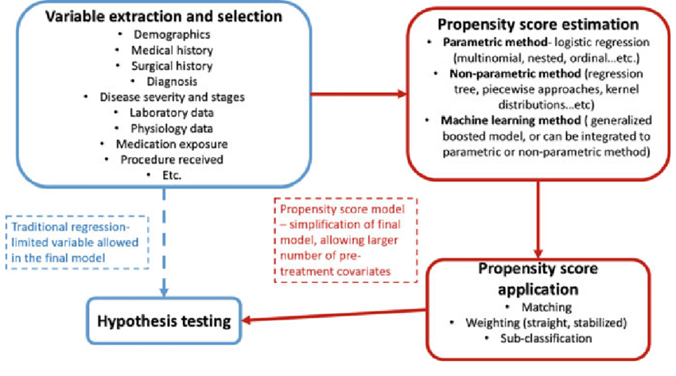
PSA Procedure Details

Slide 16


Hypothetical Example with Real-World Data
A medical device seeking label expansion to new patient population:
Device (A) in cohort study compared to control device (B) from registry data
Two-stage design - propensity score analysis will be reviewed with FDA prior to analyzing the outcomes and submitting PMA-S
 | Communicated to FDA in March Pre-Sub | Available in June | Available in December | Power
Device A Cohort | ≥ 200 | 186 | 218 | >90%
Control Device Cohort | ≥ 250 | 210 | 265
Device A Cohort form Global Study
(≥ 200 subjects)
Control Comparator from Registry
(≥ 250 subjects)
vs.
Stage 1 – Propensity score analysis
Stage 2 – Clinical endpoint analysis
FDA
review/input/approval
* Yue, L. et al., 2014 Journal of Biopharm Stat 24: 994-1010;
Yue, L. 2015 FDA-AdvaMed/MTLI Statistics Workshop

Slide 17
Propensity Score Design
Propensity score was calculated from each patient using logistic regression with treatment group as the outcome and 20 clinically relevant baseline characteristics as the independent variables.
Patients were then categorized into quintiles based on these propensity scores. Within each quintile, there were at least 5 patients from each treatment group, and overall there is adequate overlap between treatments across the quintiles. Further, for all 20 baseline characteristics, the propensity-adjusted comparison between treatment groups yielded a p-value > 0.50, supporting the adequacy of the propensity stratification.
Sufficient overlap was achieved between treatments with respect to the distribution of propensity scores.
The propensity scores and resulting quintiles created from these scores are adequate as a stratification factor to be used in the future analysis.

Slide 18
Propensity Score Analysis
Covariate | Device A (n=200) | Control (n=250) | Unadjusted P-value | PS Adjusted P-value
Age (yr) | 67.0 (9.8) | 67.2 (11.2) | 0.840 | 0.878
Gender (Male) | 120 (60%) | 82 (33%) | <0.001 | 0.712
BMI (kg/m²) | 26.5 (4.6) | 27.4 (6.5) | <0.001 | 0.735
Region (US) | 110 (55%) | 150 (60%) | 0.332 | 0.886
Index Score | 0.66 (0.25) | 0.70 (0.32) | 0.137 | 0.832
Hypertension (%) | 138 (69% | 185 (74%) | 0.287 | 0.976
Diabetic (%) | 62 (31%) | 83 (33%) | 0.693 | 0.932
Insulin-Dependent Diabetic (%) | 30 (15%) | 58 (23%) | 0.039 | 0.798
Dialysis (%) | 10 (5%) | 18 (7%) | 0.445 | 0.662
CAD (%) | 40 (20% | 70 (28%) | 0.064 | 0.941
Smoker (%) | 66 (33%) | 88 (35%) | 0.697 | 0.912
Previous Amputation (%) | 12 (6%) | 18 (7%) | 0.751 | 0.879
Renal Insufficiency (%) | 16 (8%) | 25 (10%) | 0.570 | 0.985
Lesion Length | 20.0 (12.0) | 18.0 (11.2) | 0.070 | 0.977
Total Occlusion (%) | 76 (38%) | 128 (51%) | 0.007 | 0.955
Occluded Lesion Length | 8.5 (12.2) | 9.3 (11.6) | 0.480 | 0.920
Pre-Op Aspirin (%) | 166 (83%) | 188 (75%) | 0.059 | 0.589
Claudication (%) | 152 (76%) | 213 (85%) | 0.018 | 0.711
SFA (%) | 122 (61%) | 193 (77%) | <0.001 | 0.673
Provisional Stent (%) | 32 (16%) | 83 (33%) | <0.001 | 0.781
Overall, very good overlap between the two treatments with respect to the distribution of propensity scores, supporting the adequacy of the propensity stratification
The propensity scores and resulting quintiles created from these scores are adequate as a stratification factor to be used in the future analysis on clinical outcomes evaluation

Slide 19
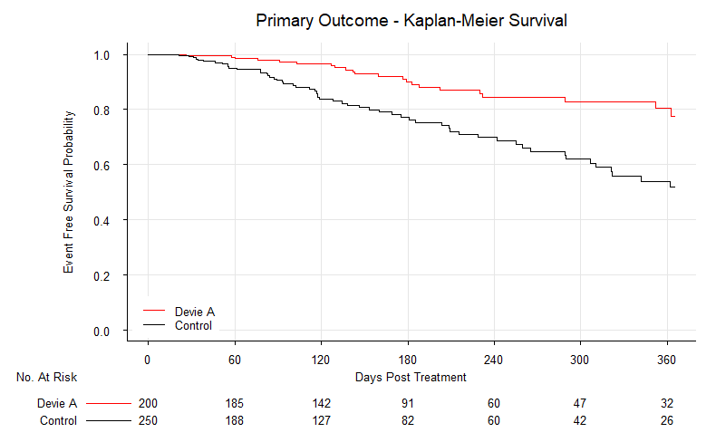
Primary Results
P < 0.0001
PS-Adjusted HR=0.35 (0.22, 0.55)

Slide 20
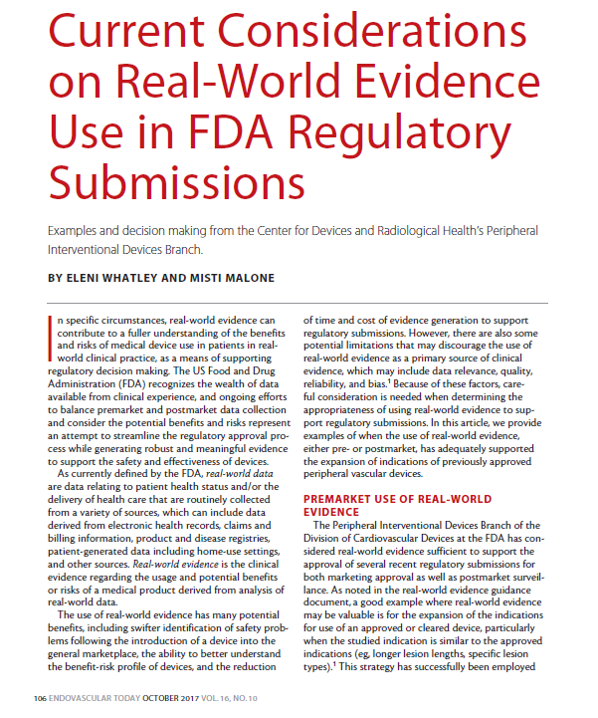
Publication for Regulatory Submission

Slide 21
Brief Summary
Rich external data sources create opportunities to support clinical studies
  Save cost and time, enhance existing evidence
  Meet regulatory requirements (if doing right)
Statistical innovative methods help generate high level of evidence upon appropriate design & execution
  Importance of valid statistical design
  Bayesian with propensity score analysis
  Valid tools include power priors, hierarchical models, matching, stratification, dynamic borrowing
Well accepted & successfully implemented in many medical device regulatory submissions

Slide 22
Final Remarks
Pre-planning is always important (data, design…)
Rigor statistical justifications are required
  DEA Model = Design + Execution + Analysis
  High quality Statistical Analysis Plan
Infrastructure, logistics & operations are critical
  Resources (e.g., Bayesian Expertise), quality system
Use of “firewalls” to help execution, increase credibility and minimize potential biases
Precise execution & robust quality system for information dissemination & decision making

Slide 23
Thank You!

