Slide 1
US EFS: Lessons Learned from a Start-Up Company
Katherine Kumar, PhD, RAC
EVP, 4C Medical Technologies, Inc.

Slide 2
Disclosures:
Employee and/or Stockholder: 4C Medical Technologies, Inc.
TAS Medical, Inc.
Board Member:
Inspired Life Medical, Inc.

Slide 3
Innovation in Medical Technology
Originated with start-up companies
Once small company is de-risked, it will be acquired by a large, strategic company
De-risked = Human experience with methodically collected clinical data

Slide 4
What’s the Difference? Small Start-Up vs. Large Strategic
Private
One product
One goal
If product fails = company fails
Public
Numerous products
Changing priorities/projects
If product fails = company moves forward

Slide 5
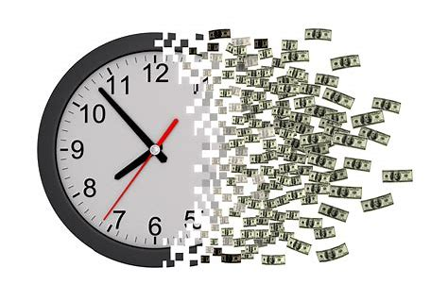
Another Difference: Funding
Large strategic self-funds new projects as they drive revenue from existing products
Start-up company is fully dependent on investors and constantly in fundraising mode
No real time progress = detrimental to the business
Two Greatest Resource Depletions:
Waiting for any feedback without real-time progress
Clinical trial initiation and execution - the predominant cost to any company, big or small
EFS made significant impact and allowed introduction of very needed products to our patients so much sooner.

Slide 6
EFS: Moved Feasibility Clinical Work to US
Before EFS: OUS
Now with EFS: US
Pros:
Shorter regulatory timeline
Lower cost
Cons:
Specific patient population
Country-specific clinical practice
Pros:
Shorter regulatory timeline
Lower cost
Diverse patient population
Cons:
Specific patient population
Country-specific clinical practice

Slide 7
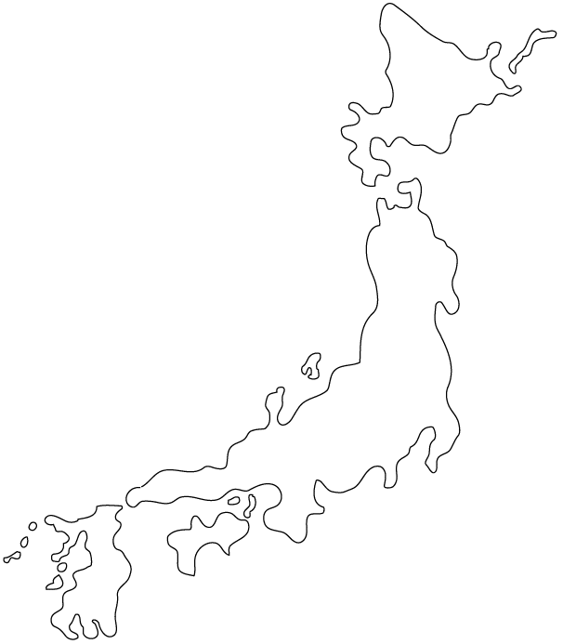
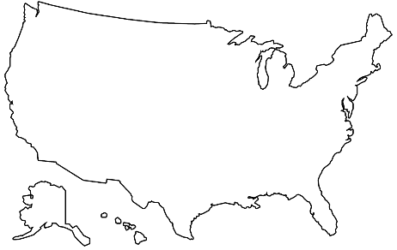
The Global Adoption of EFS
Thanks!
Andrew Farb & FDA Team
Thanks!
Harmonization by Doing (HBD)
United States - FDA
Japan - PMDA
World-Wide Impact
The Early Feasibility Study was pioneered in the US
and adopted by the second largest medical device market, Japan.

Slide 8
Engage the FDA Early
EFS = 1st Clinical Study has many unknowns
Optimization through early engagement is key

Slide 9
Proactively Communicate
We are fortunate that the FDA utilizes informal communication via email, phone that may not be possible in other countries
If FDA is part of decision making process, then they may be more versed to help you solve your challenge

Slide 10
Be Candid
EFS = novel technology
Asking questions in the “right” way may be nearly impossible
Answer the FDA’s questions fully and candidly
If FDA does not know the complete situation, they may not be able to suggest an optimal solution

Slide 11
Walk a Fine Line
When to start EFS?
There is only so much you can learn from animal studies
There are always animal model limitations
Work collaboratively with FDA and determine the right time to move from animal studies to EFS initiation

Slide 12
Significant Impact in EFS Development
You Are Not Alone
Examples may include but not limited to:
Development of varied templates like ICF, CTA, etc.
Engaging sites in US to get commitment to 60/60/60 timeline or better
CTA/IRB/1st enrollment
Since a Start-Up does not have a large company’s infrastructure, MDIC efforts are making a significant positive impact especially for start-ups

Slide 13
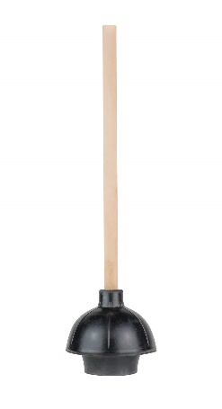
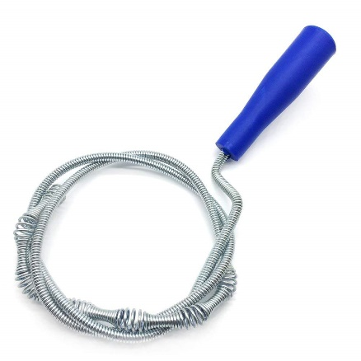
Future Enhancement of EFS: Customize the approach per product?
The FDA has to be consistent, applying the same bench and pre-clinical requirements for a group of products with the same indication for use.
Within that group of products, there are outliers that are unique: different function/mechanism. Their proof of performance should require different bench and pre-clinical requirements.
plunger vs drain auger

Slide 14
Future Advancement Beyond EFS: Can we work on streamlining the pivotal trial next?
EFS
Pivotal
Post-market registry
Real word
Current
We must ALL share the added RISK
Very selected patient population
EFS
Pivotal
Post-market registry
Real word
Future
Broad patient population

Slide 15
As Innovators and Researchers…
The FDA is your partner, so:
Engage Early, Proactively Communicate, Be Candid
Walk a Fine Line - recognize animal model limitations
You Are Not Alone - reach out to MDIC
We are all in this together, and in moving forward enhancement of EFS or advancement beyond EFS will benefit our patients. Let’s make it happen.
THANK YOU

