Slide 1
DICTATE-AHF
Efficacy and Safety of Dapagliflozin in Acute Heart Failure NCT04298229
Zachary Cox, PharmD
Professor, Lipscomb University College of Pharmacy, USA
Department of Pharmacy, Vanderbilt University Medical Center On behalf of DICTATE-AHF Investigators
August 28, 2023

Slide 2
Declaration of interest
Research contracts : AstraZeneca
Consulting/Royalties/Owner/ Stockholder of a healthcare company : ROCHE and Translational Catalyst
• •
ESC Congress 2023
Amsterdam & Online

Slide 3
Background
Two Goals for Acute Heart Failure
2) GDMT
Optimization
Improve
Post-DC Outcomes
1) Decongestion
Loop + Acetazolamide |  |  | No Improvement
Loop + Thiazide |  |  | No Improvement
Loop + SGLT2i |  |  | Improved Outcomes

Slide 4
Background
Concerns of very early in-hospital SGLT2 inhibitor SAFETY:
Hypoglycemia
Ketoacidosis
Worsening renal function
Genitourinary infections
Questionable magnitude of diuretic and natriuretic benefit
Early addition of Dapagliflozin is a potential strategy to improve achievement of both primary AHF therapeutic goals, but efficacy and safety are unknown

Slide 5
DICTATE-AHF Design
Investigator-initiated, multicenter, prospective, randomized, open-label study funded by AstraZeneca
Objective efficacy outcomes and blinded assessment of safety outcomes
240 Patients regardless of LVEF hospitalized with hypervolemic AHF were randomized
Beginning April 2020, only patients with Type 2 diabetes mellitus were included
September 2021 - protocol amended to include:
With or without type 2 diabetes mellitus
eGFR ≥ 25 mL/min/1.73m²

Slide 6
Key Inclusion Criteria
Age of 18 years or older
Randomized within 24 hours of presentation hypervolemic AHF:
≥2 objective measures of hypervolemia
Planned or current use of IV loop diuretic therapy
eGFR ≥ 25 mL/min/1.73m²

Slide 7
Key Exclusion Criteria
Type 1 diabetes
Serum glucose < 80mg/dL
Systolic blood pressure < 90mmHg
IV inotropic therapy
History of diabetic ketoacidosis
Inability to perform standing weights or measure urine output accurately

Slide 8
DICTATE-AHF
Dapagliflozin 10mg Daily + structured usual care with protocolized diuretic titration (N=120)
Screening Randomization Baseline Assessments
IV loops titrated via protocol in both treatment arms to Goal 3-5L UOP/day
Structured usual care with protocolized diuretic titration (N=120)
< 24 hours
24H urine collection
Hospital Admission
Study Day 1
Study Day 2
Study Day 5
(Or D/C if sooner)
30-Day Follow-up

Slide 9
Study Outcomes
Primary Outcome
_{Diuretic Efficiency =} Cumulative weight change (kg)
Cumulative loop diuretic dose (mg)
Calculated until Day-5 or hospital discharge if sooner
Expressed as kg/40mg IV Furosemide equivalents
Compared across treatment assignment using a proportional odds regression model adjusting for baseline weight

Slide 10
Study Outcomes
Secondary Outcomes adjudicated by blinded committee
Incidence of worsening HF during hospital stay
HF-related or diabetes-related 30-day readmissions
Safety Outcomes adjudicated by blinded committee
Incidence of diabetic ketoacidosis
Prolonged hospitalization for hypotension
Prolonged hospitalization for hypoglycemia
Change in eGFR from baseline to end-of-study
Select Exploratory Outcomes
Measures of natriuresis and diuresis
Hospital length of stay

Slide 11
Baseline Characteristics
Characteristic | Total Population (N=238) | Usual Care (N=119) | Dapagliflozin (N=119)
Age (yrs) | 65 (56 – 73) | 64 (55 – 74) | 65 (56 – 73)
Male Sex | 61% | 56% | 66%
White Race | 68% | 71% | 66%
T2DM | 71% | 71% | 71%
LVEF ≤ 40% | 52% | 55% | 48%
SBP (mmHg) | 121 (110 – 136) | 120 (110 – 136) | 121 (112 – 136)
eGFR (mL/min/1.73m²) | 53 (42 – 70) | 54 (40 – 71) | 51 (43 – 68)
IV furosemide dose prior to randomization (mg) | 80 (40 – 140) | 80 (80 – 120) | 80 (40 - 160)

Slide 12
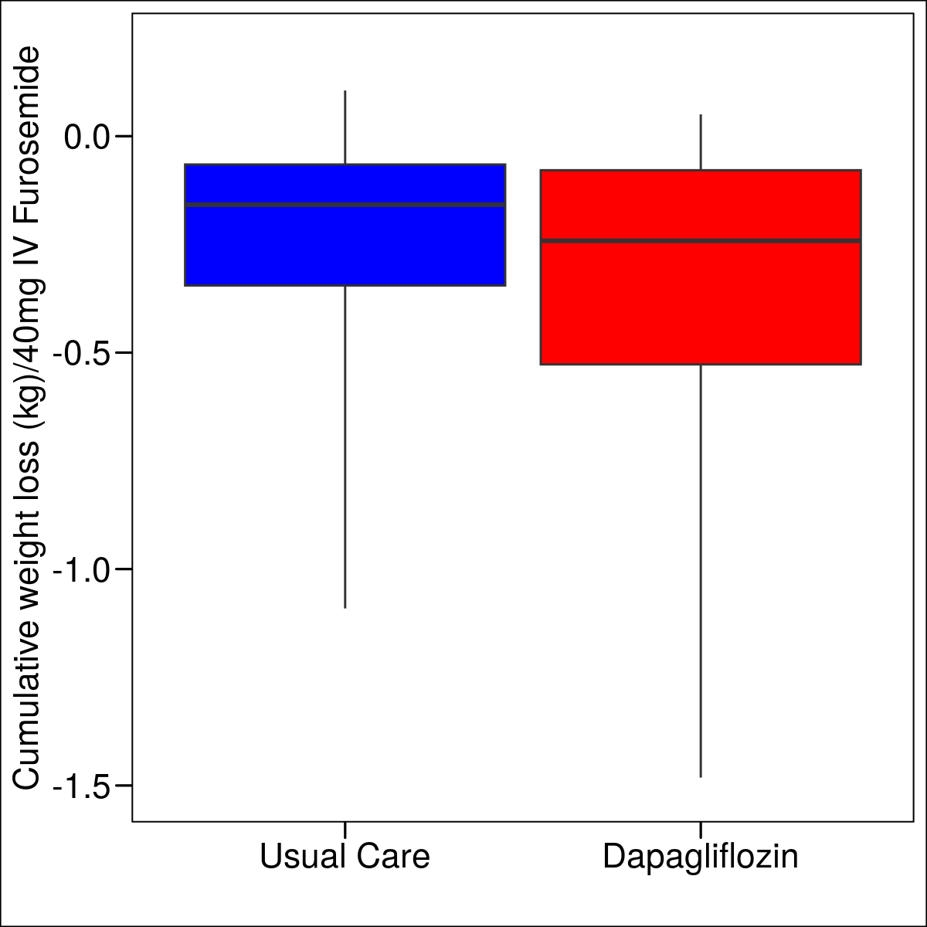
Primary Outcome
Adjusted Odds Ratio 0.65
(95% CI 0.41 – 1.01); P=0.06
Unadjusted Odds Ratio 0.64
(95% CI 0.41 – 1.00)

Slide 13
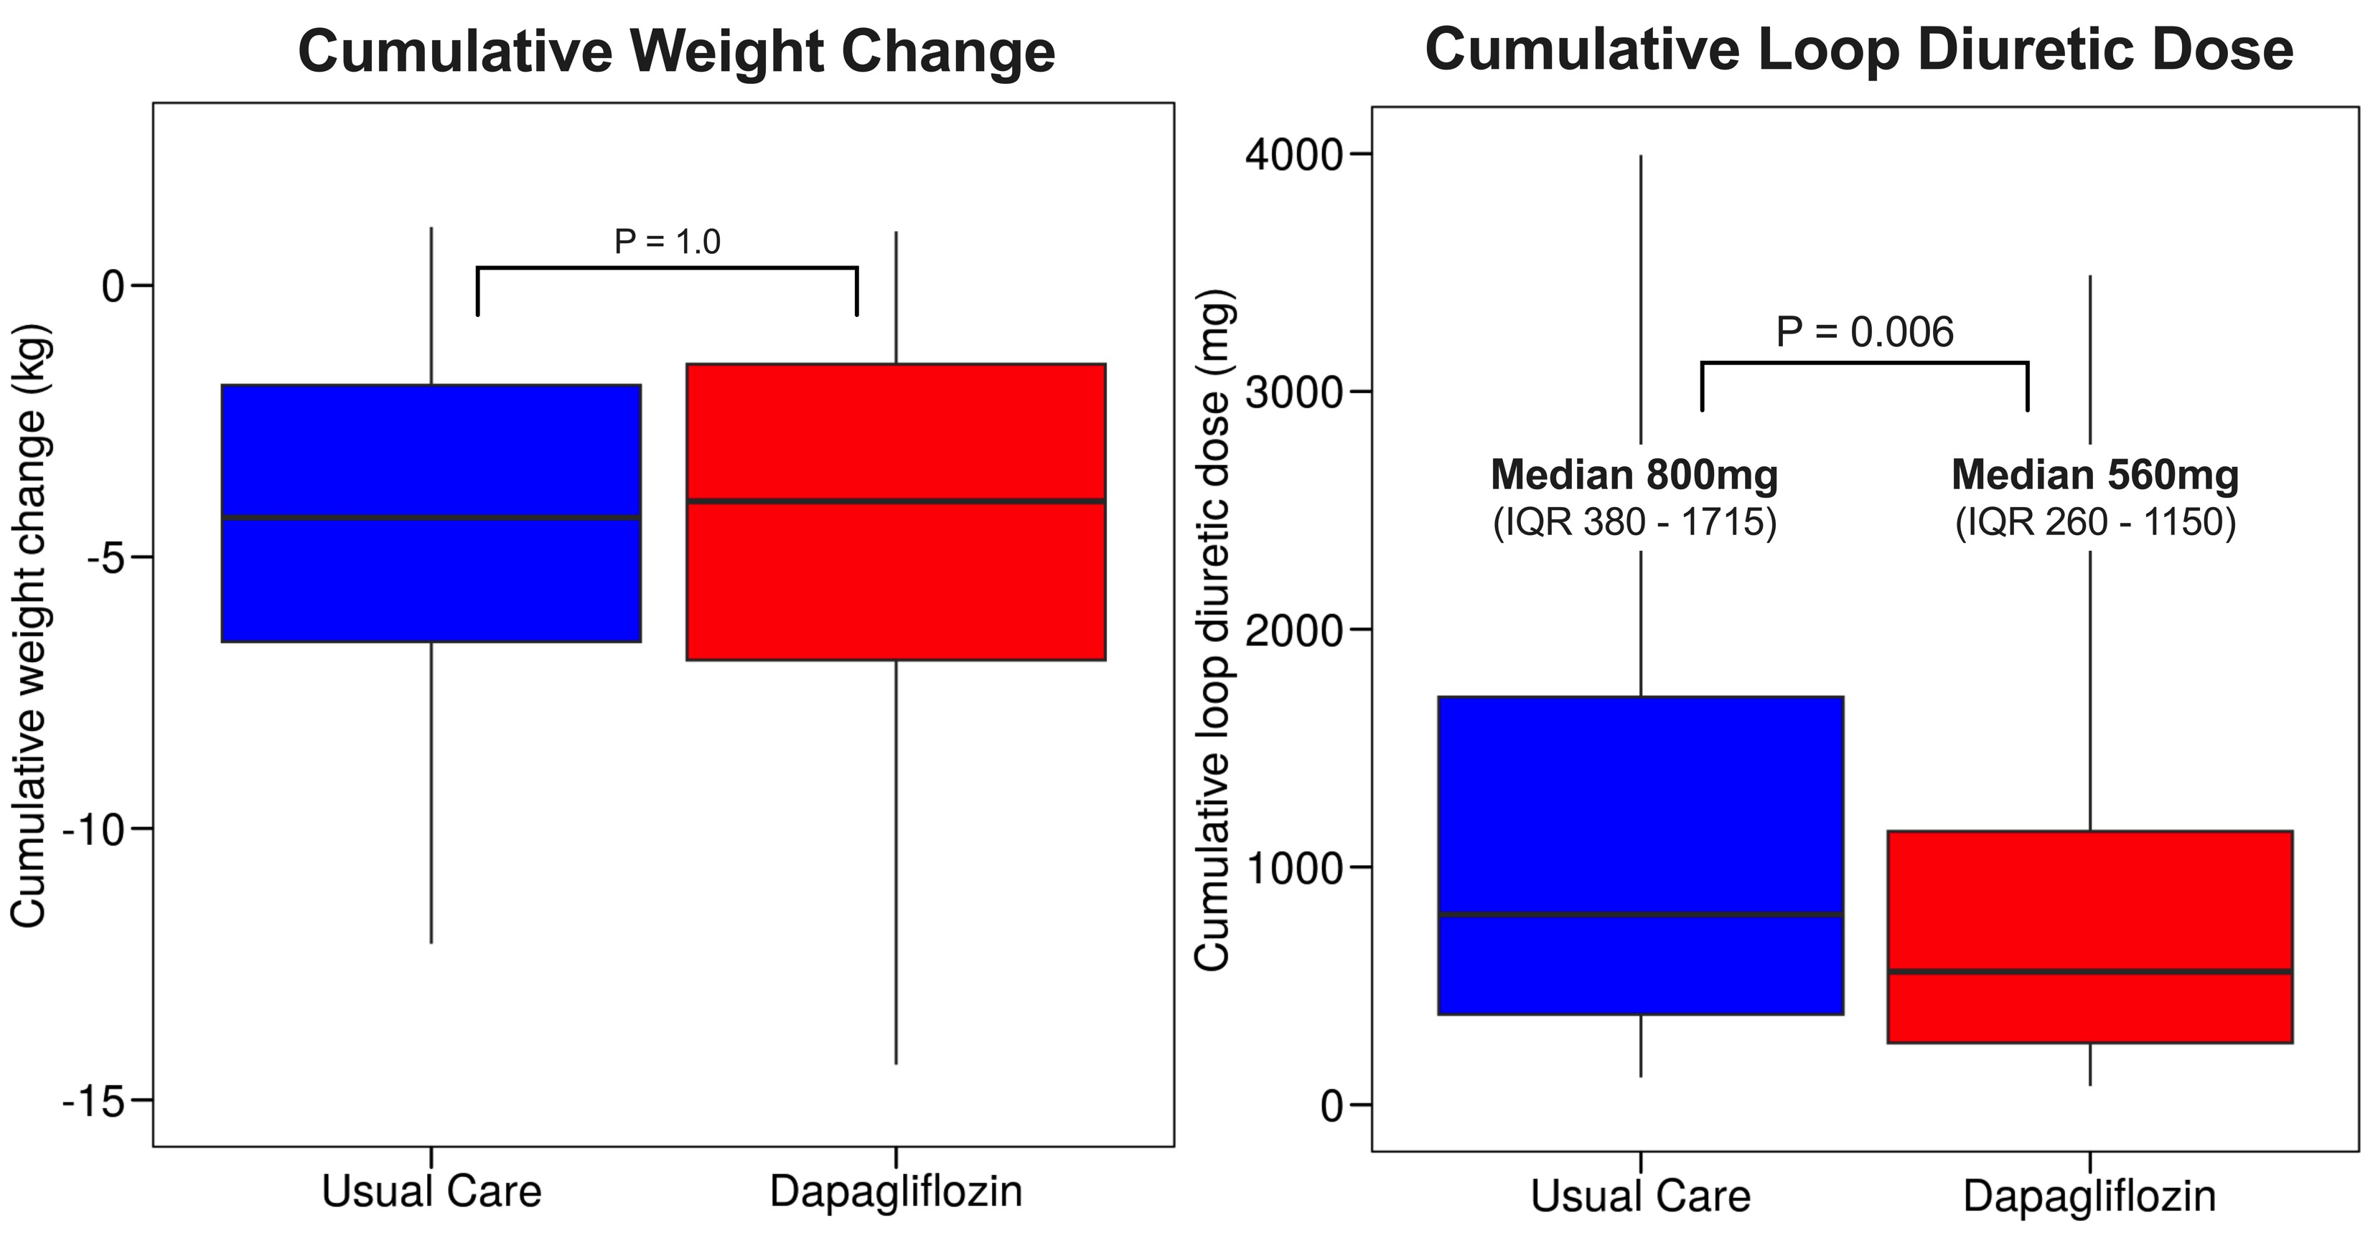
Primary Outcome Components

Slide 14
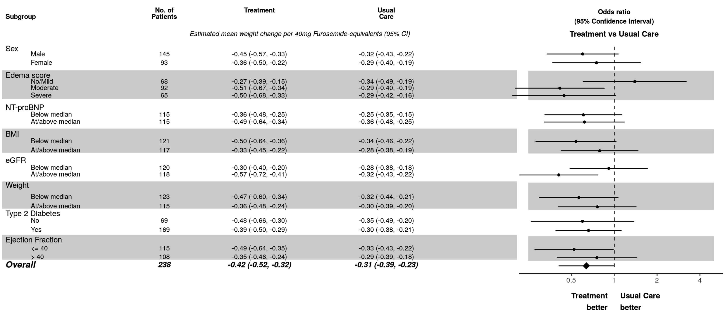
Heterogeneity of Treatment Effect

Slide 15
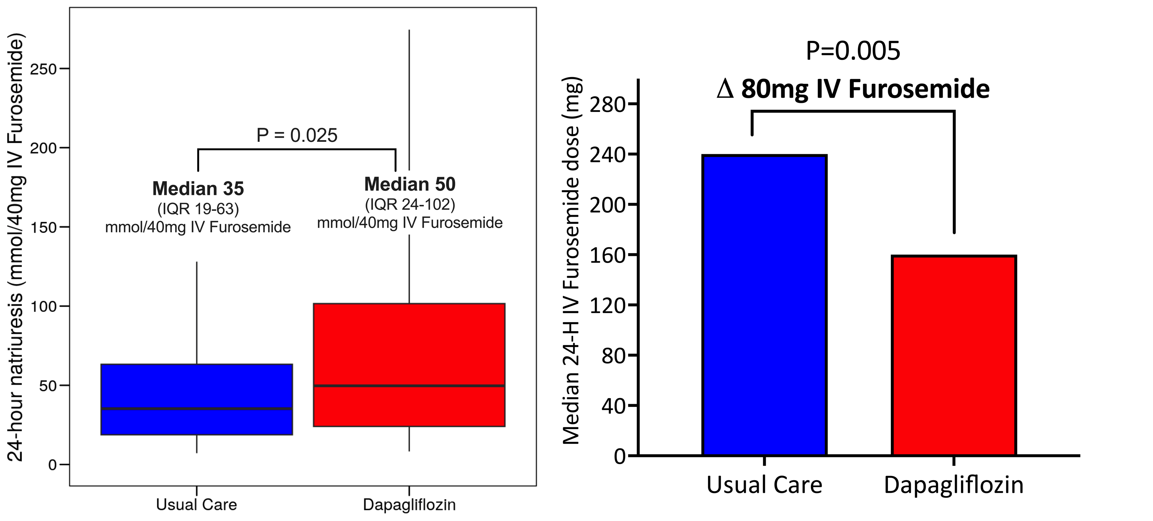
Improved 24-Hour Natriuresis with Dapagliflozin

Slide 16
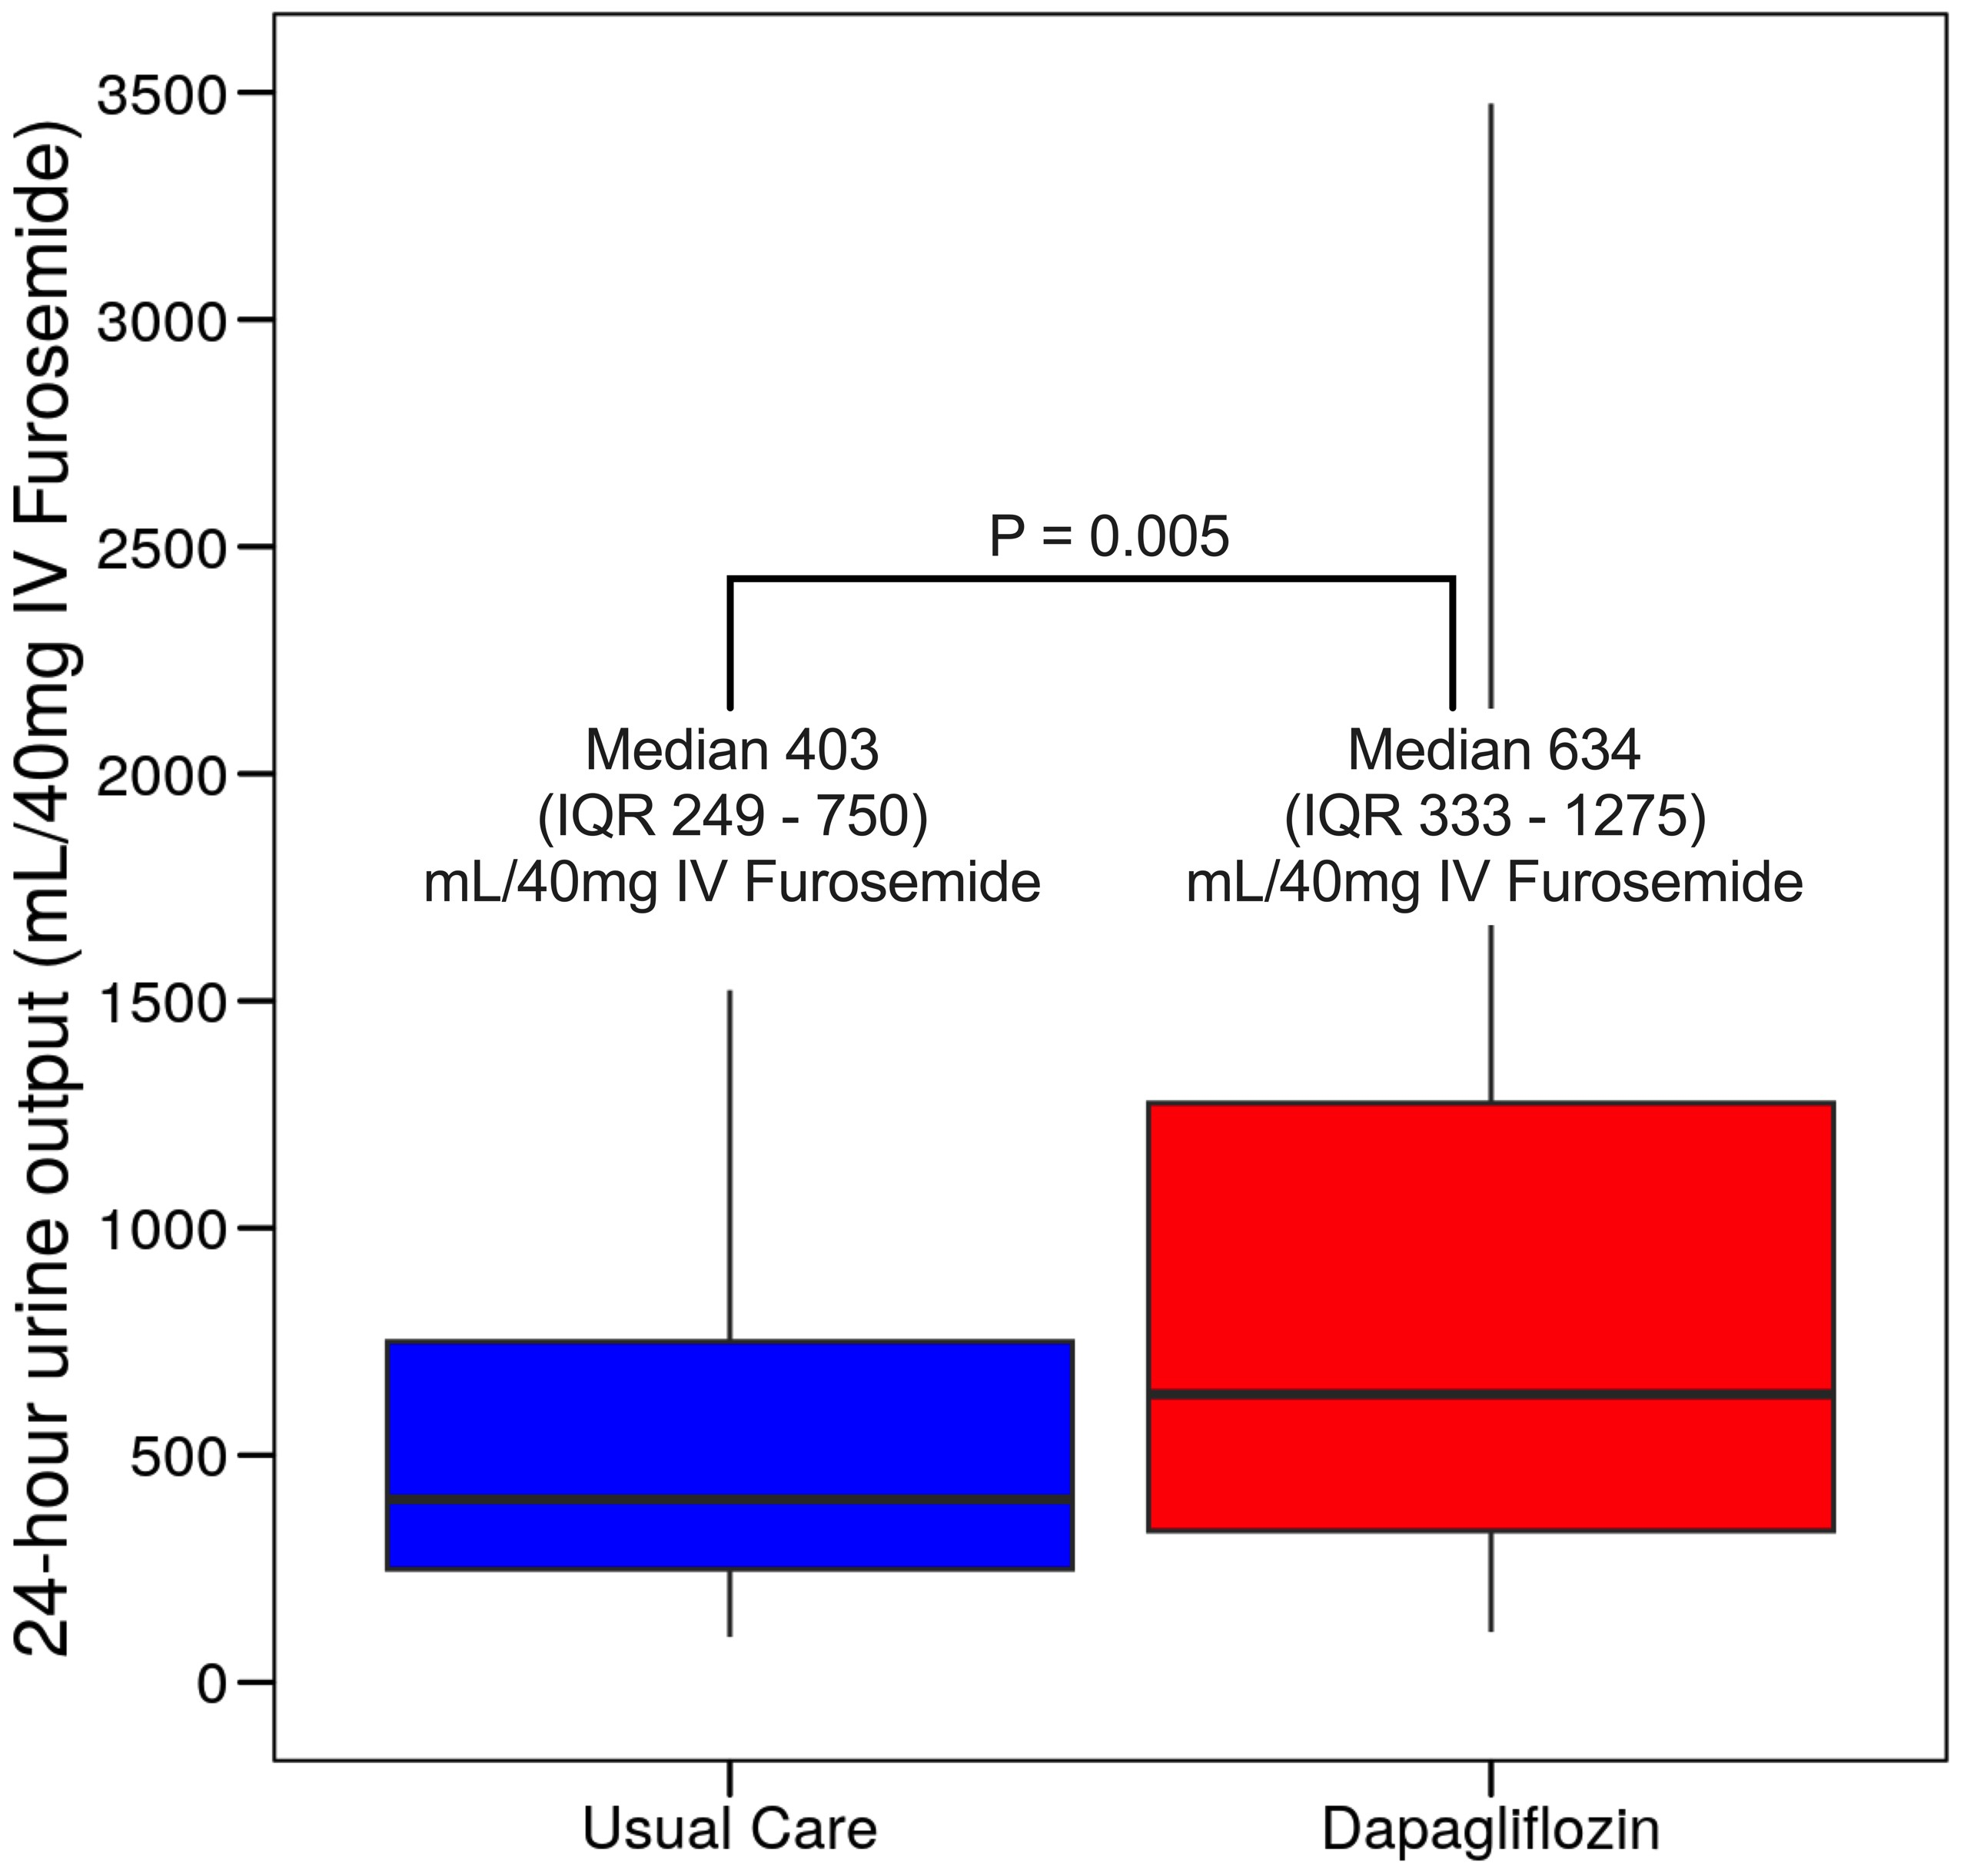
Improved 24-Hour Diuresis with Dapagliflozin

Slide 17
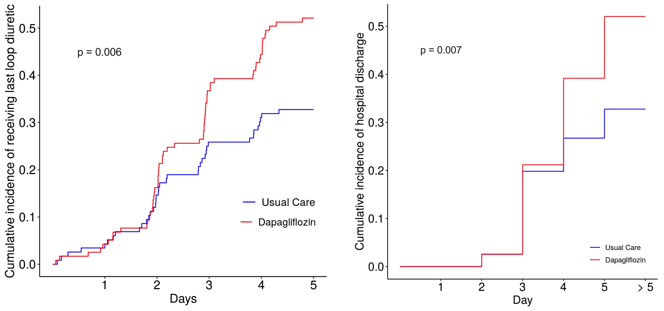
Shorter Time to discontinue IV Diuretics and to Discharge
52%
52%
33%
33%

Slide 18
Secondary Outcomes
Secondary Outcomes, N | Usual Care | Dapagliflozin
Worsening heart failure | 3 | 4
30-day hospital readmission for ADHF or diabetes-related reasons | 8 | 7
ADHF-related readmission | 8 | 6
Diabetes-related readmission | 0 | 1

Slide 19
Safety Outcomes and Adverse Events
Safety Outcomes | Usual Care | Dapagliflozin
Ketoacidosis | 0 | 0
Symptomatic hypotension | 4 | 2
Prolonged hospitalization for hypotension | 1 | 1
Hypoglycemia | 9 | 7
Prolonged hospitalization for hypoglycemia | 0 | 0
Genitourinary tract infections | 1 | 0
Change in eGFR (mL/min/1.73m²) | -3.0 (-9 to 2) | -2.0 (-10 to 4)

Slide 20
Conclusions
Despite standardized, high-dose IV loop diuretics:
Dapagliflozin had a strong signal to improve diuretic efficiency supported by:
Increased natriuresis and diuresis per 40mg of IV furosemide
Decreased total dose and duration of loop diuretics required
Decreased time to hospital discharge
Early dapagliflozin initiation was safe across all diabetic and cardiorenal outcomes
Totality of DICTATE-AHF data supports the early initiation of dapagliflozin in AHF to safely facilitate decongestion
and GDMT optimization

Slide 21
DICTATE-AHF Study Team
Principal Investigator: JoAnn Lindenfeld
Co- PI: Zachary Cox
Co- Investigator: Sean Collins
Site Investigators:
Zachary Cox, Pharm.D. – Vanderbilt University
Gabriel Hernandez, M.D. – University of Mississippi Kirkwood Adams, M.D. – University of North Carolina
A. Tom McRae, M.D. – Centennial Hospital Mark Aaron, M.D. - St Thomas Hospital System
Luke Cunningham, M.D. – Integris Medical Center
Clinical Coordinating Center:
Sean Collins, Christy Kampe, Karen Miller
Data Coordinating Center:
Chris Lindsell, Frank Harrell, Cathy Jenkins

Slide 22
Additional Slides for Potential Questions
22

Slide 23
Diuretic Efficiency:
Prior to adjustment for baseline weight
Primary Outcome | Usual Care | Dapagliflozin | Treatment Effect (95% CI)
Change in weight (kg) /40mg IV furosemide; unadjusted | -0.16 (-0.35 to - 0.07) | -0.24 (-0.53 to -0.08) | OR 0.64 (0.41 – 1.00)

Slide 24
Adverse Events
Safety Outcomes | Usual Care | Dapagliflozin
Symptomatic hypotension | 4 | 2
Prolonged hospitalization for hypotension | 1 | 1
Hypovolemic hypotension | 1 | 0
Hypoglycemia | 9 | 7
Mild hypoglycemia | 7 | 4
Moderate-to-severe hypoglycemia | 2 | 3
Prolonged hospitalization for hypoglycemia | 0 | 0
Serum potassium < 3.0 mEq/L | 1 | 1

Slide 25
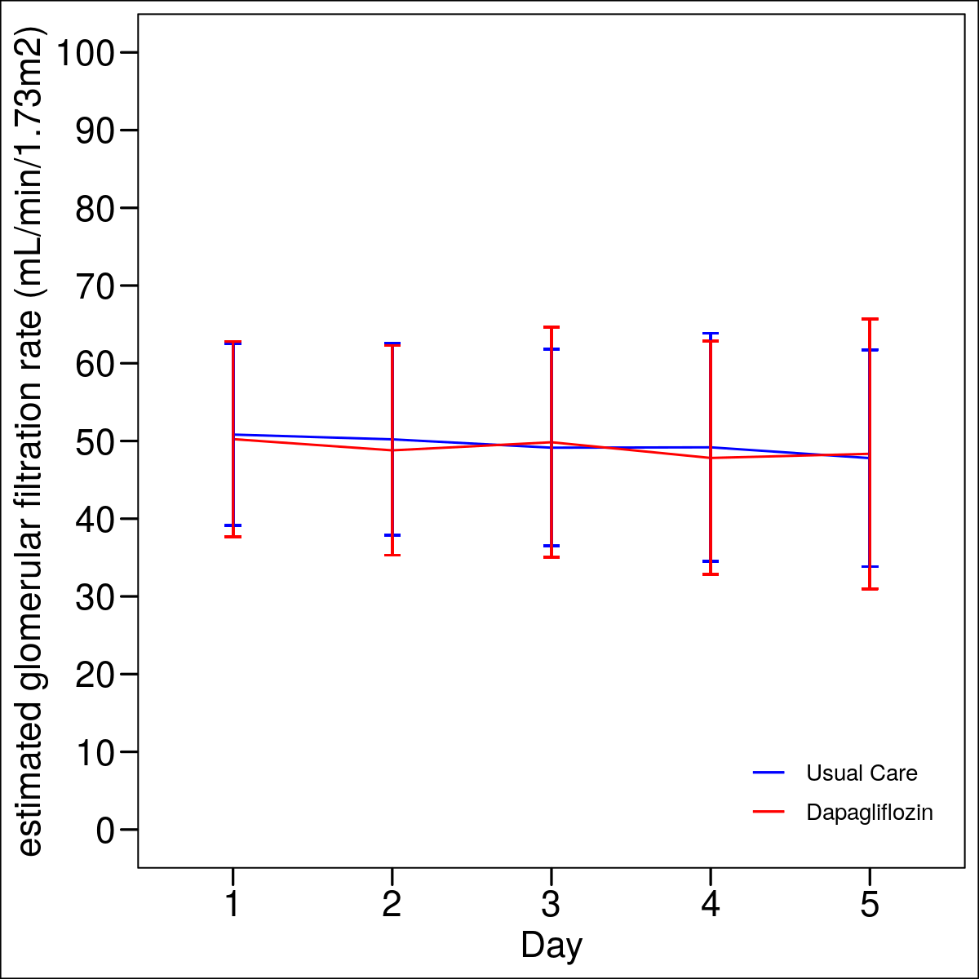
eGFR Trend over time

Slide 26
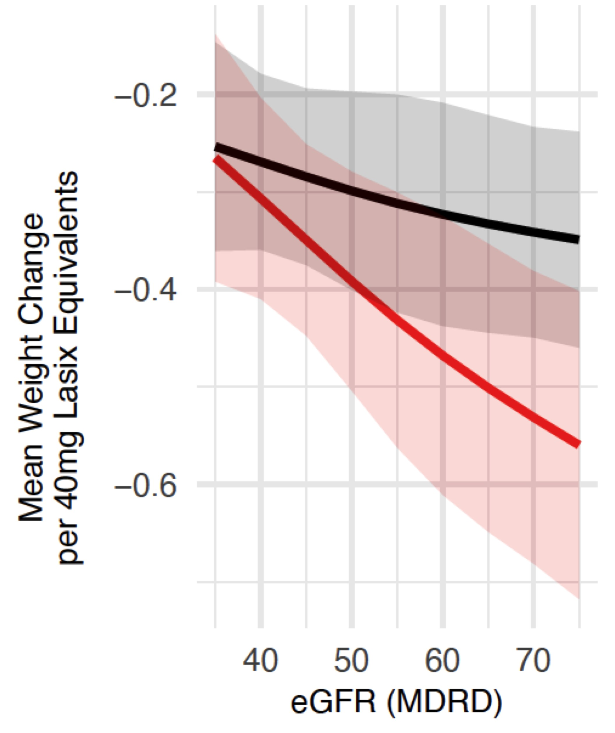
eGFR Interaction with Primary Outcome
No statistically significant interaction between baseline eGFR and the primary outcome between treatment arms (P*interaction =0.08)
Usual Care
DAPA

Slide 27
Adverse Events
Safety Outcomes | Usual Care | Dapagliflozin
Stage 2 AKI | 0 | 2
Stage 3 AKI | 1 | 2

