Slide 1
D2B: ACC Definitions
and What You Can Do
To Meet the Guidelines
Eva Kline-Rogers RN, NP, AACC
University of Michigan
Conflicts of Interest:
AC Forum Board of Directors
Consultant: American College of Physicians; Janssen

Slide 2
STEMI–Primary PCI of the Infarct Artery
I
IIa
IIb
III
Primary PCI should be performed in patients within 12 hours of onset of STEMI.
Primary PCI should be performed in patients with STEMI presenting to a hospital with PCI capability within 90 minutes of first medical contact as a systems goal.
A
I
IIa
IIb
III
B
Notes:
2

Slide 3
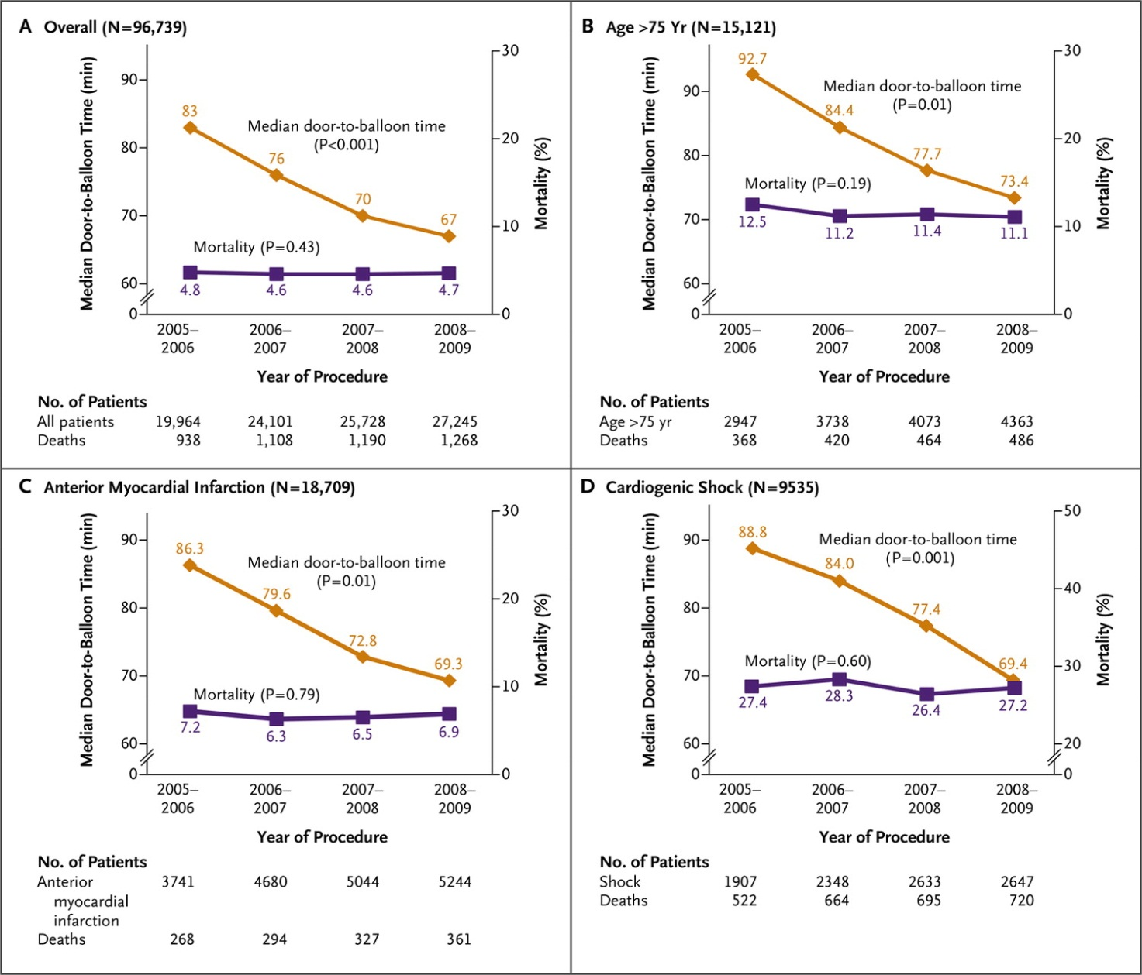
Menees DS et al. N Engl J Med 2013;369:901.
D2B Time and Mortality: NCDR 2005-2009
Notes:
Figure 1. Door-to-Balloon Times and Mortality in the Overall Population and High-Risk Subgroups, 2005 to 2009. Shown are the median door-to-balloon times and unadjusted in-hospital mortality among patients with ST-segment elevation myocardial infarction who underwent primary PCI between July 2005 and June 2009. Results are shown in the overall population (Panel A) and in selected high-risk subgroups: patients older than 75 years of age (Panel B), those with anterior myocardial infarction (Panel C), and those in cardiogenic shock (Panel D). The P values are for the comparison between findings in 2005–2006 and those in 2008–2009.

Slide 4
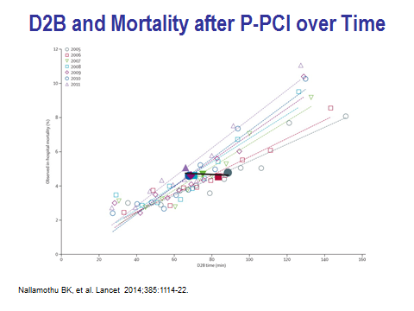

Slide 5
STEMI–Primary PCI of the Infarct Artery
Primary PCI should be performed in patients with STEMI presenting to a hospital without PCI capability within 120 minutes of first medical contact as a systems goal.
Primary PCI should be performed in patients with STEMI who develop severe heart failure or cardiogenic shock and are suitable candidates for revascularization as soon as possible, irrespective of time delay.
I
IIa
IIb
III
B
I
IIa
IIb
III
B
Notes:
5

Slide 6
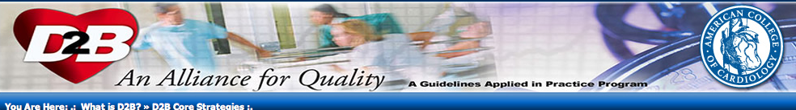
Core Strategies
1. ED physician activates the cath lab
2. One call activates the cath lab
3. Cath lab team ready in 20 – 30 minutes
4. Prompt data feedback
5. Senior management commitment
6. Team-based approach
A pre-hospital ECG to activate the cath lab is optional. While other strategies exist, including having a cardiologist in the hospital 24/7, they are not required for participation in the D2B campaign.
http://www.d2balliance.org

Slide 7
ACC/AHA 2008 Performance Measures
STEMI/NSTEMI
1. ASA at arrival
2. ASA at discharge
3. BB at discharge
4. Statin at discharge
5. Evaluation of LVSF
6. ACEI or ARB for LVSD
7. Time to fibrinolytic therapy
8. Time to primary PCI
9. Reperfusion therapy
10. Time from ED arrival to discharge in transfer pts
Time from ED arrival in referral hospital to primary PCI
Smoking cessation
13. Cardiac rehabilitation
Krumholz HM, et al. Circulation 2008;118:2596.

Slide 8
Limitations of D2B Times
  D2B time ≠ total ischemic time
  D2B time is only 1 metric for STEMI care
  Transfer-in & in-hospital patients are “invisible”
  Triage, diagnosis, treatment, and consent truncated
  Populations ≠ patients
  Public reporting may impact patient selection
  Prone to manipulation (multiple exclusions)
  Perverse Pay-for-Performance targets
  False Activations

Slide 9
Time-to-Treatment Goals
Bates ER, Jacobs AK. NEJM 2013;369:889.

Slide 10
Time-to-Treatment Goals
Bates ER, Jacobs AK. NEJM 2013;369:889.

Slide 11

Establish a Regional STEMI Plan!

Slide 12
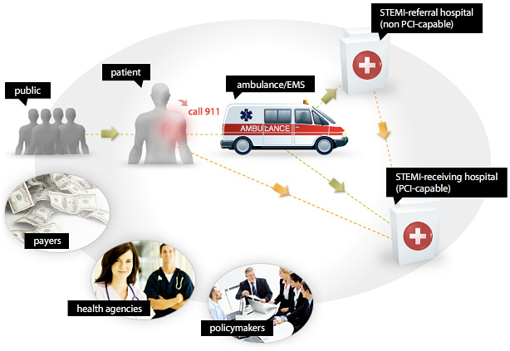

Mission Lifeline: Developing Prehospital Management and Systems of Care for STEMI

