Slide 1
Randomized Clinical Trial of Pre- hospital Sodium Nitrite in Out-of Hospital Cardiac Arrest Patients
Francis Kim MD, Charles Maynard PhD, Cameron Dezfulian MD, Michael Sayre MD, Peter Kudenchuk MD, Thomas Rea MD, Deborah Sampson RN, Michele Olsufka RN, Susanne May PhD, Graham Nichol MD MPH
University of Washington Seattle, WA

Slide 2
Background
Survival from OHCA is less than 20%
Administration of sodium nitrite during resuscitation increased survival by nearly 50% in animal model of cardiac arrest
Determine whether sodium nitrite given during resuscitation improves outcomes from out-of-hospital cardiac arrest

Slide 3
Trial Setting/Design
Emergency medical services (EMS) agencies in Seattle and surrounding King County
Individual OHCA patients double blind-randomized (1:1:1)
Intervention- 60 mg Sodium Nitrite
Intervention- 45 mg Sodium Nitrite
Control-Placebo (normal saline)

Slide 4
Eligibility
Inclusion Criteria Cardiac arrest with life
support by paramedics Age 18+
Intravenous/intraosseous access
Unconscious
Exclusion Criteria Traumatic cardiac arrest Age < 18
Known DNR Pregnant Prisoner Drowning

Slide 5
Trial Flow
Field Cardiac Arrest
2264
Not Enrolled (762)
Enrolled
1502
Excluded from Analysis(10)
1492
N=497
60 mg Nitrite
N=499
45 mg Nitrite
N=496
Placebo
Primary Outcome: Survival to Hospital Admission, Important Secondary: Survival to Discharge

Slide 6
Characteristic | Randomization group
 | 60 mg (n=497) | 45 mg (n=499) | Placebo (n=496)
Age (years) | 62+17 | 65+16 | 64+17
Men | 66% | 66% | 67%
Initial rhythm
Asystole | 44.1% | 45.9% | 41.3%
Pulseless electrical activity | 27.4% | 30.9% | 29.6%
Ventricular fibrillation | 24.9% | 19.0% | 23.6%
Ventricular tachycardia | 0.4% | 0.2% | 0.4%
Arrest before EMS arrival | 87% | 87% | 90%
Witnessed arrest | 43% | 43% | 44%
Time from call to first arrival (min) | 5.7+2.0 | 6.1+3.3 | 6.0+4.5
Time from call to randomization (min) | 22+8 (n=493) | 22+10 (n=498) | 22+10 (n=491)

Slide 7
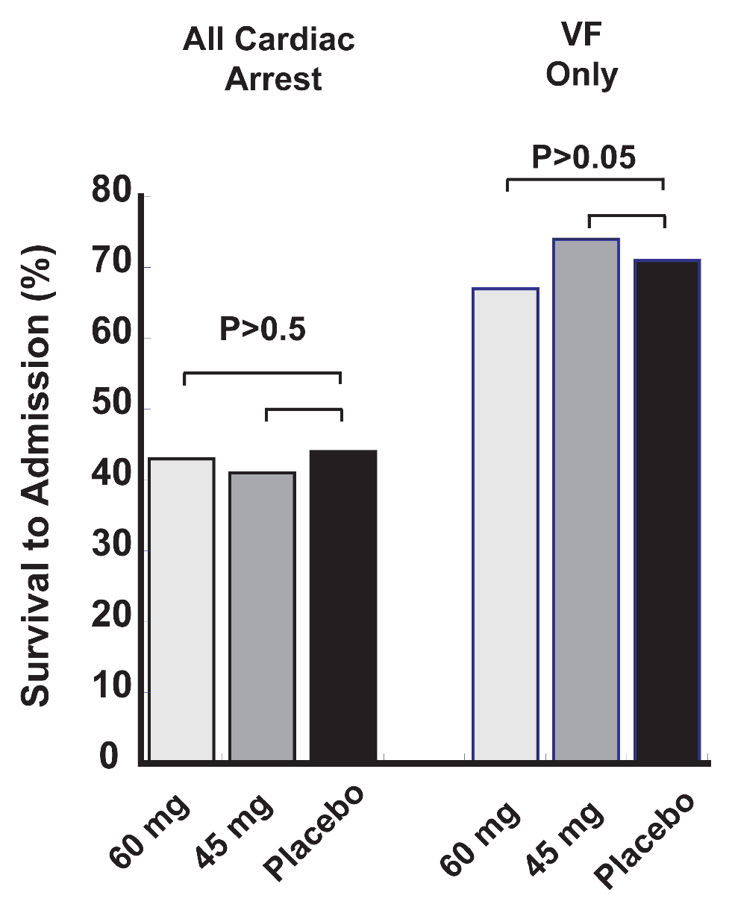
Outcomes - Survival to Hospital Admission
All Cardiac arrest 60 mg n= 212
45 mg n= 205
Placebo n= 218
VF
60 mg n=84
45 mg n=70 Placebo n=84

Slide 8
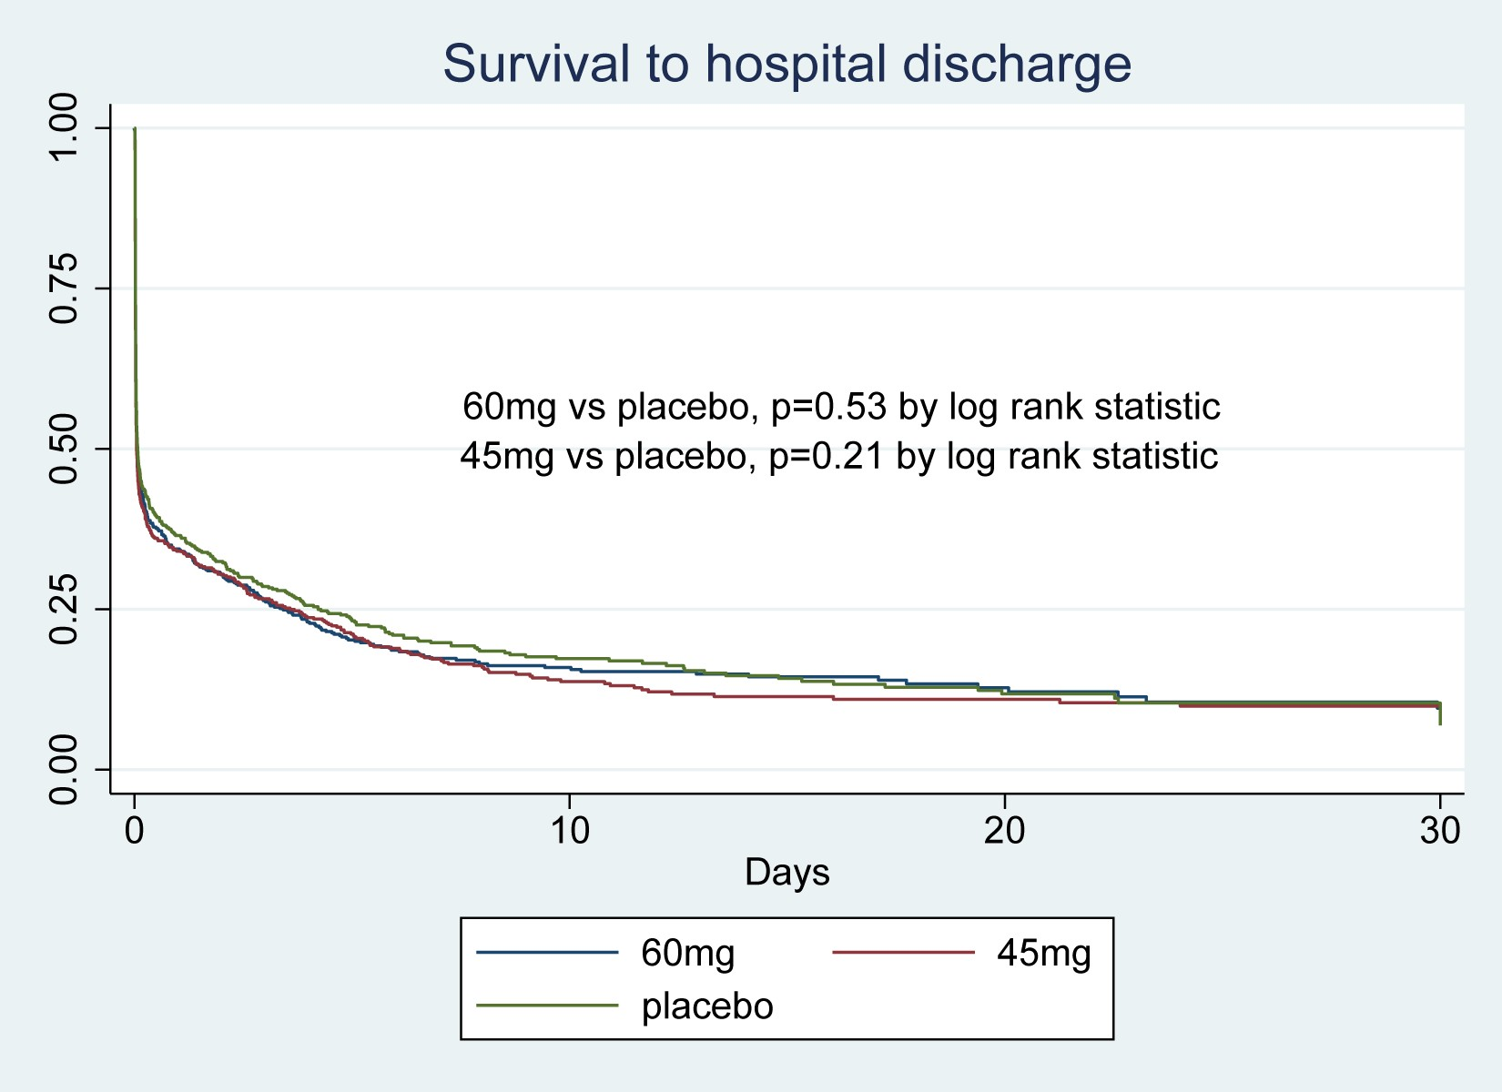
Post hoc Outcome - Survival to Discharge

Slide 9
Safety - prehospital
Event | Randomization group
 | 60 mg (n=497) | 45 mg (n=499) | Placebo (n=496)
ROSC | 58% | 53% | 58%
Norepinephrine after randomization | 16% | 16% | 15%
Epinephrine after randomization | 95% | 95% | 95%
Epinephrine dose (mg) | 3.1+1.7 (n=473) | 3.1+1.6 (n=471) | 3.2+2.0 (n=468)
Rearrest in field (ROSC) | 156/294 (53%) | 130/270 (48%) | 139/291 (48%)
Systolic BP after randomization (mm/Hg) | 128+43 (n=257) | 127+41 (n=241) | 130+44 (n=260)
Transported to hospital | 55% | 51% | 56%

Slide 10
Safety - ED and hospital
Characteristic | Randomization group
 | 60 mg (n=497) | 45 mg (n=499) | Placebo (n=496)
First systolic blood pressure in hospital (mm/Hg) | 117+35 (n=241) | 114+34 (n=222) | 122+36 (n=249)
Sustained hypotension | 9/228 (3.9%) | 11/216 (5.1%) | 14/238 (5.9%)
pH first arterial blood gas | 7.1+0.2 (n=235) | 7.1+0.2 (n=222) | 7.1+0.2 (n=235)
Pressors in first 24 hours | 185/272 (68%) | 173/255 (68%) | 190/278 (68%)
Hospital targeted temperature management | 139/272 (51%) | 130/255 (51%) | 136/278 (49%)
First hospital temperature | 35.3+1.7 (n=226) | 35.3+1.8 (n=205) | 35.1+2.0 (n=220)
Withdrawal of life sustaining therapies | 112/272 (41%) | 109/255 (43%) | 124/277 (45%)
Rearrest first 24 hours of hospitalization | 74/271(27%) | 65/249 (28%) | 76/271 (28%)
ICU days (median) | 5.3 (n=68) | 5.1 (n=56) | 4.6 (n=77)

Slide 11
Conclusions
Sodium nitrite for out-of-hospital cardiac arrest did not significantly improve survival to hospital admission or to discharge
Sodium nitrite is not associated with substantive or significant adverse effects on hemodynamics

Slide 12
Acknowledgements
Paramedics in Seattle and King County
Hospitals: Harborview Medical Center, Swedish Medical Center, Virginia Mason Hospital, UWMC, Northwest Hospital, Overlake Hospital, Valley Medical Center, Auburn General Hospital, St. Francis Hospital
DSMB:
Chair: Susan Stern, MD. Members: Kyra Becker,
MD, David Shavelle MD (USC), Dave Beiser MD(Univ. of Chicago), Al Hallstrom PhD
Funding: NIH/NHLBI

