Slide 1
Predictors of Reduction in Mitral Regurgitation by the MitraClip – Durable, Transient, or Failures in the COAPT Trial
D. Scott Lim
Gorav Ailawadi, Federico Asch, Neil Weissman, Farnaz Namazi, Jeroen Bax, Victoria Delgado, Saibal Kar, Jaime Kennedy, Mike Rinaldi, Molly Szerlip, Linda Gillam, Vivek Rajagopal, Joseph Choo, Paul Grayburn, Zhipeng Szhou, Joann Lindenfeld, Will Abraham, Michael Mack, Gregg Stone
on behalf of the COAPT Investigators

Slide 2
Disclosure Statement of Financial Interest
Within the past 12 months, I or my spouse/partner have had a financial interest/arrangement or affiliation with the organization(s) listed below.
Affiliation/Financial Relationship | Company
Grant/Research Support | Abbott Vascular, Boston Scientific, Edwards Lifesciences, Medtronic
Consulting Fees/Honoraria | Keystone Heart, Valgen, Venus, WL Gore
Major Stock Shareholder/Equity | n/a
Royalty Income | n/a
Ownership/Founder | n/a
Intellectual Property Rights | n/a
Faculty disclosure information can be found on the app

Slide 3
Background
COAPT demonstrated that TMVr with MitraClip in severe, secondary MR improves survival, reduces the rate of HF hospitalizations, and enhances quality of life
However, it is not clear what factors drive a durable MR reduction, as opposed to transient MR reduction or failure

Slide 4
Study Objective
We therefore sought to assess prognostic factors associated with a durable MR reduction during 2-year follow-up of HF patients enrolled in COAPT

Slide 5
Methods
Symptomatic HF patients with moderate-to-severe or severe secondary MR who remained symptomatic despite GDMT were randomized to TMVr plus GDMT or GDMT alone.
Endpoint definitions (based on echo core lab assessments):
Successful and durable MR reduction = residual MR of 0-2+ achieved by 30 days that persisted until study endpoint at 2 years.
Transient MR reduction = residual MR of 0-2+ at 30 days that subsequently worsened to 3-4+ during 2-year follow-up
Failure in MR reduction = 3-4+ MR at 30 days

Slide 6
Methods
The following covariates were examined for their relationship with durable, transient of failed MR reduction:
Clinical covariates: age, gender, diabetes, hypertension, previous MI, previous PCI, previous CABG, previous stroke/TIA, peripheral vascular disease, COPD, AF, BMI, Creatinine clearance, anemia, STS risk score, surgical risk
Functional covariates: NYHA Class, Cardiomyopathy type, HF Hospitalization, Preious CRT, Previous defibrillator, BNP, N-terminal BNP
Anatomic covariates: MR Grade, LVEF, LVESD, LVEDD, EROA, RV pressure, MV orifice area, MV mean gradient, TR grade, Posterior leaflet length, Tenting height, tenting area, basal mitral anterior leaflet angle, posterior mitral leaflet angle, tethering location

Slide 7
Echocardiographic Analyses
All transthoracic echocardiograms obtained at the enrolling centers following a study-specific acquisition protocol
Conventional measurements were analyzed by an independent core laboratory following ASE standards
Details of the conventional echocardiographic measurements in COAPT have been previously reported¹
1. Asch FM, et al. J Am Coll Cardiol. 2019;74:2969-2979.

Slide 8
Statistical Analyses
Baseline characteristics were summarized with means and standard deviations (SD) for continuous measures and proportions for categorical variables
Variables were compared between treatment groups with Student’s t- test for continuous measures, Chi-square test for categorical variables, and log-rank test for time-to-event variables
Event rates were estimated by the Kaplan-Meier (KM) method
Comparisons of cumulative events across strata were performed using the log-rank test
A p-value <0.05 was considered statistically significant for all tests

Slide 9
Study Results
614 subjects were enrolled
302 pts were randomized to the device arm
273 pts had evaluable studies at all time points

Slide 10
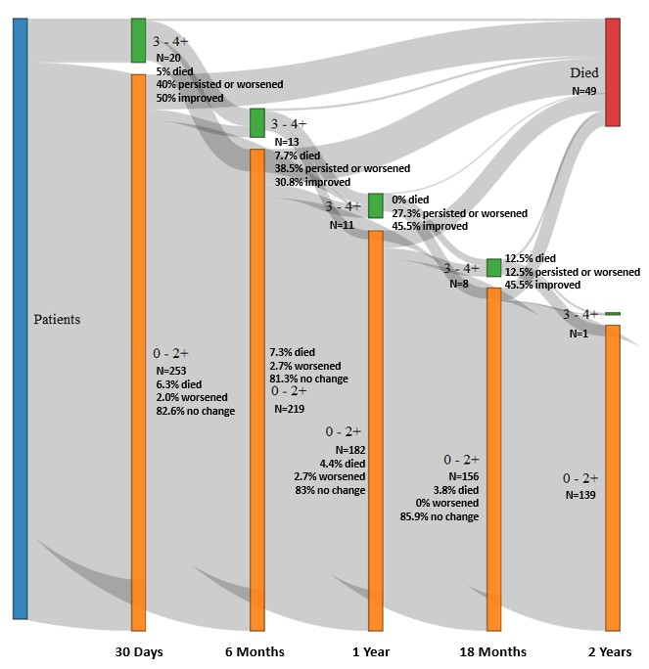
Study Results
Successful and durable MR reduction was achieved in 212 pts (77.7%)
Transient MR reduction was noted in 41 pts (15.0%)
Failure to achieve MR reduction occurred in 20 pts (7.3%).

Slide 11
Baseline Clinical and Functional Indices Associated with Durable MR Reduction
Higher baseline 6-minute walk test distinguished those with durable MR reduction
268±123 meters vs 228±126 and 197±115 meters, respectively, p=0.01 overall

Slide 12
Baseline Clinical and Functional Indices Associated with Transient MR Reduction
Renal dysfunction, hypertension, and elevated surgical risk were predictive of transient MR reduction
Creatinine clearance 45.1±19.7 vs 52.2±25.2, p=0.03
Diagnosis of hypertension in 92.7% vs 75.5%, p=0.01
Higher STS replacement scores of 8.5±4.4% vs 6.9±4.6%, p=0.04

Slide 13
Baseline Clinical and Functional Indices Associated with Failure of MR Reduction
None identified

Slide 14
Echocardiographic Indices Associated with Durable MR Reduction
None identified

Slide 15
Echocardiographic Indices Associated with Transient MR Reduction
Among those with acute MR reduction, greater anterior leaflet tethering was associated with a transient result (severe MR recurrence after 30 days)
Basal anterior leaflet angle of 36±7 degrees vs 31±6 degrees, p=.003

Slide 16
Echocardiographic Indices Associated with Failure of MR Reduction
Greater degree of baseline MR, higher inflow gradient, and P3 tethering were associated with failure to achieve MR reduction.
Failures had baseline 4+ MR in 80.0% vs 47.0% in those with durable MR reduction, p = 0.01
Failures had mean inflow gradient of 3.2±1.3 mmHg vs 2.4±1.0 mmHg, p=0.02
Failures had greater percentage demonstrating P3 tethering (17.6% vs 2.1%, p=0.001)

Slide 17
Quality of Life Predictors
At 30 days, the subset of patients with MR reduction that would later have transient MR reduction (i.e. severe MR recurrence) had lower KCCQ scores
62.0±23.1 vs 73.4±19.5, p=0.001

Slide 18
Conclusions
In the COAPT trial, acute and sustained reduction in MR to 0-2+ was related to anatomic as well as functional and clinical factors
These variables should be considered in case selection for TMVr in HF patients with severe secondary MR despite GDMT

