Slide 1


Women’s IschemiA TRial to Reduce Events In Non-ObstRuctive CAD
Eileen Handberg, PhD, FAHA, FACC, FPCNA
Professor of Medicine, University of Florida

Slide 2
RATIONALE
~ Half of women with symptoms/signs of ischemia referred to coronary angiography have no obstructive CAD (INOCA), elevated major adverse cardiac events (MACE), poor QoL and increased healthcare costs
Guidelines focus on symptom management - clinical practice advocates risk factor management and reassurance
Pilot studies suggest benefit with intensive medical therapy (IMT) high-intensity statin, maximally tolerated ACEIs or ARBs

Slide 3
HYPOTHESIS:
IMT reduces primary outcome first occurrence of MACE (all cause death, MI, stroke or hospitalization for worsening angina or HF) by 20% vs. UC at 5 yr follow-up
METHODS
Multicenter, prospective, randomized, blinded outcome evaluation (PROBE) design
Pragmatic strategy trial of IMT vs usual care (UC) in symptomatic women with suspected INOCA (NCT 03417388)
Secondary outcomes include QoL, time to return to work, healthcare utilization, angina, CV death, total events, individual primary outcome components and WIN ratio over 5 yrs F/U
Web-based data capture, e-consents, single IRB and centralized pharmacy used to
reduce burden

Slide 4

Clinically stable women with angina¹ and no obstructive coronary artery disease² by invasive coronary angiography (INV) or coronary tomographic angiography (CCTA)
Exclusions³
2476 Randomized
1239 Randomized to IMT⁴
675 INV
564 CCTA
1237 Randomized to UC⁵
678 INV
559 CCTA
Included in primary analysis
Included in primary analysis
44 Lost to follow-up
57 Lost to follow-up
¹ Angina or Angina Equivalent
² No coronary artery narrowing ≥50% diameter reduction, UAP, ACS, MI, PCI, or CABG
³ History of Cardiomyopathy, Significant Valvular or uncorrected Congenital Ht Disease, HIV, HepC, eGFR <30, liver disease, expected survival <2 yrs, or noncompliance
⁴ Intensive Medical Therapy = high intensity statin (or PCSK9 i) + ACE-I (or ARB) + low dose aspirin
⁵ Usual Care- dictated by treating physician

Slide 5

COVID 19 Pandemic Enrollment Impact:
Nov 14, 2022- WARRIOR DSMB and
External Independent Advisory Panel recommendations
Continue the trial
Maximize recruitment efforts (increase sites, reimbursement) to reach original goal of 4,476 and extend follow up.
Focus on biorepository sample collection for all participants
Encourage co-enrollment in Ancillary Studies
External independent advisory panel review – do not change the primary outcome

Slide 6
aseline WARRIOR Characteristics by Assignmen
Characteristic | Intensive Medical Therapy (IMT) (n=1239) | Usual Care (UC) (n=1237)
Demographic
Age (years), Mean (SD) | 64.2 (2.88) | 64.1 (2.89)
>65, n (%) | 466 (37.6%) | 487 (39.4%)
White, n (%) | 1104 (89.2%) | 10997 (88.7%)
BMI (kg/m²), Mean (SD) | 32.1 (8.38) | 31.7 (7.91)
>30, n (%) | 661 (53.8%) | 643 (52.6%)
Condition
CCTA, n (%) | 564 (45.5%) | 559 (45.2%)
Invasive Angiography, n (%) | 675 (54.5%) | 678 (54.8%)
History of:
Diabetes, n (%) | 266 (21.5%) | 251 (20.3%)
Myocardial Infarction, n (%) | 86 (6.9%) | 102 (8.2%)
Hypertension, n (%) | 783 (63.2%) | 812 (65.6%)
Ever Smoked cigarettes n (%) | 427 (36.8%) | 436 (37.9%)
Post Menopausal, n (%) | 1004 (81.5%) | 1010 (82.0%)
SBP (mmHg), Mean (SD) | 125.2 (15.45) | 125.9 (15.83)
LDL-C (mg/dl), Mean (SD) | 93.6 (34.46) | 92.7 (34.90)
> 70 mg/dl, n (%) | 835 (73.1%) | 834 (73.8%)
SAQ7 overall, Mean (SD) | 69.7 (20.87) | 71.6 (20.45)
COVID-19 infection, ever, n (%) | 490 (39.5%) | 489 (39.5%)
Medication
Statin, n (%) | 878 (70.9%) | 863 (69.9%)
Atorvastatin 40-80 mg | 282 (22.8%) | 264 (21.3%)
Rosuvastatin 20-40 mg | 164 (13.2%) | 158 (12.8%)
Other lipid lowering agents, n (%) | 389 (31.6%) | 385 (31.4%)
ACE-I or ARB, n (%) | 658 (53.1%) | 596(48.2%)
Beta Blocker, n (%) | 454 (36.9%) | 493 (40.2%)
Calcium Channel Blocker, n (%) | 317 (25.8%) | 348 (28.4%)
Aspirin, n (%) | 779 (62.9%) | 724 (58.5%)
B
Table 1. Baseline WARRIOR Characteristics by Assignment
t
ACE-I = angiotensin-converting enzyme inhibitor; ARB = angiotensin receptor blocker; CCTA = coronary computed angiography; CAD = coronary artery disease

Slide 7
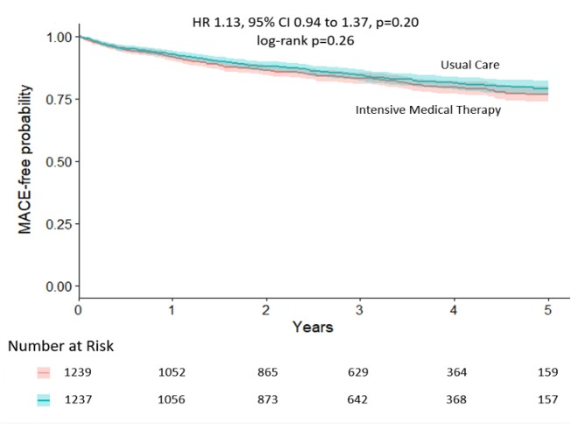
Primary Outcome

Slide 8
MACE | IMT (n=369) | UC (n=354) | Total (n=723)
Death, all cause | 27 | 17 | 44
CV Death | 4 | 5 | 9
Hospitalization for Chest Pain | 305 | 298 | 603
Hospitalization for Heart Failure | 7 | 6 | 13
Non-Fatal MI | 14 | 14 | 28
Stroke/TIA | 16 | 19 | 35
Non-CV Deaths: malignancy 7, sepsis/infection 5, neurologic 1, pulmonary 2, trauma 4, undetermined 16
*p=ns IMT vs UC

Slide 9
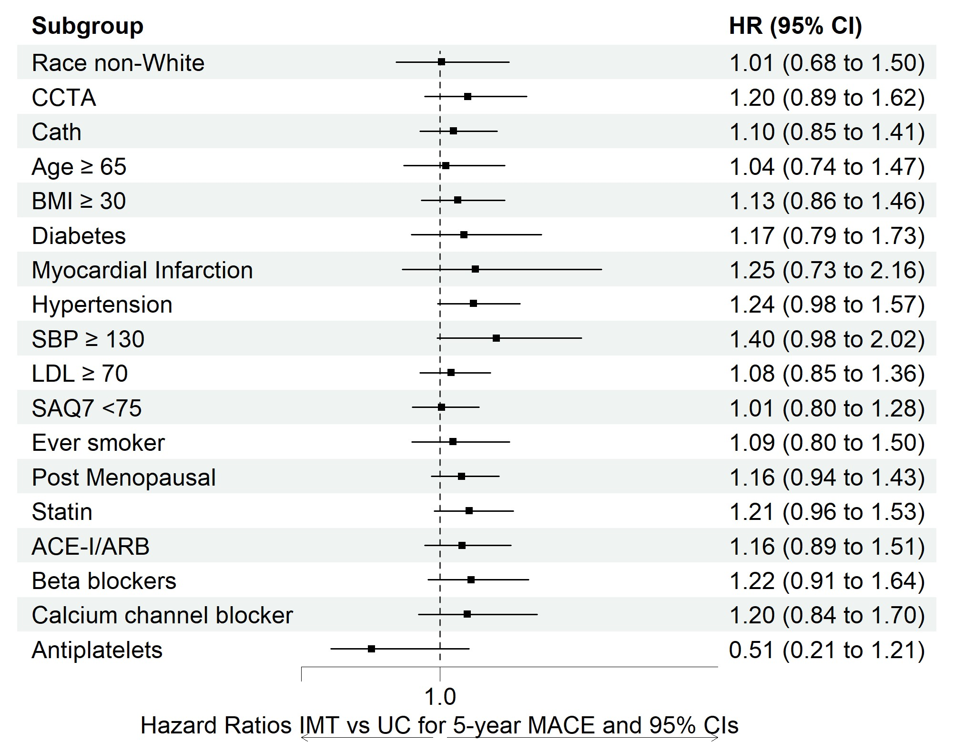
Heterogeneity of Treatment Effect for the Primary Outcome

Slide 10
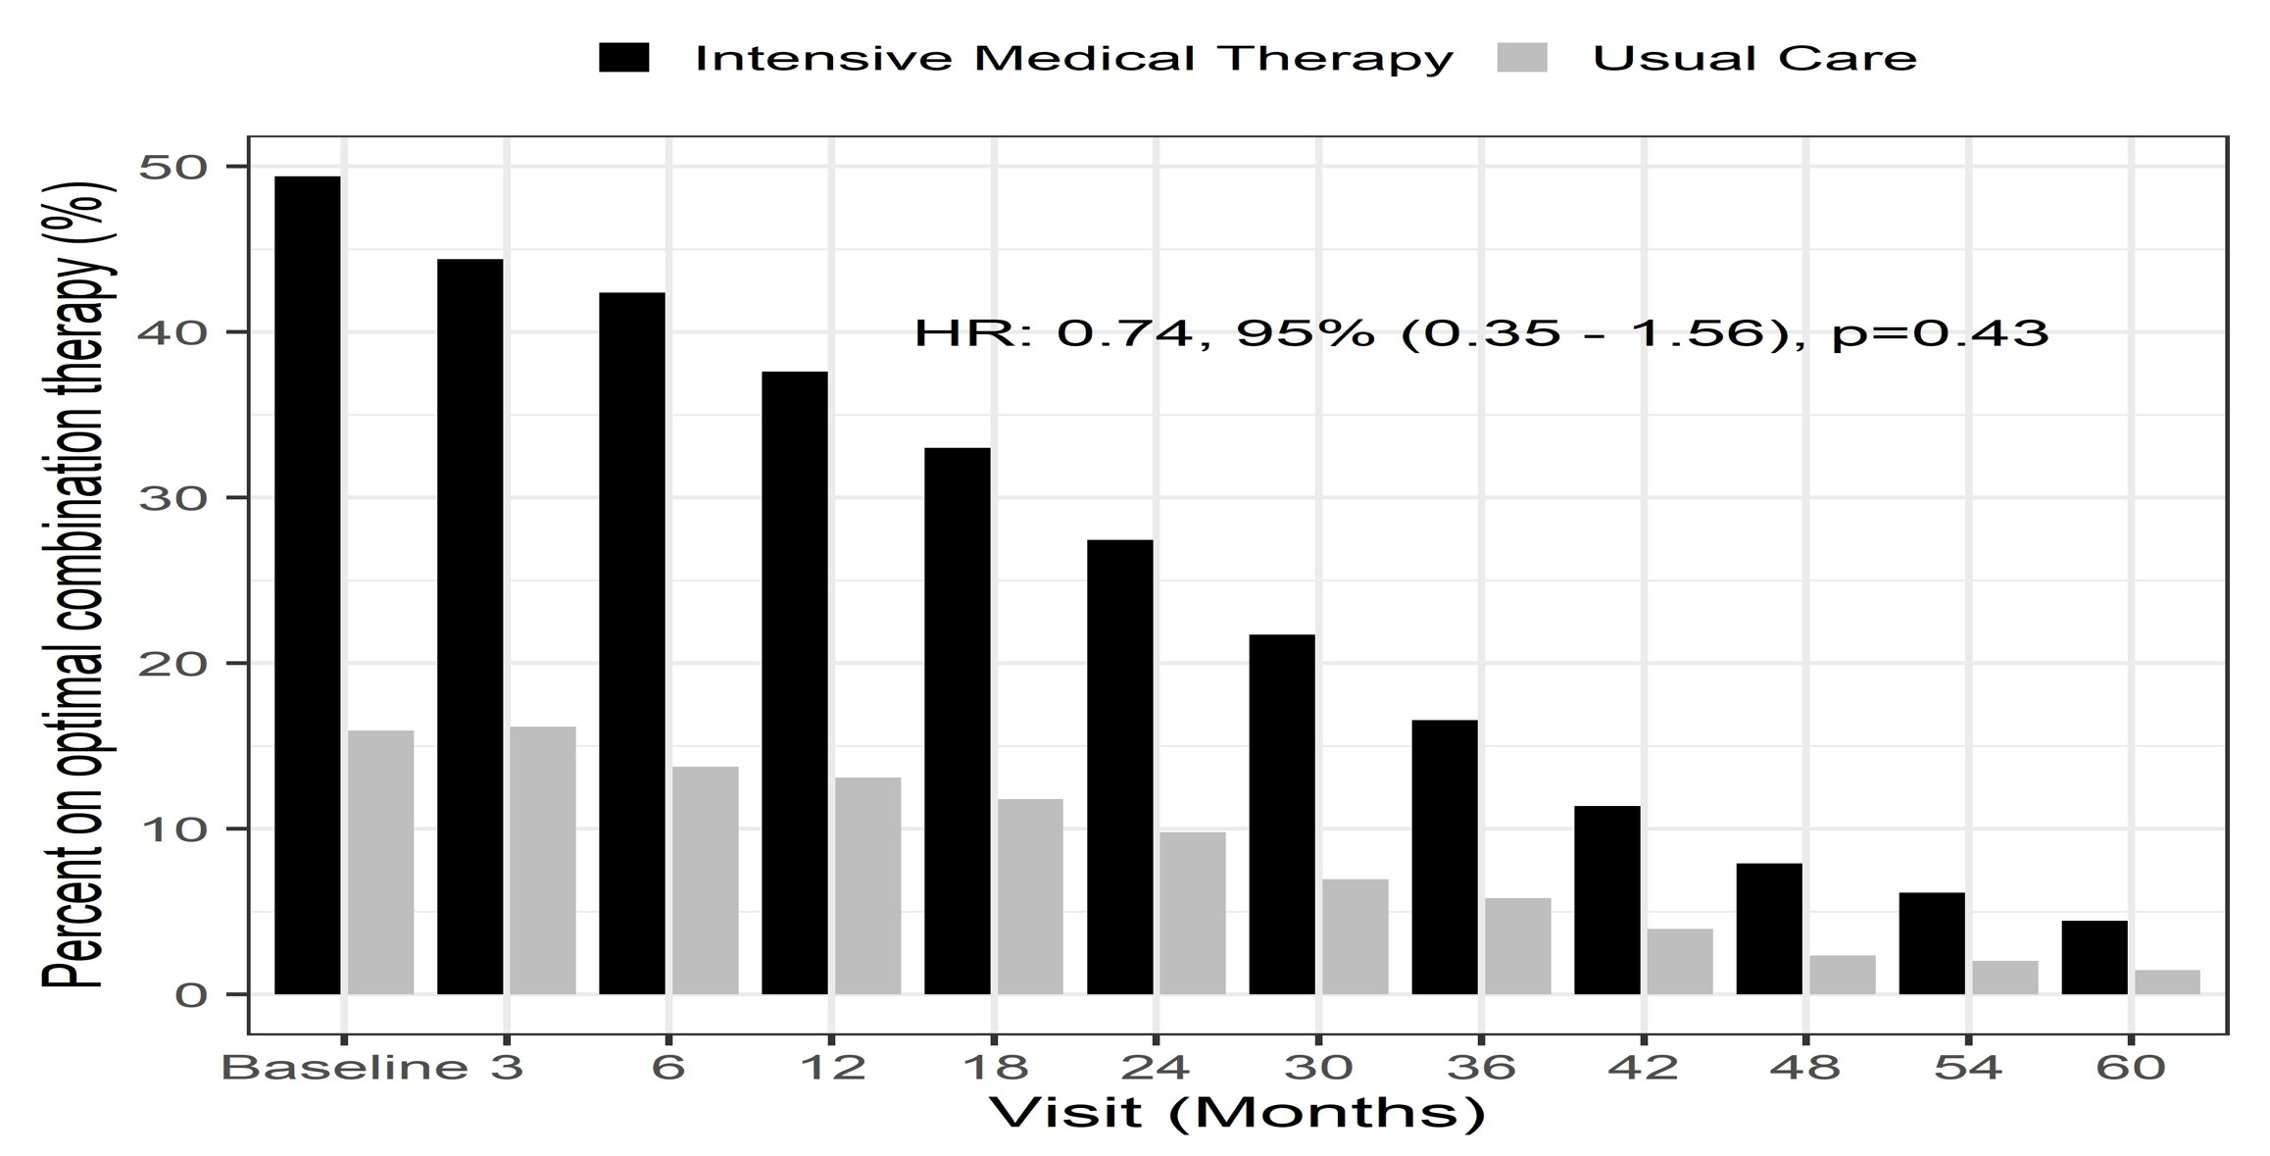
Sensitivity Analysis of Contamination- HR: 0.74, 95% (0.35 – 1.56), p=0.43

Slide 11
LIMITATIONS
Under-enrollment limited power
CCTA inclusion increased enrollment but lowered MACE risk profile
Open label, pragmatic trial design resulted in higher than anticipated trial contamination in both groups
High enrolled baseline SAQ reduced capacity to improve angina and angina-related QoL

Slide 12
SUMMARY
Largest trial in the INOCA field, documents high burden of recurrent angina hospitalization
Sensitivity analyses incorporating contamination in both arms demonstrated a non-significant 25% MACE reduction, potentially supportive of an effect had sufficient statin and ACEI/ARB been utilized.
Results extend prior literature suggesting ACEI/ARB treatment in INOCA to a goal of SBP ≤120 mmHg may be best for SAQ angina reduction

Slide 13
CONCLUSIONS
Among women with suspected INOCA, IMT did not reduce the first occurrence of all cause death, MI, stroke or hospitalization for worsening angina or HF by 20% vs. UC at 5 yrs
“Neutral trial result” should NOT be:
  Consider a negative trial, rather insufficient adherence and power to test Ho.
  Interpreted as endorsing discontinuing statin and ACEI/ARB medications among women with CV risk factors
Ongoing ancillary imaging and biorepository studies will continue to contribute to improve our understanding of this growing patient population and its’ symptom burden

Slide 14
WARRIOR PORTFOLIO OF FUNDED TRIALS
WARRIOR Trial – funded by Congressionally Directed Medical Research Program of Department of Defense award (CDMRP-DoD)
WARRIOR Ancillary Trial (WAT) – funded by NHLBI to interrogate baseline and exit coronary CT angiograms (CCTA) in response to randomization and related to primary and secondary outcomes
QUIET-WARRIOR ancillary study funded by the CDMRP-DoD will investigate CCTA mechanisms related to outcome
WARRIOR Biorepository to create more “personalized’ models for risk prediction, outcomes and define new directions for therapy

Slide 15
Steering Committee
Executive Committee
Carl J. Pepine - Study PI
Noel Bairey Merz - Stat Core PI
Eileen Handberg - DCC, CCC Rhonda Cooper-DeHoff - Pharmacy Steven Smith - Pharmacy
Margaret Lo - Adherence
Barbara Harris - Patient Representative Philip Chase - IT
Janet Wei - Stat Core Co-I
Statistical Core
Andre Rogotko Marcio Dinez Galen Cook-Wiens
Clinical Endpoint Committee
Bernard Chaitman –Chair
Carl J. Pepine -Chair
Noel Bairey Merz William Boden
Rhonda Cooper-DeHoff Bernard Chaitman Marcio Diniz
Susan Fraynes
DSMB
Nanette K. Wenger- Chair Kerry Lee
Daniel Mark
Harmony Reynolds Viviany Taqueti
Eileen Handberg Patrick O’Malley Steven Smith John Spertus Janet Wei
William Weintraub
Puja Mehta - Patient Research Monitor
DoD Project Officers
Darrell Ellsworth Rahul Thakar
David Waters Salvador Cruz
Gilbert Gosselin Lisa Alderson

