Slide 1

Changing Epidemiology of Lone Atrial Fibrillation and Oral Anticoagulant Prescriptions over 15 years in Europe: EORP-AF General Pilot, EORP-AF General Long-Term and Euro Heart Survey on AF Registries
Marco Proietti, Cécile Laroche, Robby Nieuwlaat, Harry JGM Crijns,
Aldo P Maggioni, Deirdre A Lane, Giuseppe Boriani, Gregory YH Lip
on behalf of EORP-AF General Pilot, EORP-AF General Long-Term and Euro Heart Survey on AF Registries Investigators

Slide 2
Declaration of interest
- Consulting/Royalties/Owner/ Stockholder of a healthcare company (Boehringe lngelheim)
• •
ESC Congress
Munich 2018 •

Slide 3
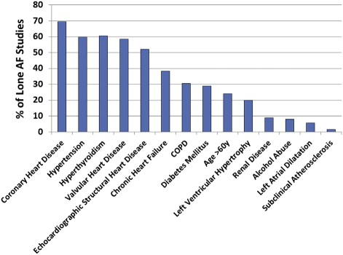
Lone AF
Large variation exists in definitions among the available evidence
Lone AF is defined as AF in young patients (<60 years) or in patients with minimally or no heart disease.
More precisely it is the absence of clinical history or echocardiographic evidence of concomitant cardiovascular or pulmonary conditions or an acute trigger for AF.
Camm AJ EHJ 2010;31:2369; Wyse DG JACC 2014;63:1716

Slide 4
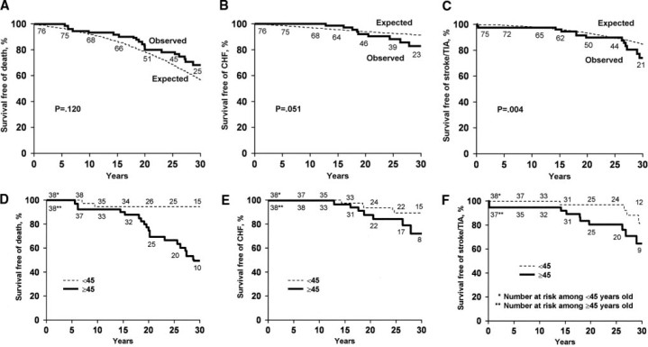
Lone AF
Lone AF has been considered as a condition burdened by a low risk of adverse events and not worthy of OAC treatment.
Jahangir A Circulation 2007;115:3050; Camm AJ EHJ 2010;31:2369

Slide 5
AIM
Aim of this study is to describe the epidemiology, associated risk factors and prescription of OAC among Lone AF patients over 15 years across three European Society of Cardiology observational registries on AF:
EORP-AF Pilot Registry
EORP-AF Long-Term Registry
Euro Heart Survey on AF Registry

Slide 6
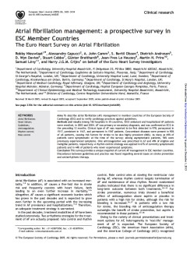
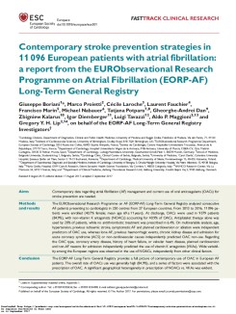
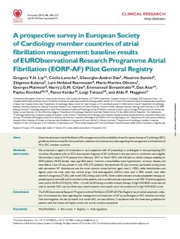
Methods
Lone AF was defined as follows:
Absence of clinical or echocardiographic other cardiovascular diseases (including hypertension), associated pulmonary disease, cardiac abnormalities or congenital diseases or age <65 years.
EHS on AF 2005
EORP-AF LT 2017
Prevalence, Clinical Profile, Thromboembolic Risk and OAC prescription in Lone AF patients were evaluated overall and across the three registries.
EORP-AF Pilot 2014

Slide 7
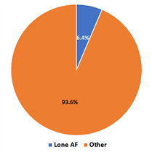
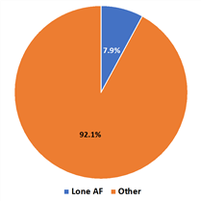
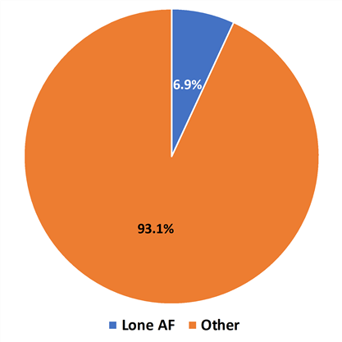
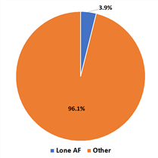
Results
Overall Prevalence N= 19548
EHS on AF
EORP-AF LT
EORP-AF Pilot
p<0.001

Slide 8
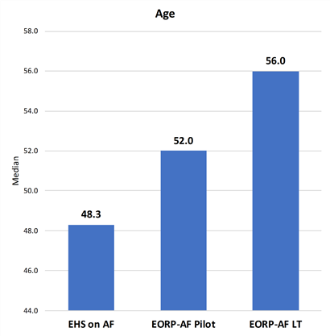
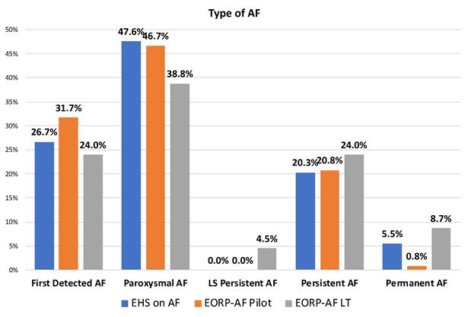
Results

Slide 9
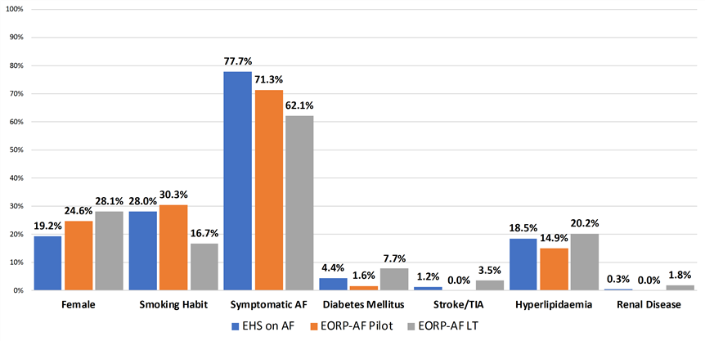
Results

Slide 10
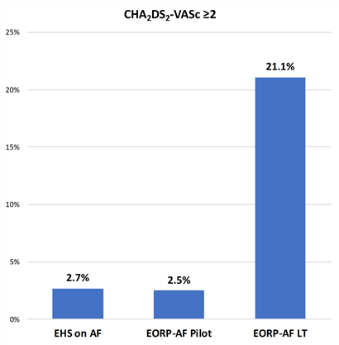
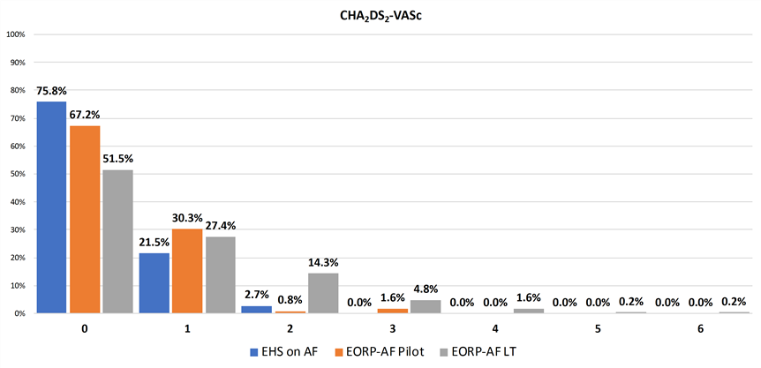
Results

Slide 11
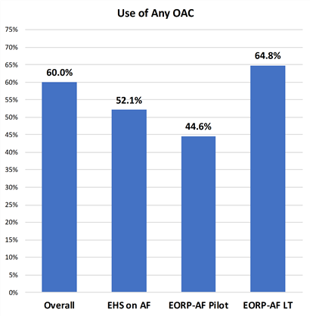
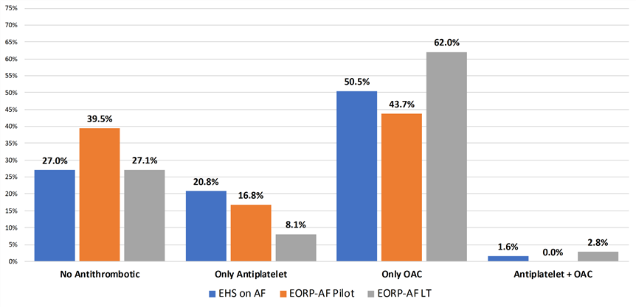
Results

Slide 12
Results
Univariate Logistic Regression for OAC Prescription
 | OR (95% CI)
Age | 1.05 (1.04-1.06)
Type of AF*
Paroxysmal | 1.34 (1.01-1.77)
LS Persistent | 11.60 (3.49-38.56)
Persistent | 4.471 (3.12-6.41)
Permanent | 3.13 (1.87-5.25)
Diabetes Mellitus | 2.40 (1.40-4.10)
Hyperlipidaemia | 1.58 (1.17-2.14)
Symptomatic Status†
Previously Symptomatic | 0.55 (0.37-0.82)
Currently Symptomatic | 0.77 (0.55-1.08)
No Physical Activity | 1.35 (1.03-1.75)
Smoking Habit | 0.54 (0.41-0.72)
Stroke/TIA | 10.06 (2.40-42.18)
Registry
EHS on AF | -
EORP-AF Pilot | 0.74 (0.49-1.13)
EORP-AF LT | 1.69 (1.30-2.20)
Multivariate Logistic Regression for OAC Prescription
 | OR (95% CI)
Age | 1.04 (1.03-1.05)
Type of AF*
Paroxysmal | 1.28 (0.95-1.74)
LS Persistent | 9.41 (2.79-31.71)
Persistent | 3.94 (2.69-5.79)
Permanent | 2.45 (1.36-4.43)
Smoking Habit | 0.70 (0.51-0.95)
Stroke/TIA | 17.20 (2.28-129.73)
*First Detected as reference
†Never Symptomatic as reference

Slide 13
Conclusions
Over the last 15 years patients with Lone AF increased and were progressively more burdened with non-cardiac stroke risk factors.
Baseline thromboembolic risk is progressively increasing
A significant change in treatment has been found, with OAC prescription increased over time
Among other predictors, history of Stroke/TIA is the clinical factor more strongly associated with OAC prescription
Future analysis on major clinical event risks and role of OAC therapy will further elucidate the actual risk in Lone AF patients

