Slide 1




Intracoronary ALLogeneic Heart STem Cells to Achieve Myocardial Regeneration (ALLSTAR): A Randomized, placebo- controlled, double-blind trial
Timothy D. Henry, Dean J. Kereiakes, Glenn Kowalchuk, Frank Aguirre, Konstantinos Malliaris, Anthony DeMaria, Gary Francis, Thomas J. Povsic, Richard Schatz, Jay H. Traverse, Tarun Chakravarty, Janice Pogoda, Paula Williams, Jeff Rudy, Rachel D. Smith, Linda Marbán, Deborah D. Ascheim, Eduardo Marbán, Raj R. Makkar
For the ALLSTAR Investigators

Slide 2
Disclosures
Trial Sponsors: Capricor, Inc.; NIH/NHLBI (Phase I - 1RC3HL103356
ARRA grant)
Funded in part by California Institute for Regenerative Medicine (CIRM; Phase 2)
Co-PIs Timothy D. Henry & Raj Makkar
Steering Committee
Anthony DeMaria, MD – Chair
Gary S. Francis, MD Frank Aguirre, MD Thomas Povsic, MD, PhD Richard Schatz, MD
Eduardo Marbán, MD – Advisor

Slide 3
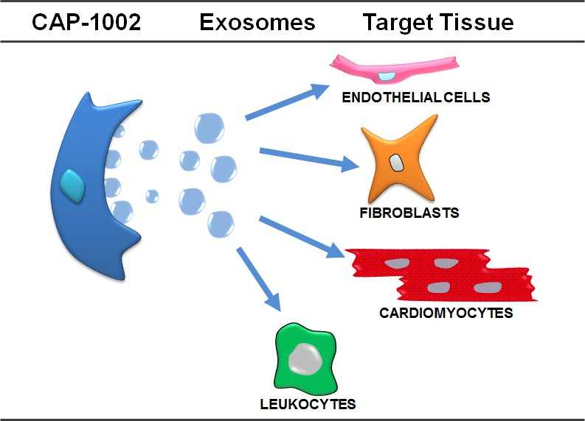
Introduction
Previous trials have demonstrated potential benefit of stem cell therapy in patients with recent MI
Phase 1 data with autologous cardiosphere-derived cells (CDCs)
demonstrated scar size reduction and
evidence for myocardial regeneration
Allogenic CDCs (CAP-1002) are equivalent to autologous CDCs in preclinical studies
Over 100 peer reviewed papers
regarding CAP-1002 since 2007

Slide 4
Rationale for Using CDCs to Treat
Post MI Cardiomyopathy
Diverse effects of CDCs support their potential to retard or reverse the
multiple pathological processes that contribute to post-MI cardiomyopathy
Pathophysiology |  | CDCs
Oxidative/nitrosative stress |  | Anti-oxidative
Inflammation |  | Anti-inflammatory
Apoptosis |  | Anti-apoptotic
Remodeling |  | Anti-remodeling
Loss of cardiomyocytes |  | Regenerative

Slide 5
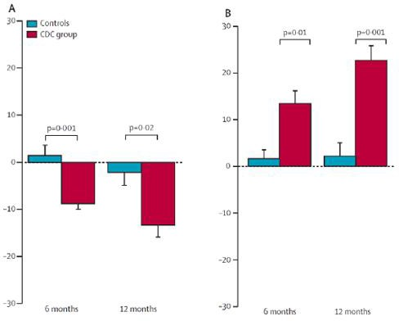

CADUCEUS: Phase I Autologous CDCs
Scar Mass (g)
Viable Mass (g)
Cedars-Sinai & Johns Hopkins
Recent MI
LVEF 25-45% following
successful PCI
2:1 allocation to autologous CDCs or routine care
Dose escalation 12.5-25M
cMRI at baseline, 6, 12 months
Makkar RR, et al., Lancet. 2012
Malliaras K, et al., J Am Coll Cardiol. 2014

Slide 6
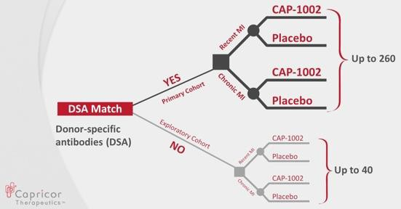
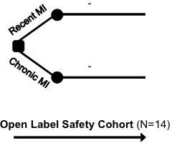
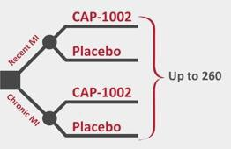
ALLSTAR Trial Design
Phase 1 | DSMB Review | Phase 2
(2:1)
* Funded by NIH ARRA RC3
* Funded by CIRM

Slide 7
Key ALLSTAR Eligibility Criteria
Inclusion Criteria
History of STEMI or NSTEMI w/in 12 mo
Successful PCI (TIMI flow = 3) in
infarct related artery
LVEF < 45%
LV infarct size > 15% of LV mass in qualifying infarct-related region (by MRI core lab)
No further revascularization
needed
Age > 18 years
Exclusion Criteria
Prior CABG
Hx ACS within 4 wks prior to infusion
Hx previous stem cell therapy
Prior ICD or pacemaker at site not certified to conduct cMRI with device
Estimated GFR < 30 mL/min
Participation in another clinical trial w/in the last 30 days
Current alcohol or drug abuse

Slide 8
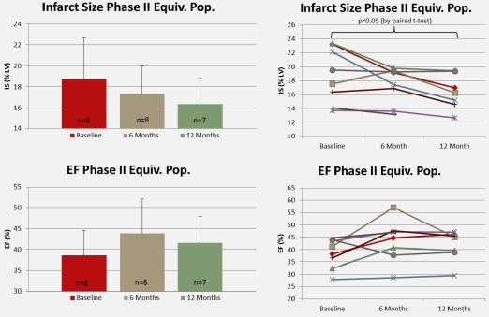

ALLSTAR Open Label Phase I Efficacy
15% reduction in scar size at one year
4% improvement in EF at one year

Slide 9
ALLSTAR Phase II Efficacy Endpoints
Primary efficacy endpoint: % change from baseline in infarct
size (cMRI as a % of LV mass) at 12 months
Secondary efficacy endpoint: absolute and % change from baseline in LV structure and function, clinical function, and cardiac biomarkers at 6 and 12 months post-infusion

Slide 10
ALLSTAR Phase II Enrollment &
Baseline Characteristics
245 pts screened
 | CAP-1002 (N = 90) | Placebo (N = 44)
Sex, male | 84.4% | 86.4%
Age [mean (SD)] | 54.8 (11.25) | 53.8 (10.23)
LVEF [mean (SD)] | 39.9% (6.62) | 38.7% (8.12)
LV Scar [mean (SD)] | 21.9% (5.15) | 23.0% (5.19)
LVESV [mL (SD)] | 129.6 (39.4) | 140.2 (46.2)
LVEDV [mL (SD)] | 213.1 (47.4) | 225.5 (52.4)
NTproBNP [pg/mL (SD)] | 883.8 (1122.8) | 736.2 (700.9)
MI other than index | 15.6% | 15.9%
103 excluded
95 randomized to CDCs
47 randomized to PBO
5 not infused
90 infused
3 not infused
44 infused
90 pts followed
matched (n=77); unmatched (n=13)
45 pts followed
matched (n=45); unmatched (n=0)
12 mos of on-study observation followed by 4 years of LT F/U

Slide 11
Interim Analysis
Pre-specified interim analysis – after all subjects observed ≥ 6
months
– All data for 134 treated subjects (Primary Cohort, n=121;
Exploratory Cohort, n=13)
Given low probability that treatment effect would be observed in primary 12 month efficacy analysis, all subjects were transitioned to annual follow-up

Slide 12
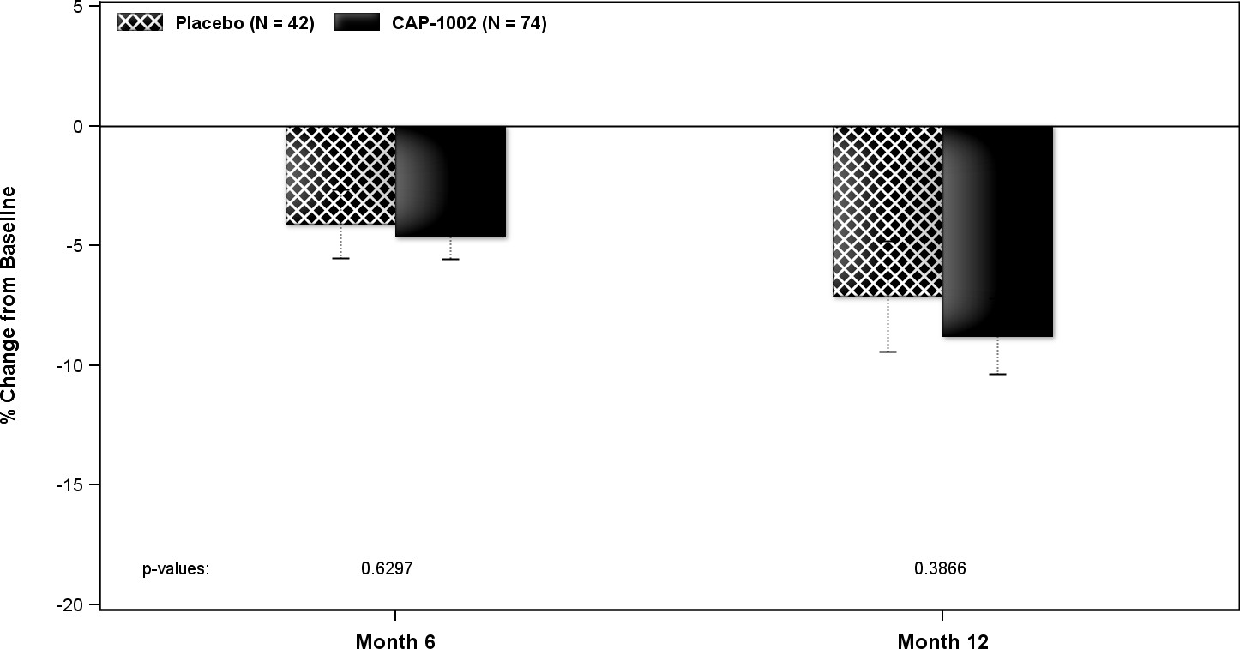
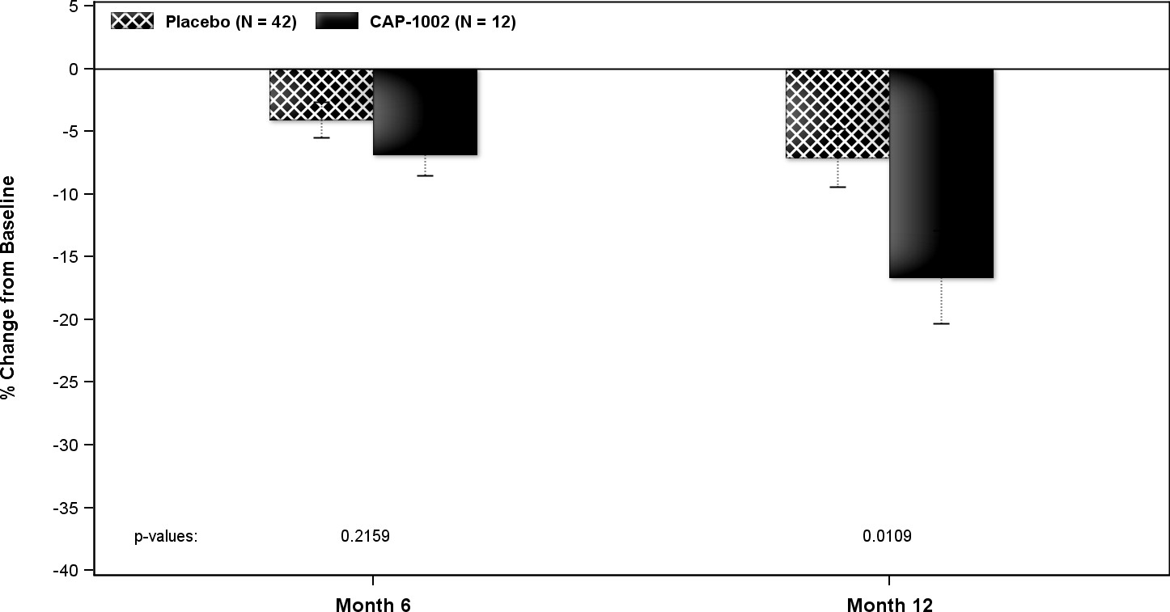





Change in Scar Size by MRI
Matched
Primary mITT Population
Unmatched
Exploratory CAP-1002 & Placebo mITTs
p = 0.63
p = 0.39
p = 0.22
p = 0.01
p = 0.63
p = 0.39

Slide 13
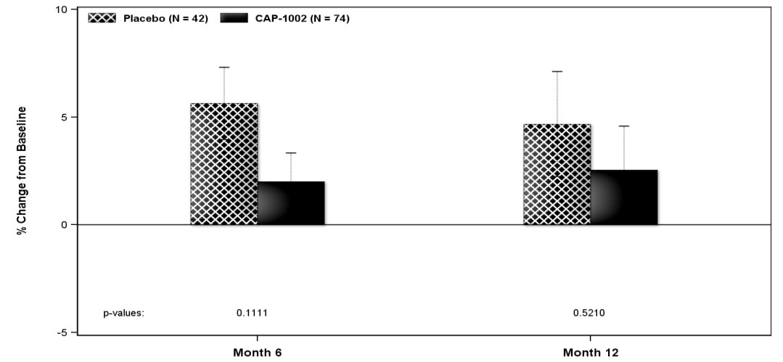
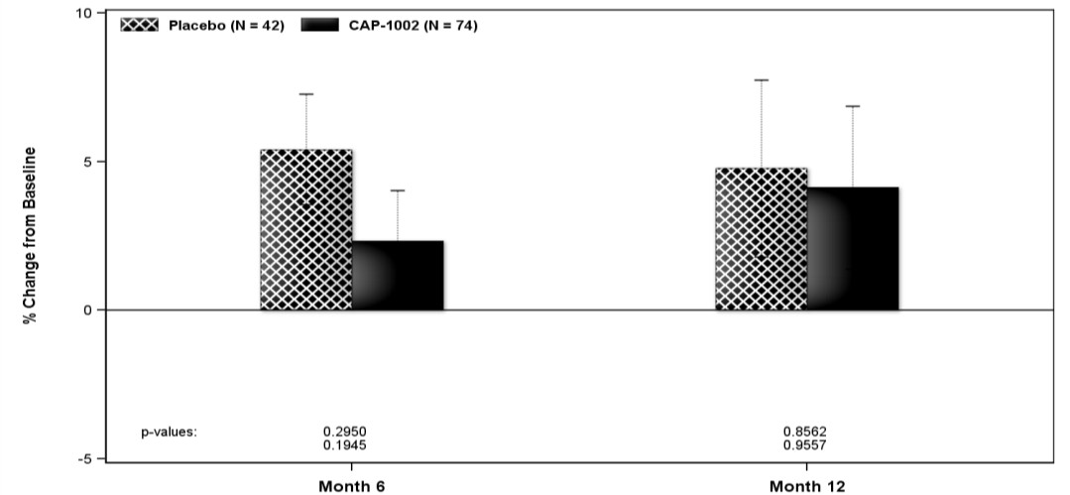








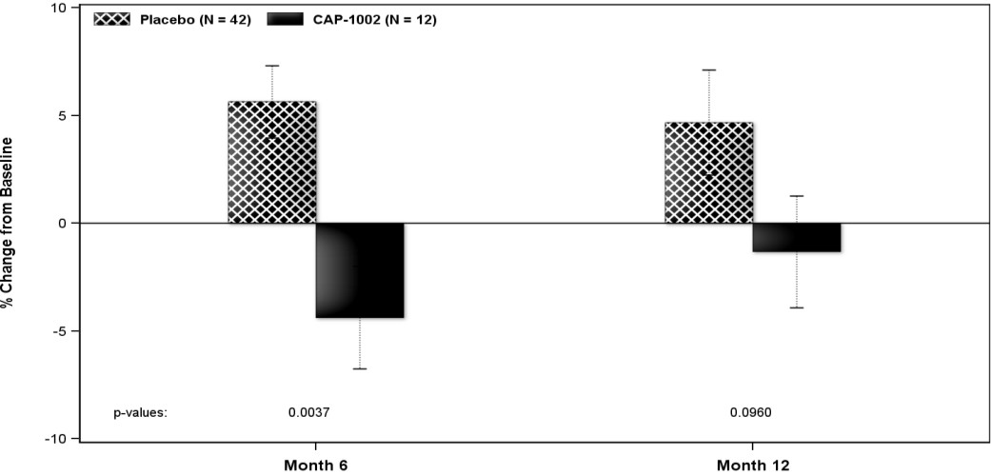
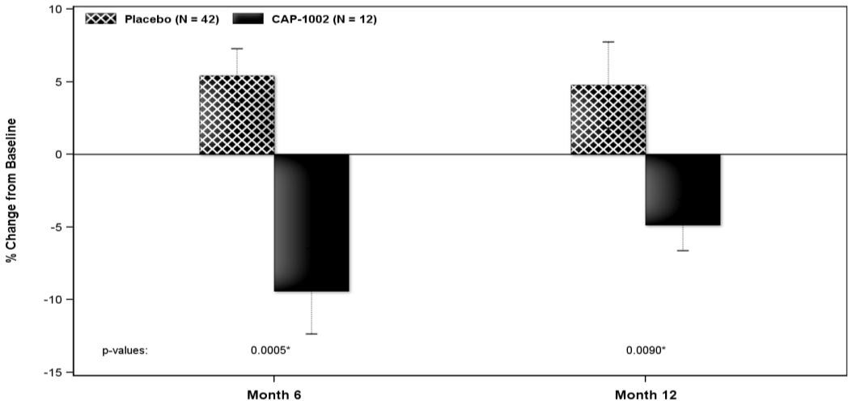






LV Volumes
“Matched”
LVEDV
LVESV
p = 0.11
p = 0.52
p = 0.30
p = 0.86
“Unmatched”
p = 0.004
p = 0.10
p = 0.0005
p = 0.009

Slide 14
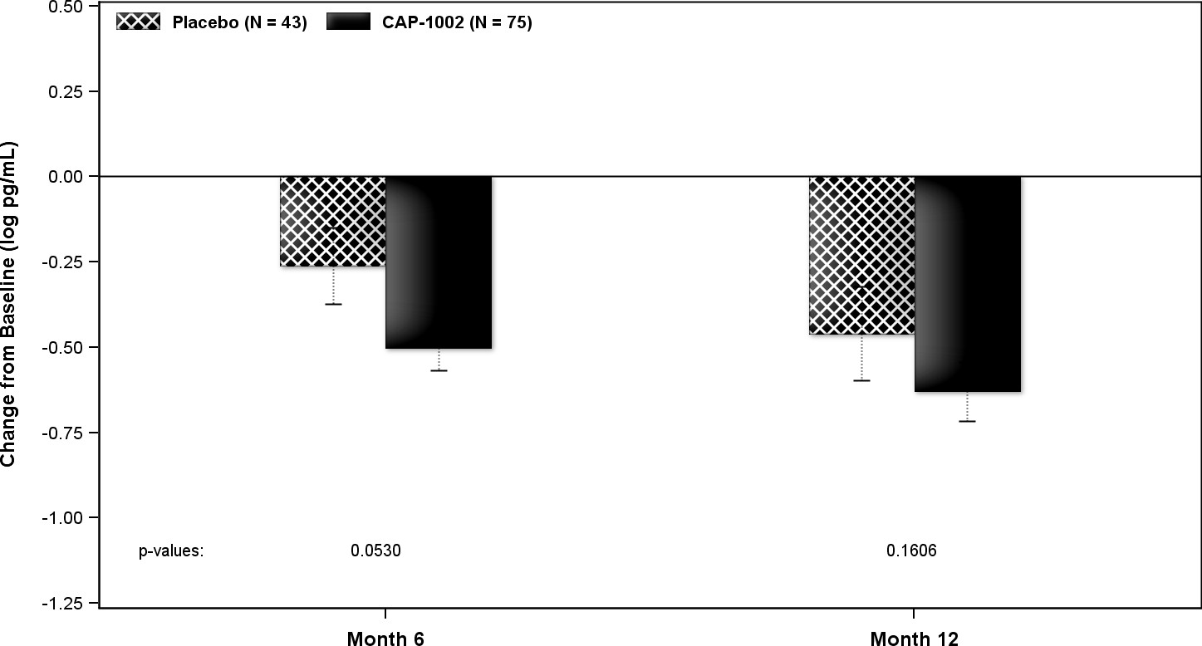
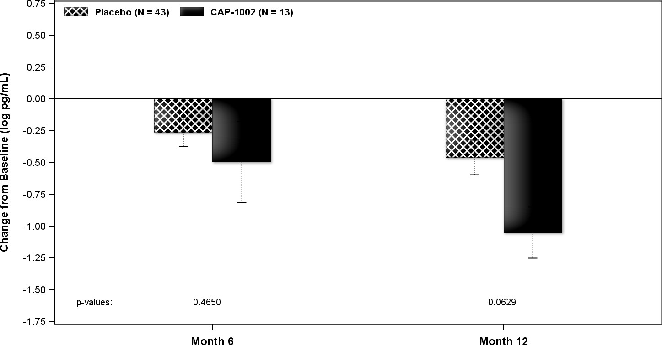







NT-proBNP
“Matched”
“Unmatched”
p = 0.053
p = 0.16
p = 0.47
p = 0.06

Slide 15
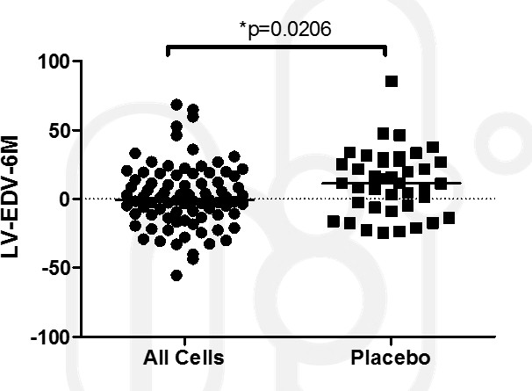
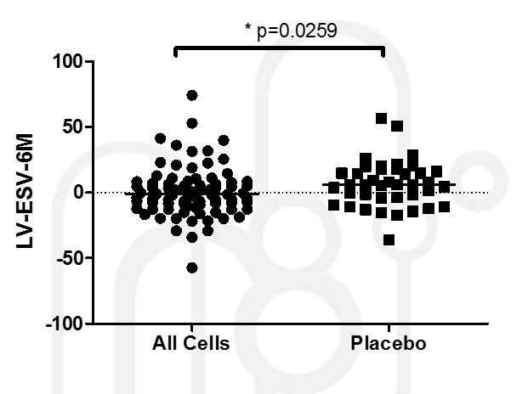
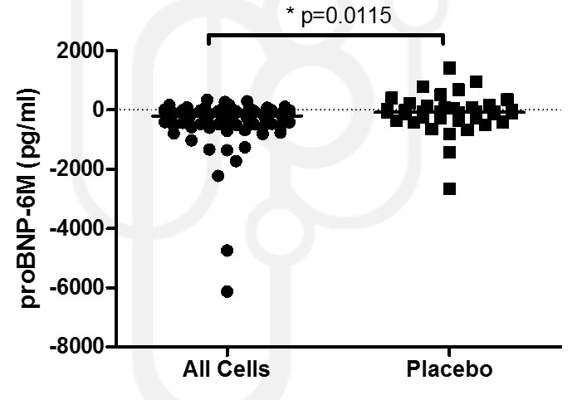
Overall Outcomes
(all CAP-1002 vs placebo, 6 months)
Δ LVEDV
Δ LVESV
Δ NT-proBNP
p = 0.0206
p = 0.0259
p = 0.0115
Deltas from Baseline to 6 months. Post hoc analysis, Mann-Whitney tests, 2-tailed

Slide 16
Safety and Clinical Events
Safety
No primary safety endpoint events were observed during the study
No significant treatment group difference in SAE rates
Clinical Events (adjudicated)
Clinical Events [n (%)] | CAP-1002 (N = 90) | Placebo (N = 44) | p-value
Death | 0(0.0) | 0(0.0) | --
Non-fatal MI | 3 (3.3) | 4 (9.1) | 0.22
HF Hosp | 4 (4.4) | 3 (6.8) | 0.68
Stroke | 0 (0.0) | 1 (2.3) | 0.33
MACE | 7 (7.8) | 5 (11.4) | 0.49

Slide 17
Conclusions
No significant difference in scar size based on 6 or 12
month MRI
Signs of improvement in LV volumes and BNP
Very low clinical events → favoring the treatment group
Challenges
  Recruitment of patients with large anterior MI
  MRI endpoint dropout and variability
To be investigated: Influence of matched vs unmatched
cells

Slide 18
Acknowledgments
Cedars-Sinai Medical Center – R. Makkar & T. Henry (17)*
Linder Center for Research & Education – D. Kereiakes (11)
Prairie Education and Research – F. Aguirre (11)
Sanger Heart & Vascular Institute – G. Kowalchuk (10)
Scripps Green Hospital – R. Schatz (9)*
Minneapolis Heart Institute– J. Traverse (6)*
Unv. Massachusetts Memorial – J. Rade (6)
Unv. Pittsburgh Medical Center – C. Toma (6)
Unv. Utah – C. Selzman (6)
Unv. Kentucky – A. Abdel-Latif (5)
Austin Heart – R. Gammon (4)
Ohio Health Research Institute – C. Sanchez (4)
SUNY Buffalo – V. Iyer (4)
Rush University Medical Center – G. Schaer (3)
Duke University Hospital – T. Povsic (3)
MHVI - J. Chambers (3)
Swedish Medical Center/ H & V Research – P. Huang (3)
The Ohio State University – K. Boudoulas (3)
UVMC – M. Watkins (3)
Aurora Healthcare – T. Bajwa(2)
Cardiology PC – F. Mendelsohn (2)
Heart Center Research/Huntsville – A. Vasquez (2)
Michigan CV Institute – S. Kassas (2)
Ottawa Heart Institute – M. Le May (2)
Unv. Florida Health Shands Hospital – C. Pepine (2)
Lenox Hill Hospital – V. Singh (1)
NC Heart – J. Zidar (1)
Unv. Pennsylvania – S. Khandhar (1)
Unv. Texas/Mem Hermann – H.V. Anderson (1)
Unv. Washington – C. Don (1)
*Participated in Phase I

Slide 19
BACKGROUND SLIDES

Slide 20
ALLSTAR Phase II Demographic & Baseline
Characteristics
 | CAP-1002 (N = 90) | Placebo (N = 44)
Sex, male | 84.4% | 86.4%
Age (years) [mean (SD)] | 54.8 (11.25) | 53.8 (10.23)
Race, white | 87.8% | 81.8%
LVEF [mean (SD)] | 39.9% (6.62) | 38.7% (8.12)
LV Scar Size [mean (SD)] | 21.9% (5.15) | 23.0% (5.19)
MI other than index event | 15.6% | 15.9%
Angioplasty other than index event | 23.3% | 25.%
Hypertension | 58.9% | 63.6%
Diabetes | 21.1% | 31.8%
ACE or ARB | 87.8% | 86.4%
ACE/neprilisyn inhibitors | 1.1% | 2.3%
Beta blockers | 97.8% | 100%
Diuretics | 14.4% | 29.5%
Aldesterone antagonists | 31.1% | 22.7%
Antithrombotic agents | 100% | 100%
Lipid lowering agents | 96.7% | 95.5%
Aspirin | 96.7% | 100%

Slide 21
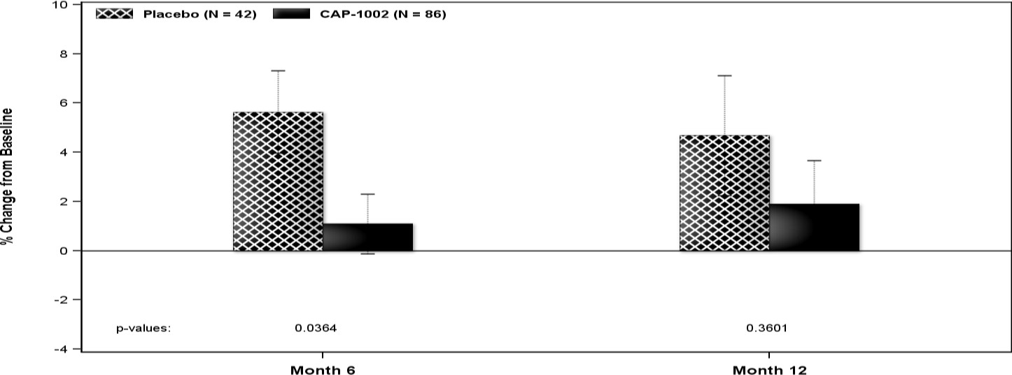
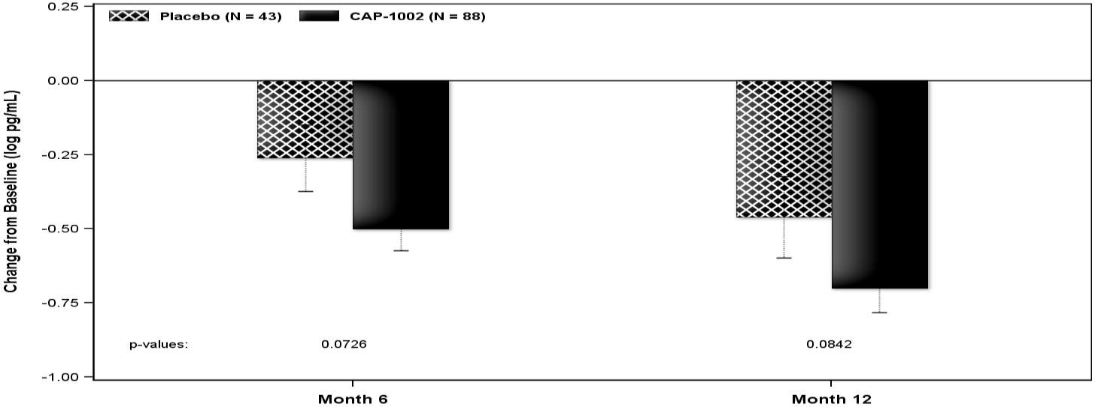
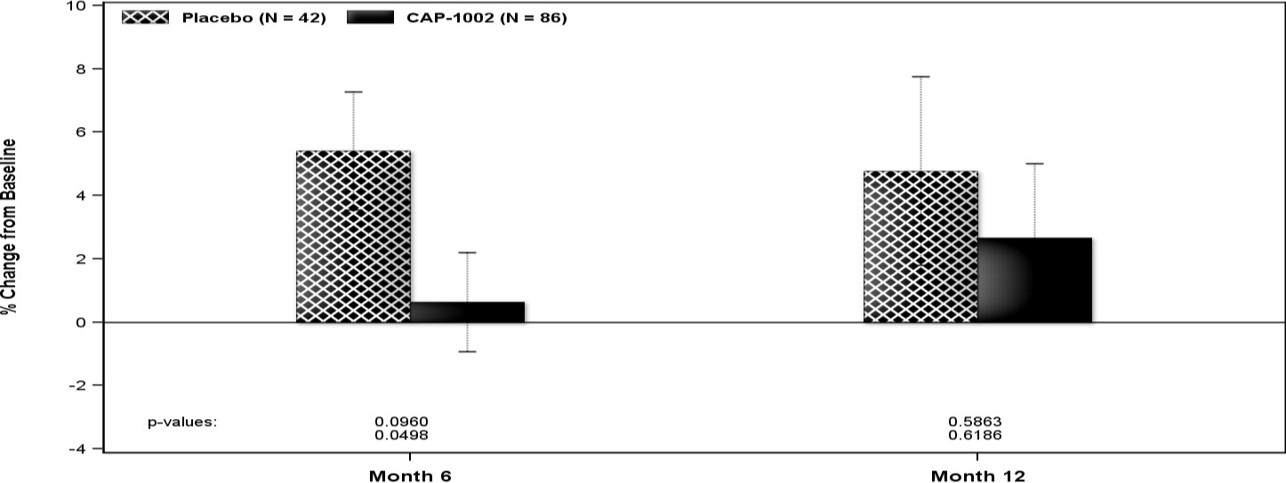
Overall Outcomes (All CAP-1002)
LVEDV
NT-proBNP
p = 0.04
p = 0.36
LVESV
p = 0.07
p = 0.08
p = 0.096
p = 0.58

Slide 22
Interim Analysis
Pre-specified interim analysis – after all subjects observed ≥ 6 months
  All data for 134 treated subjects (Primary Cohort, n=121; Exploratory Cohort, n=13)
Results of the analysis demonstrated:
  No difference in primary endpoint (% change from baseline in scar as % LV mass)
  Reduction (p = 0.054) in LVEDV, trend in reduction of LVESV (p = 0.09) and NT-proBNP (p = 0.11)
  No Safety signals in CAP-1002 cohort
Given low probability that treatment effect would be observed in primary 12 month efficacy analysis, all subjects were transitioned to annual follow-up

