Slide 1
Evaluation of a Technology Assisted Web Application to Qualify for Nonprescription Statin Administration
Steven E. Nissen MD MACC
Disclosure
Clinical Trials: AbbVie, Arrowhead, AstraZeneca, Bristol Myers Squibb, Eli Lilly, Esperion, Medtronic, New Amsterdam, Novartis, and Silence Therapeutics.
Companies are directed to pay any honoraria, speaking or consulting fees directly to charity so that neither income nor a tax deduction is received.

Slide 2
Co-Authors
Steven E. Nissen MD, Howard G. Hutchinson MD, Kathy Wolski MS, Karol Watson MD, Seth S. Martin MD MHS, Erin D. Michos MD, William S. Weintraub MD, Melanie Morris BS, Leslie Cho MD, Luke Laffin MD, Douglas Jacoby MD, Christie M. Ballantyne MD, Jan Ekelund MSc, Filip Birve BS, Venu Menon MD, Michelle Strzelecki RN, and Paul M. Ridker MD
Trial sponsor: AstraZeneca

Slide 3
Background
Although statins reduce major adverse cardiovascular outcomes, less than half of eligible patients receive treatment.
Multiple past attempts to address this problem through OTC statins were unsuccessful in achieving regulatory approval.
There were major concerns about inappropriate use
by consumers for whom statins could be unnecessary or unsafe.
The current study sought to address this problem through a novel technology-assisted self-selection Web Application to qualify consumers for nonprescription access to rosuvastatin (5 mg).

Slide 4
Web App Features
Developed as “Software as a Medical Device” based on FDA guidance.
To determine eligibility, Web App calculates 10-yr ASCVD risk score (pooled cohort equations) in 2018 Cholesterol Treatment Guidelines and a proposed Drug Facts Label for rosuvastatin.
Possible Outcomes: ‘OK to Use’, ‘Ask a Doctor’, or ‘Do Not Use.’
Only those with ‘OK to Use’ or ‘Ask a Doctor’ outcome could qualify and enroll.

Slide 5
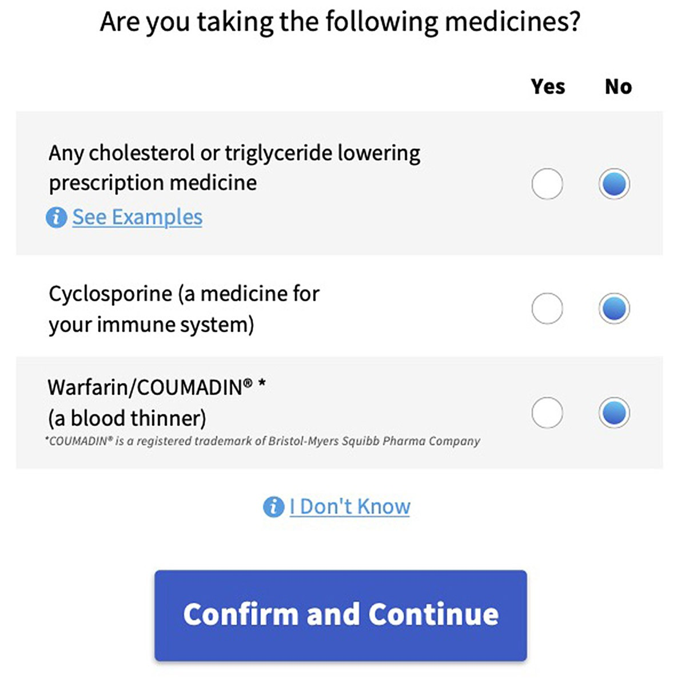
Examples of Web App Data Entry Screens

Slide 6
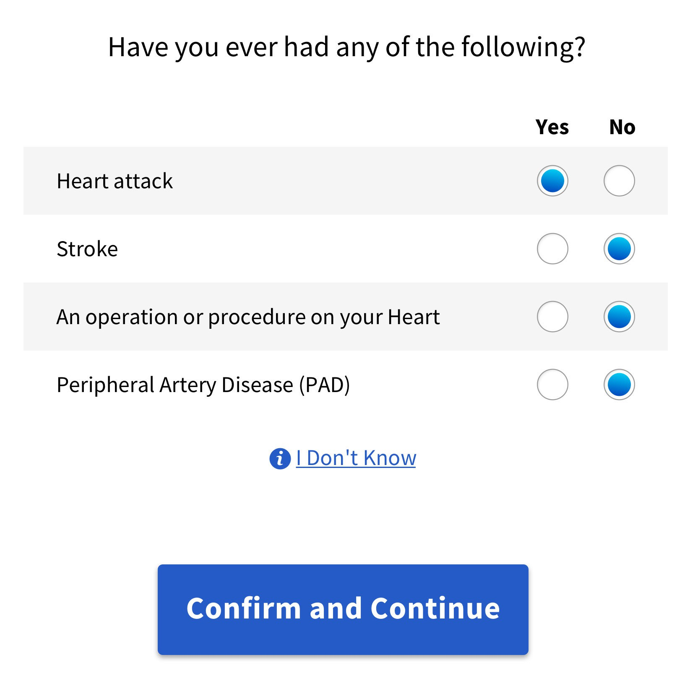
Exclusion of Participants Needing High-Intensity Statins

Slide 7
Outcomes Reported to Non-Qualified Participants
Do Not Use Talk to a Doctor

Slide 8
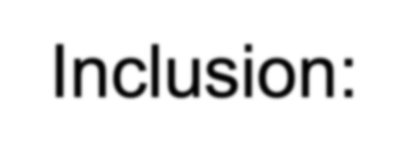
Selected Inclusion and Exclusion Criteria
Inclusion:
Men or women 20-75 year of age
Ability to read and understand English
Access to the Internet
Exclusion:
Women of childbearing potential (unless using acceptable method of birth control)
Any healthcare professional (physician, nurse, pharmacist, etc.) or ever employed by healthcare company

Slide 9
1196 Participants Enrolled: Co-Primary Endpoints
Compare consumer and HCP initial assessments (1st Co-Primary)
Participant Responds to Ad
Completes Web App assessment
Qualifies; Order medication
Virtual VISIT 1 HCP interview; Independent assessment
Compare consumer and HCP final assessments (2nd Co-Primary)
Virtual VISIT 2 HCP interview; Independent assessment
Retake Web App assessment; Reorder drug
Home drug delivery
LDL-C Retest
(3rd Co-Primary: LDL-C reduction)
HCP=Healthcare Professional

Slide 10
1st and 2nd Co-Primary Endpoint Evaluation Process
Clinicians conducting virtual visit interviews were blinded to participant’s self-selection outcome assessments.
Separate clinical coding team compared participant and clinician outcomes to determine if they were concordant.
If the outcomes differed or there was disagreement within the coding team, an adjudication team at the academic coordinating center (C5Research) further assessed concordance.

Slide 11
Statistical Analysis of Co-primary Endpoints
Concordance for initial self-selection compared:
Success defined as a lower bound of the 95% CI >85%
Concordance for final use assessment compared:
Success defined as a lower bound of the 95% CI >85%
Percent change from baseline in LDL-C determined:
Success defined as upper bound of 95% CI < -15%

Slide 12
Baseline Characteristics of Participants (n=1196)
Age (years) | 63 years
Male (%) | 60.4%
Race
White | 79.3%
Black | 11.7%
Hispanic | 3.2%
Limited literacy | 4.1%
Retired | 42.0%
Full-Time | 40.6%
Mean LDL-C | 139.6 mg/dL
Median systolic BP | 130.0 mmHg
Median 10-year risk | 10.1%
College or technical school education grad | 74%
High school or some college | 25.5%

Slide 13
Results: Co-Primary Endpoints
Overall concordance between consumers and clinicians for initial self-selection was 90.7% (95% CI, 88.9 to 92.3).
Concordant for “OK to Use” 80.3%, “Ask a Doctor” in 3.9%, and independently adjudicated as concordant in another 6.5%.
Final use assessment was concordant in 98.1% (95% CI, 97.1
to 98.8).
Concordant for “OK to Use” 72.4%, “Ask a Doctor” in 1.2%, correct rejectors 7.3%, and adjudicated as concordant in another 17.2%.
Mean change in LDL-C was -35.5% (95% CI, -36.6 to -34.3).

Slide 14
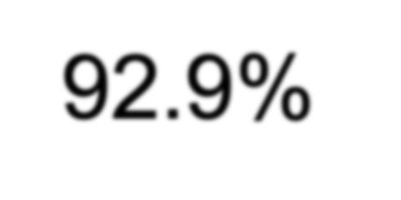
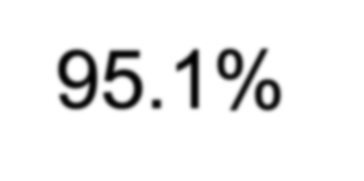
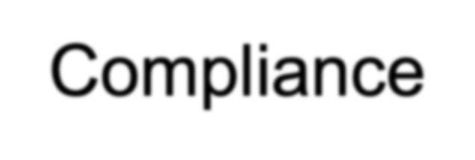
Secondary Outcomes
Compliance with retesting of LDL-C was 83.8% for the full population and 92.9% for those qualified at all reassessments.
Adherence based on pill counts was 95.1% (IQR, 84.6 to 98.9).
Compliance with ‘Ask a Doctor’ and ‘Do Not Use’ warnings were 83% and 80%, respectively. Instances of noncompliance were not associated with a significant safety risk.
No participants experienced a “Stop Use” warning.

Slide 15
Most Common Adverse Events
Any Adverse Event | 52.9%
SARS-CoV-2 positive test | 9.6%
Arthralgia | 7.0%
Headache | 5.4%
Pain in extremity | 4.3%
Myalgia | 4.1%
Adverse Event Leading to Drug Discontinuation | 7.1%
Musculoskeletal disorders | 3.1%
General disorder | 1.1%
Gastrointestinal Disorders | 0.8%
Serious Adverse Events (none related to study drug) | 2.3%

Slide 16
Limitations
The study was 6 months in duration. It remains uncertain whether self-selection can lead to long term adherence.
Only participants who could read and understand English and who had internet access were enrolled.
Other approaches to provide safe access to a nonprescription statin would be required for those who are unable to use technology.

Slide 17
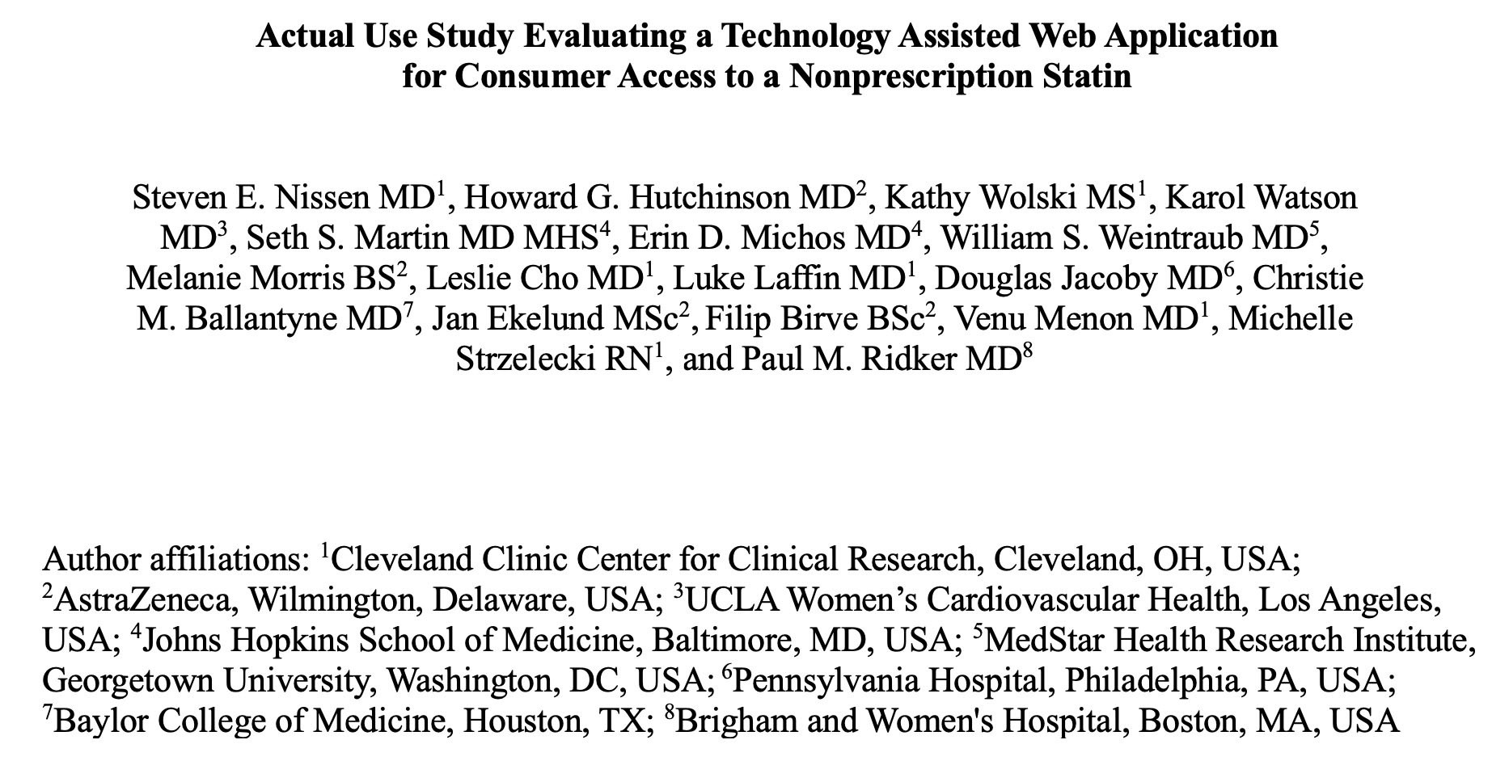
Manuscript Now Accessible at https://www.jacc.org

Slide 18
Conclusions
In an actual use study of technology assisted self-selection
for access to nonprescription rosuvastatin, 90.7% of consumers correctly self-selected for statin use.
98.1% demonstrated correct use during the trial.
Participants had a high level of adherence, 92.9% retested, and achieved clinically meaningful (35.5%) reduction in LDL-C.
There were no major safety issues.

Slide 19
A Final Thought
With less than half of eligible primary prevention patients receiving statins, innovative approaches to close this treatment gap are needed.
The use of a Web App to qualify for a nonprescription statin has the potential to expand access and reduce subsequent major cardiovascular events.

