Slide 1
Final results from the CENTURY II trial: 5-year clinical outcomes after bioresorbable versus durable polymer drug eluting stent implantation
Shigeru Saito¹, William Wijns on behalf of CENTURY II-investigators
¹Shonan Kamakura General Hospital, Kanagawa, Japan

Slide 2
Potential conflicts of interest
Saito S:
I have the following potential conflicts of interest to report
Consultant: Terumo

Slide 3
CENTURY II
Why this study?
The aim of the CENTURY II trial was to establish long-term safety and efficacy of
a sirolimus-eluting stent with bioresorbable polymer coating, Ultimaster (BP-
SES), by comparing it with permanent, biocompatible, polymer-coated, Xience
everolimus-eluting stent (PP-EES).
Inclusion criteria
Exclusion criteria - general
Additional exclusion criteria - Japan
AMI < 48h
Target lesion located in left-main trunk
Ostial lesions
Lesion in venous or arterial graft
Previous (<1month) PCI with stenting
Previous stenting in target lesion
Age ≥ 18 years (≥20 years Japan)
Suitable for treatment with DES
RVD matching stents 2.5-4.0 mm
Diameter stenosis >50%
Eligible for DAPT
EF<25%
Renal failure
Cardiogenic shock
Planned staged procedure

Slide 4
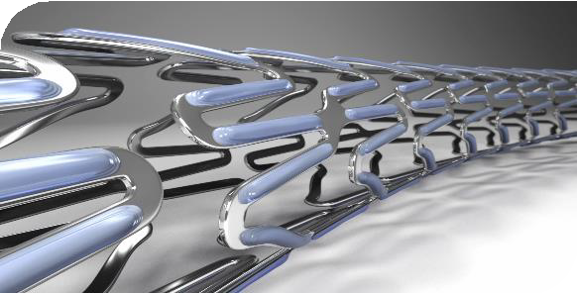
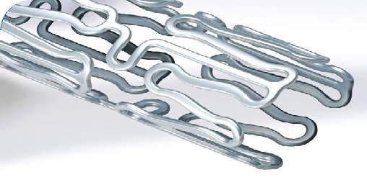
CENTURYII – Study devices What did we study?
 | Ultimaster BP-SES | Xience PP-EES
Platform | Thin-strut (80µm) Co-Cr Open cell design | Thin-strut (81µm) Co-Cr
Drug Carrier | PDLLA-PCL copolymer resorbed within 3-4 months | PVDF-HFP non-erodable fluorinated copolymer
Coating | Abluminal gradient coating technology | Circumferential coating
Drug | sirolimus 70 µg/cm² | everolimus 100 µg/cm²

Slide 5
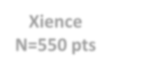
CENTURY II – Study design How was the study executed?
Total population (per-protocol analysis) N=1101 pts
Randomization (1:1)
Principal investigators: William Wijns Shigeru Saito
Ultimaster
N=551 pts
Xience
N=550 pts
Single blind, non-inferiority multi-center study 58 global study sites in Europe, Japan and Korea
Clinical Follow-up
0d 30d
4mo
9mo
12mo
2yr
3yr
4yr
5yr
Primary endpoint – Freedom from target lesion failure (TLF) at 9 months
Non-inferiority of the primary endpoint at 9 months was met: Freedom from TLF: Ultimaster vs. Xience 95.6% vs. ^{95.1%; p}non-inferiority ^{<0.0001}
5 years FU
(95.9%)
All data were monitored by independent data monitoring committee and adverse events were adjudicated by an independent clinical event committee

Slide 6
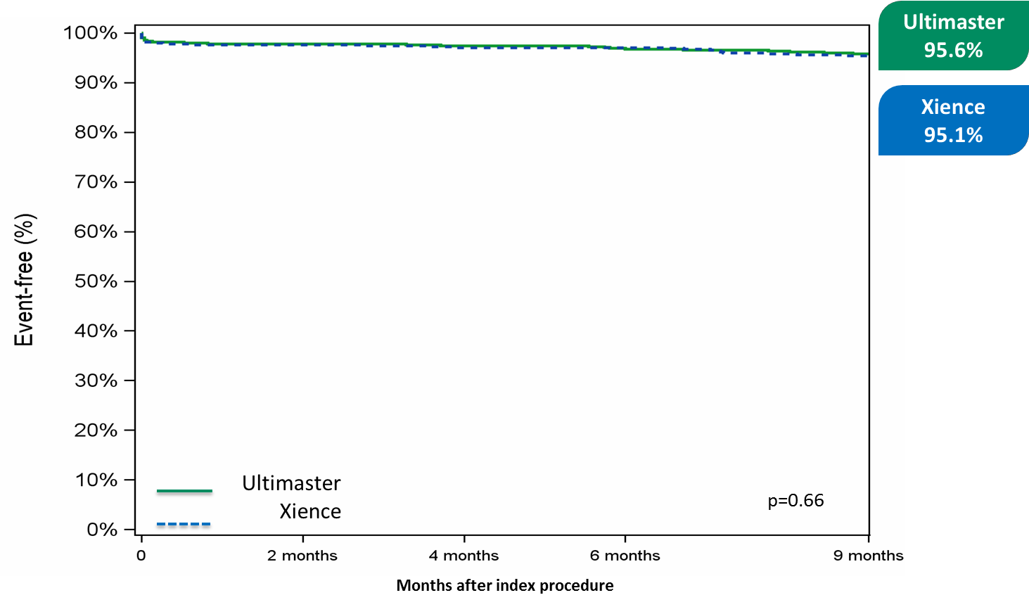
CENTURY II
Primary endpoint 9-month TLF-free rate
TLF: target lesion failure defined as cardiac death, target vessel myocardial infarction and target lesion revascularization

Slide 7
CENTURY II
Baseline patient characteristics
 | Ultimaster N=551 pts |  | Xience N=550 pts |  | P
Age, years (mean±SD) | 65.2±10.5 |  | 65.5±10.6 |  | 0.61
Gender – male, % | 78.6 |  | 82.4 |  | 0.11
DM, % | 31.9 |  | 30.9 |  | 0.71
IDDM, % | 16.5 |  | 14.7 |  | 0.65
Hypertension, % | 73.3 |  | 67.8 |  | 0.05
Current Smoker, % | 22.2 |  | 23.9 |  | 0.50
Previous smoker, % | 46.7 |  | 42.0 |  | 0.12
Previous MI, % | 28.3 |  | 27.6 |  | 0.80
Previous PCI, % | 37.2 |  | 35.0 |  | 0.45
Previous CABG, % | 4.5 |  | 3.7 |  | 0.46
Peripheral vascular disease, % | 9.6 |  | 6.6 |  | 0.06
High risk ACS, % | 22.5 |  | 24.7 |  | 0.39
ACS= acute coronary syndrome, CABG= coronary artery bypass graft, DM= diabetes mellitus, IDDM= insulin-dependent DM, MI= myocardial infarction, PCI= percutaneous coronary intervention,

Slide 8
CENTURY II
Baseline lesion and procedure characteristics
 | Ultimaster N=551 pts ^{N}lesions⁼⁷¹¹ |  | Xience N=550 pts ^{N}lesions⁼⁷¹⁶ |  | P
Multi-vessel disease, % | 39.6 |  | 41.3 |  | 0.56
Lesions detected, n | 2.0±1.3 |  | 2.0±1.3 |  | 0.67
Lesions treated,n | 1.3±0.6 |  | 1.3±0.6 |  | 0.62
Bifurcation/lesion, % | 13.8 |  | 14.4 |  | 0.74
Ostial/lesion, % | 6.0 |  | 8.4 |  | 0.08
Moderate/severe calcification, % | 21.5 |  | 17.7 |  | 0.70
Access site, % Radial Femoral | 71.7 26.7 |  | 73.1 25.6 |  | 0.55
N° of stents implanted/pt | 1.5±0.8 |  | 1.6±0.9 |  | 0.94
Total implanted stent length/pt | 29.5±17.0 |  | 29.6±18.1 |  | 0.66
Delivery success, % | 99.1 |  | 99.5 |  | 0.23
Procedure success/pt, % | 98.0 |  | 98.2 |  | 0.83

Slide 9
5-year angina status – DAPT - bleeding rate
Angina complaints during follow-up, %
Dual antiplatelet therapy (DAPT), %
20
98,4 98,2
Ultimaster Xience
Ultimaster Xience P=NS
100
89,9 _{86,9}
P=NS
15
80
66,1 64,7
% 10
8,4
% 60
40
7,3
7,6
7,5 _{6,9}
5,7
5,8
5,3
5,9
6,0
5
21,6 _{19,2}
15,7 _{13,6}
20
0
0
1 month 9 months 1 year 3 years 5 years 1 month 9 months 1 year 3 years 5 years
Bleeding rates
Bleeding rates – cumulative up to 1 year Bleeding rates – 1 to 5 years
20
Ultimaster Xience
20
Ultimaster Xience
P=NS
P=NS
15
%
10
15
% 10
10,9
8,9
8,0
6,0
5
2,9
4,0
5
3,8
2,6
3,3
1,6
0
0
1 month
9 months
1 year
1 to 3 years
3 to 5 years
NS: not significant (P>0.05)

Slide 10
What are the essential results?
5-year clinical outcomes
P=0.99
P=0.60
P=0.62
P=0.52
P=0.81
P=0.99
15
Ultimaster
Xience
10
%
7,6 7,6
6,5
6,2
5
3,8
2,9
3,5
3,3
1,8
2,4
1,3 1,3
0
Any death
Cardiac Death
Any MI
TV-related MI
TLR (CD)
ST
TV-related MI: target vessel-related myocardial infarction; CD: clinically driven; TLR: target lesion revascularization; ST: definite + probable stent thrombosis

Slide 11
What are the essential results?
5-year clinical outcomes
P=0.62
P=0.39
P=0.57
30
Ultimaster
Xience
25,6
25
24,1
20
%
15
10,2
11,1
10
7,1
5,8
5
0
Death and MI
Cardiac death and MI
POCE
POCE: patient-oriented composite endpoint of any death, any MI and any revascularization

Slide 12
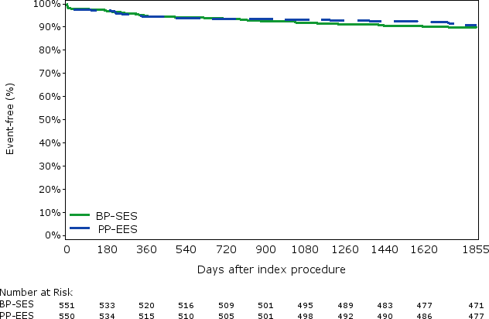
CENTURY II
5-year TLF-free rate
Xience 91.1%
Ultimaster
90.0%
Ultimaster
Xience
Log rank p=0.56
TLF: target lesion failure defined as cardiac death, target vessel myocardial infarction and target lesion revascularization

Slide 13
CENTURY II
Stent thrombosis rate during follow-up
2,0
Ultimaster
Xience
1,5
%
1,0
P=0.99
P=0.99
P=0.99
0,5
0,5
0,5
0,5
0,5
0,2
0,2
0,0
0,0
0,0
Acute
Subacute
Late
Very late

Slide 14
Why is this important?
Comparable clinical outcomes of sirolimus-eluting (Ultimaster) stent with bioresorable polymer coating versus everolimus- eluting (Xience) stent with durable polymer coating are maintained up to five years.
Particularly remarkable was the low rate of very late stent thrombosis (0.2%) in both arms.
These data supports the long term safe use and good
performance of the Ultimaster DES.

Slide 15
The essentials to remember
Why?
Establish long-term safety and efficacy of a sirolimus-eluting stent with bioresorbable polymer.
What?
Ultimaster DES with bioresorable polymer coating was compared with Xience DES with permanent,
biocompatible polymer coating.
How?
CENTURY II is a large scale, prospective, multicentre, randomized, single blind, controlled, non-
inferiority trial.
What are the results?
Comparable clinical outcomes of Ultimaster DES versus Xience DES are maintained up to five years,
with particularly low rates of very late stent thrombosis.
Why is this important?
Longest available clinical data regarding efficacy and safety following Ultimaster implantation, supporting its safe use in routine clinical PCI practice.
Final summary slide

