Slide 1

Clinical Outcomes After Interventions with DCB PCR Statement
Alexandra Lansky, MD
Professor of Medicine, Yale School of Medicine Chair Interventional Research, Barts Heart Center, Queen Mary University London

Slide 2
Disclosure Statement of Financial Interest
Speaker's name : Alexandra Lansky
Affiliation/Financial Relationship
Grant/Research Support
Company
Astra Zeneca, Abiomed, Abbott Vascular, Bard, Boston Scientific, Biocardia, Biotronik, Cagent, Cardiatis, Conformal, Gore, Intact Vascular, KeyStone Heart, Venous, Lifetech, Limflow, Medinol, Micell, Microport, Myocardia, Reva, Shockwave Medical, Surmodics, Trireme, Venus, Veryan Medical
None
None
None
None
None
Major Stock Shareholder/Equity
Royalty Income
Ownership/Founder
Intellectual Property Rights
Other Financial Benefit

Slide 3


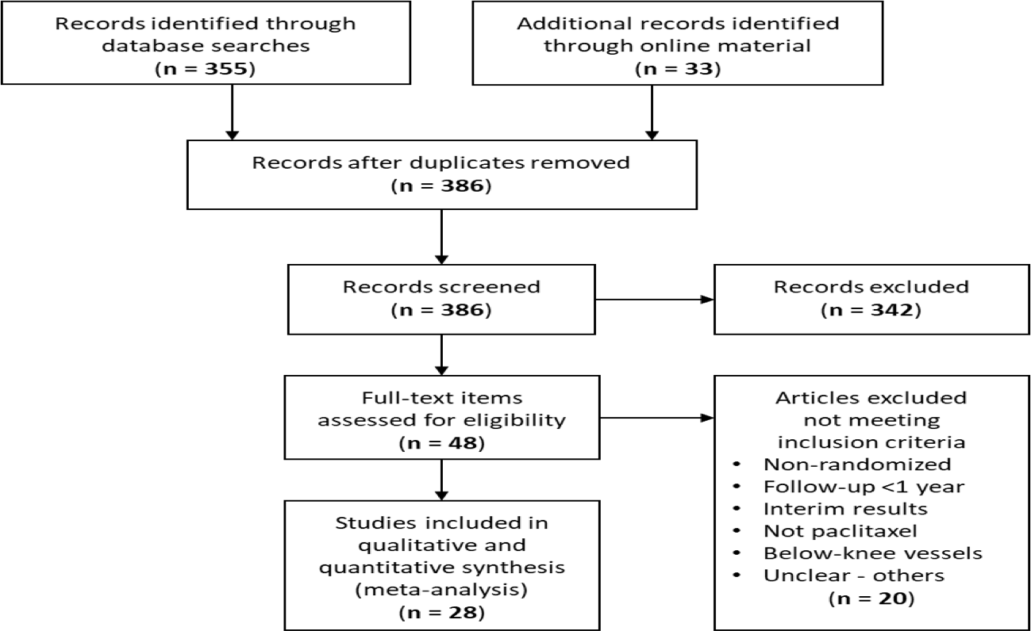
Katsanos Meta Analysis: The Controversy
SFA trials testing Paclitaxel-DCB and DES are designed to evaluate efficacy
All-cause death and safety has not been investigated
SYSTEMATIC REVIEW AND META-ANALYSIS
Risk of Death Following Application of Paclitaxel-Coated Balloons and Stents in the Femoropopliteal Artery of the Leg: A Systematic Review and Meta-Analysis of Randomized Controlled Trials
Konstantinos Katsanos, MD, PhD, MSc, EBIR; Stavros Spiliopoulos, MD, PhD; Panagiotis Kitrou, MD, PhD; Miltiadis Krokidis, MD, PhD; Dimitrios Karnabatidis, MD, PhD
28 RCTs
N=4663 patients (4133 C; 530 CLI)
16 RCT DCB vs PTA
4 RCT DCB/BMS
3 RCT in ISR
1 RCT with DES (236 pts)
Katsanos K,. JAHA 2018

Slide 4


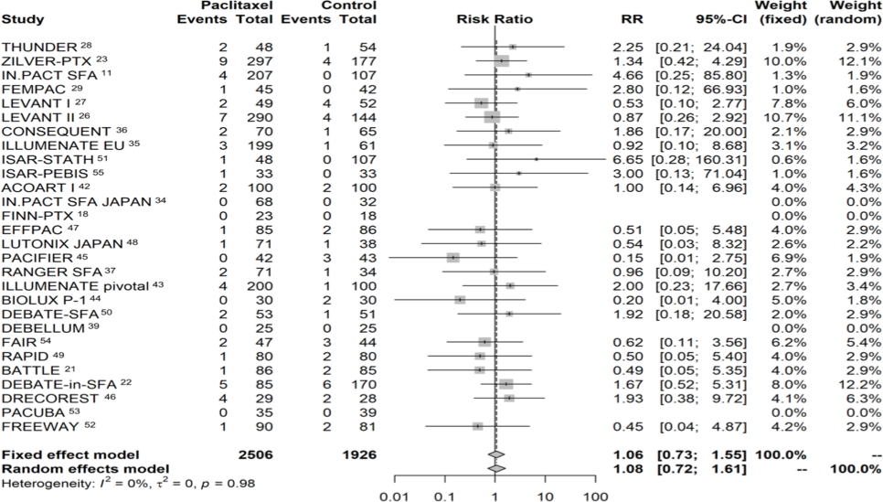
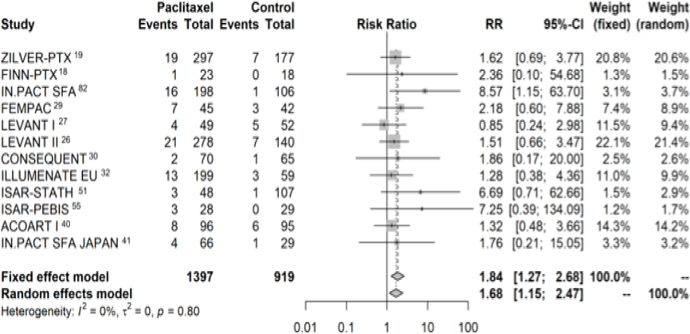
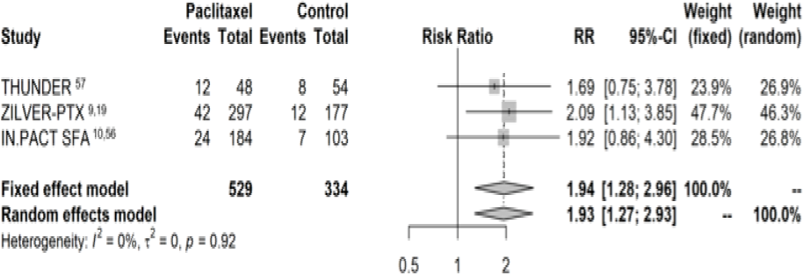
DCB Shown to Increase All-Cause Mortality after 1 year
 | 1 year | 2 year | 4-5 years
Trials | 28 | 12 | 3
Patients | 4,432 | 2,316 | 863
Crude Risk | 2.3% vs 2.3% | 7.2% vs 3.8% | 14.7% vs 8.1%
Risk Ratio | 1.08 (95%CI: 0.72–1.61) | 1.68 (95%CI: 1.15–2.47) | 1.93 (95%CI: 1.27–2.93)
Risk Difference |  | 3.5% (95%CI: 1.7–5.3) | 7.2% (95%CI: 3.1–11.3)
NNH
29 patients (95%CI: 19-59)
14 patients (95%CI: 9-32)
* 45% DES (Zilver); 55% DCB
Katsanos K JAHA 2018

Slide 5
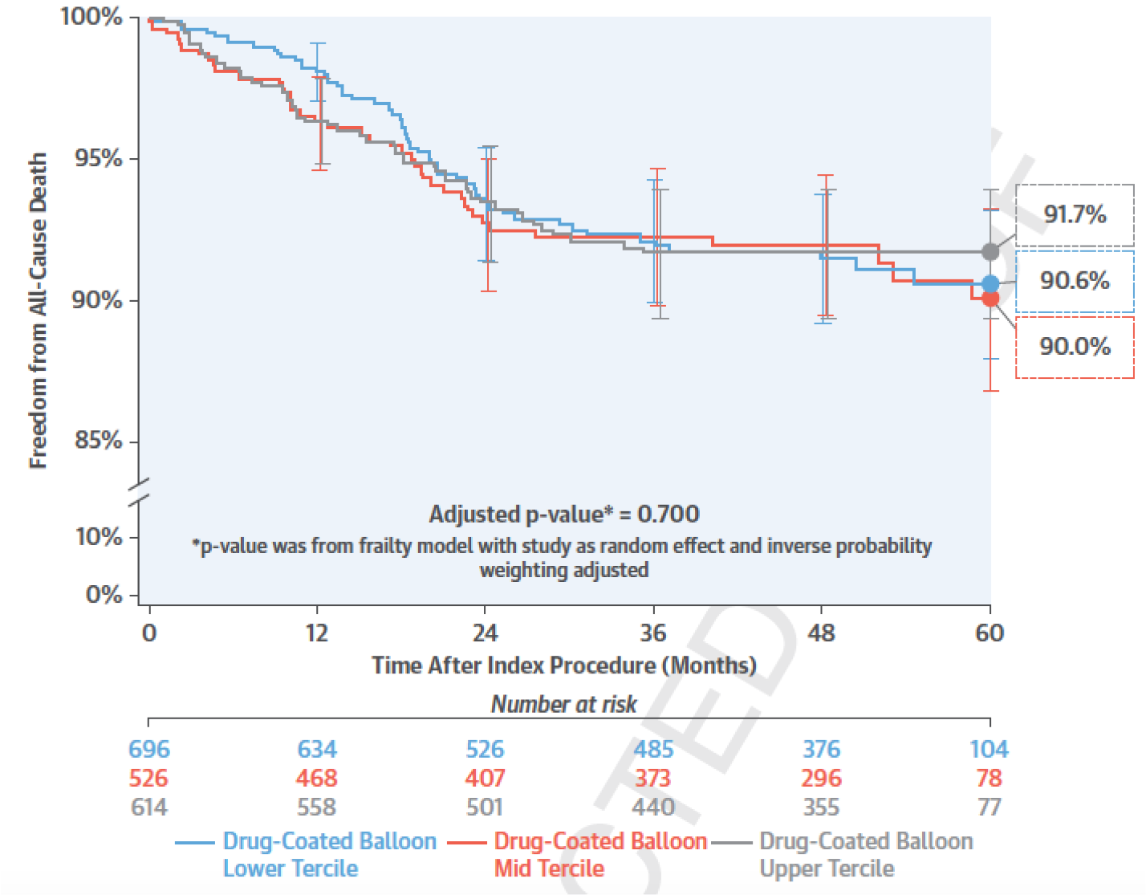
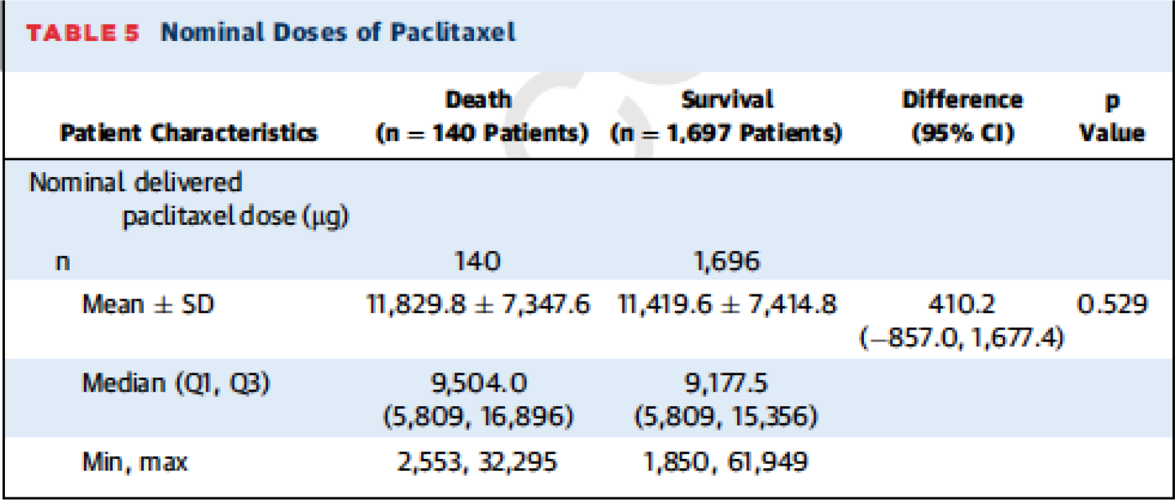
IN.PACT Pooled analysis: PTX Dose per Patient
Does not predict mortality
Product of Balloon length and diameter used per patient use to derive nominal PTX dose per patient
Death Rate by PTX Dose Tertile

Slide 6
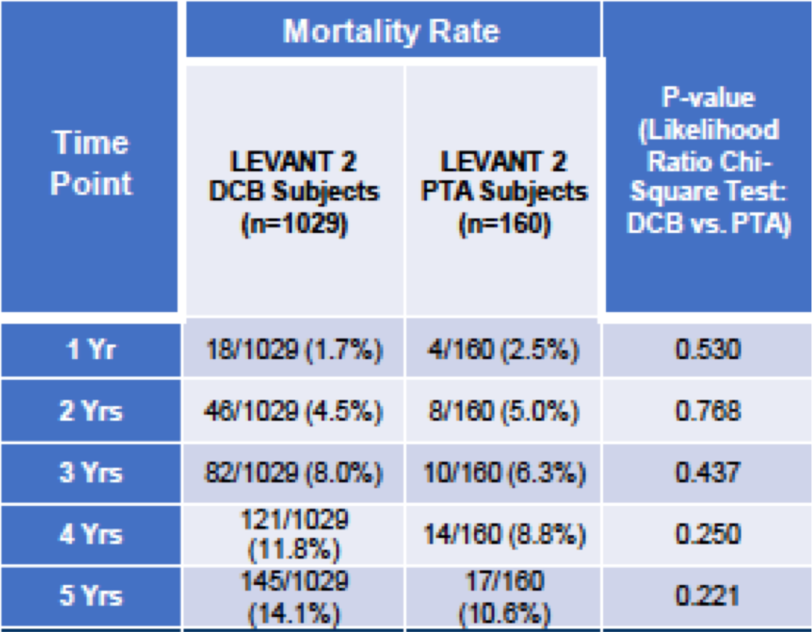
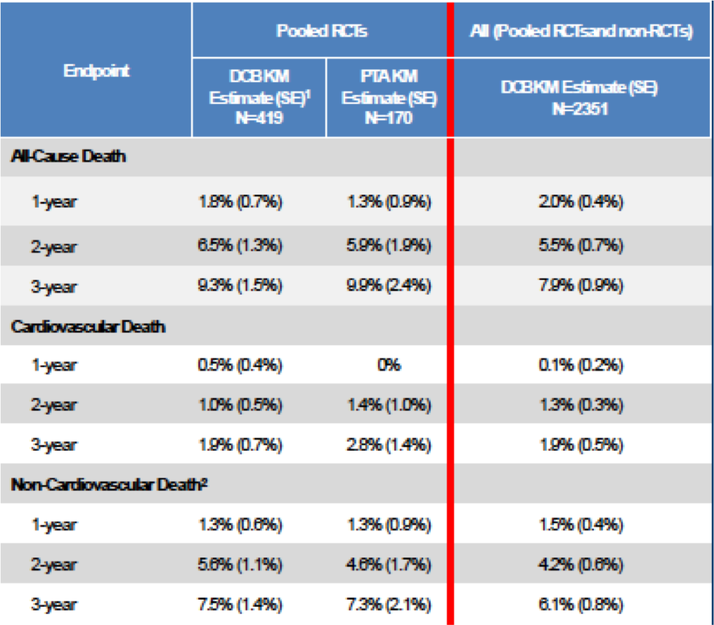
Other Pooled Patient Level Analyses
Not Associated with Increase All Cause Mortality
Levant 2: N=1189
Stellarex: N=2351
D Scheinert 2019
S Lyden 2019

Slide 7
PCR Statement on Interventions with DCB
What is Known: Current Evidence with DCB?
As for any meta analysis, the Katsanos analysis has major inherent methodological limitations that prevent reliable interpretation of primary findings, these include:
  Study level rather than patient level data
  Limited long-term data: >80% loss of patients at 4-5 years (3/28 trials), 45% are DES and High drop out rates within trials (>35% loss to FU)
  Unmeasured crossovers and re-interventions, and unknown additional PTX exposure
  Lack of adjudication of cause of death
  Errors in published death rates with subsequent corrections
  Lack of a plausible or reproducible dose response
At least 4 new patient-level analyses and a large-scale claims data analysis have failed to replicate the results of the meta analysis with DCB
Coronary DCB applications are not associated with a long-term safety signal
There is currently no strong evidence of a mortality signal

Slide 8
PCR Statement on Interventions with DCB
PCR Position on DCB
Although the results of the meta analysis are not conclusive, they cannot be ignored due to the mortality implications and the lack of high quality long-term safety data
PCR acknowledges the need for a more reliable industry-wide patient level (DCB
only) pooled analysis, expected to be presented at the upcoming FDA panel on June 19/20
PCR strongly encourages resuming the previously suspended prospective randomized DCB trials (SWEDPAD and BASIL 3) under careful adjudication and safety oversight as these will provide the evidence necessary to address the safety of DCB
Until more robust data to the contrary, there is currently no strong evidence to justify changing clinical practice and clinicians should continue to use best judgment

Slide 9
B By and Foryou
PCRonline.com

