Slide 1
Reassessing the Future of Stem Cell Therapy for Patients with AMI or
Patients with Heart Failure
Stephen E. Epstein, MD
MedStar Heart and Vascular Institute
Washington Hospital Center

Slide 2
CONFLICT OF INTEREST
I have a relevant financial relationship:
Chairman, Scientific Advisory Committee, CardioCell
Equity holder in CardioCell, LLC

Slide 3
A reassessment of the future of the stem cell field is critically important now because of the recent alarming announcement by Harvard…

Slide 4
The New York Times. Oct. 15, 2018
By Gina Kolata
Harvard Calls for Retraction of Dozens of Studies by Noted Cardiac Researcher:
“Some 31 studies by Dr. Piero Anversa contain fabricated or falsified data...”
It can’t be emphasized too strongly how profound an impact Anversa’s publications, spanning over a decade and a half, have had on the stem cell therapeutic field.
The Harvard announcement has understandably been received by many as undermining the scientific basis justifying the use of stem cell therapy for cardiac disease—and therefore undermined the credibility of this strategy.

Slide 5
The boundaries of applicability of Anversa’s data:
Anversa’s data focused on two very specific mechanistic assumptions by which stem cells—if they worked—would improve myocardial function:
Stem cells derived from adult donors will transdifferentiate into functioning myocytes;
They would thereby regenerate damaged myocardium.

Slide 6
Problem: It’s been known for years that stem cells derived from adults are no longer capable of transdifferentiation. Consequently, many stem cell investigators believed that Anversa’s data couldn’t be valid.
So if stem cells improve myocardial function they do so through other mechanisms.

Slide 7
Concept-1
MYOCARDIAL INJURY
Genetic modifiers
Epigenetic modifiers
Risk factors Chronic infection,
diabetes, obesity, smoking…
Prolonged, inappropriate inflammatory response
Progressive myocardial dysfunction
Progressive heart failure
Death

Slide 8
Concept-2
MSCs have marked anti-inflammatory effects

Slide 9
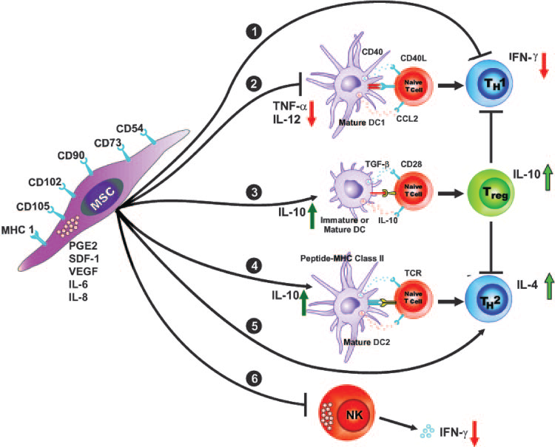
MSCs: Immunomodulatory and anti-inflammatory activities
Aggarwal S, Pittenger MF. Blood. 2005 Feb 15;105(4):1815-22.

Slide 10
Hypothesis
If excessive persistent inflammation is responsible for progressive myocardial dysfunction, and…
If MSCs secrete factors that exert systemic anti-inflammatory effects…
Then, we hypothesized, the intravenous administration of MSCs would attenuate inappropriate inflammatory responses through paracrine activities and thereby would improve cardiac function.

Slide 11
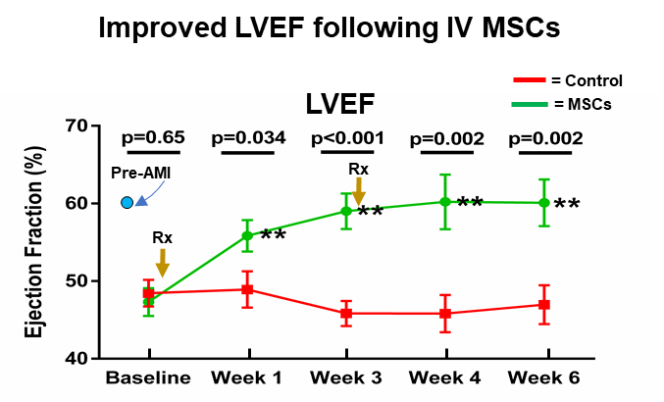
Ischemic cardiomyopathy in mice:
Effects of IV administered MSCs
4-wks post AMI
Luger, Lipinski, Epstein et al. Circ Res. 2017

Slide 12
This improvement in LV function was associated with anti-inflammatory effects
7 days post AMI (murine AMI model)
NK cells are major orchestrators of inflammation
NK cells in the Spleen
NK cells in the Heart
P=0.045
P=0.048
P<0.001
P=0.043
Splenic NK cells (%)
Luger, Lipinski, Epstein et al. Circ Res. 2017

Slide 13
We wanted to determine whether the MSC-induced decrease in NK cells are causally responsible for the improved myocardial function:
We depleted NK cells directly with an NK cell mAb
AMI
Ischemic cardiomyopathy
Pre-AMI
Baseline
30 days post-AMI
7 days
21 days
30 days post-AMI
These findings definitively demonstrate that:
Inflammation importantly contributes to myocardial dysfunction;
NK cell depletion leads to improved myocardial function.
Luger, Lipinski, Epstein et al. Circ Res. 2017

Slide 14
Concept:
A single MSC injection will not cure the problem of progressive myocardial dysfunction—there will be need for repeated injections.

Slide 15
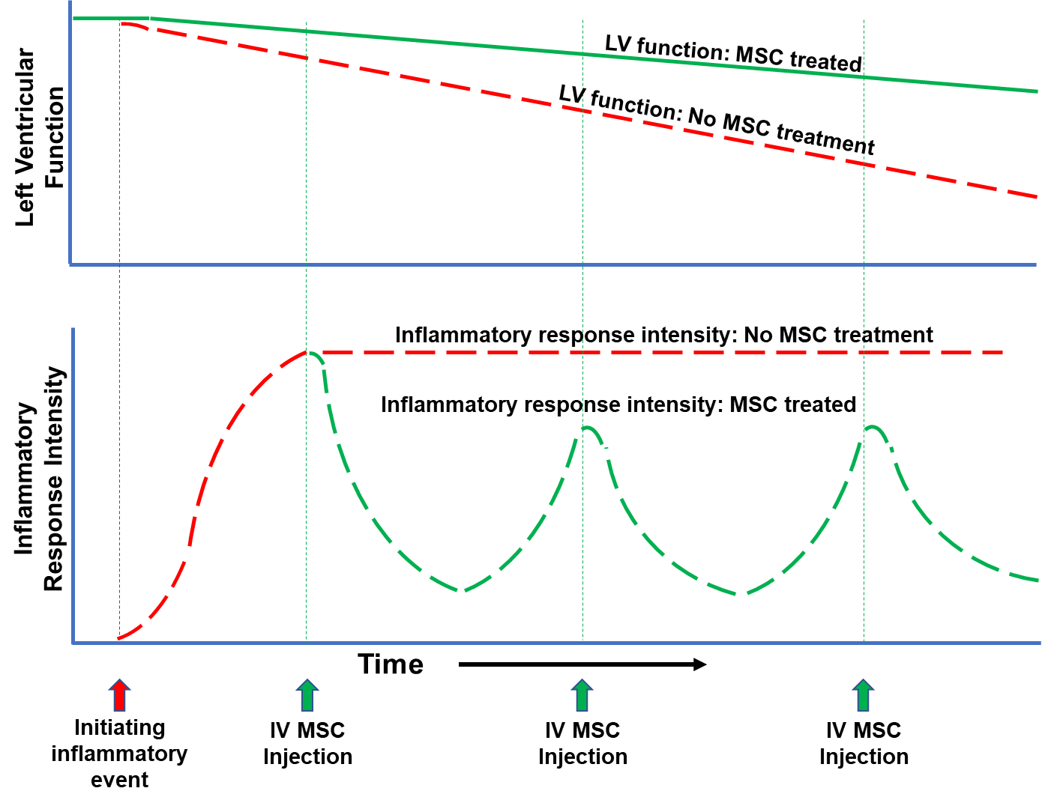
Concept:
Persistent inflammation is an important contributor to the progressive LV dysfunction occurring in AMI and in HF
Epstein, Lipinski, Luger. JAHA 2018

Slide 16
Inflammatory response: single MSC Rx
LV function: single MSC Rx
Concept:
The underlying disease processes are not “cured” by a single injection of stem cells. The lower rate progression of LV dysfunction in treated patients will revert to that of the untreated group.
Epstein, Lipinski, Luger. JAHA 2018

Slide 17
Concepts:
Optimal therapeutic effect probably requires repeated injections.
Epstein, Lipinski, Luger. JAHA 2018

Slide 18
In Summary:
Compelling preclinical studies indicate that:
Inflammation plays a critical role in the progressive myocardial dysfunction seen in AMI and in chronic HF,
IV administered MSCs exert potent anti-inflammatory effects
IV administered MSCs markedly improve LV function
Repeated injections of MSCs are probably necessary for persistent therapeutic efficacy.
The Future:
We believe these new mechanistic insights will be transformative to the stem cell field; we’re hopeful the resulting new therapeutic strategies will result in major therapeutic breakthroughs for patients with AMI and with heart failure.

