Slide 1
Analysis of changes in decision-making process during optical coherence tomography-guided percutaneous coronary interventions: Insights from the LightLab Initiative
Hiram Bezerra, Luis Dallan, Gabriel Tensol, Jana Buccola, Jason Wollmuth,
John Lopez, Richard Rapoza, Nick West, Brian Bergmark, Kevin Croce
on behalf of the LightLab Initiative Investigators.

Slide 2
Potential conflicts of interest
Speaker's name : Hiram Grando Bezerra
☑ I have the following potential conflicts of interest to declare:
Receipt of grants / research support: Medtronic
Receipt of honoraria or consultation fees: Abbott, Abiomed
Hiram
Bezerra, MD

Slide 3
Why this study?
Hiram
Bezerra, MD
Notes:
Use of intracoronary imaging during PCI affects physician decision making:
ILUMIEN I: pre-PCI OCT: 57%, post-PCI OCT: 27%
FD-OCT, Int J Cardiovasc Imaging (2013) 29:741–752: Pre-PCI OCT: 81.8%, post-PCI OCT: 54.8%
ADAPT-DES (IVUS), Witzenbichler B- JACC 2012: change in procedure strategy 74%
Use of intracoronary imaging is associated with reduced mortality:
Most recently Pan London PCI Registry, J AmColl Cardiol Intv 2018;11:1313–21: In this large observational study, OCT-guided PCI was associated with improved procedural outcomes, in hospital events, and long-term survival compared with standard angiography-guided PCI
Despite this published evidence, intravascular imaging adoption remains low. The motivation behind the LightLab initiative was to break down barriers to imaging adoption through the use of a routine workflow using OCT

Slide 4
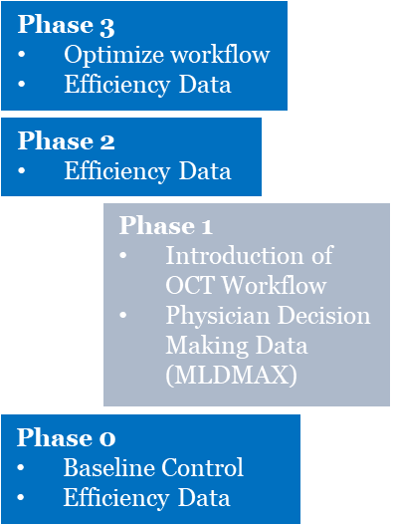
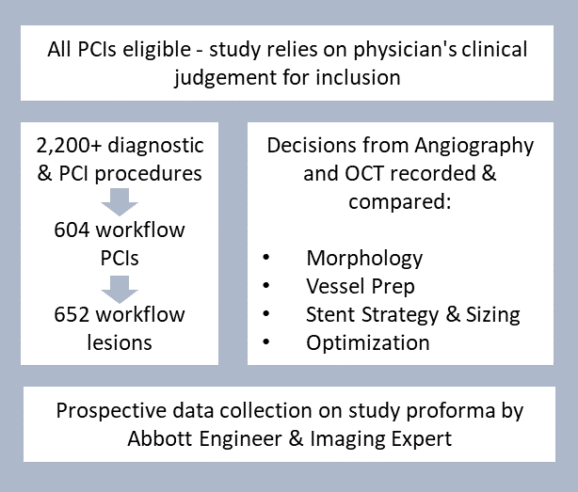
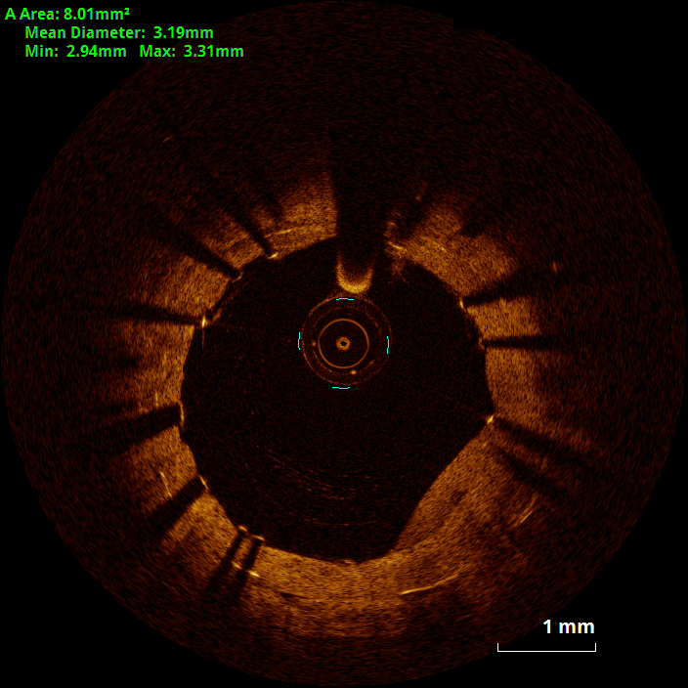
What did we study?
Pre-PCI OCT | Strategize
Morphology
Length
Diameter
Hiram
Bezerra, MD
MLD
MAX
Post-PCI OCT | Optimize
Medial Dissection
Apposition
Xpansion
Notes:
LightLab is a multicenter, prospective, observational study designed to characterize the influence of the LightLab workflow on physician’s diagnosis of the lesion, treatment strategy, and optimization decisions as compared to angiography
LightLab program is currently ongoing at 12 centers consisting 16 hospitals within the US and a total of 41 participants physicians
But what make it really unique is the fact that at each center Abbott provided a Field Clinical Engineer (FCE), highly trained expert in both imaging and the LightLab workflow who is also responsible for real time data collection for LightLab
LightLab is a multiphased study :
The Baseline phase was purely observational, and the FCE did not provide guidance or support the use of imaging during the intervention. Was a snapshot of current OCT utilization.
The LightLab workflow was first introduced in Phase 1 Decision Making, and first results are presented today. Data collection within this phase is unique from all other phases as it focuses the impact that OCT has on physician’s decisions relative to angiography.
The subsequent phases focus on optimization of the workflow to achieve efficiency gains by identifying and removing barriers to workflow adoption. Within the following 3 phases, data is collected on efficiency metrics within the procedure to compare to the Baseline Phase.
Data was recorded in just over 2,200 procedures within this phase of the program
All diagnostic procedures were excluded, as well as interventions where OCT was not used. This resulted in 710 OCT guided-procedures
OCT guided procedures where the workflow was NOT used were excluded. This resulted in 604 LightLab workflow guided procedures
Analysis was conducted on a per lesion basis specifically looking at the impact of OCT relative to angiography when the full range of information available from OCT is used for decision making. This is ensured in the subset of lesions that followed the LightLab workflow which resulted in 652 lesions for evaluation.
There was a range of procedure characteristics and lesions complexities within this population of lesions
Most notably majority were Type C lesions with almost 20% ISR, over 40% long lesions, and 10% bifurcations

Slide 5
How was the study executed?
Plaque Morphology
Lesion Length
Vessel Diameter
Medial Dissection
Stent Apposition
Stent EXpansion
Pre-PCI OCT | 83%
Post-PCI OCT | 31%
88% of lesions impacted
Cumulative OCT Impact through progression of workflow
Hiram
Bezerra, MD
change if more than ± 0.25 mm difference
change if more than ± 5 mm difference
Notes:
In the subset of lesions where the workflow was followed, OCT changed angiographic-based decisions in 88% of lesions with the majority of the impact coming from the information provided from the pre-PCI OCT pullback at 83% of lesions impacted. This pullback is used for lesion assessment and treatment planning. The post-PCI OCT pullback is used to check luminal quality after stenting, and 31% of the lesions were impacted by the information provided within this pullback resulting in additional optimization of the deployed stent.
<Slide animation>
The next slides provide a closer look at the influence of OCT on physician decision making within the specific steps of the workflow that impact stent expansion: from the pre-PCI OCT pullback there is lesion morphology (assessed within lesion type and lesion evaluation), vessel preparation and treatment decisions, stent sizing specifically stent diameter, and lastly the detection of stent under-expansion from the post-PCI OCT pullback.)
The motivation for looking at the workflow steps linked to stent underexpansion is to give insight into the clinical impact of using the workflow. Stent underexpansion is a powerful predictor of early stent thrombosis and restenosis (and thus clinical outcomes) after DES implantation according to numerous studies:
Choi S-Y “Intravascular ultrasound findings of early stent thrombosis after primary percutaneous intervention in acute myocardial infarction: a HORIZONSAMI substudy. Circ Cardiovasc Interv 2011;4:239–247.
Kang S-J “Comprehensive intravascular ultrasound assessment of stent area and its impact on restenosis and adverse cardiac events in 403 patients with unprotected left main disease” Circ Cardiovasc Interv 2011;4:562–569.
Sonoda S “Impact of final stent dimensions on long-term results following sirolimus-eluting stent implantation: serial intravascular ultrasound analysis from the Sirius Trial” J Am Coll Cardiol 2004;43:1959–1963.
Song H-G “Intravascular ultrasound assessment of optimal stent area to prevent in-stent restenosis after zotarolimus-, everolimus-, and sirolimus-eluting stent implantation. Catheter Cardiovasc Interv 2014;83:873–878.

Slide 6
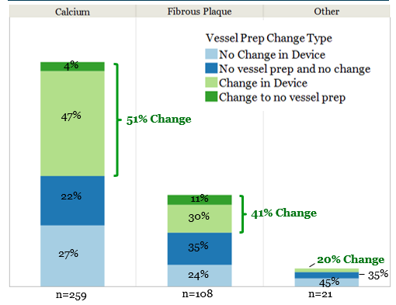
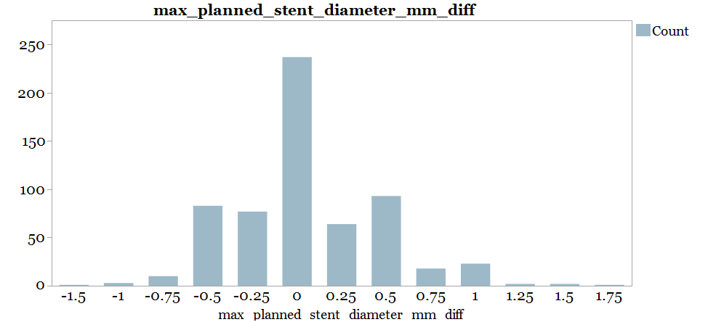
What are the essential results?
OCT significantly changes physician decisions at steps in a PCI that impact final stent expansion:
Morphology: Calcium was the predominate morphology on the pre-PCI OCT pullback when a change in strategy occurred
Diameter: Angiography over- and under-estimates stent diameter to a similar degree
62% No change
n=614
16% Over-sized by Angio
22% Under-sized by Angio
Number of Lesions
Hiram
Bezerra, MD
*Excludes n=257 lesions where vessel prep was performed before pre-PCI OCT
Difference in Max Planned Stent Diameter (OCT – Angio) in mm
Notes:
The first step of the workflow is assessment of lesion morphology. We saw that inaccurate diagnosis of calcium severity was the key driver for changes in vessel preparation strategy.
The graph looks at the subset of lesions where pre-PCI OCT was performed before vessel preparation, specifically the subset of lesions where OCT had the potential to influence the physician’s decision on vessel preparation
This graph correlates the predominate lesion morphology identified on the pre-PCI OCT pullback with the change in physician’s vessel preparation strategy relative to angiography
This correlation highlighted the impact that proper calcium characterization has on changes in vessel preparation strategy with nearly half the lesions containing calcium requiring a change in vessel preparation device
Additionally, more insight is gained by looking at the actual vessel prep devices used to treat the lesions within calcified lesions with a change versus those without. For lesions with a change, physicians used a more complex method of vessel prep (cutting, scoring balloon or atherectomy or laser) in just over 50% of the lesions whereas a more complex method was used in only 12% of the lesions without a change
The next step of the workflow is to assess lesion size, and as it relates to stent expansion, properly assessing the lesion diameter for selection of the stent size
Overall, we saw that angiographic guidance lead to inaccurate stent diameter selection (defined by more than a quarter size difference in either direction) in 38% of stented lesions
Within the 38%, angiography both over and under-estimated the stent diameter to a similar degree

Slide 7
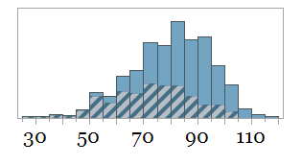
Why is this important?
Population of lesions that followed the LightLab guided workflow achieved 80% minimum stent expansion on average, before further optimization
Additional optimization performed after post-PCI OCT
No additional optimization performed after post-PCI OCT
Post dilatation performed in 85% of lesions before post-PCI OCT
Hiram
Bezerra, MD
30
40
50
60
70
80
90
100
110
Minimum % Expansion (%)
Notes:
The last step of the workflow is to perform a post-PCI OCT to check the luminal quality of the stented lesion. This pullback directly detects stent underexpansion which enables the physician to perform targeted optimization to the specific location of the stent requiring attention
In this population of lesions that followed the LightLab guided workflow, 80% minimum stent expansion was achieved on average
In the DOCTORS study, Circulation 2016;134: the optimal cut-off value of stent expansion able to predict FFR >0.90 was >79.4%
Physicians performed additional targeted optimization in 38% of lesions based on the post-PCI OCT assessment

Slide 8
The essentials to remember
OCT guidance impacted decision-making in 88% PCI cases in this prospective dataset.
The majority of changes occurred during diagnosis/planning & on treatment strategy derived from pre-PCI OCT pullback (83%):
Accurate characterization of calcium
Additional/altered vessel preparation strategy
Accurate stent and post dilatation planning; diameter & length
The population of lesions treated that followed LightLab-guided workflow achieved on average > 80% stent expansion, even before further pos-dilatation.
Appropriate physician training and software tools allow for uniform implementation of consistent OCT guided PCI workflow .
Hiram
Bezerra, MD
Notes:
In summary, the LightLab workflow utilizes the full range of information available from OCT by performing both a pre and a post-PCI OCT pullback. When this is done, the information provided changes physician’s decisions in 88% of lesions with the majority of the impact, 83%, coming from the pre-PCI OCT assessment
Information from the pre-PCI OCT pullback provides a detailed assessment of lesion morphology, specifically calcium, which alters physician’s vessel preparation strategies. Additionally, OCT provides the tools for correct vessel sizing which leads to appropriate selection of stent diameter and length
Stent underexpansion is established as a major predictor of stent failure. Guidelines for acceptable final stent expansion vary; however, 80% is supported in literature as being clinically acceptable. Within the population of lesions treated that followed the LightLab guided workflow, 80% stent expansion was achieved on average.
The LightLab program is evaluating the use of OCT in a real-world cohort and offers an unprecedented granular evaluation of procedural data focused on physician decision making, presented today at PCR, and within future phases focused on procedural efficiency

