Slide 1
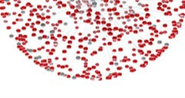





Coronary Computed Tomography Angiography and the Future Risk of Myocardial Infarction
5-Year Follow-up of the SCOT-HEART Trial on behalf of the SCOT-HEART Investigators

Slide 2
Declaration of interest
Consu lt ing/ Roy a1 lt ies/ Ow n,er /Stockholder of a1healt hcaire company (Amgen,
AstraZeneca, Br istol-Mye rs Squibb, Janssen, Pfizer, Toshiba)
- R,e sea r c.h co n t r act s (Am1 gen₁ Ast r,aZen eca1, B,o ehr inger lng,elh eim, Br ist,o1- M y ers
Squ ibb, Hoffm1a n la Roche, Janssen, Novartis, Pfizer, Sa nofi Ave nt is, GS K,
S,i em ens, Toshiba)
• •
ESC Congress
Mun· ch 2018 •

Slide 3

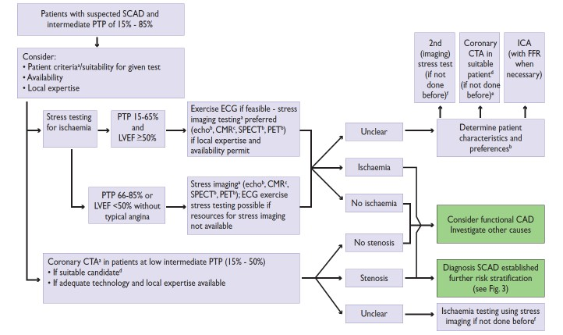
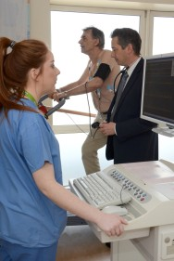
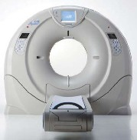
European Society of Cardiology Guideline
Investigation of Stable Chest Pain
Montalescot et al. Eur Heart J. 2013;34:2949‑3003

Slide 4
Scottish COmputed Tomography of the HEART (SCOT-HEART) Trial
To assess the clinical impact of the addition of CTCA to standard of care in patients presenting with stable chest pain to the Cardiology clinic
Diagnosis (Primary Endpoint)
Investigations
Treatments
Outcomes
Changed Diagnosis in 1 in 4
Changed Investigations in 1 in 6
Changed Treatments in 1 in 4
Pre-specified 5-year outcome:
CHD death or non-fatal myocardial infarction
Trials. 2012;13:184
Lancet 2015;385:2383-2391
JACC 2016;67:1759-1768

Slide 5


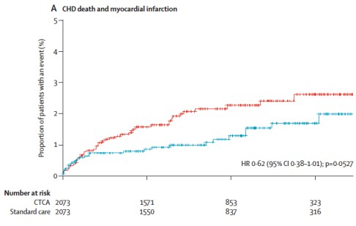
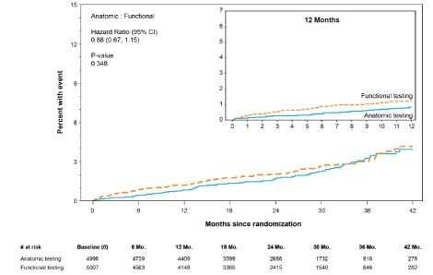

Short-term Effects of CTCA
Clinical Outcomes
The SCOT-HEART Trial The SCOT-HEA
Trial
CHD death or non-fatal myocardial infarction HR 0.62 (95% CI, 0.38-1.01), P=0.053
Death or non-fatal myocardial infarction HR 0.66 (95% CI, 0.44-1.00), P=0.049
Standard of Care
CT Coronary Angiography
Lancet 2015;385:2383-2391
N Engl J Med 2015;372:1291-1300

Slide 6
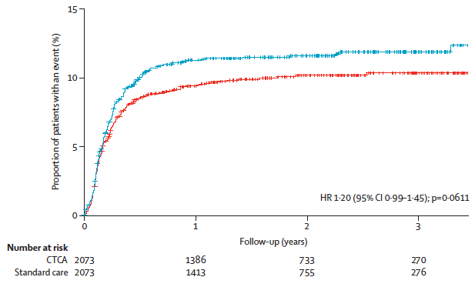
Short-term Effects of CTCA
Invasive Coronary Angiography & Coronary Revascularisation
The SCOT-HEART Trial
The SCOT-HEA Trial
P<0.001
Stress Testing CTCA
Frequency @ 90 Days (%)
14
12
10
8
6
4
2
0
CT Coronary Angiography
12.2
Coronary
Revascularisation
P<0.001
6.2
8.1
Standard of Care
3.2
HR 1.20 (95% CI, 0.99-1.45), P=0.06
Invasive Coronary Coronary Angiography Revascularisation
Lancet 2015;385:2383-2391
N Engl J Med 2015;372:1291-1300

Slide 7

Scottish COmputed Tomography of the HEART (SCOT-HEART) Trial The 5-Year Data
Pre-specified 5-year assessment of Coronary CT Angiography on:
Coronary heart disease death or non-fatal myocardial infarction
Invasive coronary angiography and coronary revascularisation
Prescription of preventative therapies
Trials. 2012;13:184

Slide 8
The SCOT-HEART Trial
Study Protocol
Primary Care Physician Referral
Computed Tomography Coronary Angiogram
Cardiovascular Risk Assessment: ASSIGN Score
Clinic Consultation History, Examination, 12-lead ECG
Result to Attending Clinician Treatment Recommendations
Exercise ECG if appropriate
Diagnosis, Investigations and Treatment Plan
6-Week Attending Clinician Review Diagnosis, Investigations and Treatment Plan
Approached for Study Inclusion Angina Questionnaire
6-Week Patient Review Angina Questionnaire
Randomised 1:1 to CTCA + Standard Care or Standard Care alone
Clinical Outcome NHS Health Records

Slide 9
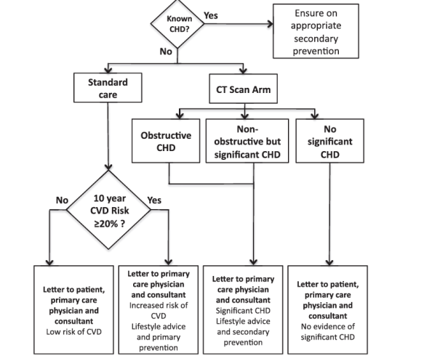


Randomisation 1:1 to
Standard Care Alone or CTCA + Standard Care
Newby et al. Trials. 2012;13:184

Slide 10

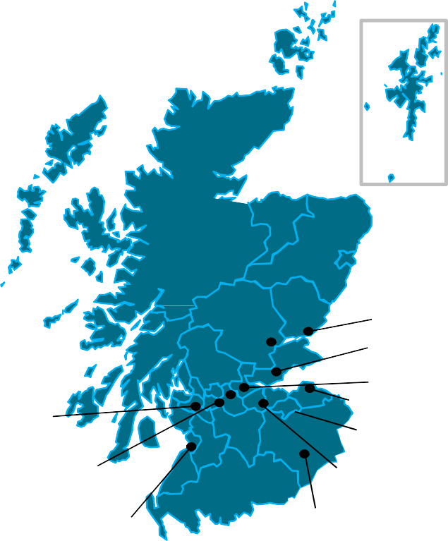


The SCOT-HEART Trial
Recruiting and Imaging Centres
Complete Health Record Data Capture
12 Centres Across Scotland
Perth Royal Infirmary, Perth Ninewells, Dundee
Victoria Hospital, Kirkcaldy Forth Valley Hospital, Larbert
Western General Hospital, Edinburgh Royal Infirmary, Edinburgh
64
64
320
Royal Alexandra Hospital, Paisley
Western Infirmary, Glasgow Glasgow Royal Infirmary, Glasgow
University Hospital, Ayr
St John’s Hospital, Livingston
Borders General Hospital, Melrose
Trials. 2012;13:184 Lancet 2015;385:2383-2391 JACC 2016;67:1759-1768

Slide 11
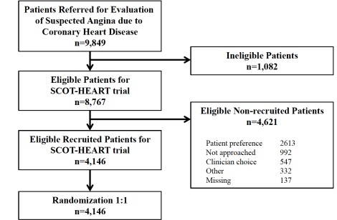
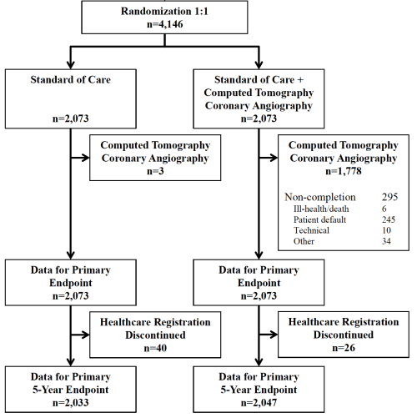
The SCOT-HEART Trial
CONSORT Diagram
Complete data over a median of 4.8 years comprising 20,254 patient-years of follow-up

Slide 12
All Participants
Standard Care + CTCA
Standard Care
Number
4146 (100%)
2073 (50%)
2073 (50%)
Male
2325 (56%)
1162 (56%)
1163 (56%)
Age (years)
57±10
57±10
57±10
Body-mass Index (kg/m²)
30±6
30±6
30±6
Atrial Fibrillation
84 (2%)
42 (2%)
42 (2%)
Prior Coronary Heart Disease
372 (9%)
186 (9%)
186 (9%)
Prior Cerebrovascular Disease
139 (3%)
91 (4%)
48 (2%)
Prior Peripheral Vascular Disease
53 (1%)
36 (2%)
17 (1%)
Current or Ex-smoker
2185 (53%)
1095 (53%)
1090 (53%)
Hypertension
1395 (34%)
712 (34%)
683 (33%)
Diabetes Mellitus
444 (11%)
223 (11%)
221 (11%)
Hypercholesterolaemia
2176 (53%)
1099 (53%)
1077 (52%)
Family History
1716 (41%)
887 (43%)
829 (40%)
Serum Total Cholesterol (mmol/L)
5.41±1.20
5.41±1.23
5.41±1.17
Serum HDL-Cholesterol (mmol/L)
1.35±0.43
1.35±0.42
1.35±0.43

Slide 13
All Participants
Standard Care + CTCA
Standard Care
Anginal Symptoms Typical
1462 (35%)
737 (36%)
725 (35%)
 | Atypical | 988 (24%) | 502 (24%) | 486 (23%)
 | Non-anginal | 1692 (41%) | 833 (40%) | 859 (41%)
Electrocardiogram | Normal | 3492 (84%) | 1757 (85%) | 1735 (84%)
 | Abnormal | 608 (15%) | 292 (14%) | 316 (15%)
Stress Electrocardiogram
Performed |  | 3517 (85%) | 1764 (85%) | 1753 (85%)
Normal |  | 2188 (62%) | 1103 (63%) | 1085 (62%)
Inconclusive |  | 566 (16%) | 284 (16%) | 282 (16%)
Abnormal |  | 529 (15%) | 264 (15%) | 265 (15%)
Further Investigation |  | 1315 (32%) | 633 (31%) | 682 (33%)
Stress Imaging Radionuclide |  | 389 (9%) | 176 (9%) | 213 (10%)
Other |  | 30 (1%) | 16 (1%) | 14 (1%)
Invasive Coronary Angiography |  | 515 (12%) | 255 (12%) | 260 (13%)
Predicted 10-year CHD Risk |  | 17±12% | 18±11% | 17±12%

Slide 14
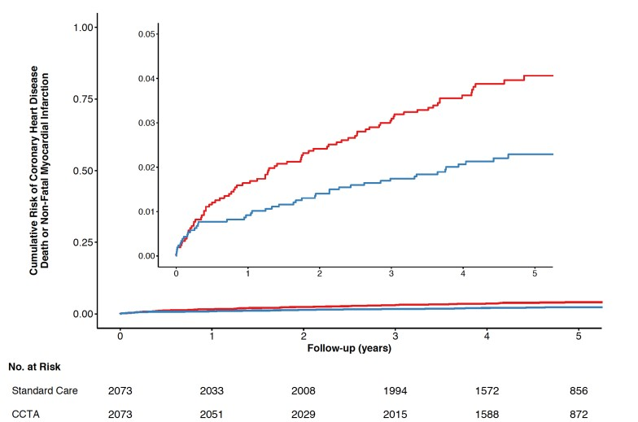
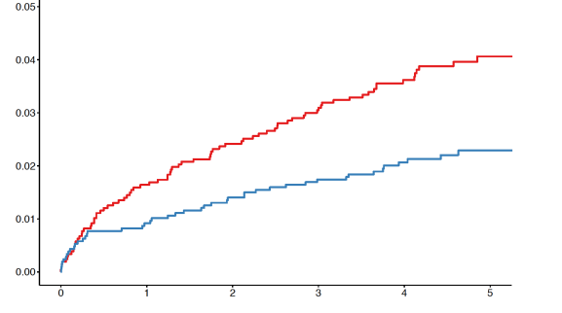
Primary Clinical End Point
Excluding the 50-day treatment delay*
Coronary Heart Disease Death or
Non-fatal Myocardial Infarction
Hazard Ratio 0.53
(95% CI, 0.36 to 0.78) P=0.001
Hazard Ratio 0.59
(95% CI, 0.41 to 0.84) P=0.004
*JACC 2016;67:1759-1768
Follow up (years)
Standard Care Alone
CTCA + Standard Care

Slide 15
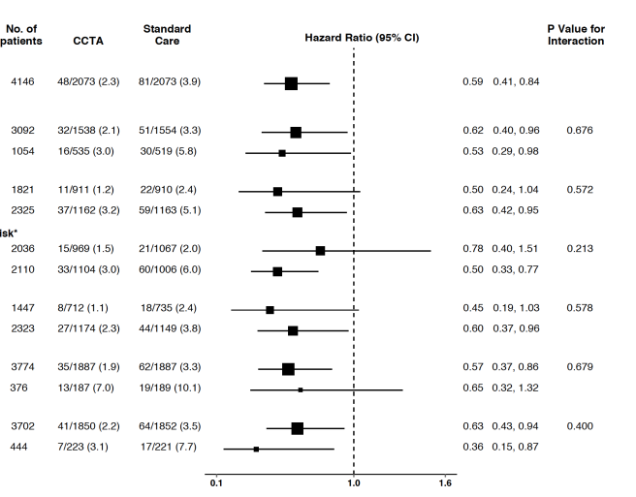
Primary Clinical End Point
Subgroups of Interest
All
Age
<65 years
>65 years
Sex
Female Male
10-Year CV Risk
 | Symptoms
 | Prior CHD
 |  | Diabetes
<15
≥15
Non-anginal Pain Possible Angina
No Yes
No Yes

Slide 16
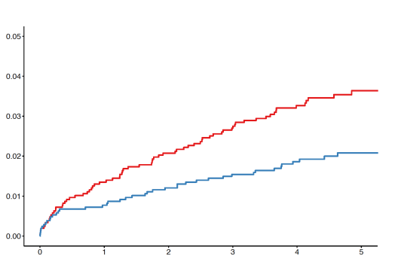
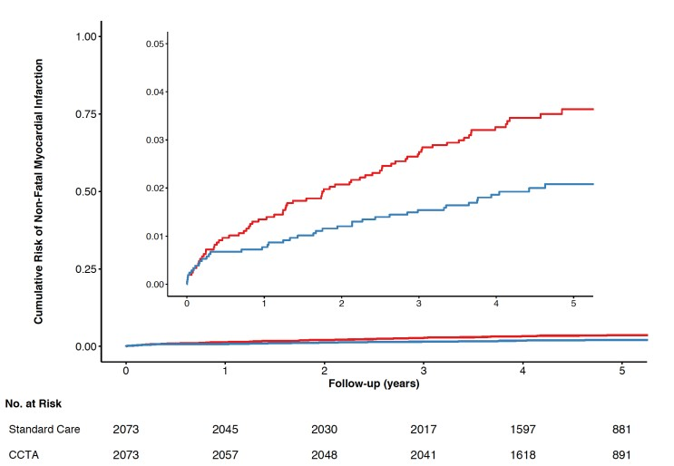
Non-fatal Myocardial Infarction
Non-fatal Myocardial Infarction
Hazard Ratio 0.60
(95% CI, 0.41 to 0.87) P=0.007
Follow up (years)
Standard Care Alone
CTCA + Standard Care

Slide 17
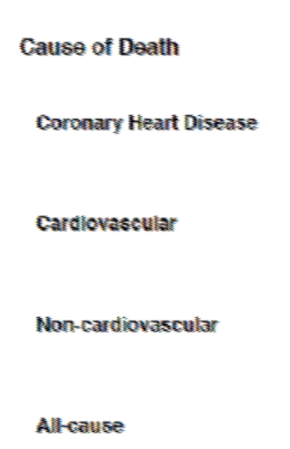
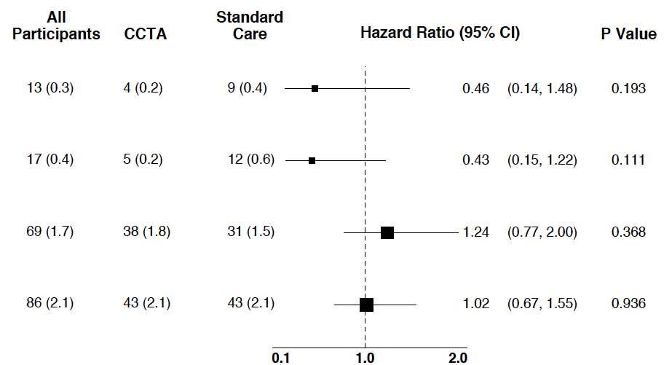
Mortality
Cardiovascular and Non-cardiovascular Death

Slide 18
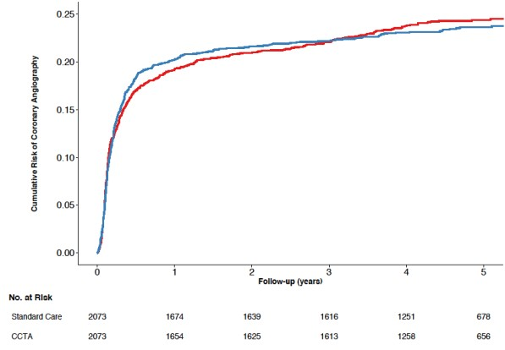
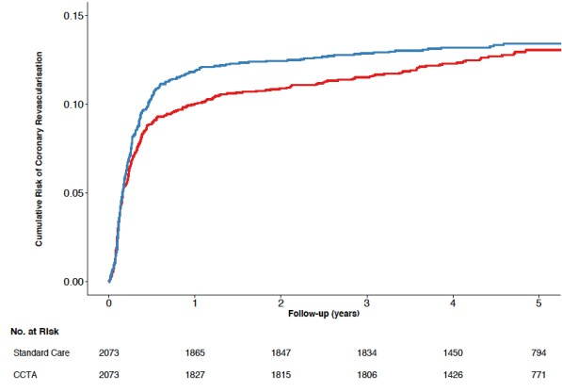
Invasive Coronary Angiography and Coronary Revascularisation
Invasive Coronary
Angiography
Coronary
Revascularisation
Hazard ratio 1.00
(95% CI, 0.88 to 1.13) P=0.993
Hazard Ratio 1.07
(95% CI, 0.91 to 1.27) P=0.409
Follow up (years)
Follow up (years)
Standard Care Alone
CTCA + Standard Care

Slide 19
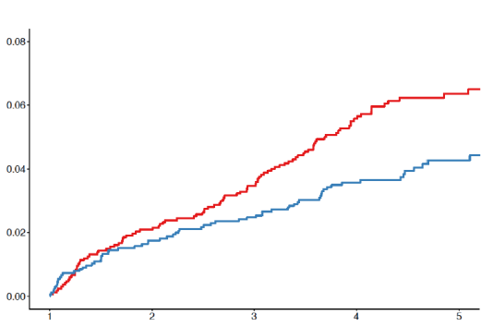
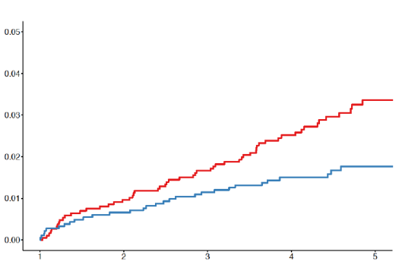
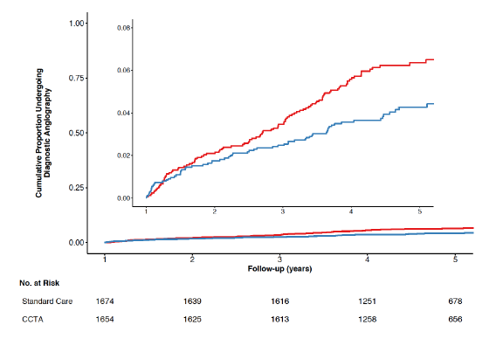
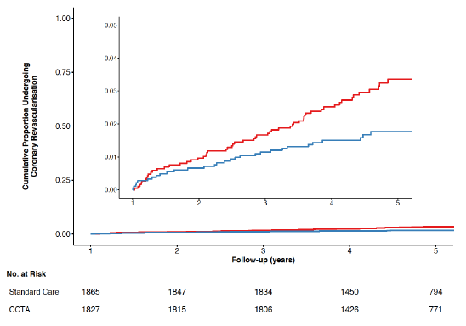
Invasive Coronary Angiography and Coronary Revascularisation Beyond One-Year (Post-hoc Analysis)
Hazard ratio 0.70
(95% CI, 0.52 to 0.95) P=0.022
Hazard Ratio 0.59
(95% CI, 0.38 to 0.90) P=0.015
Invasive Coronary
Angiography
Coronary
Revascularisation
Follow up (years)
Follow up (years)
Standard Care Alone
CTCA + Standard Care

Slide 20
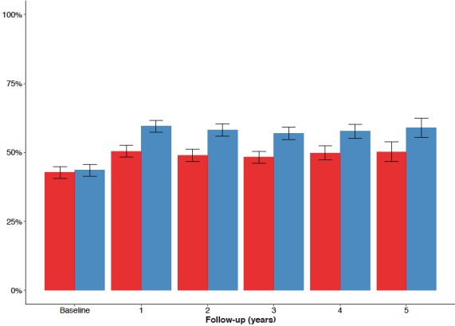
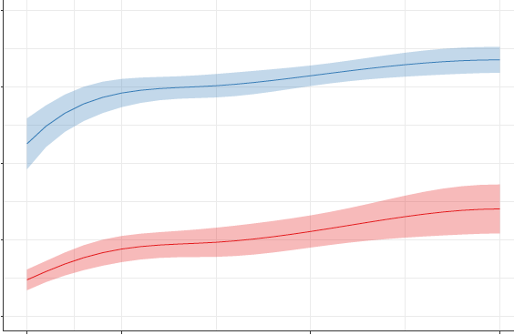
Statin Therapy Use over 5 Years
The Right Patient Gets the Right Treatment
100
Standard Care Alone CTCA + Standard Care
100
Coronary Artery Disease on CTCA
Frequency (%)
75
Frequency (%)
75
*
*
*
*
*
50
50
25
25
No Coronary Artery Disease on CTCA
0 |  |  |  |  |  |  |  |  |  |  |  |  |  |  | 0
 |  | 0 |  | 1 |  |  | 2 |  | 3 | 4 |  |  | 5 |  |  |  | 5 | 10 | 20 | 30
 |  |  |  |  | Follow up (years) |  |  |  |  |  |  |  |  |  |  |  | 10-Year Cardiovascular Risk (ASSIGN SCORE)
*P<0.0001

Slide 21
Coronary CT Angiography and the Future Risk of Myocardial Infarction
The Right Patient Gets the Right Treatment
Coronary CT angiography guided management reduces 5-year coronary heart disease death or non-fatal myocardial infarction
Early increases in invasive coronary angiography and coronary revascularisation are offset by lower rates beyond 1 year
Benefits appear to be attributable to better targeted preventative therapies and coronary revascularisation
Should CT coronary angiography be the non-invasive test of choice?

Slide 22



The SCOT-HEART Investigators
Royal Infirmary of Edinburgh, Edinburgh: Ms Barbara Allen, Prof Edwin van Beek, Dr Miles Behan, Miss Danielle Bertram, Mr David Brian, Ms Amy Cowan, Dr Nicholas Cruden, Dr Martin Denvir, Dr Marc Dweck, Ms Laura Flint, Dr Andrew Flapan, Miss Samantha Fyfe, Dr Neil Grubb, Mrs Collette Keanie, Dr Chris Lang, Dr Tom MacGillivray, Dr David MacLachlan, Miss Margaret MacLeod, Dr Saeed Mirsadraee, Mrs Avril Morrison, Dr Nicholas Mills, Dr David Northridge, Mrs Alyson Phillips, Miss Laura Queripel, Dr John Reid, Dr Neal Uren, Dr Nicholas Weir. St John’s Hospital, Livingston; Dr Ashok Jacob, Mrs Fiona Bett, Mrs Frances Divers, Ms Katie Fairley, Ms Edith Keegan, Ms Tricia White, Ms Julia Fowler. University Hospital, Ayr: Dr John Gemmill, Dr James McGowan, Mrs Margo Henry. Victoria Hospital, Kirkcaldy: Dr Mark Francis, Mr Dennis Sandeman Ms Lorraine Dinnel. Western General Hospital, Edinburgh: Prof David Newby Dr Peter Bloomfield, Dr Martin Denvir, Dr Peter Henriksen, Dr Donald MacLeod, Mrs Avril Morrison. Western Infirmary, Glasgow & Institute of Cardiovascular & Medical Sciences, University of Glasgow: Prof Colin Berry, Dr Kenneth Mangion, Dr Ify Mordi, Dr Giles Roditi, Dr Nikolaos Tzemos, Dr Eugene Connolly, Mrs Heather Boylan, Mrs Ammani Brown, Ms Lesley Farrell, Mrs Alison Frood, Ms Caroline Glover, Mrs Janet Johnstone, Mrs Tracey Steedman, Mrs Kirsten Lanaghan, Mrs Deborah McGlynn, Ms Lorraine McGregor, Ms Evonne McLennan, Ms Laura Murdoch, Miss Victoria Paterson, Ms Fiona Teyhan, Ms Marion Teenan, Ms Rosie Woodward. Borders General Hospital, Melrose: Dr Paul Neary Mrs Gillian Donaldson, Mr Terry Fairbairn, Mrs Marlene Fotheringham, Mrs Fiona Hall. Forth Valley Royal Hospital, Larbert: Dr Allister Hargreaves, Dr James Spratt, Dr Stephen Glen, Ms Sarah Perkins, Ms Fiona Taylor Mrs Louisa Cram, Ms Catherine Beveridge, Ms Avril Cairns, Ms Frances Dougherty. Glasgow Royal Infirmary: Dr Hany Eteiba, Dr Alan Rae, Ms Kate Robb, Ms Wenda Crawford, Ms Patricia Clarkin, Ms Elizabeth Lennon. Ninewells Hospital, Dundee: Prof. Graeme Houston, Prof Stuart Pringle, Dr Prasad Guntur Ramkumar, Dr Thiru Sudarshan, Dr Yvonne Fogarty, Ms Dawn Barrie, Ms Kim Bissett, Dr Adelle Dawson, Mr Scott Dundas, Mrs Deborah Letham, Ms Linda O’Neill, Mrs Valerie Ritchie. Perth Royal Infirmary, Perth: Dr Hamish Dougall. Royal Alexandra Hospital, Paisley: Dr Faheem Ahmed, Dr Alistair Cormack, Dr Iain Findlay, Dr Stuart Hood, Dr Clare Murphy, Dr Eileen Peat, Ms Lynne McCabe, Ms Margaret McCubbin.

Slide 23




