Slide 1
Multicenter registry on robotically assisted percutaneous
coronary interventions – TESLA registry
Dariusz Dudek, Adriana Zlahoda-Huzior, Holger Nef, Felix Hofmann, Fernandes Aviles, Maria Tamargo, Tsutomu Fujita, Yutaka Tadano, Eric Wyffels, Hedwig Batjoens, Steve Aerts, Jana Van Der Berghe, Constantin von zur Muhlen, Jonathan Rilinger, Michael K Lee, Alanna Siu, Aleksander Zeliaś, Katarzyna Kołodziej, Maria Kundzierewicz, Arif Khokhar, Rosella Ruggiero, Marco Toselli, Kailash Chandra, Francesco Giannini,
TESLA Study Investigators

Slide 2
Potential conflicts of interest
□ I do not have any potential conflict of interest to report
□×
I have the following potential conflicts of interest to
report:
Speaker fees from Siemens Healthineers.

Slide 3
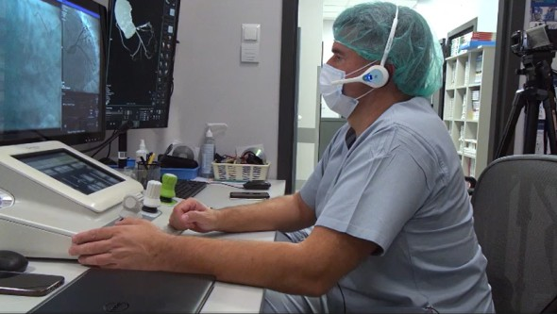
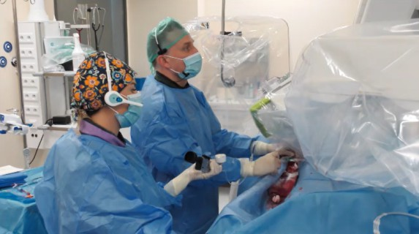
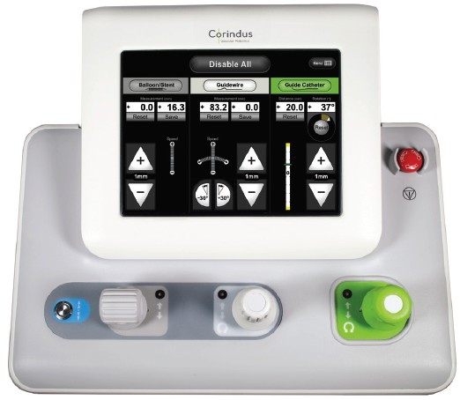
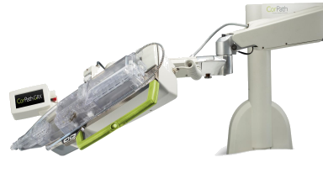
TESLA Registry – study rationale
Corindus CorPath GRX (Siemens Healthineers)
2nd generation robotic platform
Control of:
Device (balloon/stent)
Wire
Guide catheter
Joysticks & touch screen
Sub-mm movement precision
Mechanical movement precision
Precise measurements
Wide compatibility with procedural devices
console
robotic arm with cassette
Evaluated only in small scale registries and case-series, mainly in the USA
Enhanced technical precision Possibility for remote tele-stenting Low complication rates
Reduced occupational hazards High technical success Software-based automation - technIQTM

Slide 4
MulTicenter rEgiStry on roboticalLy Assisted percutaneous coronary interventions - TESLA registry
To evaluate the safety and efficacy of R-PCI with the CorPath GRX System
in real-world interventional cardiology practice.
Study objective:
retrospective
multi-center
multi-operator
investigator-initiated
Enrollment:
Spain Poland Germany Belgium Japan
Stable CAD Unstable angina STEMI/NSTEMI
CorPath GRX
Last procedure: Dec 2022
Dec 2023
n=534 R-PCI
EuroPCR.com

Slide 5
TESLA registry – study endpoints
The primary efficacy endpoint is:
Clinical success, defined as angiographic success (residual stenosis after stenting of <30% with final TIMI [Thrombolysis In Myocardial Infarction] flow grade 3) without an in-hospital major adverse cardiovascular event (MACE) (death, target vessel MI, or need of repeat target vessel revascularization);
The secondary efficacy endpoints include:
Ischemia-driven target lesion revascularization (TLR), at 1 year defined according to the Academic Research Consortium (ARC) criteria;
Target lesion failure (TLF) at 1 year, the composite of ARC-defined cardiac death, target vessel MI, or ischemia-driven TLR;
Target vessel failure (TVF) at 1 year, the composite of ARC-defined cardiac death, target vessel MI, or ischemia-driven TVR.
Procedure time, contrast volume and patient radiation exposure.

Slide 6
TESLA – study endpoints
The safety endpoints include:
In-hospital MACE, the composite of death, target vessel MI, or need of repeat target vessel revascularization;
Stent thrombosis at 1 year, defined according to the ARC criteria;
Bleeding events at 1 year, defined according to the Bleeding ARC (BARC).
Additional endpoints include:
1. Incidence and reasons for manual input and/or conversion during a R-PCI procedure.

Slide 7
TESLA registry – baseline characteristics
Variable Total (n = 534)
Variable Total (n = 534)
LVEF (Mean % (±SD)) 54,6 (±11,4)
Age (Mean years (±SD)) | 69 (±11)
BMI (Mean (±SD)) | 27.1 (±4,7)
Active/Ex-smokers | 280 (54%)
Hypertension | 396 (74%)
Dyslipidemia | 394 (74%)
Peripheral Artery Disease | 63 (13%)
Diabetes | 196 (37%)
Prior MI | 151 (28%)
Prior PCI | 297 (55,5%)
Prior CABG | 27 (5%)
Creatinine (Mean (±SD)) | 1,14 (±1,11)
eGFR (Mean (±SD)) | 79,6 (±34,3)
Dialysis | 9 (2%)
Male - 397 (74,5%)
Female - 137 (25,5%)
Heart failure: HFpEF HFrEF
10%
11%
INDICATION for R-PCI
Stable angina: 210 (44%)
Positive stress test: 30 (6,3%)
Reduction of EF: 25 (5,2%)
Positive invasive physiology: 25 (5,2%)
Unstable angina: 62 (13%)
NSTEMI: 27 (5,6%)
STEMI (<48h): 2 (0,5%)
Delayed STEMI (>48h): 3 (0,6%)
Staged procedure: 189 (39,5%)
on diet control - 25 (5%)
on medical therapy - 133 (25%)
on insulin - 38 (7%)
Manual - 284 (53.18%)
Robotic - 13 (2.43%)
Min – 0,4, Max – 14,0

Slide 8
Primary endpoint – in hospital
Clinical success: angiographic success (residual stenosis after stenting of <30% with final TIMI [Thrombolysis In Myocardial Infarction] flow grade 3) without an in-hospital major adverse cardiovascular event (MACE) (death, target vessel MI, or need of repeat target vessel revascularization);
93,5%
calculated per n of procedures
In-hospital (n=534 cases) | n (%)
Death | 0 (0%)
Target-vessel MI | 0 (0%)
Target-vessel revascularization | 0 (0%)
Stenosis <30% & TIMI 3 | 500 (93,5%)
Stent thrombosis | 0 (0%)
CIN | 4 (1%)

Slide 9
Procedural characteristics
Variable (Mean years (±SD)) | Total per procedures
Contrast agent dose [ml] | 179 (±146)
Total procedural time [min] | 67,6 (±39)
Total fluoroscopic time [min] | 21,8 (±37,5)
Dose Area Product | 9112 (±49321)
Lesion classification (n=628)
390
366
340
290
240
Catheter size [Fr]
Access side
190
155
140
107
90
5 (0,4%)
6 (95,3%)
7 (4,3%)
Right radial (74%)
Left radial (10%)
Femoral (12%)
Other (4%)
40
A
B1 + B2
C

Slide 10
Manual assistance / convertion
Temporary and permanent manual convertion (n=628 lesions)
Reasons for manual assistance / conversion: (n=151, 24%)
Intention for hybrid approach: 88 (58,0%)
Reduce procedural time: 1 (0,6%)
Operator’s decision: 26 (17,2%)
Device/hardware incompatibility: 4 (2,6%)
Inability to complete procedural steps: 23 (15,0%)
Robotic malfunction: 4 (2,6%)
Management of complications: 8 (5,3%)
9%
15%
2%
No
74%
Not possible to define
Temporary manual assistance
Permanent manual convertion

Slide 11
MACE: 30 days - 1 year
Variable (n=534 procedures) | n (%)
Death at 1 year Cardiac death | 22 (4,4%) 6 (1,1%)
MI at 1 year | 13 (2,5%)
Target lesion failure (TLF) at 1 year | 15 (2,9%)
Target vessel failure (TVF) at 1 year | 17 (3,5%)
Stent thrombosis at 1 year | 0 (0%)
Bleeding events at 1 year | 12 (2,5%)

Slide 12
Summary
First large-scale R-PCI registry with 2nd generation robotic arm in Europe & Asia with 1-year follow-up
R-PCI could be done safely in moderate & complex lesions
High clinical success of R-PCI procedures in-hospital, 30 days and 1 year follow-up
74% procedures done fully robotically, planned 15% of manual assistance (hybrid approach) and only 9% of permanent manual convertions in the registry

Slide 13
PCRonline.com

