Slide 1
A Prospective, Single-Arm, Multicenter Trial of Catheter-Directed Mechanical Thrombectomy for Intermediate-Risk Acute Pulmonary Embolism:
The FLARE Study
Thomas Tu, M.D.
On behalf of the FLARE Investigators
National PIs: Kenneth Rosenfield, M.D. and Victor Tapson, M.D.
April 27, 2018
1

Slide 2
Disclosures
Nothing to disclose
2

Slide 3
Background
Catheter-directed thrombolysis (CDT) has been shown to improve right ventricular function in patients with acute pulmonary embolism (PE)
However, prolonged ICU stay, need for thrombolytic administration, and potential bleeding complications with CDT therapy may limit its broad application
Catheter-directed mechanical thrombectomy is an alternative approach that does not require the use of thrombolytics, but hasn’t yet been widely evaluated for safety and efficacy
3

Slide 4
Increased RV/LV Ratio Is An Independent Predictor of PE-Related Mortality
Conclusion:
“Both RV strain on TTE and an increased CT RV/LV diameter ratio are predictors of PE-related 30-day mortality with similar prognostic significance.”
George et al. J Thorac Imaging 2014;29:W7-W12)
4

Slide 5
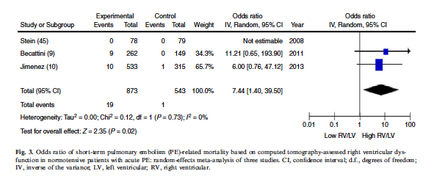
Increased RV/LV Ratio Is An Independent Predictor of PE-Related Mortality
Conclusion
“…RVD assessed by CT showed an association with an increased risk of mortality in patients with hemodynamically stable PE…”
Trujillo-Santos J, et al. J Thromb Haemost 2013;11: 1823-1832
5

Slide 6
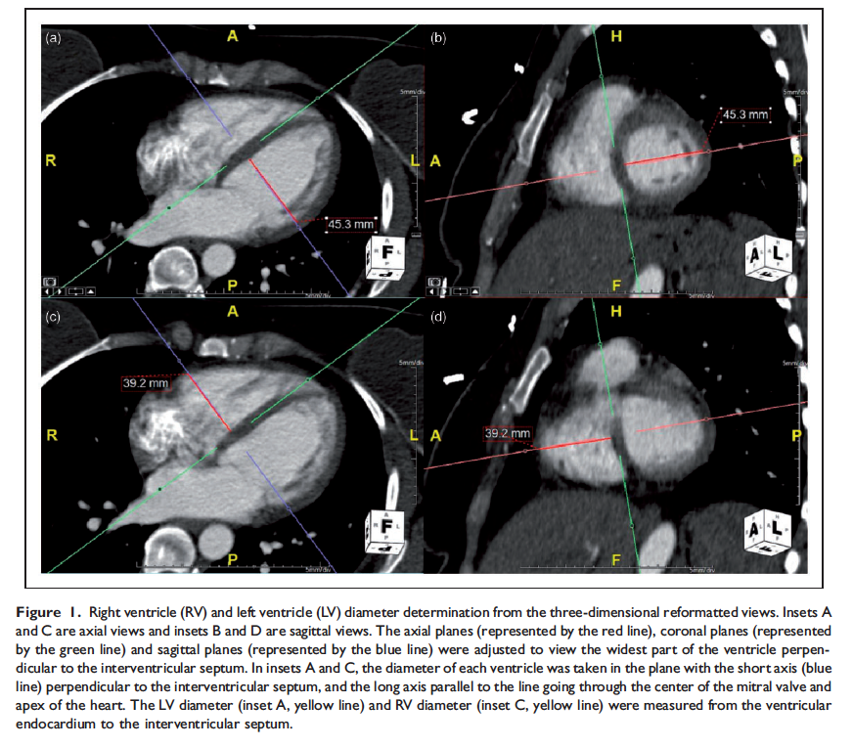
CTA-Derived RV/LV Ratio Is Reproducible and Reliable
Methodology:
The RV/LV ratio was measured in three-dimensional (3D) reformatted reconstructions, adjusting the axial, coronal, and sagittal planes to view the largest diameter of each ventricle as measured perpendicular to the interventricular septum.
Conclusion:
“The reliability of CTA for PE was excellent for the axial and multiplanar reformatted methods for quantifying the right-to-left ventricular ratio…”
Ouriel et al. Vascular Online First, published on April 18, 2016 as doi:10.1177/1708538116645056
6

Slide 7
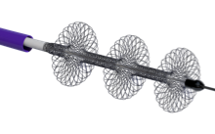
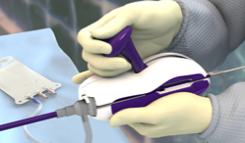
FlowTriever System
Aspiration Guide Catheter (“AGC”)
FlowTriever Device (“FT”)
Retraction Aspirator (“RA”)
Navigates through the right heart and delivers FT device to the pulmonary artery
Large bore catheter maximizes aspiration and collection of thrombus
Deployed out of AGC and into thrombus
Disrupts, engages and moves large volume of thrombus
Retracts the FT with thrombus into the AGC
Synchronizes aspiration and retrieval
Disruption, maceration and retrieval of clot
Increased lumen
Rapid flow restoration Reduced PA pressure Reduced RV strain
7

Slide 8
FLARE Study Overview
Objective
Evaluate the safety and effectiveness of the FlowTriever System for use in the removal of emboli from the pulmonary arteries in the treatment of acute PE
Study Design
Prospective, single-arm, multicenter study
106 patients, 18 sites
Follow-up at 48-hours & 30-days
Primary endpoints
Effectiveness – reduction in RV/LV ratio at 48-hours
Safety – Composite major adverse event rate
8

Slide 9
Major Adverse Event Definition
Device-related death
Major bleeding (VARC-2 definition)
Treatment-related adverse events:
Clinical Deterioration
Pulmonary vascular injury
Cardiac injury
All endpoints are measured within 48 hrs ± 8 hours

Slide 10
Study Flow
Baseline
Index Procedure
48-Hour Follow-up
30-Day Follow-Up/ Exit
FLARE was an Investigational Device Exemption (“IDE”) study with all appropriate controls including:
Data Safety and Monitoring Board
Clinical Events Committee
Independent Core Lab adjudication of RV/LV ratio for primary effectiveness endpoint
(Syntactx, LLC, New York, NY, USA)
10

Slide 11
Patient Selection
Main Inclusion Criteria:
Age ≥ 18 and ≤ 75 years
CTA evidence of proximal PE
PE symptom duration ≤ 14 days
RV/LV ratio of ≥ 0.9
Systolic BP ≥ 90 mmHg
Stable heart rate < 130 bpm
11

Slide 12
Patient Selection
Main Exclusion Criteria:
Thrombolytic use within 30 days
PHTN with peak PA pressure > 70 mmHg
Vasopressor requirement after fluids to keep pressure ≥ 90 mmHg
FiO₂ requirement > 40% room air or > 6 LPM to keep O₂ sat > 90%
Hematocrit < 28%, platelets < 100,000/µL, serum creatinine > 1.8 mg/dL, INR > 3
Cardiovascular or pulmonary surgery within 7 days
Actively progressing cancer
Pregnancy
Note: No specific exclusion for increased bleeding risk
12

Slide 13
Study Enrollment: April 2016 to October 2017
13

Slide 14
Subject Disposition
14

Slide 15
Baseline Characteristics
# Sites | 18
# Patients treated | 106
Mean age ± SD, years | 55.6 ± 13.6
Mean BMI ± SD, kg/m² | 36.1 ± 9.5
Male gender, n (%) | 58 (54.7)
Race/Ethnicity, n (%)
Caucasian | 87 (82.1)
African American | 18 (17.0)
Hispanic | 1 (0.9)
15

Slide 16
Comorbidities
 | n/106 (%)
Hypertension | 60 (56.6)
Coronary Artery Disease | 10 (9.4)
Congestive Heart Failure | 6 (5.7)
PFO / Other Shunt | 4 (3.8)
COPD | 8 (7.5)
Chronic Renal Insufficiency | 9 (8.5)
Concurrent DVT | 73 (68.9)
Prior Stroke / TIA | 10 (9.4)
Prior DVT | 14 (13.2)
Prior PE | 10 (9.4)
Recent Surgery – Ortho (4), CV (1*), Urologic (1) | 6 (5.7)
*>7 days
16

Slide 17
PE Characteristics
 | n/N (%)
sPESI
0 | 59/106 (55.7)
1 | 47/106 (44.3)
Elevated Cardiac Troponin | 60/101 (59.4)
Elevated D-Dimer | 45/60 (75.0)
Elevated B-Natriuretic Peptide | 65/89 (73.0)
PE Location
Unilateral | 5/106 (4.7)
Central | 5/106 (4.7)
Bilateral | 54/106 (50.9)
Bilateral + Central | 42/106 (39.6)
17

Slide 18
Procedural Characteristics
Pre-procedure anticoagulation, n (%)
UFH | 88 (83.0)
LMWH | 22 (20.8)
Other – VKA (1), NOAC (5) | 6 (5.7)
Right femoral access, n (%) | 101 (95.3)
Received lytics during procedure, n (%) | 2 (1.9)
Mean # devices used | 1.7
Mean # passes | 3.9 ± 1.7
Mean procedure time (min; max) | 1 hr 39 mins (39 mins; 3 hrs 11 mins)
Technical complications (delivery, deployment OR retraction) | 0
18

Slide 21
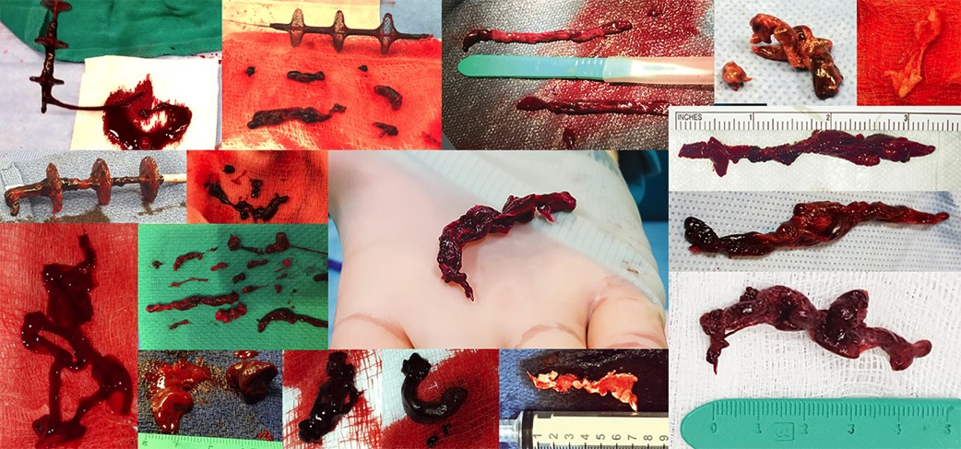
FlowTriever Clot Retrieval Experience, Acute to Chronic
ACUTE CHRONIC
21

Slide 22
RV/LV Ratio Outcomes
Reduction 0.39
p <0.0001
 | Baseline | 48 Hour | Reduction | p
All Patients (N=106) | 1.53 | 1.15 | 0.39 | p <0.0001
All Paired Patients (N=103) | 1.54 | 1.15 | 0.39 | p <0.0001
Paired Patients w/o Lytic (N=101) | 1.54 | 1.15 | 0.38 | p <0.0001
22

Slide 23
Clinical Outcomes
ICU stay post-procedure, median | 1 day
ICU stay: distribution | 0 = 44 1 = 23 2 = 18 3+ = 21
Days to discharge post-procedure, median | 3 days
# Patients lost-to-follow-up | 2
# Patients any-cause mortality | 1
# MAEs* | 4 (ITT 3.8% , mITT 3.8%)
23

Slide 24
Major Adverse Events
No intracranial hemorrhage
No access-site major bleeding
No device-related death
No device-related pulmonary injury
No device-related cardiac injury
One patient had a bleeding event
Three patients had treatment-related clinical deterioration

Slide 25
Major Adverse Events
*MAE Subject # | * MAE Description
#0404 | Hemoptysis, hemothorax, pulmonary infarction; lower lobectomy; possible reperfusion injury
#0808 | Worsening PE, surgical embolectomy
#2101 | Cardiogenic shock, acute respiratory insufficiency
#2422 | Patient agitated during procedure despite sedation; respiratory arrest with VFIB and cardioversion

Slide 26
FLARE Effectiveness in Context
 | N | Treatment | tPA | Reduction in RV/LV Ratio at 48 Hours
FLARE | 104 | FlowTriever mechanical thrombectomy | 0 mg | 0.39 / 25%
SEATTLE II (2015) | 150 | USAT | 24 mg | 0.42 / 24%
ULTIMA (2014)* | 30 | USAT arm | 10-20 mg | 0.29 / 22%
Becattini et al (2010) | 28 | Systemic Thrombolytic | 30-50 mg | 0.31 / 24%
Fasullo et al (2011) | 35 | Systemic Thrombolytic | 100 mg | 0.40 / 27%
Mi et al (2013) | 57 | Systemic Thrombolytic | 50 mg | 0.11 / 8%
*RV/LV Ratio in ULTIMA measured at 24 hours
26

Slide 27
FLARE Safety in Context
Study | Major Bleeding | Intracranial Hemorrhage (Fibrinolysis Group)
FLARE | 1/106 (.9%) | 0/106 (0%)
ULTIMA (USAT arm) (Kucher, et al. 2013) | 0/30 (0%) | 0/30 (0%)
PEITHO (tPA arm) (Meyer G, et al. 2014) | 58/506 (11.5%) | 10/506 (2%)
SEATTLE II (Piazza G, et al. 2014) | 17/150 (11.4%) | 0/150 (0%)
27

Slide 28
Conclusions
Catheter-directed mechanical thrombectomy using the FlowTriever System, without the use of thrombolytics, is safe and effective in improving RV function in patients with intermediate-risk PE
Additionally, it has the potential to reduce bleeding complications and reduce total hospital and ICU length of stay
This study establishes mechanical thrombectomy for acute pulmonary embolism as a viable alternative to thrombolytic-based catheter-directed therapy and warrants further investigation
28

Slide 29
FLARE Investigators
National PIs: Kenneth Rosenfield, M.D. and Victor Tapson, M.D.
Thomas Tu, M.D.
Christopher Adams, M.D.
Wissam Jaber, M.D.
Rohit Bhatheja, M.D.
Mitchell Silver, M.D.
Sameer Khandhar, M.D.
Rohit Amin, M.D.
Mitchell Weinberg, M.D.
Tod Engelhardt, M.D.
Eric Peden, M.D.
Robert Maholic, M.D.
David Holmes, M.D.
Scott Lilly, M.D.
Catalin Toma, M.D.
Hussam Hamdalla, M.D.
Glenn Hoots, M.D.
Victor Tapson, M.D.
Monica Hunter, M.D.
29

Slide 30
Backup Slides For Reference Only
30

Slide 31
Protocol Deviations
Major Protocol Deviations | # of Events | # (%) of Subjects
Total | 40 | 35 (33.0%)
Ineligible subject enrolled | 1 | 1 (0.9%)
Informed consent not obtained/signed/dated | 0 | 0 (0.0%)
Missing Assessment Prescribed by Protocol | 3 | 3 (2.8%)
Assessment Performed Outside Protocol Window | 7 | 7 (6.6%)
Visit Performed Outside Protocol Window | 29 | 27 (25.5%)
31

Slide 32
Limitations
The single-arm study design precluded direct comparison with the efficacy and safety of systemic fibrinolysis or anticoagulation alone.
Our study design did not allow for evaluation of clinical end points such as hemodynamic collapse or mortality.
32

Slide 33
Poolability – RV/LV Analysis No Evidence in Heterogenity Across Sites
Analysis | Pseudo-Site^{[1]} | N | Mean (SE) | P-value
ANOVA of Change in RV/LV Ratios from Baseline to 48-hour | A | 5 | 0.44 (0.09)
 | B | 6 | 0.27 (0.07)
 | C | 6 | 0.33 (0.08)
 | D | 3 | 0.55 (0.20)
 | E | 26 | 0.34 (0.06)
 | F | 7 | 0.42 (0.11)
 | G | 6 | 0.53 (0.15)
 | H | 9 | 0.38 (0.11)
 | I | 8 | 0.41 (0.08)
 | J | 25 | 0.39 (0.05) | 0.85
^{[1]} Pseudo-Sites Key: A = {2, 3, 5, 7, 12}; B = {10, 13, 15}; C = {16, 18}; D = {20, 21}; E = {4}; F = {8}; G = {9}; H = {11}; I = {14}; J = {24}.
33

Slide 34
FLARE vs. SEATTLE II
 | FLARE | SEATTLE II
Interventional Device | FlowTriever | EKOS
Design | Single arm OPC, Prospective, IDE | Single arm OPC, Prospective, IDE
Patients / Sites | 106 patients / 18 sites | 150 patients / 22 sites
Safety Endpoints | 1° Composite MAE at 48-Hours = 3.8% (n=4) 2° 30-Day Mortality = 0.9% (n=1) | 1° Major Bleeding at 72-Hours = 10% (n=15) 2° 30-Day Mortality = 2.7% (n=4)
Primary Efficacy Endpoint | Reduction in RV/LV ratio at 48 hours: 0.39 / 25% (n=106; OPC = >0.12) | Reduction in RV/LV ratio at 48 hours: 0.42 / 24%
ICU Stay | Median = 1 day % patient w/ ICU stay = 58% (n=62) | % patients w/ ICU stay = 100%
Length of Hospital Stay | Mean = 4.1 days Median = 3 days | Mean = 8.8 days
Device Metrics | Mean # FT devices/case = 1.7 Mean # passes/case = 3.9 | Mean total dose tPA = 24 mg
34

Slide 35
FLARE vs. SEATTLE II
 | FLARE | SEATTLE II
Key Inclusion Criteria | Age ≥18 and ≤75 RV/LV ≥0.9 PE symptom duration ≤14 days SBP ≥90 mmHg Stable HR <130 BPM | Age ≥18 RV/LV ≥0.9 PE symptom duration ≤14 days Massive PE (syncope, systemic arterial hypotension, cardiogenic shock, or resuscitated cardiac arrest) Submassive PE (RV dysfunction)
Key Exclusion Criteria Similarities | Major CV or pulmonary surgery within 7 days Hematocrit <28% Creatinine >1.8 mg/dL Vasopressor requirement keep pressure >90 mmHg Use of lytic within 30 days of enrollment | Major surgery within 7 days Hematocrit <30% Creatinine >2.0 mg/dL SBP <80 mmHg despite vasopressor or inotropic support Use of lytic/GP IIb/IIIa antagonists within 3 days of enrollment
Key Exclusion Criteria Differences | Peak PAP >70 mmHg FiO2 requirement >40%/6 LPM keep O2 sat >90% | Stroke or TIA within 1 year Head trauma within 1 year Other active intracranial or intra-spinal disease within 1 year Recent active bleeding from a major organ Clinician deemed subject at high risk for catastrophic bleeding
35

Slide 36
###
36

