Slide 1
Drug-Coated Balloons Used to Treat Access Graft and AV Fistulae:
US Experience and Japanese Opportunities – Industry Perspective

Slide 2
Disclosures
John Carline, Sr. Director of RA
Employee of Lutonix, Inc.

Slide 3
Agenda
Background
US Experience – AV Fistulae
Japan Opportunities – AV Fistulae

Slide 4
Background
Lutonix DCB – US/Japan
SFA Indication
LEVANT 2 SFA IDE Pivotal Study – US/EU (Started July 2011)
PMA Approval Oct 2014
LEVANT Japan SFA confirmatory Study – Japan Only (Started March 2013)
Shonin Approval Aug 2017
Below-the-Knee Indication
Lutonix BTK IDE Pivotal Study – US/Japan (Started June 2013)
AV Fistulae indication
Lutonix AVF IDE Pivotal Study – US Only (Started June 2015)
PMA Approval Aug 2017

Slide 5
US Experience AVF – Q-Subs
Bench Test Plan
FDA PTCA Guidance
Coating Characteristics – coating uniformity (±15%), coating thickness, coating integrity and drug particulate release (simulated use).
Animal Study Plan (AV Anastomosis Model)
Safety/Safety Margin (3X)/Overlap/Pharmacokinetics
Stability Test Plan/Chemistry Manufacturing and Control (CMC)
Analytical Test Development
Lot release test includes simulated use particulate testing.
Reserve Sample per 21CFR 211.170(b) of each lot of the finished device.
Clinical Study Plan

Slide 6
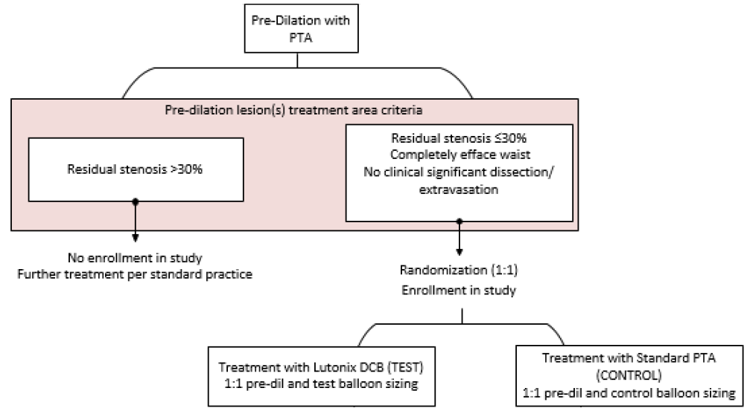
US Experience AVF – Clinical Design

Slide 7
LUTONIX AV IDE Clinical Trial
Study Design | Prospective, Global, Multicenter, Randomized, Safety and Effectiveness
Objective | To assess the safety and effectiveness of the LUTONIX® 035 AV Drug Coated Balloon PTA Catheter in the treatment of dysfunctional AV fistulae
Number of patients/sites | 285 randomized subjects at 23 clinical sites
Primary Effectiveness Endpoint | Target Lesion Primary Patency (TLPP) - 6 months
Primary Safety Endpoint | Freedom from any serious adverse event(s) involving the AV access circuit through 30 days
Follow Up | 1, 3, 6, 9, 12, 18, 24 month visits
Status | First Subject: June 2015 Enrollment Completion: March 2016

Slide 8
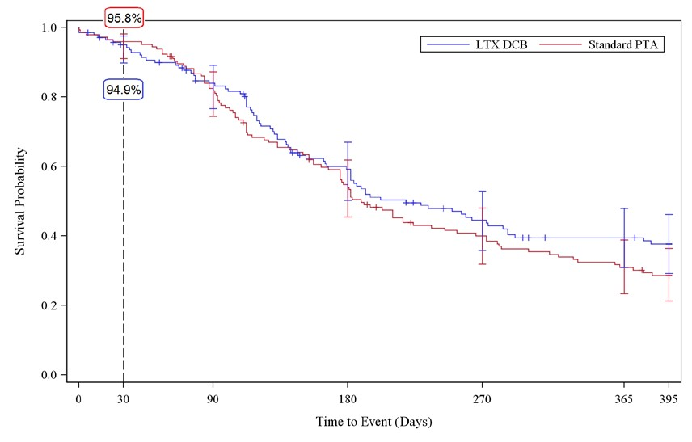
Primary Safety Endpoint 94.9% (DCB) vs. 95.8% (PTA) at 30days

Slide 9
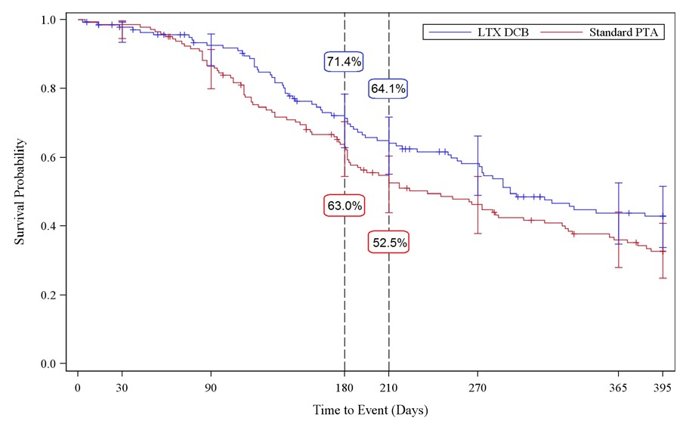
Primary Effectiveness Endpoint Δ 8.4% at 6m, Δ11.6% at 7m

Slide 10
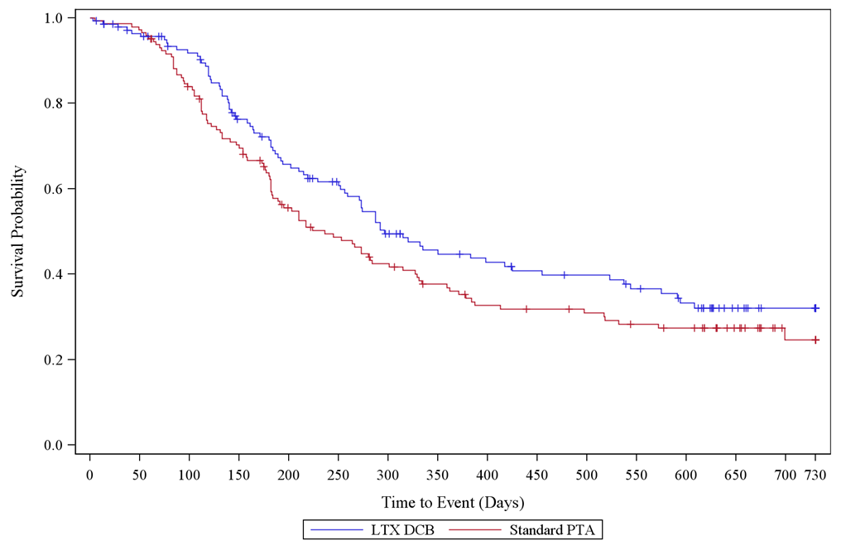
Target Lesion Primary Patency Interim Results 24m - Sustained Clinical Benefit in TLPP

Slide 11
Number of Re-interventions to Maintain Target Lesion Patency
Number of interventions required | LTX DCB (N=141) | Standard PTA (N=144) | Percent Reduction
6 Month – Interventions (Subjects) | 44 (n=37) | 64 (n=52) | 31.3% (20/64)
9 Month – Interventions (Subjects) | 76 (n=53) | 103 (n=74) | 26.2% (27/103)
12 Month – Interventions (Subjects) | 115 (n=69) | 138 (n=87) | 16.7% (23/138)

Slide 12
US Experience Conclusion
Modular PMA
Final Module (Clinical) – Jan 2017
PMA Approval – Aug 2017
Clinical Comments
Endpoint for approval vs. reimbursement
Hospital vs. access centers

Slide 13
Japan Opportunities
PMDA also has extensive consultation opportunity.
Similar needs between FDA/PMDA for Bench Testing/CMC/Animal Study Needs
Clinical data needs are also similar
High quality clinical study with consideration of ethnicity and procedural differences.

Slide 14
Japan Opportunities
Clinical Data
Use of high quality international randomized studies
Assessment of disease treatment differences (hospital vs. access center, dialysis time, etc.)
Assessment of racial differences (Caucasian vs. Asian patients)

Slide 15
Lutonix Global AV Registry
France
Germany
Greece
Italy
Objective: Demonstrate safety and assess clinical use and outcomes with the DCB for treatment of dysfunctional AV fistulae in a real world population
324 patients enrolled
23 sites from 13 countries
Primary endpoints
Efficacy - Target lesion primary patency (TLPP) - 6 months
Safety - Freedom from any serious adverse events (SAE) involving the AV access circuit – 30 days
Follow-up to 12 months
Austria
Portugal
Poland
Saudi Arabia
Singapore
Taiwan
Switzerland
Turkey
United Kingdom
15

Slide 16
Japan Opportunities Conclusion
DCBs are proven technology in Japan for SFA
For AV Fistulae, there is an opportunity to evaluate international clinical data, which address in-country medical practice and racial differences
High Quality Lutonix AV Randomized IDE Clinical Data
International Lutonix Global AV Registry Data with Asian Ethnicity

