Slide 1
IMProved Reduction of Outcomes: Vytorin Efficacy International Trial
A Multicenter, Double-Blind, Randomized Study to Establish the Clinical Benefit and Safety of Vytorin (Ezetimibe/Simvastatin Tablet) vs Simvastatin Monotherapy in High-Risk Subjects Presenting With Acute Coronary Syndrome

Slide 2
Trial Leadership
Study Chairmen: Eugene Braunwald and Robert Califf
TIMI Study Group: Christopher Cannon Robert Giugliano Amy McCagg Christina Pelland Sabina Murphy Erin Bohula May
DCRI: Michael Blazing Craig Reist Jennifer White Yuliya Lokhnygina
Curtis Campbell Cathy Martz
Merck: Thomas Musliner Andrew Tershakovec Ann Kilian Rona Harmelin-Kadouri Paul DeLucca Steve Bird
DSMB Chair: Scott Grundy
CEC Chair: Stephen Wiviott

Slide 3
National Lead Investigators and Steering Committee (1158 sites, 39 Countries)
Enrique Gurfinkel¹ Argentina (331)
Philip Aylward Andrew Tonkin* Australia (116)
Gerald Maurer Germany (935)
Frans Van de Werf Belgium (249)
Jose C. Nicolau Brazil (423)
Pierre Theroux Paul Armstrong* Jacques Genest* Canada (1106)
Ramon Cobalan Chile (152)
Daniel Isaza Colombia (568)
Jindrich Spinar Czech Rep (371)
Peer Grande² Denmark (576)
Juri Voitk Estonia (10)
Antero Kesaniemi Finland (341)
Jean-Pierre Bassand Michel Franier* France (268)
Harald Darius Germany (935)
Matayas Keltai Hungary (116)
Atul Mathur Sanjay Mittal Krishna Reddy India (259)
Basil Lewis Israel (589)
Gaetano DeFerrari Italy (593)
Ton Oude Ophuis J. Wouter Jukema* Netherlands (1191)
Harvey White New Zealand (164)
Terje Pedersen Norway (295)
Frank Britto Peru (66)
Witold Ruzyllo Poland (589)
Manuel Carrageta Portugal (102)
Ki-Bae Seung S. Korea (118)
Tibor Duris Slovakia (121)
Anthony Dalby S. Africa (186)
Jose Lopez-Sendon Spain (551)
Mikael Dellborg Sweden (480)
Francois Mach Switzerland (263)
Sema Guneri Turkey (50)
Alexander Parkhomenko Ukraine (159)
Adrian Brady United Kingdom (318)
Michael Blazing Christopher Cannon Christie Ballantyne* James de Lemos* Neal Kleiman* Darren McGuire* United States (5869)
Singapore (75), Malaysia (59), Hong Kong (58) Ecuador (45), Taiwan (46)
*Steering Comm Member, ¹ Deceased, ² 2005–2013

Slide 4
Background: Cholesterol Lowering
Lowering LDL cholesterol (LDL-C) has been a mainstay of cardiovascular prevention
Evidence mostly from statin trials which show reduction in morbidity and mortality
High-dose statins further reduce non-fatal CV events
To date, no lipid-modifying therapy added to statins has been demonstrated to provide a clinical benefit
Fibrates, niacin, CETP inhibitors
Recent ACC/AHA Guidelines have emphasized use of statin therapy
Despite current therapies, patients remain at high risk

Slide 5
Ezetimibe: Background
Ezetimibe inhibits Niemann-Pick C1-like 1 (NPC1L1) protein
located primarily on the epithelial brush border of the GI tract
resulting in reduced cholesterol absorption
When added to statin, produces ~20% further reduction in LDL-C
Two recent human genetic analyses have correlated polymorphisms in NPC1L1 with lower levels of LDL-C and lower risk of CV events*
*MI Genetics Consortium Investigators NEJM 2014; online Nov 12; Ference BA et al AHA 2014

Slide 6
Goals
IMPROVE-IT: First large trial evaluating clinical efficacy of combination EZ/Simva vs. simvastatin (i.e., the addition of ezetimibe to statin therapy):
Does lowering LDL-C with the non-statin agent ezetimibe reduce cardiac events?
“Is (Even) Lower (Even) Better?” (estimated mean LDL-C ~50 vs. 65mg/dL)
Safety of ezetimibe
Cannon CP AHJ 2008;156:826-32;
Califf RM NEJM 2009;361:712-7; Blazing MA AHJ 2014;168:205-12

Slide 7
Patient Population
Inclusion Criteria:
Hospitalization for STEMI, NSTEMI/UA < 10 days
Age ≥ 50 years, and ≥ 1 high-risk feature:
New ST chg, + troponin, DM, prior MI, PAD, cerebrovasc, prior CABG > 3 years, multivessel CAD
LDL-C 50-125 mg/dL (50–100 mg/dL if prior lipid-lowering Rx)
Major Exclusion Criteria:
CABG for treatment of qualifying ACS
Current statin Rx more potent than simva 40mg
Creat Cl < 30mL/min, active liver disease

Slide 8
Study Design
Patients stabilized post ACS ≤ 10 days:
LDL-C 50–125*mg/dL (or 50–100**mg/dL if prior lipid-lowering Rx)
*3.2mM
**2.6mM
N=18,144
Standard Medical & Interventional Therapy
Simvastatin 40 mg
Uptitrated to Simva 80 mg if LDL-C > 79
(adapted per FDA label 2011)
Ezetimibe / Simvastatin 10 / 40 mg
Follow-up Visit Day 30, every 4 months
90% power to detect
~9% difference
Duration: Minimum 2 ½-year follow-up (at least 5250 events)
Primary Endpoint: CV death, MI, hospital admission for UA,
coronary revascularization (≥ 30 days after randomization), or stroke
Cannon CP AHJ 2008;156:826-32; Califf RM NEJM 2009;361:712-7; Blazing MA AHJ 2014;168:205-12

Slide 9
Study Metrics
 | Simva (N=9077) | EZ/Simva (N=9067)
Uptitration to Simva 80mg, % | 27 | 6
Premature study drug D/C, % | 42 | 42
Median follow-up, yrs | 6.0 | 5.9
Withdraw consent w/o vital status, %/yr | 0.6 | 0.6
Lost to follow-up, %/yr | 0.10 | 0.09
Follow up for primary endpoint, % | 91 | 91
Follow up for survival, % | 97 | 97
Total primary endpoint events = 5314
Total patient-years clinical follow-up = 97,822
Total patient-years follow-up for survival = 104,135

Slide 10
Baseline Characteristics
 | Simvastatin (N=9077) % | EZ/Simva (N=9067) %
Age (years) | 64 | 64
Female | 24 | 25
Diabetes | 27 | 27
MI prior to index ACS | 21 | 21
STEMI / NSTEMI / UA | 29 / 47 / 24 | 29 / 47 / 24
Days post ACS to rand (IQR) | 5 (3, 8) | 5 (3, 8)
Cath / PCI for ACS event | 88 / 70 | 88 / 70
Prior lipid Rx | 35 | 36
LDL-C at ACS event (mg/dL, IQR) | 95 (79, 110) | 95 (79,110)

Slide 11
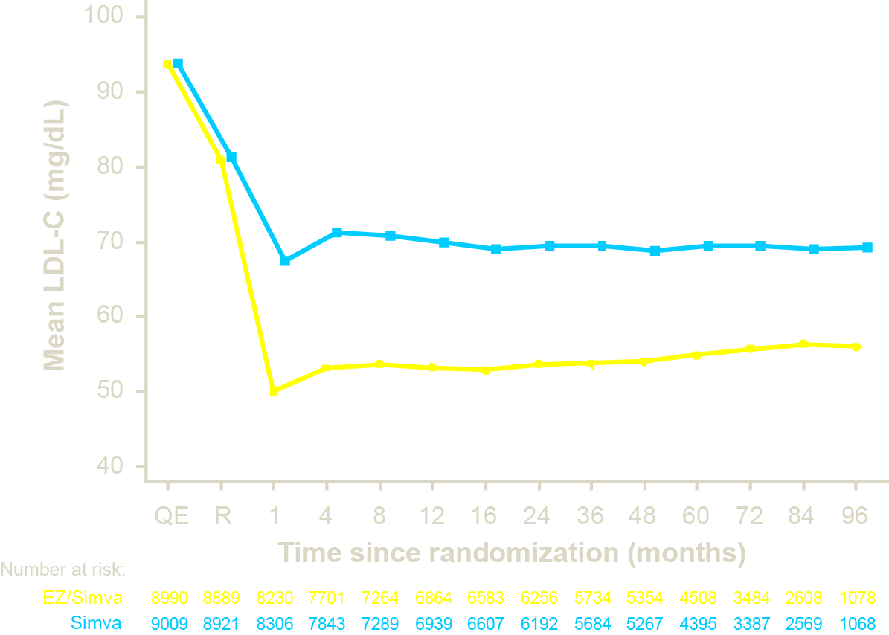
LDL-C and Lipid Changes
1 Yr Mean | LDL-C | TC | TG | HDL | hsCRP
Simva | 69.9 | 145.1 | 137.1 | 48.1 | 3.8
EZ/Simva | 53.2 | 125.8 | 120.4 | 48.7 | 3.3
Δ in mg/dL | -16.7 | -19.3 | -16.7 | +0.6 | -0.5
Median Time avg
69.5 vs. 53.7 mg/dL

Slide 12
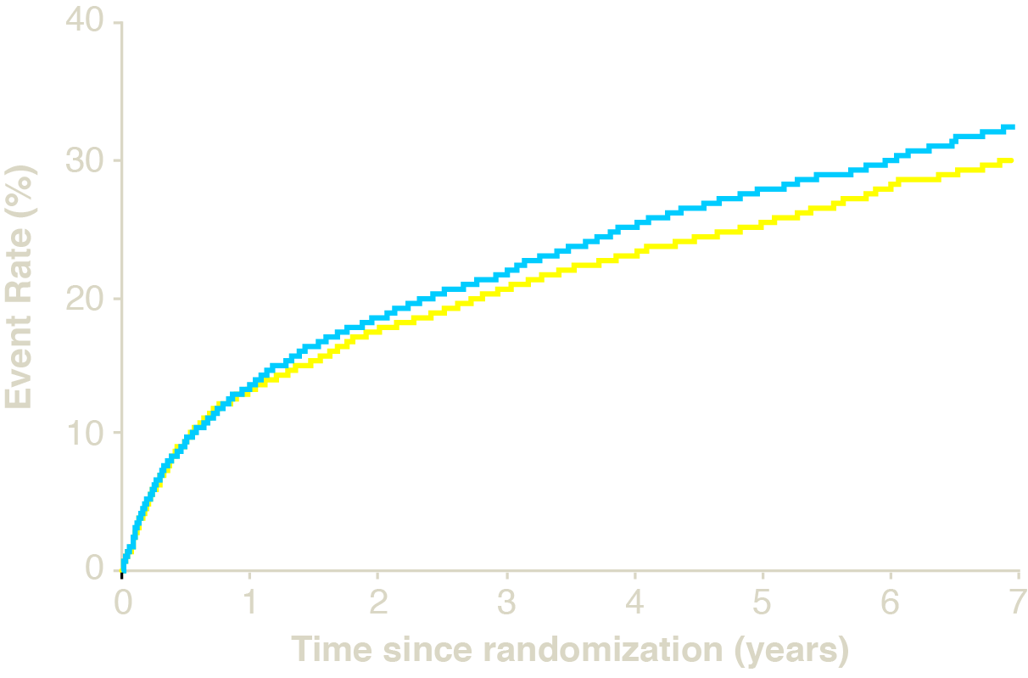
Primary Endpoint — ITT
Cardiovascular death, MI, documented unstable angina requiring rehospitalization, coronary revascularization (≥30 days), or stroke
HR 0.936 CI (0.887, 0.988)
p=0.016
Simva — 34.7%
2742 events
NNT= 50
EZ/Simva — 32.7%
2572 events
7-year event rates

Slide 13
Primary and 3 Prespecified Secondary Endpoints — ITT
 |  | Simva* | EZ/Simva* | p-value
Primary |  | 34.7 | 32.7 | 0.016
CVD/MI/UA/Cor Revasc/CVA
Secondary #1 |  | 40.3 | 38.7 | 0.034
All D/MI/UA/Cor Revasc/CVA
Secondary #2 |  | 18.9 | 17.5 | 0.016
CHD/MI/Urgent Cor Revasc
Secondary #3 |  | 36.2 | 34.5 | 0.035
CVD/MI/UA/All Revasc/CVA
0.936
0.948
0.912
0.945
0.8
1.0
1.1
*7-year event rates (%)
Ezetimibe/Simva Better
Simva Better
UA, documented unstable angina requiring rehospitalization; Cor Revasc, coronary revascularization (≥30 days after randomization); All D, all-cause death; CHD, coronary heart disease death; All Revasc, coronary and non-coronary revascularization (≥30 days)

Slide 14
Individual Cardiovascular Endpoints and CVD/MI/Stroke
 |  | HR | Simva* | EZ/Simva* | p-value
All-cause death |  | 0.99 | 15.3 | 15.4 | 0.782
CVD |  | 1.00 | 6.8 | 6.9 | 0.997
CHD |  | 0.96 | 5.8 | 5.7 | 0.499
MI |  | 0.87 | 14.8 | 13.1 | 0.002
Stroke |  | 0.86 | 4.8 | 4.2 | 0.052
Ischemic stroke |  | 0.79 | 4.1 | 3.4 | 0.008
Cor revasc ≥ 30d |  | 0.95 | 23.4 | 21.8 | 0.107
UA |  | 1.06 | 1.9 | 2.1 | 0.618
CVD/MI/stroke |  | 0.90 | 22.2 | 20.4 | 0.003
0.6
1.0
1.4
*7-year event rates (%)
Ezetimibe/Simva Better
Simva Better

Slide 15
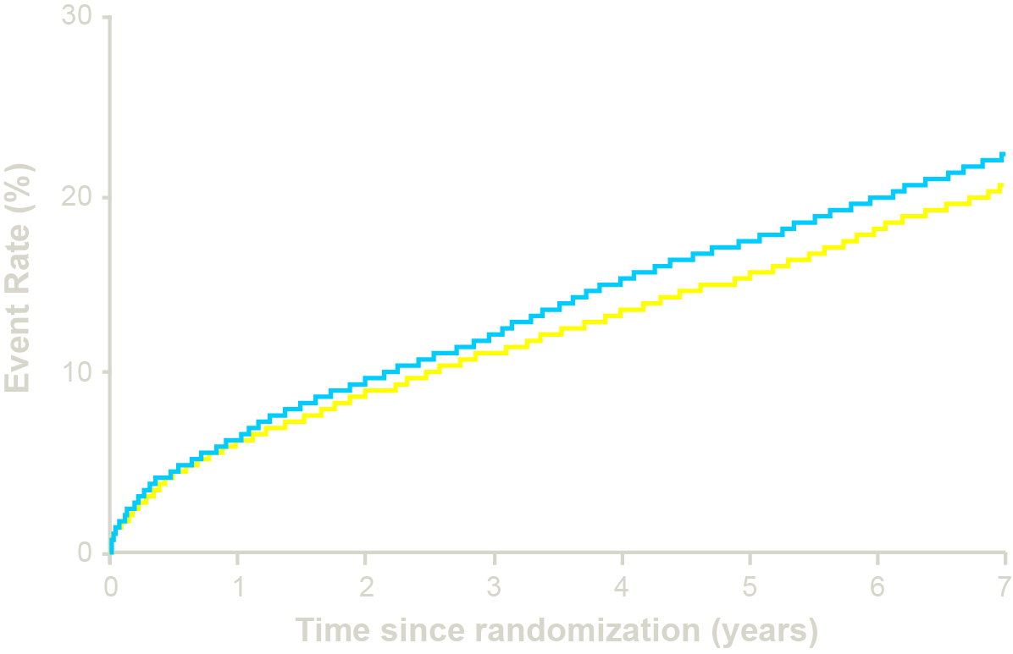
CV Death, Non-fatal MI, or Non-fatal Stroke
HR 0.90 CI (0.84, 0.97)
p=0.003
NNT= 56
Simva — 22.2%
1704 events
EZ/Simva — 20.4%
1544 events
7-year event rates

Slide 16
Major Pre-specified Subgroups
 |  | Simva† | EZ/Simva†
Male |  | 34.9 | 33.3
Female |  | 34.0 | 31.0
Age < 65 years |  | 30.8 | 29.9
Age ≥ 65 years |  | 39.9 | 36.4
No diabetes |  | 30.8 | 30.2
Diabetes |  | 45.5 | 40.0
Prior LLT |  | 43.4 | 40.7
No prior LLT |  | 30.0 | 28.6
LDL-C > 95 mg/dl |  | 31.2 | 29.6
LDL-C ≤ 95 mg/dl |  | 38.4 | 36.0
*
0.7
1.0
1.3
†7-year event rates
Ezetimibe/Simva Better
Simva Better
*p-interaction = 0.023, otherwise > 0.05

Slide 17
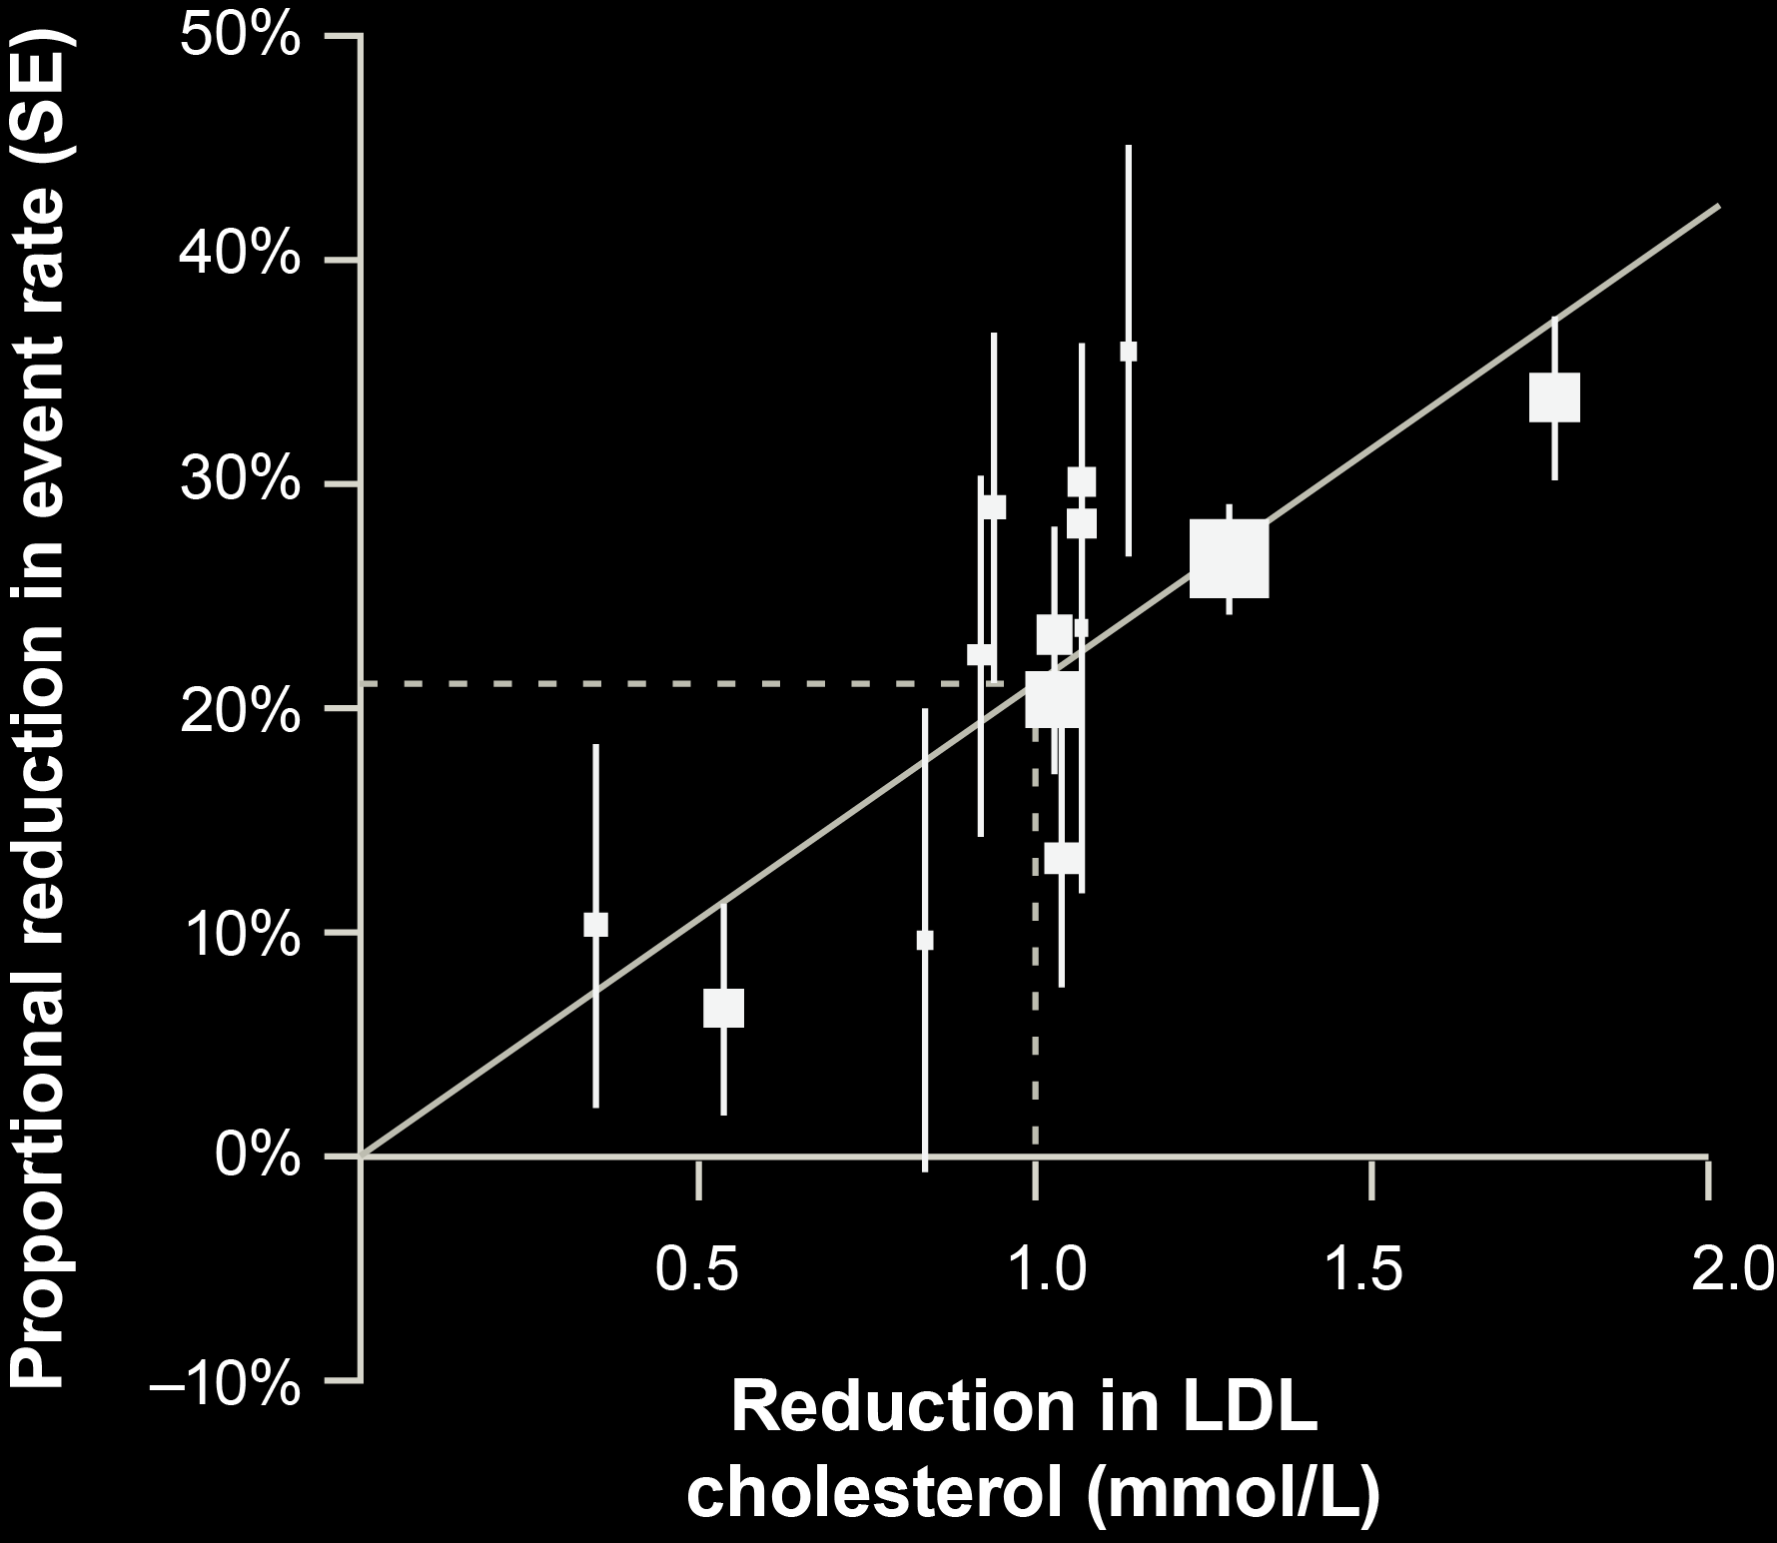
IMPROVE-IT vs. CTT: Ezetimibe vs. Statin Benefit
IMPROVE-IT
CTT Collaboration. Lancet 2005; 366:1267-78; Lancet 2010;376:1670-81.

Slide 18
Safety — ITT
No statistically significant differences in cancer or muscle- or gallbladder-related events
 | Simva n=9077 % | EZ/Simva n=9067 % | p
ALT and/or AST≥3x ULN | 2.3 | 2.5 | 0.43
Cholecystectomy | 1.5 | 1.5 | 0.96
Gallbladder-related AEs | 3.5 | 3.1 | 0.10
Rhabdomyolysis* | 0.2 | 0.1 | 0.37
Myopathy* | 0.1 | 0.2 | 0.32
Rhabdo, myopathy, myalgia with CK elevation* | 0.6 | 0.6 | 0.64
Cancer* (7-yr KM %) | 10.2 | 10.2 | 0.57
* Adjudicated by Clinical Events Committee
% = n/N for the trial duration

Slide 19
Conclusions
IMPROVE-IT: First trial demonstrating incremental clinical benefit when adding a non-statin agent (ezetimibe) to statin therapy:
YES: Non-statin lowering LDL-C with ezetimibe reduces cardiovascular events
YES: Even Lower is Even Better (achieved mean LDL-C 53 vs. 70 mg/dL at 1 year)
YES: Confirms ezetimibe safety profile
Reaffirms the LDL hypothesis, that reducing LDL-C prevents cardiovascular events
Results could be considered for future guidelines

