Slide 1
Andexanet alfa in Factor Xa Inhibitor-Associated Acute Major Bleeding
As Presented at the ACC Scientific Sessions, 12 March 2018
Stuart J. Connolly, M.D., Truman J. Milling, Jr., M.D., John W. Eikelboom, M.D., C. Michael Gibson, M.D., John T. Curnutte, M.D., Ph.D., Michele D. Bronson, Ph.D., Patrick Yue, M.D., Genmin Lu, Ph.D., Pamela B. Conley, Ph.D., Peter Verhamme, M.D., Ph.D., Jeannot Schmidt, M.D., Saskia Middeldorp, M.D., Alexander T. Cohen, M.D., Jan Beyer-Westendorf, M.D., Pierre Albaladejo, M.D., Jose Lopez-Sendon, M.D., Andrew Demchuk, M.D., Shelly Goodman, B.S.N., Janet Leeds, Ph.D., Deborah M. Siegal, M.D., Elena Zotova, Ph.D., Brandi Meeks, M.Sc., Juliet Nakamya, Ph.D., Balakumar Swaminathan, M.Sc., Mark Crowther, M.D.
on behalf of the ANNEXA-4 investigators

Slide 2
Background
Factor Xa (FXa) inhibitors reduce thrombotic events, but can precipitate major bleeding
>100,000 bleeding hospitalizations per year in the US
Fatality rate of 15-20%
Andexanet alfa was developed as a specific reversal agent for all direct and indirect FXa inhibitors
It rapidly and safely reversed anti-FXa activity in healthy volunteers
Truven Health Analytics, 12 months ending December 31, 2016 for Commercial, Medicare, and Medicaid patients
Held C et al, Eur Heart J 2015; 36: 1264-72.
Piccini JP et al, Eur Heart J 2014; 35: 1873-80.

Slide 3
Andexanet alfa: Recombinant Modified Human Factor Xa
Factor Xa Decoy
Factor Xa Inhibitor
High affinity
GLA domain removed to prevent anticoagulant effect
S419A
S419A
Gla
Catalytic Domain
S
S
Activity eliminated to prevent thrombin generation
N terminal residues retained to reduce immunogenicity
Nature Medicine, Volume 19, April 2013
Notes:
Using FX as a template, modifications were made in three regions to generate r-Antidote: deletion of a 34-residue fragment (residues 46–78) that contains the 11 GLA residues; replacement of the activation peptide (AP) with ArgLysArg (RKR) to form the RKRRKR linker that connects the light chain (LC) to the heavy chain (HC); and mutation of the active-site serine to alanine (S419A).

Slide 4
ANNEXA-4 Study Design
Bleeding and Laboratory Assessment
Patient Screening
Andexanet
After end of infusion
Safety
follow-up visit
IV Bolus
2-hour
IV Infusion
Patient with acute major bleeding
Within 18 hours of last dose of FXa inhibitor
1 hr
4 hr
8 hr
12 hr
Assessments:
Day 1
Day 3
Day 30
Efficacy Outcomes
Change in anti-fXa activity
Clinical hemostatic efficacy through 12 hours
Safety Measurements
Thrombotic events
Antibodies to FX, FXa, andexanet
30-day mortality
Notes:
Hemostatic efficacy had to be “excellent” or “good.”
Reference
Portola Data on File
ANNEXA-4 Protocol p32/para2, p33/Fig3.2
ANNEXA-4 Protocol p33/para1, p59/Sect11.5.2 para1,2
ANNEXA-4 Protocol p60 Sec11.5.3/para1
ANNEXA-4 Protocol p9/row5/Safety Objectives, p14/row2; p64 Sec11.7.1/para1,3
ANNEXA-4 Protocol p41 Sec 4.1 Inclusion Criteria
ANNEXA-4 Protocol p59/ Sec11.5.1/ para2
DIRECT PICKUP OF SLIDE 28 in ANDEXANET OVERVIEW DECK
Safety follow up: ANNEXA-4 Protocol/p73/Appendix A

Slide 5
ANNEXA-4 Dose Selection
Acute major bleeding ≤ 18 hours of last dose of apixaban, edoxaban, rivaroxaban, or enoxaparin
Andexanet IV bolus and 2 hour infusion
Pts on apixaban or >7 h from last rivaroxaban dose
Bolus 400 mg
+
Infusion 480 mg @ 4 mg/min
Pts on enoxaparin or edoxaban or ≤ 7 h from last rivaroxaban dose
Bolus 800 mg
+
Infusion 960 mg @ 8 mg/min
Pts on enoxaparin, edoxaban or ≤7 h from last rivaroxaban dose
Bolus 800 mg
+
Infusion 960 mg @ 8 mg/min

Slide 6
ANNEXA-4: Design and Analysis Plan
Analysis Populations
Safety population includes all patients receiving andexanet
Efficacy population excludes patients with baseline anti-fXa activity <75 ng/ml
(< 0.25 IU/ml for enoxaparin)
Interim analysis
Includes all patients as of October 20, 2017
ANNEXA-4 study is ongoing
Notes:
₆

Slide 7
Assessment of Clinical Hemostatic Efficacy
All cases assessed by independent committee
Independent Core Lab interpreted brain CT and MRI
Cases rated as excellent/good vs. poor/none based on specific criteria
This methodology initially developed for assessment of 4F-PCC in warfarin bleeding, where efficacy reported was 72%*
*Sarode et al, Circulation 2013; 128, 1234-43

Slide 8
Baseline Characteristics
 | Safety Population N=227 | Efficacy Population N=137
Age (yr), mean ± SD | 77(±11) | 77 (±12)
Male | 117 (52%) | 70 (51%)
Time from presentation until Andexanet (hrs) | 4.7 ± 2.8 | 5.0 ± 3.1
Estimated creatinine clearance < 30 mL/min, | 21 (9%) | 13 (10%)
Indication for anticoagulation
Atrial fibrillation | 178 (78%) | 104 (76%)
Venous Thromboembolic Disease | 52 (23%) | 38 (28%)
Atrial fibrillation and VTE | 8 (4%) | 6 (4%)
Medical History
Myocardial infarction | 32 (14%) | 15 (11%)
Stroke | 47 (21%) | 32 (23%)
Heart Failure | 52 (23%) | 36 (26%)
Diabetes mellitus | 67 (30%) | 42 (31%)

Slide 9
Site of Initial Bleeding
 | Safety Population N=227 | Efficacy Population N=137
Intracranial Bleeding | 139 (61%) | 78 (57%)
Glasgow Coma Scale, mean ± SD | 13.9 ± 1.63 | 13.9 ± 1.70
Intracerebral site | 74 (52%) | 44 (54%)
Sub-dural site | 45 (32%) | 24 (30%)
Subarachnoid site | 23 (16%) | 13 (16%)
Gastrointestinal Bleeding | 62 (27%) | 43 (31%)
Other Bleeding site | 26 (12%) | 16 (12%)

Slide 10
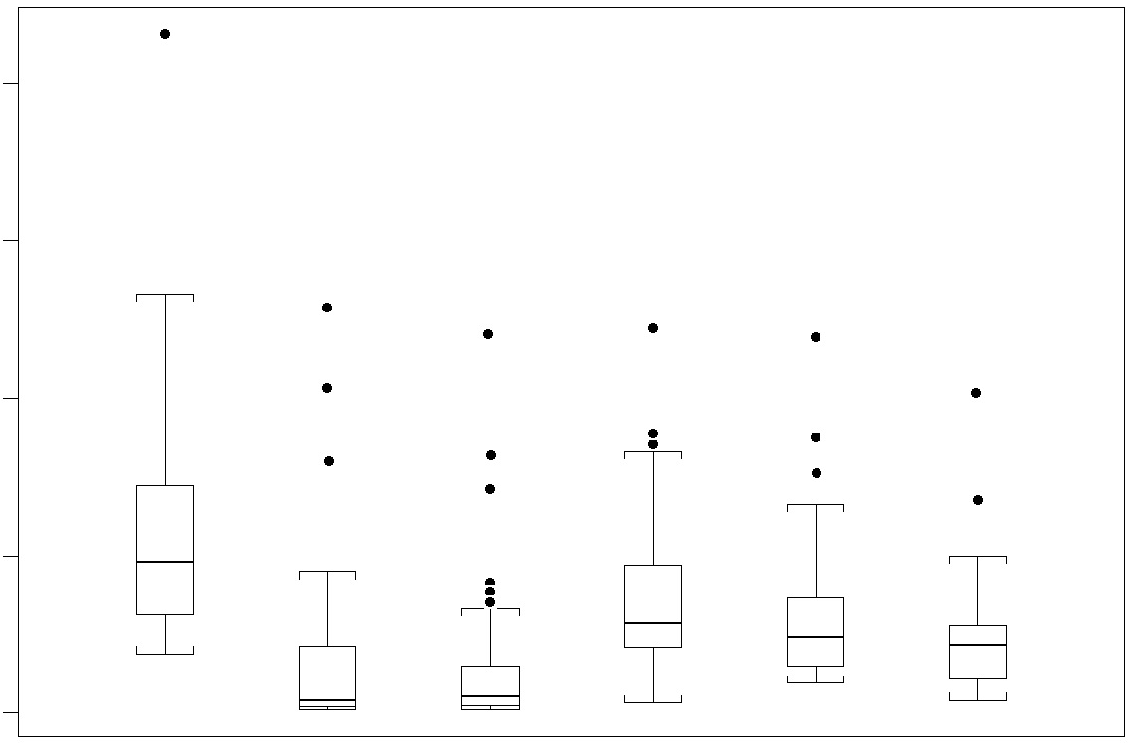
Anti-factor Xa Activity: Rivaroxaban n= 75
800
Anti-factor Xa Activity (ng/ml)
600
400
200
0
Baseline
End of Bolus
End of Infusion
4 Hr
8 Hr
12 Hr
Median | 169.75 | 11.30 | 14.40 | 96.80 | 82.60 | 72.20
Percent Change |  | -88% | -87% | -42% | -49% | -60%
(95% CI) |  | (-92 to -82) | (-89 to -82) | (-46 to -33) | (-53 to -45) | (-65 to -53)

Slide 11
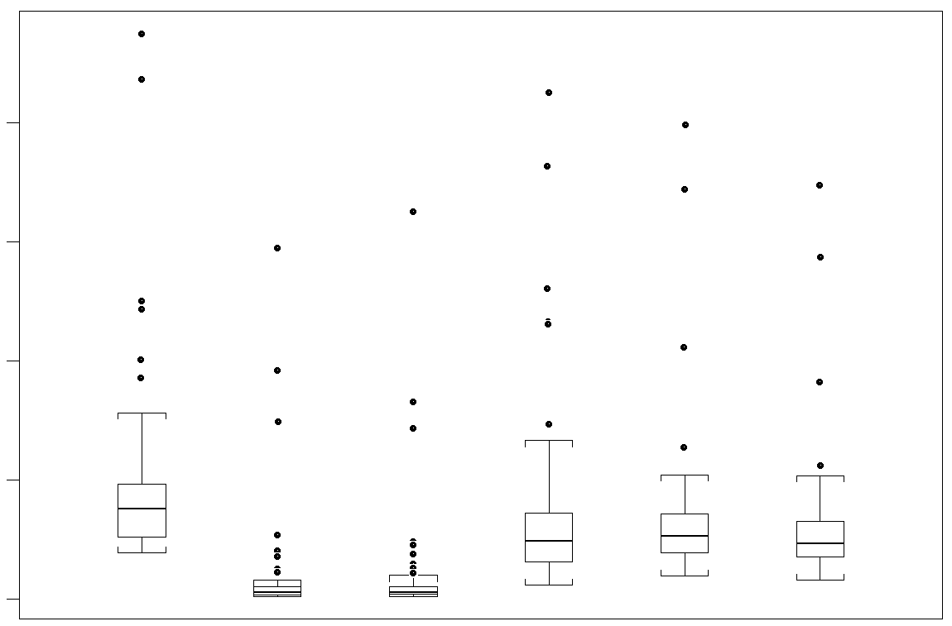
Anti-factor Xa Activity: Apixaban n= 105
Anti-factor Xa Activity (ng/ml)
800
600
400
200
0
Baseline
End of Bolus
End of Infusion
4 Hr
8 Hr
12 Hr
Median | 132.60 | 9.45 | 10.10 | 79.65 | 90.05 | 80.90
Percent change |  | -91% | -91% | -36% | -30% | -35%
(95% CI) |  | (-92 to -90) | (-92 to -90) | (-41 to -29) | (-36 to -25) | (-41 to -32)

Slide 12
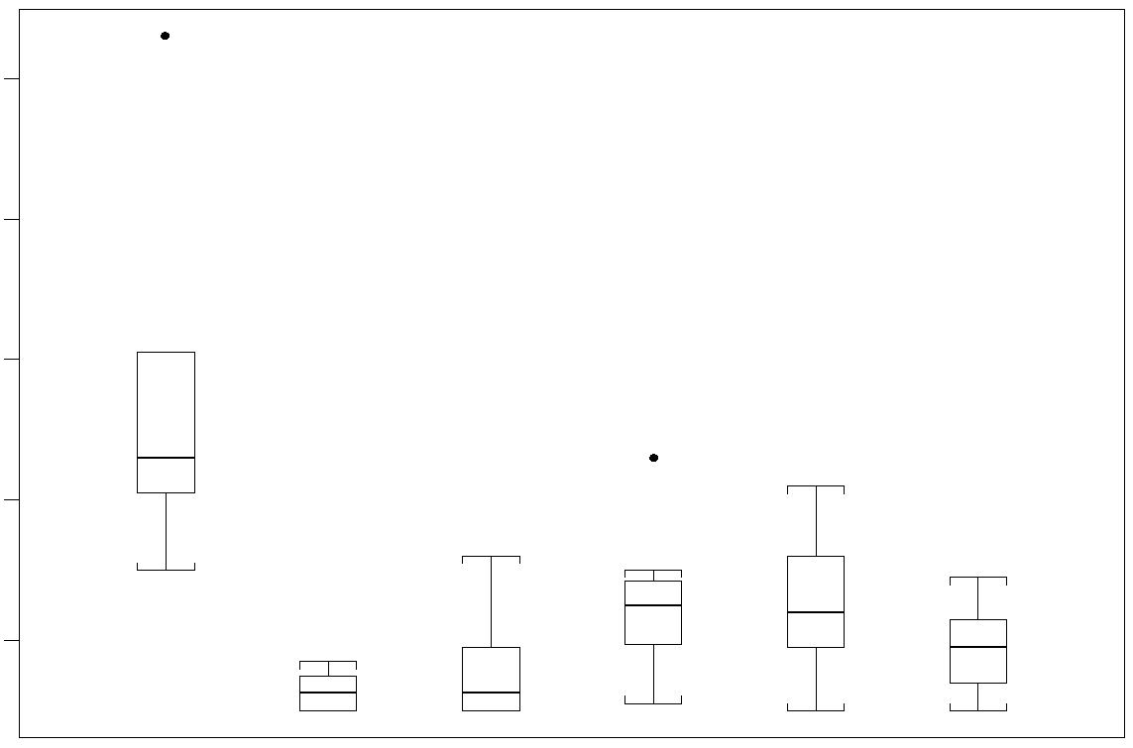
Anti-factor Xa Activity: Enoxaparin n= 16
1.0
Anti-factor Xa Activity (IU/ml)
0.8
0.6
0.4
0.2
Baseline
End of Bolus
End of Infusion
4 Hr
8 Hr
12 Hr
Median | 0.44 | 0.11 | 0.11 | 0.23 | 0.21 | 0.18
Percent Change |  | -75% | -73% | -44% | -44% | -52%
(95% CI) |  | (-83 to -66) | (-79 to -29) | (-61 to -25) | (-60to -27) | (-67to -29)

Slide 13
Effective Hemostasis at 12 hours Post Andexanet
Number of Major Bleeds Adjudicated | Number of Patients who Achieved Excellent or Good Hemostasis | Percent of Patients who Achieved Excellent or Good Hemostasis | 95% Confidence Interval
132 | 109 | 83% | 76% - 89%

Slide 14
Clinical Hemostatic Efficacy
Subgroup
No. of Patients
Excellent or Good (95% CI)
Total Efficacy Patients
132
83 ( 76- 89 )
Drug
Rivaroxaban
54
83 ( 73- 93 )
Apixaban
68
82 ( 73- 91 )
Enoxaparin
10
80 ( 55-100 )
Sex
Male
67
81 ( 71- 90 )
Female
65
85 ( 76- 93 )
Site of bleeding
Gastrointestinal
43
86 ( 76- 96 )
Intracranial
74
81 ( 72- 90 )
Other
15
80 ( 60-100 )
Age
<65 yr
18
83 ( 66-100 )
65-75 yr
38
87 ( 76- 98 )
>75 yr
76
80 ( 71- 89 )
Andexanet dose
Low
117
81 ( 74- 88 )
High
15
93 ( 81-100 )
25
50
75
100

Slide 15
Safety Assessment
Thrombotic events occurred within 3 days of andexanet in
6 (2.6%) patients and by 30 days in 24 (11%)
Anticoagulation re-started in 129 patients (57%) by 30 days
Therapeutic anticoagulation was re-started in only 9 patients before a thrombotic event occurred
27 deaths occurred by 30 days (12%), of which 11 were cardiovascular

Slide 16
Time to Death by Any Cause
0.17
0.17
0.16
Proportion with Death by Any Cause
0.16
0.15
0.15
0.14
0.14
0.13
0.13
0.12
0.12
0.11
0.11
0.10
0.10
0.09
0.09
0.08
0.08
0.07
0.07
0.06
0.06
0.05
0.05
0.04
0.04
0.03
0.03
0.02
0.02
0.01
0.01
0.00
0.00
0
0
3
3
6
6
9
9
12
12
15
15
18
18
21
21
24
24
27
27
30
30
Days of Follow-up (Day 0 is End of Infusion)
No. at risk:
227
226
221
219
213
211
208
204
197
196
188

Slide 17
Thrombotic Events
All events
Events after re-start of anticoagulation
0.12
0.12
Data as of: 20OCT2017
# Unrefuted TE after restart of AC among those restarted AC: 7 / 129
0.10
0.10
0.08
0.08
Proportion with an Event
0.06
0.06
0.04
0.04
0.02
0.02
0.00
0.00
0
0
3
3
6
6
9
9
12
12
15
15
18
18
21
21
24
24
27
27
30
30
0
0
3
3
6
6
9
9
12
12
15
15
18
18
21
21
24
24
27
27
30
30
Days of Follow-up
Days Since Re-start of AC
No. at risk:
227
221
216
210
202
201
196
188
181
179
171
129
125
124
117
114
110
99
93
82
70
48

Slide 18
Recent Regulatory Trials of Approved Reversal Agents
Pivotal Study | Reversal agent Anticoagulant | Number |  | Hemostatic Efficacy (95% CI) |  | Thrombotic Event Rate (95% CI)
 |  | Total | % ICH | Total | ICH | Total | ICH
ANNEXA-4 * | Andexanet FXa Inhibitors | 227 | 61 | 83% (76-89) | 81% (72-90) | 11% (7-16) | 12% (7-19)
REVERSE-AD | Idarucizumab Dabigatran | 301 | 33 | 68% ª | NR ^{b} | 5% (3-8) | 6% (2-13)
Sarode 2013 | 4F-PCC Warfarin | 98 | 12 | 72% (64-81) | 42% (15-72) | 8% (3-15) | NR
Sarode 2013 | Plasma Warfarin | 104 | 12 | 65% (56-75) | 58% (28-85) | 6% (3-13) | NR
4F-PCC = Four factor prothrombin complex concentrate; CI = Confidence interval; ICH = Intracranial hemorrhage; NR = Not reported
a 68% had investigator-determined, non-adjudicated time to hemostasis within 24 hours
b Time to hemostasis not calculated in ICH patients

Slide 19
Conclusions
Andexanet rapidly reverses anti-fXa activity
Effective hemostasis achieved in 83% of patients
Thrombotic events/mortality rates consistent with the high risk profile of the patients
Andexanet reversal of fXa inhibitor-bleeding has similar efficacy and safety as reported with other approved reversal agents

Slide 20
Back up Slides

Slide 21
Factor Xa Inhibitor Treatment - Total Daily Dose
Factor Xa Total Daily Dosage | Safety Population (N=227) | Efficacy Population (N=137)
Rivaroxaban Total Daily Dosage
10 mg | 2 (1%) | 0
15 mg | 25 (11%) | 15 (11%)
20 mg | 59 (26%) | 38 (28%)
30 mg | 4 (2%) | 4 (3%)
Apixaban Total Daily Dosage
5 mg | 56 (25%) | 30 (21.9)
10 mg | 60 (26%) | 40 (29.2)
>=15 mg | 1 | 0
Edoxaban Total Daily Dosage
30 mg | 2 (1%) | 0
60 mg | 1 | 0
Enoxaparin Total Daily Dosage
<=100 mg | 7 (3%) | 4 (3%)
>100 mg | 10 (4%) | 6 (4%)

Slide 22
Key Eligibility Criteria
Inclusion Criteria
Exclusion Criteria
Age > 18
Acute major bleeding (any one)
Life-threatening, with evidence of hemodynamic compromise
Hgb decrease ≥ 2 g/dL
Critical area (e.g., ICH)
Apixaban, edoxaban, enoxaparin, rivaroxaban
Last dose of FXai within 18 hours
Recent thrombotic event
GCS < 7 or ICH volume > 60 cc
Recent blood product use
Expected mortality < 1 mo
Planned surgery

Slide 23
Adjudication Criteria for Hemostatic Efficacy (Abridged)
ICH
Excellent: ≤ 20% increase in hematoma volume/thickness vs. baseline at 1 and 12 hours
Good: > 20% but ≤ 35% increase in volume/thickness at 12 hours vs. baseline
Poor/none: > 35% increase in volume/thickness at 12 hours vs. baseline
GI
Excellent: ≤ 10% decrease in corrected Hgb at 12 hours vs. baseline
Good: > 10 % to ≤ 20% decrease in corrected Hgb at 12 hours vs. baseline
Poor/none: > 20% decrease in corrected Hgb at 12 hours vs. basleine
For all bleeds, use of coagulation intervention (e.g., PCC), and/or
andexanet re-dosing will result in poor/none hemostatic efficacy

