Slide 1
On-Site Computed Tomography-Derived Fractional Flow Reserve to Guide the Management of Patients with Stable Coronary Artery Disease
——the TARGET Randomized Trial
Clinical Trial Registration: URL: https://clinicaltrials.gov Registration number: NCT03901326
Yundai Chen
Chinese PLA General Hospital
On behalf of TARGET trial Investigators

Slide 2
Disclosure
– No conflict of interest.

Slide 3
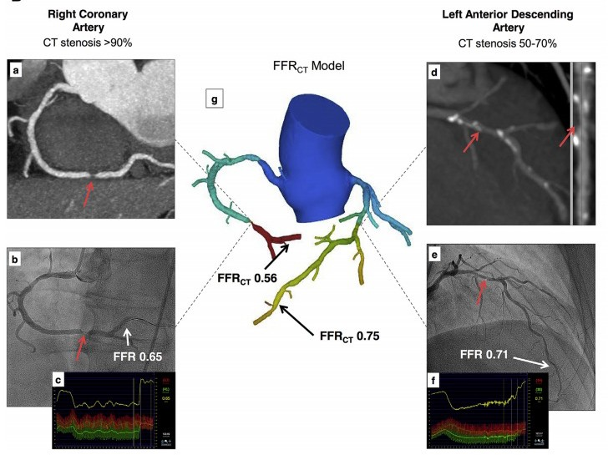
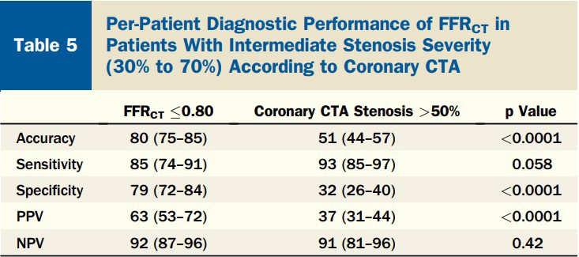
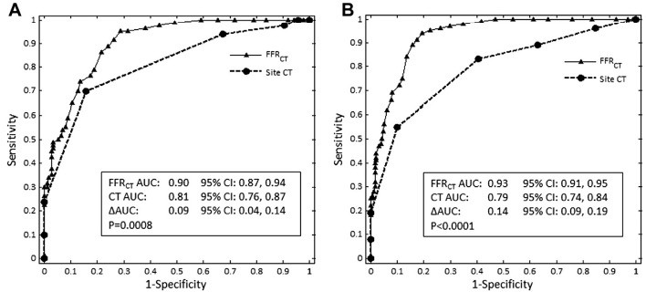
Background—— CT-FFR enables functional assessment for CAD
The NXT Trial
Per-patient
Per-vessel
J Am Coll Cardiol. 2014 Apr 1;63(12):1145-1155.

Slide 4
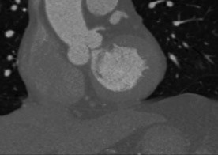
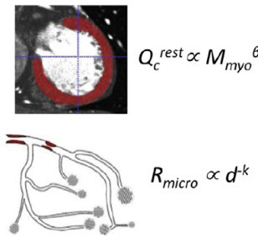
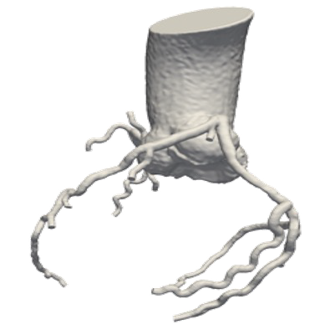
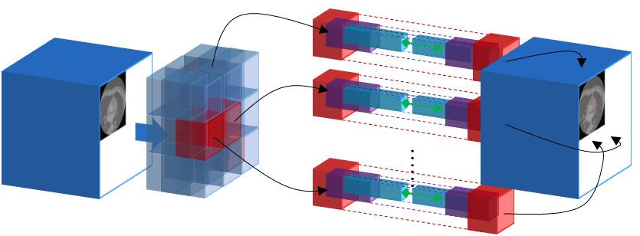
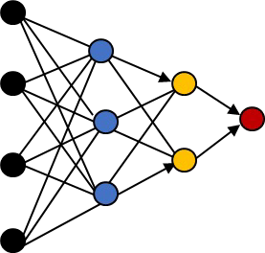
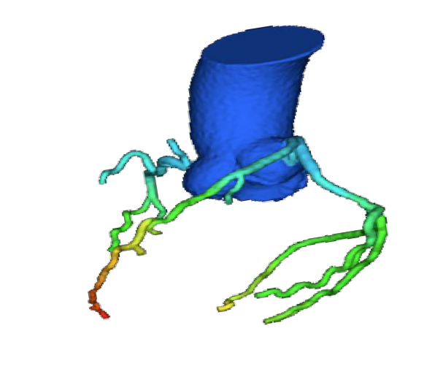
Background——Two major algorithms for CT-FFR calculation
Imaging
CFD based CT-FFR
PLATFORM study, FORECAST trial…
Good compatibility with anatomical variation
Poor extensibility
Long computation time
Structural analysis Module
Revascularization
Models of coronary physiology
Computational fluid dynamics
ML based CT-FFR
MACHIHE registry… while limited in outcome study
FFR Calculation
Functiona l Analysis Module
Good extensibility
Real time computing
Improve performance with the increase of data
Filter-Net Deep neural network to extract vascular structure & Bidirectional long-term Recurrent Neural Networks to calculate FFR

Slide 5
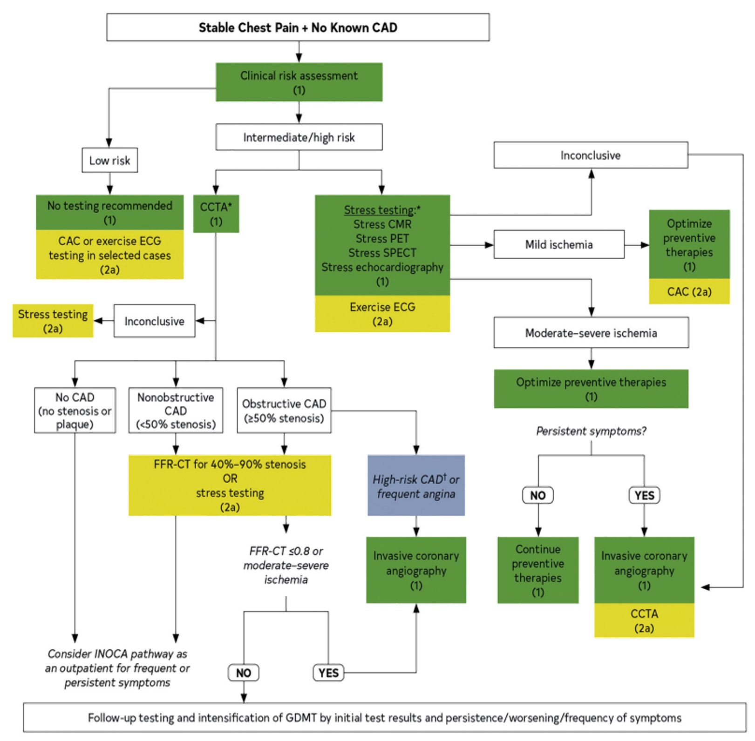
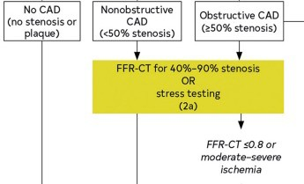
Background——Guideline recommendation for CT-FFR
2021 AHA/ACC/ASE/CHEST/SAEM/ SCCT/SCMR Guideline for the Evaluation and Diagnosis of Chest Pain
J Am Coll Cardiol. 2021 Nov 30;78(22):e187-e285.

Slide 6
Study hypothesis and study aim
Whether a strategy of on-site ML-based CT-FFR would improve clinical and economic outcomes when compared with a stress tests-based standard pathway in stable patients with intermediate stenosis by CCTA?
To evaluate the effect of an on-site CT-FFR strategy on the management of stable patients with intermediate stenosis by CCTA .

Slide 7
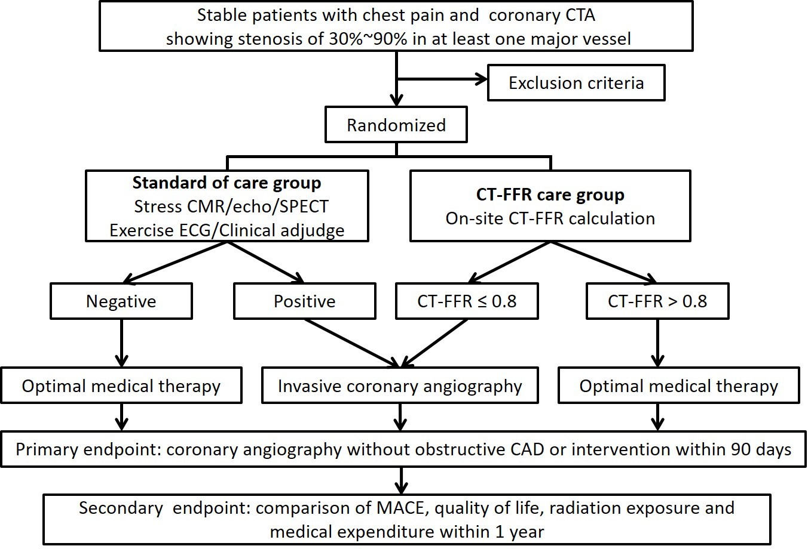
Method——Study Design
The flow chart of TARGET trial
6 tertiary hospitals across China :
Chinese PLA General Hospital.
Qilu Hospital of Shandong University.
First Affiliated Hospital of Xinjiang Medical University
Second Affiliated Hospital, School of Medicine, Zhejiang University
Tongji Hospital, Huazhong University of Science and Technology
Anzhen Hospital, Capital Medical University

Slide 8
Inclusion criteria and exclusion criteria
Inclusion criteria
Consecutive patients with new-onset chest pain suspicious for CAD.
Subjects with intermediate-to-high pretest probability of CAD will be recruited based on the CAD Consortium basic pretest probability score.
CCTA result 30-90% diameter stenosis in at least one major coronary artery (coronary artery diameter ≥ 2.5 mm).
Exclusion criteria
Diagnosed or suspected ACS requiring hospitalization or emergent testing;
Hemodynamically or clinically unstable condition systolic blood pressure < 90 mmHg or serious atrial or ventricular arrhythmias;
Known CAD with prior MI, PCI, CABG, or any angiographic evidence of ≥ 50% stenosis in any major coronary artery;
Patients with left main branch stenosis ≥ 50% or one major coronary stenosis > 90% by CCTA;
Known severe congenital, valvular (moderate and above), or cardiomyopathy process (hypertrophic cardiomyopathy or reduced systolic left ventricular function ≤ 40%) which could explain cardiac symptoms;
Unable to provide written informed consent or participate in long-term follow-up.

Slide 9
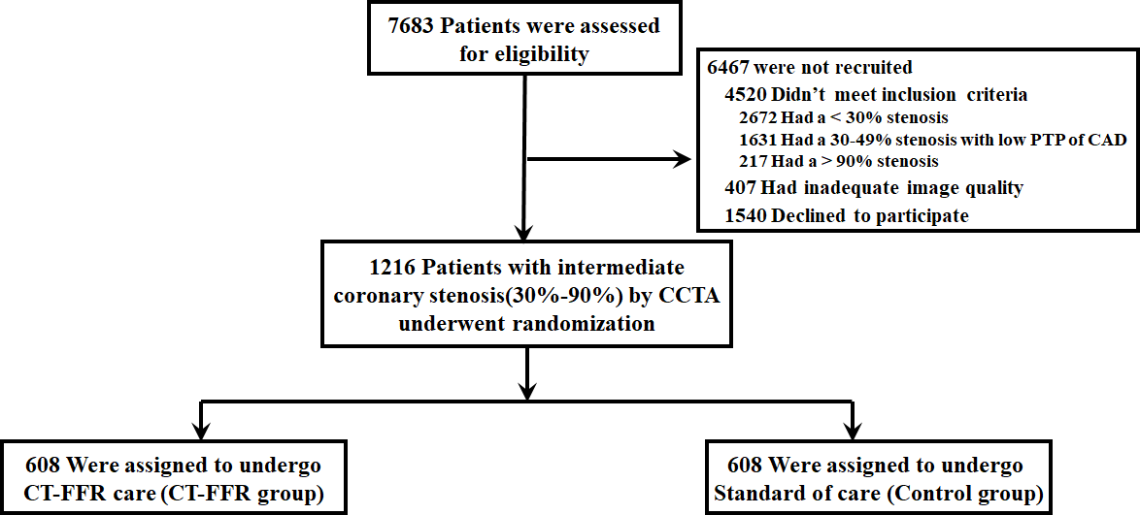
Enrollment, Randomization and Follow-up
Patients: 1216 patients with stable CAD in 6 Chinese medical centers.
Randomization：CT-FFR group: On-site CT-FFR care pathway using DEEPVESSEL FFR (Keya Medical Technology co., Ltd)
Control group: standard clinical care pathways using stress tests

Slide 10
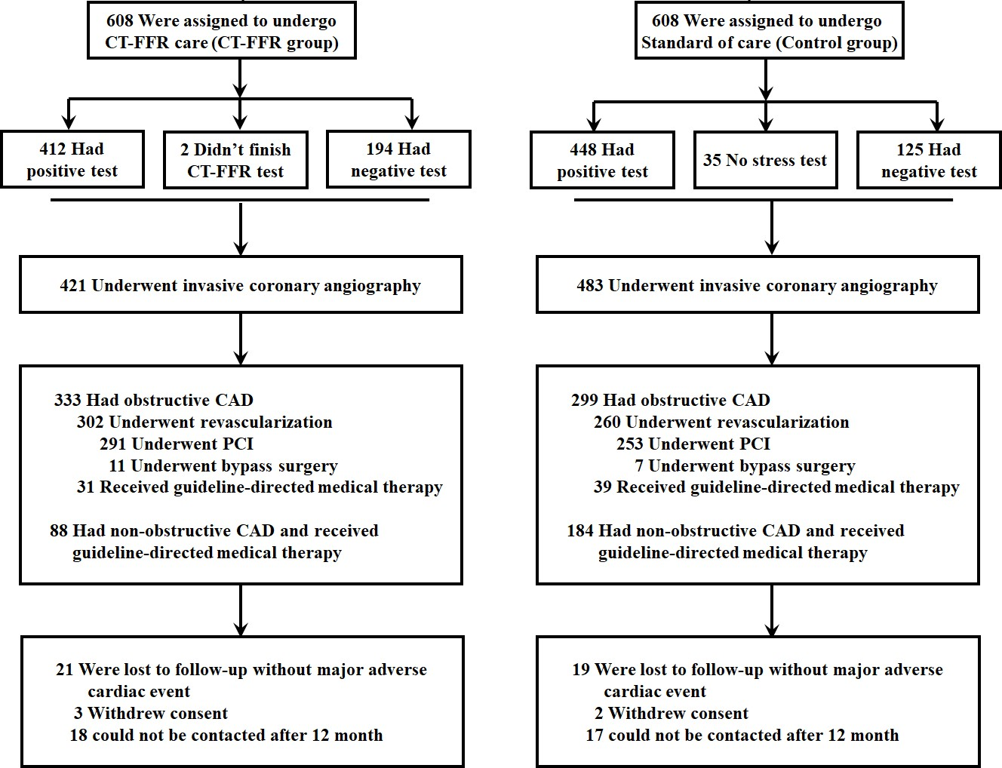
Enrollment, Randomization and Follow-up
Intention-to-treat analysis:
CT-FFR group (608); control group (608)
Per-protocol analysis:
CT-FFR group (525); control group (485)
Primary endpoint:
Rate of invasive coronary angiography (ICA) without obstructive CAD or intervention within 90 days.
Secondary endpoint:
Major adverse cardiovascular events (MACE), quality of life and medical expenditure within 1 year.

Slide 11
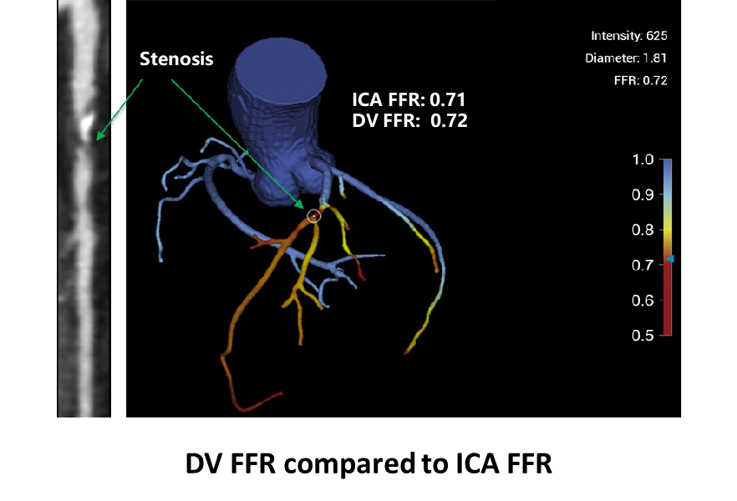
DEEPVESSEL FFR® – Regulation Progress
China: NMPA
The first AI-based medical product that has been approved by NMPA The first NMPA approved innovative medical device based on AI
The only NMPA-approved CT-FFR product for use in China
Europe: CE
The first deep learning based medical device in China with CE marking
US: FDA
First FDA approved CT-FFR product invented by Chinese Company

Slide 12
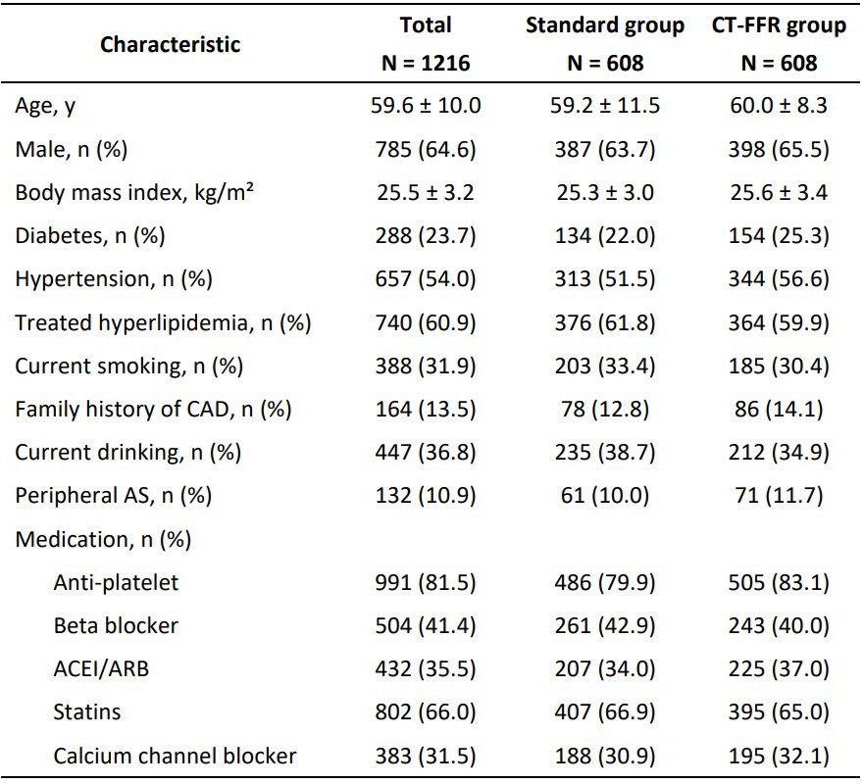
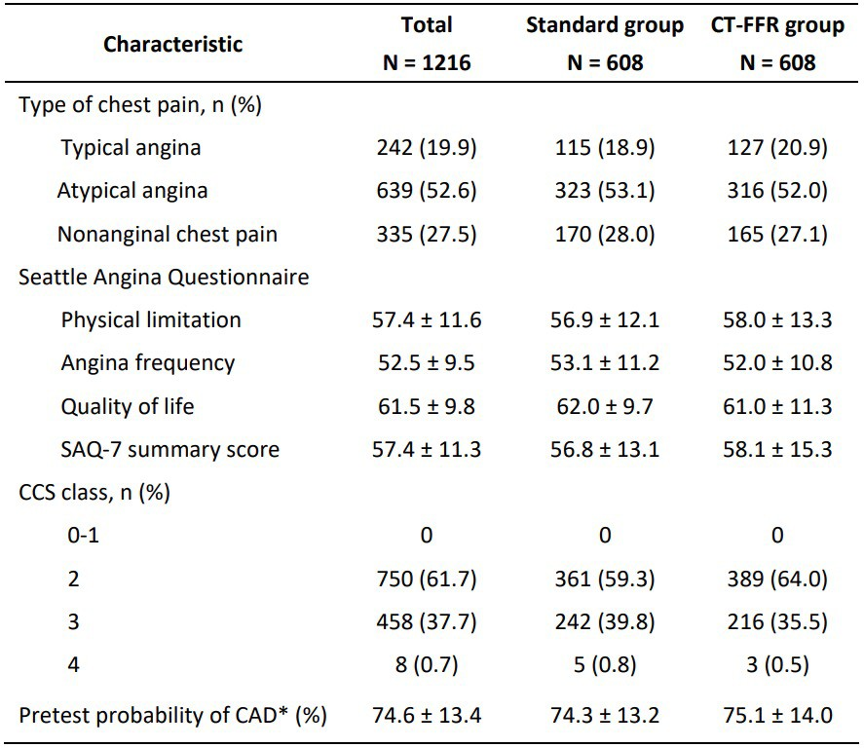
Baseline Characteristics at Randomization

Slide 13
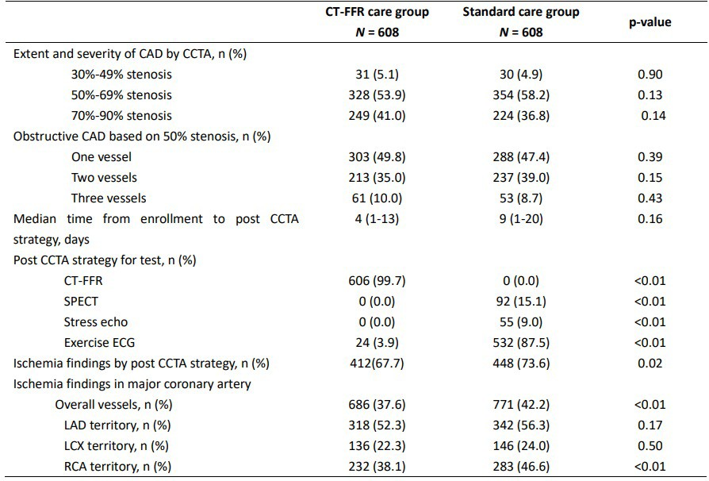
Results of Diagnostic Strategy during Initial Management

Slide 14
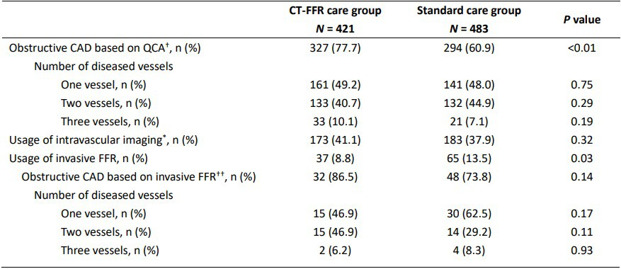
Results of Diagnostic Strategy during Invasive Coronary Angiography
†The obstructive CAD based on QCA is defined as more than or equal to 70% DS by QCA in a core lab.
*Intravascular ultrasound or optical coherence tomography.
††The obstructive CAD based on invasive FFR is defined as invasive FFR ≤ 0.8 if required.

Slide 15
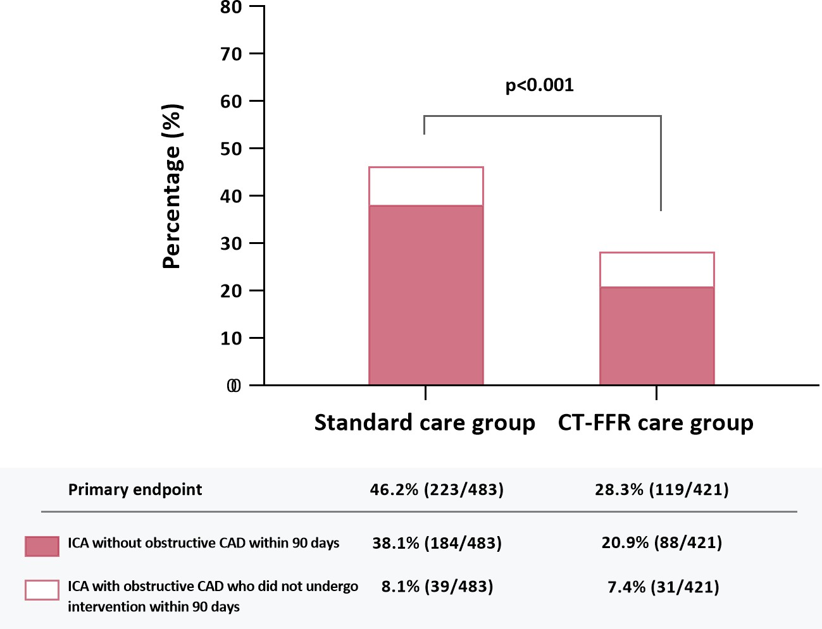
Primary endpoint
>> As compared to the standard group, the proportion of patients undergoing ICA without obstructive CAD or with obstructive CAD who did not undergo intervention within 90 days was significantly reduced in the CT-FFR group (28.3% [119/421] vs. 46.2% [223/483], P<0.001).
>>This was mainly driven by a reduction in the proportion of patients found to have no-obstructive CAD in the CT-FFR group compared to the standard group (20.9% [88/421] vs. 38.0% [184/483]).

Slide 16
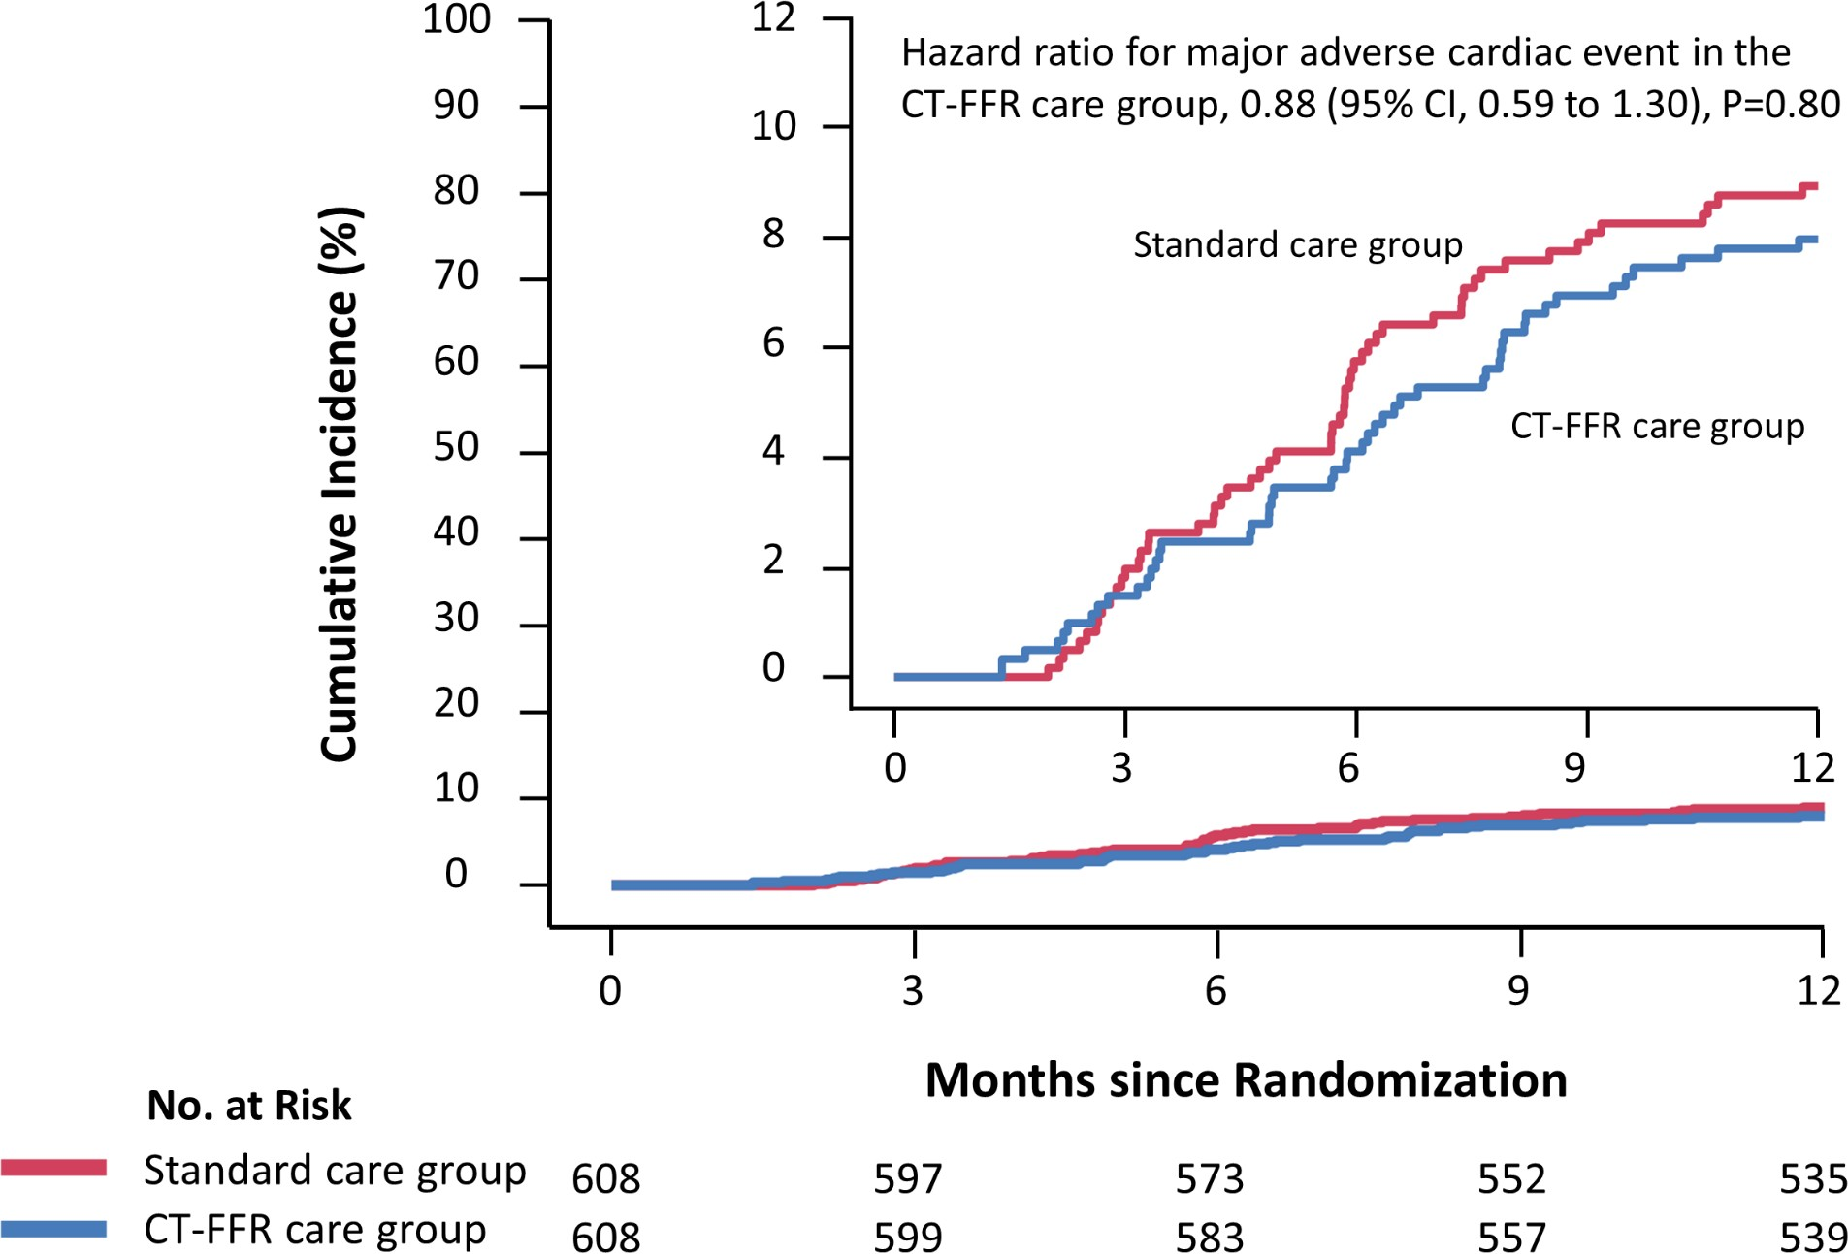
Major adverse cardiovascular events (MACE)
>> MACE did not differ significantly in the CT-FFR group (hazard ratio, 0.88; P=0.8)
Rate of major adverse cardiovascular events
CT-FFR group |  | Standard group | P-value
At least 1 events | 48 (8.2) | 54 (9.2) | 0.55
Hospitalization for unstable | 39 (6.6) | 44 (7.5) | 0.58
angina
Revascularization after 90 days | 7 (1.2) | 16 (2.7) | 0.06
Non-fatal MI | 7 (1.2) | 9 (1.5) | 0.62
Cardiovascular death | 2 (0.3) | 1 (0.2) | 0.62

Slide 17
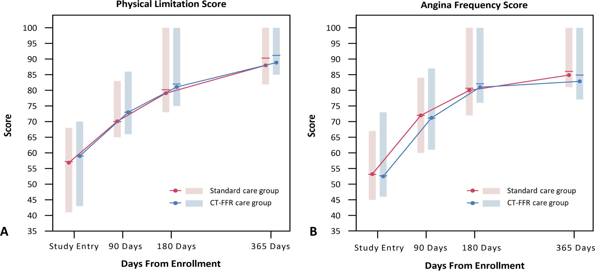
Quality of life based on The Seattle Angina Questionnaire (SAQ-7)
SAQ-7 consists of physical limitation score, angina frequency score and quality of life score.
p=0.16
p=0.13

Slide 18
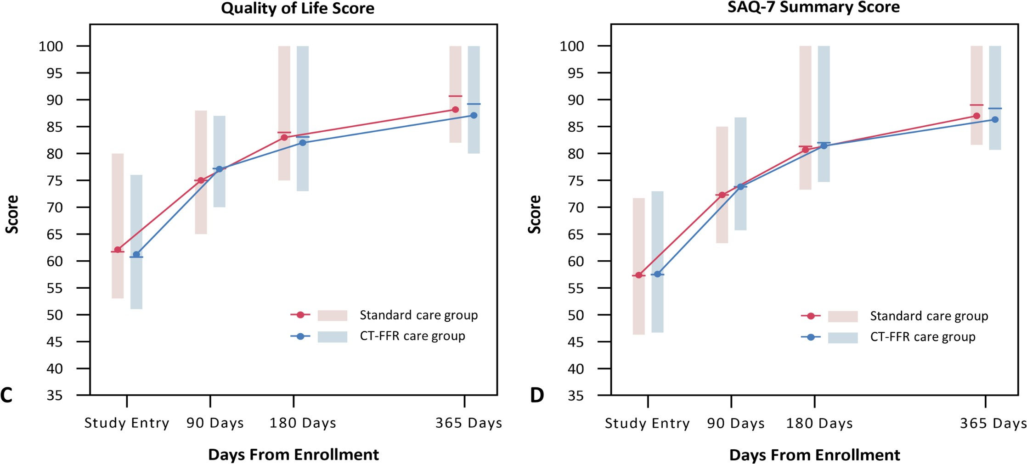
Quality of life based on The Seattle Angina Questionnaire (SAQ-7)
SAQ-7 summary score was defined as the average of three domain scores of SAQ-7.
p=0.79
p=0.15

Slide 19
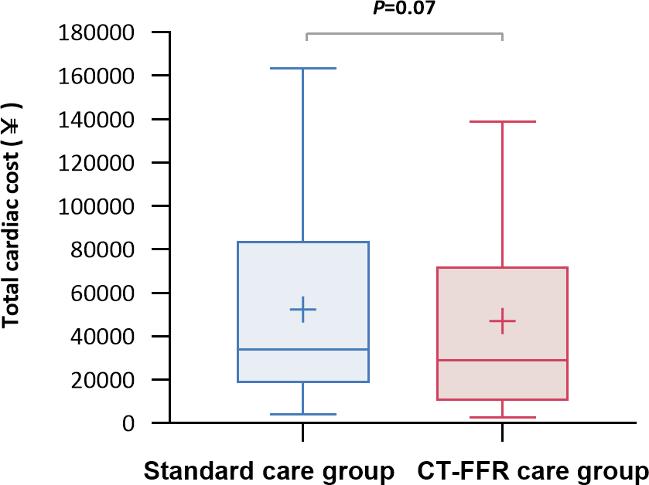
Total cardiac cost at one year of follow-up
Standard group: ¥51265 ± 41462
CT-FFR group: ¥47032 ± 38533
Difference: -¥4233 ( 95%CI, -¥8165 to ¥973 ) p=0.07
Cost of different non-invasive tests in the trial
CT-FFR |  | SPECT | Stress Echo | Exercise ECG
Cost per patient | ¥1900 | ¥3309 - ¥3731 | ¥677 - ¥873 | ¥225 - ¥275

Slide 20
Discussions
1
ML-based CT-FFR will facilitate its application in more clinical scenarios with excellent performance.
2
The standard care pathway in combination of CCTA and stress test could lead to a higher ICA rate than in the CT-FFR strategy.
3
On-site CT-FFR strategy can play an important role in the management of intermediate-to- high risk patients with stable chest pain, and further consolidate the role of CCTA as a “gatekeeper” of the cath lab.

Slide 21
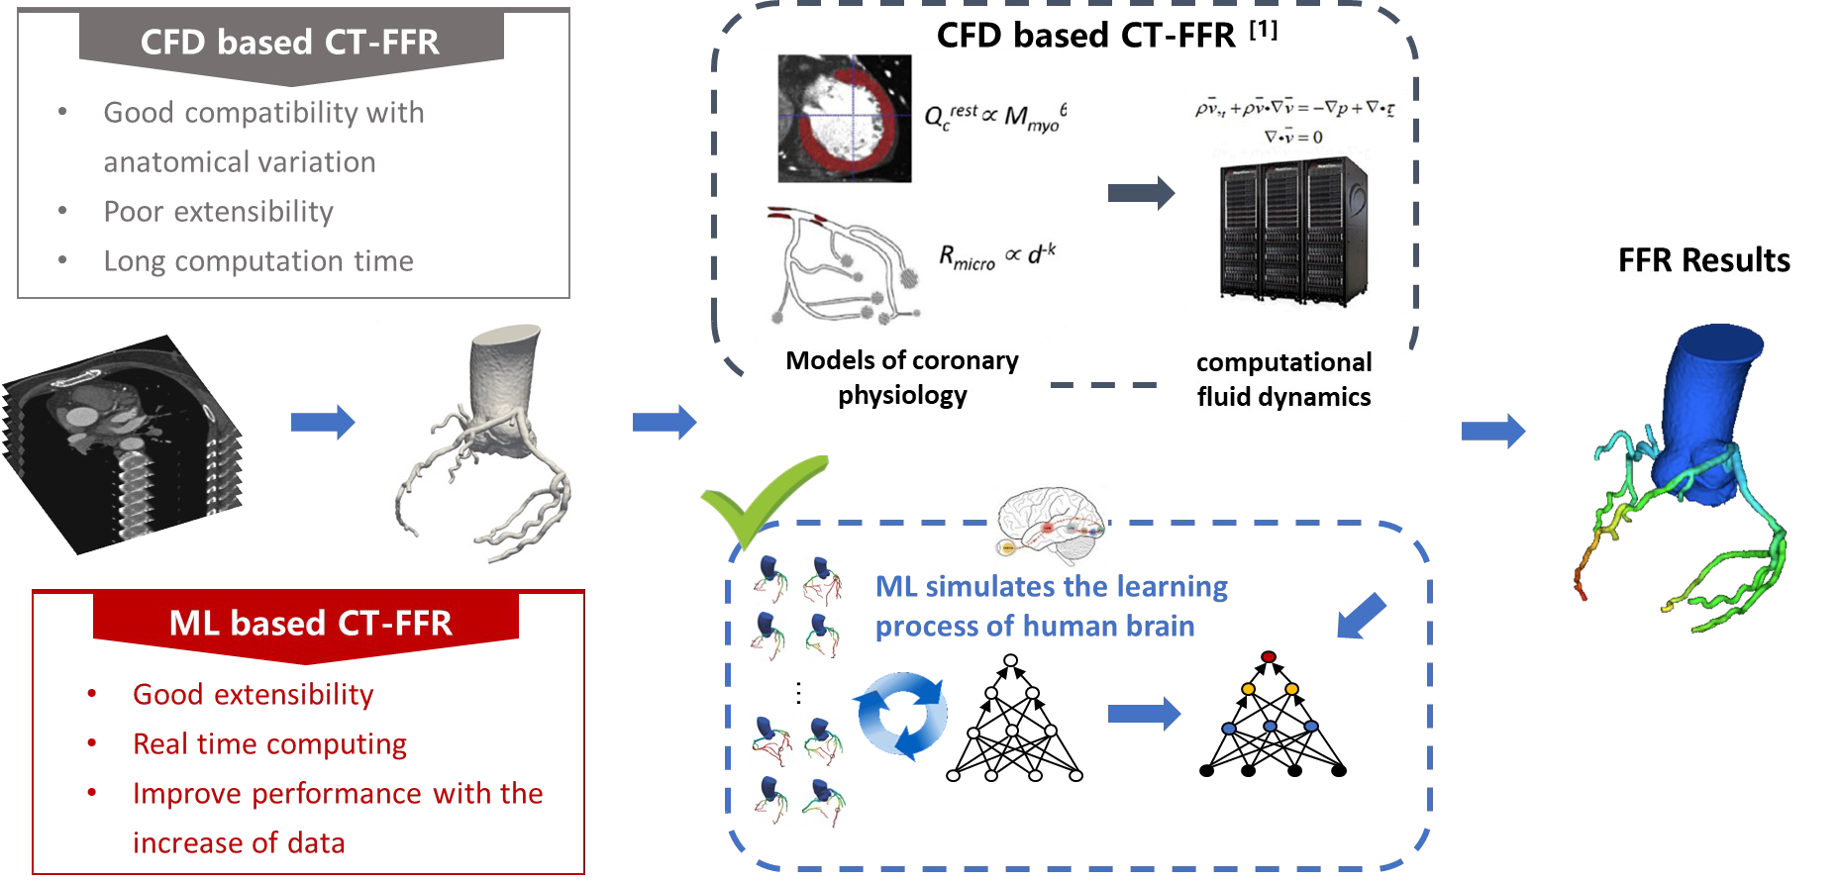
An on-site CT-FFR strategy is pragmatic and may be preferred to meet the demand of clinical practice under various clinical settings

Slide 22
Limitations
Great variety of stress tests in the standard group; none of which were for direct comparison.
The included patients have undergone rigorous screening, especially for the image quality of CCTA.
Patients who might have been asymptomatic after medication adjustment may have been enrolled.
There was no further analysis of the details and standardization of treatment for catheterization and revascularization, including whether complete or incomplete revascularization was performed.
The distribution of revascularization under different intervals of CT-FFR value is not reported.
The SAQ does not assess whether patients are experiencing other angina equivalents and patients may not be completing the SAQ accurately.

Slide 23
Conclusions
In stable patients with intermediate (30%-90%) stenosis detected by CCTA, an on-site ML based CT-FFR strategy is feasible, safe and effective.
Compared with the standard care pathway, on-site CT-FFR reduced the proportion of patients with stable CAD undergoing ICA without obstructive disease or requiring intervention within 90 days.
The on-site CT-FFR strategy increased revascularization overall without improving quality of life or reducing major adverse cardiovascular events, though a trend towards a lower cost was observed.

Slide 24
The TARGET trial is simultaneously published in Circulation
CIRCULATION. 2023; [PUBLISHED ONLINE AHEAD OF PRINT]. DOI: 10.1161/CIRCULATIONAHA.123.063996
ON-SITE COMPUTED TOMOGRAPHY-DERIVED FRACTIONAL FLOW RESERVE TO GUIDE
THE MANAGEMENT OF PATIENTS WITH STABLE CORONARY ARTERY DISEASE: THE
TARGET RANDOMIZED TRIAL
JUNJIE YANG, MD; DONGKAI SHAN, MD; XI WANG, MD; XIAOQING SUN, MBBS; MEIHUA SHAO, MM; KAN WANG, MM; YUEYING PAN, MD; ZHIQIANG WANG, MD; U. JOSEPH SCHOEPF, MD; ROCK H. SAVAGE, MD; MEI ZHANG, MD; MEI DONG, MD; LEI XU, MD; YUJIE ZHOU, MD; XIANG MA, MD; XINYANG HU, MD; LIMING XIA, MD; HESONG ZENG, MD; ZINUAN LIU, MM; YUNDAI
CHEN, MD; ON BEHALF OF THE TARGET INVESTIGATORS
CIRCULATION
HTTPS://WWW.AHAJOURNALS.ORG/DOI/10.1161/CIRCULATIONAHA.123.063996

Slide 25
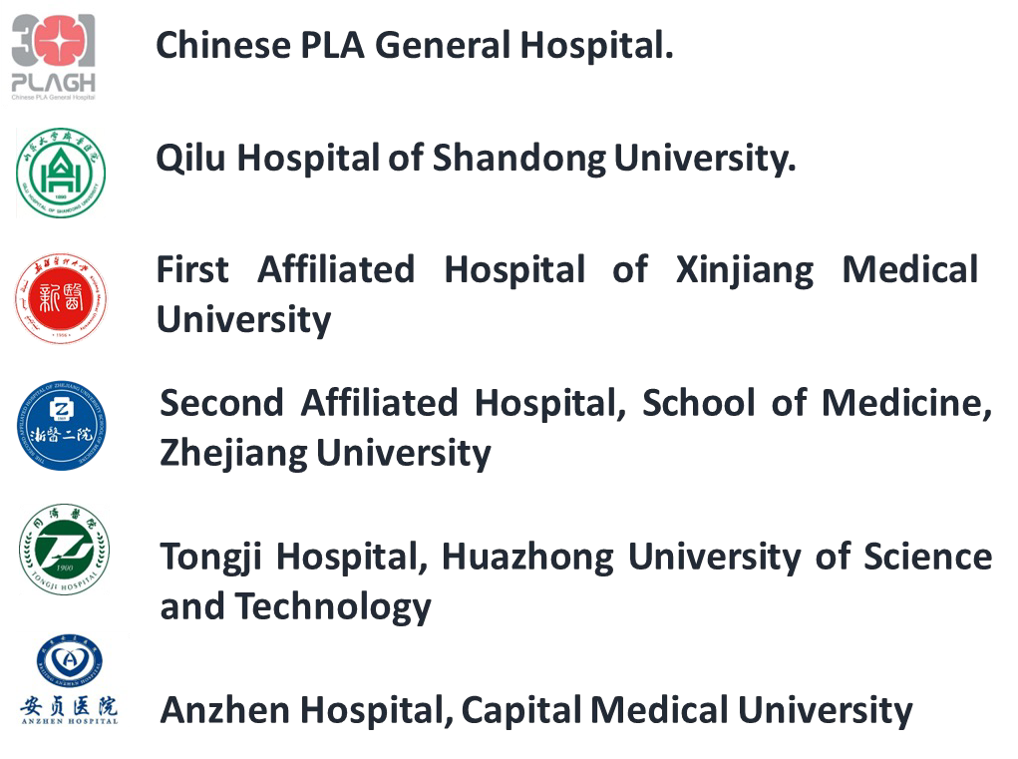
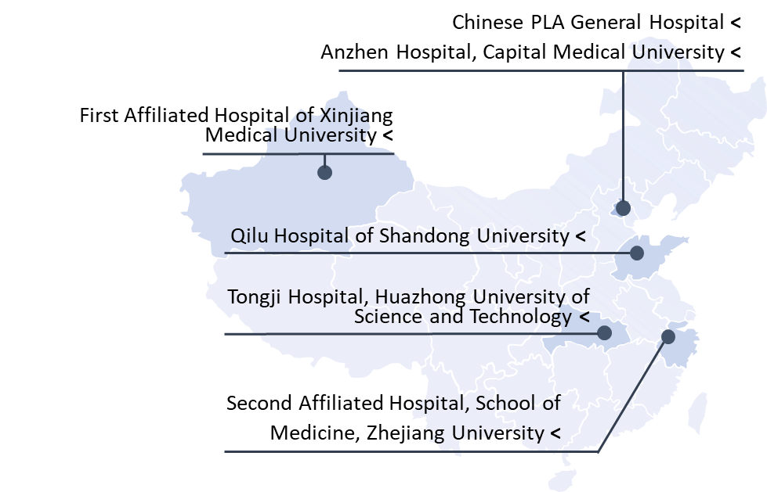
Acknowledgement: the TARGET trial research Team
Junjie Yang, Dongkai Shan, Xi Wang, Zinuan Liu, Yundai Chen
Xiaoqing Sun, Mei Dong , Mei Zhang Meihua Shao, Qian Zhao, Chen Liu, Xiang Ma
Qijing Zhou, Lihua Wang, Kan Wang, Xinyang Hu
Yueying Pan, Liming Xia, Hesong Zeng
Rui Wang, Zhiqiang Wang, Yujie Zhou, Lei Xu

Slide 26
Thank you!

