Slide 1
Hypotension-avoidance strategy versus hypertension-avoidance strategy in patients undergoing noncardiac surgery
Maura Marcucci on behalf of POISE-3 Investigators
McMaster University, Population Health Research Institute, Hamilton, ON, Canada
Funding: Canadian Institutes of Health Research (Canada), National Health and Medical Research Council (Australia), Research Grant Council (Hong Kong SAR)

Slide 2
Background
>300 millions/year adult noncardiac surgeries
Major vascular complications frequent
Hemodynamics abnormalities frequent
>25% intraoperative and/or postoperative hypotension
linked to major vascular complications
>50% take chronic antihypertensive medications
commonly continued perioperatively (although practice varies)

Slide 3
Rationale
Small studies with methodological limitations suggest
withholding ACEIs/ARBs may reduce perioperative hypotension and vascular complications
withholding beta-blockers may increase perioperative vascular complications
Intraoperative mean arterial pressure (MAP) targets ≥60 mm Hg are
commonly used
however, based on observational data, it has been questioned whether MAP
targets ≥80 mm Hg would improve outcomes
Uncertainty remains regarding optimal perioperative blood pressure management

Slide 4
Research question
In patients undergoing noncardiac surgery who are at risk of vascular events
what are effects of perioperative hypotension-avoidance strategy versus hypertension-avoidance strategy on
30-day incidence of major vascular complications?

Slide 5
Design
Partial 2x2 factorial design
10,000 patients in tranexamic acid or placebo trial
Expected 6,500 patients in blood pressure trial
Patients, healthcare providers, and study personnel aware of blood pressure treatment assignment
Outcome adjudicators masked to treatment assignment

Slide 6
Eligibility criteria
Included patients
≥45 years old, undergoing inpatient noncardiac surgery
at risk of perioperative cardiovascular events
chronically taking ≥1 antihypertensive medication
Excluded patients
cranial neurosurgery
NYHA class III-IV, or LVEF ≤30%; hemodynamically unstable
hypertension-related cerebral hemorrhage, thyrotoxicosis, pheochromocytoma

Slide 7
Intervention
Patients told not to take antihypertensive medications night before and morning of surgery
– bring medications to preoperative holding area
hypotension-avoidance vs hypertension-avoidance
based on blood pressure abnormality preferentially intended to avoid

Slide 8
Hypotension-avoidance strategy
Preoperative management
hold chronic ACEI/ARBs
other chronic antihypertensive meds based on algorithm
Intraoperative management
target MAP ≥80 mm Hg
Postoperative management day 0-2
hold chronic ACEI/ARBs
other chronic antihypertensive meds based on algorithm

Slide 9
Hypotension-avoidance algorithm

Slide 10
Hypertension-avoidance strategy
Preoperative management
given chronic antihypertensive medications
Intraoperative management
target MAP ≥60 mm Hg
Postoperative management
restart chronic antihypertensive medications after surgery

Slide 11
Primary outcome
Major vascular complication
– composite of vascular death and nonfatal myocardial injury after noncardiac surgery (MINS), stroke, and cardiac arrest at 30 days after randomization

Slide 12
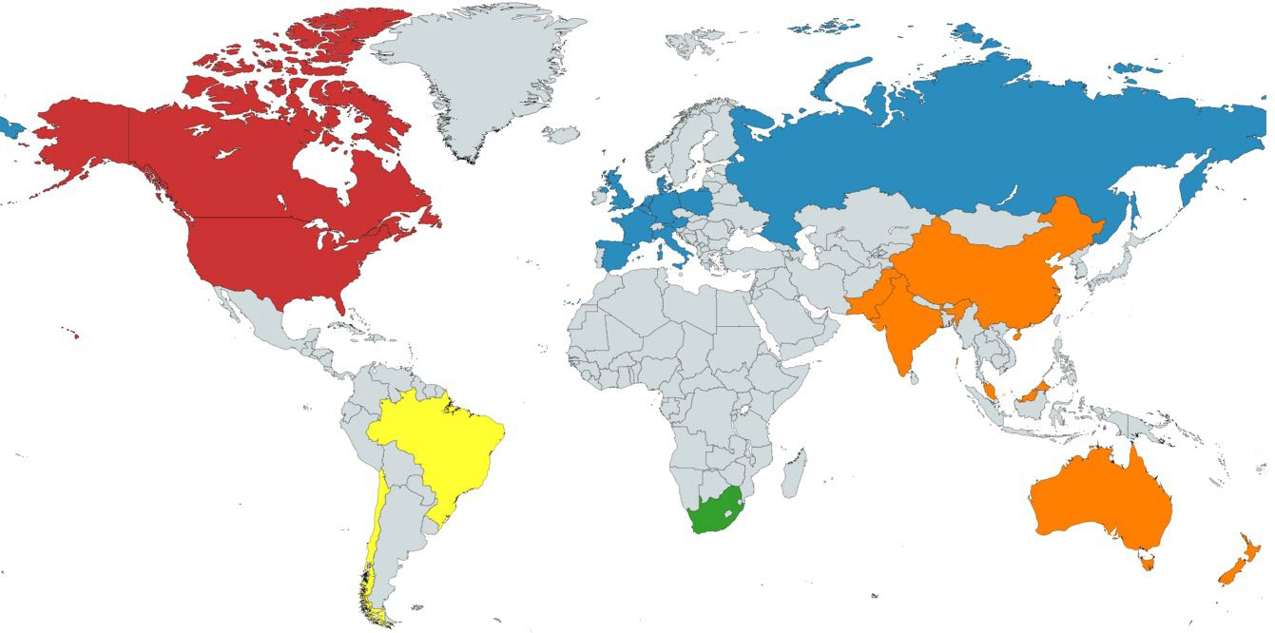
7490 patients randomized
110 centres, 22 countries
3,058
2,304
1,960
150
18
99.9% completed 30-day follow-up

Slide 13
Baseline characteristics
 | Hypotension-avoidance (N = 3742) | Hypertension-avoidance (N = 3748)
age, years | 70 | 70
male | 2075 (56%) | 2096 (56%)
number of chronic antihypertensive meds
mean (sd) | 2 (1) | 2 (1)
≥3 meds | 1038 (28%) | 1011 (27%)
chronic ACEI or ARB | 2684 (72%) | 2684 (72%)
chronic beta-blocker | 1668 (45%) | 1601 (43%)

Slide 14
Intraoperative compliance
 | Hypotension- avoidance (N = 3742) | Hypertension- avoidance (N = 3748) | Median difference (95% CI)
Intraoperative MAPs | Minutes, median (IRQ)*
MAP <60 | 0 (0 - 0) | 0 (0 - 2) | NA
MAP 60-79 | 25 (5 - 63) | 56 (20 - 108) | -31 (-34 to -28)
MAP ≥80 | 101 (55 - 165) | 70 (26 - 125) | 31 (27 to 36)
*mean duration of surgery 170 minutes

Slide 15
Pre- and postoperative compliance
 | Hypotension-avoidance (N = 3742) | Hypertension-avoidance (N = 3748)
Day | % compliance (95% CI)
Day of Surgery* | 68 (67 - 70) | 57 (55 - 58)
Postoperative day 1 | 75 (73 - 76) | 67 (65 - 68)
Postoperative day 2 | 72 (71 - 74) | 70 (69 - 72)
*before and after surgery

Slide 16
Medications received perioperatively
 | Day of surgery |  | Day 1 after surgery |  | Day 2 after surgery
 | Hypo | Hyper | Hypo | Hyper | Hypo | Hyper
received ACEI/ARB | 5% | 38% | 6% | 47% | 7% | 50%
received beta- blocker | 23% | 32% | 25% | 36% | 28% | 37%
received ≥1 antihypertensive | 36% | 70% | 39% | 79% | 42% | 83%
Hypo = hypotension-avoidance Hyper = hypertension-avoidance

Slide 17
Primary outcome
 | Hypotension- avoidance N = 3742 n (%) | Hypertension- avoidance N = 3748 n (%) | Hazard ratio (95% CI) | P value
Major vascular complication | 520 (13.9) | 524 (14.0) | 0.99 (0.88-1.12) | 0.92
Results not modified by status of randomization to tranexamic acid or placebo group (interaction P=0.54)

Slide 18
Secondary outcomes
 | Hypotension- avoidance N = 3742 n (%) | Hypertension- avoidance N = 3748 n (%) | Hazard ratio (95% CI) | P value
Myocardial injury after noncardiac surgery (MINS) | 474 (12.7) | 481 (12.8) | 0.99 (0.87-1.12) | 0.84
MINS not fulfilling universal definition of MI | 424 (11.3) | 439 (11.7) | 0.97 (0.85-1.10) | 0.61
Myocardial infarction | 54 (1.4) | 46 (1.2) | 1.18 (0.80-1.75) | 0.41
Stroke | 17 (0.5) | 17 (0.5) | 1.00 (0.51-1.96) | >0.99
Vascular mortality | 25 (0.7) | 24 (0.6) | 1.04 (0.60-1.83) | 0.88
All-cause mortality | 50 (1.3) | 43 (1.1) | 1.17 (0.78-1.75) | 0.46

Slide 19
Tertiary outcomes
 | Hypotension- avoidance N = 3742 n (%) | Hypertension- avoidance N = 3748 n (%) | Hazard ratio (95% CI) | P value
Non-fatal cardiac arrest | 7 (0.2) | 3 (<0.1) | 2.34 (0.60-9.04) | 0.22
Hemorrhagic stroke | 0 (0.0) | 1 (<0.1) | - | -
Non-hemorrhagic stroke | 17 (0.5) | 16 (0.4) | 1.07 (0.54-2.11) | 0.86
Acute congestive heart failure | 21 (0.6) | 18 (0.5) | 1.17 (0.62-2.19) | 0.63
New clinically important AF | 62 (1.7) | 44 (1.2) | 1.42 (0.96-2.08) | 0.08
Sepsis | 47 (1.3) | 57 (1.5) | 0.88 (0.60-1.29) | 0.51

Slide 20
Other tertiary outcomes
 | Hypotension- avoidance N = 3742 median days (IRQ) | Hypertension- avoidance N = 3748 median days (IRQ) | Median difference (95% CI) | P value
Length of hospital stay | 4.0 (2.1-7.1) | 4.0 (2.1-7.0) | 0.05 (-0.05, 0.14) | 0.34
Days alive and at home | 25.0 (21.0-28.0) | 25.0 (21.0-28.0) | >-0.01 (-0.29, 0.29) | 1.00

Slide 21
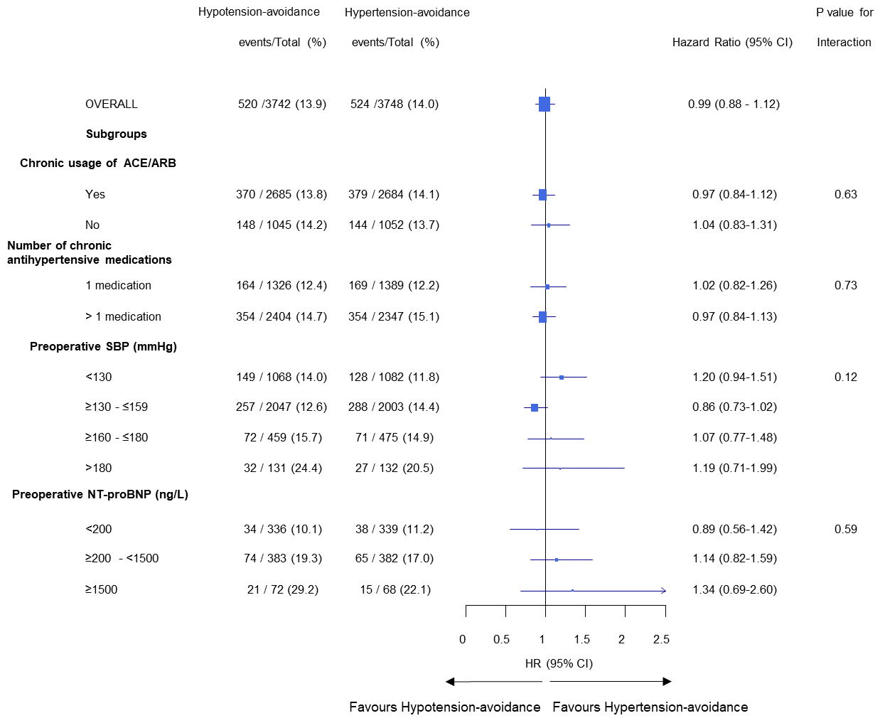
Subgroup analyses

Slide 22
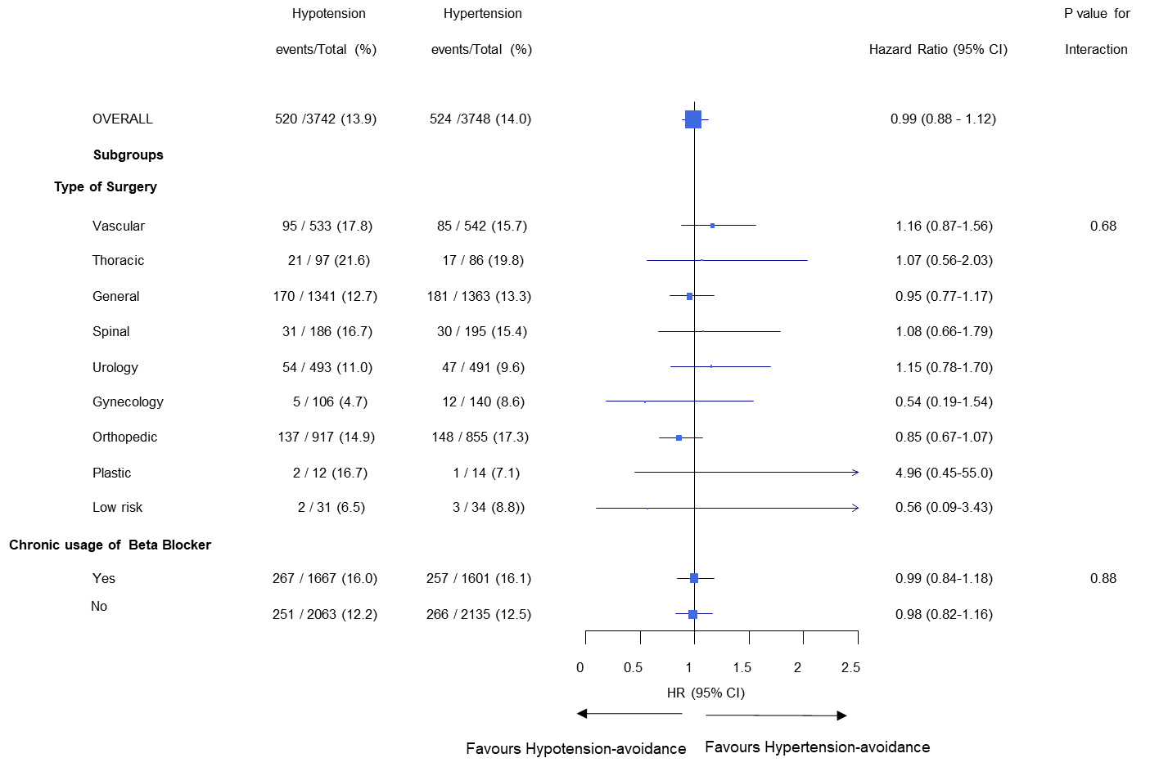
Subgroup based on type of surgery and chronic beta-blocker

Slide 23
Post-hoc analyses
Two potential explanations for main results
compliance with the planned strategies decreased the effects that we might have seen with optimal compliance
interventions differed insufficiently in their impact on hemodynamics (even with optimal compliance)

Slide 24
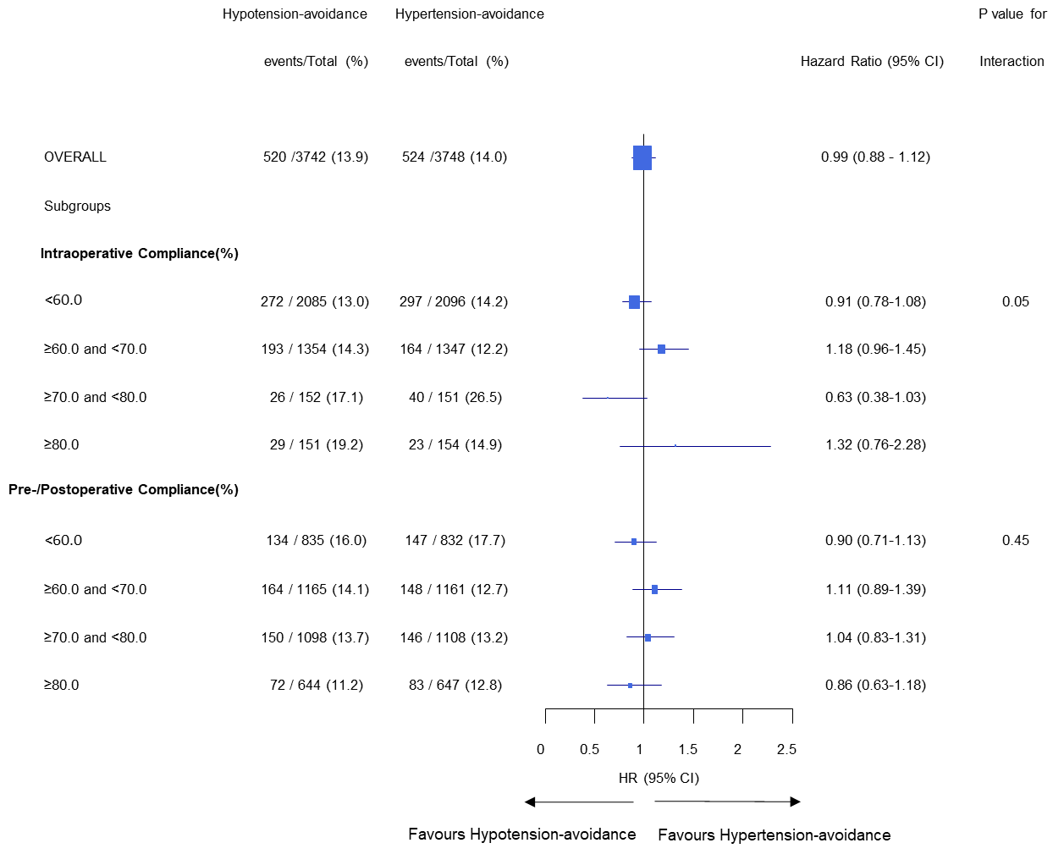
Effects on primary outcome by centre compliance

Slide 25
Effects on hemodynamics
Post-randomization time | Hypotension- avoidance mean | Hypertension- avoidance mean | Mean difference (95% CI)
 | Systolic blood pressure, mm Hg
before anesthetic induction | 147.5 | 146.5 | 1.0 (0.0, 2.0)
in PACU (2 hrs from surgery) | 132.5 | 131.3 | 1.2 (0.1, 2.3)
upon arrival to surgical ward | 132.1 | 130.4 | 1.7 (0.7, 2.7)
day 1 after surgery | 129.0 | 127.4 | 1.6 (0.8, 2.4)
day 2 after surgery | 131.8 | 130.7 | 1.1 (0.2, 2.0)
 | Heart rate, bpm
before anesthetic induction | 75.4 | 74.8 | 0.6 (0.0, 1.2)
in PACU (2 hrs from surgery) | 76.0 | 74.7 | 1.3 (0.5, 2.1)
upon arrival to surgical ward | 76.6 | 75.2 | 1.4 (0.7, 2.1)
day 1 after surgery | 77.0 | 75.8 | 1.2 (0.6, 1.8)
day 2 after surgery | 78.7 | 77.3 | 1.4 (0.7, 2.1)

Slide 26
Effects on hemodynamics by centre compliance
Effects of blood pressure strategies on hemodynamics consistent across centres with different compliance
Interaction P=0.72 for systolic blood pressure
Interaction P=0.15 for heart rate

Slide 27
Conclusions
Perioperative hypotension-avoidance strategy did not differ from hypertension-avoidance strategy regarding effects on 30-day major vascular complications

Slide 28
Implications
POISE-3 informs questions that commonly confront physicians taking care of patients undergoing surgery
during surgery: target MAPs ≥60 or ≥80 produced similar vascular
outcomes
perioperatively: holding ACEI/ARBs and continuing other chronic antihypertensive meds based on blood pressure, versus continuing all antihypertensive meds, resulted in no substantial impact on hemodynamics and vascular outcomes
Further research is needed to evaluate perioperative interventions that can modify hemodynamics to extent and in direction that will lead to favorable impact on clinical outcomes

