Slide 1
CRT 2016
February 20-23, 2016
Washington, DC, USA
Patient Care Post-TAVR:
What are the Essentials
Sameer Gafoor^{1,2}
.
¹CVC Frankfurt: Jennifer Franke, Simon Lam, Stefan Bertog, Laura Vaskelyte,
Ilona Hofmann, Markus Reinartz, Horst Sievert
²Swedish Heart and Vascular: Ming Zhang, John Petersen II, Eric Lehr, Madalena Petrescu, Nimish Muni,
Paul Huang, Darryl Wells, Adam Zivin, Eric Williams, Robert Bersin,
Glenn Barnhart, Samuel Youssef, Pat Ryan, Irina Penev, Amanda Ray,
Michelle Batjargal, Thearry Deap, Zachary Newhart, David Mazza, Heather Garcia
CVC: CardioVascular Center Frankfurt, Frankfurt, Germany
Swedish Heart and Vascular: Swedish Medical Center, Seattle, WA, USA

Slide 2
Successful TAVR! Now what?
Where does the patient go?
What do we watch out for?
What management decisions do we make?
What do we do for follow-up?

Slide 3
After procedure
If conscious sedation and no pacing needs → go to telemetry (or PACU and telemetry)
If conscious sedation and backup pacing needs → go to pacing-capable floor (often ICU/CCU)
If general anesthesia and no pacing needs → go to PACU and consider floor
If general anesthesia and backup pacing needs → often ICU/CCU

Slide 4
What do we watch out for?
Day 0-1
Access site management
Perforation/Effusion
Rhythm abnormalities
Neuro evaluation
Day 1-2
Neuro evaluation
Fluid and medication management
Mobility
Consider early discharge
Day 3
Hypertension, Renal status
Mobility
Why is the patient still here?

Slide 5
Access site management
Will focus on transfemoral cases
Currently, we are at > 95% transfemoral route
Eventually we will be at > 99% TF route
How do we optimize this?

Slide 6
Vascular Abnormalities
Should have complete vascular exam prior to case and in lab
Final angiography in lab
Postprocedural care
Early evaluation: every 15 min x 2 hours, then hourly
Evaluate access site: Hematoma, color, warmth, pulse
Be aware of retroperitoneal hematoma and hypotension
Watch for limb ischemia – peripheral embolization or large size sheath, compartment syndrome
Early involvement of ultrasound, repeat angiography, covered stenting, vascular surgery if need

Slide 7
Perforation and Effusion
Can come from RV or LV… or from aorta
Early echocardiography during case should always begin and finish with evaluation of the pericardium and note the size of any effusion if present
Early management and drainage, bedside if possible

Slide 8
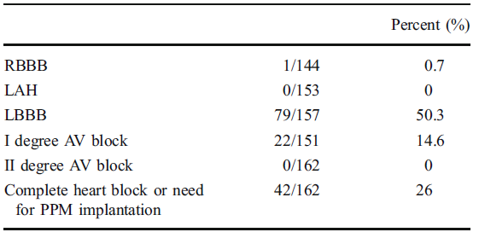
Pacemaker abnormalities
Calvi V. J Interv Card Electrophysiol (2012) 34:189–195

Slide 9
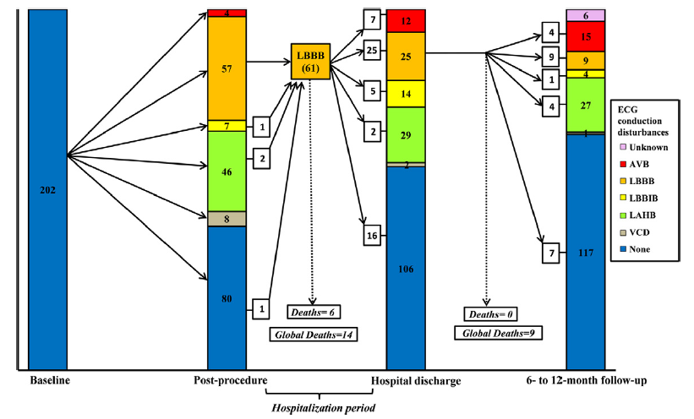
New-Onset LBBB
New-onset LBBB 30%,
Resolved in 38% and 57% at discharge and 6-12 months
Urena M. JACC 2012;60(18)

Slide 10
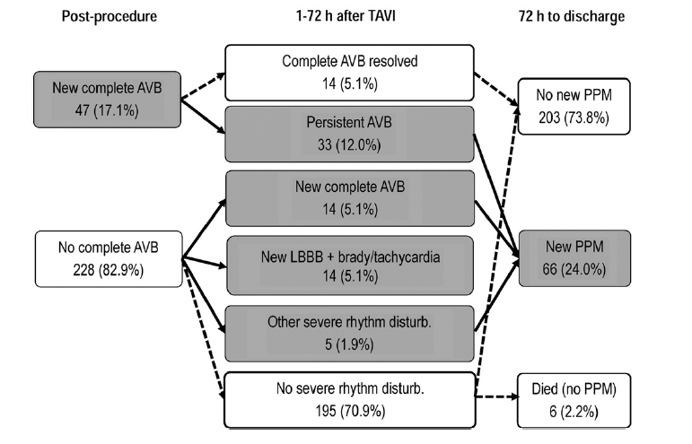
New Complete Heart Block
De Carlo M. Am Heart J 2012;163:492-9

Slide 11
Postprocedural Pacemaker Management - Bern
Temporary pacemaker Standard back-up: 24hrs
Prolonged back-up: 48hrs in case of new LBBB plus AVB 1 (>250 ms)
ECG telemetry Standard monitoring
Prolonged monitoring in case of new conduction disturbances
Permanent pacemaker Postprocedural AVB III or II
Postprocedural AVB I (PQ >300ms) plus bifascicular block
Sick Sinus, Slow Afib
(according to PM guidelines)

Slide 12
When do we switch to a permanent pacemaker?
T
A
V
I
Number of patients
-7 -6 -5 -4 -3 -2 - 1 0 1 2 3 4 5 6 7 8 9 10 11 12 13 14 15 16 17 18 19 20 21 22
Days post TAVI
Buellesfeld CRT 2013: 98 patients (27.8%)

Slide 13
After putting in PPM, is it needed?
36 patients with PPM after CoreValve, f/u 1-40m
Indication:
AV block type 2 (2 patients)
Complete heart block (28 patients)
postoperative symptomatic bradycardia (3)
Afib slow response (1)
brady-tachy syndrome (1)
LBBB (1)
Of high degree AV block – 16/30 patients did not need PPM at followup visit
Of all patients 20/36 did not need PPM at followup
v.d.Boon – IJC 2013

Slide 14
So what do we do?
This pushes us to keep the temporary pacemaker in longer
This intensifies the level of care, increases the costs, and decreases mobility
Germany approach: right subclavian access and implantation of an RV active-fixation screw in lead to generator. Allows full mobility.
What this means for US – impact on nursing protocols, off-label use of products, responsibility for interrogation, location of removal

Slide 15
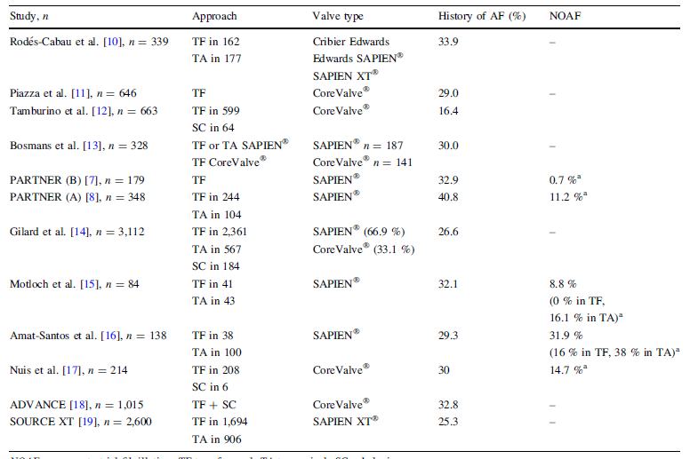
Atrial Fibrillation Following TAVI
History of AF 16-40%
New onset of AF 1-16%
Mok M. J Thromb Thrombolysis 2012

Slide 16
Anticoagulation after Atrial Fibrillation
Anticoagulation indicated
Triple therapy avoided
Newer oral anticoagulation therapies are probably superior but valve disease patients excluded in previous trials
Same with prasugrel/ticagrelor
What I do:
If recent DES: thienopyridine + warfarin
If not recent DES: aspirin + warfarin

Slide 17
Neurological Status
Daily physical examination for gross motor and sensory dysfunction
New Neurologic deficit → new consultation/imaging. Differential is
Thromboembolic complications (Atrial fibrillation, debris (aorta, valve, device)
Carotid artery disease
Post-procedural delirium
Close contact with stroke team

Slide 18
Transfer to Floor
Depends on Floor Capabilities
Nursing requirements, Pacemaker capability
Still requires telemetry for duration of stay
Requires close monitoring

Slide 19
Goals for Floor
Ambulation: out of bed with assist to walking
Nutrition: advance diet
If foley – remove catheter, make sure urinate and have BM (should not have had Foley catheter in)
Rule out bleeding
Continue anticoagulation, maximize other medications including beta-blocker, antilipidemic

Slide 20
Floor Studies
Labs: Daily Complete Blood Count, Chem panel
Echocardiogram before discharge
Valve function: Pressure gradient, AVA, AI/PVL
Myocardial function: LVEDD, LVESD, LVEF, RVSF,
Valvular disease: MR/TR
Pericardial effusion

Slide 21
Why is the patient still here after n days?
Complications
Vascular access, pericardial, neurological, pacemaker need, nephrologic injury, infection
How quickly was this recognized and treated?
Debilitation
Why was early mobility not obtained?
Social issues
Patient did not have a ride home
Patient needs rehab/SNF
Patient lives alone
How much can this be treated pre-procedure? Need a continual audit and process improvement initiative to focus on this.

Slide 22
Discharge
Discharge location
Home, Home Health, Facility
Discharge Instructions
Come back to hospital if …
Call MD if …
Involve social services, physical therapy, occupational therapy
Communicate with primary cardiologist to establish plan of care

Slide 23
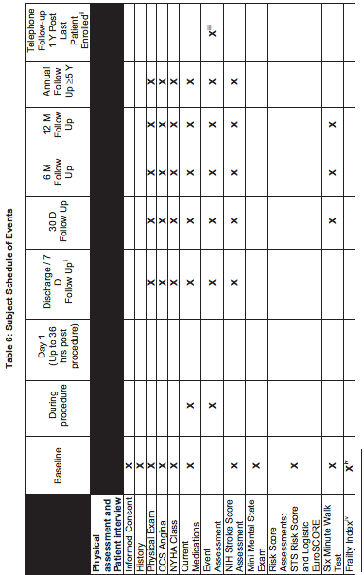
Followup Visit
PARTNER-US IDE Trial – CAP and Post-Approval Protocol 2011

Slide 24
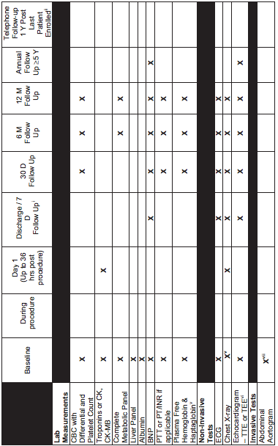
Followup – Labs and Tests

Slide 25
Followup – QOL Measures
PARTNER-US IDE Trial – CAP and Post-Approval Protocol 2011

Slide 26
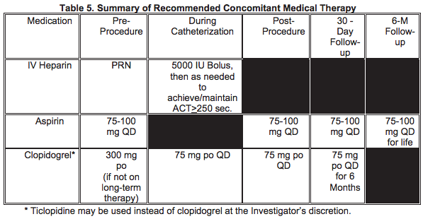
Follow-up Visit - Meds
PARTNER-US IDE Trial – CAP and Post-Approval Protocol 2011

Slide 27
Followup visits
Discharge-30 days
7 day check at hospital or local site
Phone call to patient at 7 days, 21 days
30 days
Access site, rhythm, mobility, & valve function/EF
Evaluate functional status/QOL
Communicate with the referring physician
1 year
Evaluate interval events
Evaluate valve function, LVEF, functional status, QOL
Communicate with the referring physician

Slide 28
What can we do to make it simple(r)?
Advance the technology
Smaller sheaths
Embolic protection systems (?)
Advance the culture
Early mobility, early transfer, early discharge
Create hybrid nursing units that focus on post-TAVR patients, that can manage more and faster
Advance the communication
Multiple iterations
Need for regular standardized communication to all parties that take care of these patients post-procedure

