Slide 1
PLATFORM: Economic and Quality of Life Outcomes of an FFR_{CT} Diagnostic Strategy in Suspected CAD
Mark A Hlatky, Bernard De Bruyne, Gianluca Pontone, Manesh Patel, Alan Wilk, Campbell Rogers, Pamela Douglas, PLATFORM Investigators
Supported by HeartFlow, Inc.

Slide 2
Disclosure Statement of Financial Interest
I, DO NOT have a financial interest/arrangement or affiliation with one or more organizations that could be perceived as a real or apparent conflict of interest in the context of the subject of this presentation.

Slide 3
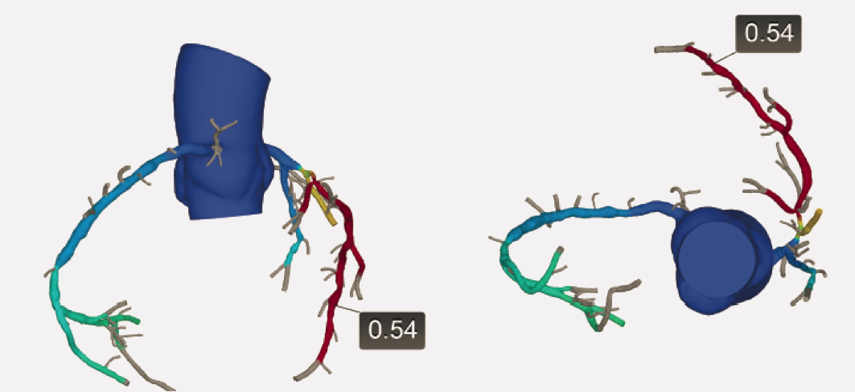

Fractional Flow Reserve by CT Coronary Angiography (FFR_{CT})
CT angiography can detect anatomic lesions, but does not determine whether they significantly obstruct blood flow
Coronary blood flow can be modelled with computational fluid dynamics
Fractional flow reserve can be estimated from standard CT data
Hemodynamically significant LAD lesion by FFR_{CT}

Slide 4
Background and Aims
Optimal evaluation of new onset stable chest pain is uncertain
In PLATFORM, use of FFR_{CT} reduced rate of invasive angiography without obstructive coronary artery disease from 73% to 12%
STUDY AIM: Assess economic and quality of life outcomes of using CTA with FFR_{CT} instead of usual care

Slide 5
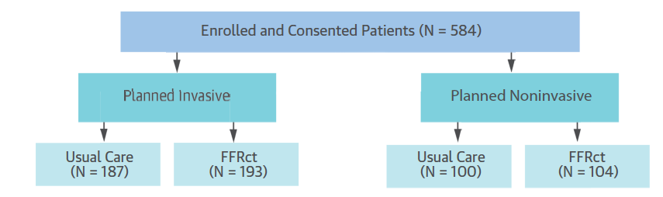
Study Design
Patients with stable symptoms, intermediate probability of CAD, and no established CAD diagnosis

Slide 6
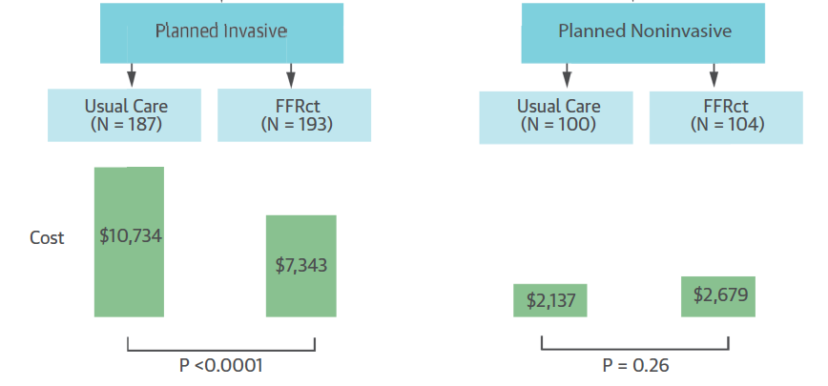
Costs Over 90 Days

Slide 7
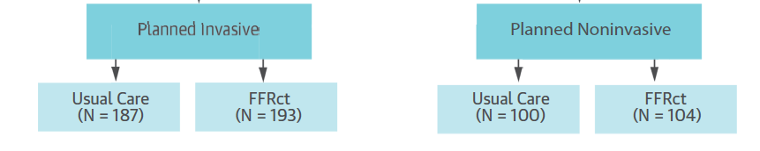
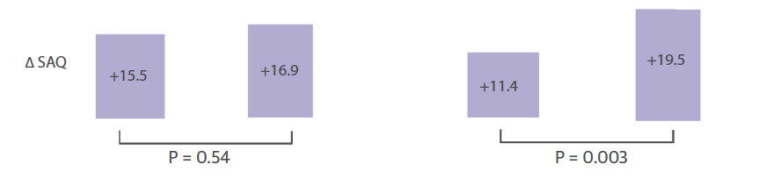
Changes in Quality of Life Over 90 Days

Slide 8
Conclusions
In symptomatic patients with intermediate probability of CAD, evaluation strategies based on FFR_{CT} had
  Lower cost than invasive coronary angiography
  Greater improvement in QOL than usual non-invasive testing

Slide 9
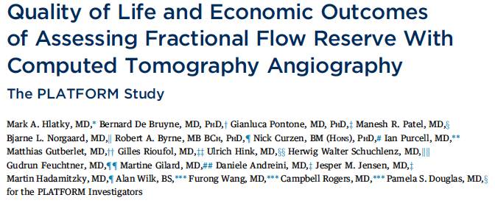
Published today in J Am Coll Cardiol

