Slide 1
Fractional flow reserve versus quantitative flow ratio for the assessment of non-culprit coronary stenoses in patients with ST-segment myocardial infarction: a substudy of the REDUCE MVI trial
Lin Wang, Alejandro Travieso, Nina van der Hoeven,
Maarten AH van Leeuwen, Gladys Janssens, Hernán Mejía-Rentería, Adrian Jeronimo, Nieves Gonzal, Robin Nijveldt, Niels van Royen,
Javier Escaned

Slide 2
Potential conflicts of interest
Speaker's name:
Lin Wang
☑ I do not have any potential conflict of interest to declare

Slide 3
Why this study?
The management of non-culprit lesions (NCL) in patients with ST segment elevation myocardial infarction (STEMI) and multivessel disease has been the focus of major randomised trials over the last decade. (1)
Use of fractional flow reserve (FFR) to decide revascularisation of non-culprit lesions (NCL) in STEMI patients remains controversial. (2)
Quantitative flow ratio (QFR) is a novel approach for functional evaluation of coronary stenosis and has shown good agreement with pressure wire–determined FFR measurements in patients with stable coronary artery disease. (3)
(1)Mehta SR .New England Journal of Medicine.
2019
Cerrato E, JACC Cardiovasc Interv. 2020.
Xu S. Lancet. 2021

Slide 4
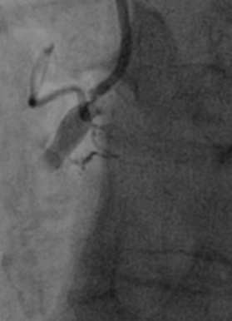
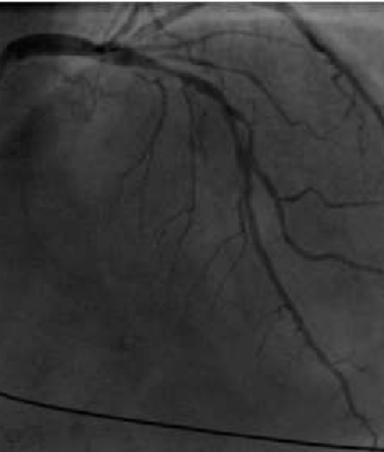
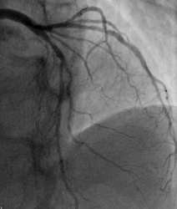
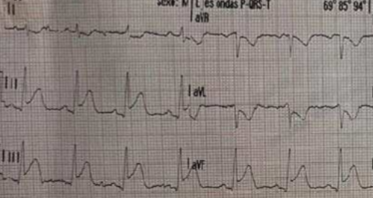
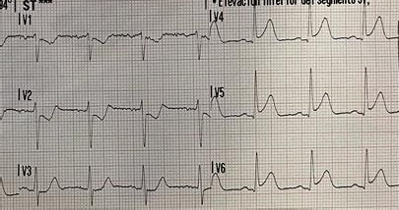
Why this study?
Which is the best tool to perform funcional assessment of NCL in STEMI?
Inferior STEMI
Nonculprit lesion in LAD
Occluded RCA PPCI
Nonculprit lesion in LAD 30-days later

Slide 5
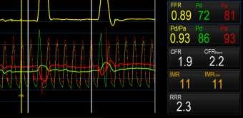
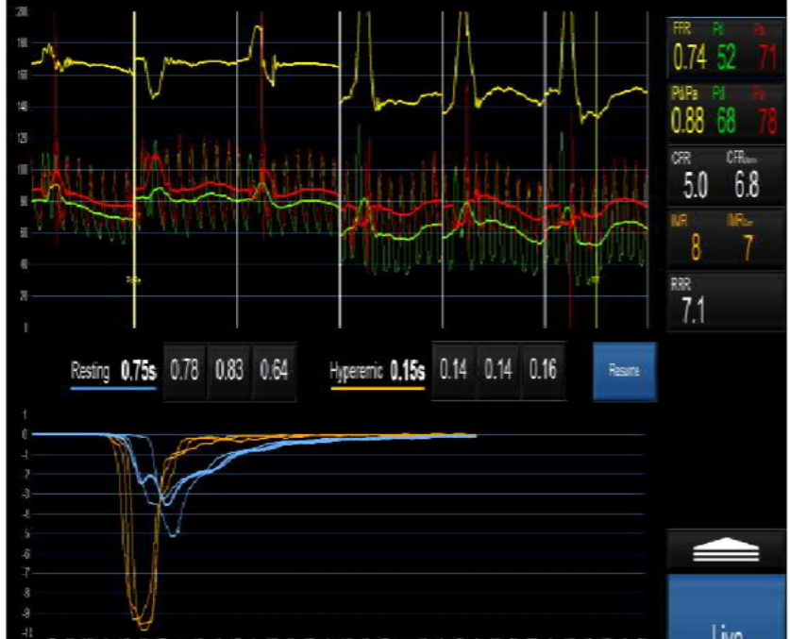
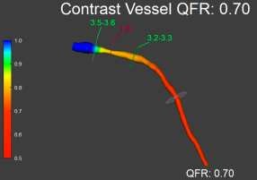
Why this study?
NCL at stage of acute STEMI
30-day follow-up
FFR 0.74
FFR
QFR

Slide 6
Objectives
Main objective
To compare the value of FFR and angiography –based quantitative
flow ratio ( QFR ) in assessing NCL during the acute STEMI phase
and predicting functional NCL relevance ( FFR ) once microvascular
/hemodynamic conditions return to normal ( 30 day follow up )

Slide 7
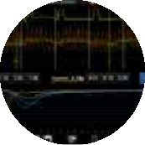
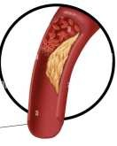
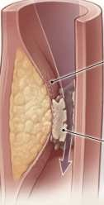
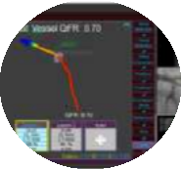
How was it executed?
A substudy of the REDUCE MVI trial (Clinical Trial Identifier: NCT02422888)
70 patients with a first STEMI and ≥1
intermediate NCL
84.3%
15.7%
Invasive FFR measurements were obtained in NCL during PPCI and 30 day follow up
QFR was measured from angiograms
obtained at PPCI and 30 days
CULPRIT RCA 42.9%
NCL
LAD 34.3%, LCX 34.3%

Slide 8
What are the essential results? Functional measurements
Variable | Baseline | 30-day | P value
FFR | 0.88 (0.08) | 0.85 (0.10) | 0.003
QFR | 0.84 (0.09) | 0.83 (0.10) | 0.310
CFR | 2.85 (1.36) | 3.98 (2.15) | <0.001
IMR | 23.7 (16.0) | 21.5 (16.3) | 0.404

Slide 9
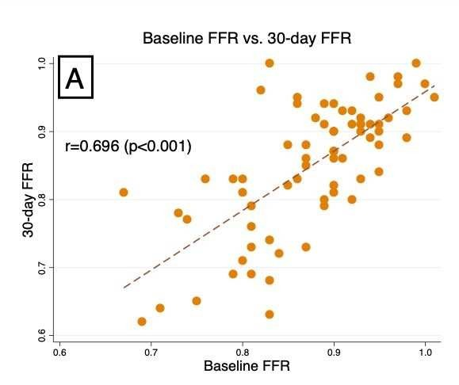
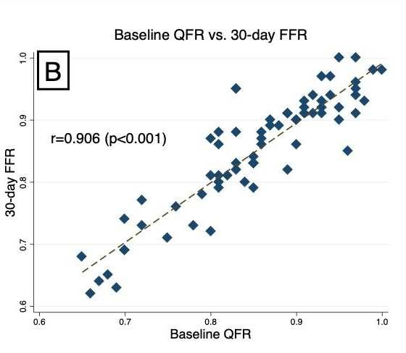
What are the essential results? Correlation between PPCI- and 30-day measurements
Correlation and agreement between QFR and FFR
FFR QFR

Slide 10
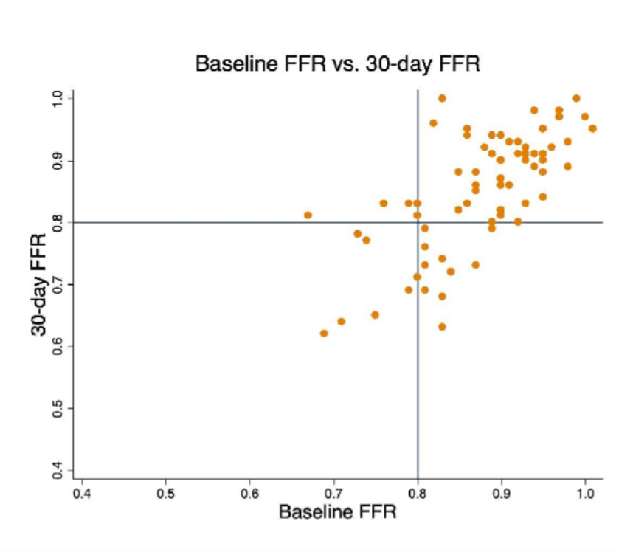
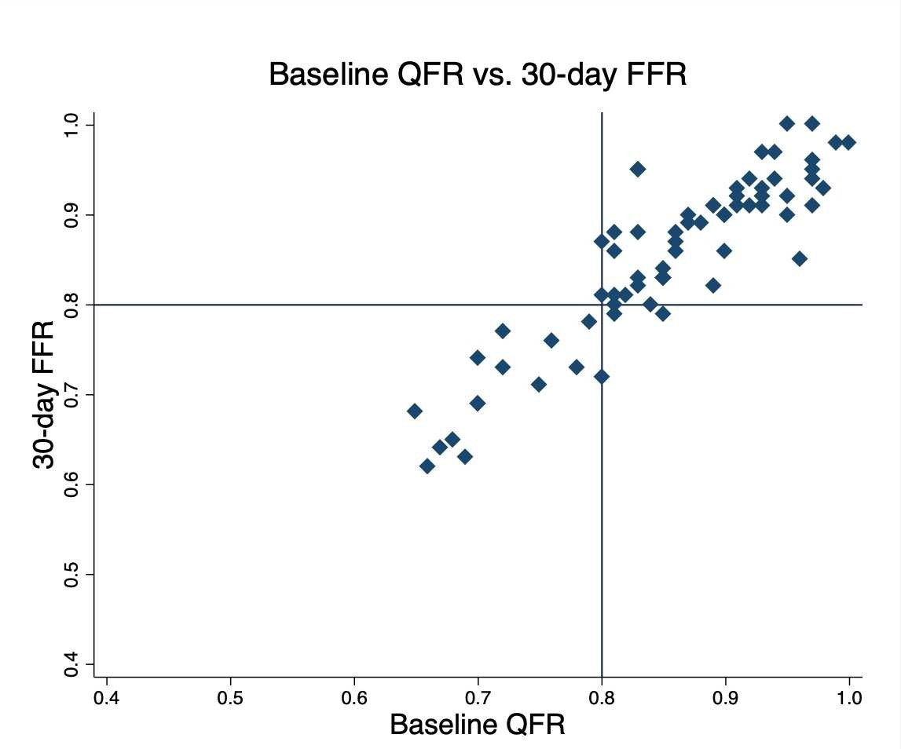
What are the essential results? Discordance between FFR and QFR
Discordance between FFR and QFR
FFR QFR
11（18.03%）
3 （5.36%）

Slide 11
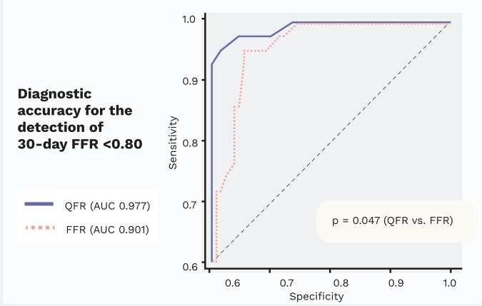
What are the essential results?
Diagnostic performance of QFR present study
FFR
QFR
0.88
Acute
0.84
30 days
QFR AUC = 0.977 FFR AUC = 0.901 p=0.047
0.85
Subacute
0.83
p=0.001
p=0.31

Slide 12
Why is this important / Relevance of the trial
Our findings confirm that FFR values in NCL lesions vary significantly from acute to subacute STEMI phases. This phenomenon was not observed for QFR.
When measured at the time of PPCI, QFR outperforms FFR in predicting NCL FFR values in the subacute STEMI phase.
QFR might become the physiological index of choice for clinical decision making in patients with STEMI and NCL. The findings also may help in interpreting the results of previous trials and in formulating new ones.
Online publication of this study in JACC Cardiovascular Interventions will take place simultaneously with the presentation in EuroPCR 2023.

Slide 13
PCRonline.com

