Slide 1
The Mitral Valve Surgery Volume-Outcome Relationship in the United States
Vinay Badhwar, MD
On behalf of co-investigators: Sreekanth Vemulapalli MD, Michael A. Mack MD,
A. Marc Gillinov MD, J. Scott Rankin MD, Joseph A. Dearani MD, Maria V. Grau- Sepulveda MD MPH, Robert Habib MD, Joanna Chikwe MD, Patrick M. McCarthy, MD, Jeffrey P. Jacobs MD, Jordan P. Bloom MD, Paul A. Kurlansky, MD, Moritz
C. Wyler von Ballmoos MD, Vinod H. Thourani MD, James R. Edgerton MD, Christina M. Vassileva MD, David M. Shahian MD

Slide 2
Disclosure Statement of Financial Interest
I, Vinay Badhwar DO NOT have a financial interest/arrangement or affiliation with one or more organizations that could be perceived as a real or apparent conflict of interest in the context of the subject of this presentation.

Slide 3
Management of Primary Mitral Regurgitation
Early surgical correction of severe primary degenerative MR is recommended provided optimal outcomes are achievable.
Durable mitral valve repair is superior to replacement for primary MR
The association of volume to outcome for mitral valve surgery has not been defined by contemporary national clinical data
Nishimura RA, et al. J Am Coll Cardiol 2017;70:252-289

Slide 4
Objectives
Assess volume of MV repair or replacement (MVRR)
Assess 30-day and 1 year outcomes following isolated MVRR for primary MR using national clinical data
Define the MV surgery volume-outcome relationship at the hospital level and surgeon level

Slide 5
Methods
55,311 patients with Primary MR
The Society of Thoracic Surgeons (STS) Adult Cardiac Surgery Database (ACSD):
  1,111 hospitals, 3,137 surgeons, 50 states
  >95% of all adult operations performed in the US
  Routine random annual 3rd party data audits of 10%
Linkage to Centers for Medicare and Medicaid Services (CMS) for 1-year Outcomes

Slide 6
Methods
Outcomes
Primary Outcome:
  Operative Mortality of isolated MV surgery for primary MR
Secondary Outcomes:
  30-day: Composite Mortality/Morbidity (bleeding, stroke, prolonged ventilation, renal failure, wound infection)
  Successful Repair Rate of primary MR (residual MR ≤ mild/1+)
  1-year: Mortality, Reoperation, Heart Failure Re-hospitalization

Slide 7
Patient Characteristics
Lowest vs. Highest Volume Quartiles
 | Lowest | Highest | P value
No Insurance | 4.04% | 2.35% | < 0.001
Black/Hispanic Race | 14.8% | 10.2% | < 0.001
Class III/IV Symptoms | 31.9% | 23.8% | < 0.0001
Class I Symptoms | 1.8% | 4.1% | < 0.0001

Slide 8
Overall MV Repair Rate for Primary MR
81%
(44,692/55,311)

Slide 9
Operative Characteristics
Lowest vs. Highest Volume Quartiles
 | Lowest | Highest | P value
MV Repair for Primary MR | 63.8% | 84.5% | < 0.0001
Mini or Robotic | 8.0% | 37.0% | < 0.001

Slide 10
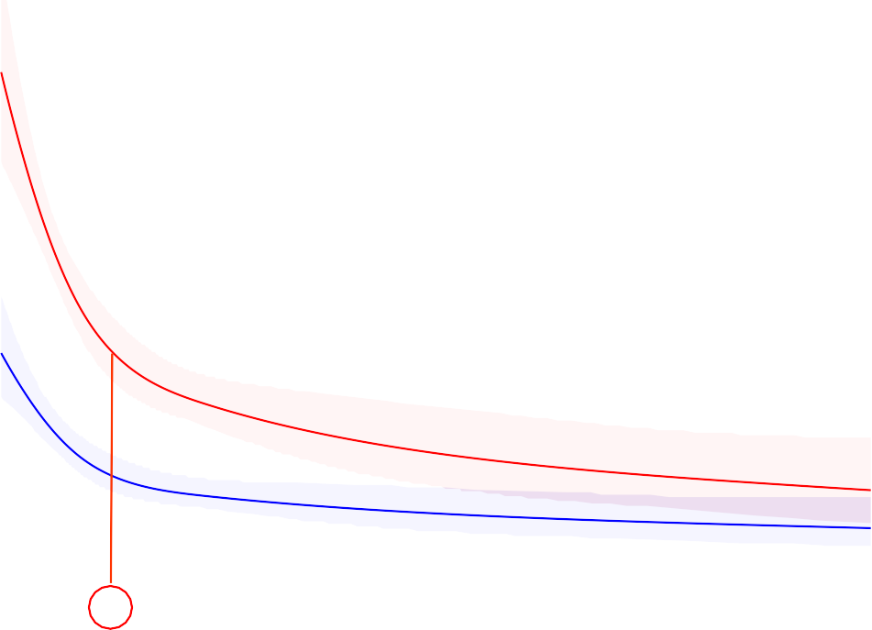
Hospital Level Outcomes
4
30-day Risk Adjusted Operative Mortality
3
Mortality %
2
1
Unadjusted Adjusted
0
75
100
Estimated
200 300
Annual Volume
Unadjusted P Adjusted P
<0.001 <0.001
0
400
500
Association

Slide 11

Hospital Level Outcomes
Successful MV Repair Rate
100
99
98
97
MV Repair %
96
148 hospitals (14%) performed ≥ 75 cases/year
95
94
Unadjusted Adjusted
93
92
75
100
Estimated
200 300
Annual Volume
Unadjusted P Adjusted P
<0.001 <0.001
0
400
500
Association

Slide 12
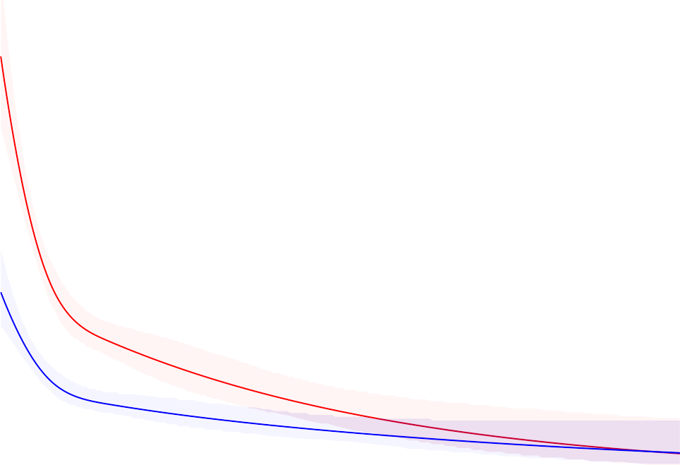

Surgeon Level Outcomes
4
30-day Risk Adjusted Operative Mortality
3
Unadjusted P Adjusted P
Association <.001 <.001
Linearity <.001 <.001
Mortality %
2
1
Unadjusted Adjusted
0
35
100 200
Annual MVRR Volume
Unadjusted P Adjusted P
<0.001 <0.001
0
300
Estimated
Association

Slide 13
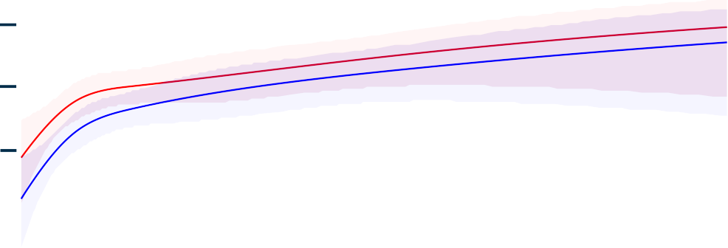
Surgeon Level Outcomes
100
99
98
97
MV Repair % 96
 | Successful MV Repair Rate
 |  | 303 surgeons (13%) performed
 | 35
≥ 35 cases/year
95
94
Unadjusted Adjusted
93
92
100 200
Annual MVRR Volume
Unadjusted P Adjusted P
<0.001 <0.001
0
300
Estimated
Association

Slide 14
Conclusions
National hospital level and surgeon level inverse volume-outcome relationships were identified for:
Successful Repair of Primary MR
30-day Operative Mortality
1-year Mortality

Slide 15
Implications
These findings may further inform guideline-directed efforts to define access to experienced hospitals and surgeons for primary MR or complex MV disease.

