Slide 1
VenaSeal Closure System Utilization of the Pre-Submission Process & Interactive Review Sponsor’s Perspective
24 February 2015

Slide 2
CRT 2015 - Presentation Disclosure
Kristine Canavan, MPH
I am an employee of Medtronic plc (Covidien)
2

Slide 3
FDA Pre-Submission Program
Outlines all types of requests allowed for FDA feedback
Explains Q-Sub tracking and logistics
Provides guidance and examples of what is appropriate for Q-sub process
3

Slide 4
Is the Process…
Helpful?
4

Slide 5
Highlights of the Pre-Sub Process
Facilitate interactions with FDA on key development and/or clinical programs and statutory meetings (agreement, determination, PMA Day 100, study risk)
Opportunities to gain understanding with FDA early and throughout the regulatory process
Make regulatory application process and review more streamlined for both FDA and the Sponsor
5

Slide 6
Case Study:
VenaSeal Closure System
6

Slide 7
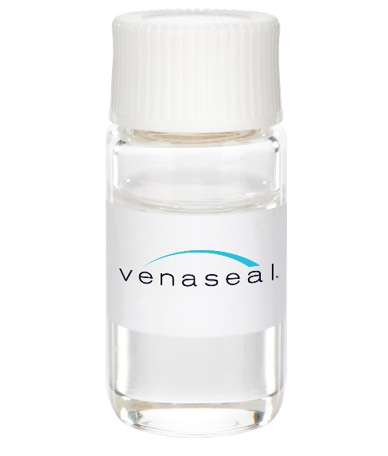
VenaSeal Closure System
Sterile, single-use kit
Proprietary cyanoacrylate-based material (adhesive)
Delivery tools to prepare and deliver this adhesive at the target locations within the vein
Key Design Features
Polymerize without migration
Provide quick and durable vein closure
Be pliable following polymerization
Be slowly resorbed by body
7

Slide 8
Reasons for early interactions with FDA on VenaSeal System
Provide education on VenaSeal Adhesive
Understand cyanoacrylate material testing requirements (FDA Guidance document for non-implant applications – material characterizations)
Propose product indication
Understand regulatory requirements (commercial pathway and clinical studies)
8

Slide 9
Results of Early Interaction Pre-Sub Meetings
Identified early the regulatory pathway (PMA)
Defined implant material testing requirements
biocompatibility
material characterization
mechanical performance
Defined clinical study requirements
clinical indication
patient selection criteria
efficacy and safety assessments
control group
control for bias in study conduct
9

Slide 10
Results of Ongoing Pre-Sub Meetings
Defined conduct of clinical study and data requirements to support the PMA application (and approval)
Follow up time points and data analysis
IDE Report formats and content
Defined the format and timeline for PMA submission
Define modular PMA format and content
Agreement on modular PMA timeline
Agreement on presentation of clinical study results
Interactive review of PMA-related documents
Provided documentation to support FDA’s decision on Panel meeting and post-approval study
IFU, package labels, and patient labeling
SSED
10

Slide 11
Overall Results for VenaSeal System Regulatory Pathway Using the Pre-Submission Process
Early and Ongoing interaction with FDA throughout the pre-IDE, IDE and PMA process provided a clear and predictable path
Good organization of content and presentation of information does facilitate a timely review of materials and productive discussion with FDA
Collaboration and productive discussion between Sponsor & FDA results in expeditious reviews with fewer gaps to resolve at the end
11

Slide 12
Opportunities for Improvements
on Utilization of Pre-Sub Process
The pre-submission process is well-defined…. More helpful with FDA team input for how to best prepare and use the process
As part of the review of the pre-Sub, more communication with the Sponsor would be helpful as it would ensure the content is sufficient and helpful in providing answers to the questions being asked.
12

Slide 13
Thank you
13

