Slide 1
FLOWer
The Complete Embolic Protection Device
Antonio Sorropago MD, ITALY

Slide 2
Potential Conflicts of Interest
I do not have any potential conflict of interest to report

Slide 3
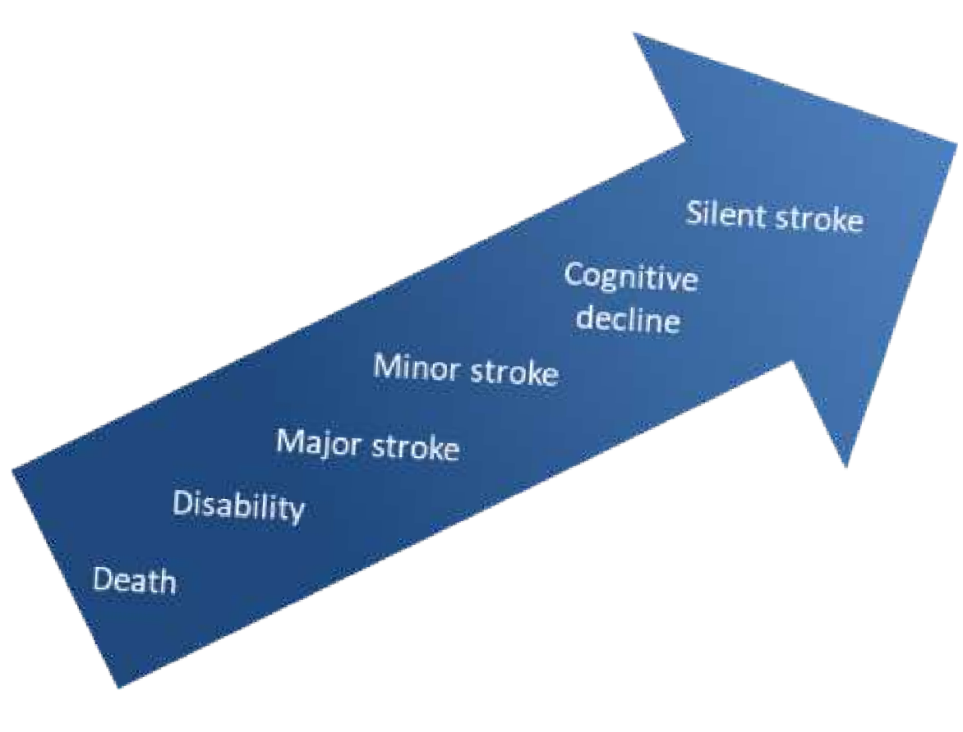
TAVI Procedures Carry an Inherent Risk of Stroke
Stroke mainly occurs during or within 30 days after TAVI. It is a dreaded complication of TAVI because it often causes severe disability and increases mortality risk¹
During TAVI, cerebrovascular accidents can occur at any time²
New brain lesions (Sentinel trial) |  |  |  |  | 92,0%
Worsening neurological assessment (MoCa or NIHSS) |  |  |  | 59,0%
Worsening neurocognitive assessment (MoCa) |  |  | 35,0%
Stroke by definition (ASA/AHA) |  | 19,0%
Any Stroke (VARC2) | 6,0%
Disabling Stroke (VARC2) | 1,2%
Davlouros PA et al. Journal of Geriatric Cardiology 2018; 15: 95-104;
Gallo M et al. European Journal of Cardio-Thoracic Surgery 53; 2018: 1118–26;

Slide 4
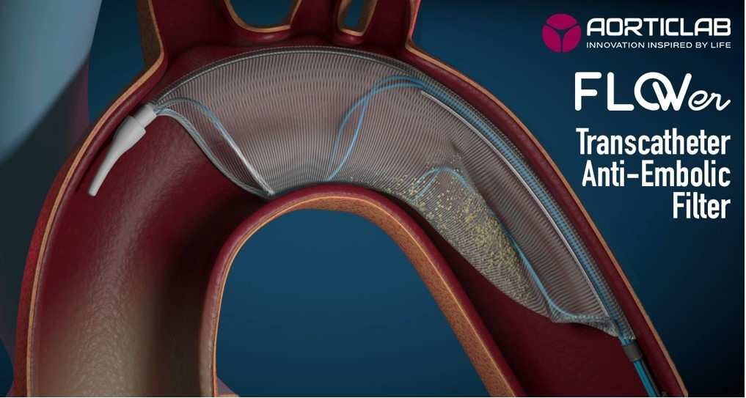
FLOWer – The Complete Embolic Protection Device

Slide 5
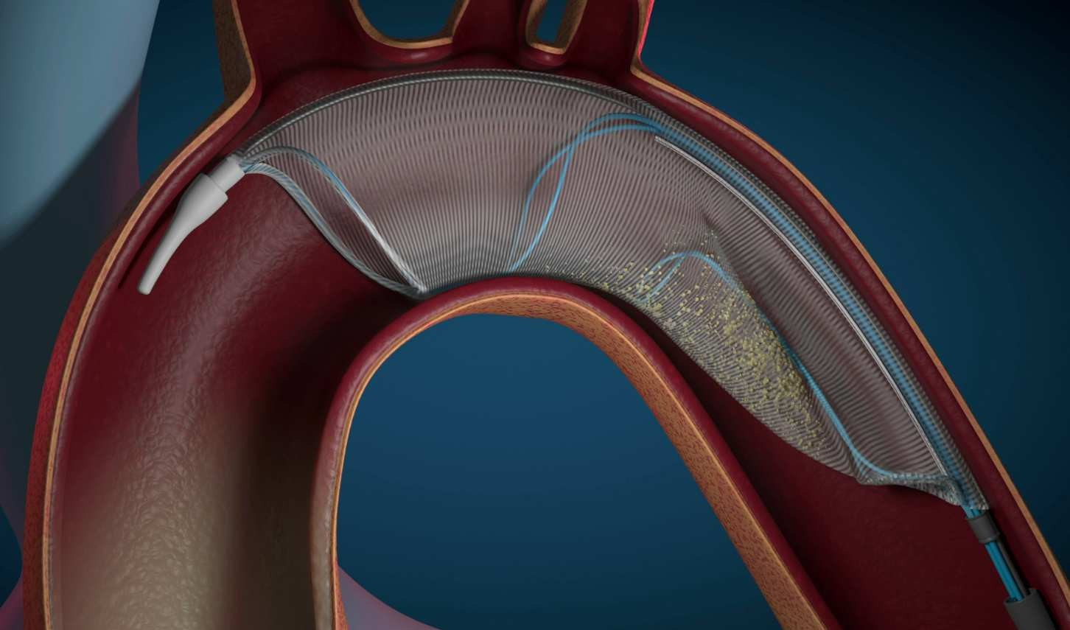
FLOWer – The Complete Embolic Protection Device
FLOWer is an innovative Embolic Protection Device (“EPD”) by AorticLab that filters and removes the debris normally released during TAVI procedures without compromising the normal patient’s blood flow
12Fr femoral access site
CATCH&FLOW proprietary technology: advanced fabric with mesh pore size of 60µm even captures the smallest embolic debris
3 sizes covering >95% of the aortic arch geometries
FLOWer contributes to performing safer TAVI procedures by reducing serious adverse events incidence
Pigtail for TAVI procedures integrated within FLOWer
FLOWer is easy to deploy in the ascending aorta fitting perfectly the aortic wall

Slide 6
FLOWer Device Illustration
Distal Structure
Proximal Structure
Compatible with 12 Fr introducer
Tip
TAVR and BAV port
Debris retention funnel

Slide 7
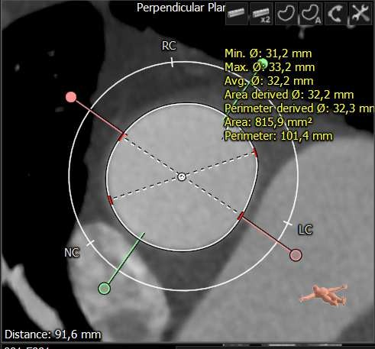
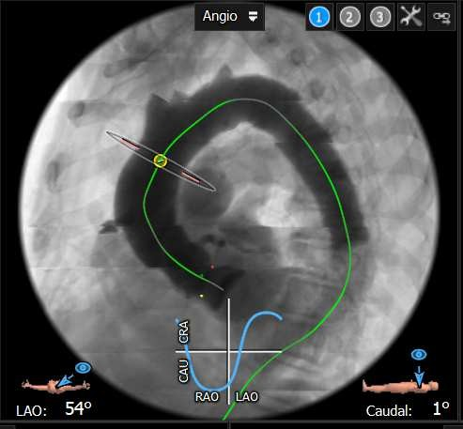
NAUTILUS - Pre-Procedure CT Scan Evaluation
NO need for additional CT scan: The determination of the FLOWer size and positioning is made by using the same CT scan performed for the TAVI implant.
Device Size | Aortic Diameter range [mm]*
FLOWer 28 | from 25 to 29
FLOWer 32 | from 29 to 34
FLOWer 36 | from 34 to 39
* Aortic diameter 10 mm upstream innominate artery
CT scan screening to determine FLOWer device size and optimal LAO/RAO & CRA/CAU views supporting intraprocedural positioning and deployment (fitting to the aorta and stability during TAVI procedure)

Slide 8
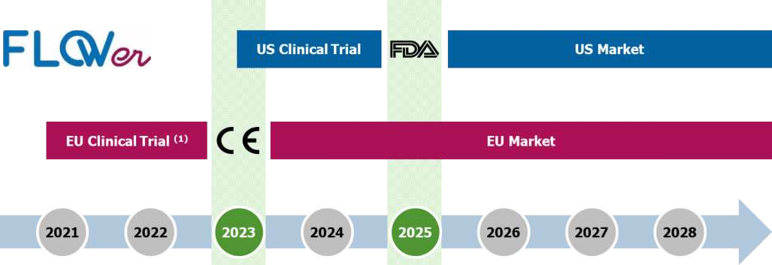
FLOWer Regulatory Pathway

Slide 9
NAUTILUS - Study Overview
STUDY DESIGN | A single arm, prospective, multicenter non-randomized clinical study
OBJECTIVES | To assess the safety, performance and treatment effect of the use of AorticLab FLOWer System, in preventing cerebral thromboembolic complications in patients with indication for a TAVI (Transcatheter Aortic Valve Implant).
PATIENT POPULATION | Patients with severe native aortic valve stenosis who meet the clinically approved indications for aortic valve interventions, such as TAVI, and comply with the protocol’s inclusion/exclusion criteria
NUMBER OF PATIENTS | 100 patients / 75 patients (as of May 2023)
NUMBER OF SITES | 7 sites in Europe
STUDY TIMELINE | Enrollment start: Q3-2021 Enrollment duration: 15 months for 100 patients Patient follow-up: 30 days Completion: Q2-2023

Slide 10
NAUTILUS - Study End-points
Safety End-points:
MACCEs rate [Timeframe: 30 days]
Cumulative occurrence of serious clinical events [Timeframe: 7 days and 30 days]
Performance End-points:
Technical success & system usability [Time Frame: immediately after procedure]
Debris capture post-TAVI by FLOWer with gross and histopathological evaluation including particle size and composition
Clinical Benefit End-points:
Brain imaging (DW-MRI) [Timeframe: within 2-5 days after procedure vs. baseline].
Neurocognitive protection assessed by NIHSS, Montreal Cognitive Assessment and mRS [Timeframe: 2-7 days and 30-days vs. baseline]

Slide 11
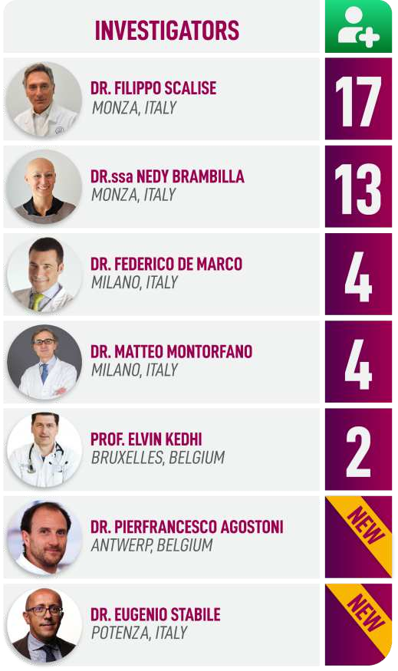
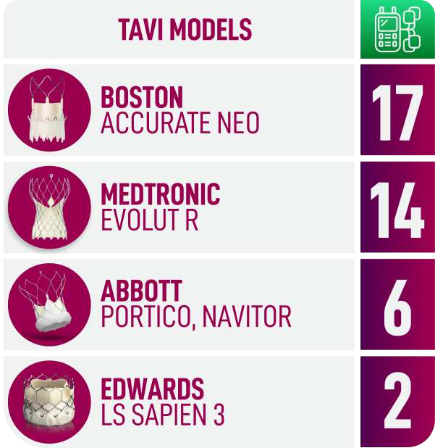
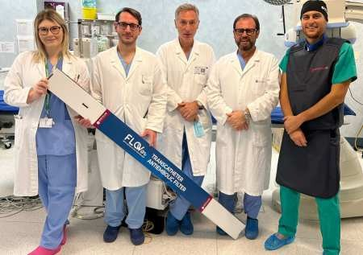
NAUTILUS Study - Enrollment
INVESTIGATORS
75 pts enrolled in 7 Centers in EU
32
6
23
5
3
2
4
First 23 Pts
TAF - Early safety assessment
Completion 52 Pts
FLOWer Early safety assessment
TAVI MODELS
28
21
14
9
MERIL
2
MYVAL

Slide 12
NAUTILUS - FLOWer with TAVI procedures

Slide 13
NAUTILUS – Interim Safety Results¹
MACCE rate @ 30 days follow-up
Rate of Major Adverse Cardiac and Cerebrovascular Events (MACCEs) related to FLOWer device and procedure as adjudicated by a Clinical Event Committee. [Timeframe: 30 Days]
15%
14.3% threshold from overall literature data on control arms of Sentinel trials
10%
9.9%
7.3%
AKI
All stroke All death
5%
5.2%
0.0%
0%
FLOWer N (PP) = 37
TAF + FLOWer N(PP) = 58
Sentinel ²
N = 234
Unprotected N = 111
2
Nautilus trial overall MACCE 30 days events rate is promising compared to literature data.
1: 30 days Follow-up not completed for all the patients, calculation on Per Protocol population 2: Sentinel IDE Trial

Slide 14
NAUTILUS – Interim Performance End-points
Average number of debris captured per filter (15 pts)¹
400
300
200
x9,1
< 150 µm
> 150 µm
100
x3,6
0
FLOWer Sentinel
FLOWer captures more than 9 times the debris captured by Sentinel (x 3,6 > 150µm)
with an average of 420
1: Histopathological analysis from CVPath Institute Inc.

Slide 15
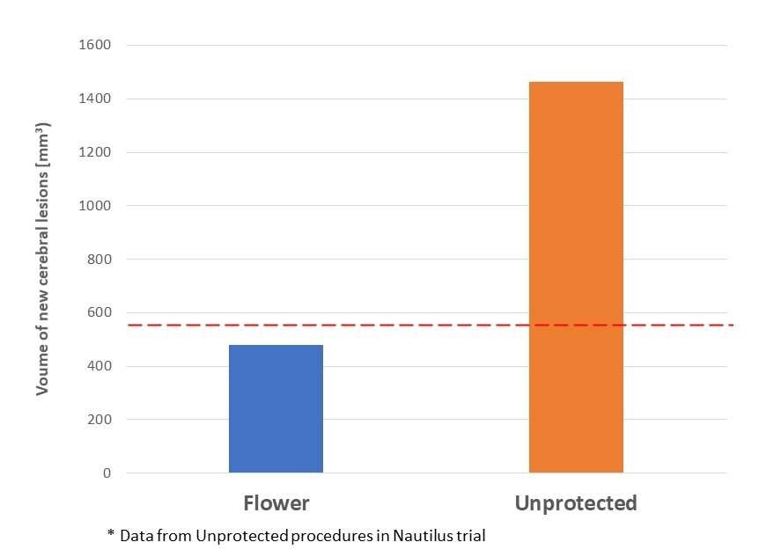
NAUTILUS – Interim Clinical Benefits End-points
Total volume of new cerebral lesions (mm³)¹
562.4 mm³ threshold from Unprotected Arm (Pooled Sentinel trials data)
2
FLOWer protects the brain reducing the lesions that TAVI may generate
1: 32 pts
2: 4 pts

Slide 16
Key Take-Aways
Nautilus Study preliminary results show that FLOWer is a safe Embolic Protection Device, effective at catching emboli as small as 60 µm.
It can be a great ally for cardiologists to minimize the risk of stroke during TAVI, without adding significant time to the procedure.
FLOWer remains stable in the aortic arch and thus protects all brain and peripheral vessels.

Slide 17
PCRonline.com

