Slide 1
Selective Intracoronary Hypothermia in STEMI to Reduce Infarct Size
THE EURO-ICE STUDY

Slide 2
Potential conflicts of interest
Speaker's name : Nico Pijls
☑ I have the following potential conflicts of interest to declare: Receipt of grants / research support: Abbott, Hexacath
Receipt of honoraria or consultation fees: Heartflow (SAB)
Stock shareholder: ASML, GE HealthCare, Heartflow , Philips
Patents pending in the field of aortic valve stenosis and the coronary microcirculation

Slide 3
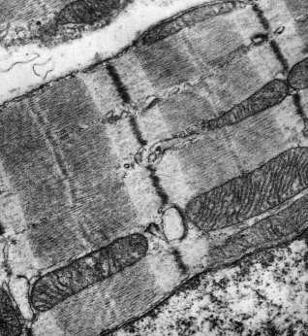
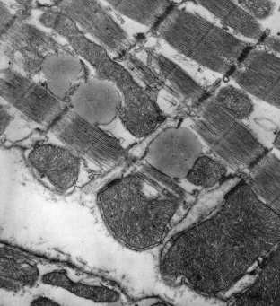
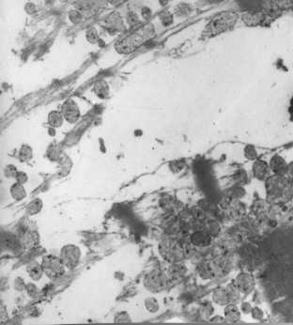
Why this study?
Background of the EURO-ICE study
Reperfusion Injury in myocardial infarction occurs in the first minutes around reperfusion, i.e immediately after opening the occluded coronary artery
Hypothermia reduces reperfusion injury and infarct size in animal models of acute myocardial infarction only if started and effective before reperfusion occurs
Systemic hypothermia in humans shows no benefit due to slow and insufficient induction of temperature decrease in infarct area
Limitations of Systemic Cooling Methods
(like vena cava coil, intravenous cold saline, ice packages, etc) Cooling not fast enough
Coolino not deep enouoh: 2-5 °C only
Too many side-effects: shivering, volume overload
Cooling occurs everywhere except at the place to be: the occluded myocardium
Logistically complex: ambulance, cathlab, anesthesiology, CCU or IC unit all involved
normal
90 min of occlusion
2 min after reperfusion

Slide 4
What did we study?
Hypothesis of the EURO-ICE study:
Selective intracoronary hypothermia in the infarct area only, started before reperfusion, and monitored by distal coronary temperature measurement, overcomes prior limitations and limits infarct size
RCT of selective intracoronary hypothermia in 200 patients
PI: Nico Pijls, Eindhoven, NL
Clinical coordination: Mohamed El Farissi, Danielle Keulards
MRI Corelab: University of Glasgow, UK (Colin Berry, Kenneth Mangion)
Statistics: Marcel van ‘t Veer, PhD, QME
DSMB: Nils Johnson, Jacques Koolen, Emanuele Barbato
EXCLUSION CRITERIA
Age <18 or > 80 years
Pre-PPCI TIMI flow 2-3
Cardiogenic shock / hemodynamic instability
Known severe Left ventricular dysfunction or severe valvular disease
Known history of anterior wall infarction
Previous CABG
Contra-indication for CMR imaging
Participating centers: Catharina Hospital, Eindhoven (Otterspoor, El Farissi)
Golden Jubilee, Glasgow ( Oldroyd, Good)
Rigshospital Copenhagen ( Engstrom, Thomson-Lonborg) Essex Heart Center (Keeble, Karamasis)
Belgrade (Beleslin) Aalst ( De Bruyne) Orebro ( Frobert) Lund (Erlinge)

Slide 5
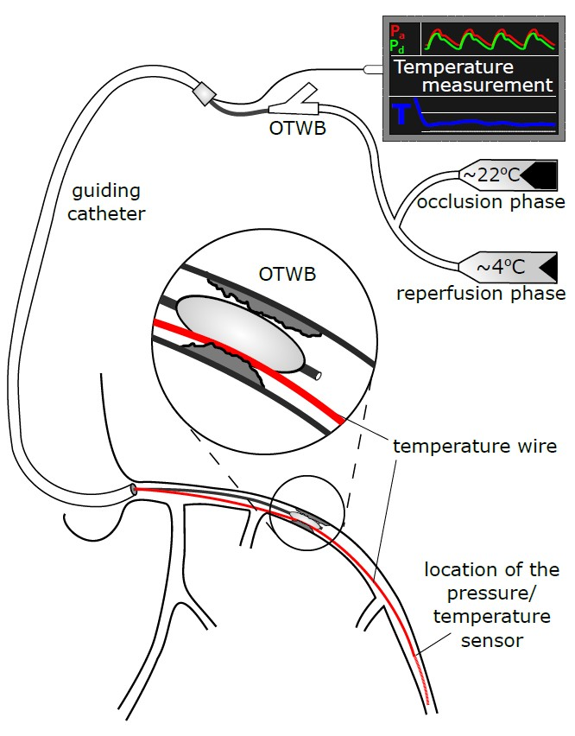
How was the study executed?
200 patients (18-80 years) with large anterior wall STEMI (ƩST ≥ 5mm) and
TIMI 0-1 flow were randomization 1 : 1 to SIH + PPCI or PPCI alone (controls)
SIH group: Infarcted myocardium selectively cooled prior to opening of
the infarct-related artery during 10 min (using OTWB or CoolCell-catheter *)
“occlusion phase” (saline infusion of 22° C at ~ 20 ml/min)
Continuous instantaneous feedback of distal pressure & temperature
(Abbott Pressure Wire® for pressure & temperature):target temp = 29-33 °C
no risk of volume overload, no systemic effects
cooling exclusively in the infarcted area; adjacent myocardium unaffected
After 10 min, balloon deflated and cooling continued for 10 more minutes: “reperfusion phase” (saline of 4 ° C at 15-30 ml/min)
Primary endpoint: infarct size on MRI at 3 month
* CoolCell Catheter® is modified Rayflow® monorail infusion catheter, equipped with balloon (Hexacath)
hh
:

Slide 6
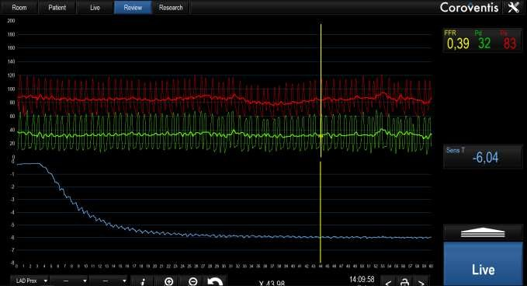
What are the essential results?
Continuous feedback of aortic pressure (red), distal coronary pressure(green), and distal coronary temperature (blue) using the Coroventis ® software
Start intracoronary cooling (occluded coronary artery)
aortic pressure
distal coronary pressure
-6°C
distal coronary temperature
10 sec

Slide 7
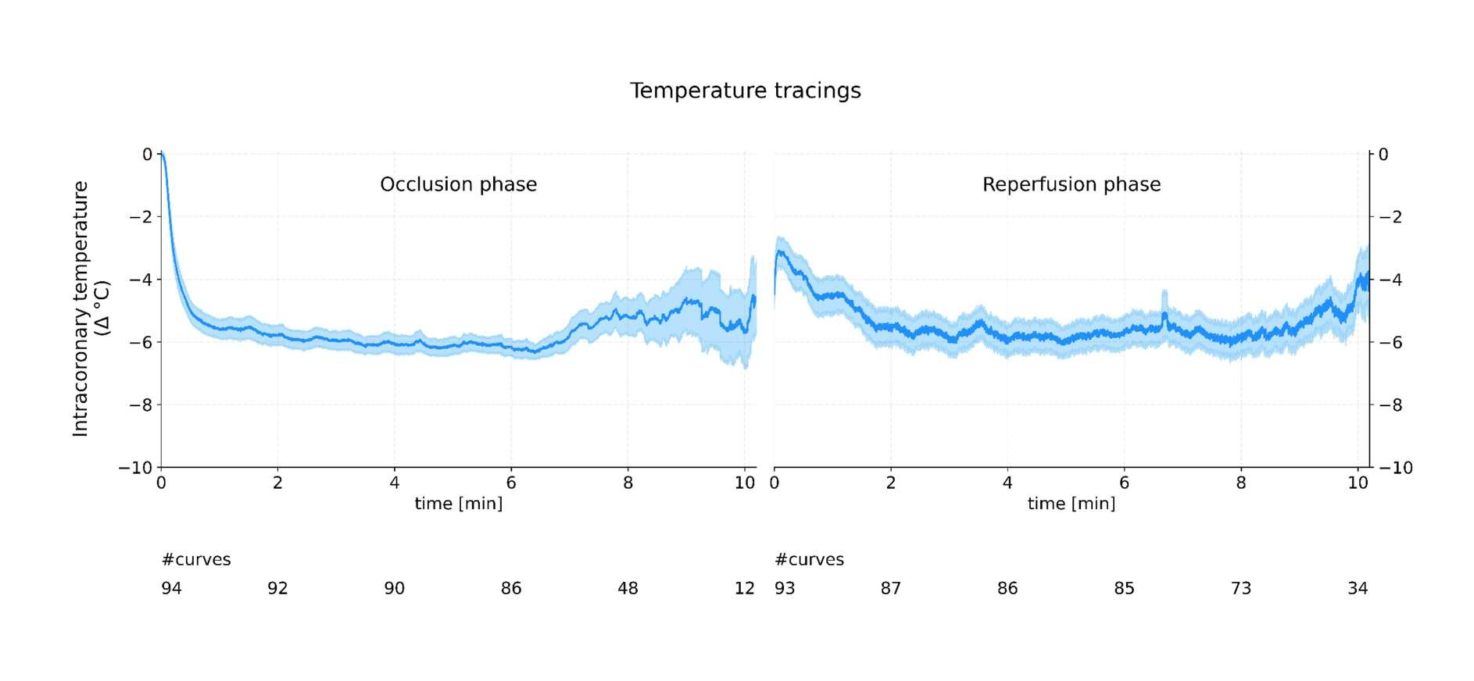
What are the essential results?
distal intracoronary temperature
average 95 % C.I.
occlusion phase
reperfusion phase
6 °C
10 minutes 10 minutes
Average cooling (°C) in all patients (average and 95 % C.I.))

Slide 8
What are the essential results?
SIH (COOLING) GROUP
CONTROL GROUP
Baseline: | summed ST elevation (mm) | 16 | 13 | NS
 | proximal vs mid-LAD | 51/49 | 49/51 | NS
 | TIMI 0/1 flow | 83/17 | 88/12 | NS
 | Door-to-balloon time (min) | 176(incl “occlusion phase”) | 154 | P<0.01
Safety | number of patients with VF | 9 | 7 | NS
Outcome: | Area at Risk on 2-day MRI (%) | 48 | 49 | NS
 | Infarct Size at 3-month MRI (LGE) | 23 | 22 | NS
 | (% of LV Mass)
 | LVEF at 3-month MRI | 49 | 50 | NS
 | Mortality at 3 months | 2 | 1
Sub-analysis (non-predefinied):
optimum vs suboptimum “switch”between occlusion and reperfusion phase
infarct size at 3-month (% of LV Mass at MRI)
LVEF at 3-month echo(%)
23
31
P=0.05
50
44
P=0.13

Slide 9
Why is This Important/ In Summary / Essentials to Remember:
Selective intracoronary Hypothermia as investigated in the EURO-ICE study:
is applicable during routine PPCI for STEMI with standard PCI equipment
can be performed logistically without involvement or help of “third parties”
(ambulance, anesthesiology). Everything happens within the cathlab with standard equipment
induces adequate hypothermia (-6° to -10 ° C) within 20 seconds, in the infarct-area only
is safe and not associated with any significant side-effects; it prolongs ischemic time by 15 minutes only
Unfortunately, it did not result to any difference in infarct size on MRI after 3 months, neither in LVEF
It challenges the concept that Cooling of the heart in STEMI to limit infarct size will ever become reality
Important spin-off: Cooling Catheter enables administration of potentially useful protective drugs directly
into the threatened myocardium BEFORE reperfusion occurs (cyclosporine, gap-junction inhibitors, etc)

Slide 10
PCRonline.com

Slide 11
The essentials to remember
In STEMI, repefusion injury occurs during the first minutes and can be reduced in animals by selective cooling of the infarct area, started before reperfusion occurs
In humans, every attempt so far to use systemic cooling in STEMI, was useless
Our technique for selective intracoronary hypothermia, starting before reperfusion occurs,
is feasible with regular cathlab equipment, in casu an OTWB or the specific CoolCell Catheter, and was absolutely safe
Cooling was quick ( < 30 sec), adequate ( > -6°C) and started before reperfusion.
Despite this optimum technique, Infarct Size was not reduced.
Further studies using hypothermia to reduce STEMI become questionable.
Important spin-off, however: The Cooling Catheter enables administration of potentially useful protective drugs into the threatened area BEFORE reperfusion occurs (cyclosporine, gap-junction inhibitors, anti-inflammatory drugs, etc)

Slide 12
How was the study executed?
200 patients (18-80 years) with large anterior wall STEMI (ƩST ≥ 5mm) and TIMI 0-1 flow
Randomization 1 : 1 to SIH + PPCI or PPCI alone (control group)
SIH group: Infarcted myocardium selectively cooled prior to opening of
the infarct-related artery (using OTWB or CoolCell-catheter *)
Continuous instantaneous feedback of distal pressure & temperature
(Abbott Pressure Wire® for pressure & temperature)
target temp = 29-33 °C
no risk of volume overload (saline infusion rate 15-30 ml/min)
no systemic effects
cooling exclusively in the infarcted area, started 10 min before actual reperfusion leaving the adjacent myocardium unaffected (“occlusion phase”)
After 10 min, balloon deflated and cooling continued for 10 more ^{minutes (“reperfusion phase”)}
Primary endpoint: infarct size on MRI at 3 month
* CoolCell Catheter® is modified Rayflow® monorail infusion catheter, equipped with balloon (Hexacath)
hh

