Slide 1
Contemporary Outcomes with MitraClip™ (NTR/XTR) System in Primary Mitral Regurgitation: Results from the Global EXPAND Study
D. Scott Lim, MD
Professor of Medicine University of Virginia, VA, USA
Wolfgang Rottbauer, Paul Mahoney, Ralph Stephan von Bardeleben, Matthew
J. Price, Mathew Williams, Mustafa Ahmed, Bassem Chehab, Gilbert H. L. Tang, Annapoorna Kini, Jose L. Zamorano, Federico Asch, Francesco Maisano, and Saibal Kar - on behalf of the EXPAND Study Investigators

Slide 2
Disclosure Statement
D. Scott Lim, MD
Personal consulting:
Abbott, Edwards Lifesciences, Pipeline, Venus
Equity:
510Kardiac, Venus
My institution receives research grants on my behalf from:
Abbott, Boston Scientific, Corvia, Edwards Lifesciences,
Keystone Heart, LivaNova, Medtronic, WL Gore
EXPAND (NCT03502811) is funded by Abbott

Slide 3
Background
MitraClip™ for the Treatment of Primary MR
The MitraClip™ System was FDA approved in 2013 for the treatment of subjects with primary (or degenerative) mitral regurgitation who are at prohibitive risk for mitral valve surgery
Since the original EVEREST II trials, no new core-lab adjudicated data on subjects with primary MR have been reported

Slide 4
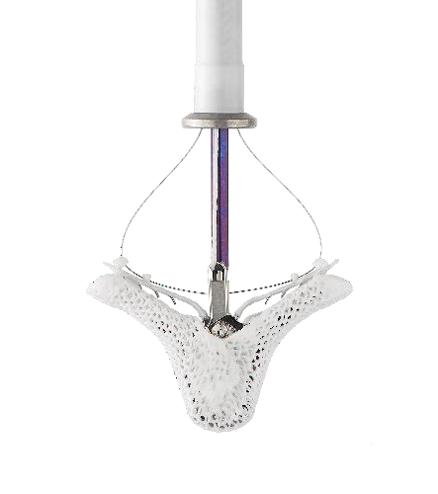
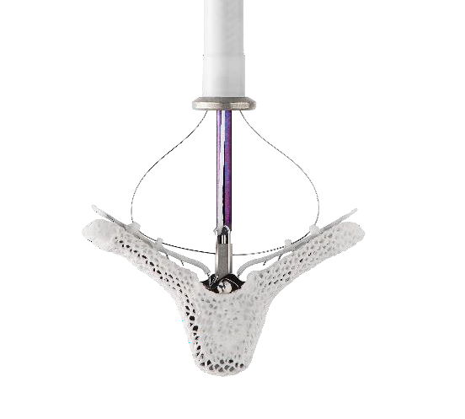
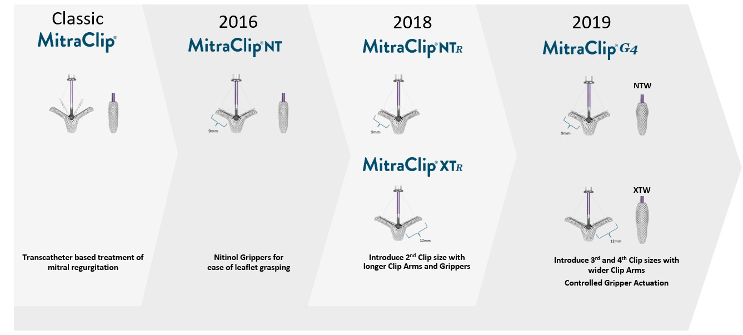


Background
MitraClip™ Evolution - NTR/XTR
9mm
12mm
17mm
22mm
XTR
Longer arms, with an improved delivery catheter system
NTR
Improved delivery system

Slide 5
Primary Objective
To Report on:
Real World, Echo Core Lab and Clinical Events Committee Adjudicated Outcomes in Patients with Significant Primary Mitral Regurgitation Treated with the Next Generation MitraClip™ NTR and XTR Systems in the 1000+ Patient Global EXPAND Study

Slide 6
Secondary Objectives
Evaluate MR reduction outcomes as a function of mitral valve anatomic complexity
Confirm the safety (including single leaflet device attachments and leaflet injuries) and effectiveness of MR reduction associated with the MitraClip™ NTR and XTR systems

Slide 7
Methods
EXPAND Study Design
Design: Prospective, Multi-center, Single Arm, International, Post-Market, Real W orld, Observational Study Conducted in United States, Europe, and the Middle East
Intended Sample Size: A minimum of 1000 consecutive consented subjects receiving the MitraClip NTR/XTR at up to 60 sites
Follow-up: Baseline, Discharge, 30 days, 6 months, and 12 months
Key Outcome Measures: MR Severity, Major Adverse Events, Survival, Procedural Measures, Quality of Life Assessed using Kansas City Cardiomyopathy Questionnaire (KCCQ), and functional capacity assessed using New York Heart Association (NYHA) functional class
Data Adjudication: Clinical Events Committee (CEC) utilized for adjudication of adverse events; Echocardiographic Core Laboratory (ECL) utilized for adjudication of echocardiographic measures; An Independent Physician Committee utilized for evaluation of single leaflet device attachment (SLDA) and leaflet damage events

Slide 8


Methods
EXPAND Study Design
INCLUSION CRITERIA
Subjects with symptomatic MR (≥3+) as assessed by sites
Subjects provided consent for study participation
Subjects eligible to receive the MitraClip per the current approved indications for use in their respective geographies
EXCLUSION CRITERIA
1. Subjects participating in another clinical study that may impact the follow-up or results of this study.

Slide 9
ECL MR Severity Assessment Methodology
A multiparametric algorithm adapted from the criteria recommended by the American Society of Echocardiography Guidelines employed for MR severity assessments consistent with the previous MitraClip trials (EVEREST II, REALISM).
MR Severity 3+ or 4+ (graded by 1 of 3 criteria)
Tier 1 | EROA ≥ 0.3 cm² or PV systolic flow reversal
Tier 2 | With any 1 of the following:
EROA 0.2 | RV ≥ 45 ml/beat
cm² - <0.3 | RF ≥ 40%
cm² | VC width ≥ 0.5 cm
 | With at least 2 of the following:
 | RV ≥ 45 ml/beat
Tier 3 EROA not measured or <0.2 cm² | RF ≥ 40% VC width ≥ 0.5 cm PISA radius > 0.9 cm, but CW of MR jet not done Large (≥ 6.0 cm)
 | holosystolic jet wrapping
 | around LA
 | Peak E velocity ≥ 150 cm/s
MR Grade | Color Doppler Area Size | PV flow | Vena Contracta
1+, Mild | Central and small, (<4 cm² or <10% of the LA area) | Systolic dominant | <0.5 cm
2+, Moderate | Central and moderate (4-6 cm² or 10-30% of the LA area) | Diastolic dominant
3+, Moderate to Severe | Central, large (6-8 cm² or 30- 40% of the LA area) or eccentric reaching 1 PV. | All diastolic (systolic blunting) | ≥0.5 cm
4+, Severe | Eccentric, large (≥8 cm² or ≥40% of the LA area), or eccentric reaching the second PV | Systolic flow reversal

Slide 10
ECL MV Complexity Assessment Criteria
Presence of at least one of the functional and anatomic features below at the baseline echocardiogram:
Primary jet outside of A2P2
Presence of more than one significant jet
Presence of an extremely wide jet
Small Valve
Calcification Landing Zone
Minimal leaflet tissue for attachment
Presence of severely degenerative leaflets or wide flail gaps or widths

Slide 11














Overall Study Subject Population
1041 Subjects Consented and Underwent MitraClip Implantation
117 Subjects with Missing Baseline Images from Sites
89 Subjects not evaluable by
ECL
835 Subjects with Adequate Imaging for
ECL Assessment
422
Subjects with Primary or Mixed etiology
Focus of the Present Analysis
413
Subjects with Secondary MR Etiology

Slide 12
Echo Core Lab (ECL) Adjudication
Enrollment period: April 2018 through June 2019
2 ECLs utilized to ensure consistency of measurements across sites:
ECL -1
Utilized for assessment of MR etiology (Baseline) and MR severity (Baseline and Follow-Up)
Ensure consistent assessment with prior MitraClip trials (e.g. EVEREST II, REALISM, COAPT etc)
MR Etiology
MR Severity
ECL -2
Utilized for detailed baseline mitral valve anatomic characterization and LV dimensional measurements over the study follow-up duration
MV Anatomic Characterization
LV Assessment

Slide 13
Baseline Characteristics
Demographics and Comorbidities | Value (N=422)
Age (years) | 79.5 ± 9.4
Male | 52.1% (220/422)
Body Mass Index (kg/m²) | 25.2 ± 4.8
STS Replacement Score* (%) | 7.3 ± 5.6
STS Repair Score (%) | 5.5 ± 5.4
Cardiac Arrhythmia | 60.5% (254/420)
o Atrial Fibrillation | 92.5% (235/254)
Renal Failure | 28.2% (119/422)
Diabetes | 19.2% (80/416)
Dyslipidemia | 52.5% (219/417)
Hypertension | 79.5% (334/420)
Prior Heart Failure Hospitalization within 1 year | 43.2% (164/380)
Prior Myocardial Infarction | 13.5% (56/415)
* Continuous data presented as mean ± s.d.; Categorical data presented as a proportion of subjects where
data was provided (missing data excluded)
** STS PROM formula has changed since EVEREST Trials. For reference, STS Replacement Mortality Risk
(Mean±SD) for EVEREST II HRR was: 18.2± 8.0 (n=78); for EVEREST II REALISM was 11.1± 7.0 (n=628); and
for Prohibitive Risk Primary MR Cohort was 13.2 ± 7.3% (n=127)

Slide 14
ECL Adjudicated Baseline Echo Parameters for Subjects with Primary MR
ECL Measure | Value
Baseline MR of 3+ or 4+ | 66.4% (279/420)
Baseline MR of ≤2+* | 33.6% (141/420)
Effective Regurgitant Orifice Area (EROA, cm²) | 0.40 ± 0.21 (282)
Mean Mitral Inflow Velocity (cm/sec) | 47.0 ± 14.1 (342)
Baseline TR of 3+ or 4+ | 22.6% (84/372)
Left Ventricular Ejection Fraction (LVEF, %) | 62 ± 10 (390)
Left Ventricular End Systolic Volume (LVESV, mL) | 47.9 ± 30.4 (390)
Left Ventricular End Diastolic Volume (LVEDV, mL) | 121.0 ± 48.6 (390)
*These patients assessed as baseline MR Severity 3+/4+ by the sites.

Slide 15
Procedural Outcomes vs. Previous Trials
 | PROHIBITIVE RISK PRIMARY MR ^{1,2} (N=127) | TVT Registry³ (N=2,952) | EXPAND PRIMARY MR (N=422)
Implant Rate % (n/N) [95% Confidence Interval] | 95.3%¹ (121/127) | NA | 99.5% (420/422) [98.3%, 99.9%]
Acute Procedural Success (APS)* % (n/N) [95% Confidence Interval] | NA | 91.8% (2,709/2,952) Site-Reported | 94.5% (396/419) [91.9%, 96.5%] (ECL)
Fluoroscopy Time (min) Median [Inter-Quartile Range] | 39.0² [NA] | NA | 18.0 [11.3-27.0]
Procedure Time (min) Median [Inter-Quartile Range] | 134² [NA] | NA | 82.0 [53.0- 120.0]
Length of Stay in Hospital for Index Procedure (days) Median [Inter-Quartile Range] | 2.9 ± 3.1 days¹ (mean ± sd) | 2.0 [1.0–5.0] | 1.0 [1.0-3.0] (US)
*APS defined as successful implantation of the MitraClip® device with resulting MR ¹Lim et al. ACC 2018 severity of 2+ or less on discharge Echocardiogram (30-day echocardiogram was used ²MitraClip Summary of Safety and Effectiveness if discharge is unavailable or uninterpretable). Subjects who die or undergo mitral for Prohibitive Risk DMR valve surgery before discharge are considered to be an APS failure ³Sorajja et al. J Am Coll Cardiol 2017;70:2315–27)

Slide 16
MitraClip Type Used in Subjects w/ Primary MR
19.0%
Both
46.2%
34.8%
NTR Only
XTR Only
XTR was used more frequently to treat primary MR compared to NTR (p < 0.0001)

Slide 17
Clip Usage by Baseline MR Severity
Baseline MR Severity | XTR Only (N=194) | NTR only (N=146) | XTR and NTR (N=80)
≤ 2+: Moderate¹ | 26.3% (51/194) | 47.6% (69/145) | 25.3% (20/79)
≥ 3+: Severe¹ | 73.7% (143/194) | 52.4% (76/145) | 74.7% (59/79)
The baseline MR severity were statistically different across the 3 device groups More XTR Clip usage (XTR-only or XTR and NTR) in subjects with baseline MR ≥3+ ¹: p < 0.0001 Pearson’s Chi-square test

Slide 18
Mitral Gradients (ECL Adjudicated) by MitraClip Size
 | XTR Only (N=194) | NTR only (N=146) | XTR and NTR (N=80) | Total (N= 420)
Pre Procedure Mitral Gradient, mmHg | 2.51 ± 1.35 (145) | 2.31 ± 1.22 (121) | 2.71 ± 1.62 (57) | 2.48 ± 1.40 (318)
30 day Mitral Gradient, mmHg | 3.51 ± 1.69 (156) | 3.89 ± 1.89 (121) | 3.99 ± 1.82 (66) | 3.74 ± 1.79 (337)
Pre-procedure gradient was not different across clip type groups (P =0.17) MitraClip XTR was not associated with increased mitral valve gradient post procedure compared to MitraClip NTR.

Slide 19
30-Day Major Adverse Events*
All-cause Death | 2.4% (N=10)
Myocardial Infarction | 0.0% (N=0)
Peri-procedural MI | 0.0% (N=0)
Spontaneous MI | 0.0% (N=0)
Stroke | 1.2% (N=5)
Ischemic | 1.0% (N=4)
Hemorrhagic | 0.2% (N=1)
Non-elective CV surgery for device-related complications | 0.9% (N=4)
*CEC Adjudicated

Slide 20
Device Related Leaflet Adverse Events
 | Confirmed Events
Single Leaflet Device Attachment (SLDA) | 1.9% (N=8)*
Leaflet injury (leaflet tear or perforation) | 0.2% (N=1)
An independent multidisciplinary physician committee (including the ECL) reviewed and adjudicated all SLDA and leaflet injury events (including review of procedural and follow-up echoes as well as confirmation from surgery, etc.) Overall, 8 subjects were confirmed to have an SLDA and 1 subject experienced a leaflet injury *Adjudication for 3 SLDA events were inconclusive due to missing echo images at the time of the panel review, and not included in the final adjudication results.

Slide 21
ECL Adjudicated MR Severity
0.8%
2.2%
0.5%
2.2%
100%
10.2%
10.4%
80%
33.3%
60%
49.1%
59.2%
33.1%
MR ≤ 2+
97.3%
MR ≤ 1+
40%
86.9%
20%
28.1%
37.7%
MR = 0+
27.7%
27.7%
0%
5.5%
Baseline
N=420
MR 0+
Discharge
N=403
MR 2+
30 Days
N=365
MR 4+
MR 1+
MR 3+
MR Reduction to None/Trace was achieved in 27.7% of primary MR subjects; MR ≤ 1+ was achieved in 86.9% and MR ≤ 2+ was achieved in 97.3% at 30 days follow up.

Slide 22
ECL Adjudicated MR Severity – by Baseline MR
Baseline MR Severity ≤ 2+ (n=141)
Baseline MR Severity ≥ 3+ (n=279)
100%
0.8%
2.3%
0.8%
4.0%
1.1%
3.0%
0.8%
2.9%
13.8%
13.5%
80%
50.2%
46.5%
54.4%
60%
83.7%
50.8%
MR ≤ 1+
95.2%
MR ≤ 2+
99.2%
61.8%
MR ≤ 2+
96.3%
MR ≤ 1+
82.8%
40%
50.4%
49.8%
20%
40.8%
31.3%
16.3%
0.0%
21.0%
0%
0.0%
Baseline
N=141
Discharge
N=133
30 days
N=125
MR 1+
Baseline
N=279
MR 3+
Discharge
N=268
MR 4+
30 Days
N=238
MR 0+
MR 2+

Slide 23
ECL Adjudicated MR Severity
EXPAND Primary MR Subjects
w/ Baseline MR Severity ≥ 3+ (n=279)
EVEREST/REALISM Prohibitive Risk Primary MR Cohort¹ (n=123)
100%
1.1%
3.0%
4.9%
13.8%
13.0%
80%
31.5%
50.2%
28.5%
60%
50.8%
MR ≤ 2+
95.9%
40%
MR ≤ 1+
82.1%
MR ≤ 2+
82.1%
58.9%
52.0%
MR ≤ 1+
53.6%
49.8%
20%
31.3%
0%
9.6%
1.6%
Baseline N=279
Discharge N=268
MR 1+
Baseline N=123
MR 3+
Discharge N=123
MR 0+
MR 2+
MR 4+
¹Lim et al. ACC 2018
MR Reduction to ≤ 1+ at 30 days was numerically greater in EXPAND compared to Prohibitive Risk Cohort from prior EVEREST studies (Same ECL and methodology used)

Slide 24
LV Remodeling
Left Ventricle Dimensions and Volumes at 30 Days vs. Baseline
P<0.0001
P<0.0001
60
160
140
120
100
80
60
40
20
0
(mm)
P<0.0001
(mL)
50
LV Diameter
40
LV Volume
P=0.01
30
51.9
49.3
20
120.6
110.0
35.2
33.2
10
47.0 44.7
Baseline 30 days LVESV
0
Baseline 30 days LVESD
Baseline 30 days LVEDD
Baseline 30 days LVEDV
Early evidence of reduction in left ventricular dimensions and volumes; Larger, more clinically significant changes may be evident at longer term follow-up

Slide 25
Quality of Life and Functional Capacity
NYHA Class Change
P < 0.001
30 Day Change in KCCQ Score (N=354)
P < 0.001*
100
100%
0.9%
9.5%
2.4%
90
15.0%
80%
80
37.0%
70.0
70
% Population
60%
KCCQ Score
60
64.1%
52.6%
50
50.2
40%
45.3%
40
30
20%
21.6%
31.5%
20
15.3%
10
0%
4.8%
Baseline
N=421
Discharge
N=373
30 Days
N=352
0
Baseline 30 Days
* Pairwise comparison to Baseline
NYHA Class I
NYHA Class II
NYHA Class III
NYHA Class IV

Slide 26
OUTCOMES STRATIFIED BY MITRAL VALVE ANATOMIC COMPLEXITY
ECHO CORE-LAB ASSESSMENT

Slide 27
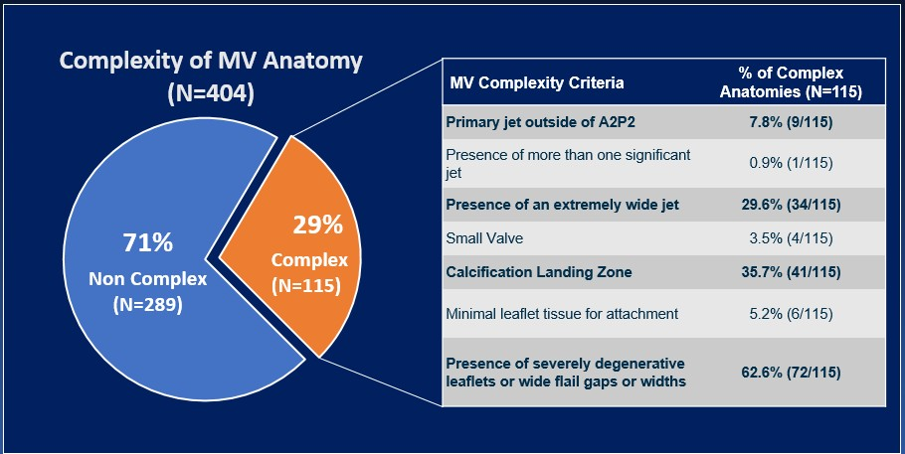
ECL Adjudicated MV Complexity
Complexity of MV Anatomy _{% of Complex}
_{(N=404)} MV Complexity Criteria _{Anatomies (N=115)}
Primary jet outside of A2P2 7.8% (9/115)
Presence of more than one significant
_{jet} 0.9% (1/115)
Presence of an extremely wide jet 29.6% (34/115)
_{71%} ^{29%} Small Valve 3.5% (4/115)
Complex
_{Non Complex (N=115)} Calcification Landing Zone 35.7% (41/115)
^{(N=289)} Minimal leaflet tissue for attachment 5.2% (6/115)
Presence of severely degenerative
leaflets or wide flail gaps or widths ^{62.6% (72/115)}

Slide 28
Baseline MR Severity by MV Complexity
Baseline MR Severity | Subjects with Complex Anatomies (N=115) | Subjects with Non-Complex Anatomies (N=289)
2+ or less¹ 20.9% (24/115) 37.7% (109/289)
3+ or higher¹ 79.1% (91/115) 62.3% (180/289)
Subjects with complex anatomies had greater degrees of MR at baseline compared to subjects with non-complex anatomies ¹: p = 0.0011

Slide 29
MR Reduction – Complex vs. Non-Complex
Complex Anatomy
(N=115)
Non-Complex Anatomy (N=289)
0.8%
100%
3.1%
2.0%
53.1%
8.3%
17.5%
26.8%
80%
60%
61.2%
MR ≤ 2+
96.9%
35.7%
MR ≤ 2+
97.2%
59.8%
MR ≤ 1+
40%
26.1%
MR ≤ 1+
79.4%
88.9%
20%
31.0%
19.1%
27.7%
19.6%
0%
1.7%
6.5%
Baseline
N=114
30 Days
N=97
MR 0+
Baseline
N=289
MR 3+ MR 4+
30 Days
N=253
MR 1+
MR 2+

Slide 30
NTR/XTR CLIP USE BASED ON MITRAL VALVE ANATOMIC MEASURES
ECHO CORE-LAB ASSESSMENT

Slide 31
MV Anatomic Complexity
 | XTR Only (N=194) | NTR only (N=146) | XTR and NTR (N=80)
Non-Complex (n=289) | 71.8% (135/188) | 72.8% (99/136) | 68.7% (55/80)
Complex (n=115) | 28.2% (53/188) | 27.2% (37/136) | 31.3% (25/80)
Type of clip used was not different across subjects with non- complex vs. complex MV anatomies

Slide 32
MV Anatomic Characteristics
XTR vs NTR Use
Prolapse Gap
Flail Gap
P<0.024
10
10
Prolapse Gap (mm)
8
Flail Gap (mm)
8
P<0.017
6
6
4
4
2
2
0
0
XTR NTR XTR NTR
XTR was more often used in subjects with larger prolapse/flail gaps

Slide 33
30 day MR Reduction of ≥ 2 Grades
Complex Anatomy
P=0.0383
Non-Complex Anatomy
Subjects with MR
Reduction ≥ 2 Grades (%)
100
Subjects with MR
Reduction ≥ 2 Grades (%)
100
P=0.6802
80
80
60
60
40
40
20
20
0
0
XTR-only (n=45)
NTR-only (n=30)
XTR-only (n=117)
NTR-only (n=88)
Greater MR reduction achieved using the XTR clip in Complex Anatomies (p = 0.0383)

Slide 34
Limitations
Real world nature of the study results in variability in the quality of echocardiographic acquisitions and hence certain measurements were not available for all patients
Enrollment was based on site interpretation of MR Severity rather than prospective core lab adjudication
Only acute procedure outcomes presented; Longer term follow-up ongoing

Slide 35
Conclusions
This study represents the first contemporary report of ECL and CEC adjudicated 30 day clinical outcomes in patients with primary MR treated with the next generation NTR and XTR MitraClips
Approximately one-third of patients had a complex mitral valve anatomy that reflects the difference in patients treated in the real world in comparison to past clinical trials.
Results show that MR ≤ 1+ is being achieved more often with MitraClip™ NTR and XTR than previously observed in EVEREST II trials
MitraClip™ XTR was associated with greater MR reduction compared to NTR, in more complex anatomies

Slide 36
Summary
The EXPAND study confirms the safety and effectiveness of the next generation MitraClip NTR/XTR system in Primary MR patients in a contemporary, real-world setting

Slide 37
Thank you

Slide 38
APPENDIX

Slide 39
Baseline Characteristics (ii)
Prior Interventions | Value (N=422)
Permanent Pacemaker | 12.1% (51/422)
Cardiac Resynchronization Therapy (CRT or CRT-D) | 3.6% (15/422)
Intracardiac Defibrillation (ICD or CRT-D) | 5.9% (25/422)
Prior Valve Procedure (Surgery or Transcatheter) | 15.4% (65/422)
o Prior Mitral Valve Procedure (Surgery or Transcatheter) | 6.6% (28/422)
Prior Surgical Mitral Valve Repair or Annuloplasty | 3.3% (14/422)
Prior Transcatheter Mitral Valve Repair** | 3.3% (14/422)
o Prior Aortic Valve Procedure (Surgery or Transcatheter)*** | 8.8% (37/422)
Prior Coronary Revascularization | 30.8% (130/422)
o Prior CABG | 11.4% (48/422)
o Prior PCI | 24.7% (104/422)
* Continuous data presented as mean ± s.d.; Categorical data presented as a proportion of subjects where data was
provided (missing data excluded)
** One subject with transcatheter repair also underwent a surgical procedure, and counted as one under surgery.
***One subject had both prior aortic and mitral valve procedures, and counted as one under mitral repair.

Slide 40
ECL Adjudicated MR Severity – US vs. OUS
US Subjects (N=208)
OUS Subjects (N=207)
0.5%
2.0%
0.5%
3.3%
1.0%
0.6%
1.1%
100%
2.5%
11.3%
9.0%
7.7%
13.0%
25.8%
80%
40.7%
60%
47.8%
50.5%
59.7%
58.7%
MR ≤ 2+
96.2%
35.7%
MR ≤ 2+
98.3%
MR ≤ 1+
MR ≤ 1+
40%
30.1%
90.6%
83.2%
20%
38.4%
29.0%
26.8%
37.0%
30.9%
24.5%
0%
2.4%
8.5%
Baseline N=209
Discharge N=203
30 Days N=184
Baseline N=213
MR 3+
Discharge N=200
MR 4+
30 Days N=181
MR 0+ MR 1+ MR 2+
No significant difference in MR reduction outcomes between US and OUS Subjects

Slide 41
ECL Adjudicated Baseline Echo Parameters – Mean ± SD, Range
Effective Regurgitant Orifice Area (EROA, cm²) Mean ± SD (n) Range (Min, Max) | 0.40 ± 0.21 (282) (0.06, 1.52)
Mean Mitral Gradient (mean MVG, mmHg) Mean ± SD (n) Range (Min, Max) | 2.47 ± 1.36 (323) (0.38, 10.89)
Left Ventricular Ejection Fraction (LVEF, %) Mean ± SD (n) Range (Min, Max) | 62 ± 10 (390) (15.44, 81.63)
Left Ventricle End Systolic Diameter (LVESD, mm) Mean ± SD (n) Range (Min, Max) | 35.4 ± 7.7 (401) (20.9, 62.5)
Left Ventricle End Diastolic Diameter LVEDD, mm) Mean ± SD (n) Range (Min, Max) | 52.0 ± 6.6 (403) (35.6, 79.2)
Left Ventricle End Systolic Volume (LVESV, mL) Mean ± SD (n) Range (Min, Max) | 47.9 ± 30.4 (390) (11.89, 278.49)
Left Ventricle End Diastolic Volume (LVEDV, mL) Mean ± SD (n) Range (Min, Max) | 121.0 ± 48.6 (390) (41.25, 376.61)

Slide 42
Length of Stay – US vs. OUS
 | US Subjects (N=209) | OUS Subjects (N=213)
Length of Stay in Hospital for Index Procedure (days) Mean ± SD (n) Median [Inter-Quartile Range] | 2.7 ± 3.5 (209) 1.0 (1.0, 3.0) | 8.0 ± 6.9 (213) 6.0 (4.0, 9.0)
Longer length of stay is reported for OUS subjects compared to US (p<0.0001)

Slide 43
30 Day MAE* vs. Previous Trials
RISK COHORT
DATA ADDED
 | Prohibitive Risk Primary MR Cohort¹ (N=127) | EVEREST II HRR² (N=78) | EVEREST II REALISM³ (N=628) | EXPAND Primary MR (N=420)
All-cause Death | 6.3% (8) | 7.7% (6) | 4.1% (26) | 2.4% (10)
Myocardial Infarction | 0.8% (1) | 2.6% (2) | 0.5% (3) | 0.0% (0)
Peri-procedural MI | NA | 0.0% (0) | 0.0% (0) | 0.0% (0)
Spontaneous MI | NA | 1.3% (1) | 0.5% (3) | 0.0% (0)
Stroke | 2.4% (3) | 2.6% (2) | 2.1% (13) | 1.2% (5)
Ischemic | NA | 2.6% (2) | NA | 1.0% (4)
Hemorrhagic | NA | 0.0% (0) | NA | 0.2% (1)
Non-elective CV surgery for device-related complications | 0.8% (1) | 0.0% (0) | 1.3% (8) | 0.9% (4)
¹Lim et al. Prohibitive Risk Cohort. ACC 2018, _{*CEC Adjudicated} ²Whitlow et al. EVEREST II HRS. JACC 2012, ³Feldman et al. REALISM HR data. EuroPCR 2015

Slide 44
MV Anatomic Complexity / TTE
 | XTR Only (N=194) | NTR only (N=146) | XTR and NTR (N=80) | P-value
Primary jet outside of A2P2 | 4/53 (7.5%) | 1/37 (2.7%) | 4/25 (16.0%) | 0.160¹
Presence of more than one significant jet | 1/53 (1.9%) | 0/37 (0.0%) | 0/25 (0.0%) | 1.000²
Presence of a wide jet | 16/53 (30.2%) | 8/37 (21.6%) | 10/25 (40.0%) | 0.296¹
Small Valve | 1/53 (1.9%) | 2/37 (5.4%) | 1/25 (4.0%) | 0.683²
Calcification Landing Zone | 11/53 (20.8%) | 20/37 (54.1%) | 10/25 (40.0%) | 0.005¹
Minimal leaflet tissue for attachment | 5/53 (9.4%) | 1/37 (2.7%) | 0/25 (0.0%) | 0.260²
Presence of severely degenerative leaflets or wide flail gaps or widths | 39/53 (73.6%) | 17/37 (45.9%) | 16/25 (64.0%) | 0.028¹
For primary MR subjects with complex MV anatomy: Calcification Landing Zone and Presence of severely degenerative leaflets or wide flail gap are statistically different across the three groups of device use More subjects with NTR have Calcification Landing Zone More subjects with XTR present severely degenerative leaflets or wide flail gaps 1: Pearson’s Chi-square test 2: Fisher’s exact test

Slide 45
30 Day MR Severity XTR vs. NTR
Complex Anatomy Non-Complex Anatomy
XTR-only
NTR-only
XTR-only
1.7%
NTR-only
100%
3.4%
1.1%
4.4%
2.5%
5.6%
11.1%
11.1%
16.2%
80%
23.3%
33.3%
43.3%
54.7%
MR ≤ 2+
95.6%
MR ≤ 1+
84.5%
MR ≤ 2+
96.6%
MR ≤ 1+
73.3%
MR ≤ 2+
95.8%
MR ≤ 1+
84.7%
34.3%
MR ≤ 2+
98.9%
MR ≤ 1+
93.3%
60%
62.9%
57.8%
61.0%
16.2%
50.0%
36.3%
40%
32.1%
41.4%
20%
35.1%
23.7%
26.7%
23.3%
23.7%
30.4%
0%
13.2%
5.4%
6.7%
8.1%
Baseline 30 Days N=53 N=45
Baseline 30 Days
Baseline 30 Days N=135 N=118
Baseline 30 Days N=98 N=89
N=30
MR 0+ MR 1+ MR 2+ MR 3+ MR 4+
N=37
XTR clip resulted more often in MR reduction ≤1+ in complex anatomies, whereas NTR clip achieved more
often MR reduction to ≤1+ in non-complex anatomies, although the results are not statistically significant

Slide 46
Procedural Outcomes vs. Previous Trials
 | EXPAND PRIMARY MR | EVEREST II HRR¹ | EVEREST II REALISM² | TVT Registry³
Implant Rate % (n/N) [95% Confidence Interval] | 99.5% (420/422) [98.3%, 99.9%] | 96.2% (75/78) | 96.0% (603/628) | NA
Acute Procedural Success (APS)* % (n/N) [95% Confidence Interval] | 94.5% (396/419) [91.9%, 96.5%] (ECL) | 71.8% (56/78) (ECL) | 84.8% (518/611) (ECL) | 91.8% (2,709/2,952) Site-Reported
Device Time (min) Median [Inter-Quartile Range] | 48.0 [33.0-76.0] | NA | 94.0 [NA] | NA
Fluoroscopy Time (min) Median [Inter-Quartile Range] | 18.0 [11.3-27.0] | NA | 33.0 [NA] | NA
Procedure Time (min) Median [Inter-Quartile Range] | 82.0 [53.0- 120.0] | NA | 126.0 [NA] | NA
Length of Stay in Hospital for Index Procedure (days) Median [Inter-Quartile Range] | 1.0 [1.0-3.0] (US) | 2.0 [NA] | 2.0 [NA] | 2.0 [1.0–5.0]
*APS defined as successful implantation of the MitraClip® device with 1Whitlow et al. EVEREST II HRS. JACC 2012 resulting MR severity of 2+ or less on discharge Echocardiogram (30-day 2Feldman et al. REALISM HR data. EuroPCR 2015 echocardiogram is used if discharge is unavailable or uninterpretable). 2Sorajja et al. J Am Coll Cardiol 2017;70:2315–27) Subjects who die or undergo mitral valve surgery before discharge are considered to be an APS failure

Slide 47
ECL Adjudicated MR Severity
EXPAND Primary MR Subjects
w/ Baseline MR Severity ≥ 3+ (n=279)
EVEREST II HRR (n=78)
EVEREST II REALISM HR (n=587)
100%
0.8%
2.9%
4.3
28.6
1.5
8.5
13.5%
21.8
80%
22.9
50.2%
35.1
51.6
60%
24.3
61.8%
MR ≤ 2+
96.3%
MR ≤ 2+
88.8
40%
MR ≤ 1+
82.8%
76.9
MR ≤ 2+
72.9
MR ≤ 1+
54.9
49.8%
MR ≤ 1+
48.6
53.7
20%
48.6
18.4
21.0%
0%
1.3
1.4
1.2
Baseline N=279
30 Days N=238
MR 0+
Baseline N=78
MR 2+
30 days N=70
MR 3+
Baseline N=587
30 days N=587
MR 1+
MR 4+
MR Reduction to ≤ 1+ at 30 days was numerically greater in EXPAND compared to prior studies (Same ECL used in all 3 studies for MR Severity assessment)

Slide 48
Mitral Valve Remodeling of the Annulus
Mitral Valve Annular Dimensions at 30 Days vs. Baseline
P<0.0001
P<0.0001
40
P<0.0001
P<0.0001
Annular Dimension (mm)
30
20
28.8
32.2
29.0
28.9
31.6
28.8
25.9
25.9
10
0
Baseline 30 days
AP¹ Systolic Annular D.
Baseline 30 days
AP¹ Diastolic
Annular D.
Baseline 30 days CC² Systolic Annular D.
Baseline 30 days CC² Diastolic Annular D.
Significant reduction in annular dimensions within 30 days of treatment
¹AP: Anterior Posterior
²CC: Commissure to Commissure

Slide 49
MitraClip Use in Subjects w/ Primary MR
Clip Size Use by # of Clips
100%
90%
80%
70%
60%
50%
40%
30%
20%
10%
0%
Clip Size Use in Primary MR
44.7%
37.3%
51.8%
19.0%
Both
24.9%
55.3%
46.2%
XTR Only
17.9%
37.8%
34.8%
NTR Only
30.4%
1 Clip
2 Clips
3 or more clips
52%
(217 pts)
43%
(180 pts)
5%
(23 pts)
XTR Only NTR Only Both NTR & XTR
XTR was used more frequently to treat primary MR compared to NTR (p < 0.0001)

Slide 50
Mitral Gradients (ECL Adjudicated) by MitraClip Size
 | XTR Only (N=194) | NTR only (N=146) | XTR and NTR (N=80) | Total (N= 420)
Pre Procedure Mitral Gradient, mmHg | 2.51 ± 1.35 (145) | 2.31 ± 1.22 (121) | 2.71 ± 1.62 (57) | 2.48 ± 1.40 (318)
Discharge Mitral Gradient, mmHg | 3.48 ± 1.92 (173) | 3.96 ± 1.81 (124) | 4.02 ± 1.68 (73) | 3.75 ± 1.87 (363)
30 day Mitral Gradient, mmHg | 3.51 ± 1.69 (156) | 3.89 ± 1.89 (121) | 3.99 ± 1.82 (66) | 3.74 ± 1.79 (337)
1 Clip Only | 61.9% (120/194) | 66.4% (97/146) | 0.0% (0/80) | 51.7% (217/420)
2 Clips | 34.5% (67/194) | 30.8% (45/146) | 85% (68/80) | 42.9% (180/420)
3+ Clips | 3.6% (7/194) | 2.7% (4/146) | 15% (12/80) | 5.0% (21/420)
Pre-procedure gradient was not different across clip type groups (P =0.17) MitraClip XTR was not associated with increased mitral valve gradient post procedure compared to MitraClip NTR.

