Slide 1
Enhanced Monitoring For Atrial Fibrillation Following Cardiac Surgery Primary Results of The SEARCH-AF CardioLink Trial
Embargoed for 9:05am CT 11-16-20
Subodh Verma MD PhD, FRCSC
University of Toronto, Toronto, Canada
Andrew C.T. Ha, Subodh Verma, C. David Mazer, Adrian Quan, Bobby Yanagawa, David A. Latter, Terrence M. Yau, Frédéric Jacques, Craig D. Brown,
Rohit K. Singal, Michael H. Yamashita, Tarit Saha, Kevin H. Teoh, Buu-Khanh Lam, Marc W. Deyell, Marnee Wilson, Makoto Hibino, Christopher C. Cheung, Andrew Kosmopoulos, Vinay Garg, Shira Brodutch, Hwee Teoh, Fei Zuo, Kevin E. Thorpe, Peter Jüni, Deepak L. Bhatt, Atul Verma

Slide 2
Disclosures for Professor Subodh Verma
Has received speaking and/or research support from Abbott, Amgen, AstraZeneca, Bayer, Boehringer Ingelheim, Bristol Myers Squibb, Eli Lilly, HLS Therapeutics, Janssen, Merck, Novartis, Novo Nordisk, Pfizer, PhaseBio, Sanofi, and Valeant
Is the NC for DAPA-HF, DELIVER-HFpEF, EMPEROR-Preserved, EMPEROR-Reduced, SOLOIST, and SELECT
Is on the SEC for EMPEROR-Reduced, EMPEROR-Preserved, DETERMINE-A and DETERMINE-B
Is the Co-PI for ACE, CAMRA, ENABLE-Chiropody, EMPA-HEART, EMPA-HEART 2, NEWTON-CABG, and SEARCH-AF
Is President of the Canadian Medical and Surgical Knowledge Translation Research Group
Is on the SC of CIRT and BELIEVE

Slide 3
Background - 1
Early post-operative atrial fibrillation (POAF) occurs in
30-50% of patients, peaking at 3-5 days and declining afterwards
The natural history of POAF after discharge from cardiac surgery is not well defined because the observation period in most studies have been limited to the hospitalization phase

Slide 4
Background - 2
Unclear if the risk of POAF persists in post-surgical patients, especially those without AF pre-operatively or during hospitalization
Guidelines provide little or no direction on optimal duration of monitoring post cardiac surgery particularly if they are in SR at discharge
Randomized data guiding detection and management of POAF after hospitalization for cardiac surgery are lacking

Slide 5
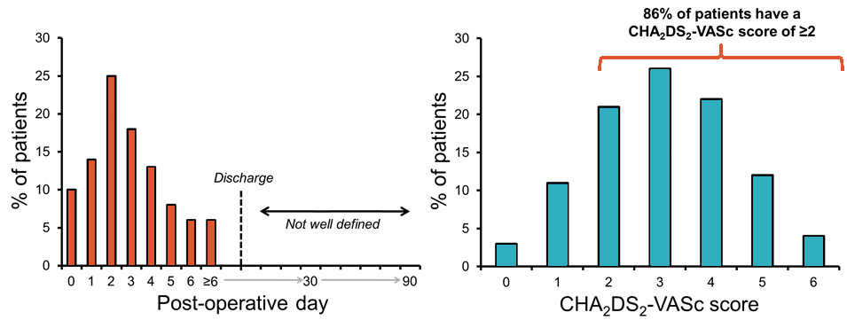
Rationale Behind SEARCH-AF
POAF after cardiac surgery is associated with
adverse short- and long-term outcomes (e.g. death, stroke)
A strategy to enhance our ability to detect POAF during the subacute post-operative phase (e.g. after discharge) could incrementally identify patients who might benefit from therapeutic interventions (e.g. oral anticoagulation)

Slide 6
Primary Objective
To determine whether enhanced cardiac rhythm monitoring with an adhesive, continuous monitoring device results in higher rates of atrial fibrillation/flutter (AF/AFL) detection during the subacute, post-discharge period of cardiac surgical patients who are at risk of stroke and developing post-operative atrial arrhythmias

Slide 7
Study Hypothesis
A strategy of enhanced cardiac rhythm monitoring will result in an increase in AF/AFL when compared to usual care within 30 days after randomization among post-cardiac surgical patients without a previous history of AF/AFL and at high risk of stroke

Slide 8
Key Inclusion and Exclusion Criteria
INCLUSION
Isolated CABG or valve replacement/repair ± CABG
Sinus rhythm at the time of randomization
No intent to initiate oral anticoagulation at the time of discharge
CHA₂DS₂-VASC ≥4 or
≥2 with ≥1 of the following:
COPD | sleep apnea |
eGFR <60 mL/min/1.73m² |
≥mild left atrial dilatation |
BMI ≥30 kg/m²
EXCLUSION
Known previous history of AF/AFL
AF/AFL for ≥24 hours post-operatively
Subjects who will be treated with OAC due to POAF/AFL
Mechanical valve
Hospitalization for ≥10 days
(Day #0 = day of surgery)
Received ≥5 g of IV/oral amiodarone

Slide 9
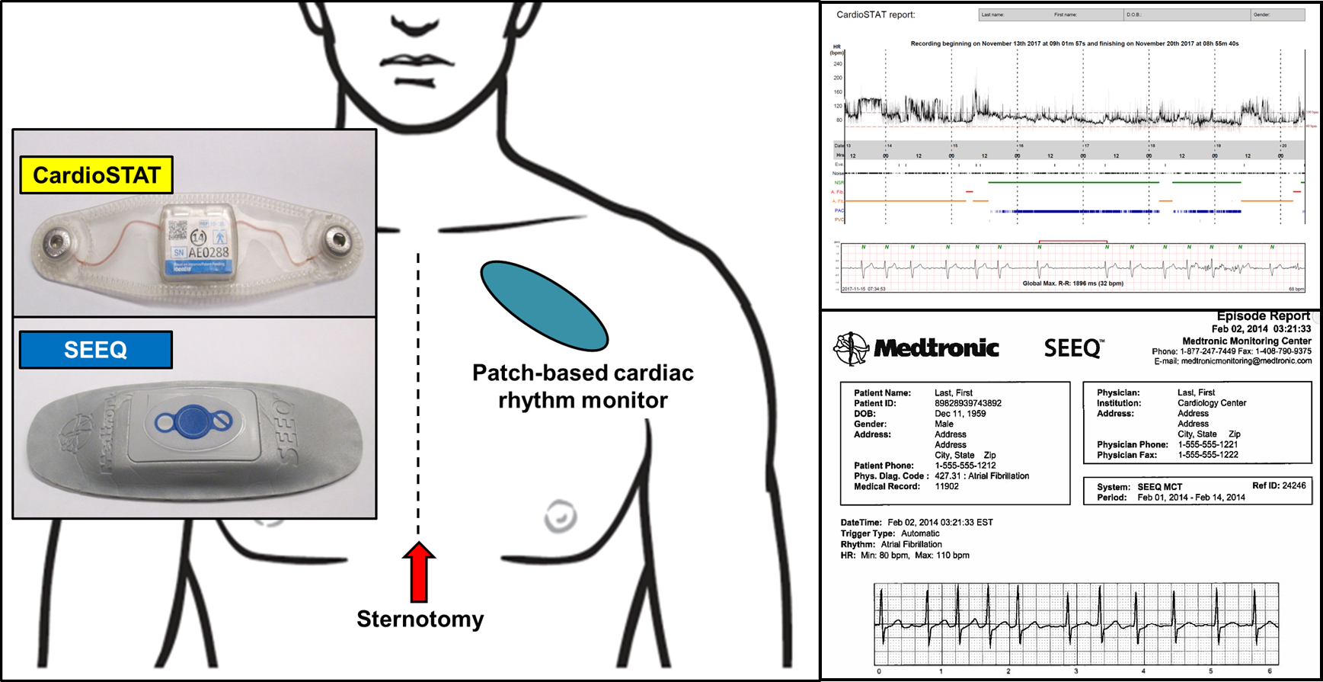
Study Groups
Enhanced Cardiac Rhythm Monitoring (Intervention)
Continuous cardiac rhythm monitoring
with SEEQ™ (Medtronic) or CardioSTAT® (Icentia Inc.)
within the first 30 days after randomization
Usual Care (Control)
No protocol-mandated continuous cardiac rhythm monitoring
ECG and/or Holter monitoring at the discretion of the treating physicians

Slide 10
Study Design
Post-cardiac surgical subjects without a previous history of AF/AFL and with risk factors for stroke
R
Multicenter
Parallel group (2-arm)
Open-label
Randomized
Blinded adjudication of outcomes (PROBE design)
Enhanced
Cardiac Rhythm Monitoring
Usual Care
Cumulative AF/AFL duration ≥6 minutes or documentation of AF/AFL by a 12-lead ECG
1º
All participants received 14-days of enhanced rhythm monitoring
6±1 months post-surgery
Telephone follow-up
9±1 months post-surgery

Slide 11
Outcome Measures
PRIMARY Outcome
Cumulative AF/AFL duration ≥6 min or documentation of AF/AFL by a 12-lead ECG
SECONDARY Outcomes
Day 0
Day 30
Day 45
Cumulative AF/AFL duration ≥6 h and ≥24 h
Non-protocol mandated Holter/event recorder
Prescription of oral anticoagulation
Major bleeding
Death, MI, ischemic stroke, or non-CNS
thromboembolism
Prescription of oral anticoagulation
Major bleeding
Death, MI, ischemic stroke, or non-CNS
thromboembolism

Slide 12
Impact of COVID-19
March 19, 2020
Enrollment suspended
336 subjects had been randomized (85% of the planned sample of 396)
July 17, 2020
Enrollment of additional subjects was stopped
Analysis of outcomes is based on results from the 336 subjects randomized into the trial

Slide 13
Abbreviated CONSORT Diagram
2803
Assessed for eligibility
2467 Excluded
840 declined participation
1204 ineligible per protocol
423 other reason
336 Randomized
163
Enhanced
Cardiac Rhythm Monitoring
173
Usual Care
Cumulative AF/AFL duration ≥6 minutes or documentation of AF/AFL by a 12-lead ECG

Slide 14
Baseline Characteristics
n (%) unless otherwise stated | Enhanced Cardiac Rhythm Monitoring (n=163) | Usual Care (n=173)
Age (mean±SD), years | 67.5 ± 8.1 | 67.4 ± 8.2
Female | 35 (21.5) | 38 (22.0)
Hypertension | 151 (92.6) | 162 (93.6)
Diabetes | 90 (55.2) | 86 (49.7)
Heart failure | 10 (6.1) | 13 (7.5)
Stroke or Transient Ischemic Attack | 17 (10.4) | 18 (10.4)
Myocardial infarction | 65 (39.9) | 60 (34.7)
COPD | 11 (6.7) | 16 (9.2)
CHA₂DS₂-VASc (median, IQR) | 4.0 (3.0, 4.5) | 4.0 (3.0, 4.0)
HAS-BLED (median, IQR) | 2.0 (2.0, 3.0) | 2.0 (2.0, 3.0)
CABG only | 124 (76.1) | 131 (75.1)
Valve repair or replacement only | 17 (10.4) | 22 (12.7)
CABG and valve surgery | 22 (13.5) | 20 (11.6)
Ejection fraction (mean±SD) (%) | 55.1 ± 10.4 | 57.4 ± 9.8
AF (<24 hours) during hospitalization after cardiac surgery) | 6 (3.7) | 12 (6.9)
n (%) unless otherwise stated | Enhanced Cardiac Rhythm Monitoring (n=163) | Usual Care (n=173)
Age (mean±SD), years | 67.5 ± 8.1 | 67.4 ± 8.2
Female | 35 (21.5) | 38 (22.0)
Hypertension | 151 (92.6) | 162 (93.6)
Diabetes | 90 (55.2) | 86 (49.7)
Heart failure | 10 (6.1) | 13 (7.5)
Stroke or Transient Ischemic Attack | 17 (10.4) | 18 (10.4)
Myocardial infarction | 65 (39.9) | 60 (34.7)
COPD | 11 (6.7) | 16 (9.2)
CHA₂DS₂-VASc (median, IQR) | 4.0 (3.0, 4.5) | 4.0 (3.0, 4.0)
HAS-BLED (median, IQR) | 2.0 (2.0, 3.0) | 2.0 (2.0, 3.0)
CABG only | 124 (76.1) | 131 (75.1)
Valve repair or replacement only | 17 (10.4) | 22 (12.7)
CABG and valve surgery | 22 (13.5) | 20 (11.6)
Ejection fraction (mean±SD) (%) | 55.1 ± 10.4 | 57.4 ± 9.8
AF (<24 hours) during hospitalization after cardiac surgery) | 6 (3.7) | 12 (6.9)

Slide 15
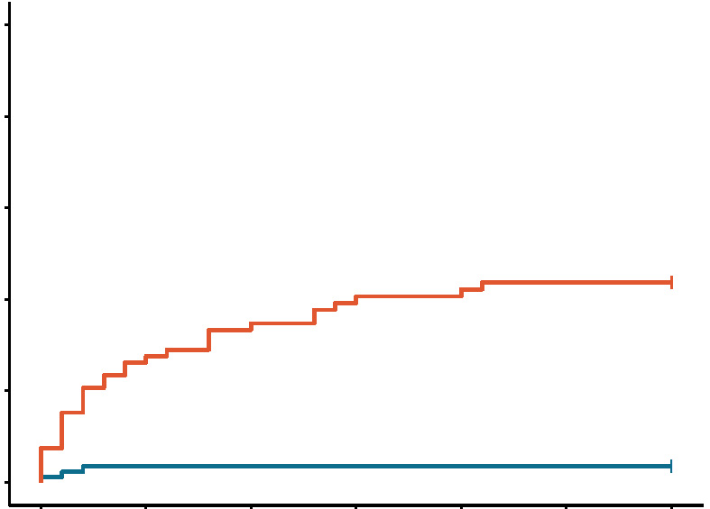
Primary Outcome: Cumulative AF/AFL duration ≥6 min or documentation of AF/AFL by a 12-lead ECG
Absolute rate difference (95% CI)
17.9% (11.5%, 24.3%) P<0.001
50
Number needed to screen (95% CI)
6 (4 to 9)
40
30
Enhanced
Cardiac Rhythm Monitoring
Cumulative incidence (%)
20
10
Usual Care
0
n=32/163
n=3/173
0
5
10
15
20
25
30
Number of Days After Randomization

Slide 16
Primary Outcome and Its Components
n (%) unless otherwise stated | Enhanced Cardiac Rhythm Monitoring (n=163) | Usual Care (n=173) | Rate Difference (95% CI)
Primary Outcome
Cumulative AF/AFL duration ≥6 min or documentation of AF/AFL by a 12-lead ECG within first 30 days | 32 (19.6) | 3 (1.7) | 17.9* (11.5 to 24.3)
Components of the Primary Outcome
Cumulative AF/AFL duration ≥6 min within first 30 days | 30 (18.4) | 0 (0.0) | 18.4* (12.5 to 24.4)
Documentation of ≥1 episode of AF/AFL by a 12-lead ECG within first 30 days | 6 (3.7) | 3 (1.7) | 1.9 (-1.5 to 5.4)

Slide 17
Secondary Outcomes
n (%) unless otherwise stated | Enhanced Cardiac Rhythm Monitoring (n=163) | Usual Care (n=173) | Rate Difference (95% CI)
Cumulative AF/AFL duration ≥6 hours within first 30 days | 14 (8.6) | 0 (0.0) | 8.6 (4.3 to 12.9)
Cumulative AF/AFL duration ≥24 hours within first 30 days | 5 (3.1) | 0 (0.0) | 3.1 (0.4 to 5.7)
Non-protocol mandated Holter/event recorder within first 30 days | 5 (3.1) | 4 (2.3) | 0.8 (-2.7 to 4.2)
Prescription of oral anticoagulation within first 45 days | 7 (4.3) | 4 (2.3) | 2 (-1.9 to 5.8)
Prescription of oral anticoagulation after 45 days | 6 (3.7) | 4 (2.3) | 1.4 (-2.3 to 5)
Major bleeding within first 45 days | 0 (0.0) | 1 (0.6) | -0.6 (-1.7 to 0.6)
Major bleeding after 45 days | 1 (0.6) | 3 (1.7) | -1.1 (-3.4 to 1.2)
Death, MI, ischemic stroke, or non-CNS thromboembolism within the first 45 days | 1 (0.6) | 1 (0.6) | 0 (-1.6 to 1.7)
Death, MI, ischemic stroke, or non-CNS thromboembolism after 45 days | 1 (0.6) | 3 (1.7) | -1.1 (-3.4 to 1.2)

Slide 18
Primary Outcome Stratified by Pre-specified Subgroups
Subgroup |  | No. of patients with events/Total No. |  | Adjusted Odds Ratio (95% CI)
 |  | Enhanced Cardiac Rhythm Monitoring | Usual Care
Isolated CABG
 | Yes | 20/124 | 2/131 |  | 12.3 (2.8, 54.2)
 | No | 12/39 | 1/42 |  | 15.3 (1.9, 125.8)
Age
 | <67 years | 9/64 | 2/70 |  | 5.0 (1.0, 24.7)
 | ≥67 years | 23/99 | 1/103 |  | 29.7 (3.9, 226.0)
CHA₂DS₂-VASc score
 | <4 | 8/56 | 2/80 |  | 6.9 (1.4, 34.0)
 | ≥4 | 24/107 | 1/93 |  | 27.3 (3.6, 207.3)
Sex
 | Male | 26/128 | 3/135 |  | 10.7 (3.1, 37.0)
 | Female | 6/35 | 0/38
Large atrial enlargement
 | Yes | 8/63 | 2/64 |  | 4.8 (0.9, 24.1)
 | No | 9/28 | 0/32

Slide 19
Cumulative AF Duration Per Patient in the Intervention Arm During the First 30 Days
4000
150
3500
3000
100
2500
Cumulative AF duration (minutes)
2000
Cumulative AF duration (minutes)
50
1500
1000
0
500
0
1
2
3
4
Weeks After Randomization to Enhanced Cardiac Rhythm Monitoring

Slide 20
Summary
In post-cardiac surgical patients at high risk of stroke and with little or no AF during index hospitalization, continuous rhythm risk of AF (by a factor of 10) vs. usual care.
Similar findings were seen for longer durations of detected AF include ≥6 hours and ≥24 hours
While incidence of POAF decreased over the 4 weeks of monitoring, it was much higher than a normal matched population (prior studies report an AF incidence of ~1-1.5 per 100 patient years in a general population with similar CHA₂DS₂-VASc score vs. 20% 30-day incidence observed in this trial)
The rates of oral anticoagulation were lower than the rates of detected AF

Slide 21
Limitations
The primary endpoint was limited to 30 days with repeat monitoring at 6-months
This may have underestimated the long-term, ongoing risk of POAF
Only individuals with no/minimal AF burden in hospital were included
Those with prolonged stay were excluded
Both criteria could have underestimated POAF and CV events
SEARCH-AF was not powered to detect differences in stroke and whether oral anticoagulation would alter risk

Slide 22
Conclusions and Implications
In patients who have undergone cardiac surgery (isolated CABG, valve, or CABG+valve) and have an elevated risk of stroke with no history of pre-operative or pre-discharge AF, a strategy of continuous rhythm monitoring unveiled a significant persistent burden of unrecognized and potentially actionable AF
POAF after cardiac surgery is not confined to the hospitalization period per se
These data should help inform on clinical practice guidelines on monitoring for POAF in such patients

