Slide 1
Anticoagulation with Edoxaban in Patients with Atrial High-Rate Episodes (AHRE)
Results of the NOAH – AFNET 6 Trial
Paulus Kirchhof, Tobias Toennis, Andreas Goette, A John Camm, Hans Christoph Diener, Nina Becher, Emanuele Bertaglia, Carina Blomstrom Lundqvist, Martin Borlich, Axel Brandes, Nuno Cabanelas, Melanie Calvert, Gregory Chlouverakis, Gh.-Andrei Dan, Joris R. de Groot, Wolfgang Dichtl, Borys Kravchuk, Andrzej Lubiński, Eloi Marijon, Béla Merkely, Lluís Mont, Ann-Kathrin Ozga, Kim Rajappan, Andrea Sarkozy, Daniel Scherr, Rafał Sznajder, Vasil Velchev, Dan Wichterle, Susanne Sehner, Emmanuel Simantirakis, Gregory Y. H. Lip, Panos Vardas, Ulrich Schotten,
Antonia Zapf
p.kirchhof@uke.de

Slide 2
Declaration of interest
- Research contracts : NOAH-AFNET 6 was supported by DZHK and Daiichi Sankyo Europe. PK receives research support for basic, translational, and clinical research projects from European Union,
British Heart Foundation, Leducq Foundation, Medical Research Council (UK), and German Center for Cardiovascular Research, from several drug and device companies active in atrial fibrillation, and
has received honoraria from several such companies in the past, but not in the last three years. PK is listed as inventor on two issued patents held by University of Hamburg (Atrial Fibrillation
Therapy WO 2015140571, Markers for Atrial Fibrillation WO 2016012783).
• •
ESC Congress 2023 •
Amsterdam & On ine

Slide 3
NOAH – AFNET 6 Background
Oral anticoagulation prevents strokes in patients with atrial fibrillation.^{1,2}
In the absence of ECG-documented atrial fibrillation, anticoagulants given for stroke prevention mainly cause bleeding, e.g. in patients with ESUS^{3,4} or heart failure.^{5,6}
Atrial fibrillation is often only detected after a first stroke^{7,8}, calling for earlier diagnosis to enable anticoagulation.⁹
Less time in atrial fibrillation may carry a lower stroke risk: Stroke risk is lower in paroxysmal atrial fibrillation than in chronic forms, and early rhythm control therapy reduces time in atrial fibrillation and cardiovascular events.⁹⁻¹²
1 Hart RG, et al. Ann Intern Med 2007;146:857-67. DOI: 10.7326/0003-4819-146-12-200706190-00007.
2 Ruff CT, et al. Lancet 2014;383:955-62. DOI: 10.1016/S0140-6736(13)62343-0.
3 Hart RG, et al. N Engl J Med 2018;378:2191-2201. DOI: 10.1056/NEJMoa1802686.
4 Diener HC, et al. N Engl J Med 2019;380:1906-1917. DOI: 10.1056/NEJMoa1813959.
5 Zannad F, et al. N Engl J Med 2018;379:1332-1342. DOI: 10.1056/NEJMoa1808848.
6 Homma S, et al. N Engl J Med 2012;366:1859-69. DOI: 10.1056/NEJMoa1202299.
7 Grond M, et al. Stroke 2013;44:3357-64. DOI: 10.1161/STROKEAHA.113.001884.
8 Gladstone DJ, et al. N Engl J Med 2014;370:2467-77. DOI: 10.1056/NEJMoa1311376.
9 Schnabel RB, et al. Europace 2022. DOI: 10.1093/europace/euac062.
Vanassche T, et al. Eur Heart J 2015;36:281-7a.DOI: 10.1093/eurheartj/ehu307.
Kirchhof P, et al. N Engl J Med 2020. DOI: 10.1056/NEJMoa2019422.
Eckardt L, et al. Eur Heart J 2022;43:4127-4144. DOI: 10.1093/eurheartj/ehac471.

Slide 4
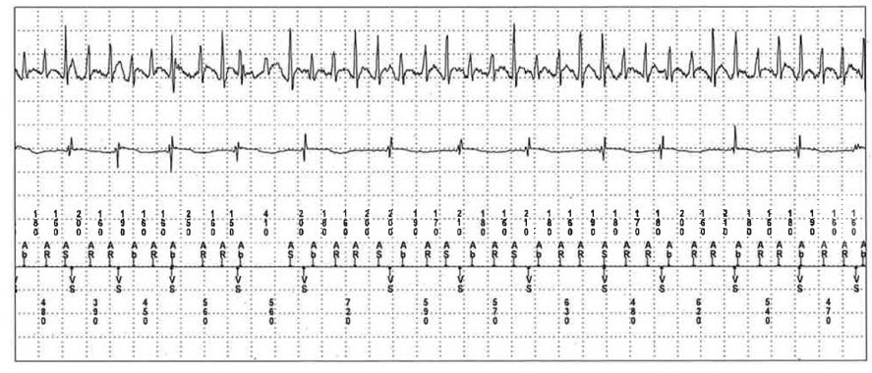
NOAH – AFNET 6 Rationale
Pacemaker, defibrillators, CRTs, and loop recorders continuously monitor atrial rhythm.
These devices detect atrial high-rate episodes in 10-30% of patients.
Toennis T, et al. Europace 2023. DOI: 10.1093/europace/euad166

Slide 5
NOAH – AFNET 6 Hypothesis
The Non vitamin K antagonist Oral anticoagulants in patients with Atrial High- rate episodes trial (NOAH-AFNET 6)
Oral anticoagulation with edoxaban prevents stroke and systemic embolism in patients with atrial high-rate episodes and stroke risk factors compared to no anticoagulation.

Slide 6
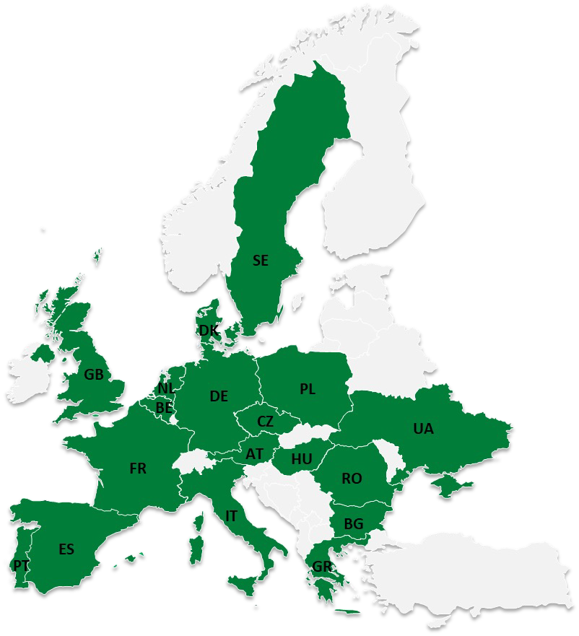
NOAH – AFNET 6 Design
Investigator-initiated, double-blind, double-dummy, randomized trial
conducted in 206 sites across 18 European countries
Sample size: 80% power, α=0.05, to detect a hazard ratio of 0.68 in patients assigned to anticoagulation (220 events)
Primary analysis population: all randomized patients who received at least one dose of study drug.
Sample size: Initially 3,400 patients, adapted to 2,538 after a planned, blind interim analysis after 1,000 follow-up years
Sponsor: AFNET Financial support:
DZHK, Daiichi Sankyo Europe
Kirchhof P, et al. Am Heart J 2017;190:12-18. DOI: 10.1016/j.ahj.2017.04.015.

Slide 7
NOAH – AFNET 6 Design
Patients with
AHRE episodes ≥6 minutes duration and ≥170 bpm atrial rate, all verified by a core lab, and
Age ≥65 years and at least one stroke risk factor of heart failure, hypertension, diabetes, prior stroke, vascular disease, or age ≥75 years
1:1 randomly assigned
Placebo (1,266 patients)
double blind, double dummy
No active compound or acetylsalicylic acid 100 mg based on accepted indications (PAD, CAD/MI, stroke)
Anticoagulation (1,270 patients)
double blind, double dummy Edoxaban 60 mg, reduced to 30 mg following
approved dose reduction criteria, aspirin dummy
Primary outcome: Composite of stroke, systemic embolism, or cardiovascular death
Safety outcome Composite of major ISTH bleeding or all-cause death Change to open-label anticoagulation upon ECG-documentation of atrial fibrillation
ECG during every 6-monthly study visit
All patients were followed up until the end of the trial
Kirchhof P, et al. Am Heart J 2017;190:12-18. DOI: 10.1016/j.ahj.2017.04.015.

Slide 8
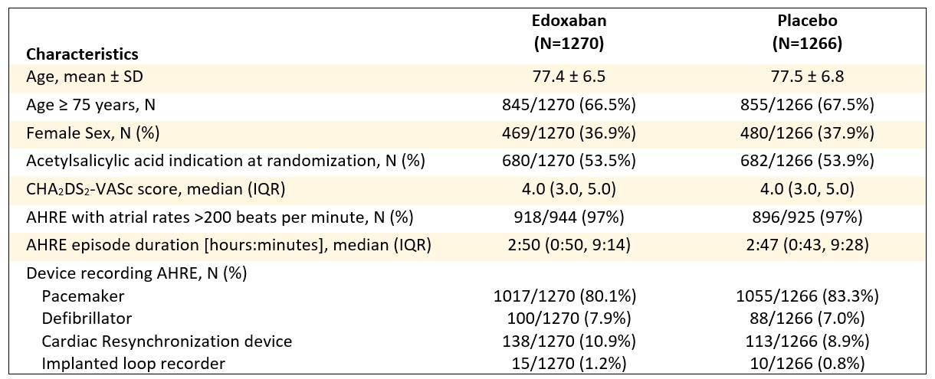
NOAH – AFNET 6 Clinical Characteristics
684
9
683

Slide 9
NOAH – AFNET 6 Early Termination
The unanimous decision to terminate NOAH – AFNET 6 was taken in Sep 2022 after enrolment of all planned patients at a median follow-up of 21 months.
Final visits were conducted until 31 December 2022, capturing 184/220 (84%) of the planned primary outcome events.
Anticoagulation (Edoxaban):
232/1,270 patients developed atrial fibrillation (8.7%/year), 134 withdrew consent
No anticoagulation:
230/1,266 patients developed atrial fibrillation (8.8%/year), 134 withdrew consent

Slide 10
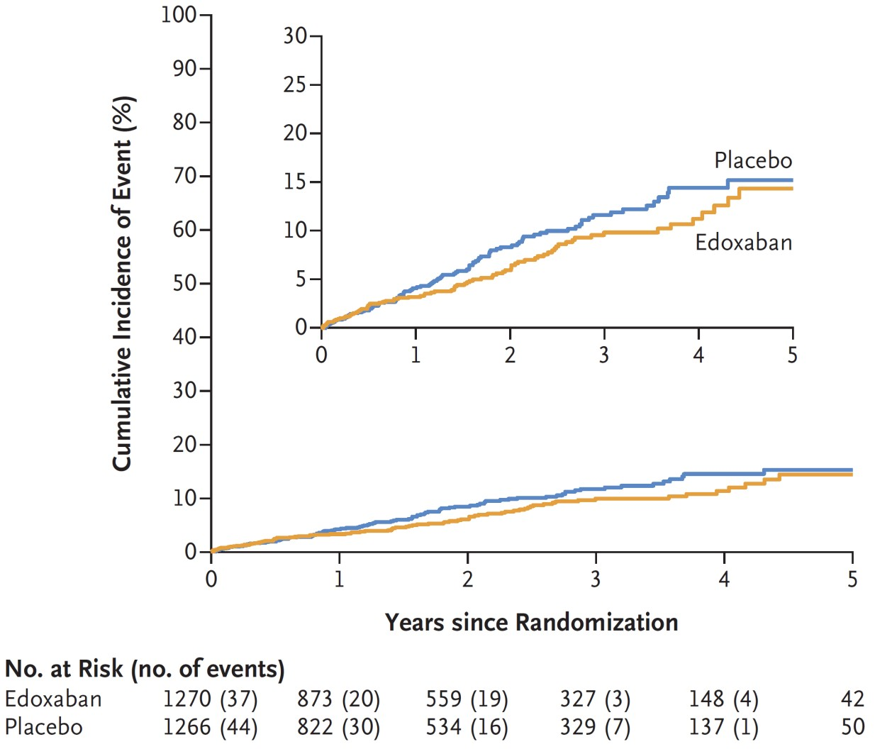
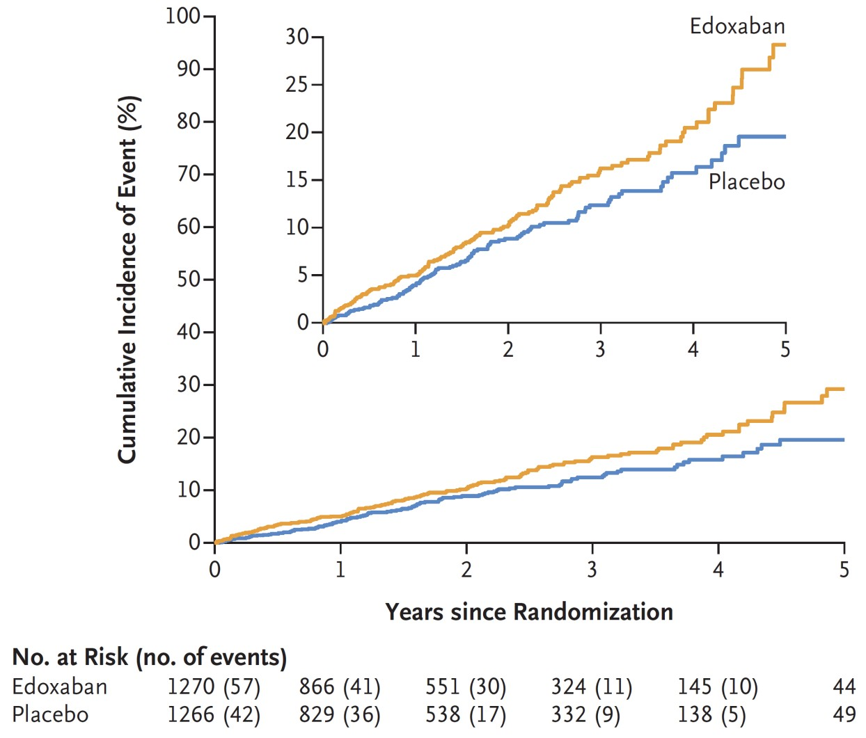
NOAH – AFNET 6 Outcomes
Primary Outcome
Safety Outcome
Stroke, systemic embolism or CV death
Major bleeding or death
Edoxaban |  | Placebo | Adjusted hazard ratio (95% CI) | P value
Primary Outcome | 83 (3.3) | 101 (4.0) | 0.81 (0.60 to 1.08) | 0.15
Ischemic stroke | 22 (0.9) | 27 (1.1) | 0.79 (0.45 to 1.39)
Systemic embolism | 14 (0.5) | 28 (1.1) | 0.51 (0.27 to 0.96)
Cardiovascular death | 52 (2.0) | 57 (2.2) | 0.90 (0.62 to 1.31)
Ischemic stroke or systemic embolism | 25 (1.0) | 38 (1.5) | 0.65 (0.39 to 1.07)
Anticoagulation (Edoxaban) 149 patients with event
p=0.15 (n.s.)
Placebo
p=0.03
101 patients with event
Anticoagulation (Edoxaban) 83 patients with event
Placebo
114 patients with event
The findings were robust in sensitivity analyses with and without censoring at the time of
study drug discontinuation, Covid-19 infections, Ukrainian patients after 24 Feb 2022, or ECG-diagnosed AF.

Slide 11
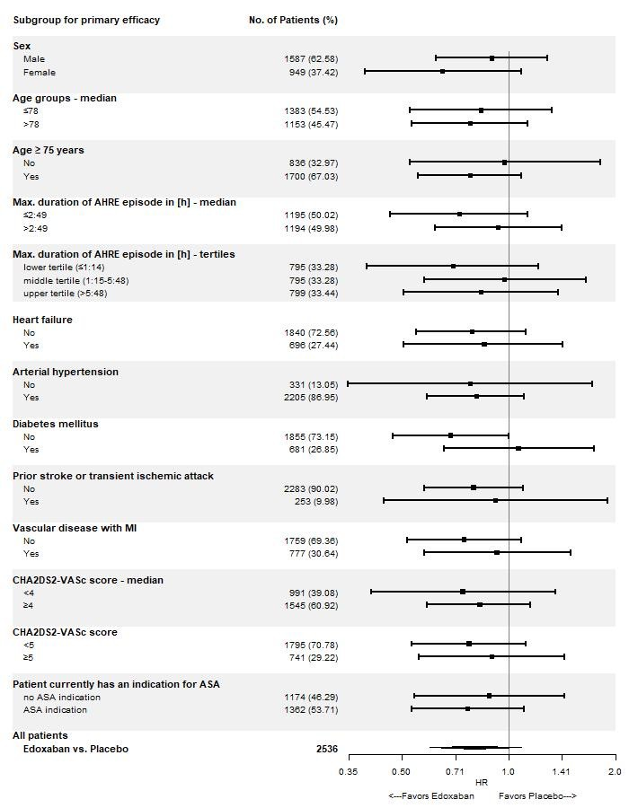
NOAH – AFNET 6 Subgroup Analyses

Slide 12
NOAH – AFNET 6 Strengths and Limitations
Double-blind, double-dummy design (aspirin in 54% of patients without anticoagulation).
Complete follow-up of entire primary analysis population for primary outcome and safety outcome. Expected increase in bleeding with anticoagulation compared to no anticoagulation.
Not sufficient power to rule out a small effect of oral anticoagulation on cardiovascular events. Only one NOAC tested (edoxaban).
Trial conducted in 18 European countries. Effects in other ethnicities unknown.

Slide 13
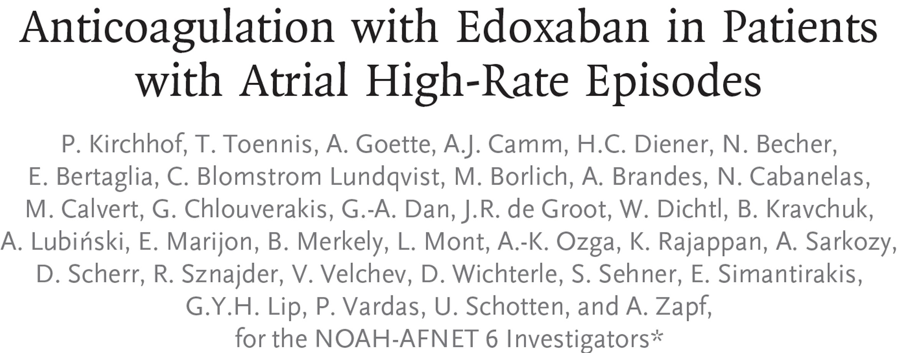
NOAH – AFNET 6 Conclusions
In patients with atrial high-rate episodes (AHRE) and clinical stroke risk factors, anticoagulation with edoxaban in the dose approved for atrial fibrillation does not reduce a composite outcome of stroke, systemic embolism, or cardiovascular death.
As expected, anticoagulation increases major bleeding. Stroke rate was low with and without anticoagulation.
Based on these results, patients with AHRE should be managed without anticoagulation until atrial fibrillation is diagnosed by ECG.
Additional methods are needed to estimate stroke risk in patients with rare atrial arrhythmias such as AHRE.
Kirchhof P et al. NEJM published online 25 August 2023. doi: 10.1056/NEJMoa2303062

