Slide 1



Cost-Effectiveness of Low-Dose Colchicine after Myocardial Infarction in the COLchicine Cardiovascular Outcomes Trial (COLCOT)
Michelle Samuel MPH, PhD Post-Doctoral Fellow
Michelle Samuel MPH PhD, Jean-Claude Tardif MD, Paul Khairy MD PhD, François Roubille MD PhD, David D Waters MD, Jean C Grégoire MD, Fausto J Pinto MD PhD, Aldo P Maggioni MD, Rafael Diaz MD, Colin Berry MD PhD, Wolgang Koenig MD, Petr Ostadal MD PhD, Jose Lopez-Sendon MD, Habib Gamra MD, Ghassan S Kiwan MD, Marie-Pierre Dubé PhD, Mylène Provencher PhD, Andreas Orfanos MBBCh, Lucie Blondeau MSc, Simon Kouz MD, Philippe L L’Allier MD, Reda Ibrahim MD, Nadia Bouabdallaoui MD, Dominic Mitchell PhD,
Marie-Claude Guertin PhD, Jacques LeLorier MD PhD
1

Slide 2

Disclosures
Nothing to disclose
2

Slide 3

¹Tardif JC et al. N Engl J Med. 2019; 381:2497-2505.
3

Slide 4

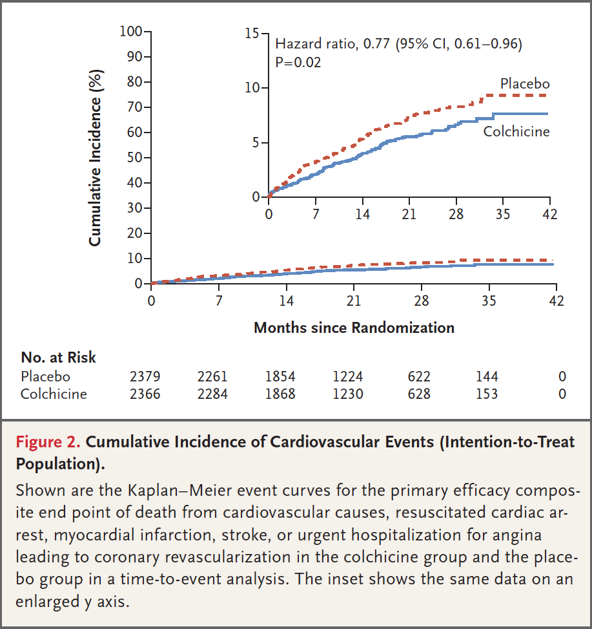
Overview of COLCOT¹
Randomized, double-blind, placebo-controlled trial
Patients who had a myocardial infarction ≤30 days were randomized 1:1 to low dose colchicine (0.5 mg per day) or placebo
4,745 randomized patients
(Colchicine: N=2,366 and Placebo: N=2,379)
Follow-up: 2 years
Primary composite endpoint included:
  Death from cardiovascular causes
  Resuscitated cardiac arrest
  Myocardial infarction
  Stroke
  Urgent hospitalization for angina leading to revascularization
¹Tardif JC et al. N Engl J Med. 2019; 381:2497-2505.
4

Slide 5
Present Study
Objective
To assess the in-trial period and lifetime cost-effectiveness of low-dose colchicine compared to placebo in post-MI patients on standard-of-care therapy
Primary Methods
Multi-state Markov model
Based on the intent-to-treat results of COLCOT
1st and 2nd events included in base case model
Deterministic approach was used to calculate the incremental cost-effectiveness ratio (ICER)
In-trial (2-year) and lifetime (20 year) ICERs
Canadian (primary) and United States perspectives
5

Slide 6
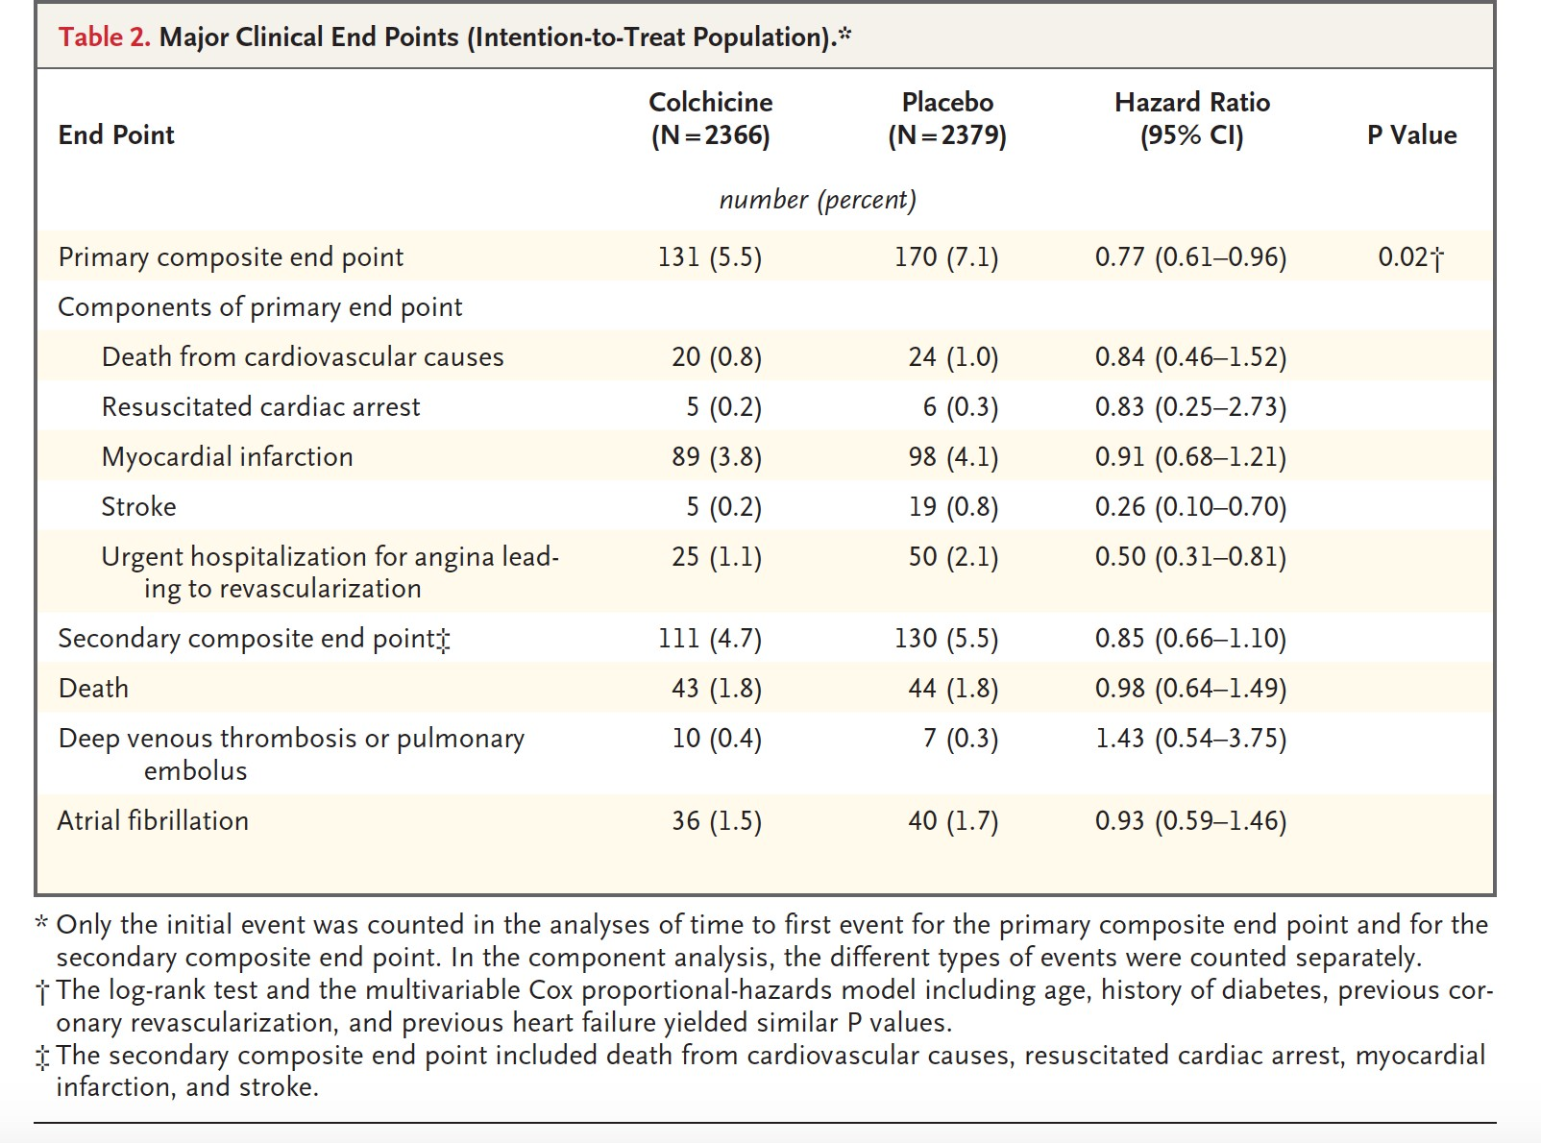
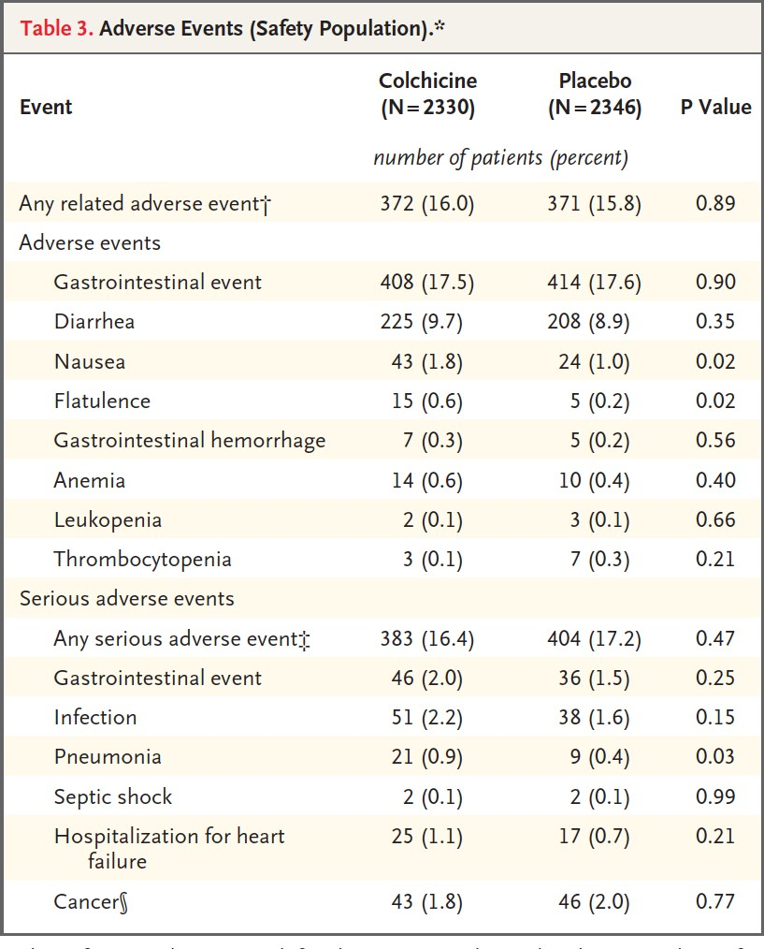
Health States in Markov Model
¹Tardif JC et al. N Engl J Med. 2019; 381:2497-2505.
6

Slide 7
Cost Inputs (Canadian Perspective- single payer)
Event / Medication | Base value
Colchicine (per pill) ¹ | $0.26
Acute event costs ²
Resuscitated cardiac arrest | $9,673
Myocardial infarction | $7,769
Stroke | $10,224
Coronary revascularization Coronary artery bypass graft surgery Percutaneous coronary intervention | $24,283 $8,894
Pneumonia | $8,206
Long-term follow-up costs
Resuscitated cardiac arrest ³ | $458
Myocardial infarction ⁴ | $766
Stroke ⁵ | $1,557
Coronary artery bypass graft surgery ³ | $1,276
Percutaneous coronary intervention ³ | $766
¹ Régie de l'assurance maladie du Québec. 2019.; ² Ontario Case Costing Initiative. OCC Costing Analysis Tool. Ontario Ministry of Health and Long Term Care. 2018;; ³Fernando SM et al. Resusciation.
2020;146:138-144.; ⁴ Trans DT et al. Can J Cardiol. 2018;34:1298-1305.
7

Slide 8
Utility Inputs
Utilities/Disutilities | Base value
Baseline utility¹ | 0.682
Disutilities
Resuscitated cardiac arrest² | 0.101
Myocardial infarction¹ | 0.147
Stroke ¹ | 0.178
Coronary revascularization³ Coronary artery bypass graft surgery Percutaneous coronary intervention | 0.090 0.060
Pneumonia⁴ | 0.020
Mean age in trial= 60 years (Utility=0.829)
All patients had a prior MI (Disutility= 0.147)
¹Nyman JA et al. Med Care. 2007;45:618-28.; ²Marti J et al. Resuscitation. 2017;117:1-7.; ³ Ariyaratne TV et al. Eur Heart J Qual Care Clin Outcomes. 2016;2:261-270.; ⁴ Atwood M et al. Can J Public
Health. 2018;109:756-768.
8

Slide 9
In-Trial (2-year) ICERs
Analysis | Average cost, CAD $ |  |  | Average QALYs Gained |  |  | ICER†
 | Colchicine | Placebo | Difference* | Colchicine | Placebo | Difference*
Base case Primary endpoints, non-CV deaths, and pneumonia 1st and 2nd (recurrent) events | $265 | $502 | -$237 47% | 1.34 | 1.30 | 0.04 | Dominant
Sensitivity analyses
Base case and inclusion of all recurrent events | $265 | $494 | -$222 | 1.34 | 1.30 | 0.04 | Dominant
Base case and inclusion of tertiary endpoint: all coronary revascularizations | $745 | $855 | -$111 | 1.30 | 1.29 | 0.01 | Dominant
Base case and inclusion of: all coronary revascularization and all recurrent events | $749 | $858 | -$98 | 1.30 | 1.29 | 0.01 | Dominant
*Differences compare average costs and QALYs of colchicine to placebo.
† Dominant ICERs are not presented and results from lower costs and higher QALYs for colchicine.
9

Slide 10
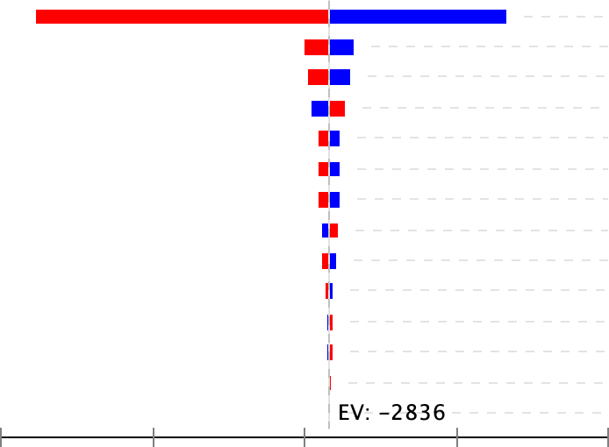
1-way Sensitivity Analysis: In-Trial
Cost myocardial infarction (acute)
Cost myocardial infarction (long-term follow-up) Utility healthy
Cost urgent percutaneous coronary intervention (acute) Disutility myocardial infarction
Cost stroke (acute)
Cost resuscitated cardiac arrest (acute)
Cost urgent percutaneous coronary intervention (acute) Utility stroke
Cost stroke (acute)
Cost urgent percutaneous coronary intervention (long-term follow-up)
Cost pneumonia (acute)
Cost stroke (long-term follow-up)
Cost resuscitated cardiac arrest (long-term follow-up)
Expected value: -2836
-2,000
-5,000
-4,000
-3,000 -1,000
Incremental Cost-Effectiveness Ratio (ICER)
*The red bar shows the change in ICER with a high uncertainty value (+25%) and blue bar shows the change in ICER with a low uncertainty value (-25%).
10

Slide 11
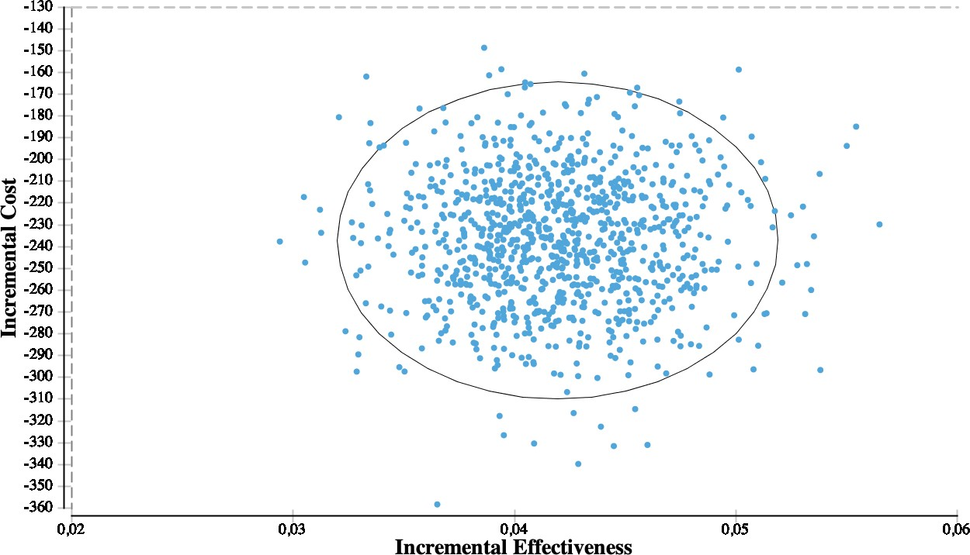
Probabilistic: In-Trial Incremental Cost-Effectiveness
100% dominant
11
*Red dot marks deterministic ICER.

Slide 12
Lifetime (20-year) ICERs
Analysis | Average cost, CAD $ |  |  | Average QALYs Gained |  |  | ICER†
 | Colchicine | Placebo | Difference* | Colchicine | Placebo | Difference*
Base case Primary endpoints, non-CV deaths, pneumonia 1st and 2nd (recurrent) events | $2,590 | $8,239 | -$5,647 69% | 11.68 | 8.82 | 2.86 | Dominant
Sensitivity analyses
Base case and inclusion of all recurrent events | $2,597 | $8,172 | -$5,539 | 11.69 | 8.73 | 2.96 | Dominant
Base case and inclusion of tertiary endpoint: all coronary revascularizations | $13,737 | $14,175 | -$438 | 8.51 | 7.98 | 0.53 | Dominant
Base case and inclusion of: all coronary revascularizations and all recurrent events | $13,825 | $14,284 | -$400 | 8.51 | 7.98 | 0.53 | Dominant
12

Slide 13
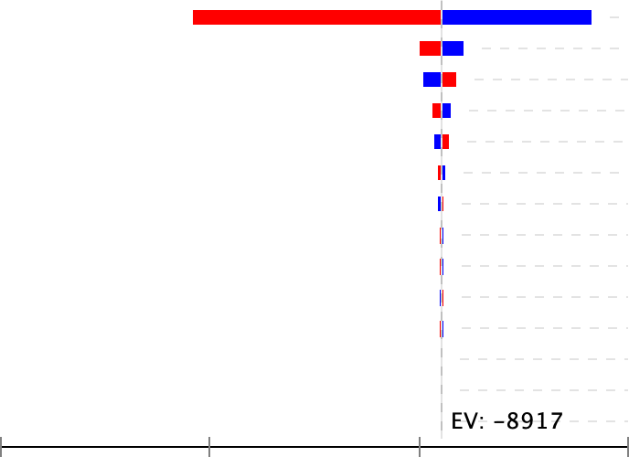
1-way Sensitivity analysis: Lifetime
Cost myocardial infarction (acute)
Utility healthy
Cost urgent percutaneous coronary intervention (acute) Disutility myocardial infarction
Cost stroke (acute)
Cost pneumonia (acute)
Cost myocardial infarction (long-term follow-up) Disutility urgent percutaneous coronary intervention Cost resuscitated cardiac arrest (acute)
Cost urgent percutaneous coronary intervention (long-term follow-up) Disutility stroke
Cost stroke (long-term follow-up)
Disutility resuscitated cardiac arrest
Expected value: -8917
Disutility pneumonia
-30,000
-20,000 0
-10,000
Incremental Cost-Effectiveness Ratio (ICER)
13
*The red bar shows the change in ICER with a high uncertainty value (+25%) and blue bar shows the change in ICER with a low uncertainty value (-25%).

Slide 14
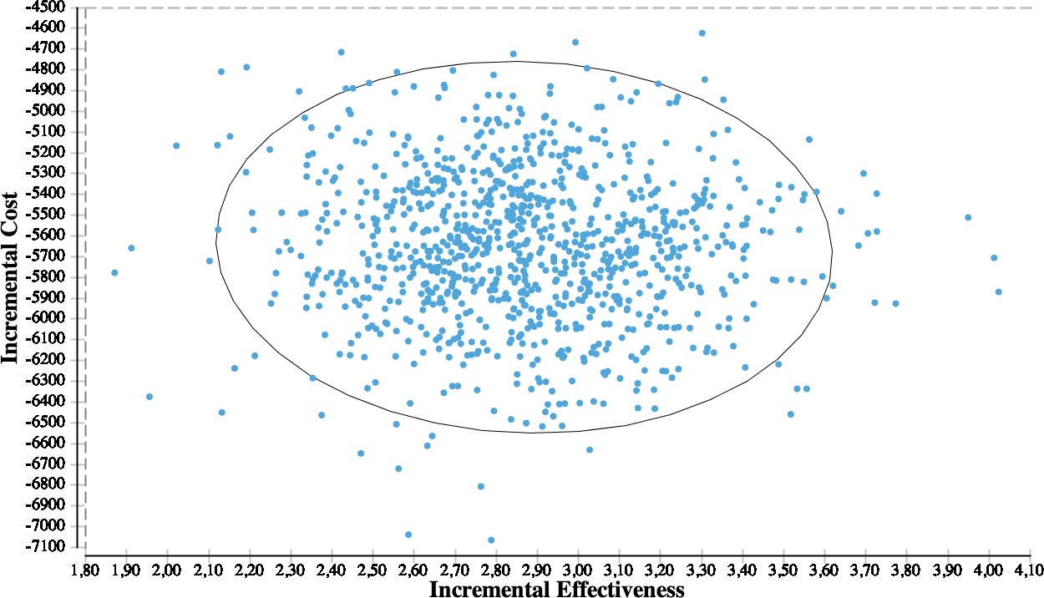

Probabilistic: Lifetime Incremental Cost-Effectiveness
100% dominant
14
*Red dot marks deterministic ICER.

Slide 15
Varying the Cost of Colchicine (Canada)
60,000
In-trial ICER Lifetime ICER
50,000
ICER ($ per QALY)
40,000
30,000
20,000
10,000
Dominant
Dominant
0
$0.26 $0.50 $0.55 $0.75 $1.00 $1.15 $1.25 $2.00 $3.00 $3.50 $4.00
Cost of Colchicine (CAD $)
*Base case includes all primary outcomes, non-cardiovascular mortality, and pneumonia (1st and 2nd event)
**The price points of maximum dominance and maximum cost effectiveness were the same when all recurrent events were included
15

Slide 16
US Cost-Effectiveness: Medicare
80,000
70,000
60,000
50,000
ICER ($ per QALY)
40,000
In-Trial ICER Lifetime ICER
30,000
20,000
Dominant
10,000
0
$4 $4.50 $5 $5.50 $6
Cost of Colchicine (US $)
*Base case includes all primary outcomes, non-cardiovascular mortality, and pneumonia (1st and 2nd event)
**The price points of maximum dominance and maximum cost effectiveness were the same when all recurrent events were included
¹ Analytics TH. Red Book Online. https://truvenhealth.come/Portals/0/Assets/Brochures/InternationalINTL_12543_0413)RedbookPS_WEB1.pdf. ²Healthcare cost and utilization pr¹o⁶ject. https://hcupnet.ahrq.gov. ³Centers for Medicare and Medicaid Services. http://www.cms.gov/app/physician-fee-schedule/overview.

Slide 17
US Cost-Effectiveness: Private Insurance
12,000
*All lifetime ICERs were dominant
10,000
8,000
6,000
ICER ($ per QALY)
4,000
In-Trial ICER Lifetime ICER
Dominant
2,000
0
$4 $4.50 $5 $5.50 $6
Cost of Colchicine (US $)
*Base case includes all primary outcomes, non-cardiovascular mortality, and pneumonia (1st and 2nd event)
**The price points of maximum dominance and maximum cost effectiveness were the same when all recurrent events were included
¹ Analytics TH. Red Book Online. https://truvenhealth.come/Portals/0/Assets/Brochures/InternationalINTL_12543_0413_RedbookPS_WEB1.pdf. ²Wallace PJ et al. Health Aff (Millw¹⁷ood).
2014;33(7):1187-1194.

Slide 18
Limitations
Utility and disutility measures were obtained from published literature on populations that closely resembled the COLCOT study population
The magnitude of disutility for recurrent events were assumed same as the disutility for the 1st event (few published studies measure utilities and disutilities for recurrent events)- underestimates cost- effectiveness
Effect estimates based on COLCOT (2-year study) and assumed hazards were constant over 20-year lifetime perspective
18

Slide 19
Conclusions
From the Canadian healthcare system perspective, the addition of low-dose colchicine (0.5 mg daily) to standard of care therapy after MI is economically dominant
  Mean overall per patient costs reduced by 47% for the in-trial period and 69% for the lifetime period
  Quality adjusted life years (QALYs) increased
From the US Medicare system perspective, low-dose colchicine therapy post- MI was cost-effective (<$50,000 per QALY) for the in-trial period and economically dominant at a price of <$5 per pill
From the US private insurance system perspective, low-dose colchicine post-MI was economically dominant
at ≤$5 per pill for the in-trial period and $4-6 per pill for the lifetime period
19

Slide 20
Thank You
Michelle Samuel MPH PhD
Post Doctoral Fellow, Cardiovascular Epidemiology Email: michelle.samuel@mhi-rc.org
Jean-Claude Tardif MD Principal Investigator for COLCOT
Director of the Research Center at the MHI Email: Jean-Claude.Tardif@icm-mhi.org
20

