Slide 1
Systematic Review and Meta-Analysis on Management Strategies for Asymptomatic Severe Aortic Stenosis
Philippe Généreux, MD
Associate Professor of Medicine, Interventional Cardiologist,
Hôpital du Sacré-Coeur de Montréal, Québec, Canada
Director, Angiographic Core Laboratory
Cardiovascular Research Foundation, New York, NY
CRT July 6th 2016

Slide 2
Disclosure Statement of Financial Interest Within the past 12 months, I or my spouse/partner have had a financial interest/arrangement or affiliation with the organization(s) listed below
Edwards LifeSciences
Consultant, Speaker Fees, Proctor

Slide 3
Recommendations and Levels of Evidence for Diagnosis, Follow-up, and Timing of Aortic Valve Replacement in Patients With Asymptomatic Severe Aortic Stenosis
 | ACC/AHA | ESC/EACTS
Indications for aortic valve replacement
Left ventricular ejection fraction <50% | I, B | I, C
Undergoing other cardiac surgery | I, B | I, C
Symptoms on exercise test clearly related to aortic stenosis | I, B | I, C
Decreased exercise tolerance | IIa, B | IIa, C
Exercise fall in systolic blood pressure | IIa, B | IIa, C
Very severe AS (PV≥5.0 m/s [ACC]; >5.5m/s [ESC] and low surgical risk | IIa, B | IIa, C
Rate of PV progression ≥0.3 m/s per year and low surgical risk | IIb, C | IIa, C
Repeatedly markedly elevated natriuretic peptide and low surgical risk | - | IIb, C
Increase of MG with exercise by >20 mmHg and low surgical risk | - | IIb, C
Excessive LVH in the absence of hypertension and low surgical risk | - | IIb, C
Diagnostic
Transthoracic echocardiography as the initial diagnostic modality | I, B | -
Exercise testing | IIa, B | -
Exercise echocardiography | IIa, B | -
Follow-up
Echocardiography every 6-12 months | 1, C | -
ACC = American College of Cardiology; AHA = American Heart Association; EACTS = European Association for Cardio-Thoracic Surgery; European ESC = European Society of Cardiology
3 Class I indications…3 Class IIa indications…
Level of evidence B or C
No Randomized trial
Nishimura et al. J Am Coll Cardiol. 2014; 63(22):e57-185
Vahanian et al. Eur Heart J. 2012; 33(19):2451-96

Slide 4
ACC/AHA and ESC/EACTS Guidelines
Asymptomatic Severe AS
MG≥40mmhg, AVA≤ 1.0 cm2 and EF >50%
PV ≥5m/s (ACC/AHA) or ≥5.5m/s (ESC): Class IIa
PV progression≥0.3m/s/year:
ACC/AHA IIb and ESC Class IIa
Severe LVH: ESC Class IIb
Repeatedly markedly elevated BNP:
ESC Class IIb
Exercise Testing (ACC/AHA Class IIa)
+
+
-
Limiting Symptoms
Angina
Syncope
Dyspnea
Decrease exercise tolerance
Exercise Imaging (ACC/AHA class IIa)
Abnormal SBP response (drop or <20mmhg rise)
Increase in MG with exercise by >20 mm Hg
ACC/AHA Class I
ESC Class I
ACC/AHA Class IIa
ESC Class IIa
ESC Class IIb
If Stress test and Stress Echo normal:
Clinical and Echo follow-up 6-12 months ACC/AHA Class I
Nishimura et al. J Am Coll Cardiol. 2014; 63(22):e57-185
Vahanian et al. Eur Heart J. 2012; 33(19):2451-96

Slide 5
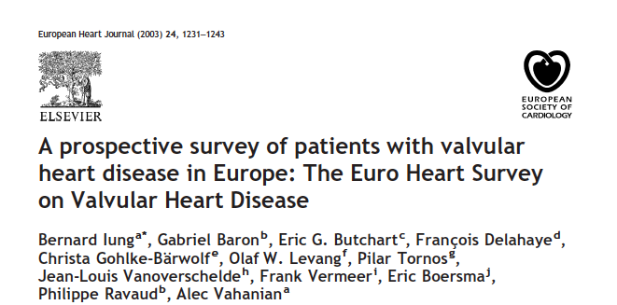
“In severe AS, an exercise test was performed in only 5.7% of patients with no symptoms…”
“This under-use may be explained by an insufficient implementation of the current guidelines and fear of complications or inexperience in exercise testing…”
Lung et al. Eur Heart J 2003; 24, 1231–1243

Slide 6
Why Early SAVR In Asymptomatic Severe AS is Rarely Performed?
Sudden Death
Severe Asymptomatic AS
~1-2%/year
Peri-operative Mortality
SAVR
~1-5%
TAVR may be a better option for Asymptomatic patients
30-day Mortality Notion Trial all-comers
Core Valve TAVR | SAVR
2.1% | 3.7%
30-day Mortality PARTNER trial 2A Intermediate PM
Sapien 3 TAVR | SAVR
1.1% | 4.0%
Généreux et al. J Am Coll Cardiol 2016;67:2263–88; Thourani et al. Lancet 2016; 387: 2218–25; Thyregod et al. J Am Coll Cardiol 2015;65:2184–94

Slide 7
Asymptomatic Severe AS: Rationale for Early AVR
Pros
Cons
Reduce irreversible myocardial damage and subsequent consequences
Decreased operative risk for asymptomatic patients
AS progression highly variable; potential for a very rapid deterioration
Risk of late (or too late) symptoms reporting
Sudden death without preceding symptoms
Mortality potentially low among a specific subset of low-risk and truly asymptomatic patients with normal stress test and stress echo
Frequent follow-up could potentially identified patients ready for AVR in a timely fashion
Inherent mortality and morbidity of AVR
Long-term complication of AVR (anticoagulation, need for re-op, endocarditis, thrombosis, etc.)

Slide 8
Practical Issues with “Watchful Waiting” Strategy
Clinicians still have a fear of stress test with Severe AS patients; low penetration and underused
Stress Imaging requires expertise and specific set-up that most community hospitals don’t have
Sub-optimal follow-up and lost of follow-up are frequent
Many sudden deaths occurred in Asx patients with no Class I indication of AVR and no preceding symptoms
“Wishful Thinking” Strategy…

Slide 9
What is the Prevalence of Asymptomatic Severe AS?
~40-50% of all Severe AS from major echo databases ^{1,2,3}
~10-20% are bicuspid
~20-25% have multiple valve disease, clinically significant CAD, prior AVR
Isolated Asymptomatic Severe AS represents ~25-30% of all Severe AS referred to Echo lab
~500,000 patients >65 years old in US⁴
¹Pellikka et al. Circulation. 2005;111:3290-3295
³Kitai et al. Heart 2011;97:2029e2032.
²Pai et al. Ann Thorac Surg 2006;82:2116 –22
⁴Source U.S. Census Bureau, 2014 National Projections.

Slide 10
What is the Prognosis of Asx Severe AS Patients?

Slide 11
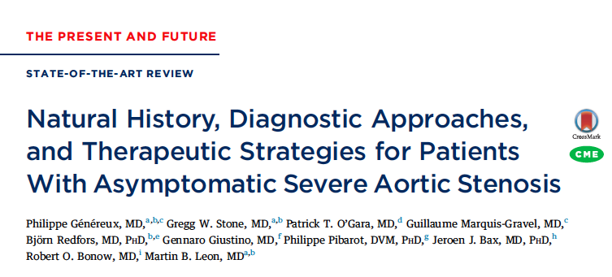
Généreux et al. J Am Coll Cardiol 2016;67:2263–88

Slide 12
Systematic Review and Meta-Analysis
MEDLINE, Embase, and Cochrane Central Register of Controlled Trials
Severe AS asymptomatic patients
>18 years old and reporting outcomes
503 articles
27 observational studies pertinent identified
4 studies with observational comparison AVR vs. Medical treatment; N= 2,486 patients
Généreux et al. J Am Coll Cardiol 2016;67:2263–88

Slide 13
Studies Comparing AVR vs. Observation in Asymptomatic Severe AS Patients; N=2,486
Authors | AS definition | N | Age | Female | Follow-up (median)
Pellikka et al.1990 | Severe AS; Doppler PV ≥4m/s | 143 30 AVR 113 Medical | 72 (mean) 40 to 94 | 38% | AVR 21 m Medical 20 m
Pai et al. 2006 | Severe AS AVA <0.8cm² | 338 99 AVR 239 Medical | 71±15 | 49% | 3.5 y
Kang et al. 2010 | Very severe AS AVA ≤0.75 cm² AND PV ≥4.5 m/s or a MG ≥50 mmHg | 197: 102 AVR 95 Medical | 63±12 | 50% | AVR 1265 d Medical 1769 d
Taniguchi et al. 2015 | Severe AS AVA: <1cm2 MG: >40mmhg PV: >4m/s | 1808: 291 AVR 1517 Medical | AVR 71.6±8.7 Medical 77.8±9.4 | 60% | 1361 d
Généreux et al. J Am Coll Cardiol 2016;67:2263–88

Slide 14
All-Cause Mortality AVR vs. Medical Therapy in Asymptomatic Severe AS; N=2,486
Unadjusted: ~3.5 fold increase in all-cause Mortality
Généreux et al. J Am Coll Cardiol 2016;67:2263–88

Slide 15
All-Cause Mortality AVR vs. Medical Therapy in Asymptomatic Severe AS
Adjusted: ~3.7 fold increase in all-cause Mortality
Généreux et al. J Am Coll Cardiol 2016;67:2263–88

Slide 16
Sudden Death In Asx Severe AS
Studies | Sudden death (n) | Preceded by symptoms (n) | Not preceded by symptoms (n)
Pellikka et al. 1990 n=143 | 3 | 3 | 0
Rosenheck et al. 2000; n=128 | 1 | - | -
Amato et al. 2001; n=66 | 4 | - | 4
Lancellotti et al 2005; n=69 | 2 | - | -
Pellikka et al. 2005; n=622 | 11 | 0 | 11
Avakian et al. 2008; n=133 | 7 | 3 | 4
Monin et al. 2009; n=107 | 2 | - | -
Cioffi et al. 2009; n=218 | 2 | - | -
Kang et al. 2010; n=197 | 9 | 2 | 7
Lancellotti et al. 2010; n=163 | 3 | 0 | 3
Rosenheck et al. 2010; n=113* | 1 | 0 | 1
Stewart et al. 2010; n=183 | 4 | - | -
Saito et al. 2012; n=103 | 6 | 4 | 2
Yingchoncharoen et al.; 2012; n=79 | 1 | - | -
Levy et al. 2014; n=43 | 0
*6 cardiac deaths occurred: 1 sudden without symptoms and 5 cardiac but with patients asymptomatic at the last follow-up
~1% sudden death/year
~Among all the sudden deaths,
73% (32/44) had
no classical preceding AS Symptoms
Généreux et al. J Am Coll Cardiol 2016;67:2263–88

Slide 17
Predictors of Adverse Events In Asymptomatic Severe Aortic Stenosis

Slide 18
Predictor of Adverse Events in Patients with Asymptomatic Severe Aortic Stenosis
Echocardiographic | Stress Imaging
Peak velocity (>4m/s; >5m/s; >5.5m/s) | Increase in MG during exercise (>18mmhg or >20mmhg)
Rates of progression of PV (>0.3m/s/year) | Decrease in LVEF at peak exercise
AVA or IAVA (<0.7cm² or<0.6cm²/m²) | Exercise induced pulmonary hypertension (best cut-off SPAP >60mm Hg)
Mean Gradient | Peak VO2 ≤14 mL/kg/min, VE/VCO2 slope >34
Calcification severity
Left ventricle hypertrophy or LVMI
LVEF or LVEF<50%
LVEDV
Mitral regurgitation 3 or 4
Left atrial area
LV strain
Valvuloarterial impedance (Zva) (especially>4.5)
Low stroke volume (<35cc/m²)
Pressure drop / flow slope
Généreux et al. J Am Coll Cardiol 2016;67:2263–88

Slide 19
Stress Test Severe Asymptomatic AS?

Slide 20
Abnormal Stress Test in Asx AS
Studies | Moderate-Severe AS |  |  | Severe AS only
 | % Abnormal Stress Test | n | N | % Abnormal Stress Test | n | N
Takeda et al. 2001 | 27% | 13 | 49
Amato et al. 2001 |  |  |  | 67% | 44 | 66
Alborino et al. 2002 | 60% | 18 | 30
Das et al. 2003 | 29% | 19 | 65
Das et al. 2005 | 37% | 46 | 125
Lancellotti et al. 2005 |  |  |  | 38% | 26 | 69
Peidro et al. 2007 | 66% | 67 | 102
Marechaux et al. 2007 |  |  |  | 48% | 24 | 50
Lancellotti et al. 2008 |  |  |  | 47% | 60 | 128
Lafitte et al. 2009 |  |  |  | 65% | 39 | 60
Marechaux et al. 2010 | 27% | 51 | 186
Rajani et al. 2010 | 15% | 3 | 20 | 39% | 7 | 18
Donal et al. 2011 | 33% | 69 | 207
Levy et al. 2014 |  |  |  | 28% | 12 | 43
Total |  | 286 | 784 |  | 212 | 434
% Abnormal Stress test | Range: 15-66% | Pooled: 36.5% |  | Range: 28-67% | Pooled: 48.8%
Abnormal Stress Test in Asx Severe AS:
Range: 26-67%
~50% Abnormal Stress Test
Généreux et al. J Am Coll Cardiol 2016;67:2263–88

Slide 21
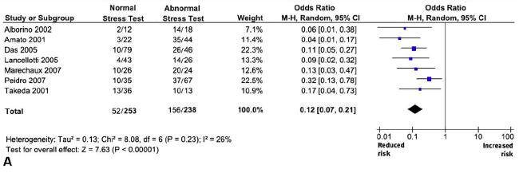
Abnormal stress test associated
with ~8 fold increase in CV Events
Rafique et al. Am J Cardiol 2009;104:972–977

Slide 22
Abnormal stress test associated with
~6 fold increase in Cardiac Death
Rafique et al. Am J Cardiol 2009;104:972–977

Slide 23
What about the “truly” Asymptomatic Severe AS?

Slide 24
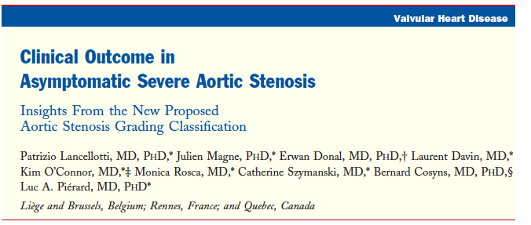
“Truly” Asymptomatic Severe AS
N=150 with AVA <1cm² (no gradient criteria)
Exclusion: 1) LVEF <55% 2) other moderate-severe valve disease 3) Atrial Fibrillation 4) COPD 5) positive stress test 6) incapacity to perform stress test
Endpoint: CV death or need for AVR motivated by the development of symptoms or LVEF<50%)
Lancellotti et al. J Am Coll Cardiol 2012;59:235–43

Slide 25
51% (76/150) events at mean follow-up 27 months
6% (9/150) deaths; 5.3% (8/150) cardiac deaths
2% (3/150) sudden deaths without preceding symptoms
70 (47%) had indication for AVR:
Spontaneous symptoms: 58 (83%)
Progressive AS: 2 (3%)
Positive stress test during follow-up: 8 (11%)
LVEF <50%: 2 (3%)
Lancellotti et al. J Am Coll Cardiol 2012;59:235–43

Slide 26
Adjusted Incidence of CV events among patients with Normal Stress Test: n=150
100%
LF/LG group (n=11)
90%
p=0.009
80%
LF/HG group (n=15)
~70%
70%
60%
Adjusted Incidence of
Cardiac Events, %
50%
NF/HG group (n=78)
40%
30%
~30%
NF/LG group (n=46)
20%
10%
0%
0
6
12
18
24
30
36
42
Follow-up, months
Among the subset of patients with Asymptomatic Severe AS AND Normal stress test, ~70% of patients have at least 50% chance to have adverse CV events at 2 years
Pts at risk:
46
78
15
11
37
49
8
6
21
22
3
3
3
9
2
1
NF/LG group
NF/HG group
LF/HG group
LF/LG group
LF= indexed stroke volume <35cc/m²
LG= MG <40mmhg
Lancellotti et al. J Am Coll Cardiol 2012;59:235–43

Slide 27
Should and could we recommend an early intervention strategy for “truly” Asymptomatic Severe Aortic Stenosis patients?

Slide 28
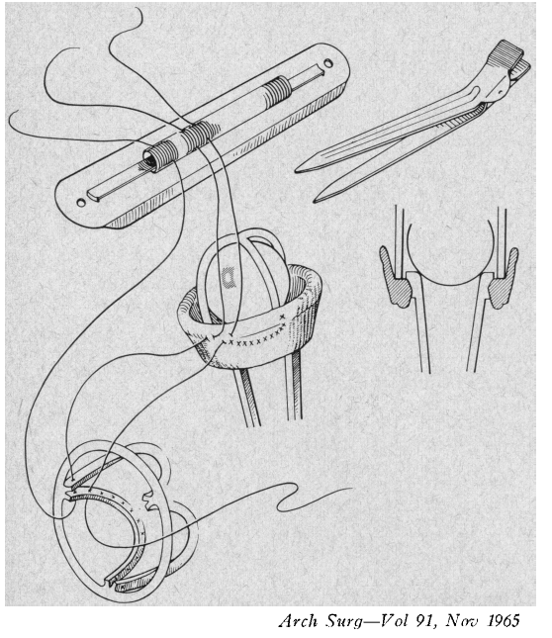
1925-1999
‘‘Low hospital mortality tends to justify a policy of accepting patients for operation earlier in the natural progression of their disability, because it is recognized that there is a definite risk of rapid deterioration or sudden death in the earlier policy of deferring operation patients until their disability had become definite and progressive and until their cardiac reserve was nearly depleted.”
McGoon DC, Pestana C, Moffitt EA. Arch Surg.1965;Nov,91:779-86.

Slide 29
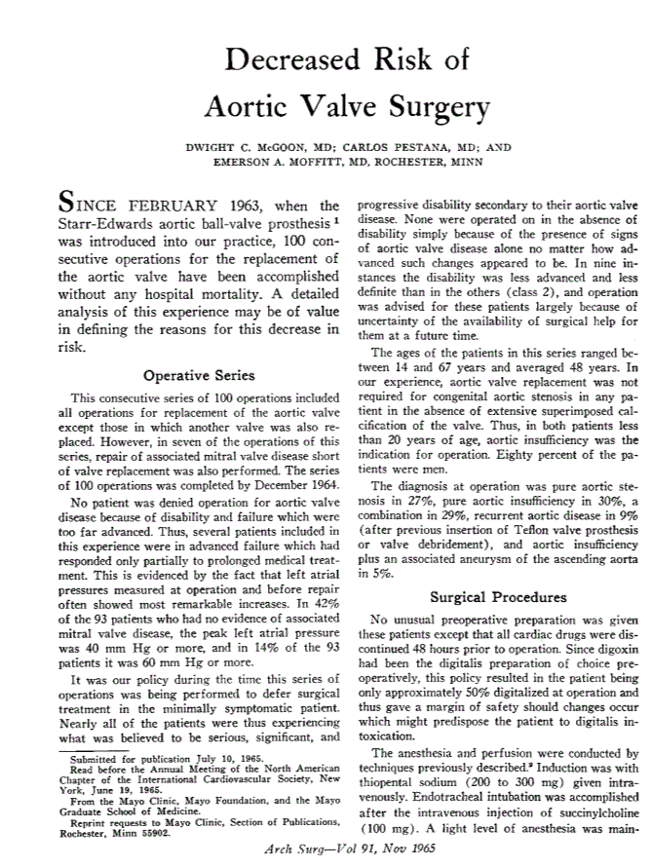
Dwight C. McGoon, MD
1925-1999
Mayo Clinic
“McGoon was an accomplished pianist and sailor. He loved philosophy and was an avid essayist on diverse topics.”

Slide 30
Conclusions
Asymptomatic Severe AS is frequent, representing ~50% of the Severe AS referred to echo lab
Stress tests are abnormal in ~50% of the patients, and are associated with high rates of adverse cardiac events at follow-up
Rate of sudden death are ~1.0%/year, with high proportion of sudden death occurring without preceding symptoms

Slide 31
Conclusions
Better level of evidences (randomized trial) is clearly needed to improve level of recommendations and patients care

