Slide 1
Arterial Revascularization Trial (ART)
Randomized comparison of single versus bilateral internal thoracic artery grafts in 3102 CABG patients:
Major cardiovascular outcomes at ten years of follow up
David P Taggart MD (Hons), PhD, FRCS, FESC Professor of Cardiovascular Surgery
University of Oxford, United Kingdom
for the Arterial Revascularization Trial Investigators (No conflicts declared)
ESC 2018

Slide 2
Declaration of interest
- I have nothing to declare
• •
ESC Congress
Munich 2018 •

Slide 3
Background: What We Already Know
① Coronary artery bypass grafting (CABG) is highly effective for symptoms and/or prognosis in multi-vessel and left main coronary artery disease (SYNTAX, CORONARY, PRECOMBAT, BEST, EXCEL, NOBLE: 2013-2016)
② Over 1 million CABG performed worldwide each year; standard operation in
>90% is CABG x 3 (1 internal thoracic artery (ITA) and 2 vein grafts)
③ Strong angiographic evidence of increasing failure of vein grafts over time (due to progressive atherosclerosis) that accelerates after 5 years and that increases overall mortality and cardiac morbidity
④ Strong angiographic evidence that ITA grafts have excellent long term patency rates (> 90% at 20 years)
⑤ Left ITA is established as the standard of care for grafting the left anterior descending (LAD) coronary artery during CABG
⑥ Numerous observational studies have estimated a 20% reduction in mortality with Bilateral versus Single ITA grafts over the long-term
⑦ Low use of Bilateral ITA (<10% in Europe, <5% in USA) due to 3 concerns
increased technical complexity
potentially increased mortality and morbidity ?
lack of evidence from RCTs

Slide 4
Design and Outcome Measures
RCT of Bilateral ITA (plus vein grafts) versus Single ITA (plus vein grafts)
SAMPLE SIZE
Estimate: that at 10 years, Bilateral ITA grafts will result in an absolute 5% reduction in mortality (i.e. from 25% to 20%) vs. Single ITA graft
Confirm: with 90% power at p <0.05 requires 2928 patients
Aim: to enrol >3000 patients (1500 in each arm) over 3-years
OUTCOMES AT 10 YEARS
PRIMARY: All-cause Mortality
SECONDARY: COMPOSITE of All-cause Mortality, Myocardial infarction or Stroke

Slide 5
Eligibility
✔ INCLUSION:
CABG patients with multi-vessel +/- left main coronary artery disease
CABG for acute coronary syndrome (BUT not acute myocardial infarction)
CABG could be performed “on-pump” or “off-pump”
✗ EXCLUSION:
✗Patients requiring single graft
✗Patients with evolving myocardial infarction
✗ Patients requiring concomitant valve surgery
✗Patients requiring redo CABG

Slide 6
Results
Enrolment from June 2004 to December 2007
28 cardiac surgery centres
7 countries (UK, Poland, Australia, Brazil, India, Italy, Austria)
3102 patients randomized (1554 patients to single and1548 to bilateral ITA)
At 10 years high use of guideline based medical therapy:
aspirin (81%), statins (89%), ACE-inhibitor or Angiotensin receptor blockers (73%), beta blockers (74%)
(Much higher than other contemporary PCI vs CABG trials)

Slide 7
Analysis of Results at 10 Years:
98.4% of Patients With Vital Status
① Intention To Treat (ITT):
② As Treated (AT): Non-Randomized
36% of Patients Received A ‘Different’ Treatment Strategy
14% of Bilateral ITA crossed to Single ITA
22% of Single ITA had a 2nd Arterial Graft (Radial Artery)

Slide 8
Baseline Characteristics Near ‘Identical’ | Bilateral ITA (n=1548) | Single ITA (n=1554)
Male | 85% | 86%
Age mean (SD) years | 64 (9) | 64 (9)
Current smoker | 15 % | 14 %
Systolic BP mean (SD) [mmHg] | 132 (18) | 132 (19)
Body Mass index mean (SD) | 28 (4) | 28 (4)
Caucasian | 92 % | 92 %
South Asian | 5 % | 5 %
Insulin dependent diabetes | 6 % | 5 %
Non insulin dependent diabetes | 18 % | 18 %
Hypertension | 77 % | 78 %
Hyperlipidemia | 94 % | 93 %
Peripheral arterial disease | 7 % | 8 %
Prior stroke | 3 % | 3 %
Prior myocardial infarction | 40 % | 44 %
Prior PCI | 16 % | 16 %
NYHA class 1 and 2 | 78% | 79%
CCS class 1-3 | 84% | 84%

Slide 9
Surgical Details, Post-operative Care and Length of Stay
Procedures | Bilateral ITA |  | Single ITA
Details of operation | (n=1531) |  | (n=1546)
On pump | 58 % |  | 60 %
Off pump | 42 % |  | 40 %
Conversion to bypass | 2 % |  | 2 %
CABG duration minutes mean (SD) | 222 (61) | 23 mins 1 |  |  | 99 (58)
Number of grafts
2 | 18 % |  | 18 %
3 | 50 % |  | 49 %
 |  | 82%
4+ | 31 % |  |  | 33 %
Radial Artery Graft | 19 % |  | 22 %
Cell saver | 31 % |  | 32 %
Aprotinin during surgery | 24 % |  | 24 %
Blood transfusion | 12 % |  | 12 %
Return to operating theatre | 4 % |  | 4 %
Intra-aortic balloon pump use | 4 % |  | 4 %
Renal support therapy | 6 % |  | 4 %
Hospital stay Mean days (SD) | 8 (7) |  | 8 (8)

Slide 10
MORTALITY AT 10 YEARS (Intention To Treat)
25
Patients Who Died (%)
20
Single ITA
HR (95% CI) = 0.96 (0.82, 1.12)
p = 0.62
15
Bilateral ITA
10
5
0
0
2
4 6
Time from randomisation (years)
8
10
No. at risk
Bilateral graft 1548
Single graft 1554
1481
1484
1417
1432
1359
1370
1283
1283
882
894

Slide 11
MORTALITY AT 10 YEARS (As Treated)
25
Patients Who Died (%)
20
Single Arterial Graft
15
HR (95% CI) = 0.81 (0.68, 0.95)
10
Multiple Arterial Grafts
5
0
0
2
4 6
Time from enrolment (years)
8
10
No. at risk MAG
SAG
1690 | 1632 | 1567 | 1510 | 1430 | 998
1330 | 1270 | 1222 | 1163 | 1081 | 750

Slide 12
DEATH, MI, STROKE AT 10 YEARS (Intention To Treat)
30
Single ITA
25
Patients With Event (%)
HR (95% CI) = 0.90 (0.78, 1.03)
p = 0.12
20
Bilateral ITA
15
10
5
0
0
2
4 6
Time from randomisation (years)
8
10
No. at risk
Bilateral graft 1548
Single graft 1554
1435
1427
1362
1366
1299
1296
1214
1194
830
821

Slide 13
DEATH, MI, STROKE AT 10 YEARS (As Treated)
30
Single Arterial Graft
Patients With Event (%)
25
20
HR (95% CI) = 0.80 (0.69, 0.93)
Multiple Arterial Grafts
15
10
5
0
0
2
4 6
Time from enrolment (years)
8
10
No. at risk MAG
SAG
1690 | 1591 | 1510 | 1442 | 1353 | 934
1330 | 1212 | 1162 | 1101 | 1006 | 692

Slide 14
Why No Difference in Bilateral vs Single ITA Grafts @ 10 years (Intention To Treat) ?
① Genuinely NO Difference:
(Concept of Complete vs Incomplete Revascularization ?)
② Guideline Based Medical Therapy: in > 80% (slows vein graft failure ?)
③ Radial Artery Use:
22% of Single ITA: (superior 5yr patency and clinical outcomes)
④ Differential X-over:
14% of Bilateral ITA ➔ Single ITA; 4% Single ITA ➔ Bilateral ITA
⑤ Surgeon Experience:
Individual Surgeon X-over from Bilateral ITA to Single ITA : 0%-100%

Slide 15
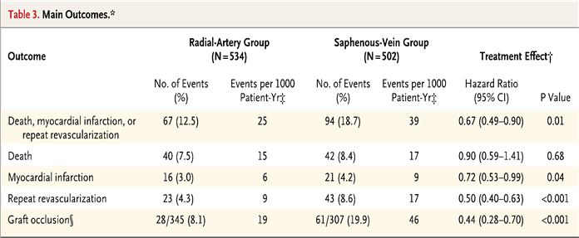
[May 2018]

Slide 16
Effects of Surgeon Volume in ART Intention To Treat Analysis
P value for Interaction
Subgroup
Bilateral ITA
Single ITA
Hazard Ratio (95% CI)
Mortality
< 50 operations
≥ 50 operations
0.015
172/829 (20.8)
127/637 (19.9)
151/846 (17.9)
159/634 (25.1)
1.17 (0.94, 1.46)
0.79 (0.62, 0.99)
Composite – Death/MI/Stroke
0.058
< 50 operations
≥ 50 operations
210/829 (25.3)
156/637 (24.5)
207/846 (24.5)
195/634 (30.8)
1.03 (0.85, 1.25)
0.78 (0.63, 0.96)
.5
Favors Bilateral ITA
.67
1
1.5 2
Favors Single ITA

Slide 17
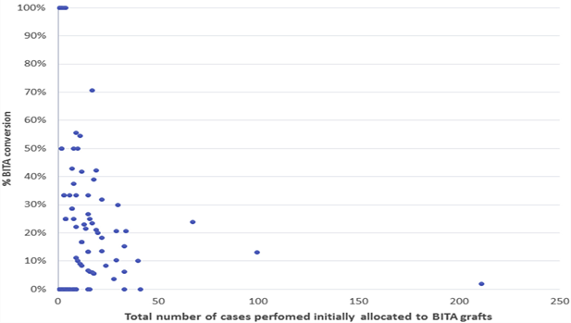
[JTCVS 2018]
Conversion rate from Bilateral to Single ITA:14% (Single to Bilateral ITA 4%)
Individual Surgeon: 0-100%
Individual Centres: 0-49%
✗ INFERIOR CLINICAL OUTCOMES AT 5 YEARS

Slide 18
Intention to Treat
10-Year MORTALITY FOR HIGHEST VOLUME (n=416) SURGEON IN ART
30
((
1.2% X-Over from BITA to SITA
1.2% X-Over BITA to SITA
Single ITA
25
Patients Who Died (%)
20
HR (95% CI) = 0.69 (0.46, 1.03)
15
Bilateral ITA
10
5
0
0
2
4 6
Time from randomisation (years)
8
10
No. at risk
Bilateral graft 211
Single graft 205
202
196
195
188
188
175
175
161
122
114

Slide 19
Summary: Ten Year Analysis of the ART
ART Largest CABG trial with long term follow-up (>98% @ 10 yrs)
Excellent 10 year outcomes for CABG in both groups
14% allocated to Bilateral ITA actually received Single ITA, and 22% of single ITA received additional radial artery graft
Intention To Treat: Confirms safety of Bilateral ITA grafts @ 10 years
Intention To Treat: No significant differences in all cause mortality or composite of mortality, myocardial infarction or stroke
As Treated (Non randomized): Potential for multiple arterial grafts to provide superior outcomes
Surgeon experience appears to be a crucial factor for outcomes with Bilateral ITA grafts
Need for further trials of Single vs Multiple arterial grafts by appropriately experienced surgeons

Slide 20
Randomized comparison of the clinical Outcome of single versus Multiple Arterial grafts: the ROMA trial

Slide 21
Acknowledgements:
In Memoriam Prof Doug Altman: RIP June 2018
Presented on behalf of all investigators and patients participating in ART
Trial Steering Committee: Peter Sleight, Doug Altman, Keith Channon, John Dark, Barbara Farrell, Marcus Flather, Alastair Gray, John Pepper, Rod Stables, David Taggart, Geza Vermez, Jeremy Pearson, Mark Pitman, Belinda Lees, Umberto Benedetto
Data Monitoring Committee: Salim Yusuf, Stuart Pocock, Desmond Julian, Tom Treasure
Clinical Events Adjudicators, Luckasz Krzych (Poland)
Trial Management: Belinda Lees, Carol Wallis, Jo Cook, Edmund Wyatt, Surjeet Singh (SITU), Stephen Gerry (Statistical Support)
Funded by UK Medical Research Council, British Heart Foundation, National Institute of Health Research Efficacy and Mechanism Evaluation, sponsored by University of Oxford
Design, conduct and analysis conducted independently of funding agencies and sponsor

